Slide 1

Using Python to Retrieve and Visualize Data (part 1 of 2)
Jon Goodall
Hydroinformatics
Fall 2014
This work was funded by National Science Foundation Grants EPS 1135482 and EPS 1208732

Slide 2
Quick Review
What we have learned so far
Describing data with effective metadata
Data model design – organizing your data/metadata
Database implementation – creating a database and loading data
SQL – slicing and dicing your data
Today: Creating reproducible, reusable, and sharable visualizations from data in your database.

Slide 3
Learning Objectives
Create reproducible data visualizations
Write and execute computer code to automate difficult and repetitive data related tasks
Manipulate data and transform it across file systems, flat files, databases, programming languages, etc.

Slide 4
Reproducible results
“A script is a record of the entire modeling or data analysis process. By simply running the script you reprocess the entire model or analysis. How about that for reproducible results?”
Bakker, M. (2014), Python Scripting: The Return to Programming. Groundwater. doi: 10.1111/gwat.12269

Slide 5
Reproducible results
“In order to maximize reproducibility, everything needed to re-create the output should be recorded automatically in a format that other programs can read.” – Wilson et al., 2013
Wilson G, Aruliah DA, Brown CT, Chue Hong NP, Davis M, et al. (2014) Best Practices for Scientific Computing. PLoS Biol 12(1): e1001745. doi:10.1371/journal.pbio.1001745

Slide 6
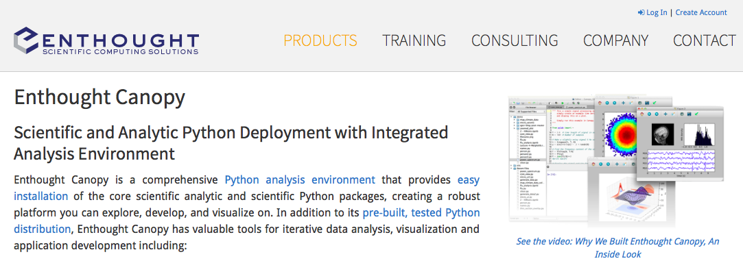
Enthought Canopy
Other similar products exist including Anaconda and Python(x,y). It is also
common to use a package manager like Homebrew (on OSX) or pip.

Slide 7
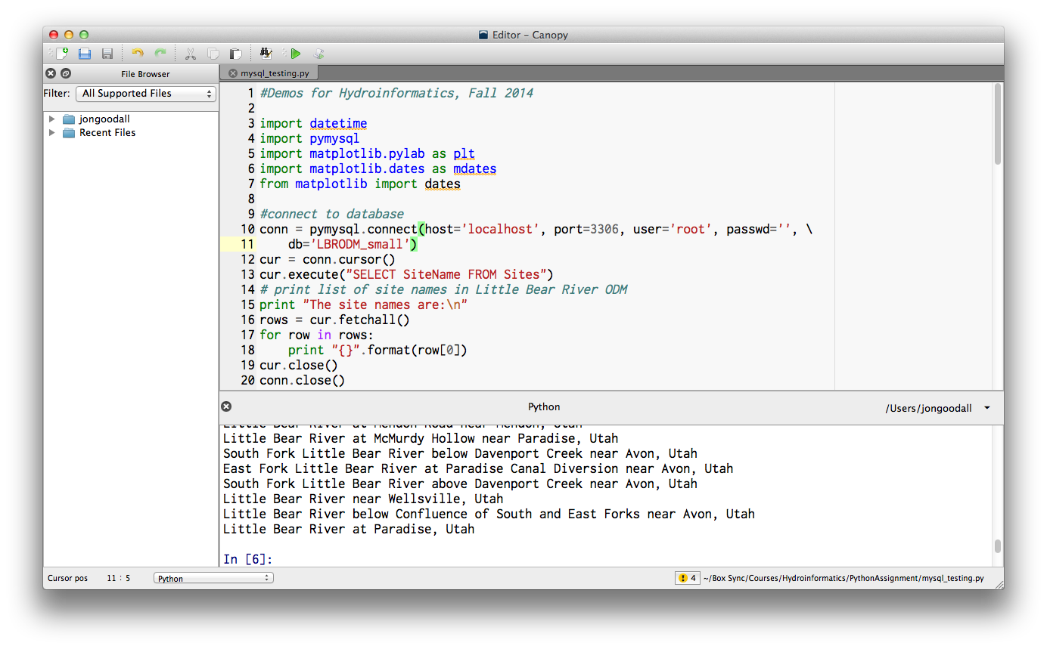
Canopy Editor

Slide 8
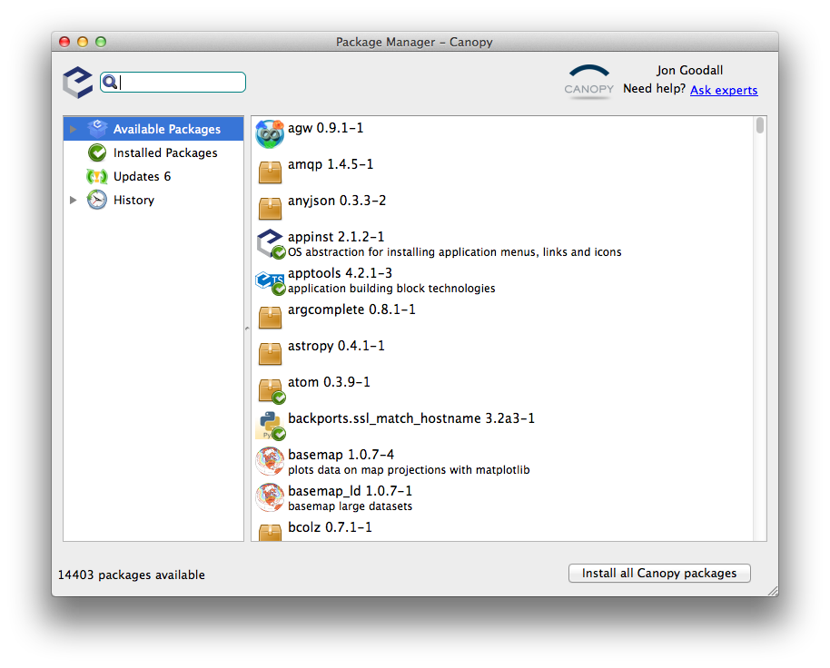
Canopy Package Manager

Slide 9
Python Packages
List of packages included with Canopy: https://www.enthought.com/products/canopy/package-index/
Instructions to install packages not included with Canopy: http://docs.enthought.com/canopy/quick-start/canopy_terminal.html
Most popular Python packages: http://pypi-ranking.info/alltime
Packages vs. to modules: http://stackoverflow.com/questions/7948494/whats-the-difference-between-a-python-module-and-a-python-package

Slide 10
Style
Having ‘pretty code’ is just as important as having working code. Remember the code needs to be read by humans as well as computers. We will discuss this more next class.
When formatting and commenting your code, do your best to follow a style guide:
The ‘official’ guide: Guido van Rossum’s Python style guide: http://legacy.python.org/dev/peps/pep-0008/
Google’s Python style guide: https://google-styleguide.googlecode.com/svn/trunk/pyguide.html

Slide 11
Demo: How to Create a Times Series Plot using Python
We will use the following Python packages:
For plotting: matplotlib http://matplotlib.org
For connecting to your MySQL database: PyMySQL https://github.com/PyMySQL/PyMySQL
I encourage you to look through the matplotlib documentation, especially the gallery of example plots with code: http://matplotlib.org/gallery.html

Slide 12
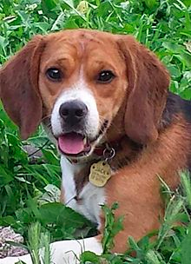
VERY Brief Reminder about Object-Oriented Programming
Class: dog
#Create new instance of dog class
this_dog = dog(‘beagle’,’Rex’,20)
#Get the dog’s name
print this_dog.name
‘Rex’
#Make the dog bark
print this_dog.bark()
‘Ruff!’
Attributes:
Breed
Name
Weight_lbs
Etc.
Sound familiar?
Here’s where it differs from data modeling…
Important: Why ruff and not woof for this dog?
Methods:
Bark
Run
Etc.
Attributes are properties
Methods are actions
Because of its property bread is set to beagle.

Slide 13
Demo Steps
Connect to database
Determine the SQL statement needed to extract a time series for the ODM database
Execute the needed SQL statement on the database
Restructure the data so that it can be plotted
Plot the data
Set properties of the plot (axis labels, title, etc.)

Slide 14
Connect to database
Use the PyMySQL package to establish a connection to your database
This uses the connection object in PyMySQL
import pymysql
#connect to database
conn = pymysql.connect(host='localhost', port=3306, user='root', passwd='’, db='LBRODM_small')
Note that I am using the ‘small’ version of the database, which I named LBRODM_small. Your database name may differ.
Your database server must be started for this connection to work.

Slide 15
Determine the SQL statement needed to extract a time series for the ODM database
A time series is a collection of observations made over time at one site and for one variable. We also need to include in the where clause a statement to only include QualityControlLevelID = 1 (quality controlled data).
sql_statement = “SELECT LocalDateTime, DataValue FROM DataValues WHERE SiteID = 2 AND VariableID = 36 AND QualityControlLevelID = 1 ORDER BY LocalDateTime”

Slide 16
Execute the needed SQL statement on the database
Create a cursor object from the connection object you created earlier
cursor = conn.cursor()
Use the cursor object’s execute method to execute the SQL statement
cursor.execute(sql_statement)
Use the cursor object’s fetchall method to get all resulting rows at once
rows = cursor.fetchall()

Slide 17
Restructure the data so that it can be plotted
Use Python’s built-in zip function to transform the result from the query into two lists, one storing the values from the LocalDateTime field and the second storing the values from the DataValue field
localDateTimes, dataValues = zip(*rows)
An explanation of the * before rows is here.

Slide 18
Create a Figure and Subplot
Import matplotlib’s pyplot (MATLAB-like) plotting framework.
import matplotlib.pyplot as plt
Create a figure object, and from the figure object, create a subplot. The response from the add_subplot method is an axes object for that subplot.
fig = plt.figure()
ax = fig.add_subplot(111)

Slide 19
Plot the data
Create a plot of the localDateTimes and dataValues lists. Have a solid grey line with no markers.
ax.plot(localDateTimes, dataValues, color='grey', linestyle='solid', markersize=0)
Show the plot
plt.show()

Slide 20
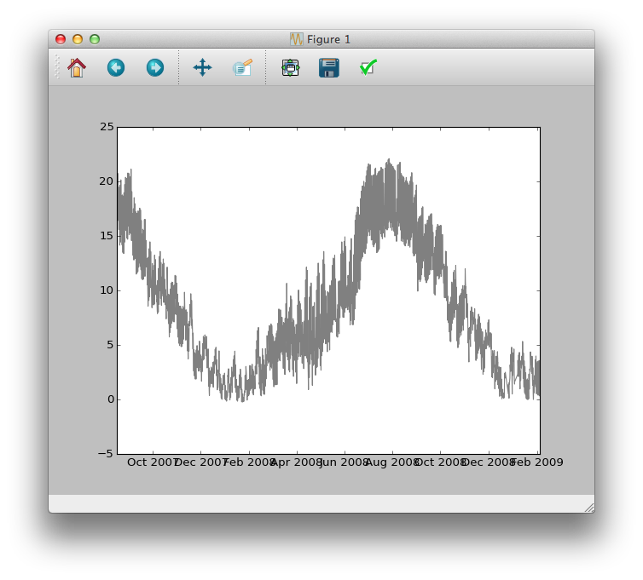
If you execute what we have so far in Canopy, you should see the following
Good start, but we need to clean some things up (axis labels and axis tick labels, for example)

Slide 21
Set properties of the plot (axis labels, title, etc.)
Set the ylabel and xlabel properties
ax.set_ylabel("Temperature ($^\circ$C)")
ax.set_xlabel("Date/Time")
Clean up the xaxis tick mark labels
from matplotlib import dates
import datetime
ax.xaxis.set_minor_locator(dates.MonthLocator())
ax.xaxis.set_minor_formatter(dates.DateFormatter('%b'))
ax.xaxis.set_major_locator(dates.YearLocator())
ax.xaxis.set_major_formatter(dates.DateFormatter('\n%Y'))

Slide 22
Add a grid, title, and change the font size
Add a grid
ax.grid(True)
Set the title
ax.set_title('Water temperature at Little Bear River \n at McMurdy Hollow near Paradise, Utah')
Set the default font size
from matplotlib import rc
font = {'family' : 'normal',
'weight' : 'normal',
'size' : 12}
rc('font', **font)

Slide 23
Clean up the figure spacing, print figure to image file
One quick way to clean up the figure spacing is by using the tight_layout method on the figure object.
fig.tight_layout()
You can save the figure directly to an image file for inclusion in a presentation, report, paper, etc.
fig.savefig(‘plot1.png’)

Slide 24
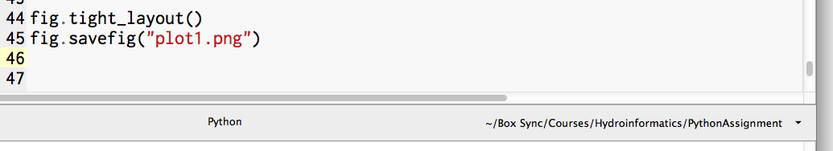
Setting the Working Directory in Canopy
When saving the figure, if you don’t provide a full path for the figure, then be sure to set the working directory in Canopy as shown below.
Click down arrow to set your
working directory

Slide 25
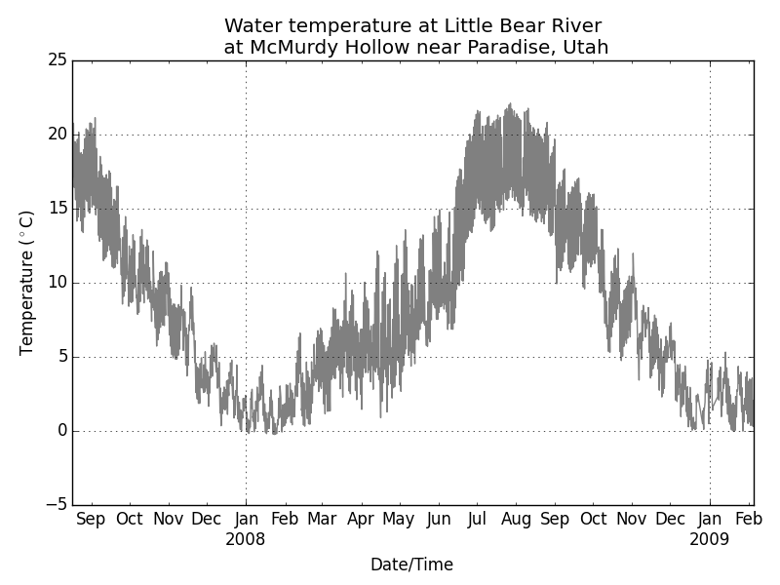
Final Product

Slide 26
Challenge Question 1
Can you modify the code so that a user can set siteID and variableID variables at the bringing of the script and the script produces a plot for the provided siteID and variableID?

Slide 27
Challenge Question 2
Can you modify the code so that the user can set a StartDateTime and EndDateTime at the beginning of the script, and the script produces a plot for just that time range?

Slide 28
Summary
You learned how to create a time series plot that reads data directly from an ODM MySQL database
If you completed the challenge questions, you were able to generalize the script to work for any siteID, VariableID, StartDateTime, and EndDateTime
Next class we will talk about
Creating a figure with multiple subplots
Organizing your code into functions and/or classes
Using the Pandas library for data analysis in Python.

Slide 29
Resources for Learning Python
Google’s Python Class
https://developers.google.com/edu/python/
MIT’s Python Course
http://ocw.mit.edu/courses/electrical-engineering-and-computer-science/6-00-introduction-to-computer-science-and-programming-fall-2008/
Many other books, sites, courses, etc. online

