Slide 1
Lecture 22
Numerical and Scientific Computing Part 2

Slide 2
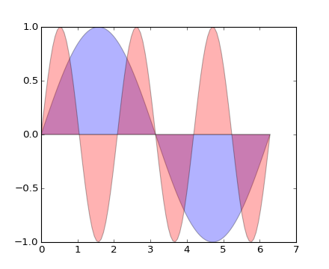
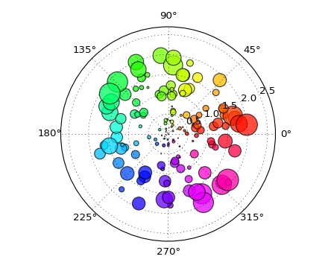
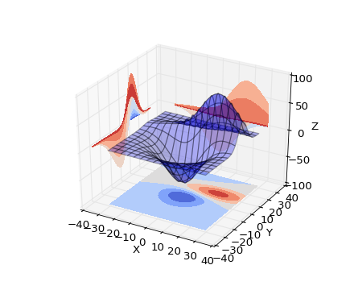
Matplotlib
We’re going to continue our discussion of scientific computing with matplotlib. Matplotlib is an incredibly powerful (and beautiful!) 2-D plotting library. It’s easy to use and provides a huge number of examples for tackling unique problems.

Slide 3
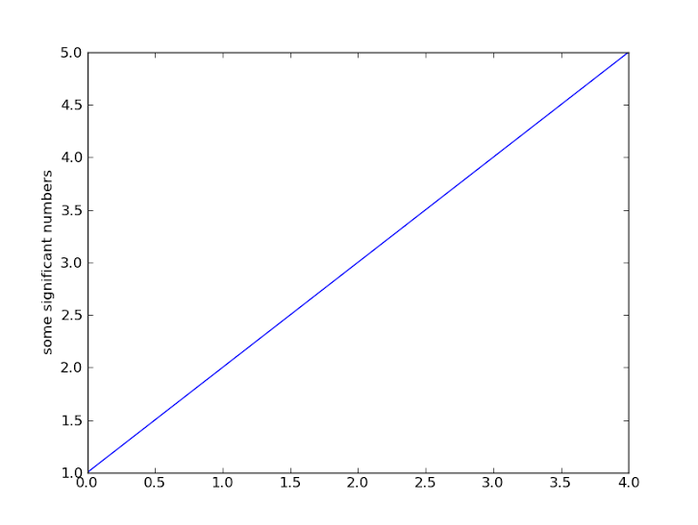
pyplot
At the center of most matplotlib scripts is pyplot. The pyplot module is stateful and tracks changes to a figure. All pyplot functions revolve around creating or manipulating the state of a figure.
import matplotlib.pyplot as plt plt.plot([1,2,3,4,5]) plt.ylabel('some significant numbers') plt.show()
When a single sequence object is passed to the plot function, it will generate the x-values for you starting with 0.

Slide 4
pyplot
The plot function can actually take any number of arguments. Common usage of plot: plt.plot(x_values, y_values, format_string [, x, y, format, ])
The format string argument associated with a pair of sequence objects indicates the color and line type of the plot (e.g. ‘bs’ indicates blue squares and ‘ro’ indicates red circles). Generally speaking, the x_values and y_values will be numpy arrays and if not, they will be converted to numpy arrays internally. Line properties can be set via keyword arguments to the plot function. Examples include label, linewidth, animated, color, etc…

Slide 5
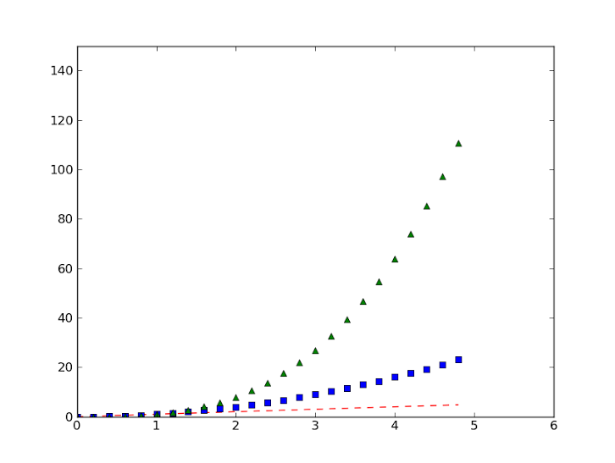
pyplot
import numpy as np import matplotlib.pyplot as plt # evenly sampled time at .2 intervals t = np.arange(0., 5., 0.2) # red dashes, blue squares and green triangles plt.plot(t, t, 'r--', t, t**2, 'bs', t, t**3, 'g^') plt.axis([0, 6, 0, 150]) # x and y range of axis plt.show()

Slide 6
Behind the scenes
It’s important to note that a figure is a separate idea from how it is rendered. Pyplot convenience methods are used for creating figures and immediately displaying them in a pop up window. An alternative way to create this figure is shown below.
import numpy as np import matplotlib.figure as figure t = np.arange(0, 5, .2) f = figure.Figure() axes = f.add_subplot(111) axes.plot(t, t, 'r--', t, t**2, 'bs', t, t**3, 'g^') axes.axis([0, 6, 0, 150])

Slide 7
pyplot
import numpy as np import matplotlib.pyplot as plt def f(t): return np.exp(-t) * np.cos(2*np.pi*t) t1 = np.arange(0.0, 5.0, 0.1) t2 = np.arange(0.0, 5.0, 0.02) plt.figure(1) # Called implicitly but can use # for multiple figures plt.subplot(211) # 2 rows, 1 column, 1st plot plt.plot(t1, f(t1), 'bo', t2, f(t2), 'k') plt.subplot(212) # 2 rows, 1 column, 2nd plot plt.plot(t2, np.cos(2*np.pi*t2), 'r--') plt.show()
A script can generate multiple figures, but typically you’ll only have one. To create multiple plots within a figure, either use the subplot() function which manages the layout of the figure or use add_axes().

Slide 8
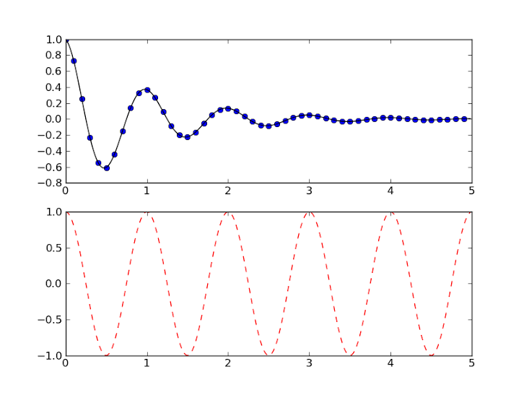
pyplot

Slide 9
pyplot
The text() command can be used to add text in an arbitrary location
xlabel() adds text to x-axis.
ylabel() adds text to y-axis.
title() adds title to plot.
clear() removes all plots from the axes.
All methods are available on pyplot and on the axes instance generally.

Slide 10
pyplot
import numpy as np import matplotlib.pyplot as plt mu, sigma = 100, 15 x = mu + sigma * np.random.randn(10000) # the histogram of the data n, bins, patches = plt.hist(x, 50, normed=1, facecolor='g', alpha=0.75) plt.xlabel('Smarts') plt.ylabel('Probability') plt.title('Histogram of IQ') plt.text(60, .025, r'$\mu=100,\ \sigma=15$') #TeX equations plt.axis([40, 160, 0, 0.03]) plt.grid(True) plt.show()

Slide 11
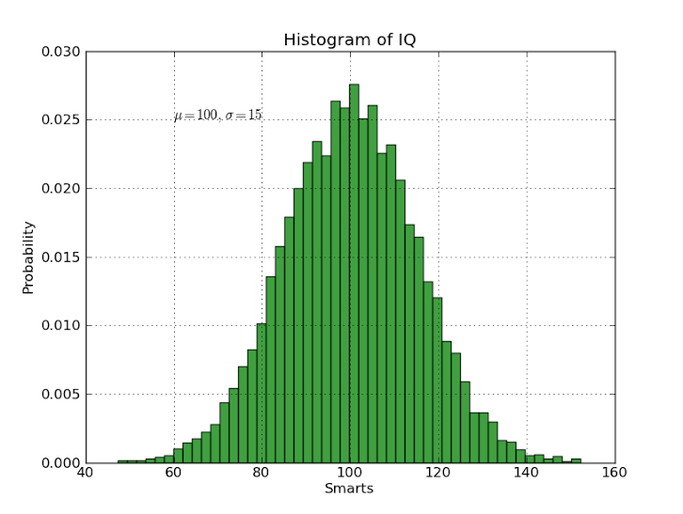
pyplot

Slide 12
pyplot
There are tons of specialized functions – check out the API here. Also check out the examples list to get a feel for what matploblib is capable of (it’s a lot!). You can also embed plots into GUI applications. For PyQt4, use matplotlib.backends.backend_qt4agg.
Let’s do a little demonstration.

Slide 13
plot gui
The two most important classes from matplotlib.backends.backend_qt4agg:
FigureCanvasQTAgg(fig): returns the canvas the figure fig renders into.
NavigationToolbar2QT(canvas, prnt): creates a navigation toolbar for canvas which has the parent prnt.
Furthermore, a canvas object has the following method defined:
canvas.draw(): redraws the updated figure on the canvas.

Slide 14
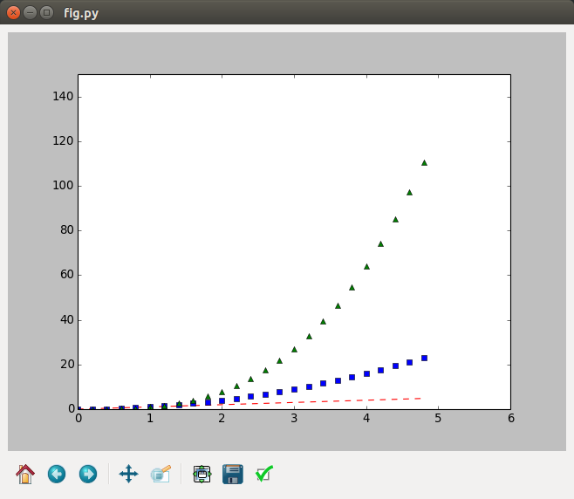
Plot gui
Let’s look at a little example using some plotting code from earlier. Check out plot_test.py.

Slide 15
IPython
IPython stands for Interactive Python. IPython was developed out of the desire to create a better interactive environment than the built-in Python interpreter allows.
Interactive shell: ipython
Interactive shell with PyQt GUI: ipython qtconsole
Notebook server: ipython notebook To install IPython, simply issue sudo pip install ipython.

Slide 16
ipython
To start with, the IPython shell can be used just like the Python interpreter.
IPython 3.0.0 -- An enhanced Interactive Python.
? -> Introduction and overview of IPython's features.
%quickref -> Quick reference.
help -> Python's own help system.
object? -> Details about 'object', use 'object??' for extra details.
In [1]: print "Hello, World!"
Hello, World!
In [2]: import sum_squares
In [3]: sum_squares.sum_of_squares(100)
Out[3]: 338350
In [4]: 2 + 7*3
Out[4]: 23

Slide 17
ipython
To start with, the IPython shell can be used just like the Python interpreter.
We can execute python statements one at a time as well as import modules and call functions just like we can with the Python interpreter. Note the interface is a series of inputs to and outputs from the shell.
IPython’s goal, however, is to provide a superior interpreted environment for Python so there’s a lot more we can do.
In [1]: print "Hello, World!"
Hello, World!
In [2]: import sum_squares
In [3]: sum_squares.sum_of_squares(100)
Out[3]: 338350
In [4]: 2 + 7*3
Out[4]: 23

Slide 18
Ipython reference
Whenever you start up IPython, you’ll get the following message:
The first will basically show you IPython’s quick documentation and the second gives you a rundown of a lot of the functionality. For either, type ‘q’ to go back to the shell.
? -> Introduction and overview of IPython's features.
%quickref -> Quick reference.
help -> Python's own help system.
object? -> Details about 'object', use 'object??' for extra details.

Slide 19
Ipython help
Whenever you start up IPython, you’ll get the following message:
The help command can be used to either start up a separate help interpreter (just type help()) or get help for a specific object.
? -> Introduction and overview of IPython's features.
%quickref -> Quick reference.
help -> Python's own help system.
object? -> Details about 'object', use 'object??' for extra details.
In [13]: x = 3 In [14]: help(x)

Slide 20
Ipython object inspection
The object? command can be used to get some more details about a particular object. IPython refers to this as dynamic object introspection. One can access docstrings, function prototypes, source code, source files and other details of any object accessible to the interpreter.
In [16]: l = [1,2,3]
In [17]: l?
Type: list
String form: [1, 2, 3]
Length: 3
Docstring:
list() -> new empty list
list(iterable) -> new list initialized from iterable's items

Slide 21
Ipython tab completion
Tab completion: typing tab after a python object will allow you to view its attributes and methods. Tab completion can also be used to complete file and directory names.
In [4]: sum_ sum_squares sum_squares.py sum_squares.pyc sum_squares.py~ In [4]: sum_squares.s sum_squares.square_of_sum sum_squares.sum_of_squares In [4]: sum_squares. sum_squares.print_function sum_squares.py~ sum_squares.py sum_squares.square_of_sum sum_squares.pyc sum_squares.sum_of_squares

Slide 22
Ipython Magic commands
IPython supports “magic commands” of the form %command.
These commands can be used to manipulate the IPython environment, access directories, and make common system shell commands.
Line-oriented magic commands accept as arguments whatever follows the command, no parentheses or commas necessary.
Examples: %run, %timeit, and %colors
Cell-oriented magic commands (prefixed with %%) take not only the rest of the line, but also subsequent lines as arguments.
Examples: %%writefile, %%timeit, %%latex

Slide 23
Ipython magic commands
The %timeit command comes in both line-oriented and cell-oriented form.
Optionally: -n <N> Execute the given statement <N> times in a loop. -r <R> Repeat the loop iteration <R> times and take the best result. -o Return a TimeitResult that can be stored in a variable.
In [1]: %timeit range(1000)
100000 loops, best of 3: 13.2 us per loop
In [2]: %%timeit x = range(10000)
...: max(x)
...:
1000 loops, best of 3: 287 us per loop

Slide 24
Ipython magic commands
The %%script command allows you to specify a program and any number of lines of script to be run using the program specified.
Optionally: --bg Whether to run the script in the background. --err ERR The variable in which to store stderr from the script. --out OUT The variable in which to store stdout from the script.
In [1]: %%script bash
...: for i in 1 2 3; do
...: echo $i
...: done
1
2
3

Slide 25
Ipython run command
The magic command %run is especially useful: it allows you to execute a program within IPython. The IPython statement In [1]: %run file.py args is similar to the command $ python file.py args but with the advantage of giving you IPython’s tracebacks, and of loading all variables into your interactive namespace for further use

Slide 26
Python run command
print "Hello from test.py!" def f(x): print "Argument is ", x if __name__ == "__main__": print "Calling f(3)." f(3)
Consider the python program test.py to the right.
By default, programs are run with __name__ having the value “__main__”. The –n flag indicates that __name__ should have the module’s name instead.
In [1]: %run test.py Hello from test.py! Calling f(3). Argument is 3 In [2]: %run -n test.py Hello from test.py!

Slide 27
Python run command
print "Hello from test.py!" def f(x): print "Argument is ", x print "The variable y is ", y
if __name__ == "__main__": print "Calling f(3)." f(3)
Consider the python program test.py to the right.
The –i flag indicates that we should use IPython’s namespace instead of a brand new empty one.
In [1]: y = 4 In [2]: %run -i test.py Hello from test.py! Calling f(3). Argument is 3 The variable y is 4

Slide 28
Python run command
def f(x): total = x for i in range(1000000): total += i if __name__ == "__main__": f(3)
Consider the python program test.py to the right.
The –t flag indicates that we would like to time the execution of the module N times.
In [1]: %run -i -t -N100 test.py IPython CPU timings (estimated): Total runs performed: 100 Times : Total Per run User : 8.81 s, 0.09 s. System : 0.04 s, 0.00 s. Wall time: 8.84 s.

Slide 29
Python run command
test.py
total = 0 def f(x): global total total = x for i in range(100): total += i if __name__ == "__main__": f(3)
Consider the python program test.py to the right.
Running a .ipy or .nb file indicates that we’d like the contents to be interpreted as ipython commands.
In [1]: %run test.ipy Type: int String form: 4953 Docstring: int(x=0) -> int or long int(x, base=10) -> int or long
test.ipy
%run -i test.py total?

Slide 30
Python edit command
The %edit command allows us to bring up an editor and edit some code. The resulting code is immediately executed in the IPython shell.
In [15]: %edit
IPython will make a temporary file named: /tmp/ipython_edit_qHYbnt/ipython_edit_mB8nlR.py
Editing... done. Executing edited code...
Out[15]: 'def say_hello():\n print "Hello, World!"\n‘
In [17]: say_hello()
Hello, World!
In [18]: %edit say_hello
Editing... done. Executing edited code...
In [19]: say_hello()
Hello again, world!

Slide 31
Ipython history
In [17]: say_hello() Hello, World! In [18]: edit say_hello Editing... done. Executing edited code... In [19]: say_hello() Hello again, world! In [20]: In[17] Out[20]: u'say_hello()' In [21]: exec(In[17]) Hello again, world!
One of the most convenient features offered by IPython is the ability to save and manipulate the interpreter’s history.
Up- and down- arrow keys allow you to cycle through previously-issued commands, even across IPython sessions. Previously issued commands are available in the In variable, while previous output is available in the Out variable.

Slide 32
Ipython history
The last three objects in output history are also kept in variables named _, __ and ___. A number of magic commands also accept these variables (e.g. %edit _). The %history magic command will also list some previous commands from your history.
In [25]: 2+3 Out[25]: 5 In [26]: _ + 4 Out[26]: 9 In [27]: _ + __ Out[27]: 14

Slide 33
Ipython shell
You can run any system shell command within IPython by prefixing it with a !.
In [32]: !ls ticket_app/app/ forms.py __init__.py static templates ticket_scraper.py views.py In [33]: files = !ls ticket_app/app/ In [34]: print files ['forms.py', '__init__.py', 'static', 'templates', 'ticket_scraper.py', 'views.py']

Slide 34
Ipython notebook
So, now we’ve seen IPython’s awesome command shell. Whether you choose terminal or Qt-based, it’s definitely a great step-up from the built-in Python interpreter.
IPython Notebook, however, provides an entirely new type of environment for developing, executing, and displaying Python programs.
IPython Notebook is a web-based interactive computational environment for creating IPython notebooks. An IPython notebook is a JSON document containing an ordered list of input/output cells which can contain code, text, mathematics, plots and rich media.
Check out the Notebook gallery.

Slide 35
Ipython notebook
IPython Notebook has two components:
Web application: you can start an IPython notebook server for writing documents that contain IPython tools.
Notebook documents: a computational record of a session within the IPython notebook server.

Slide 36
Ipython notebook
Start a notebook server with the following command:
This will print some information about the notebook server in your console, and open a web browser to the URL of the web application (by default, http://127.0.0.1:8888).
The page you open to will display a listing of the notebooks in your current directory.
Additionally, you can specify that a particular notebook should be opened when the application is launched:
$ ipython notebook
$ ipython notebook some_notebook.ipynb

Slide 37
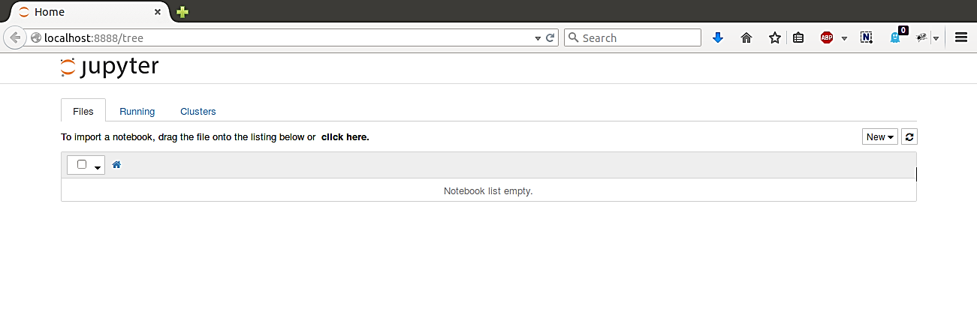
Ipython notebook
Start a notebook server with the following command:
$ ipython notebook

Slide 38
Ipython notebook
Initializing an IPython server means that you are initializing an IPython kernel.
Traditionally, interpreters use a REPL format to communicate with the user. That is, the user enters a statement which is read, evaluated, and the output of which is printed to the screen. This loop continues until the user quits the interpreter. Almost all aspects of IPython, however, use a unique two process model where every interactive session is really a client connection to a separate evaluation process, of which the IPython kernel is in charge.

Slide 39
Ipython notebook
So, what’s the advantage of this two-process model?
Several clients can connect to the same kernel.
Clients can connect to kernels on a remote machine.
To connect to the most-recently created kernel: $ ipython notebook --existing
To connect to a specific kernel: $ ipython notebook --existing kernel-19732.json
Use the magic command %connect_info to get the connection file for a kernel.

Slide 40
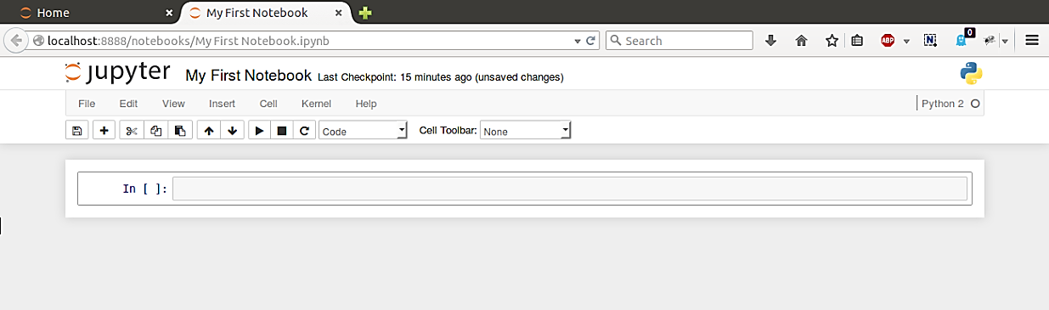
Ipython notebooks
Let’s create an IPython notebook together.
The notebook consists of a sequence of cells. A cell is a multi-line text input field, and its contents can be executed by using Shift-Enter.

Slide 41
Ipython notebook
There are four types of cells, each having different execution behavior:
Code cells – contain Python code by default, but other languagues as well. Output is not limited to text, but can also be figures and other rich media.
Markdown cells – contain Markdown code and render rich text output.
Raw cells – contain output directly. Raw cells are not evaluated by kernel.
Heading cells – contain one of 6 different heading levels to provide structure to document. The default is code cell, but you can change this in the toolbar.

Slide 42
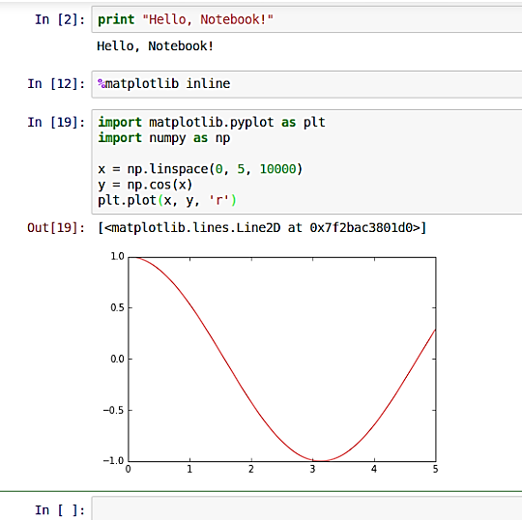
Ipython notebook
Here are some basic code cells examples. We can clearly write and execute typical Python code in our code cells. But we can also write and execute code with rich output, like matplotlib plots.
Behind the scenes, the code of the cell is submitted to the kernel which evaluates the code and returns a response to the client application.

Slide 43
Python notebook
To display more exotic rich media, you’ll need IPython’s display module.
Image([filename, url, …]) creates a displayable image object.
SVG() for displayable scalable vector graphics.
FileLink() to create links.
HTML()
etc.
from IPython.display import display

Slide 44
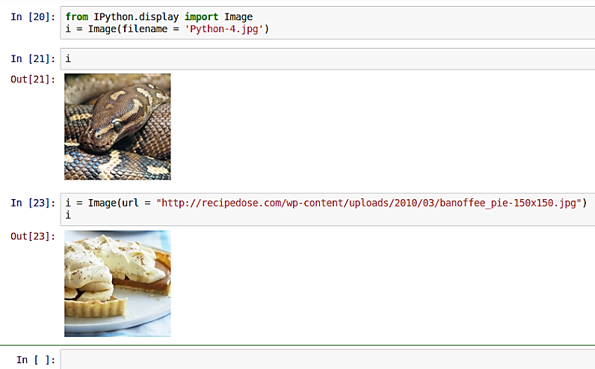
Python notebook

Slide 45
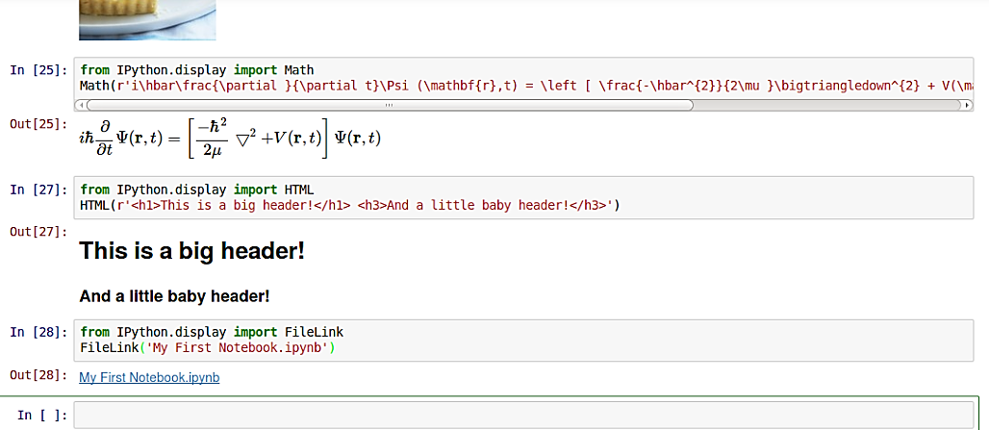
Python notebook

