Slide 1


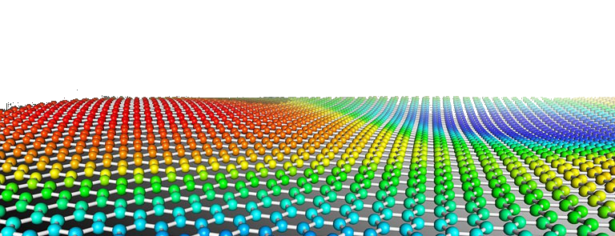
PYTHON
Prof. Muhammad Saeed

Slide 2
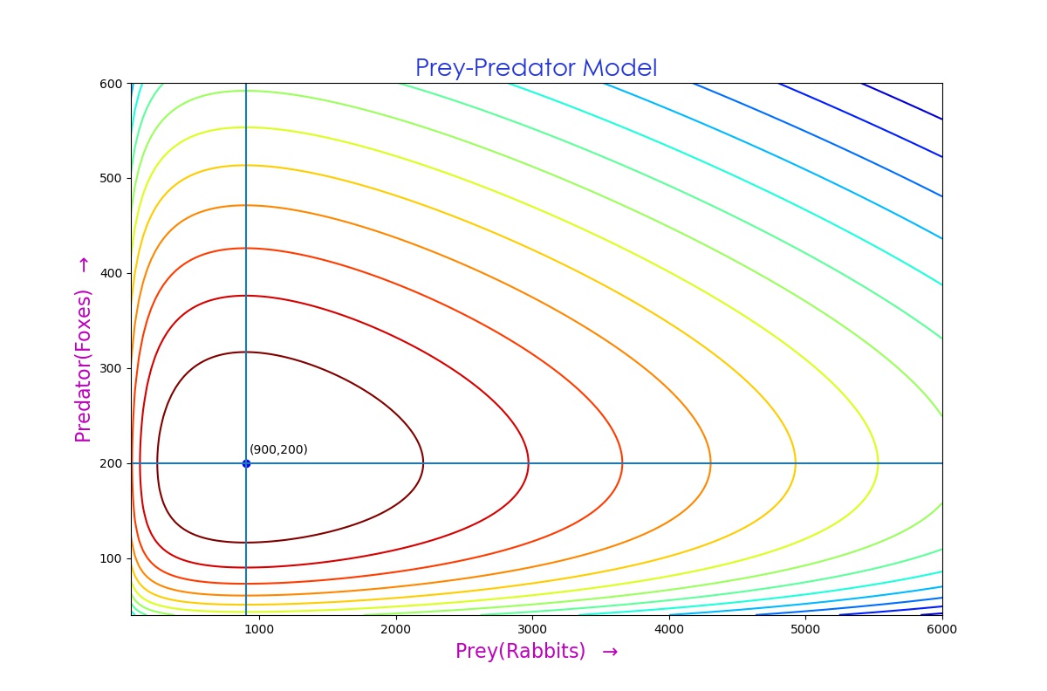
Graphs
With
matplotlib
Python Dept. Of Comp. Sc. & IT, FUUAST

Slide 3
2D Graphs
Python Dept. Of Comp. Sc. & IT, FUUAST

Slide 4
Graph 2D
import matplotlib.pyplot as plt
import numpy as np
Plot I
x= np.arange(-12*pi, 12*pi, 0.15)
y=np.exp(-0.05*x)*np.sin(x)
plt.plot(x,y,’o-r’,lw=1)
plt.title('Damped Oscillator')
plt.xlabel('Angle')
plt.ylabel('Amplitude')
Plot II
plt.plot(x, y, alpha = 0.5, color = ‘#FF7F00’, linestyle = ‘-.’, linewidth = 3,
marker = ‘o’, markeredgecolor = ‘#000000’, markeredgewidth = 2,
markerfacecolor = ‘#FF7F00’, markersize=10)
Python Dept. Of Comp. Sc. & IT, FUUAST

Slide 5
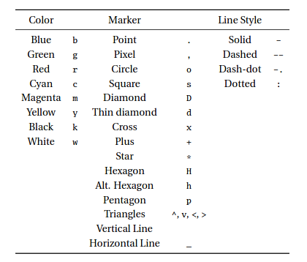
Graph 2D
Color, Marker & Line Style
Python Dept. Of Comp. Sc. & IT, FUUAST

Slide 6
Graph 2D
Scatter Plot:
z = numpy.random.randn(100,2)
x=z[:,0]
y=z[:,1]
plt.scatter(x,y)
plt.scatter(x+0.2,y, s = 60, c = ’#FF7F00’, marker=’s’, alpha = .5)
Bar Charts:
import numpy as np
import matplotlib.pyplot as plt
y = np.random.randn(5)
x = np.arange(5)
plt.bar(x,y)
Python Dept. Of Comp. Sc. & IT, FUUAST

Slide 7
Graph 2D
Stem Plot:
import numpy as np
import matplotlib.pyplot as plt
x=np.linspace(-2*np.pi,2*np.pi,400)
y=np.cos(x)**2
plt.stem(x,y,’-.’,bottom=-2)
Stacked Bar Plot:
import matplotlib.pyplot as plt
A = [5., 30., 45., 22.]
B = [5., 25., 50., 20.]
X = range(4)
plt.bar(X, A, color = 'b')
plt.bar(X, B, color = 'r', bottom = A)
Python Dept. Of Comp. Sc. & IT, FUUAST

Slide 8
Graph 2D
Step Plot:
import numpy as np
import matplotlib.pyplot as plt
x = np.linspace(-np.pi,np.pi,40)
y = np.sin(x)
plt.step(x, y)
Histogram
x = np.random.randn(1000)
plt.hist(x, bins = 30)
plt.hist(x, bins = 30, cumulative=True, color='#FF7F00')
Python Dept. Of Comp. Sc. & IT, FUUAST

Slide 9
Graph 2D
Pie Chart
y = np.random.rand(5)
plt.pie(y) ;
expld = np.array([.2,0,0,0,0])
clrs = [‘#FF0000','#FFFF00','#00FF00','#00FFFF','#0000FF']
labls = [’One’, ’Two’, ’Three’, ’Four’, ’Five’]
plt.pie(y,
explode = expld,
colors = clrs,
labels = labls,
autopct = ’%2.0f’,
shadow = True)
Python Dept. Of Comp. Sc. & IT, FUUAST

Slide 10
Graph 2D
Multiple Graphs …………..
import matplotlib.pyplot as plt
Import numpy as np
clrs = ['#FF0000','#FFFF00','#00FF00','#00FFFF','#0000FF']
fig,ax = plt.subplots(nrows=2,ncols=2, figsize=(12,8))
ax=np.ravel(ax)
y = np.random.randn(100)
ax[0].plot(y)
ax[0].set_title('1')
y = np.random.rand(5)
x = np.arange(5)
ax[1].bar(x, y)
ax[1].set_title('2')
Python Dept. Of Comp. Sc. & IT, FUUAST

Slide 11
Graph 2D
------ Multiple Graphs
y = np.random.rand(5)
ax[2].pie(y, colors=clrs)
ax[2].set_title('3')
z = np.random randn(100, 2)
x = z[:, 0]
y = z[:, 1]
ax[3].scatter(x, y)
ax[3].set_title('4')
Python Dept. Of Comp. Sc. & IT, FUUAST

Slide 12
3D Graphs
Python Dept. Of Comp. Sc. & IT, FUUAST

Slide 13
3D Graphs 3D curves
Import mpl_toolkits.mplot3d.axes3d
import matplotlib.pyplot as plt
from numpy import sin, cos, linspace, pi
x = linspace(-8*pi,8*pi,400)
y = x*sin(x)
x = 2*cos(x)
z = x*y
fig = plt.figure()
ax=fig.gca(projection='3d')
ax.plot(x,y,z)
ax.set_title(‘TITLE’)
plt.show()
#ax.set_axis_off() ; #ax.grid(b=‘off’)
Python Dept. Of Comp. Sc. & IT, FUUAST

Slide 14
3D Graphs 3D curve
import mpl_toolkits.mplot3d.axes3d
import numpy as np
import matplotlib as mpl
import matplotlib.pyplot as plt
fig = plt.figure()
ax = fig.gca(projection='3d')
theta = np.linspace(-8 * np.pi, 8 * np.pi, 200)
z = np.linspace(-2, 2, 200)
r = z**2+2
x = r * np.sin(theta)
y = r * np.cos(theta)
ax.plot(x, y, z)
plt.show()
Python Dept. Of Comp. Sc. & IT, FUUAST

Slide 15
3D Graphs 3D Wireframe
import matplotlib.pyplot as plt
import numpy as np
fig = plt.figure()
ax = fig.gca(projection='3d')
X = np.arange(-5, 5, 0.2)
Y = np.arange(-5, 5, 0.2)
X, Y = np.meshgrid(X, Y)
R = np.sqrt(X**2 + Y**2)
Z = np.sin(R)
ax.plot_wireframe(X, Y, Z, rstride=1,cstride=1,lw=1,antialiased=False)
plt.show()
Python Dept. Of Comp. Sc. & IT, FUUAST

Slide 16
3D Graphs 3D curves
import mpl_toolkits.mplot3d.axes3d
import matplotlib.pyplot as plt
import numpy as np
fig= plt.figure()
ax = fig.add_subplot(111, projection='3d')
x = np.arange(-10, 10, 0.2)
y = np.arange(-10, 10, 0.2)
X, Y = np.meshgrid(x, y)
R = np.sqrt(X**2 + Y**2)
Z = np.sin(R)/R
ax.plot_surface(X, Y, Z, rstride=2, cstride=2, linewidth=0)
#ax.set_zlim3d(-1, 1)
Python Dept. Of Comp. Sc. & IT, FUUAST

Slide 17
3D Graphs Scatter
import numpy as np
Import mpl_toolkits.mplot3d.axes3d
import matplotlib.pyplot as plt
def randrange(n, vmin, vmax):
return (vmax - vmin)*np.random.rand(n) + vmin
fig = plt.figure()
ax = fig.add_subplot(111, projection='3d')
n = 100
for c, m, zl, zh in [('r', 'o', -50, -25), ('b', '^', -30, -5)]:
xs = randrange(n, 23, 32)
ys = randrange(n, 0, 100)
zs = randrange(n, zl, zh)
ax.scatter(xs, ys, zs, c=c, marker=m)
ax.set_xlabel('X Label'); ax.set_ylabel('Y Label'); ax.set_zlabel('Z Label')
#ax.set_axis_off(); #ax.grid(b='off'); #ax.set_title('Hello')
plt.show()
Python Dept. Of Comp. Sc. & IT, FUUAST

Slide 18
C
O
L
O
R
S
Python Dept. Of Comp. Sc. & IT, FUUAST

Slide 19
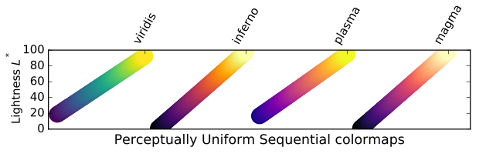
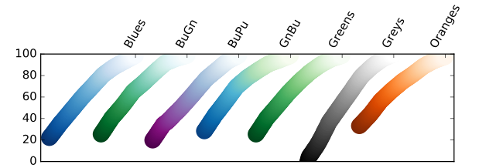
Python Dept. Of Comp. Sc. & IT, FUUAST

Slide 20
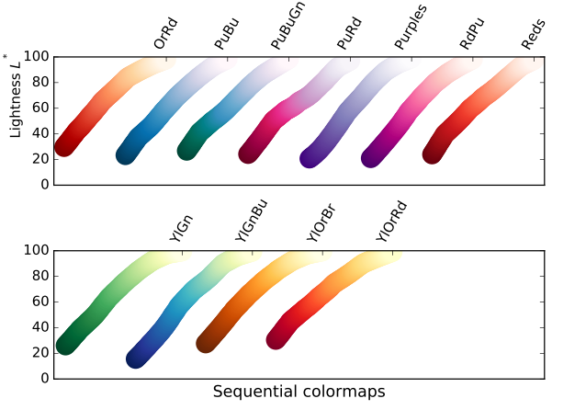
Python Dept. Of Comp. Sc. & IT, FUUAST

Slide 21
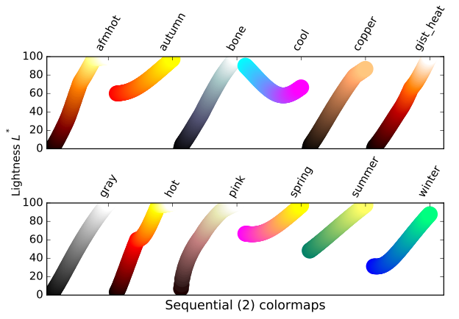
Python Dept. Of Comp. Sc. & IT, FUUAST

Slide 22
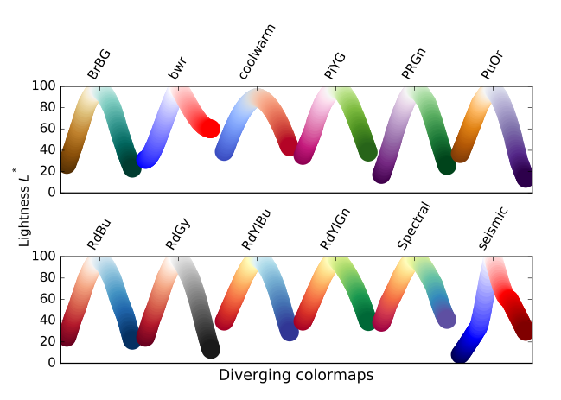
Python Dept. Of Comp. Sc. & IT, FUUAST

Slide 23
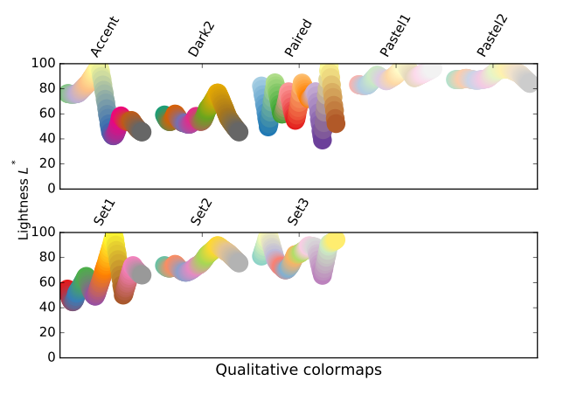
Python Dept. Of Comp. Sc. & IT, FUUAST

Slide 24
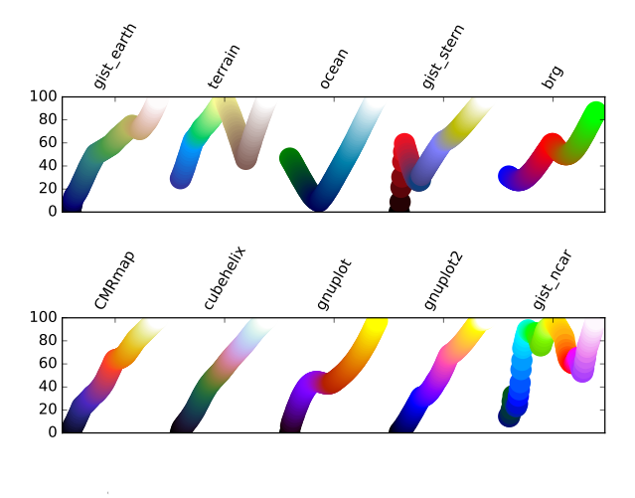
Python Dept. Of Comp. Sc. & IT, FUUAST

Slide 25
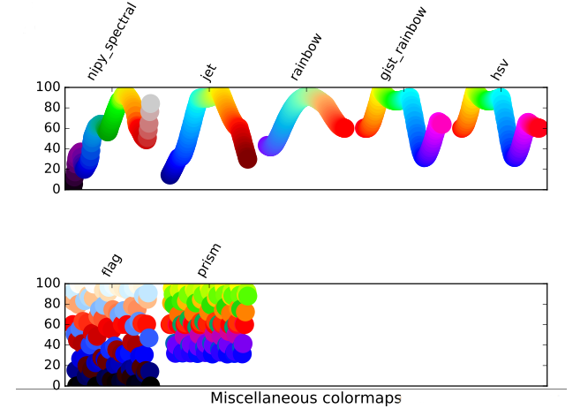
Python Dept. Of Comp. Sc. & IT, FUUAST

Slide 26
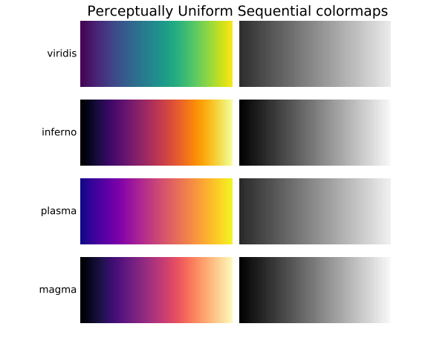
Python Dept. Of Comp. Sc. & IT, FUUAST

Slide 27
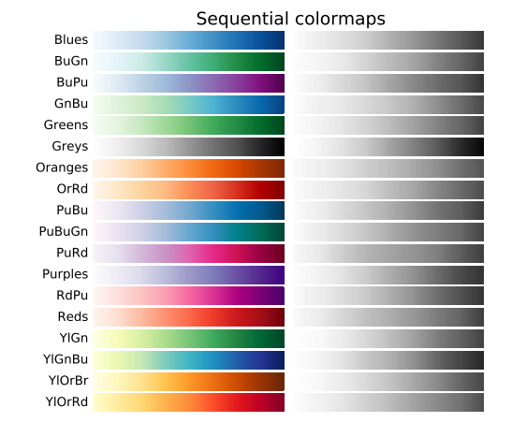
Python Dept. Of Comp. Sc. & IT, FUUAST

Slide 28
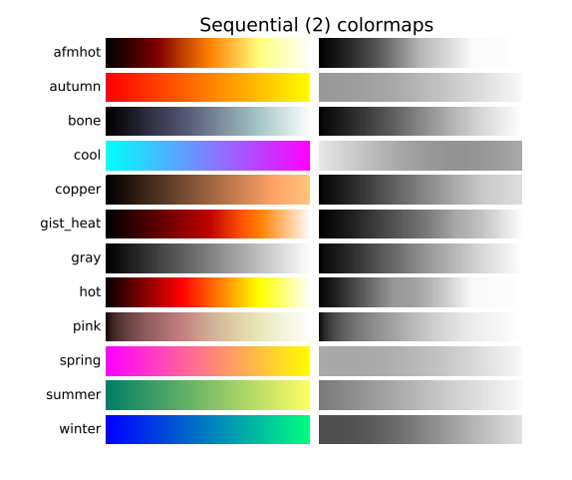
Python Dept. Of Comp. Sc. & IT, FUUAST

Slide 29
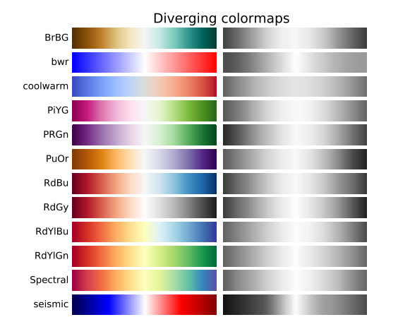
Python Dept. Of Comp. Sc. & IT, FUUAST

Slide 30
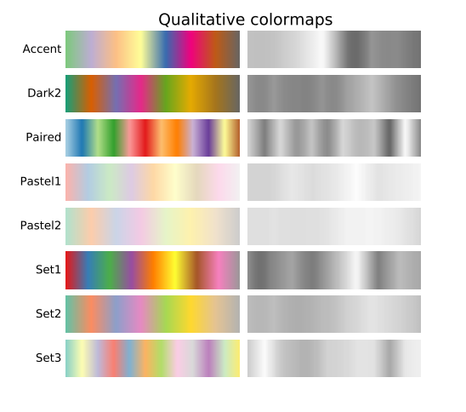
Python Dept. Of Comp. Sc. & IT, FUUAST

Slide 31
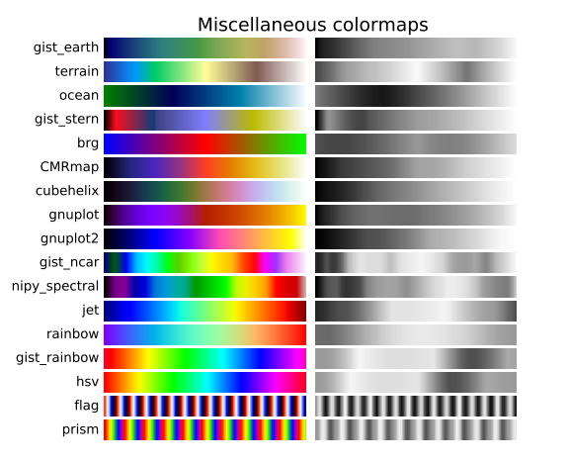
Python Dept. Of Comp. Sc. & IT, FUUAST

Slide 32
[('Perceptually Uniform Sequential',
['viridis', 'inferno', 'plasma', 'magma']),
('Sequential', ['Blues', 'BuGn', 'BuPu',
'GnBu', 'Greens', 'Greys', 'Oranges', 'OrRd',
'PuBu', 'PuBuGn', 'PuRd', 'Purples', 'RdPu',
'Reds', 'YlGn', 'YlGnBu', 'YlOrBr', 'YlOrRd']),
('Sequential (2)', ['afmhot', 'autumn', 'bone', 'cool',
'copper', 'gist_heat', 'gray', 'hot',
'pink', 'spring', 'summer', 'winter']),
('Diverging', ['BrBG', 'bwr', 'coolwarm', 'PiYG', 'PRGn', 'PuOr',
'RdBu', 'RdGy', 'RdYlBu', 'RdYlGn', 'Spectral',
'seismic']),
('Qualitative', ['Accent', 'Dark2', 'Paired', 'Pastel1',
'Pastel2', 'Set1', 'Set2', 'Set3']),
('Miscellaneous', ['gist_earth', 'terrain', 'ocean', 'gist_stern',
'brg', 'CMRmap', 'cubehelix',
'gnuplot', 'gnuplot2', 'gist_ncar',
'nipy_spectral', 'jet', 'rainbow',
'gist_rainbow', 'hsv', 'flag', 'prism'])]
Python Dept. Of Comp. Sc. & IT, FUUAST

Slide 33
Graphs & Colors
END
Python Dept. Of Comp. Sc. & IT, FUUAST

