Slide 1
Python plotting curves chapter 10_5
From
Think Python
How to Think Like a Computer Scientist

Slide 2
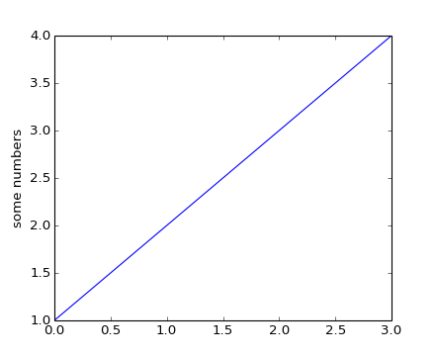
MatPlotLib
matplotlib.pyplot is a collection of command style functions that make matplotlib work like MATLAB. Each pyplot function makes some change to a figure: eg, create a figure, create a plotting area in a figure, plot some lines in a plotting area, decorate the plot with labels, etc....
import matplotlib.pyplot as plt
plt.plot([1,2,3,4])
plt.ylabel('some numbers')
plt.show()
from matplotlib.pyplot import *
plot([1,2,3,4])
ylabel('some numbers')
show()
Auto generates x values here!

Slide 3
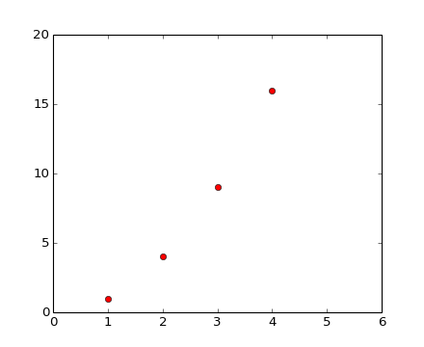
PLOT
plot() is a versatile command, and will take an arbitrary number of arguments. For example, to plot x versus y, you can issue the command:
plt.plot([1,2,3,4], [1,4,9,16])
For every x, y pair of arguments, there is an optional third argument which is the format string that indicates the color and line type of the plot.
import matplotlib.pyplot as plt
plt.plot([1,2,3,4], [1,4,9,16], 'ro')
plt.axis([0, 6, 0, 20])
plt.show()
red circle

Slide 4
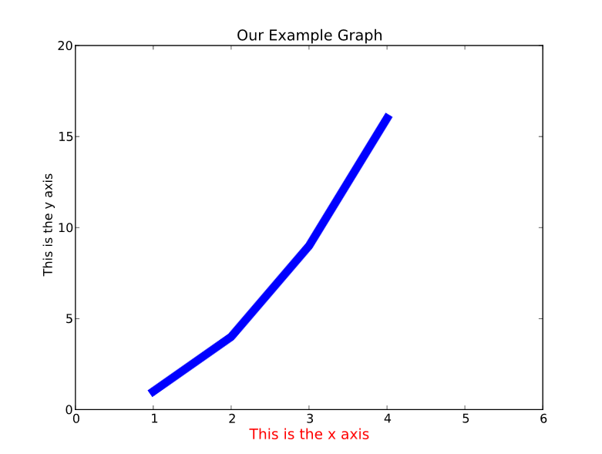
Line and Text Properties
import matplotlib.pyplot as plt
plt.plot([1,2,3,4], [1,4,9,16], linewidth=8.0 ) #thick line
plt.axis([0, 6, 0, 20]) #sets y axis values
plt.xlabel('This is the x axis', fontsize=14,color = 'red')
plt.ylabel('This is the y axis')
plt.title('Our Example Graph')
plt.show()
2d Line Properties
Text Properties

Slide 5
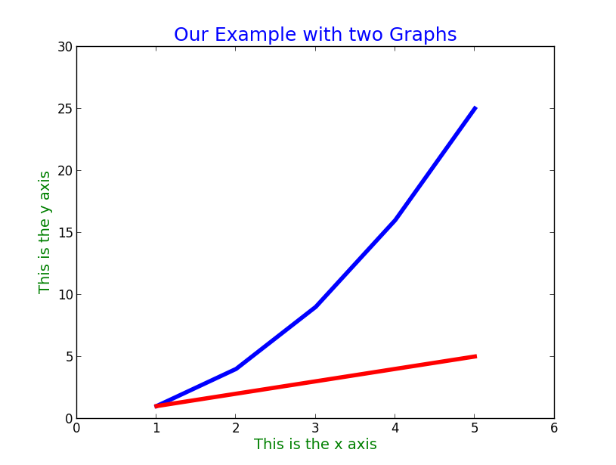
Two graphs
import matplotlib.pyplot as plt
# plot graphs
plt.plot([1,2,3,4,5], [1,4,9,16,25], linewidth = 4.0 , color='blue') #thick line
plt.plot([1,2,3,4,5],[1,2,3,4,5], linewidth = 4.0, color='red')
plt.axis([0, 6, 0, 30]) #sets y axis values
plt.xlabel('This is the x axis', fontsize = 14, color = 'green')
plt.ylabel('This is the y axis', fontsize = 14, color = 'green')
plt.title('Our Example with two Graphs', fontsize = 18, color = 'blue')
plt.show()

