Slide 1
Data visualization in Python
Martijn Tennekes, Ali Hürriyetoglu
THE CONTRACTOR IS ACTING UNDER A FRAMEWORK CONTRACT CONCLUDED WITH THE COMMISSION

Slide 2
Outline
Overview data visualization in Python
ggplot
Folium
Conclusion

Slide 3
Which packages/functions
Standard charts (e.g. line chart, bar chart, scatter plot):
Matplotlib, Pandas, Seaborn, ggplot, Altair, ...
Thematic maps
Folium, Basemap, Cartopy, Iris, …
Other visualisations
Bokeh (interactive plots), plotly, …

Slide 4
ggplot
Based on one of the most popular R package (ggplot2)
Based on the Grammar of Graphics (Wilkinson, 2005)
Charts are build up according to this grammar:
data
mapping / aestetics
geoms
stats
scales
coord
Facets
Pandas DataFrames are used natively in ggplot.

Slide 5
ggplot and qplot
Data: DataFrame.
Stacking of layers and transformations with +
ggplot(mpg, aes(x = displ, y = cty) ) + geom_point()
Aestatics: x, y, color, fill, shape
Geometry: points
Shortcut function: qplot (quick plot):
qplot(diamonds.carat, diamonds.price)

Slide 6
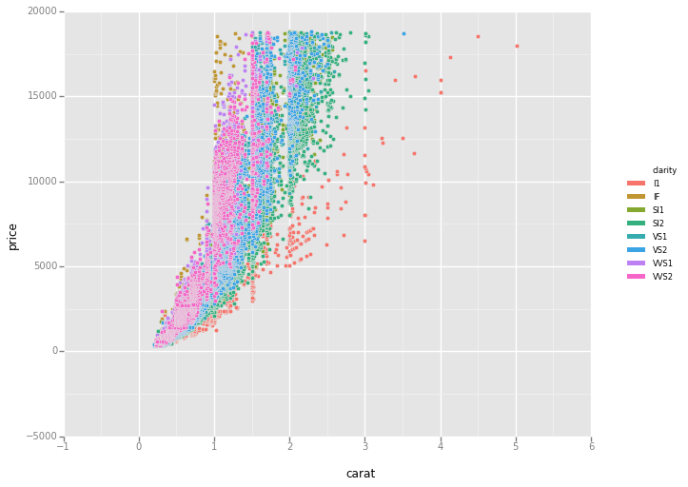
Aesthetics
Mapping of data to visual attributes of geometric objects:
Position: x, y
Color: color
Shape: shape
ggplot(aes(x='carat', y='price', color='clarity'), diamonds) + geom_point()

Slide 7
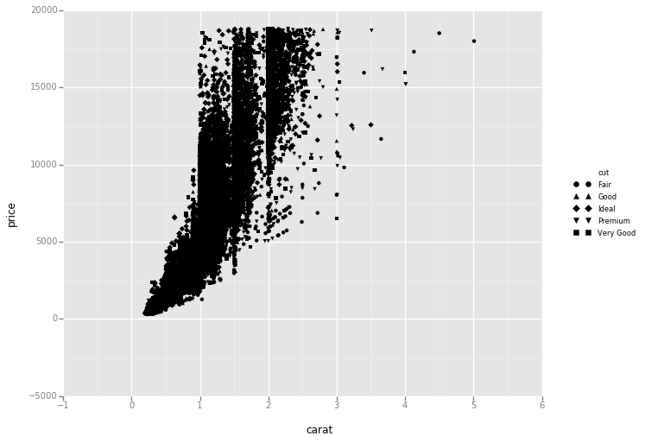
Aesthetics
Mapping of data to visual attributes of geometric objects:
Position: x,y
Color: color
Shape: shape
ggplot(aes(x='carat', y='price', shape="cut"), diamonds) + geom_point()

Slide 8
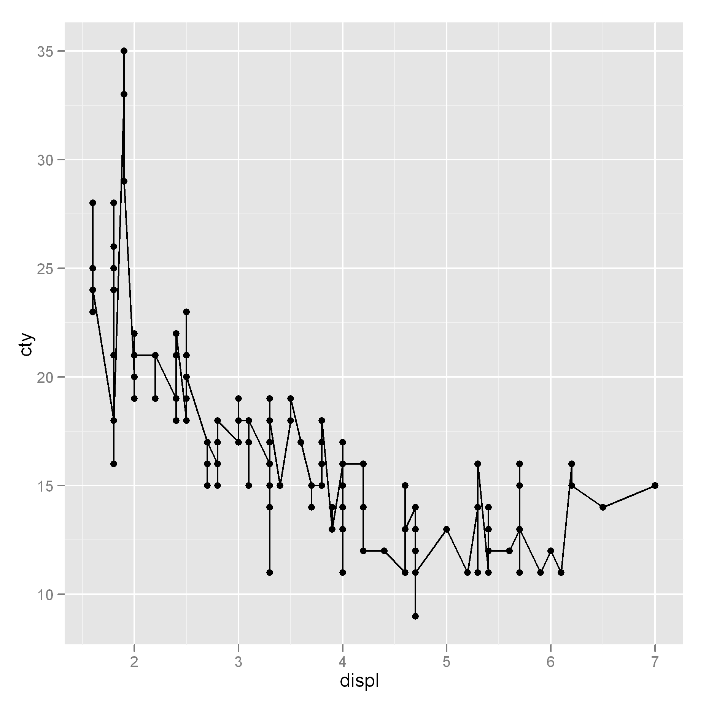
Geom
Geometric objects:
Points, lines, polygons, …
Functions start with “geom_”
Also margins:
geom_errorbar(), geom_pointrange(), geom_linerange().
Note: they require the aesthetics ymin and ymax.
ggplot(mpg, aes(x = displ, y = cty)) + geom_point() + geom_line()

Slide 9
Stat
stat_smooth() and stat_density() enable statistical transformation
Most geoms have default stat (and the other way round)
geom and stat form a layer
One or more layers form a plot

Slide 10
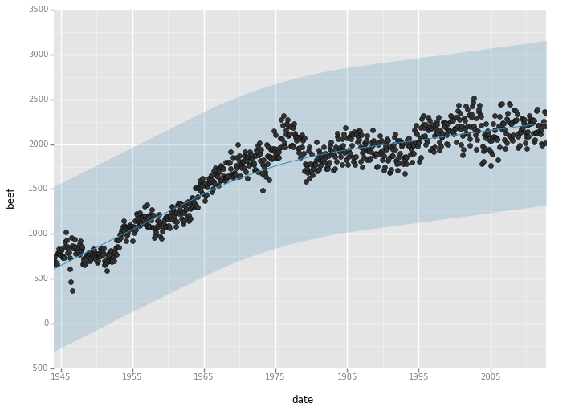
stat_smooth
ggplot(aes(x='date', y='beef'), data=meat) + geom_point() + \
stat_smooth(method='loess')

Slide 11
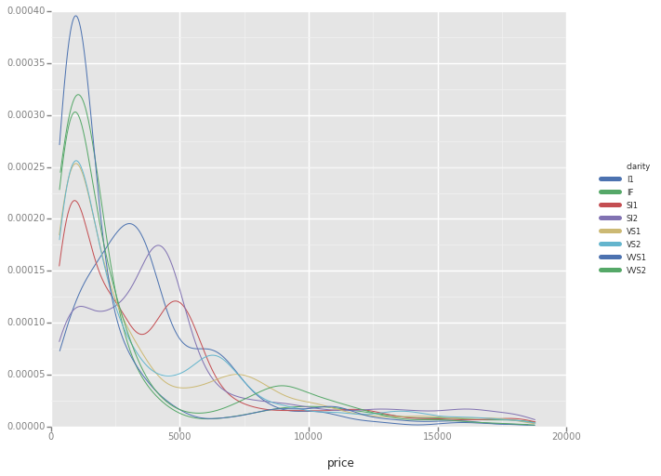
stat_density
ggplot(aes(x='price', color='clarity'), data=diamonds) + stat_density()

Slide 12
Scales (and axes)
A scale indicates how the value of a variable scales with an aesthetic
Therefore:
A scale belongs to one aesthetic (x, y, color, fill, etc.)
The axis is an essential part of a scale
With scale_XXX, the scales and axes can be adjusted (XXX stands for the a combination of aesthetic and type of scale, e.g. scale_fill_gradient)

Slide 13
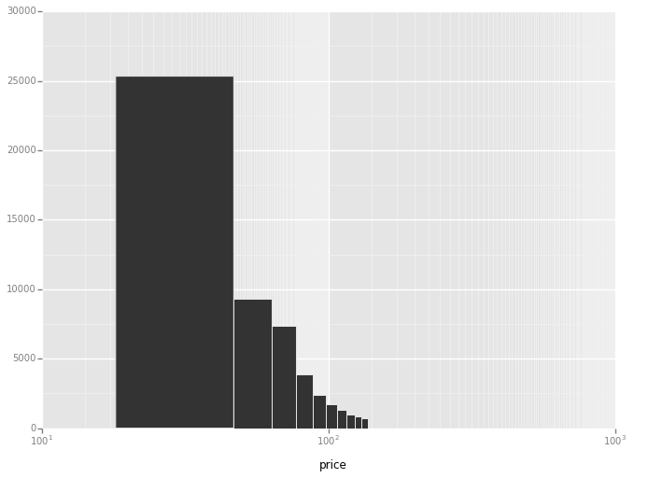
scale_x_log
ggplot(diamonds, aes(x='price')) + geom_histogram() + scale_x_log(base=100)

Slide 14
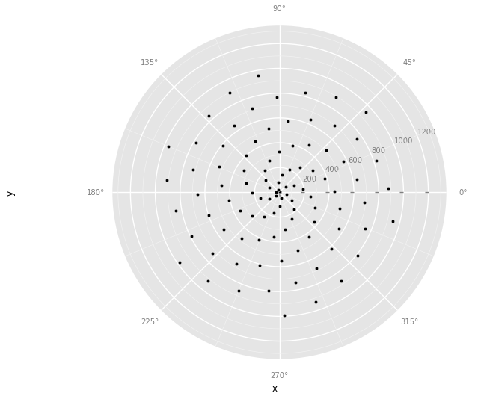
Coord
A chart is drawn in a coordinate system. This can be transformed.
A pie chart has a polar coordinate system.
df = pd.DataFrame({"x": np.arange(100)})
df['y'] = df.x * 10 # polar coords
p = ggplot(df, aes(x='x', y='y')) + geom_point() + coord_polar() print(p)

Slide 15
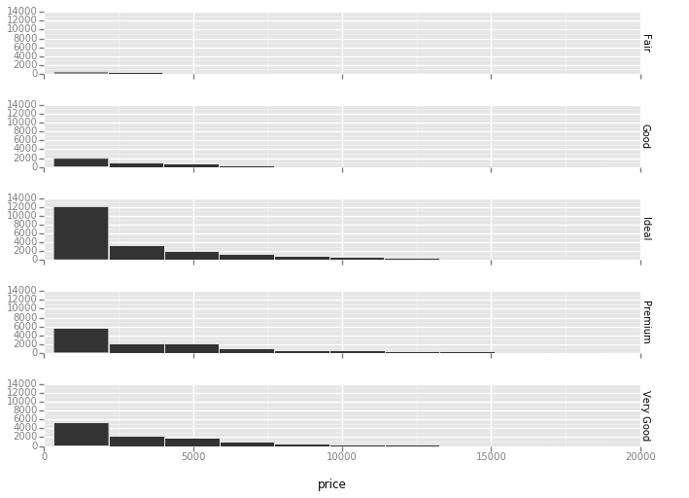
Facets
With facets, small multiples are created.
Each facet shows a subset of the data.
ggplot(diamonds, aes(x='price')) + \ geom_histogram() + \
facet_grid("cut")

Slide 16
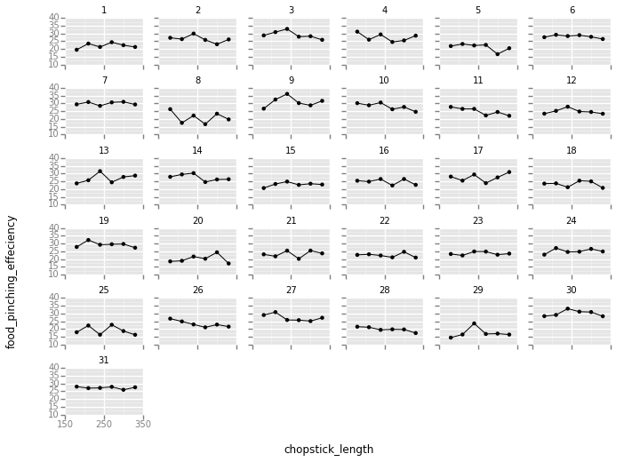
Facets example
ggplot(chopsticks, aes(x='chopstick_length', y='food_pinching_effeciency')) + \
geom_point() + \
geom_line() + \
scale_x_continuous(breaks=[150, 250, 350]) + \ facet_wrap("individual")

Slide 17
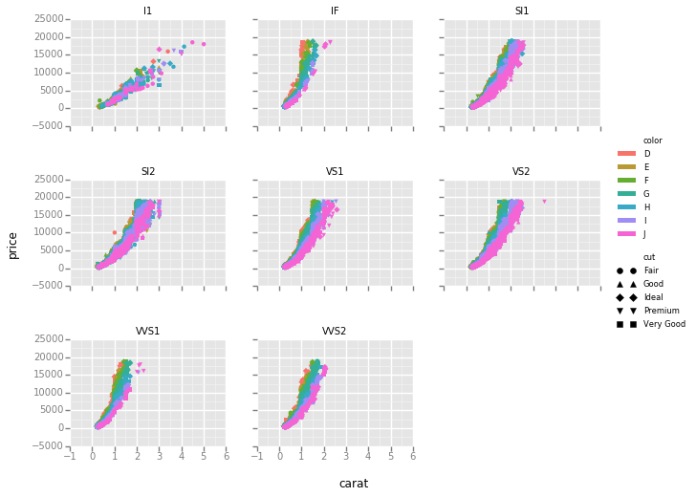
Facets example 2
ggplot(diamonds, aes(x="carat", y="price", color="color", shape="cut")) + geom_point() + facet_wrap("clarity")

Slide 18
ggplot tips
You can annotate plots
Assign a plot to a variable, for instance g:
The function save saves the plot to the desired format:
ggplot(mtcars, aes(x='mpg')) + geom_histogram() + \
xlab("Miles per Gallon") + ylab("# of Cars")
g = ggplot(mpg, aes(x = displ, y = cty)) + geom_point()
g.save(“myimage.png”)

Slide 19
Folium: Thematic maps
A thematic map is a visualization where statistical information with a spatial component is shown.
Other libraries are: Basemap, Cartopy, Iris
Folium builds on the data wrangling strengths of the Python ecosystem and the mapping strengths of the Leaflet.js library.
Manipulate your data in Python, then visualize it in on a Leaflet map via Folium.

Slide 20
Folium features
Built-in tilesets from OpenStreetMap, MapQuest Open, MapQuest Open Aerial, Mapbox, and Stamen
Supports custom tilesets with Mapbox or Cloudmade API keys.
Supports GeoJSON and TopoJSON overlays,
as well as the binding of data to those overlays to create choropleth maps with color-brewer color schemes.

Slide 21
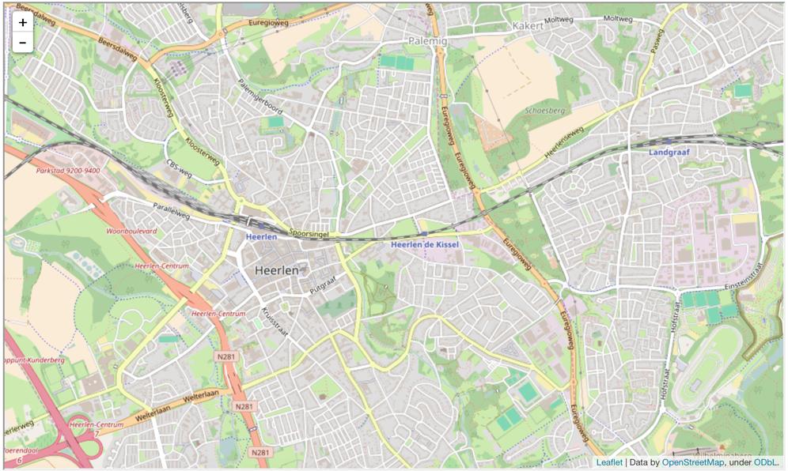
Basic Maps
folium.Map(location=[50.89, 5.99], zoom_start=14)

Slide 22
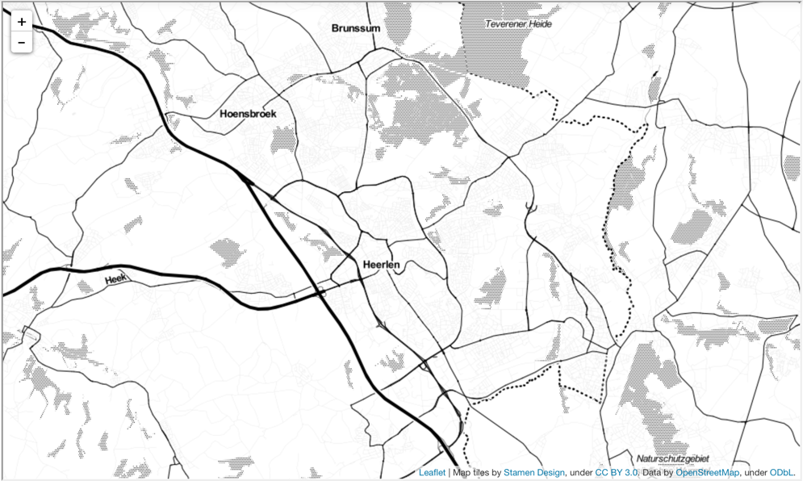
Basic maps
folium.Map(location=[50.89, 5.99], zoom_start=14, tiles='Stamen Toner')

Slide 23
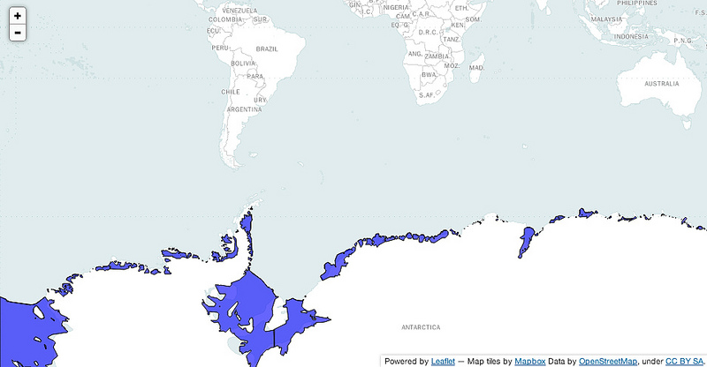
GeoJSON/TopoJSON Overlays
ice_map = folium.Map(location=[-59, -11], tiles='Mapbox Bright', zoom_start=2)
ice_map.geo_json(geo_path=geo_path)
ice_map.geo_json(geo_path=topo_path, topojson='objects.antarctic_ice_shelf')
ice_map.create_map(path='ice_map.html')

Slide 24
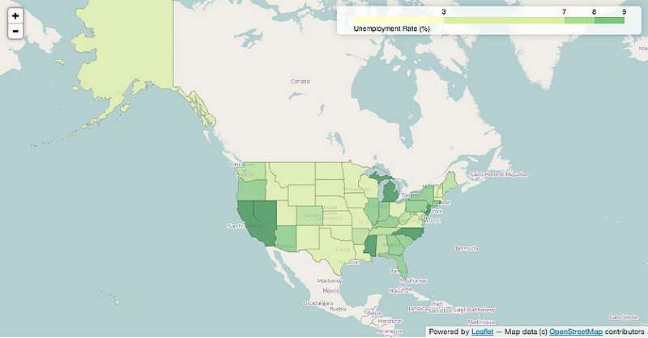
Choropleth maps
map = folium.Map(location=[48, -102], zoom_start=3)
map.choropleth(geo_path=state_geo, data=state_data,
columns=['State', 'Unemployment'], key_on='feature.id',
fill_color='YlGn', fill_opacity=0.7, line_opacity=0.2,
legend_name='Unemployment Rate (%)')

Slide 25
Summary
Python has many options for data visualization
Each visualisation library has a particular audience
Javascript backend is mostly used to extend power of the visualisation
Python’s extensive data processing tools integrates well with visualisation requirements

Slide 26
References
http://yhat.github.io/ggplot/
https://folium.readthedocs.io/en/latest/

