Slide 1
Matplotlib
  http://matplotlib.sourceforge.net/
A python 2D plotting library
  Publication quality figures in several hardcopy formats and interactive environments across platforms
Can be used in
  Python scripts,
  the Python and IPython shell (a la matlab or mathematica),
  web application servers, and
  6 GUI toolkits
Toolkits (4)
  http://matplotlib.sourceforge.net/users/toolkits.html
  E.g., Basemap plots data on map projections (with continental and political boundaries)

Slide 2
Installation
In the Matplotlib homepage, click on the download link
In the download page, click
  matplotlib-1.3.0.win32-py2.7.exe
Download and install
Under C:\Python26\Lib\site-packages, 2 new folders
  matplotlib
  mpl_toolkits

Slide 3
To test, in the Python command line,
  type the 1st example (3 lines plotting a straight line) in the Tutorial (see below)
plot() creates an object and outputs info on it
  Not an error report
show() displays a figure
  Close it to return from the command

Slide 4
Documentation
Documentation page (links): http://matplotlib.org/contents.html
PyplotTutorial (8 pp.)
  http://matplotlib.sourceforge.net/users/pyplot_tutorial.html
User’s Guide
  http://matplotlib.org/users/
  Refer to as needed
Cookbook / Matplotlib
  http://matplotlib.org/api/cbook_api.html
  Lots of good examples
  Shows figure, link to page giving code and explanation

Slide 5
Cyrille Rossant, Learning IPython for Interactive Computing and Data Visualization, Packt Publishing, 2013, 138 pages
  Amazon $27, 4.5 on 8 reviews
matplotlib FAQ
  http://matplotlib.sourceforge.net/faq/index.html
Using matplotlib in a python shell
  http://matplotlib.sourceforge.net/users/shell.html
  For performance, by default, matplotlib defers drawing until the end of the
  But, to test things out interactively (in the shell), usually want to update after every command
  Shows how to do this
    Do it with IPython

Slide 6
Examples
  http://matplotlib.org/examples/
  Just names under headings, but names are descriptive
The “What's new” page
  http://matplotlib.org/users/whats_new.html
  Every feature ever introduced into matplotlib is listed here under the version that introduced it
  Often with a link to an example or documentation
Global Module Index: http://matplotlib.org/py-modindex.html
  Documentation on the various modules
  This and the next 2 are comprehensive
The Matplotlib API: http://matplotlib.sourceforge.net/api/
  Documentation on the various packages
Pyplot documentation (142 pp.): http://matplotlib.org/api/pyplot_api.html

Slide 7
IPython
  http://ipython.org
Enhanced Python shell for efficient interactive work
Library to build customized interactive environments using Python
System for interactive distributed and parallel computing
“Python Programming Environments: IPython,” UC Davis
  http://csc.ucdavis.edu/~chaos/courses/nlp/Software/iPython.html
  Simple introduction and some links

Slide 8
Installation and Documentation
Under Windows, IPython needs PyReadline to support color, tab completion, etc.
  http://ipython.org/pyreadline.html
  Download the installer: follow the link and download and run
    pyreadline-1.7.1.win32.exe
For IPython itself, go to the download page (http://ipython.org/download.html) and click the link for the binary Windows installer for Python 2
The documentation page (http://ipython.org/documentation.html) has links to the manual and lots of other documentation

Slide 9
matplotlib.pyplot vs. pylab
Package matplotlib.pyplot provides a MATLAB-like plotting framework
Package pylab combines pyplot with NumPy into a single namespace
  Convenient for interactive work
  For programming, it’s recommended that the namespaces be kept separate
See such things as
    import pylab
  Or
    import matplotlib.pyplot as plt
    The standard alias
    import numpy as np
    The standard alias

Slide 10
  Also
    from pylab import *
  Or
    from matplotlib.pyplot import *
    from numpy import *
We’ll use
  from pylab import *
  Some examples don’t show this—just assume it

Slide 11
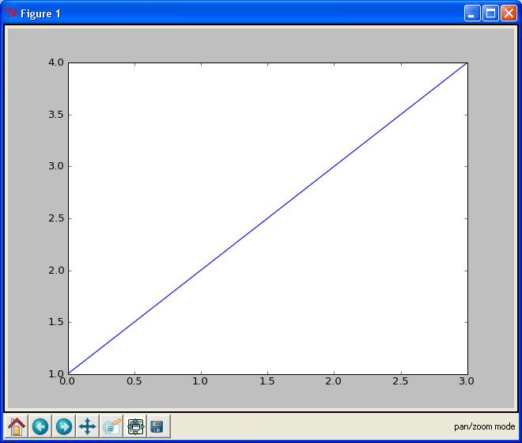
Batch and Interactive Use
In a script,
  import the names in the pylab namespace
  then list the commands
Example: file E:\SomeFolder\mpl1.py
  from pylab import *
  plot([1,2,3,4])
  show()
Executing
    E:\SomeFolder>mpl1.py
  produces the figure shown
The command line hangs until the figure is dismissed (click ‘X’ in the upper right)

Slide 12
plot()
Given a single list or array, plot() assumes it’s a vector of y-values
Automatically generates an x vector of the same length with consecutive integers beginning with 0
  Here [0,1,2,3]
To override default behavior, supply the x data: plot(x,y )
  where x and y have equal lengths
show()
Should be called at most once per script
  Last line of the script
  Then the GUI takes control, rendering the figure

Slide 13
In place of show(), can save the figure to with, say,
    savefig('fig1.png')
  Saved in the same folder as the script
Override this with a full pathname as argument—e.g.,
    savefig('E:\\SomeOtherFolder\\fig1.png')
Supported formats: emf, eps, pdf, png, ps, raw, rgba, svg, svgz
  If no extension specified, defaults to .png

Slide 14
Matplotlib from the Shell
Using matplotlib in the shell, we see the objects produced
  >>> from pylab import *
  >>> plot([1,2,3,4])
  [<matplotlib.lines.Line2D object at 0x01A3EF30>]
  >>> show()
Hangs until the figure is dismissed or close() issued
show() clears the figure: issuing it again has no result
  If you construct another figure, show() displays it without hanging

Slide 15
draw()
Clear the current figure and initialize a blank figure without hanging or displaying anything
Results of subsequent commands added to the figure
    >>> draw()
    >>> plot([1,2,3])
    [<matplotlib.lines.Line2D object at 0x01C4B6B0>]
    >>> plot([1,2,3],[0,1,2])
    [<matplotlib.lines.Line2D object at 0x01D28330>]
  Shows 2 lines on the figure after show() is invoked
Use close() to dismiss the figure and clear it
clf() clears the figure (also deletes the white background) without dismissing it
Figures saved using savefig() in the shell by default are saved in
  C:\Python27
  Override this by giving a full pathname

Slide 16
Interactive Mode
In interactive mode, objects are displayed as soon as they’re created
Use ion() to turn on interactive mode, ioff() to turn it off
Example
Import the pylab namespace, turn on interactive mode and plot a line
  >>> from pylab import *
  >>> ion()
  >>> plot([1,2,3,4])
  [<matplotlib.lines.Line2D object at 0x02694A10>]
  A figure appears with this line on it
  The command line doesn’t hang
Plot another line
  >>> plot([4,3,2,1])
  [<matplotlib.lines.Line2D object at 0x00D68C30>]
  This line is shown on the figure as soon as the command is issued

Slide 17
Turn off interactive mode and plot another line
  >>> ioff()
  >>> plot([3,2.5,2,1.5])
  [<matplotlib.lines.Line2D object at 0x00D09090>]
  The figure remains unchanged—no new line
Update the figure
  >>> show()
  The figure now has all 3 lines
  The command line is hung until the figure is dismissed

Slide 18
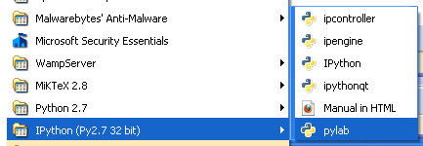
Matplotlib in IPython
Recommended way to use matplotlib interactively is with ipython
  In the IPython drop-down menu, select pylab

Slide 19
IPython’s pylab mode detects the matplotlibrc file
  Makes the right settings to run matplotlib with your GUI of choice in interactive mode using threading
IPython in pylab mode knows enough about matplotlib internals to make all the right settings
Plots items as they’re produce without draw() or show()
Default folder for saving figures on file
  C:\Documents and Settings\⟨current user ⟩

Slide 20
More Curve Plotting
plot() has a format string argument specifying the color and line type
  Goes after the y argument (whether or not there’s an x argument)
  Can specify one or the other or concatenate a color string with a line style string in either order
  Default format string is 'b-' ( solid blue line)
Some color abbreviations
    b (blue), g (green), r (red), k (black), c (cyan)
  Can specify colors in many other ways (e.g., RGB triples)
Some line styles that fill in the line between the specified points
    - (solid line), -- (dashed line), -. (dash-dot line), : (dotted line)
Some line styles that don’t fill in the line between the specified point
    o (circles), + (plus symbols), x (crosses), D (diamond symbols)
For a complete list of line styles and format strings,
    http://matplotlib.sourceforge.net/api/pyplot_api.html#module-matplotlib.pyplot
  Look under matplotlib.pyplot.plot()

Slide 21
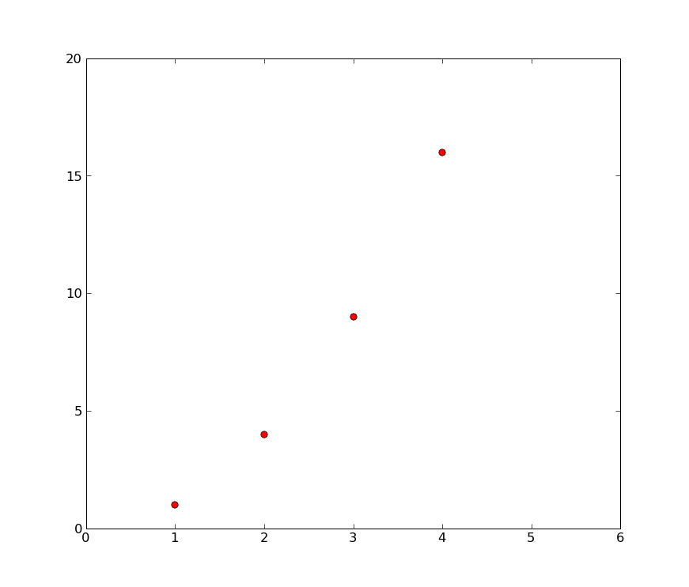
The axis() command takes a list
    [xmin, xmax, ymin, ymax]
  and specifies the view port of the axes
Example
  In [1]: plot([1,2,3,4], [1,4,9,16], 'ro')
  Out[1]: [<matplotlib.lines.Line2D object at 0x034579D0>]
  In [2]: axis([0, 6, 0, 20])
  Out[2]: [0, 6, 0, 20]

Slide 22
Generally work with arrays, not lists
  All sequences are converted to NumPy arrays internally
plot() can draw more than one line at a time
  Put the (1-3) arguments for one line in the figure
  Then the (1-3) arguments for the next line
  And so on
Can’t have 2 lines in succession specified just by their y arguments
  matplotlib couldn’t tell whether it’s
    a y then the next y or
    an x then the corresponding y
The example (next slide) illustrates plotting several lines with different format styles in one command using arrays

Slide 23
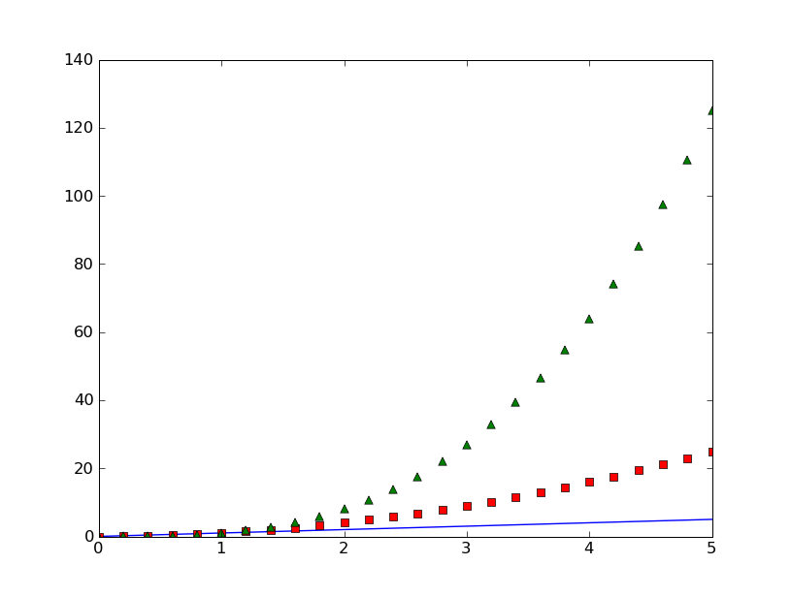
  In [1]: t = arange(0.0, 5.2, 0.2)
  In [2]: plot(t, t, t, t**2, 'rs', t, t**3, 'g^')
  Out[2]:
  [<matplotlib.lines.Line2D object at 0x02A6D410>,
  <matplotlib.lines.Line2D object at 0x02A6D650>,
  <matplotlib.lines.Line2D object at 0x02A6D8D0>]

Slide 24
Lines you encounter are instances of the Line2D class
Instances have the following properties
Property | Values
alpha | The alpha transparency on 0-1 scale
antialiased | True | False - use antialised rendering
color | a matplotlib color arg
label | a string optionally used for legend
linestyle | One of -- : -. -
linewidth | a float, the line width in points
marker | One of + , o . s v x > < ^
markeredgewidth | The line width around the marker symbol
markeredgecolor | The edge color if a marker is used
markerfacecolor | The face color if a marker is used
markersize | The size of the marker in points
alpha = 0.0 is complete transparency, alpha = 1.0 is complete opacity

Slide 25
One of 3 ways to set line properties: Use keyword line properties as keyword arguments—e.g.,
  plot(x, y, linewidth=2.0)
Another way: Use the setter methods of the Line2D instance
  For every property prop, there’s a set_prop() method that takes an update value for that property
  To use this, note that plot() returns a list of lines
  The following has 1 line with tuple unpacking
    line, = plot(x, y, 'o')
    line.set_antialiased(False)

Slide 26
The 3rd (and final) way to set line properties: use function setp()
  1st argument can be an object or sequence of objects
    The rest are keyword arguments updating the object’s (or objects’) properties
  E.g.,
    lines = plot(x1, y1, x2, y2)
    setp(lines, color='r', linewidth=2.0)

Slide 27
Text
The text commands are self-explanatory
  xlabel()
  ylabel()
  title()
  text()
In simple cases, all but text() take just a string argument
  text() needs at least 3 arguments:
    x and y coordinates (as per the axes) and a string
All take optional keyword arguments or dictionaries to specify the font properties
They return instances of class Text

Slide 28
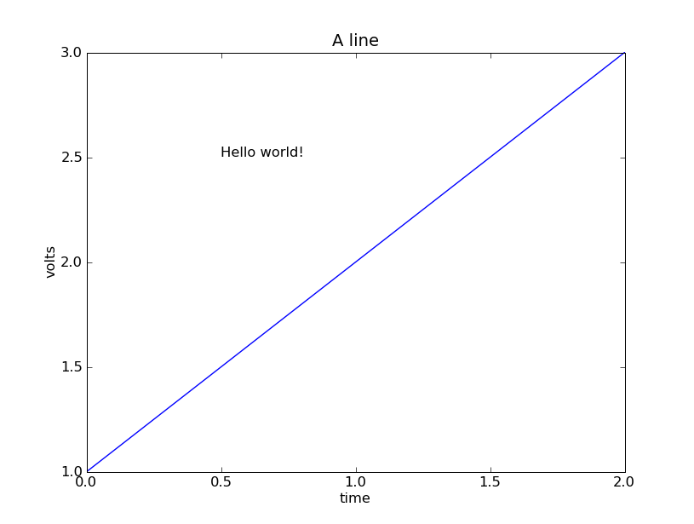
  plot([1,2,3])
  xlabel('time')
  ylabel('volts')
  title('A line')
  text(0.5, 2.5, 'Hello world!')

Slide 29
The following font properties of Text instances can be set
Property | Values
alpha | The alpha transparency on 0-1 scale
color | a matplotlib color argument
fontangle | italic | normal | oblique
fontname | Sans | Helvetica | Courier | Times | Others
fontsize | a scalar, eg, 10
fontweight | normal | bold | light 4
horizontalalignment | left | center | right
rotation | horizontal | vertical
verticalalignment | bottom | center | top

Slide 30
Three ways to specify font properties: using
  setp
  object oriented methods (We skip this)
  font dictionaries
Use setp to set any property
  t = xlabel('time')
  setp(t, color='r', fontweight='bold')
  Also works with a list of text instances—e.g.,
      labels = getp(gca(), 'xticklabels')
      setp(labels, color='r', fontweight='bold')

Slide 31
All text commands take an optional dictionary argument and keyword arguments to control font properties
  E.g., to set a default font theme and override individual properties for given text commands
    font = {'fontname' : 'Courier',
    'color' : 'r',
    'fontweight' : 'bold',
    'fontsize' : 11}
    plot([1,2,3])
    title('A title', font, fontsize=12)
    text(0.5, 2.5, 'a line', font, color='k')
    xlabel('time (s)', font)
    ylabel('voltage (mV)', font)

Slide 32
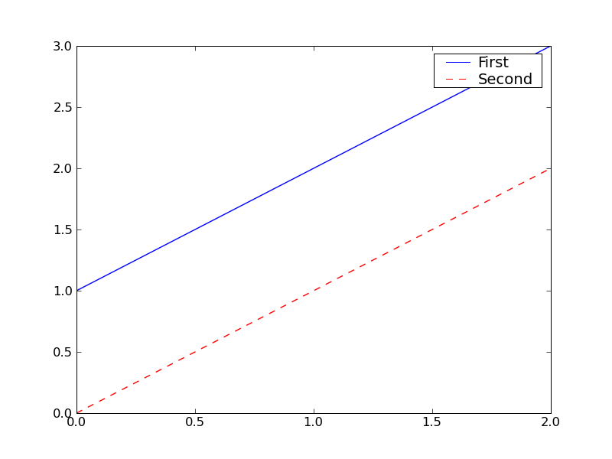
Legends
A legend is a box (by default in upper right) associating labels with lines (displayed as per their formats)
  legend(lines, labels)
  where lines is a tuple of lines, labels a tuple of corresponding strings
from pylab import *
lines = plot([1,2,3],'b-',[0,1,2],'r--')
legend(lines, ('First','Second'))
savefig('legend')

Slide 33
If there’s only 1 line, be sure to include the commas in the tuples
  lengend((line1,), ('Profit',))
Use keyword argument loc to override the default location
  Use predefined strings or integer codes
    ‘upper right’ 1
    ‘upper left’ 2
    ‘lower left’ 3
    ‘lower right’ 4
    ‘right’ 5
    ‘center left’ 6
    ‘center right’ 7
    ‘lower center’ 8
    ‘upper center’ 9
    ‘center’ 10
E.g.,
  legend((line,), ('Profit',) , loc=2)

Slide 34
Bar Charts
Function bar() creates a bar chart
Most of the arguments may be either scalars or sequences
  Say in […] what they normally are
Required arguments
  left x coordinates of the left sides of the bars [sequence]
  height height of the bars [sequence]

Slide 35
Some optional keyword arguments
  orientation orientation of the bars (‘vertical’ | ‘horizontal’)
  width width of the bars [scalar]
  color color of the bars [scalar]
  xerr if not None,
  generates error ticks on top the bars [sequence]
  yerr if not None,
  generates errorbars on top the bars [sequence]
  ecolor color of any errorbar [scalar]
  capsize length (in points) of errorbar caps (default 2) [scalar]
  log False (default) leaves the orientation axis as is,
  True sets it to log scale

Slide 36
For the following example, need the following
yticks(seq, labels)
  Make the ticks on the y axis at y-values in seq with labels the corresponding elements of labels
  Without labels, number as per seq
xticks(seq, labels)
  Same, but for the x axis
xlim(xmin, xmax)
  The values on the x axis go from xmin to xmax

Slide 37
  from pylab import *
  labels = ["Baseline", "System"]
  data = [3.75, 4.75]
  yerror = [0.3497, 0.3108]
  xerror = [0.2, 0.2]
  xlocations = array(range(len(data)))+0.5
  width = 0.5
  csize = 10
  ec = 'r'
  bar(xlocations, data, yerr=yerror, width=width,
  xerr=xerror, capsize=csize, ecolor=ec)
  yticks(range(0, 8))
  xticks(xlocations+ width/2, labels)
  xlim(0, xlocations[-1]+width*2)
  title("Average Ratings on the Training Set")
  savefig('bar')

Slide 38
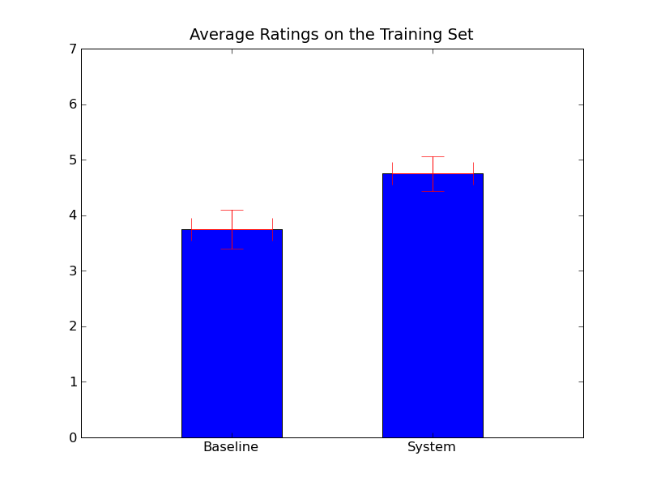

Slide 39
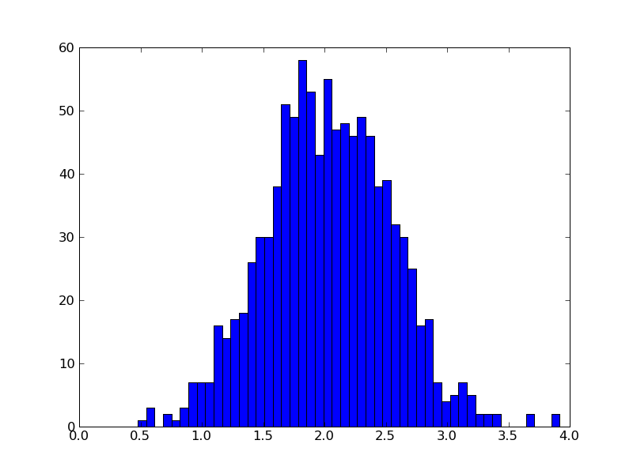
Histograms
hist(x, bins=n )
Computes and draws a histogram
x: a sequence of numbers (usually with many repetitions)
If keyword argument bins is an integer, it’s the number of (equally spaced) bins
  Default is 10
from pylab import *
import numpy
x = numpy.random.normal(2, 0.5, 1000)
hist(x, bins=50)
savefig('my_hist')

Slide 40
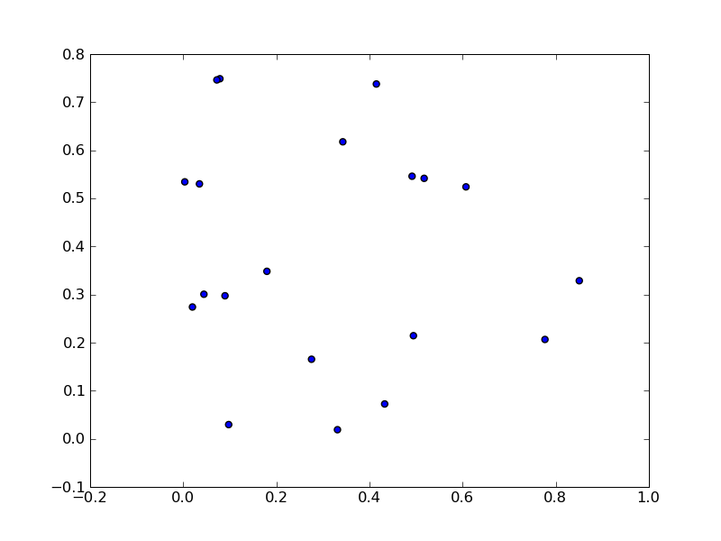
Scatter Plots
scatter(x, y )
x and y are arrays of numbers of the same length, N
Makes a scatter plot of x vs. y
  from pylab import *
  N = 20
  x = 0.9*rand(N)
  y = 0.9*rand(N)
  scatter(x,y)
  savefig('scatter_dem')

Slide 41
Keyword Arguments
s
If an integer, size of marks in points² , i.e., area occupied (default 20)
If an array of length N, gives the sizes of the corresponding elements of x, y
marker
Symbol marking the points (default = ‘o’)
Same options as for lines that don’t connect the dots
  And a few more
c
A single color or a length-N sequence of colors

Slide 42
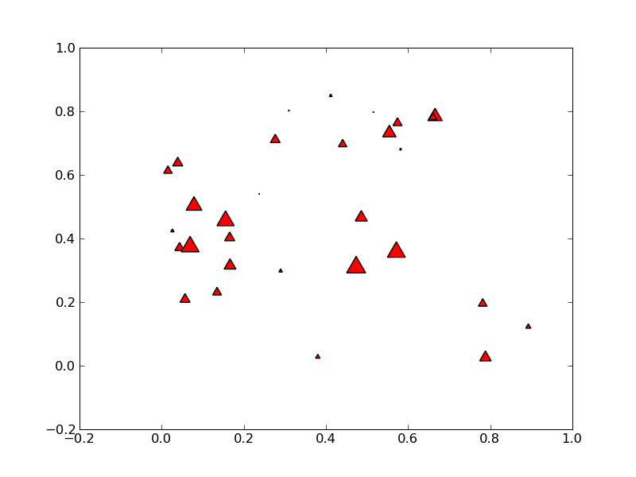
from pylab import *
N = 30
x = 0.9*rand(N)
y = 0.9*rand(N)
area = pi * (10 * rand(N))**2 # 0 to 10 point radius
scatter(x,y,s=area, marker='^', c='r')
savefig('scatter_demo')

Slide 43
Odds and Ends
Horizontal and Vertical Lines
hlines(y, xmin, xmax )
Draw horizontal lines at heights given by the numbers in array y
If xmin and xmax are arrays of same length as y, they give the left and right endpoints of the corresponding lines, resp.
  If either is a scalar, all lines have the same endpoint, specified by it
Some keyword arguments
  linewidth (or lw): line width in points
  color: default ‘k’
vlines(x, ymin, ymax ) is similar but for vertical lines

Slide 44
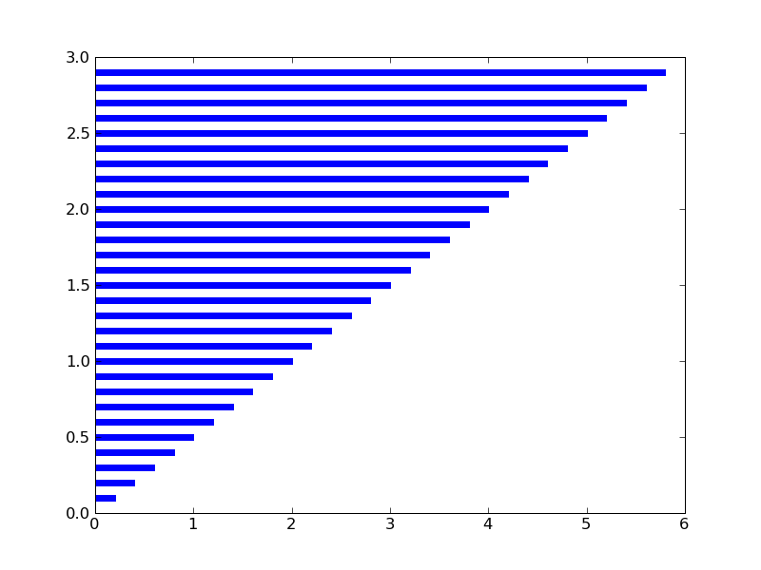
from pylab import *
y = arange(0,3,0.1)
x = 2*y
hlines(y, 0, x, color='b', lw=4)
savefig('hlines')

Slide 45
Axis Lines
axhline() draws a line on the x axis spanning the horizontal extent of the axes
axhline(y ) draws such a line parallel to the x axis at height y
Some keyword arguments
  color: default ‘b’
  label
  linewidth in points
axvline() is similar but w.r.t. the y axis

Slide 46
Grid Lines
grid(True) produces grid lines at the tick coordinates
  grid(None) suppresses the grid
  grid() toggles the presence of the grid
Some keyword arguments
  color: default ‘k’
  linestyle: default ‘:’
  linewidth
Some Axes instance methods
  get_xgridlines()
  get_ygridlines()
Example:
  setp(gca().get_xgridlines(), color='r')

Slide 47
Resizing the Figure
Often should make the figure wider or higher so objects aren’t cramped
  Use Figure instance methods get_size_inches() and set_size_inches()
To get an array of the 2 dimensions in inches (width then height):
  fig = gcf()
  dsize = fig.get_size_inches()
E.g., to double the width
  fig.set_size_inches( 2 * dsize[0], dsize[1] )
See the example in the SciPy Cookbook
  http://www.scipy.org/Cookbook/Matplotlib/AdjustingImageSize

Slide 48
Multiple Subplots
Functions axes() and subplot() both used to create axes
  subplot() used more often
subplot(numRows, numCols, plotNum)
  Creates axes in a regular grid of axes numRows by numCols
  plotNum becomes the current subplot
    Subplots numbered top-down, left-to-right
      1 is the 1st number
Commas can be omitted if all numbers are single digit
Subsequent subplot() calls must be consistent on the numbers or rows and columns

Slide 49
subplot() returns a Subplot instance
  Subplot is derived from Axes
Can call subplot() and axes() in a subplot
  E.g., have multiple axes in 1 subplot
See the Tutorial for subplots sharing axis tick labels

Slide 50
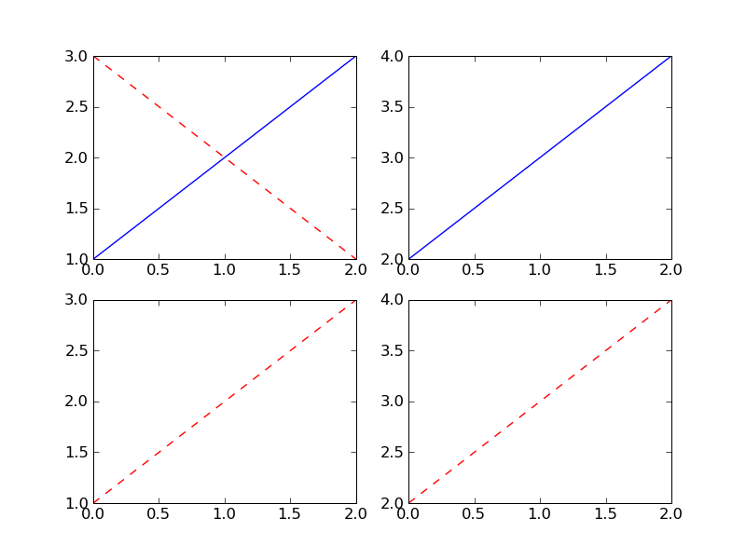
from pylab import *
subplot(221)
plot([1,2,3])
subplot(222)
plot([2,3,4])
subplot(223)
plot([1,2,3], 'r--')
subplot(224)
plot([2,3,4], 'r--')
subplot(221)
plot([3,2,1], 'r--')
savefig('subplot')

Slide 51
3D Matplotlib: mplot3d
See http://matplotlib.org/mpl_toolkits/mplot3d/tutorial.html
An Axes3D object is created like any other axes, but using the projection='3d' keyword
Create a new matplotlib.figure.Figure and add to it a new axes of type Axes3D
  import matplotlib.pyplot as plt
  from mpl_toolkits.mplot3d import Axes3D
  fig = plt.figure()
  ax = fig.add_subplot(111, projection='3d')

Slide 52
Example: Line Plots
Axes3D.plot(xs, ys, *args, **kwargs)
  Plot 2D or 3D data
xs, ys are the arrays of x, y coordinates of vertices
zs is the z value(s), either 1 for all points or (as array) 1 for each point
zdir gives which direction to use as z (‘x’, ‘y’ or ‘z’) when plotting a 2D set
Other arguments are passed on to plot()

Slide 53
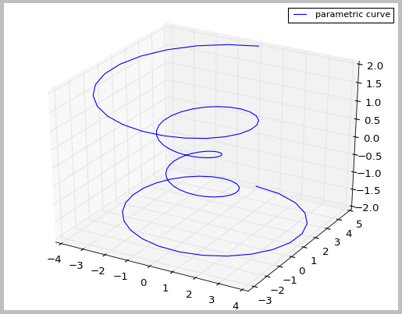
Example
import matplotlib as mpl
from mpl_toolkits.mplot3d import Axes3D
import numpy as np
import matplotlib.pyplot as plt
mpl.rcParams['legend.fontsize'] = 10
fig = plt.figure()
ax = fig.gca(projection='3d')
theta = np.linspace(-4 * np.pi, 4 * np.pi, 100)
z = np.linspace(-2, 2, 100)
r = z**2 + 1
x = r * np.sin(theta)
y = r * np.cos(theta)
ax.plot(x, y, z, \
label='parametric curve')
ax.legend()
plt.show()

Slide 54
Animation
The Old Way
To take an animated plot and turn it into a movie,
  save a series of image files (e.g., PNG) and
  use an external tool to convert them to a movie
Can use mencoder, part of the mplayer suite
  See http://www.mplayerhq.hu/design7/news.html
  Can download binaries for Windows
Or use ImageMagick’s convert (“the Swiss army knife of image tools”)
  See http://www.imagemagick.org/script/convert.php

Slide 55
Matplotlib Animation
Matplotlib Animation Tutorial
  http://jakevdp.github.com/blog/2012/08/18/matplotlib-animation-tutorial/
Matplotlib animation documentation
  http://matplotlib.org/api/animation_api.html
Matplotlib animation examples
  http://matplotlib.org/examples/animation/
  Official and good, but documentation limited to meager program comments
    The tutorial (above) goes through several of these
  Alias http://matplotlib.sourceforge.net/examples/animation/index.html
  This replaces the Cookbook examples
    http://www.scipy.org/Cookbook/Matplotlib/Animations

