Slide 1
PH2150 Scientific Computing Skills
#Lecture 2: Common mistakes from the first week
# raw_input returns a string, some were using the int () constructor, which caused unexpected errors when running the code.
C = raw_input ('C=?') # raw_input takes a string as argument
C = float (C) # redefines C as a floating point number
The function eval ( ) can be used to input an argument that is a string, and treat the string as if it was a Python expression.
# Another error due to incorrectly defined type
Y = 1/3 # returns 0, integer division
Y = 1.0/3.0 # returns 0.33333333333333333

Slide 2
PH2150 Scientific Computing Skills
Importing functions from Modules/Packages
When you launch Canopy,
Welcome to Canopy's interactive data-analysis environment!
with pylab-backend set to: qt
Type '?' for more information.
import numpy
import matplotlib
from matplotlib import pylab, mlab, pyplot
np = numpy
plt = pyplot
from IPython.display import display
from IPython.core.pylabtools import figsize, getfigs
from pylab import *
from numpy import *
This creates over a thousand names in the ‘namespace’,
This can be modified from within Canopy in the dropdown menu:
EDIT→PREFERENCES →PYTHON

Slide 3
PH2150 Scientific Computing Skills
Importing functions from Modules/Packages
In contrast, in a python module (*.py file, i.e the script that you are writing and saving), you must explicitly import every name which you use. This is much more robust, and since you are not constantly typing and retyping as you would do at the prompt, the extra typing is well worth it.
We will have a quick look at the different ways of doing.
import modulename e.g. import math
# then you can use function by calling modulename.functionname()
from modulename import functionname e.g. from math import sqrt
# Explicitly import a function by its name also you to call the functionname()
from modulename import *
# imports all the functionnames from the module
import modulename as alias
A Module: A file containing Python definitions (functions, variables and objects)
themed around a specific task. The module can be imported into your program. The convention is that all import statements are made at the beginning of your code.

Slide 4
PH2150 Scientific Computing Skills
Importing functions from Packages
A Package: Is a set of modules or a directory containing modules linked through a shared theme. Importing a package does not automatically import all the modules contained within it.
Some useful packages:
SciPy (maths, science and enginering module),
Numpy (Numerical Python for arrays, fourier transforms and more),
matplotlib (graphical representation),
mayavi (3D visualisation module in Enthought distribution)
from PackageName import specific_submodule
import PackageName.submodulename as alias
e.g. import matplotlib.pyplot as plt
Then to use the function xlabel from matplotlib.pyplot to set the x-axis label:
plt.xlabel(‘axis label’)

Slide 5
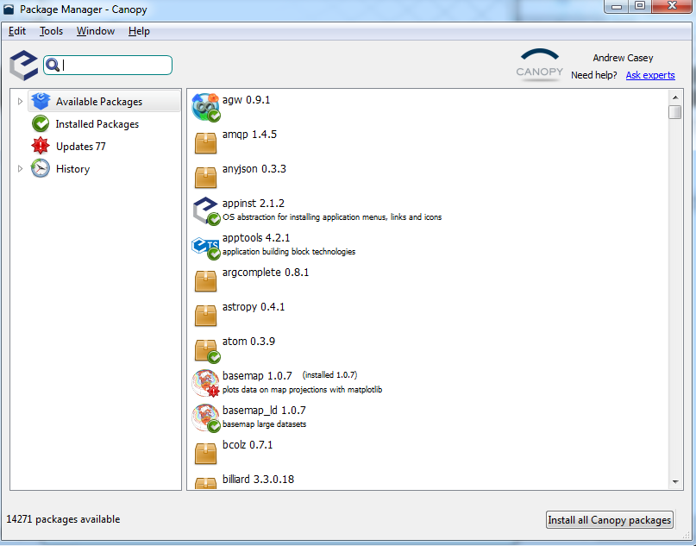
PH2150 Scientific Computing Skills
Importing functions from Packages
If when running your script you get the error:
ImportError: No module named [module/package name]
And you are sure that you have made no errors in the package name, then you may need to install the package via the Canopy Package manager

Slide 6
PH2150 Scientific Computing Skills
Control Structures: Section 6
Repeat a block of statements
Repeat the same operation on elements in a list
Branch off along multiple paths
while and for loops
if, else, elif statements

Slide 7
PH2150 Scientific Computing Skills
User defined functions: Section 7
def name (parameters,…,…):
“”” documentation string”””
<Block of statements>

Slide 8
PH2150 Scientific Computing Skills
The NumPy Array
http://docs.scipy.org/doc/numpy/reference/arrays.html
The number of elements in an array is fixed.
You cannot add elements to an array once it is created, or remove them.
The elements of an array must all be of the same type, such as all floats or all integers.
You cannot mix elements of different types in the same array and you cannot change the type of the elements once an array is created.

Slide 9
PH2150 Scientific Computing Skills
The NumPy Array
Lists, as we have seen, have neither of these restrictions. Why would we ever use an array if lists are more flexible? The answer is that arrays have several significant advantages over lists as well:
Arrays can be two-dimensional, like matrices in algebra. That is, rather than just
a one-dimensional row of elements, we can have a grid of them. Indeed, arrays can
in principle have n-dimensions. Lists, by contrast, are always just one-dimensional
containers.
Arrays behave roughly like vectors or matrices: you can do arithmetic with them, such
as adding them together, and you will get the result you expect. As we have seen this
is not true with lists, addition results in concatenation of the list.
Arrays work faster than lists. Especially if you have a very large array with many
elements then calculations may be significantly faster using an array.

Slide 10
PH2150 Scientific Computing Skills
The NumPy Array
http://docs.scipy.org/doc/numpy/reference/arrays.html
#Creating Arrays in Numpy
import numpy as np
x=np.array([[1,2,3,4],[5,6,7,8]])
print 'size of array', np.size(x)
print 'shape of array', np.shape(x)
print 'x=', x
y=np.linspace(0,1,20)
print 'y=',y

Slide 11
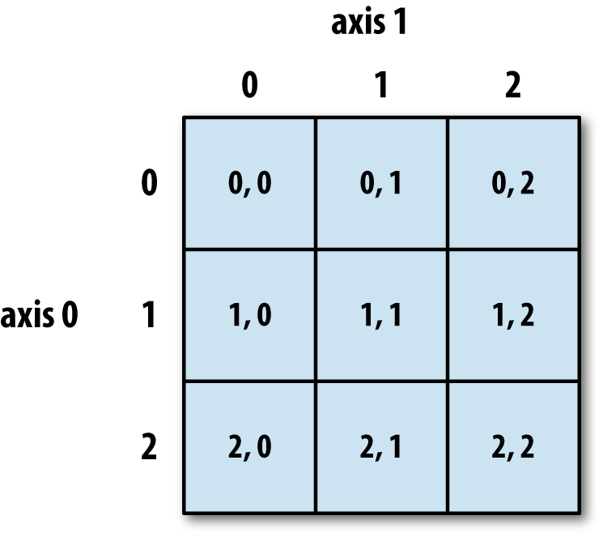
PH2150 Scientific Computing Skills
The NumPy Array: Indexing and Slicing

Slide 12
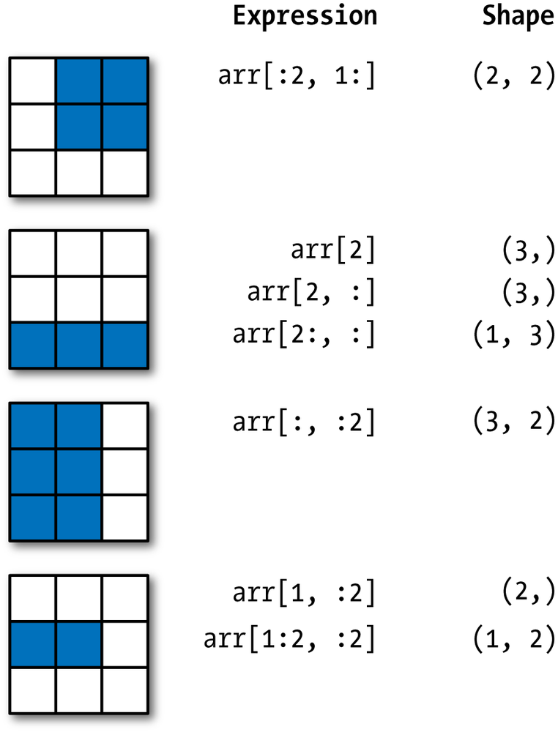
PH2150 Scientific Computing Skills
The NumPy Array: Indexing and Slicing

Slide 13
