Slide 1
Programming for the Natural and Social Sciences COMP 132 2019 T2 .
Xiaoying Gao
"Sharon"
Computer Science
Victoria University of Wellington

Slide 2
Admin
Teaching evaluation is open
Use the link on blackboard
Only takes 5 mins, due this Saturday
Assignment 3 is due Friday 5pm
First year workshop Mon Wed 5-8 AM106, with Howard and Jordan
Help desk Wed 12 noon at CO242A
Labs
Term test after the break

Slide 3
Weekly plan
Previous week
Numpy functions
Numpy array is a data type
Array indexing, fancy indexing
Array methods
Array attributes
This week
Data visualisation
Matplotlib basics
Data visualisation case study, Tuesday lecture, bring your laptop
How to prepare for the term test, Thursday lecture

Slide 4
Data Science
Data Collection
Data pre-processing
Data Transformation
Data Analysis
Step 4
Data Visualization
Step 1
Step 3
Step 2
Data Representation

Slide 5
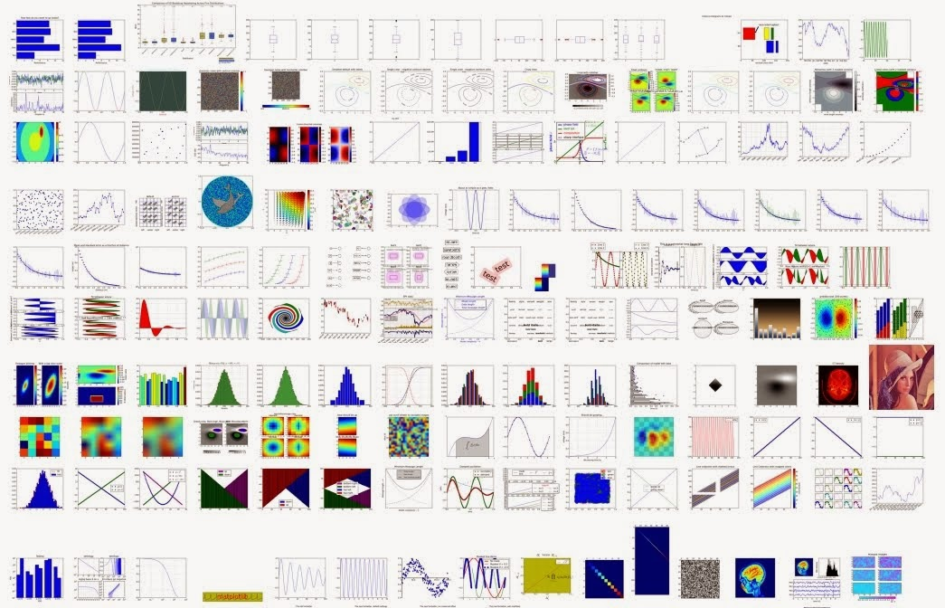
Matplotlib and its Gallery
https://matplotlib.org/3.1.0/gallery/index.html

Slide 6
matplotlib
One popular library for data visualisation
Pre-installed with Anaconda and in lab machines
Must import explicitly
Big libraries have many modules. We need one module pyplot
import matplotlib.pyplot as plt
To use interactive plotting in Jupyter notebook
%matplotlib inline

Slide 7
Functions in matplotlib.pyplot
Matplotlib.pyplot module has functions that create many different kinds of plots quickly.
plt.plot()
plt.bar()
plt.scatter()
plt.hist()
plt.xlabel()
plt.ylabel()
plt.show()
…
Documentation: https://matplotlib.org/api/_as_gen/matplotlib.pyplot.html
Jupyter Notebook, Help, Matplotlib, API: Find matplotlib.pyplot
Tutorial: https://matplotlib.org/users/pyplot_tutorial.html
https://matplotlib.org/tutorials/introductory/pyplot.html#sphx-glr-tutorials-introductory-pyplot-py
Study the examples
Google for questions
Trial and error

Slide 8
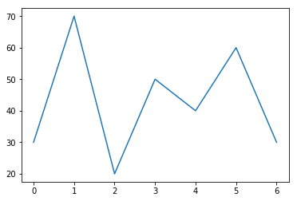
Simple line plot
to draw a sequence of lines (x1, y1) (x2, y2) (x3,y3) (x4, y4) (x5,y5) (x6, y6) (x7,y7)
You can use the default value for x1, x2, x3, x4, x5,e.g. 0, 1, 2, 3, 4, 5, 6
Then you need a sequence of numbers y1, y2, y3, y4, y5, y6, y7
Can use list or Numpy array,
%matplotlib inline
import matplotlib.pyplot as plt
plt.plot([30, 70, 20,50,40,60,30])
plt.show()

Slide 9
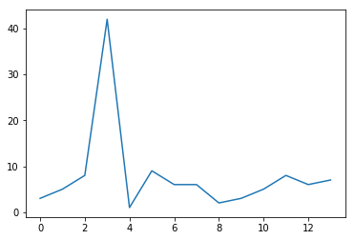
Line plot using data in a file
Read data from a file to a Numpy array
Line plot
import numpy as np
import matplotlib.pyplot as plt
data = np.loadtxt("data2.txt")
print(data)
plt.plot(data)
plt.show()

Slide 10
Line plot
What if you do not want to use the default for x
Change colour
Change line style
…
Documentation at https://matplotlib.org/api/_as_gen/matplotlib.pyplot.plot.html
Read the documentation
plot() is a versatile command, and will take an arbitrary number of arguments
*args any number of arguments
**kwargs any number of keyword arguments
[ ] optional
* zero or more
+ one or more

Slide 11
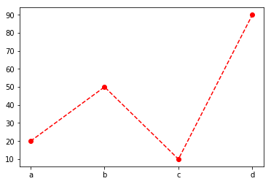
Exercise
plt.plot(['1985','1990','1995','2000'],[123, 345, 234, 400])
x=['a','b','c','d']
y=[20, 50, 10, 90]
Notes:
plt.plot(x, y, color='r', linestyle='--', marker='o')

Slide 12
Simple bar plot
https://matplotlib.org/api/_as_gen/matplotlib.pyplot.bar.html
x is not optional, require both x and y
What if I don't have x
Generate the default x=[0,1,2,…]
How many numbers, what is the length of the list?
must be the same length as y
range(n) gives a list of numbers from 0 to n-1

Slide 13
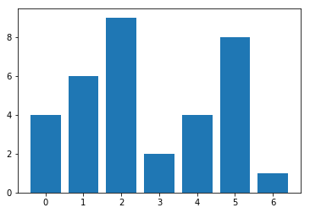
Simple bar chart
import matplotlib.pyplot as plt #you only need to load it once in a program
nums = [4, 6, 9, 2, 4, 8, 1]
n = len(nums)
print(n)
x = range(n)
print(x)
plt.bar(x, nums)
plt.show()

Slide 14
Data Visualization
%matplotlib inline
import matplotlib.pyplot as plt #you only need to load it once in a program
Bar chart
plt.bar()
plt.barh()
Point plot
plt.scatter()
Pie plot
Find the method
Find the arguments
Try it out

Slide 15
Histogram
A histogram is a kind of bar plot that gives a discretized display of value frequency.
The data points are split into discrete, evenly spaced bins, and the number of data points in each bin is plotted.
Keyword Parameter: bins for Number of bins
Example
Term test score: 0~50
0-10, 10-20, 20-30, 30-40, 40-50
5 bins
Try it out

Slide 16
Labels, title, scales
plt.xlabel()
plt.ylabel()
plt.title()
plt.xscale()
plt.yscale()
More functions …

Slide 17
Optional: matplotlib has an object-oriented interface
You do not have to use this approach
Many examples in matplotlib gallery use this approach
Typically used for subplot
Each subplot is an object, ax1, ax2, ax3, ax4
Call instance methods from these objects
Some methods are the same
ax1.plot(), ax2.hist(), ax3.barh(),
Some methods have a different name
ax1.set_title(), ax2.set_xlabel(), ax3.set_xticks(), ax1.set_ylabel(),

Slide 18
Data Visualisation case study
Waveform analyser
Download data file from the lecture page at https://ecs.victoria.ac.nz/Courses/COMP132_2019T2/CourseSchedule
Read data from the file: waveform2.txt
Plot the data
Find the statistics: mean, standard deviation, max, min
Use a threshold of 200, find the distortion rate
percent of numbers are bigger than 200 or smaller than -200
Draw two horizontal lines to show the threshold (boundary)
Show the numbers out of the boundary using a different colour

Slide 19
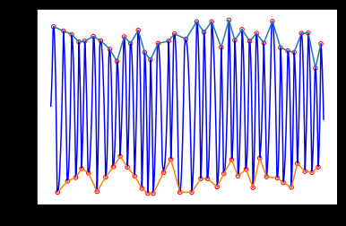
Visualisation tasks:
Find the peaks and draw the peak points
Draw two envelopes

Slide 20
Writing notes during programming
Horizontal lines
plt.axhline(y=THRESHOLD, color='g')
Plot dot points as small red circles (20 as the size)
plt.scatter(xlist, ylist, s=20, facecolor='none', edgecolor='r')
Display on the same figure: plot all first, then plt.show()
Display separately, plot, show and then plot, show.

Slide 21
Matplotlib notes (optional, not used in code)
In line plot, if you want to change colours for some points
Make a copy
Change the not plot points to NaN (the array has to be all in float type)
floatlist1 = floatlist.copy()
floatlist1[x<5] = np.NaN
Then change colour and plot
plt.plot(range(len(floatlist1)), floatlist1, color='r')

Slide 22
Scipy to find the peaks
Find the index of the peaks
from scipy.signal import argrelextrema
max_index_tuple = argrelextrema(nums, np.greater)
max_index_list = max_index_tuple[0]
Similarly for local minima peaks
min_index_tuple = argrelextrema(nums, np.less)
Returns a tuple and the first element is the list with all index of the lower peaks

Slide 23
Today
Information on Term Test
Room allocation
How it works
Rules
Topics covered
Exercises
Must save your file frequently

Slide 24
Term test: Sep 5, Thursday
Room allocation by your family name
4:10pm to 5:00pm
CO219: Aiyum----Cruz
CO238: Damiano----Hampton
CO242: Hanson----Kelly
5:10pm to 6:00pm
CO219: Kerr----Randell
CO238: Reid----The
CO242: Totton----Zhao

Slide 25
How it works
Must use lab computers, ID on desk
Laptop are not allowed
A data file is provided for you to copy and paste
Submit online
Submit only one file called termtest.ipynb
Must save frequently,
Tutors can help with file problems, computer problems

Slide 26
Rules
Open book
Notes are allowed
Can view all documentation
Can Google
No communication
Do not use email, massager, phone, forum, Facebook,…
Do not post any questions
Do not post any answers
4:10 group must stay till 5pm, can not leave early
Do not talk about the test with other students until Friday 5pm.

Slide 27
Topic covered in test
Everything taught in the first 6 weeks
A1, A2, A3
If
For
String
Numpy array
Matplotlib for visualisation
list

Slide 28
Prepare for the test
Check the term test page
Login to lab computer,
Play with the data file, copy and paste
Save your file, find your saved file
Try to submit a file and then delete
The test exam archive page
Do 2018 term test
Do part of 2018 exam
Study the Assignments
A3 model solutions will be available in CO219

Slide 29
Strategy
Do the easy questions first
Do not spend too much time on a question if you get stuck.
Save file after you finish each question
If there is a file problem or a computer problem
Do not panic
Ask for help
We may give you extra time
We may have to move you to a different room
Questions?

Slide 30
Exercise

Slide 31
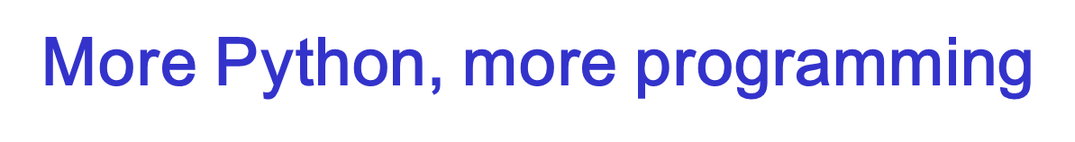
Tuple
Dictionary
More on dictionary, more exercises tomorrow

Slide 32
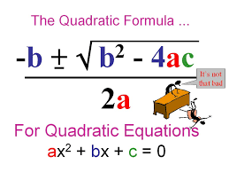
tuple is a built in data type
Tuple is also for a sequence of data, similar to list or numpy array, then why?
Many methods return a tuple,
when you use Scipy to find the peaks, they are returned as a tuple,
you need to use result[0] to get the first returned value.
Some attributes are tuples
a = np.array([3,6,2,1])
a.shape
You may need to return more than one value in your own function
Some sequences do not change
(January, February,…,December)
(Monday, Tuesday, …, Sunday)

Slide 33
tuple
A tuple is a type of sequence similar to list, but the length is fixed and it is immutable
If you have a sequence that does not change, the right data structure is tuple
A tuple can contain any data type data, e.g. ("Alex", 20, True)
Create a tuple object using ( )
fruit=("apple", "banana", "pear") ok without the ( )
type(fruit)
Tuple with a single element n =(3,)
Convert other type to a tuple
tuple([1,5,7,3])
tuple("aeuio")
Many methods return a tuple (when a method returns many values, it is easy to pack them into a tuple)

Slide 34
Tuple is similar to list
Can access each item with index
vowel = ('a', 'e', 'i', 'u', 'o')
vowel[2]
Iterable
for v in vowel:
print(v)
Only has a few instance methods
vowel.count('a')

Slide 35
Tuple is not a list, because it is "immutable"
Immutable objects doesn't allow modification after creation
t = (2, 3, 6, 8)
t[2]
t[2]=9 error, can not re-assign any value
Can redefine a new one, but the original one that is created (2, 3, 6, 8) does not change
(2, 3, 6, 8) can not change, but t is a variable and it can change
If you want the variable to change, re-assign it back
t = t + (3, 2, 4, 5)
to save constants list, e.g. vowels, punctuations,

Slide 36
Tuple operations
Concatenation: +
Multiplication
t =(1,3,5)
t*3
(1,3,5,1,3,5,1,3,5)
Unpacking tuples
tup=(4, 5, 6, 1,2)
a, b, c, d, e =tup
a, b, *rest =tup
tup =(4, 5, (6,7))
a, b, (c, d) = tup

Slide 37
Python is special
Swap two variables
a, b = 1, 2
b, a = a, b

Slide 38
Iterating a sequence of tuples
seq = [(1,2,3), (4, 5, 6), (10, 2, 4)]
for a, b, c in seq:
print(a, b, c)

Slide 39
Immutable or Mutable
Immutable objects
int float bool str tuple
When you pass a immutable object to a function, a copy is created , the original does not change
Mutable
list, numpy array, dict,
When you pass a mutable object to a function,
In general, list is past as reference and it can changed
Not true for numpy array universal functions, the original array is not changed.

Slide 40
Mutable or immutable
m = [1,2,3]
s = m
print(s)
print(m)
s.extend([5,6])
print(s)
print(m)
x= 10
y =x
print(x)
print(y)
y = y+1
print(x)
print(y)

Slide 41
Mutable or immutable
A mutable object exhibits time-varying behaviour. Changes to a mutable object are visible through all names bound to it.
Python's lists are an example of mutable objects. An immutable object does not exhibit time-varying behaviour. If you don't want this, use a tuple.
The value of immutable objects can not be modified after they are created.
E.g. If integers were not immutable I could change the meaning of the number '2' throughout my program.

Slide 42
Later in the course
Dataframe is mutable
If you do not want a slice to share data, use .copy to create a new copy.
But the index objects are immutable, can not do index[2]=new_value, immutable array
The index can not be changed after it is created. If you do want to change it, re-assign it back, or replace it with a completely new index

Slide 43
More Python, More programming
Dictionary is a built in data type
A dictionary associates a set of keys with values
phonebook = {"Sarah": "47492020", "Alex": "8383830", "Tim":4289570}
person ={"name": "Bob", "age": 40, "gender": "M"}

Slide 44
Dictionaries
A dictionary is similar to a list, but you access values by looking up a key instead of an index. A key can be any string or number. Dictionaries are enclosed in curly braces
d = {'key1' : value1, 'key2' : value2, 'key3' : value3}
# Assigning a dictionary with three key-value pairs to residents:
residents = {'Puffin' : 104, 'Sloth' : 105, 'Burmese Python' : 106}
print(residents['Puffin']) # Prints Puffin's room number
print(residents['Burmese Python'])

Slide 45
Adding keys and replacing values
info ={ }
info["name"]= "Sandy"
info["occupation"] = "hacker"
info
info["occupation"] = "manager"
Info

Slide 46
Accessing values
info["name"]
info["job"]
Error
if "job" in info:
print(info["job"])
Or use a method, it returns None if not found.
info.get("job")

Slide 47
Add a new key value pairs to a dictionary
dict_name[new_key] = new_value
The length len() of a dictionary is the number of key-value pairs it has. Each pair counts only once, even if the value is a list.
menu = {} # Empty dictionary
menu['Chicken Alfredo'] = 14.50 # Adding new key-value pair
print(menu['Chicken Alfredo'])
menu['fish']=10.3
menu['seafood']=20.5
menu['pasta']=5.3
print("There are " + str(len(menu)) + " items on the menu.")
print(menu)

Slide 48
Removing keys
info.pop("occupation")
info
info.clear()

Slide 49
Changing a dictionary
dict_name.pop(key_name)
dict_name[key] = new_value
# key - animal_name : value - location
zoo_animals = { 'Unicorn' : 'Cotton Candy House',
'Sloth' : 'Rainforest Exhibit',
'Bengal Tiger' : 'Jungle House',
'Atlantic Puffin' : 'Arctic Exhibit',
'Rockhopper Penguin' : 'Arctic Exhibit'}
# A dictionary (or list) declaration may break across multiple lines
# Removing the 'Unicorn' entry. (Unicorns are incredibly expensive.)
zoo_animals.pop('Unicorn')
zoo_animals.pop('Sloth' )
zoo_animals.pop('Bengal Tiger')
zoo_animals['Rockhopper Penguin'] = 'Australia'
print(zoo_animals)

Slide 50
Dictionary instance methods
d ={"a":10, "c":30, "f":2, "e":50}
d.clear()
d.pop()
d.get()
…
Examples: https://www.programiz.com/python-programming/methods/dictionary
d.keys()
d.values()
d.items()
for key in d:
key is bound to each key in d in an unspecified order
You can use any variable name instead of key, default to be bound to each key

Slide 51
Try the methods
my_dict = {"address": "45L", "phone":"234", "ID":8428}
print(my_dict.items())
print(my_dict.keys())
print(my_dict.values())
The .items() method returns an object that can be converted to an array of tuples with each tuple consisting of a key/value pair from the dictionary:
The .keys() method returns an object that can be converted to a list of the dictionary's keys, and
The .values() method returns an object that can be converted to a list of the dictionary's values.
Note: these methods will not return the keys or values from the dictionary in any specific order.

Slide 52
Traversing a dictionary
my_dict = {
"address": "45L",
"phone":"234",
"ID":84288
}
for key in my_dict:
print(key, my_dict[key])

Slide 53
Traversing a dictionary
hex_to_binary_table = {‘0’:’0000’, ‘1’:’0001’, ‘2’:’0010’, ‘3’:’0011’, ‘4’:’0100’}
for digit in hex_to_binary_table:
print(hex_to_binary_table[digit])
Print in order
the_keys = list(hex_to_binary_table.keys())
the_keys.sort()
for k in the_keys:
print(k, hex_to_binary_table[k])

Slide 54
Traversing a dictionary
Traverse with the values or items
map = {'a':10, 'c':30, 'f':20, 'b':15}
for v in map.values():
print(v)
for k, v in map.items():
print(k, v)

Slide 55
Representing 2D data
A nested list: a list of lists
A list of tuples
Dictionary where each value is a list
Later in this course:
New data type: DataFrame

Slide 56
Exercise
Build a collection of products and their prices
bread: 2.5
milk: 3.8
butter: 5.9
…
Add a new product
Delete a product
Ask the user for a product name, print the price for this product
Update the price for this product to put it on sale with a 20% off
Print the price sheet with all products and their prices
Ask the user for a shopping list, separate products by comma
Calculate the total cost and print the bill (price for each product, and total cost)

Slide 57
Exercise continued
What if the user has a quantity for each product
e.g bread 2, milk 3, butter 1
What data type?
Create the shopping list
Print the bill

Slide 58
Review
What data types are covered so far?
Term test covers material in the first 6 weeks
if
for
list
numpy
matplotlib

Slide 59
Dictionary can hold different data types
my_dict = {
"fish": ["c", "a", "r", "p"],
"cash": -4483,
"luck": "good"
}
print my_dict["fish"][0]

Slide 60
Exercise (dictionary with different type of values)
inventory = {
'gold' : 500,
'pouch' : ['flint', 'twine', 'gemstone'], # Assigned a new list to 'pouch' key
'backpack' : ['xylophone','dagger', 'bedroll','bread loaf']
}
# Adding a key 'burlap bag' and assigning a list to it
inventory['burlap bag'] = ['apple', 'small ruby', 'three-toed sloth']
# Sorting the list found under the key 'pouch'
inventory['pouch'].sort()
# Your code here
inventory['pocket']=['seashell','strange berry','lint']
inventory['backpack'].sort()
inventory['backpack'].remove('dagger')
inventory['gold']= inventory['gold']+50
Print(inventory)

Slide 61
Dictionaries are not ordered
Note that dictionaries are unordered, meaning that any time you loop through a dictionary, you will go through every key, but you are not guaranteed to get them in any particular order.
webster = {
"Aardvark" : "A star of a popular children's cartoon show.",
"Baa" : "The sound a goat makes.",
"Carpet": "Goes on the floor.",
"Dab": "A small amount."
}
# Add your code below!
for mykey in webster:
print(webster[mykey])

Slide 62
The 'in' Operator
For iterating over lists, tuples, dictionaries, and strings, Python also includes a special keyword: in. You can use in very intuitively, like so:
for number in range(5):
print(number)
d = {
"name": "Eric",
"age": 26
}
for key in d:
print(key, d[key])
for letter in "Eric":
print(letter,) # note the comma!

Slide 63
Exercise
Two lists are available for you:
life_exp which contains the life expectancy for each country and
gdp_cap, which contains the GDP per capita (i.e. per person) for each country expressed in US Dollars.
GDP stands for Gross Domestic Product. It basically represents the size of the economy of a country. Divide this by the population and you get the GDP per capita. Print the last item from both the list gdp_cap, and the list life_exp; it is information about Zimbabwe.
Build a line chart, with gdp_cap on the x-axis, and life_exp on the y-axis. Does it make sense to plot this data on a line plot?
Don't forget to finish off with a plt.show() command, to actually display the plot.

Slide 64
Exercise
# Change the line plot below to a scatter plot
plt.scatter(gdp_cap, life_exp)
# Put the x-axis on a logarithmic scale
plt.xscale('log')
# Show plot
plt.show()

Slide 65
Exercise
In the previous exercise, you saw that that the higher GDP usually corresponds to a higher life expectancy. In other words, there is a positive correlation.
Do you think there's a relationship between population and life expectancy of a country? The list life_exp from the previous exercise is already available. In addition, now also pop is available, listing the corresponding populations for the countries in 2007. The populations are in millions of people.

Slide 66
Histogram
# Create histogram of life_exp data
plt.hist(life_exp)
# Display histogram
plt.show()

Slide 67
Number of bins
# Build histogram with 5 bins
plt.hist(life_exp, bins=5)
# Show and clean up plot
plt.show()
plt.clf()
# Build histogram with 20 bins
plt.hist(life_exp, bins=20)
# Show and clean up again
plt.show()
plt.clf()

Slide 68
More bins
# Histogram of life_exp, 15 bins
plt.hist(life_exp, bins=15)
# Show and clear plot
plt.show()
plt.clf()
# Histogram of life_exp1950, 15 bins
plt.hist(life_exp1950, bins=15)
# Show and clear plot again
plt.show()
plt.clf()

Slide 69
Scatter, Labels
# Basic scatter plot, log scale
plt.scatter(gdp_cap, life_exp)
plt.xscale('log')
# Stringsxlab = 'GDP per Capita [in USD]‘
ylab = 'Life Expectancy [in years]‘
title = 'World Development in 2007‘
# Add axis labels
plt.xlabel(xlab)
plt.ylabel(ylab)
plt.title(title)
# After customizing, display the plot
plt.show()

Slide 70
yticks example
plt.yticks([0,1,2], ["one","two","three"])
In this example, the ticks corresponding to the numbers 0, 1 and 2 will be replaced by one, two and three, respectively.

Slide 71
xticks
# Scatter plot
plt.scatter(gdp_cap, life_exp)
# Previous customizations
plt.xscale('log')
plt.xlabel('GDP per Capita [in USD]')
plt.ylabel('Life Expectancy [in years]')
plt.title('World Development in 2007')
# Definition of tick_val and tick_lab
tick_val = [1000,10000,100000]
tick_lab = ['1k','10k','100k']
# Adapt the ticks on the x-axis
plt.xticks(tick_val, tick_lab)
# After customizing, display the plot
plt.show()

Slide 72
Looks good, but increasing the size of the bubbles will make things stand out more.
Import the numpy package as np.
Use np.array() to create a numpy array from the list pop. Call this Numpy array np_pop.
Double the values in np_pop by assigning np_pop * 2 to np_pop again. Because np_pop is a Numpy array, each array element will be doubled.
Change the s argument inside plt.scatter() to be np_pop instead of pop.

Slide 73
code
# Import numpy as np
import numpy as np
# Store pop as a numpy array: np_pop
np_pop = np.array(pop)
# Double np_pop
np_pop = np_pop * 2
# Update: set s argument to np_pop
plt.scatter(gdp_cap, life_exp, s = np_pop)
# Previous customizations
plt.xscale('log')
plt.xlabel('GDP per Capita [in USD]')
plt.ylabel('Life Expectancy [in years]')
plt.title('World Development in 2007')
plt.xticks([1000, 10000, 100000],['1k', '10k', '100k'])
# Display the plot
plt.show()

