Slide 1
Week01
Time Complexity of Algorithms

Slide 2
Objectives
Looking ahead – in this chapter, we’ll consider:
Peak finding problem
Big-O Notation, the Properties of the Big-O Notation. Ω and Θ Notations
Typical examples of complexities (time complexity hierarchy)
Finding Asymptotic Complexity. Best, Average, and Worst Cases
Solving recurrences in Big-O notation
Analyze pseudocode in Big-O notation

Slide 3
Computational and Asymptotic Complexity
Algorithms are an essential aspect of data structures
Data structures are implemented using algorithms
Some algorithms are more efficient than others
Efficiency is preferred; we need metrics to compare them
An algorithm’s complexity is a function describing the efficiency of the algorithm in terms of the amount of data the algorithm must process
There are two main complexity measures of efficiency

Slide 4
Computational and Asymptotic Complexity (continued)
Time complexity describes the amount of time an algorithm takes in terms of the amount of input
Space complexity describes the amount of memory (space) an algorithm takes in terms of the amount of input
For both measures, we are interested in the algorithm’s asymptotic complexity
This asks: when n (number of input items) goes to infinity, what happens to the algorithm’s performance?

Slide 5
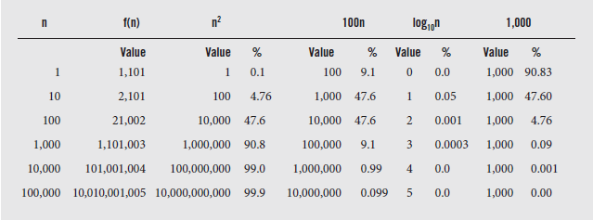
Computational and Asymptotic Complexity (continued)
To illustrate this, consider f(n) = n² + 100n + log₁₀n + 1000
As the value of n increases, the importance of each term shifts until for large n, only the n² term is significant.
The growth rate of all terms of function f(n) = n² + 100n + log₁₀n + 1000

Slide 6
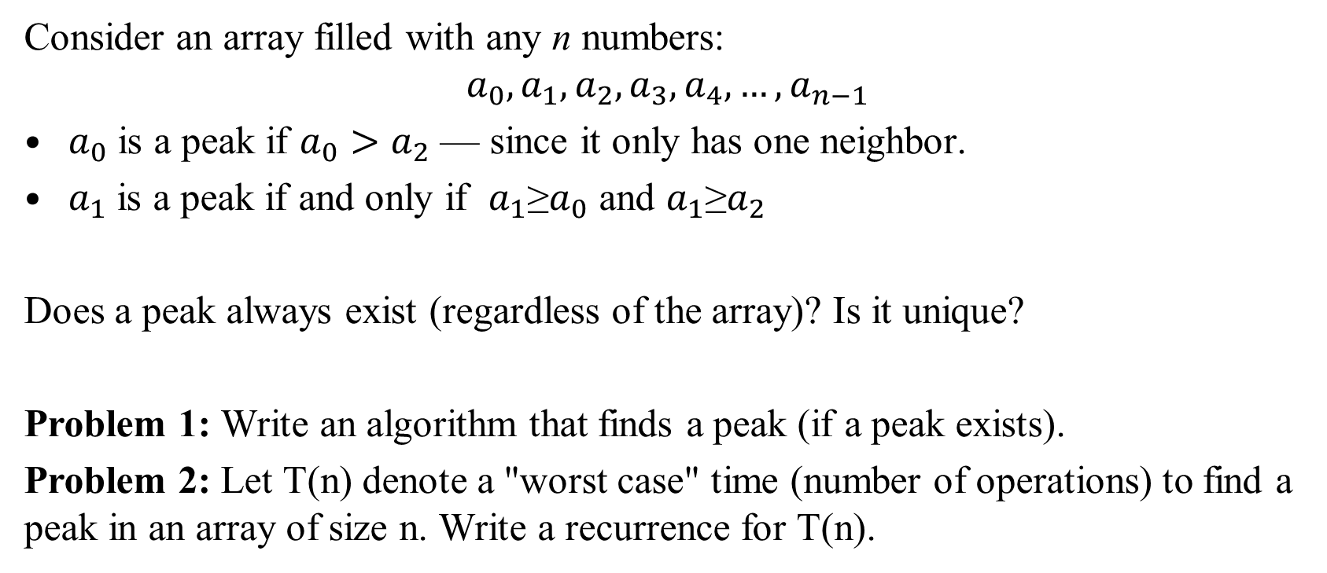
Peak Finding Problem
Consider an array filled with any n numbers:
$$a_{0},a_{1},a_{2},a_{3},a_{4}, …,a_{n−1}$$
$a_{0}$ is a peak if $a_{0}>a_{2}$ — since it only has one neighbor.
$a_{1}$ is a peak if and only if $a_{1}$≥$a_{0}$ and $a_{1}$≥$a_{2}$
Does a peak always exist (regardless of the array)? Is it unique?
Problem 1: Write an algorithm that finds a peak (if a peak exists).
Problem 2: Let T(n) denote a "worst case" time (number of operations) to find a peak in an array of size n. Write a recurrence for T(n).

Slide 7
Write Pseudocode to Do Linear Search
Problem Variant #1:
Human-readable code to find peaks (Python + English sentences?). Use Linear Search – scan the array until you find the peak.
Recurrence for T(n) – how increasing the size of array can be reduced to an array of a smaller size?
Solve the recurrence to find the complexity.

Slide 8
More Efficient algorithm to find Peaks
Problem Variant #2:
Write pseudocode for an algorithm that does not need to scan the whole array linearly.
Recurrence for T(n) – express time used for larger inputs via time used for smaller inputs.
Solve the recurrence for T(n)

Slide 9
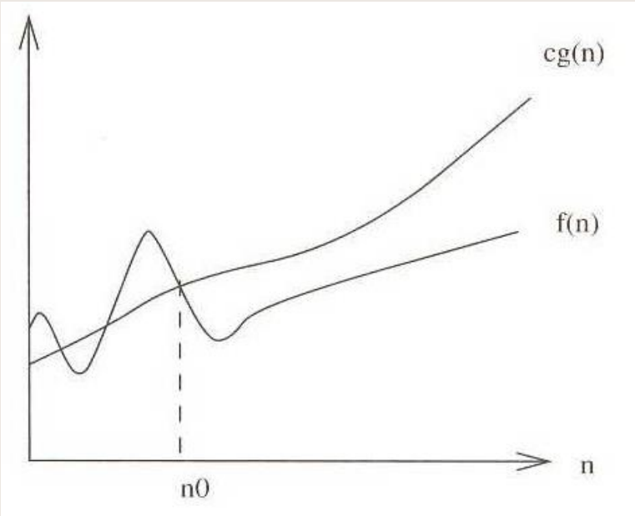
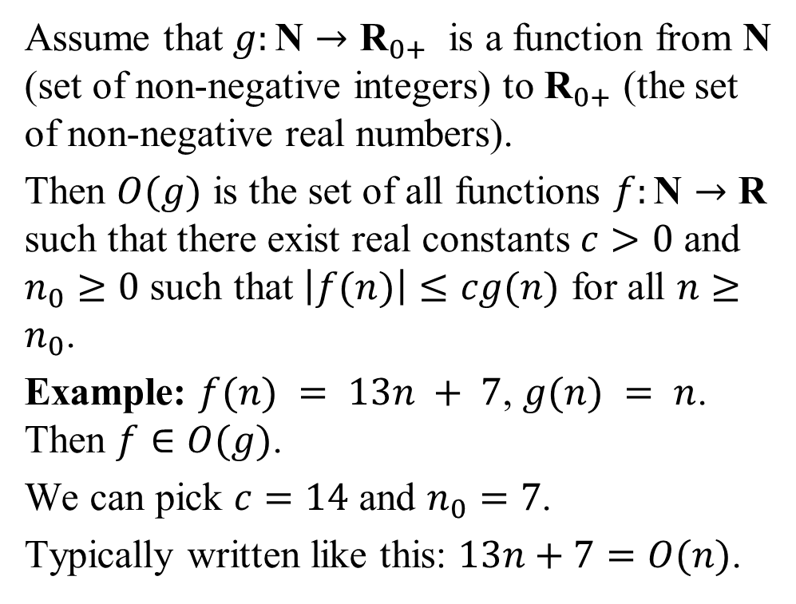
Big-O Notation
Assume that $g:\text{N}→{\text{R}}_{0+}$ is a function from N (set of non-negative integers) to ${\text{R}}_{0+}$ (the set of non-negative real numbers).
Then $O(g)$ is the set of all functions $f:\text{N}→\text{R}$ such that there exist real constants $c>0$ and $n_{0}≥0$ such that $\left|f(n)\right|≤cg(n)$ for all $n≥n_{0}$.
Example: $f(n) = 13n + 7$, $g(n) = n$. Then $f∈O(g)$.
We can pick $c=14$ and $n_{0}=7$.
Typically written like this: $13n+7=O(n)$.
Notes:
Big-O provides a formal method for expressing asymptotic upper bounds, bounding the growth of a function from above
Knowing where a function lies within the big-O hierarchy lets us compare it quickly with other functions
Thus we have an idea of which algorithm has the best time performance

Slide 10
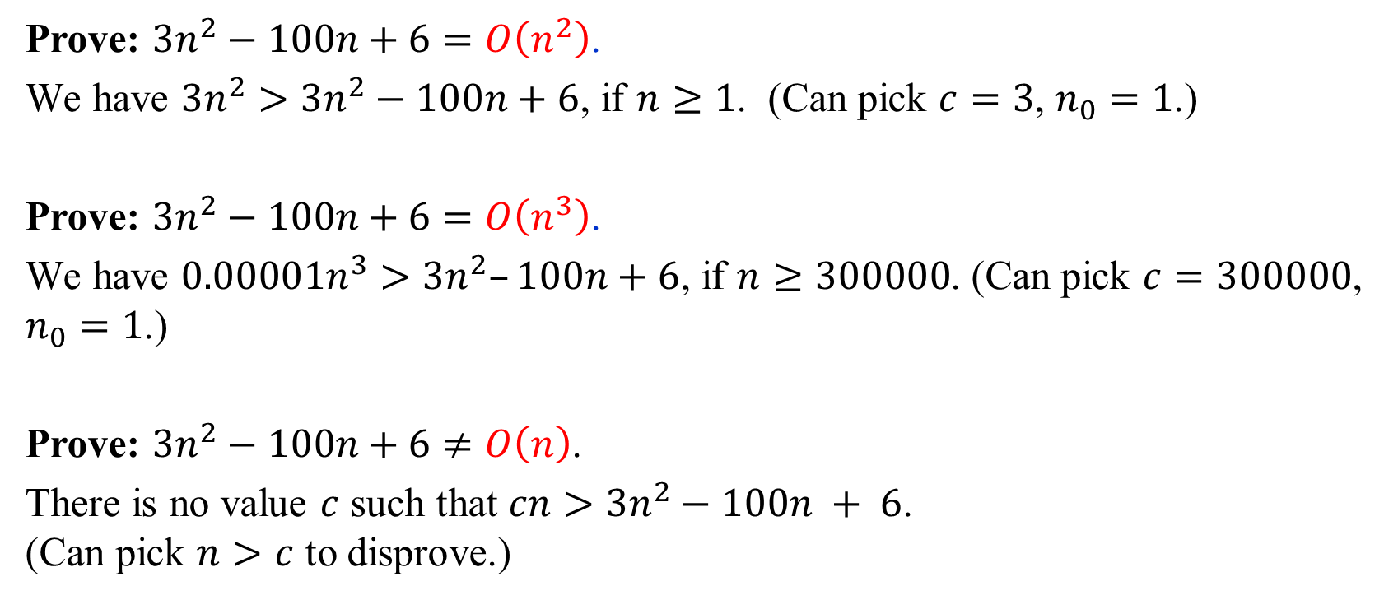
Big-O: Examples
Prove: $3n^{2}−100n+6=O\left(n^{2}\right)$.
We have $3n^{2}>3n^{2}−100n+6$, if $n≥1$. (Can pick $c=3$, $n_{0}=1$.)
Prove: $3n^{2}−100n+6=O\left(n^{3}\right)$.
We have $0.00001n^{3}>3n^{2}–100n+6$, if $n≥300000$. (Can pick $c=300000$, $n_{0}=1$.)
Prove: $3n^{2}−100n+6≠O\left(n\right)$.
There is no value $c$ such that $cn>3n^{2}−100n + 6$.
(Can pick $n>c$ to disprove.)

Slide 11
Big-O Notation
Function inside the Big-O Notation is typically simple:
Functions are all in O(n²)
  n² + n,
  4n² - n log n + 12,
  n²/5 - 100n,
  n log n,

Slide 12
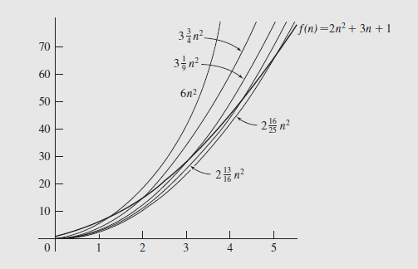
Big-O Notation
f(n) should be squeezed under cg(n) for some constant c.
While c and N exist, it does not tell us how to calculate them or what to do if multiple candidates exist (and they often do)
Consider the function f:
f (n) = 2n² + 3n + 1
and g:
g(n) = n²
Clearly f (n) is O(n²); possible candidates for c and N are shown in the next slide

Slide 13
Example: Check by Definition
Consider the function 3n² + 4n - 2
We need a c and N such that:
3n² + 4n - 2 < cn²
for all n > N

Slide 14
Example: Check by Definition
Dividing by n² gives us
3 + 4/n – 2/n² < c
Choosing N = 1, we need to find a c such that
3 + 4 – 2 < c
We can set c = 6, so we have
3n² + 4n - 2 < 6n²
for all n > 1
So our function is O(n²)

Slide 15
Properties of Big-O Notation
Big-O is transitive: if f(n) = O(g(n)) and g(n) is O(h(n)), then f(n) = O(h(n))
If f(n) = O(h(n)) and g(n) is O(h(n)), then f(n) + g(n) = O(h(n))
A function an^{k} = O(n^{k}) for any a > 0
Any k^{th} degree polynomial is O(n^{k+j}) for any j > 0
f(n) = O(g(n)) is true if lim_{n->∞} f(n)/g(n) is a constant. Put another way, if f(n) = cg(n), then f(n) = O(g(n))
log_{a}n = O(log_{b} n) for any a, b > 1. Typically we don’t care what base our logarithms are
Given the preceding, we can use just one base and rewrite the relationship as log_{a}n = O(log n) for positive a ≠ 1 and lg n = log₂n

Slide 16
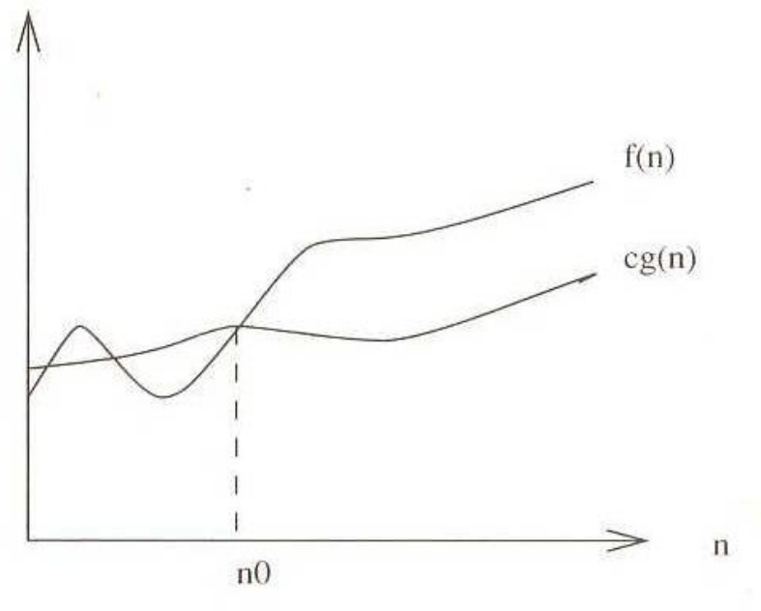
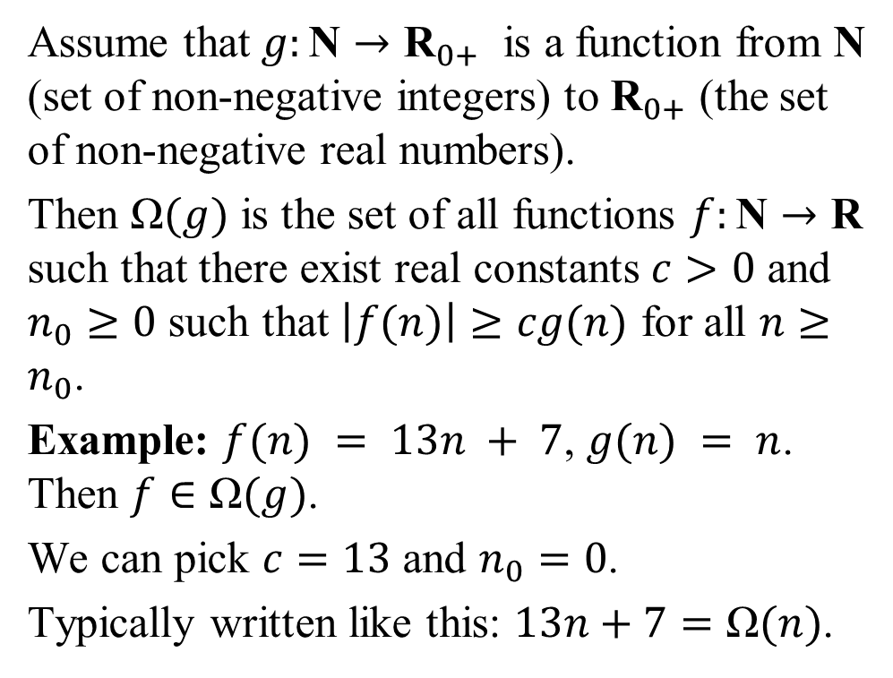
Big-Ω (Big-Omega) Notation
Assume that $g:\text{N}→{\text{R}}_{0+}$ is a function from N (set of non-negative integers) to ${\text{R}}_{0+}$ (the set of non-negative real numbers).
Then $\text{Ω}(g)$ is the set of all functions $f:\text{N}→\text{R}$ such that there exist real constants $c>0$ and $n_{0}≥0$ such that $\left|f(n)\right|≥cg(n)$ for all $n≥n_{0}$.
Example: $f(n) = 13n + 7$, $g(n) = n$. Then $f∈\text{Ω}(g)$.
We can pick $c=13$ and $n_{0}=0$.
Typically written like this: $13n+7=\text{Ω}(n)$.
Notes:
Big-O only gives us the upper bound of a function
So if we ignore constant factors and let n get big enough, some function will never be bigger than some other function
This can give us too much freedom
Consider that selection sort is O(n³), since n² is O(n³) - but O(n²) is a more meaningful upper bound
We need a lower bound, a function that always grows more slowly than f(n), and a tight bound, a function that grows at about the same rate as f(n)

Slide 17
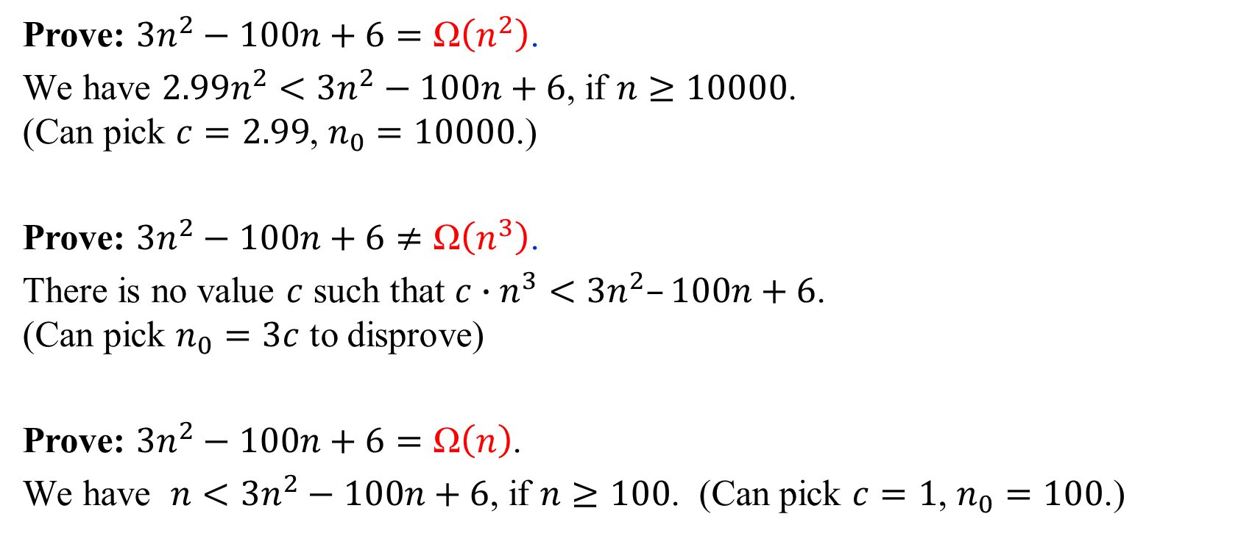
Big-Ω: Examples
Prove: $3n^{2}−100n+6=\text{Ω}\left(n^{2}\right)$.
We have $2.99n^{2}<3n^{2}−100n+6$, if $n≥10000$.
(Can pick $c=2.99$, $n_{0}=10000$.)
Prove: $3n^{2}−100n+6≠\text{Ω}\left(n^{3}\right)$.
There is no value $c$ such that ${c∙n}^{3}<3n^{2}–100n+6$.
(Can pick $n_{0}=3c$ to disprove)
Prove: $3n^{2}−100n+6=\text{Ω}\left(n\right)$.
We have $n<3n^{2}−100n+6$, if $n≥100$. (Can pick $c=1$, $n_{0}=100$.)

Slide 18
Ω and Θ Notations (continued)
Big-Ω is for lower bounds what big-O is for upper bounds
Definition: Let f(n) and g(n) be functions, where n is a positive integer. We write f(n) = Ω(g(n)) if and only if g(n) = O(f(n)). We say "f of n is omega of g of n.“
So g is a lower bound for f ; after a certain n, and without regard to multiplicative constants, f will never go below g
Finally, theta notation combines upper bounds with lower bounds to get tight bound
Definition: Let f(n) and g(n) be functions, where n is a positive integer. We write f(n) = Θ(g(n)) if and only if g(n) = O(f(n)) and g(n) = (f(n)). We say "f of n is theta of g of n."

Slide 19
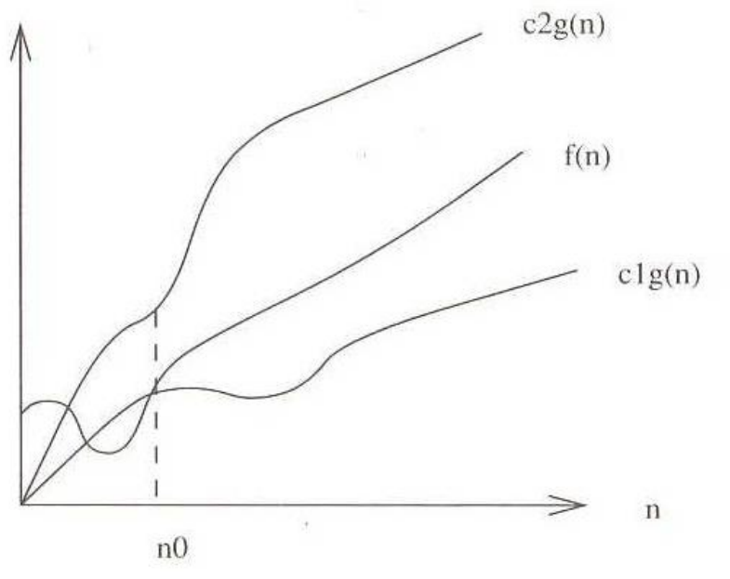
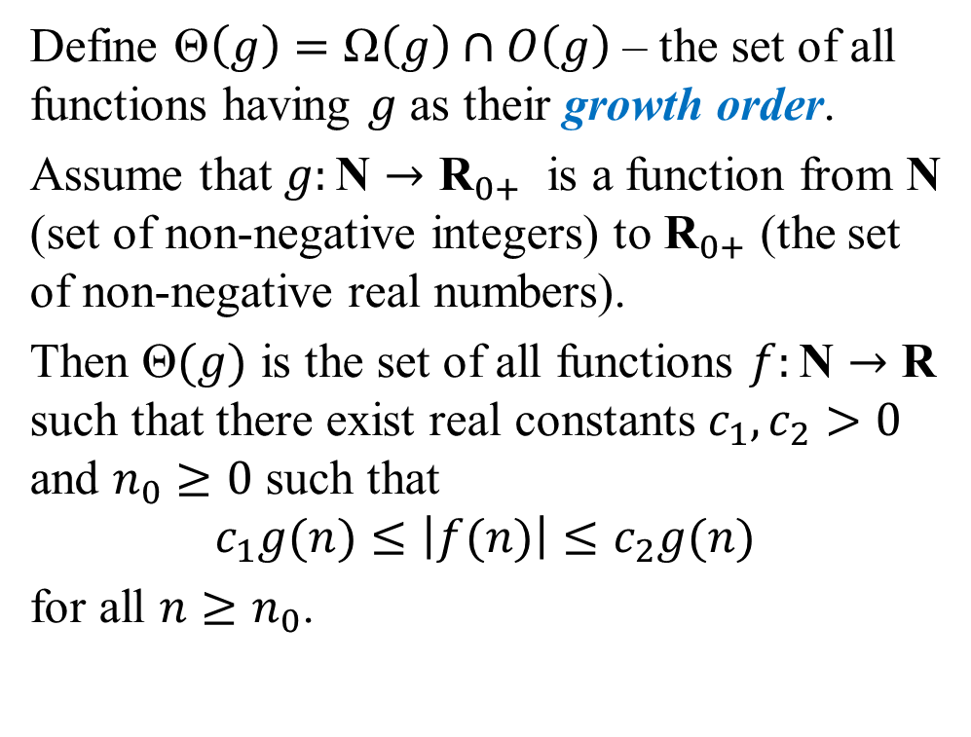
Big-Θ (Big-Theta) Notation
Define $\text{Θ}\left(g\right)=\text{Ω}\left(g\right)∩O\left(g\right)$ – the set of all functions having $g$ as their growth order.
Assume that $g:\text{N}→{\text{R}}_{0+}$ is a function from N (set of non-negative integers) to ${\text{R}}_{0+}$ (the set of non-negative real numbers).
Then $\text{Θ}(g)$ is the set of all functions $f:\text{N}→\text{R}$ such that there exist real constants $c_{1},c_{2}>0$ and $n_{0}≥0$ such that
$$c_{1}g(n)≤\left|f(n)\right|≤c_{2}g(n)$$
for all $n≥n_{0}$.

Slide 20

Big-Θ: Examples
$3n^{2}−100n+6=\text{Θ}\left(n^{2}\right)$, since both O and Ω are satisfied:
$3n^{2}−100n+6=O\left(n^{2}\right)$ and $3n^{2}−100n+6=\text{Ω}\left(n^{2}\right)$
$3n^{2}−100n+6≠\text{Θ}\left(n^{3}\right)$, since only O is satisfied.
$3n^{2}−100n+6≠\text{Θ}\left(n\right)$, since only Ω is satisfied.

Slide 21
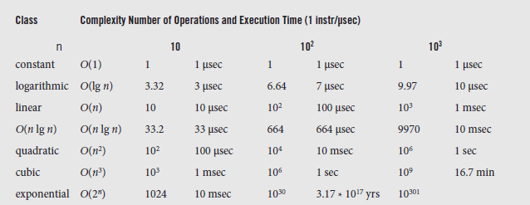
Examples of Complexities
Algorithms in terms of their time complexity can be classified by Big-O.
Classes of algorithms and their execution times on a computer executing 1 million operations per second (1 sec = 10⁶ μsec = 10³ msec)

Slide 22
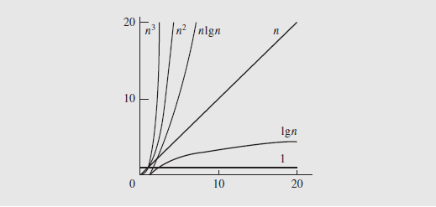
Examples of Complexities (continued)
This graph, and the previous chart, show that some algorithms have no practical application
Cubic order algorithms or higher are impractical for large inputs (in complexity theory – all polynomial time is considered feasible).

Slide 23
Some simple recurrences
Many algorithms are based on this idea:
Divide the big problem into smaller subproblems
Solve the subproblems and combine them into the larger solution.
Runtime depends on:
  The size and the count of subproblems
  The time of decomposition (and re-assembly)
We mention 5 examples of recurrences that appear in analysis of real algorithms.

Slide 24
Cost Models
How to apply asymptotic bounds for
Time is measured within a certain cost model. Several possibilities:
  Time is measured as executed pseudocode lines.
  Time is measured as certain basic operations (such as comparisons a<b in sorting algorithms).
  The cost model assigns weight w(n) to some "expensive" operations
  Time can be measured empirically in units such as microseconds.

Slide 25
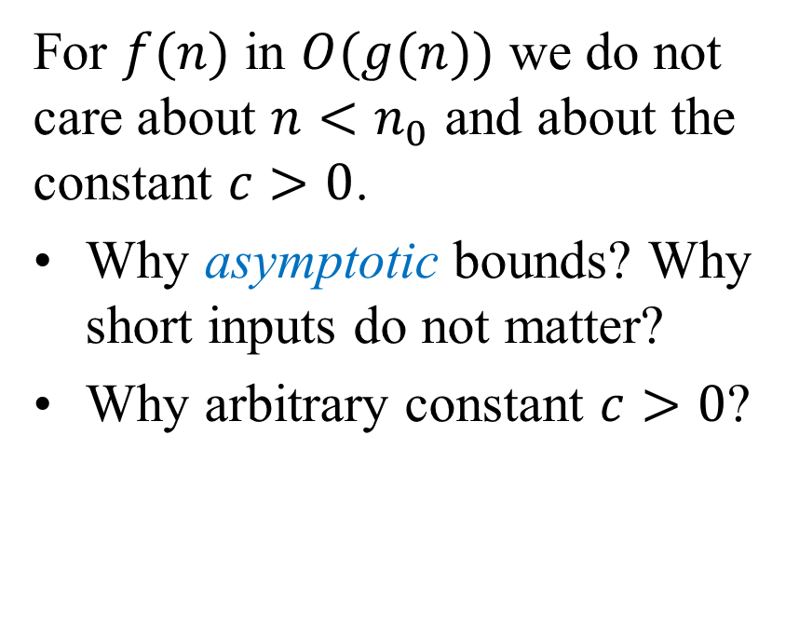
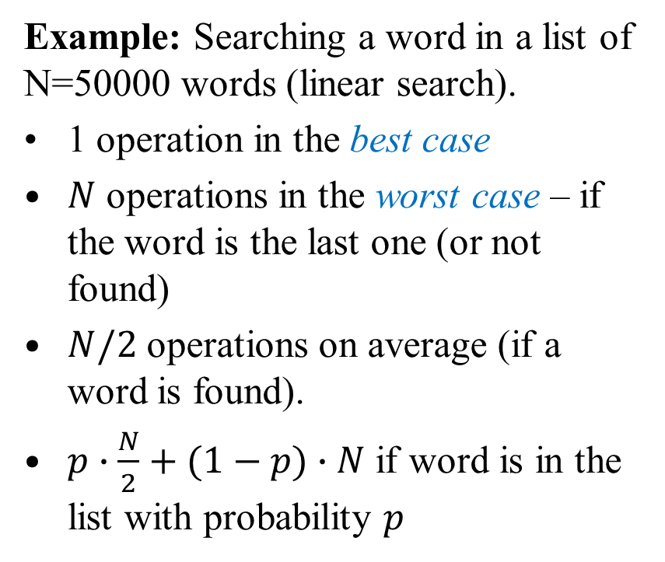
Worst-case input as "smoothing"
Example: Searching a word in a list of N=50000 words (linear search).
1 operation in the best case
$N$ operations in the worst case – if the word is the last one (or not found)
$N/2$ operations on average (if a word is found).
$p∙\frac{N}{2}+(1−p)∙N$ if word is in the list with probability $p$
For $f(n)$ in $O(g(n))$ we do not care about $n<n_{0}$ and about the constant $c>0$.
Why asymptotic bounds? Why short inputs do not matter?
Why arbitrary constant $c>0$?

Slide 26
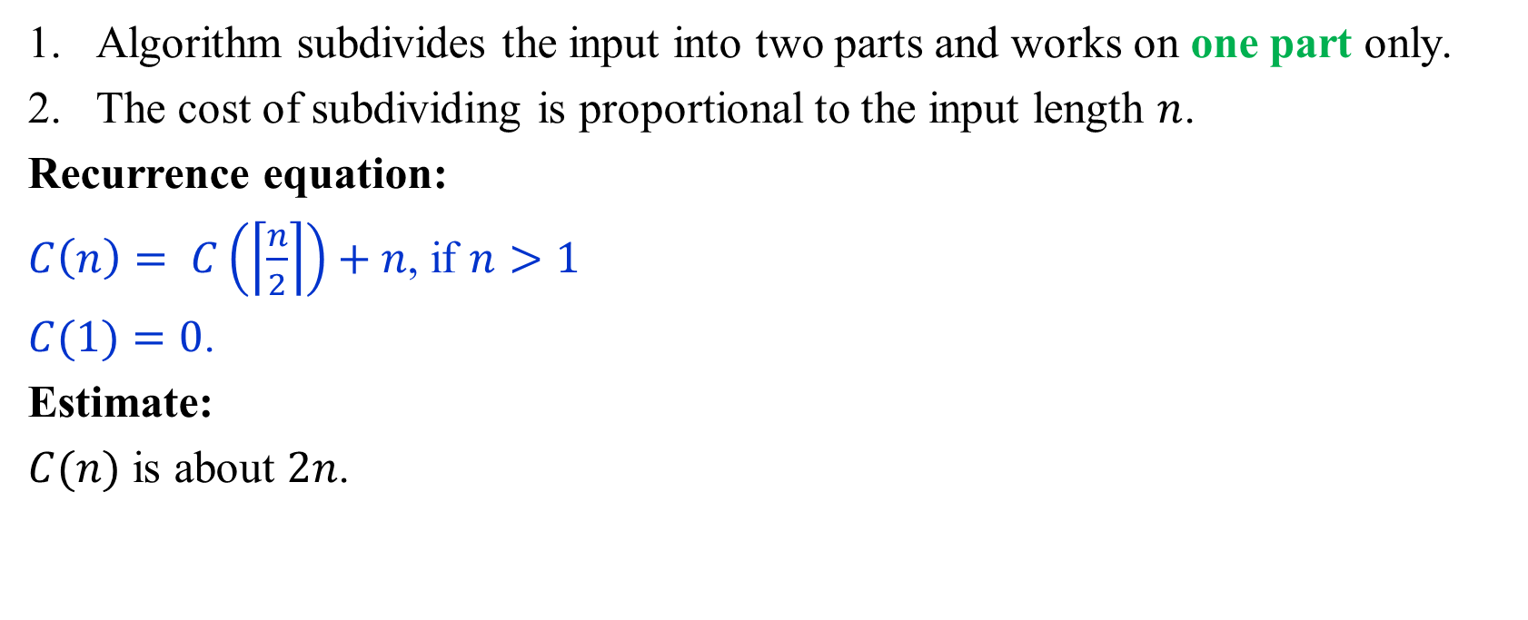
Example 1: Recurrence
Algorithm subdivides the input into two parts and works on one part only.
The cost of subdividing is proportional to the input length $n$.
Recurrence equation:
$C\left(n\right)= C\left(\left\lceil \frac{n}{2}\right\rceil \right)+n$, if $n>1$
$C(1)=0$.
Estimate:
$C(n)$ is about $2n$.

Slide 27
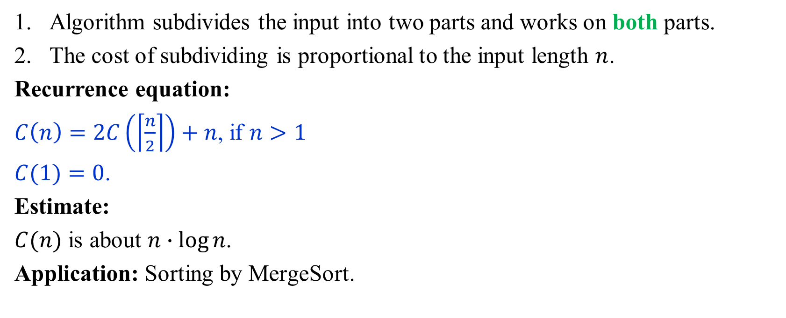
Example 2: Recurrence
Algorithm subdivides the input into two parts and works on both parts.
The cost of subdividing is proportional to the input length $n$.
Recurrence equation:
$C\left(n\right)=2C\left(\left\lceil \frac{n}{2}\right\rceil \right)+n$, if $n>1$
$C(1)=0$.
Estimate:
$C(n)$ is about $n∙\log{n}$.
Application: Sorting by MergeSort.

Slide 28
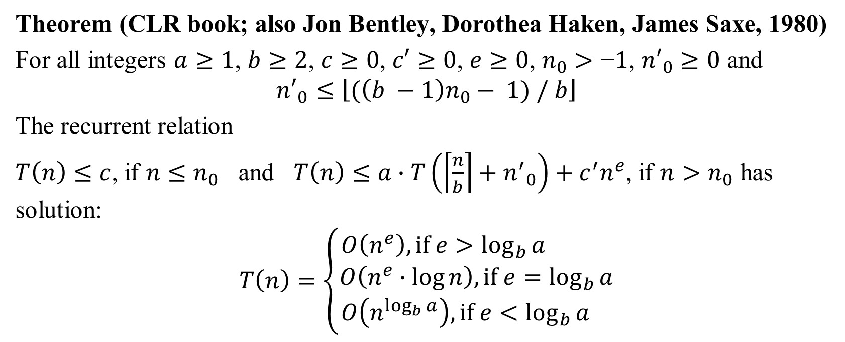
Master Theorem: General Recurrence
Theorem (CLR book; also Jon Bentley, Dorothea Haken, James Saxe, 1980)
For all integers $a≥1$, $b≥2$, $c≥0$, $c′≥0$, $e≥0$, $n_{0}>\text{−}1$, ${n′}_{0}≥0$ and
$${n′}_{0}≤\left\lfloor (\left(b −1\right)n_{0}− 1) / b\right\rfloor$$
The recurrent relation
$T\left(n\right)≤c$, if $n≤n_{0}$ and $T\left(n\right)≤a∙T\left(\left\lceil \frac{n}{b}\right\rceil +{n^{′}}_{0}\right)+c^{′}n^{e}$, if $n>n_{0}$ has solution:
$$T\left(n\right)=\left\{\begin{matrix}O\left(n^{e}\right), if e>\log_{b}{a} \\ O\left(n^{e}∙\log{n}\right), if e=\log_{b}{a} \\ O\left(n^{\log_{b}{a}}\right), if e<\log_{b}{a} \end{matrix}\right.$$

Slide 29
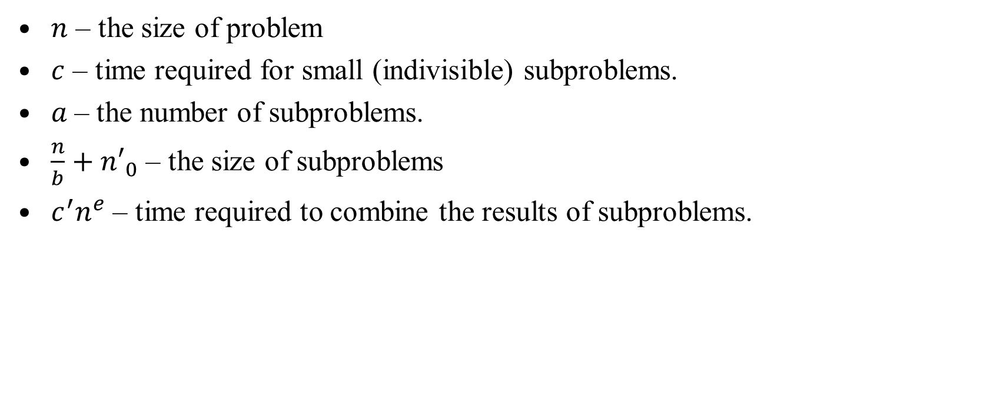
Notation in Master's Theorem
$n$ – the size of problem
$c$ – time required for small (indivisible) subproblems.
$a$– the number of subproblems.
$\frac{n}{b}+{n′}_{0}$ – the size of subproblems
$c^{′}n^{e}$ – time required to combine the results of subproblems.
Notes:
Exercises
Algorithm reduces problem size by 1 at every iteration. The costs of iterations change from n to 1 (or 1 to n).
Given a recurrence, identify what is the Big-O notation for it.

Slide 30
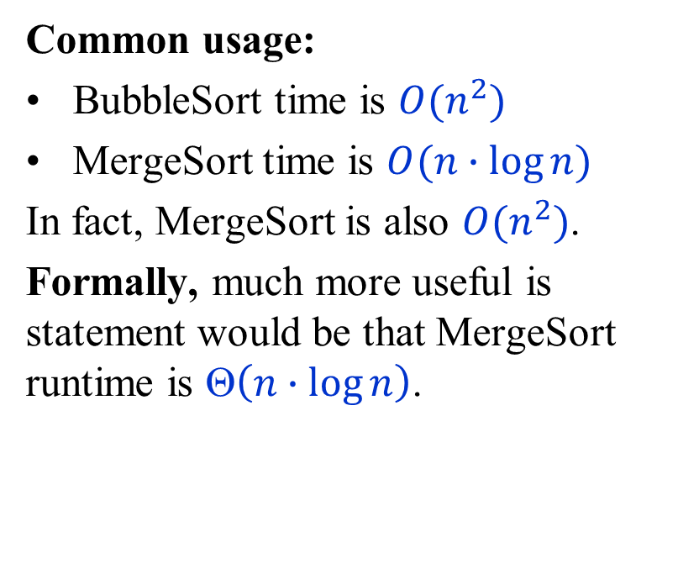
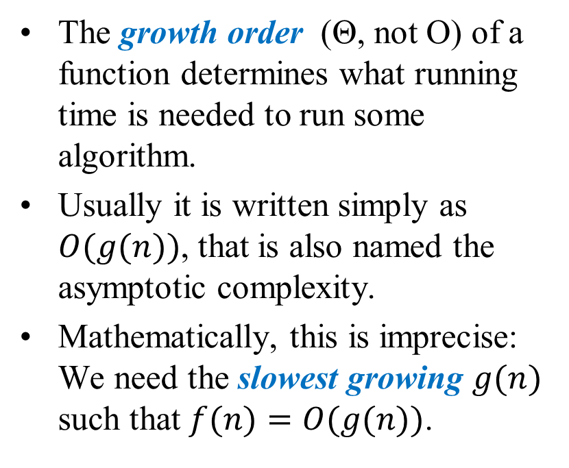
Time Analysis is about Growth Order
The growth order (Θ, not O) of a function determines what running time is needed to run some algorithm.
Usually it is written simply as $O(g(n))$, that is also named the asymptotic complexity.
Mathematically, this is imprecise: We need the slowest growing $g(n)$ such that $f(n)=O(g(n))$.
Common usage:
BubbleSort time is $O(n^{2})$
MergeSort time is $O(n∙\log{n})$
In fact, MergeSort is also $O(n^{2})$.
Formally, much more useful is statement would be that MergeSort runtime is $\text{Θ}\left(n∙\log{n}\right)$.
Typically, Θ is usually not written. Using Θ would imply am obligation to prove two inequalities.
Using O is the lazy way.

Slide 31
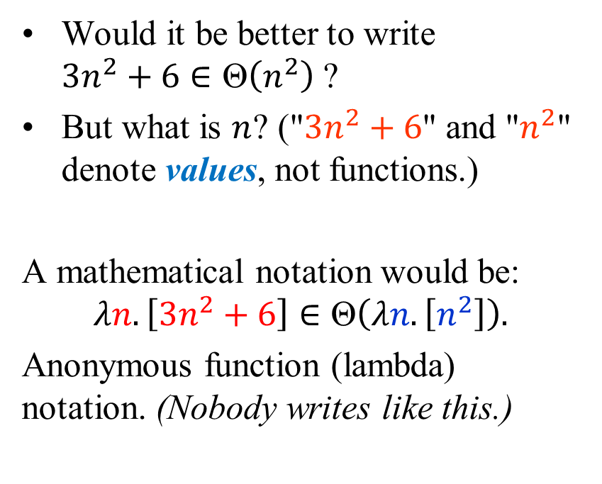
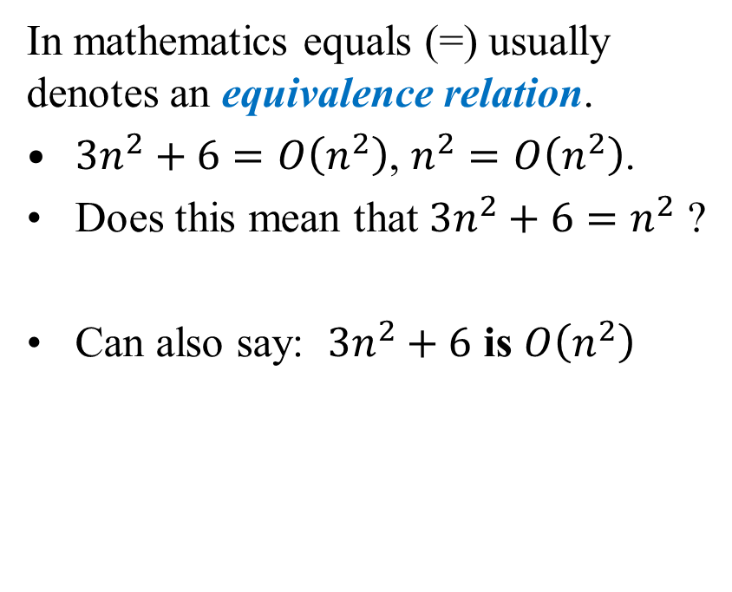
Why Big-O Notation is Often Sloppy?
In mathematics equals (=) usually denotes an equivalence relation.
$3n^{2}+6=O\left(n^{2}\right)$, $n^{2}=O\left(n^{2}\right)$.
Does this mean that $3n^{2}+6=n^{2}$ ?
Can also say: $3n^{2}+6$ is $O\left(n^{2}\right)$
Would it be better to write
$3n^{2}+6∈\text{Θ}\left(n^{2}\right)$ ?
But what is $n$? ("$3n^{2}+6$" and "$n^{2}$" denote values, not functions.)
A mathematical notation would be:
$$λn.\left[3n^{2}+6\right]∈\text{Θ}\left(λn.\left[n^{2}\right]\right).$$
Anonymous function (lambda) notation. (Nobody writes like this.)

Slide 32
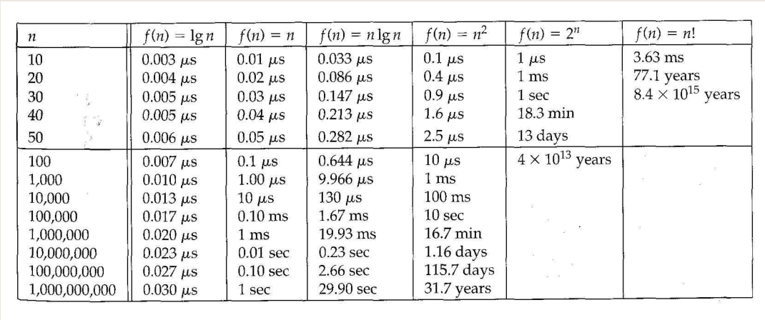

Waiting Times and Asymptotics
1 operation is 1 nanosecond (${10}^{−9}$ s). 1 μs = ${10}^{−6}$ s. 1 ms = ${10}^{−3}$ s.

Slide 33

Various Exponent Functions
Problem. Given functions $g\left(n\right)=5^{n}$, $f_{1}\left(n\right)=2^{n}$, and $f_{2}\left(n\right)={10}^{n}$, test if $g(n)$ is in $O(f_{1}\left(n\right))$ and also in $O(f_{2}(n))$.
Use the definition of Big-O
Namely: Do there exist constants $C$ and $n_{0}$ as in the definition?

Slide 34
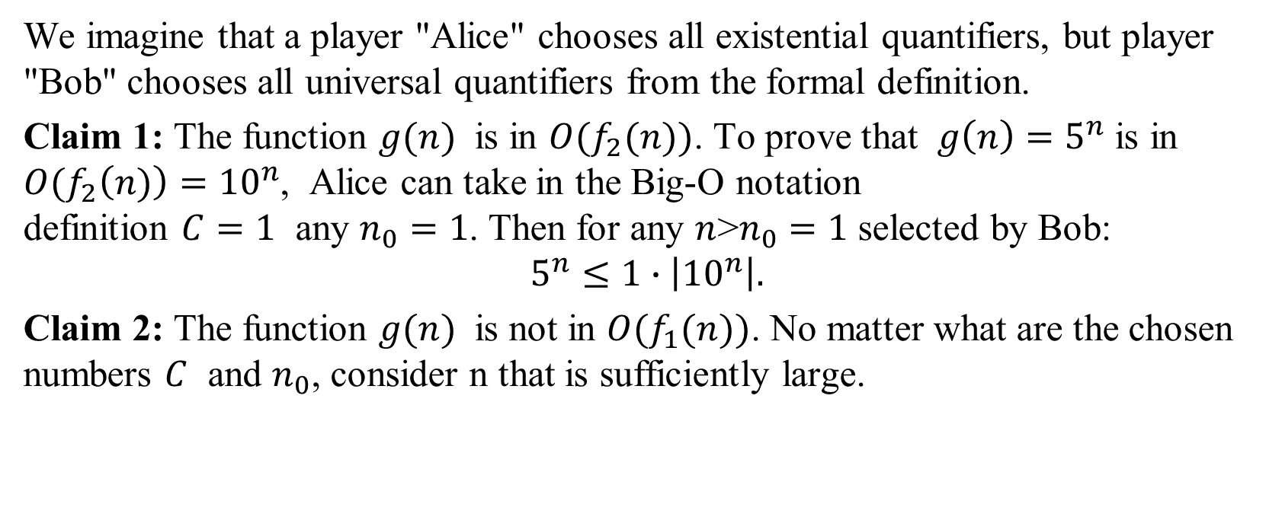
Various Exponent Functions: Solution
We imagine that a player "Alice" chooses all existential quantifiers, but player "Bob" chooses all universal quantifiers from the formal definition.
Claim 1: The function $g(n)$ is in $O(f_{2}(n))$. To prove that $g\left(n\right)=5^{n}$ is in ${O(f}_{2}\left(n)\right)={10}^{n}$, Alice can take in the Big-O notation
definition $C=1$ any $n_{0}=1$. Then for any $n$>$n_{0}=1$ selected by Bob:
$$5^{n}≤1∙\left|{10}^{n}\right|.$$
Claim 2: The function $g(n)$ is not in $O(f_{1}(n))$. No matter what are the chosen numbers $C$ and $n_{0}$, consider n that is sufficiently large.

Slide 35
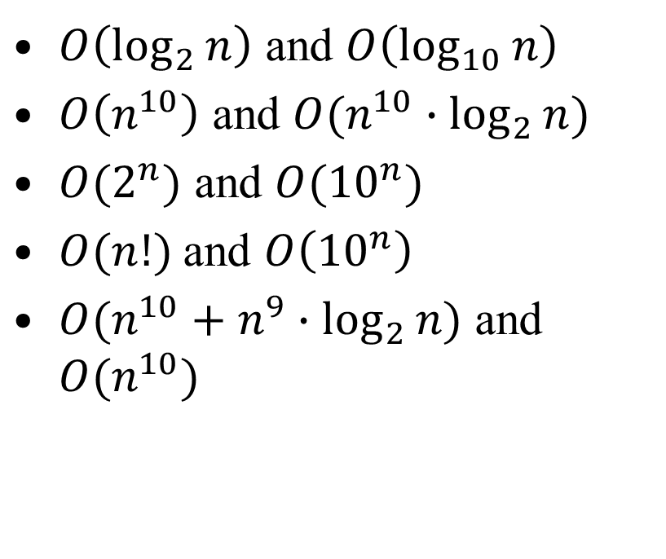
Comparing Big-O Sets
$O\left(\log_{2}{n}\right)$ and $O\left(\log_{10}{n}\right)$
$O\left(n^{10}\right)$ and $O(n^{10}∙\log_{2}{n})$
$O(2^{n})$ and $O({10}^{n})$
$O(n!)$and $O\left({10}^{n}\right)$
$O(n^{10}+n^{9}∙\log_{2}{n})$ and $O(n^{10})$
For each pair of Big-O notations decide, if the left-side class of functions is larger than the right-side class. Or are they equal?

Slide 36
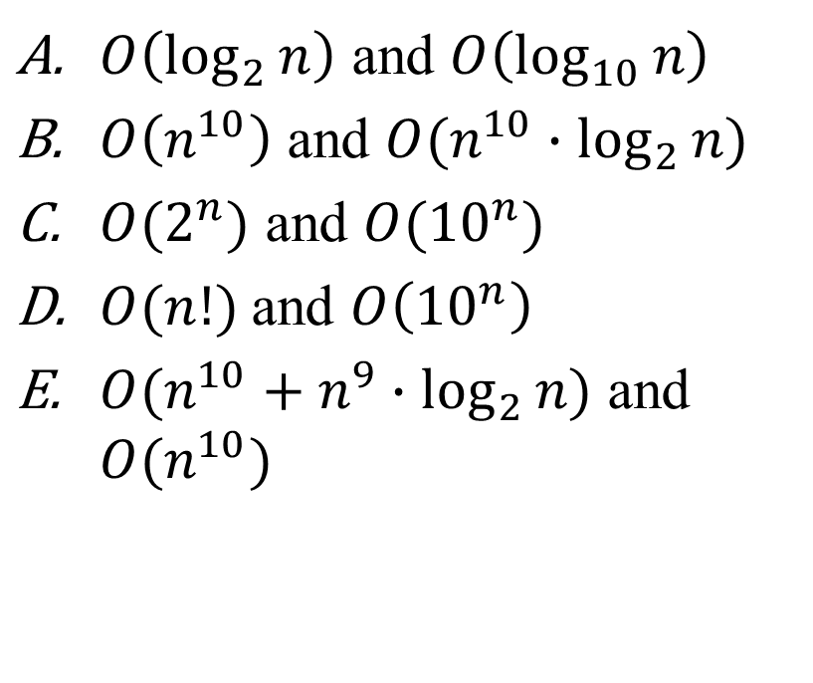
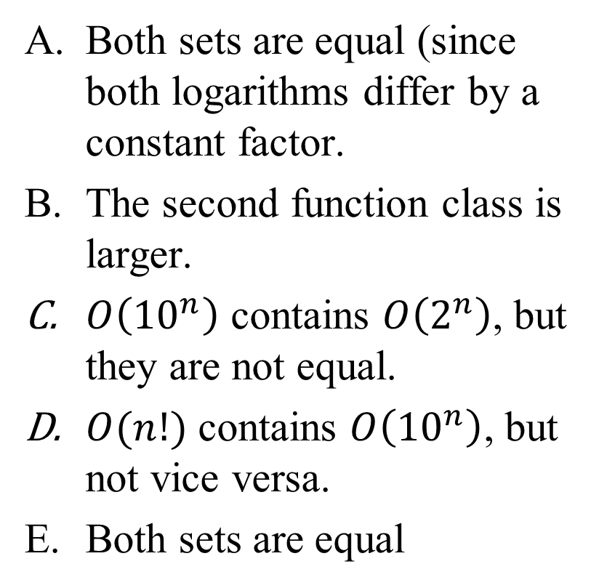
Comparing Big-O Sets: Solution
$O\left(\log_{2}{n}\right)$ and $O\left(\log_{10}{n}\right)$
$O\left(n^{10}\right)$ and $O(n^{10}∙\log_{2}{n})$
$O(2^{n})$ and $O({10}^{n})$
$O(n!)$and $O\left({10}^{n}\right)$
$O(n^{10}+n^{9}∙\log_{2}{n})$ and $O(n^{10})$
Both sets are equal (since both logarithms differ by a constant factor.
The second function class is larger.
$O\left({10}^{n}\right)$ contains $O\left(2^{n}\right)$, but they are not equal.
$O(n!)$ contains $O\left({10}^{n}\right)$, but not vice versa.
Both sets are equal

Slide 37
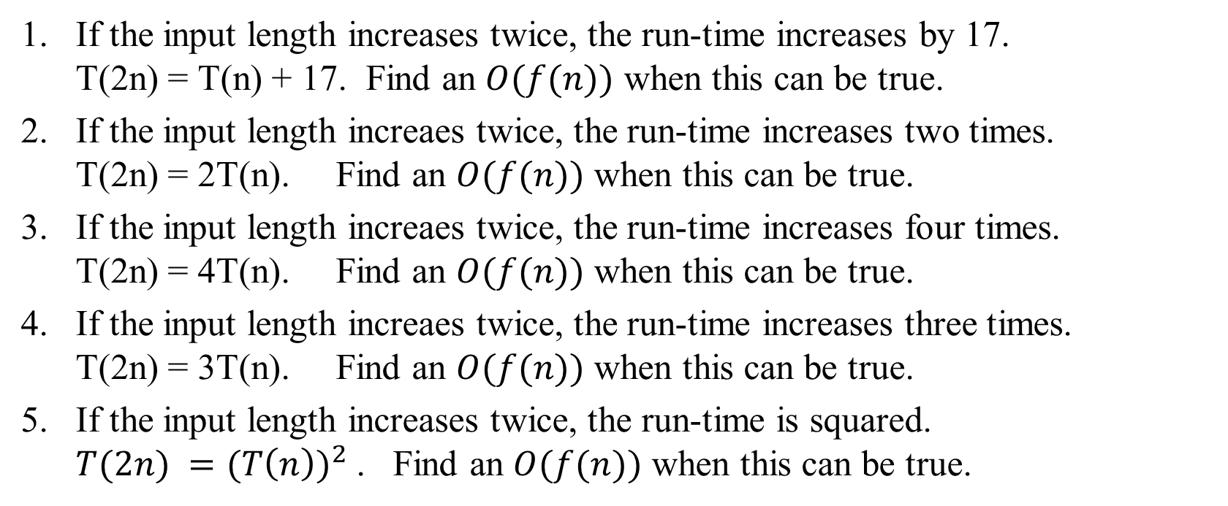
Doubling Input Length
If the input length increases twice, the run-time increases by 17.
T(2n) = T(n) + 17. Find an $O(f(n))$ when this can be true.
If the input length increaes twice, the run-time increases two times.
T(2n) = 2T(n). Find an $O(f(n))$ when this can be true.
If the input length increaes twice, the run-time increases four times.
T(2n) = 4T(n). Find an $O(f(n))$ when this can be true.
If the input length increaes twice, the run-time increases three times.
T(2n) = 3T(n). Find an $O(f(n))$ when this can be true.
If the input length increases twice, the run-time is squared.
$T(2n) ={(T\left(n\right))}^{2}$ . Find an $O(f(n))$ when this can be true.
Notes:
If the input length increases twice, the run-time increases by 17.
Can take $O(\log_{2}{n})$
If the input length increaes twice, the run-time increases two times.
Can take $O(n)$
If the input length increaes twice, the run-time increases four times.
Can take $O(n^{2})$
If the input length increaes twice, the run-time increases three times.
Can take $O(n^{\log_{2}{3}})$
If the input length increases twice, the run-time is squared.
Can take $O(2^{n})$

Slide 38
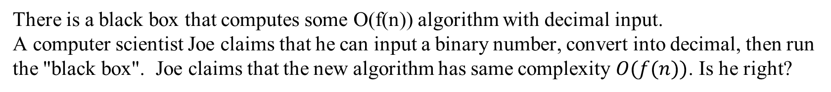
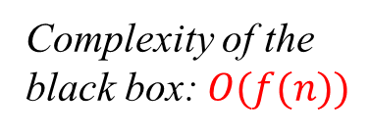
Decimal vs. Binary Algorithms
There is a black box that computes some O(f(n)) algorithm with decimal input.
A computer scientist Joe claims that he can input a binary number, convert into decimal, then run the "black box". Joe claims that the new algorithm has same complexity $O(f(n))$. Is he right?
Complexity of the
black box: $O(f(n))$
Complexity of the
modified algorithm
Binary input
Decimal input
Convert from binary to decimal
Some output
(Yes/No or similar)
Some output
(Yes/No or similar)
$$O(f\left(n\right))$$ | $$O(\log_{2}{n})$$ | $$O(n)$$ | $$O(n\log_{2}{n})$$ | $$O(n^{3})$$ | $$O(3^{n})$$ | $$O(n!)$$
True/False?
Notes:
https://www.bigocheatsheet.com/
For polynomial time algorithms (vast majority of practical algorithms) the encoding (decimal/binary) does not affect the time complexity.
For logarithmic time algorithm (something very fast – does not even read all the input), converting from binary to decimal "dominates" the time (it is O(n)).
For exponential time algorithms (something very slow) multiplying or dividing argument n by some factor changes the O(f(n)).

Slide 39
Traditional Time Analysis
In textbooks algorithm analysis uses two criteria of the efficiency:
  Running time
  Used space/memory (usually RAM memory).
Space can be taken by lots of recursive calls OR by creating large data structures on the heap.
Time is analyzed more frequently than space.
Time can sometimes be saved by wasting some extra space – algorithms may have tradeoffs.

Slide 40
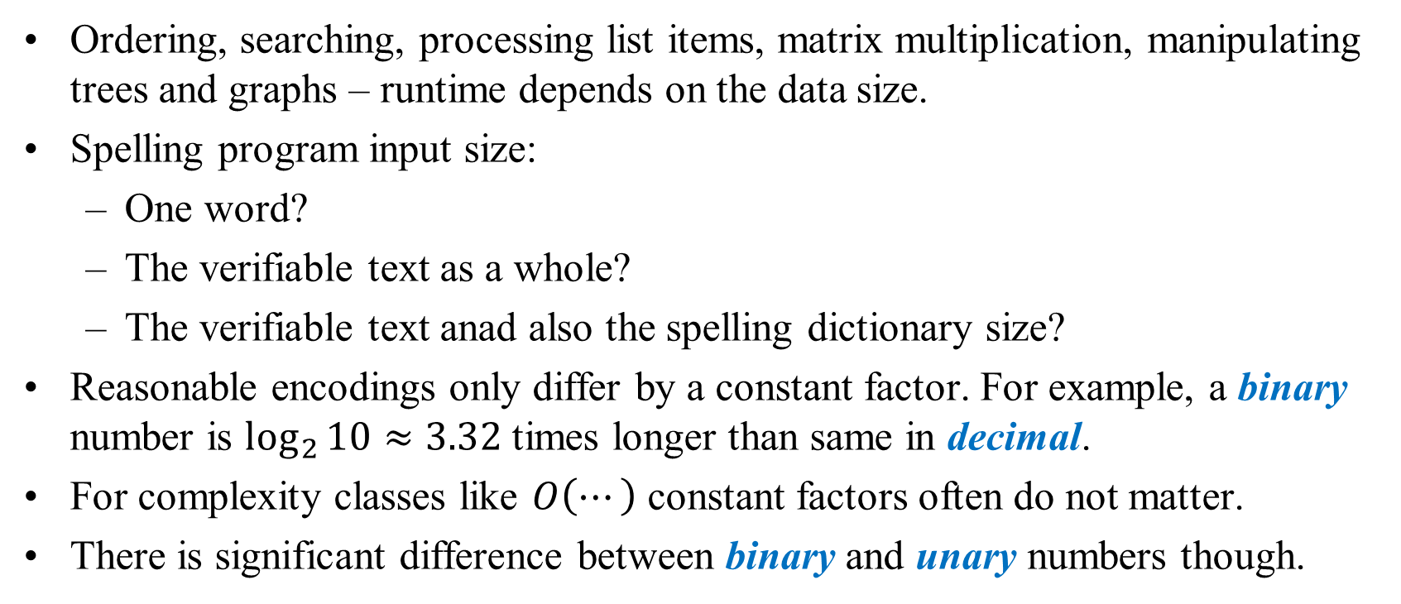
What is Input Data Size?
Ordering, searching, processing list items, matrix multiplication, manipulating trees and graphs – runtime depends on the data size.
Spelling program input size:
  One word?
  The verifiable text as a whole?
  The verifiable text anad also the spelling dictionary size?
Reasonable encodings only differ by a constant factor. For example, a binary number is $\log_{2}{10}≈3.32$ times longer than same in decimal.
For complexity classes like $O\left(⋯\right)$ constant factors often do not matter.
There is significant difference between binary and unary numbers though.

Slide 41
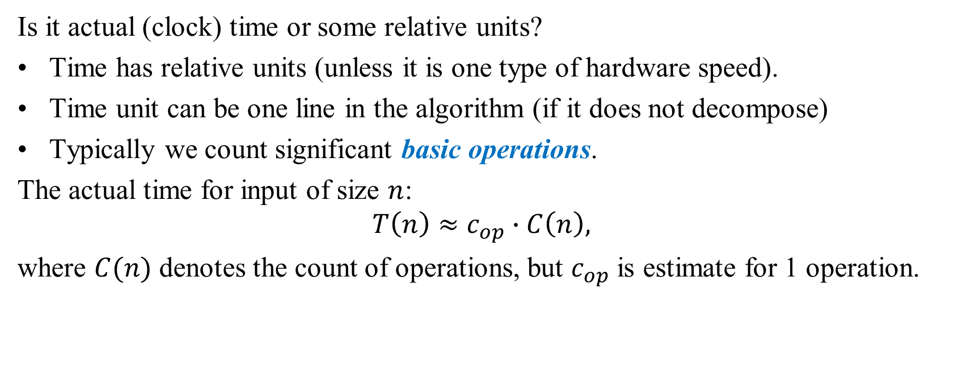
Time Units in Analysis
Is it actual (clock) time or some relative units?
Time has relative units (unless it is one type of hardware speed).
Time unit can be one line in the algorithm (if it does not decompose)
Typically we count significant basic operations.
The actual time for input of size $n$:
$$T\left(n\right)≈c_{op}∙C\left(n\right),$$
where $C(n)$ denotes the count of operations, but $c_{op}$ is estimate for 1 operation.

Slide 42
What can be Counted?
Addition, subtraction
Multiplication, division
Floating point operations
Reading a variable
Updating a variable
Comparison
Boolean (AND, OR, NOT)
I/O operation
Memory allocation
Memory deallocation
Type casting
(Recursive) function call

Slide 43
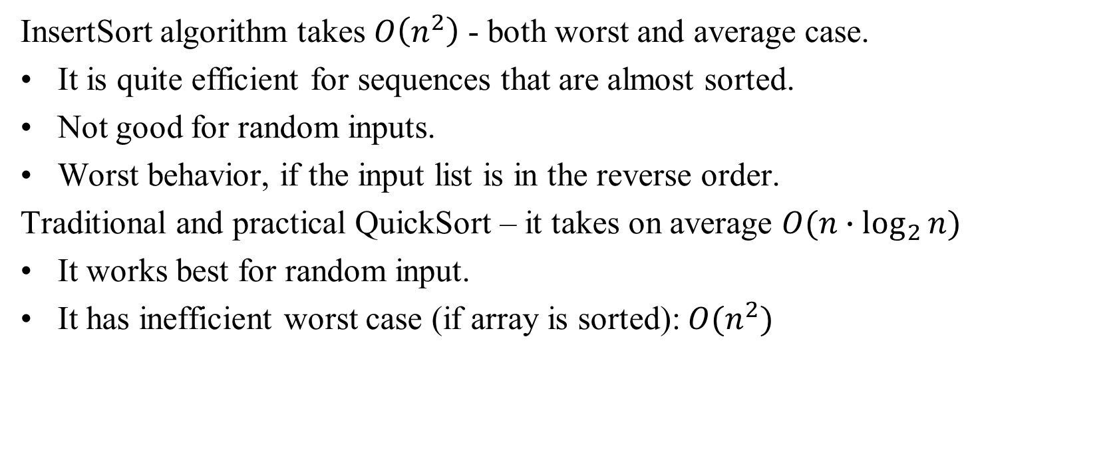
Dependence on the Choice of Data
InsertSort algorithm takes $O\left(n^{2}\right)$ - both worst and average case.
It is quite efficient for sequences that are almost sorted.
Not good for random inputs.
Worst behavior, if the input list is in the reverse order.
Traditional and practical QuickSort – it takes on average $O(n∙\log_{2}{n})$
It works best for random input.
It has inefficient worst case (if array is sorted): $O(n^{2})$

Slide 44
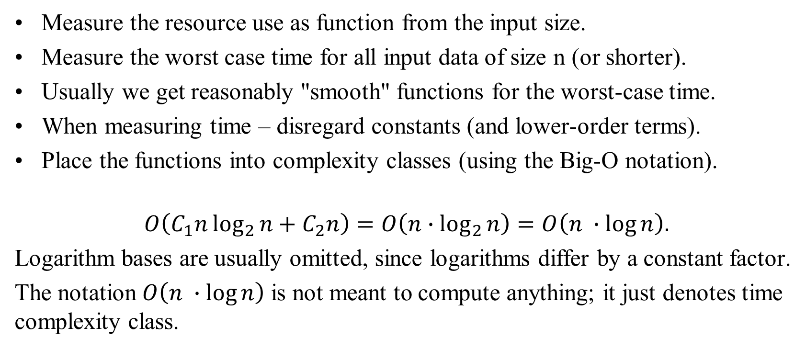
What Inputs Measure Time Complexity?
Measure the resource use as function from the input size.
Measure the worst case time for all input data of size n (or shorter).
Usually we get reasonably "smooth" functions for the worst-case time.
When measuring time – disregard constants (and lower-order terms).
Place the functions into complexity classes (using the Big-O notation).
$$O\left(C_{1}n\log_{2}{n}+C_{2}n\right)=O\left(n∙\log_{2}{n}\right)=O\left(n ∙\log{n}\right).$$
Logarithm bases are usually omitted, since logarithms differ by a constant factor.
The notation $O\left(n ∙\log{n}\right)$ is not meant to compute anything; it just denotes time complexity class.

Slide 45
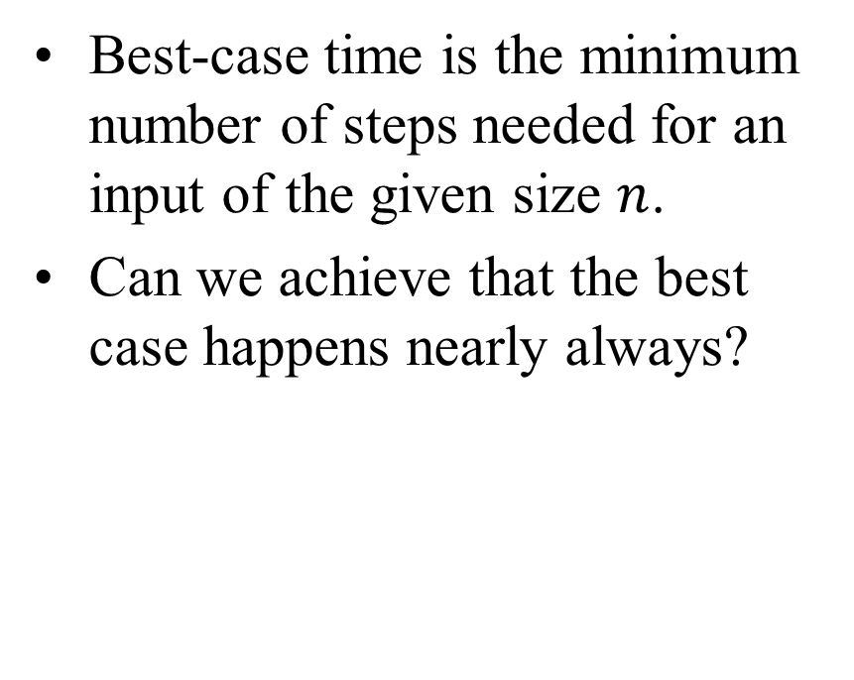
Worst-case and Best-case Analysis
Worst-case time analysis is the max number of steps/operations that may be needed for input data of the given size.
Can investigate, how to avoid these situations (or switch to another algorithm, if they do).
Best-case time is the minimum number of steps needed for an input of the given size $n$.
Can we achieve that the best case happens nearly always?

Slide 46
Finding Asymptotic Complexity
As we have seen, asymptotic bounds are used to determine the time and space efficiency of algorithms
Generally, we are interested in time complexity, which is based on assignments and comparisons in a program
We’ll focus on assignments for the time being
Consider a simple loop:
for (i = sum = 0; i < n; i++)
sum = sum + a[i]
Two assignments are executed once (sum = 0 and i = sum) during initialization
In the loop, sum = sum + a[i] is executed n times

Slide 47
Finding Asymptotic Complexity
(continued)
In addition, the i++ in the loop header is executed n times
So there are 2 + 2n assignments in this loop’s execution and it is O(n)
Typically, as loops are nested, the complexity grows by a factor of n, although this isn’t always the case
Consider
for (i = 0; i < n; i++) {
for (j = 1, sum = a[0]; j <= i; j++)
sum += a[j];
cout << ”sum for subarray 0 through “ << i
<<” is “<<sum<<end1;
}

Slide 48
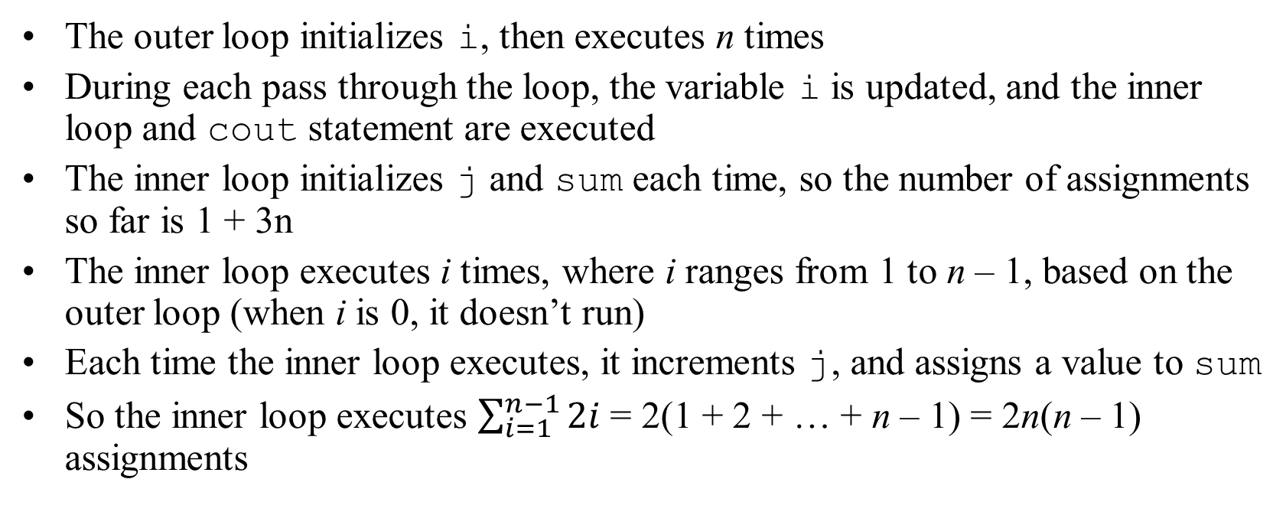
Finding Asymptotic Complexity
(continued)
The outer loop initializes i, then executes n times
During each pass through the loop, the variable i is updated, and the inner loop and cout statement are executed
The inner loop initializes j and sum each time, so the number of assignments so far is 1 + 3n
The inner loop executes i times, where i ranges from 1 to n – 1, based on the outer loop (when i is 0, it doesn’t run)
Each time the inner loop executes, it increments j, and assigns a value to sum
So the inner loop executes $\sum_{i=1}^{n−1}{2i}$ = 2(1 + 2 + … + n – 1) = 2n(n – 1) assignments

Slide 49
Finding Asymptotic Complexity
(continued)
The total number of assignments is then 1 + 3n + 2n(n - 1), which is O(1) + O(n) + O(n²) = O(n²)
As mentioned earlier, not all loops increase complexity, so care has to be taken to analyze the processing that takes place
However, additional complexity can be involved if the number of iterations changes during execution
This can be the case in some of the more powerful searching and sorting algorithms

Slide 50
Best, Average, and Worst Cases
If we want to truly get a handle on the complexity of more complicated algorithms, we need to distinguish three cases:
  Worst case – the algorithm takes the maximum number of steps
  Best case – the algorithm takes the fewest number of steps
  Average case – performance falls between the extremes
For simple situations we can determine the average case by adding together the number of steps required for each input and dividing by the number of inputs
However, this is based on each input occurring with equal probability, which isn’t always likely

Slide 51

Problem: Finding Maximum
Finding the maximum in a list of numbers.
MaxElement(A[0..n-1])
result = A[0]
for i = 1 to n-1 do
if A[i] > maxval
maxval = a[i]
return result
The number of comparisons:
$$C\left(n\right)=\sum_{i=1}^{n−1}{1}=n−1∈Θ\left(n\right).$$

Slide 52
Analyzing non-recursive algorithms
Select the parameter that determines the size of input data.
Determine the basic operations in the algorithm.
Check, if the count of basic operations depends just on the size of input data.
Write a formula (typically, a sum) showing the number of basic operation.
Use summation formulas to simplify the obtained sum.
If possible, determine the asymptotic growth rate of this function.

Slide 53
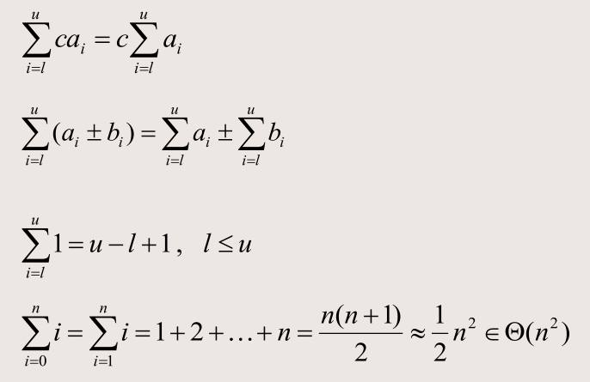
Summation Formulas

Slide 54

Problem: Checking AllUnique
Check if an array contains one copy of each element:
AllUnique (int A[0..n-1]):bool
for i=0 to n–2 do
for j=i+1 to n-1 do
if A[i] = A[j]
return false
return true
Input parameter is the array size $n$
The basic operation is comparison inside if statement.

Slide 55
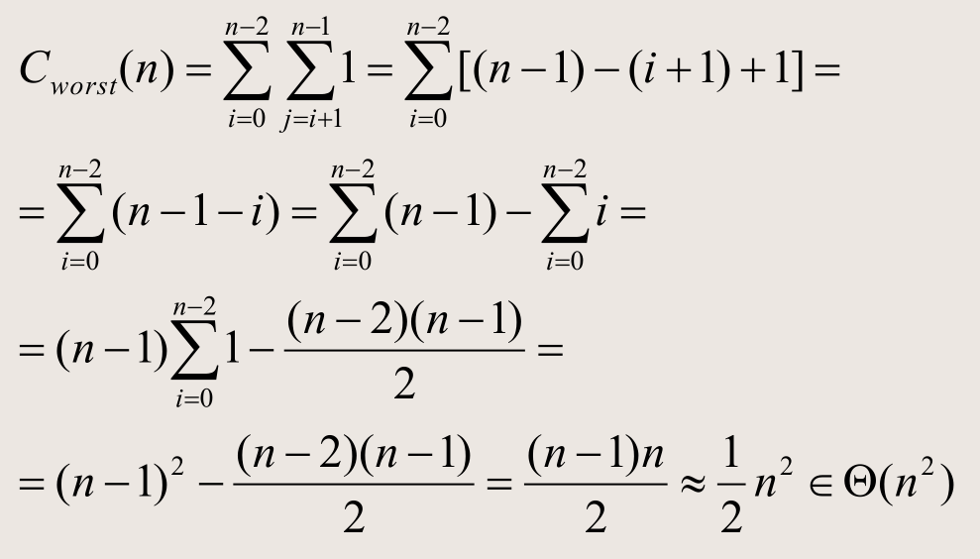



The analysis of the Problem
$$j$$
$$n=6$$
$$i$$

Slide 56
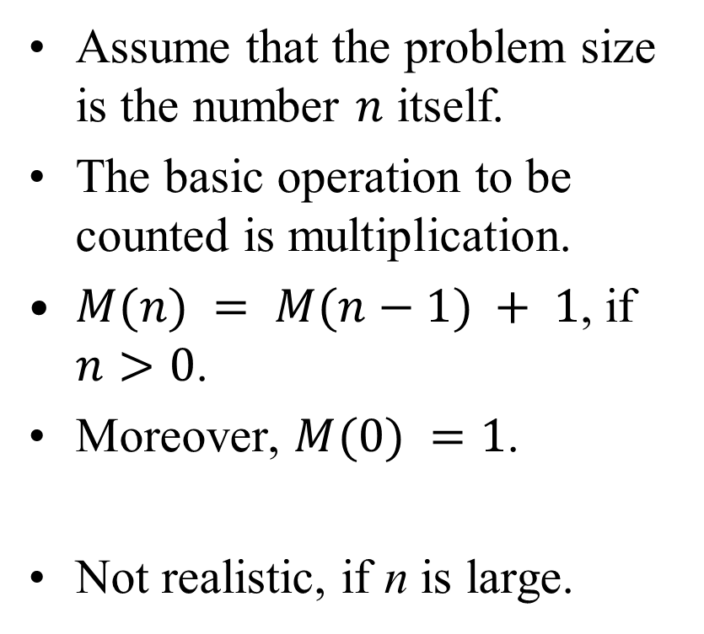
Example: Factorial
Compute factorial n!
Factorial(n):
if n = 0
return 1
else
return Factorial(n-1)*n
Assume that the problem size is the number $n$ itself.
The basic operation to be counted is multiplication.
$M(n) = M(n−1) + 1$, if $n>0$.
Moreover, $M(0) =1$.
Not realistic, if n is large.

Slide 57
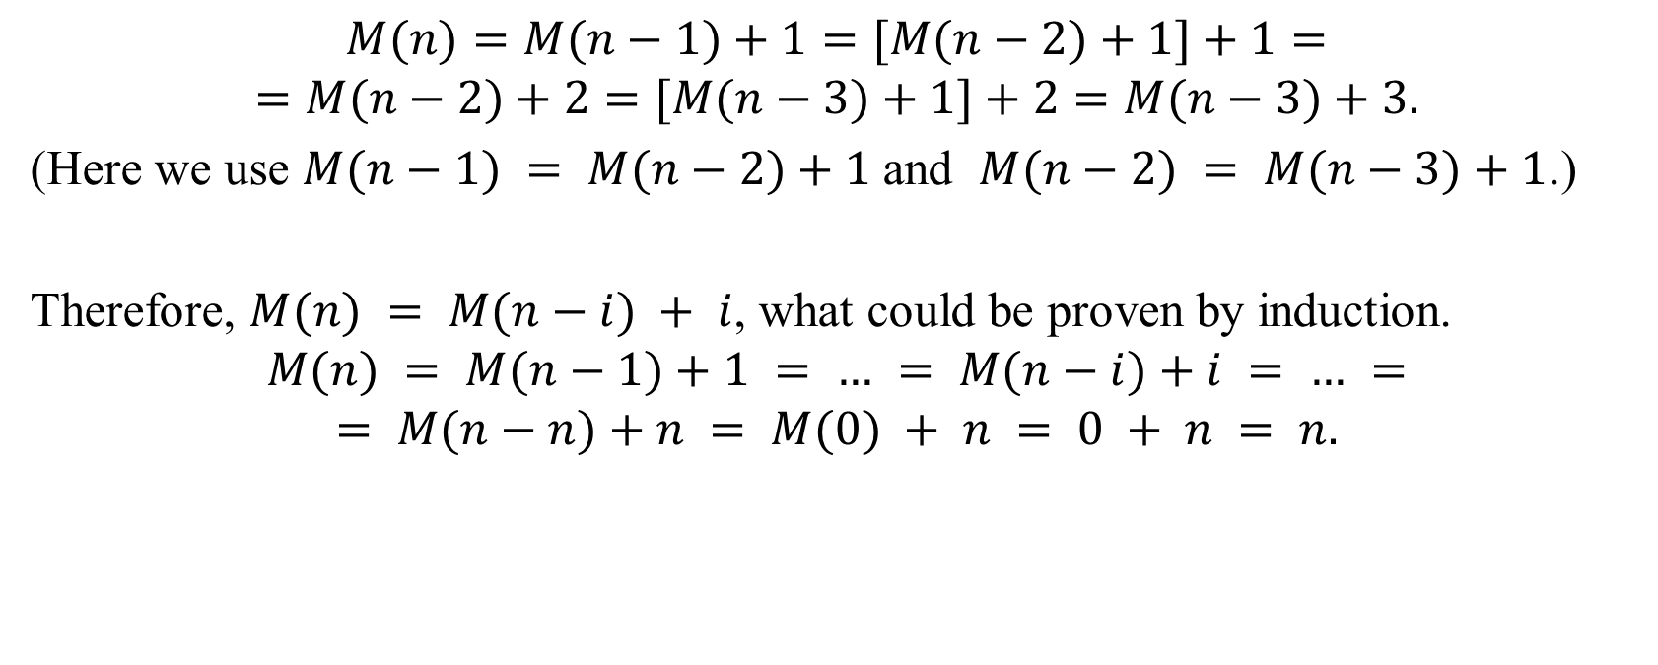
Multiplications in Factorial
$$M(n)=M(n−1)+1=[M(n−2)+1]+1=$$
$$=M(n−2)+2=[M(n−3)+1]+2=M(n−3)+3.$$
(Here we use $M(n−1) = M(n−2)+1$and $M(n−2) = M(n−3)+1$.)
Therefore, $M(n) = M(n−i) + i$, what could be proven by induction.
$$M(n) = M(n−1)+1 = … = M(n−i)+i = … =$$
$$= M(n−n)+n = M(0) + n = 0 + n = n.$$

Slide 58
Analyzing Recursive Algorithm
Determine the parameter for the input data size.
Determine the basic operation of the algorithm.
Check, if the number of basic operations depends only on the input data size.
Write the recurrent equalities to express the count of basic operations.
Try to solve the recurrence – express it with explicit formula.
If solving is difficult, we can use the theorem explained before.

Slide 59
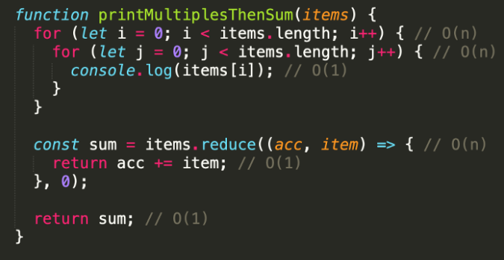
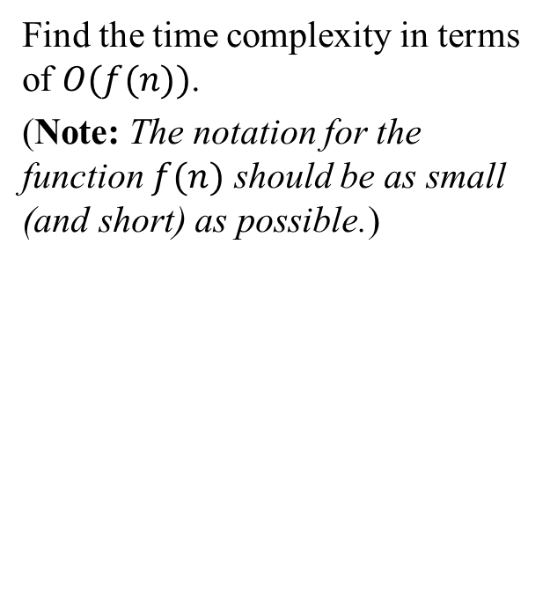
Doing Asymptotics "Inside-Out" – 1
Find the time complexity in terms of $O(f(n))$.
(Note: The notation for the function $f(n)$ should be as small (and short) as possible.)
Notes:
https://medium.com/better-programming/big-o-notation-a-simple-explanation-with-examples-a56347d1daca

Slide 60
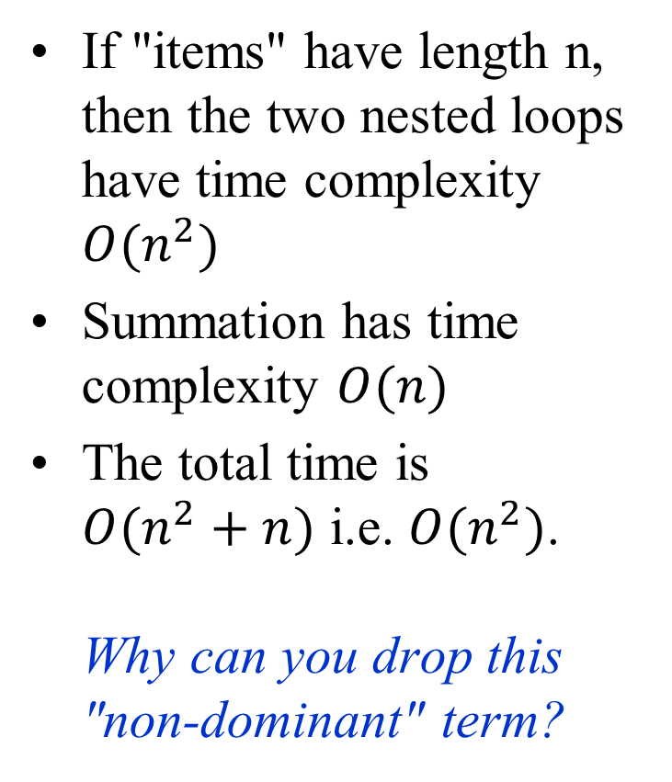
Doing Asymptotics "Inside-Out" – 2
If "items" have length n, then the two nested loops have time complexity $O(n^{2})$
Summation has time complexity $O(n)$
The total time is
$O(n^{2}+n)$ i.e. $O(n^{2})$.
Why can you drop this "non-dominant" term?

