Slide 1
First Year Seminar Fall 2020, Week 10
Kalvis Apsītis

Slide 2
Prototype Grading (max 300 points)
Teamwork (max 50 points): Team Working Agreement Delegation and Task/Issue Management Bookmarks in GitHub. | Functional Specification (50 points) Requirements alligned with Value Proposition. Functional Design document Peer-reviews and reacting to these reviews. | Config. Mgmt. (max 100 points): Orderly procedure to apply changes. "Deliver Early and Often" Testability of your solution. | Iteration Planning (max 50 points): Planning, reviewing and retrospecting your iterations by Agile/Scrum methodology. Iteration 1 Iteration 2 Iteration 3 | Validation/Data (max 50 points): Perceiving real-world feedback. Metrics and Reports External data integration (mandatory for BITL teams)

Slide 3
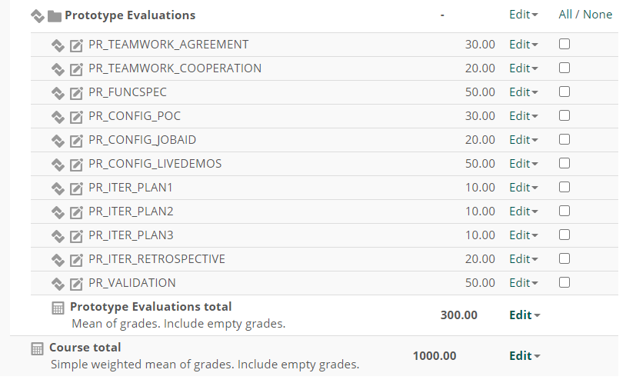
Objectives
Submitted
Team-site
URLs
Func.Spec. submitted
Keep up-to-date
POC = what is technically
challenging
Live Meetings
May also do a deployment guide
You will fill in a Q/A form

Slide 4
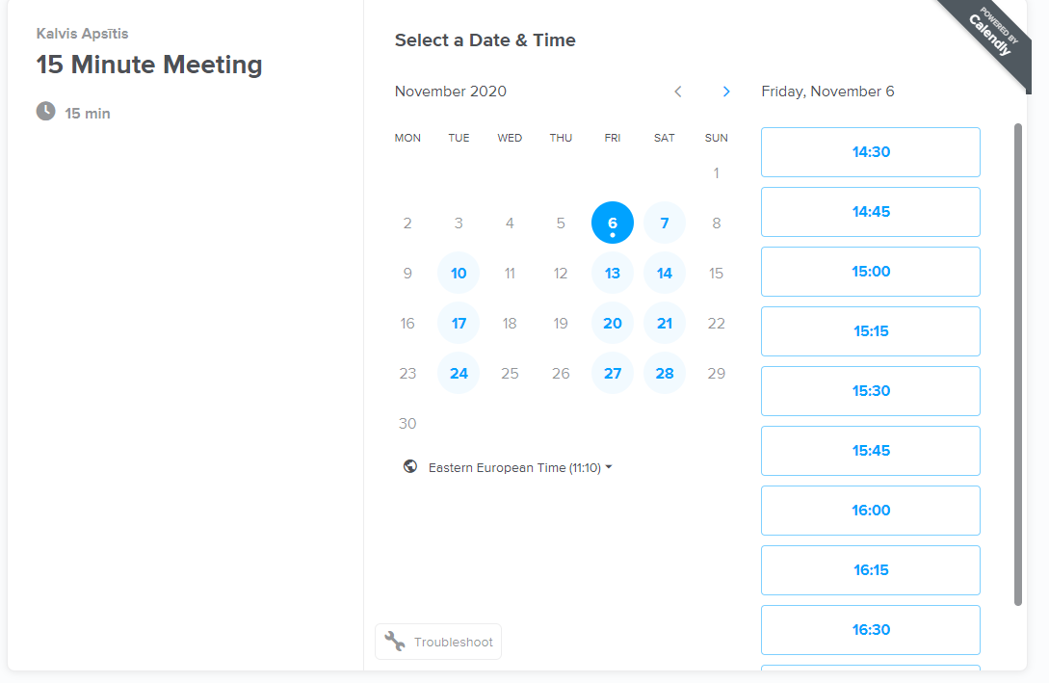
Scheduling a meeting
https://calendly.com/kalvis-apsitis/15min?month=2020-11&date=2020-11-06

Slide 5
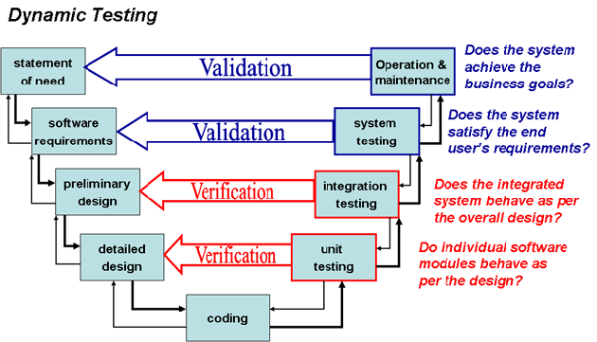
V-Model in Product Development
Today's focus:
Testing, Verification: Check, if it meets requirements you wrote
Validation: Check, if it matches your business goals

Slide 6
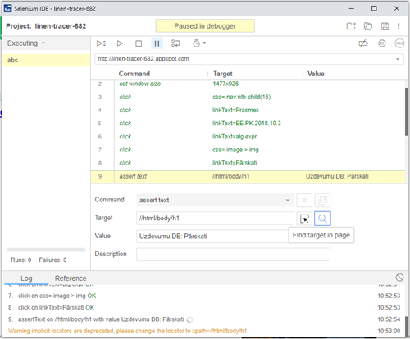
SeleniumDemo
Record a testcase
Add more asserts
Run a testcase, a testsuite
Full Web client automation: can automate "likes", social media posts. The HTTP client is usually indistinguishable from a real (non-robot) user.
"Captchas" can be passed by humans – and the Selenium script can run on.

