Slide 1
First Year Seminar Fall 2020, Week 13
Kalvis Apsītis

Slide 2
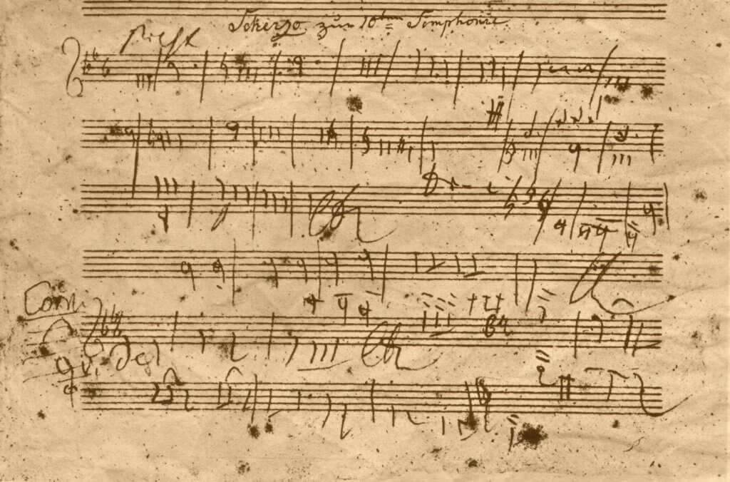
Beethoven's 10th Symphony, Sketch
Your work should go through multiple drafts.
Beta-testing – in programming, in content creation (some stand-up comedians test their jokes, etc.)

Slide 3
Comparison of Presentations (Context and Audience)
Final Presentation
Presented in front of a jury (course instructors, Bauska municipality people)
Focus on Business decisions
10-15 minute presentation (To be clarified). Q&A session.
Typically from a prepared slide-deck.
Goal: High stakes evaluation
Beta-Run Today
Presented in front of other teams (other teams provide feedback to you)
Focus on prototype/validation
5 minute presentation. Questions from other teams.
Live demo and story or slides (up to you)
Goal: Elicit feedback

Slide 4
Final FYS Presentation (Along these Lines on December 11)
Team name, punchline/important message; what have you built.
What are your team members; their responsibilities
What was the initial product/service idea, its stakeholders.
Which investigation steps did you take.
What pivots/iterations brought you to your current idea.
How does your product/service look now; how is it tested and validated?
What is the future of your solution.
What have you learned during this project (what were your initial considerations – what is important to build a good product; what do you think is important now).

Slide 5
The "bare minimum" prototype demo (This is what happens Today)
Proper pitching practices will be covered by Aldis (next week)
This week is just your prototype+validation (to prepare your team for the prime-time)
Introduce yourselves – who you are, what have you built.
Condensed form of your customer value story. The most important customer/stakeholder, the key gains.
A demo of your product and service (Can replace features by screenshots, wireframes and some hand-waving, but stay focused on the flow).
Key developments related to your product: Pivots, iterations, lessons learned, the future prospects.
Some questions from a fellow team; 1 question from the instructor. Your answers should be brief and specific (1 sentence or 1 short paragraph).

Slide 6
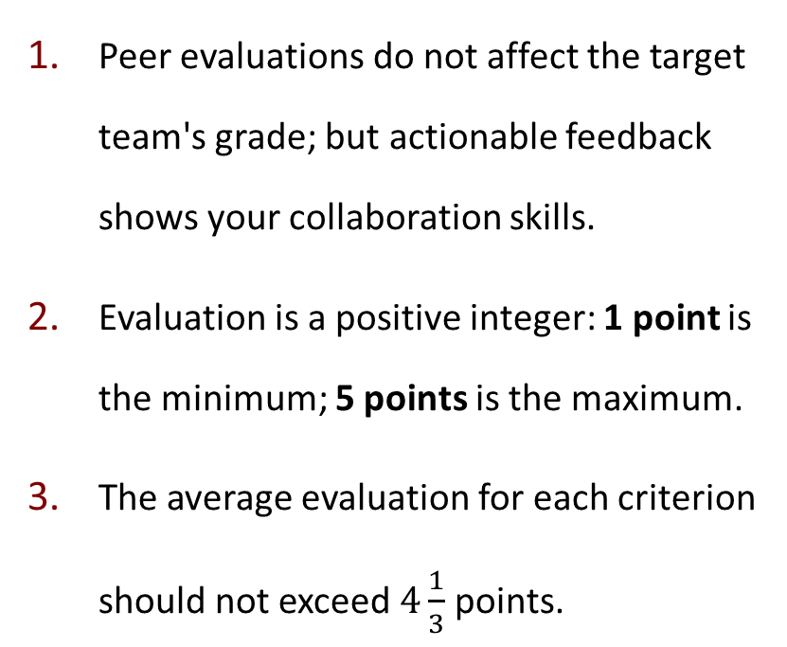
Peer Evaluation Guidelines
Comments accompanying your evaluations are highly appreciated (including praise for max evaluations).
At least one half of your evaluations should contain some comments, suggestions for improvement.
(If you missed some team's presentation or did not understand it, can mark it as non-evaluated – but you should skip no more than 3 presentations).
Peer evaluations do not affect the target team's grade; but actionable feedback shows your collaboration skills.
Evaluation is a positive integer: 1 point is the minimum; 5 points is the maximum.
The average evaluation for each criterion should not exceed $4\frac{1}{3}$ points.

