Slide 1
Predicates and Quantifiers
Section 1.4

Slide 2
Summary
Predicate Logic (First-Order Logic (FOL), Predicate Calculus)
The Language of Quantifiers
Logical Equivalences
Nested Quantifiers
Translation from Predicate Logic to English
Translation from English to Predicate Logic

Slide 3
Section Summary
Predicates
Variables
Quantifiers
Universal Quantifier
Existential Quantifier
Negating Quantifiers
De Morgan’s Laws for Quantifiers
Translating English to Logic
Logic Programming (optional)

Slide 4
Propositional Logic Not Enough
If we have:
“All men are mortal.”
“Socrates is a man.”
Does it follow that “Socrates is mortal?”
Can’t be represented in propositional logic. Need a language that talks about objects, their properties, and their relations.
Later we’ll see how to draw inferences.

Slide 5
Introducing Predicate Logic
Predicate logic uses the following new features:
Variables: x, y, z
Predicates: P(x), M(x)
Quantifiers (to be covered in a few slides):
Propositional functions are a generalization of propositions.
They contain variables and a predicate, e.g., P(x)
Variables can be replaced by elements from their domain.

Slide 6
Propositional Functions
Propositional functions become propositions (and have truth values) when their variables are each replaced by a value from the domain (or bound by a quantifier, as we will see later).
The statement P(x) is said to be the value of the propositional function P at x.
For example, let P(x) denote “x > 0” and the domain be the integers. Then:
P(-3) is false.
P(0) is false.
P(3) is true.
Often the domain is denoted by U. So in this example U is the integers.

Slide 7
Examples of Propositional Functions
Let “x + y = z” be denoted by R(x, y, z) and U (for all three variables) be the integers. Find these truth values:
R(2,-1,5)
Solution: F
R(3,4,7)
Solution: T
R(x, 3, z)
Solution: Not a Proposition
Now let “x - y = z” be denoted by Q(x, y, z), with U as the integers. Find these truth values:
Q(2,-1,3)
Solution: T
Q(3,4,7)
Solution: F
Q(x, 3, z)
Solution: Not a Proposition

Slide 8
Compound Expressions
Connectives from propositional logic carry over to predicate logic.
If P(x) denotes “x > 0,” find these truth values:
P(3) ∨ P(-1) Solution: T
P(3) ∧ P(-1) Solution: F
P(3) → P(-1) Solution: F
P(3) → ¬P(-1) Solution: T
Expressions with variables are not propositions and therefore do not have truth values. For example,
P(3) ∧ P(y)
P(x) → P(y)
When used with quantifiers (to be introduced next), these expressions (propositional functions) become propositions.

Slide 9
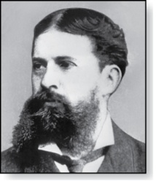
Quantifiers
Charles Peirce (1839-1914)
We need quantifiers to express the meaning of English words including all and some:
“All men are Mortal.”
“Some cats do not have fur.”
The two most important quantifiers are:
Universal Quantifier, “For all,” symbol: ∀
Existential Quantifier, “There exists,” symbol: ∃
We write as in ∀x P(x) and ∃x P(x).
∀x P(x) asserts P(x) is true for every x in the domain.
∃x P(x) asserts P(x) is true for some x in the domain.
The quantifiers are said to bind the variable x in these expressions.

Slide 10
Universal Quantifier
∀x P(x) is read as “For all x, P(x)” or “For every x, P(x)”
Examples:
If P(x) denotes “x > 0” and U is the integers, then ∀x P(x) is false.
If P(x) denotes “x > 0” and U is the positive integers, then ∀x P(x) is true.
If P(x) denotes “x is even” and U is the integers, then ∀ x P(x) is false.

Slide 11
Existential Quantifier
∃x P(x) is read as “For some x, P(x)”, or as “There is an x such that P(x),” or “For at least one x, P(x).”
Examples:
If P(x) denotes “x > 0” and U is the integers, then ∃x P(x) is true. It is also true if U is the positive integers.
If P(x) denotes “x < 0” and U is the positive integers, then ∃x P(x) is false.
If P(x) denotes “x is even” and U is the integers, then ∃x P(x) is true.

Slide 12
Uniqueness Quantifier (optional)
∃!x P(x) means that P(x) is true for one and only one x in the universe of discourse.
This is commonly expressed in English in the following equivalent ways:
“There is a unique x such that P(x).”
“There is one and only one x such that P(x)”
Examples:
If P(x) denotes “x + 1 = 0” and U is the integers, then ∃!x P(x) is true.
But if P(x) denotes “x > 0,” then ∃!x P(x) is false.
The uniqueness quantifier is not really needed as the restriction that there is a unique x such that P(x) can be expressed as:
∃x (P(x) ∧∀y (P(y) → y =x))

Slide 13
Thinking about Quantifiers
When the domain of discourse is finite, we can think of quantification as looping through the elements of the domain.
To evaluate ∀x P(x) loop through all x in the domain.
If at every step P(x) is true, then ∀x P(x) is true.
If at a step P(x) is false, then ∀x P(x) is false and the loop terminates.
To evaluate ∃x P(x) loop through all x in the domain.
If at some step, P(x) is true, then ∃x P(x) is true and the loop terminates.
If the loop ends without finding an x for which P(x) is true, then ∃x P(x) is false.
Even if the domains are infinite, we can still think of the quantifiers this fashion, but the loops will not terminate in some cases.

Slide 14
Thinking about Quantifiers as Conjunctions and Disjunctions
If the domain is finite, a universally quantified proposition is equivalent to a conjunction of propositions without quantifiers and an existentially quantified proposition is equivalent to a disjunction of propositions without quantifiers.
If U consists of the integers 1,2, and 3:
Even if the domains are infinite, you can still think of the quantifiers in this fashion, but the equivalent expressions without quantifiers will be infinitely long.

Slide 15
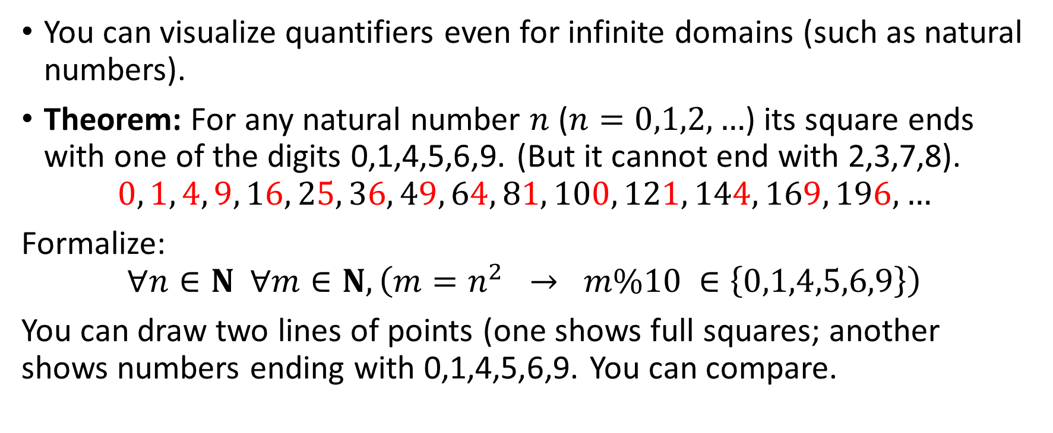
Diagrams for infinite domains
You can visualize quantifiers even for infinite domains (such as natural numbers).
Theorem: For any natural number $n$ ($n=0,1,2,…$) its square ends with one of the digits 0,1,4,5,6,9. (But it cannot end with 2,3,7,8).
$$0, 1, 4, 9, 16, 25, 36, 49, 64, 81, 100, 121, 144, 169, 196,…$$
Formalize:
$$∀n∈N ∀m∈N,\left(m=n^{2} → m\%10 ∈\left\{0,1,4,5,6,9\right\}\right)$$
You can draw two lines of points (one shows full squares; another shows numbers ending with 0,1,4,5,6,9. You can compare.

Slide 16
Properties of Quantifiers
The truth value of ∃x P(x) and ∀ x P(x) depend on both the propositional function P(x) and on the domain U.
Examples:
If U is the positive integers and P(x) is the statement “x < 2”, then ∃x P(x) is true, but ∀ x P(x) is false.
If U is the negative integers and P(x) is the statement “x < 2”, then both ∃x P(x) and ∀ x P(x) are true.
If U consists of 3, 4, and 5, and P(x) is the statement “x > 2”, then both ∃x P(x) and ∀ x P(x) are true. But if P(x) is the statement “x < 2”, then both ∃x P(x) and ∀ x P(x) are false.

Slide 17
Precedence of Quantifiers
The quantifiers ∀ and ∃ have higher precedence than all the logical operators.
For example, ∀x P(x) ∨ Q(x) means (∀x P(x))∨ Q(x)
∀x (P(x) ∨ Q(x)) means something different.
Unfortunately, often people write ∀x P(x) ∨ Q(x) when they mean ∀ x (P(x) ∨ Q(x)).

Slide 18
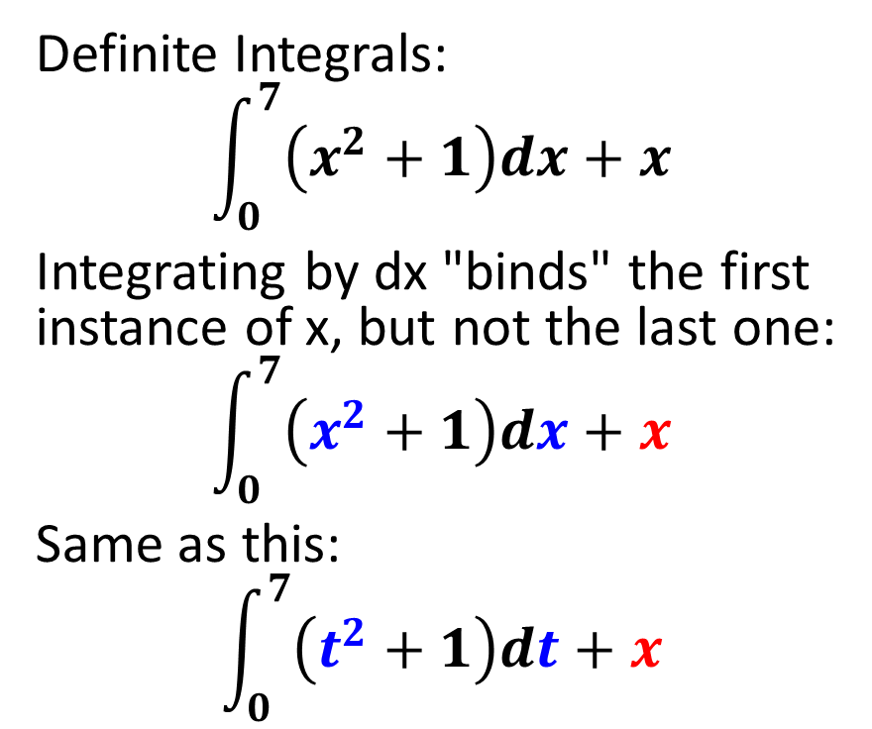
Other Examples of Variable Scope (Optional)
Definite Integrals:
$$\int_{0}^{7}{\left(x^{2}+1\right)dx+x}$$
Integrating by dx "binds" the first instance of x, but not the last one:
$$\int_{0}^{7}{\left(x^{2}+1\right)dx+x}$$
Same as this:
$$\int_{0}^{7}{\left(t^{2}+1\right)dt+x}$$

Slide 19
Socrative Quiz 2A: Precedence and Scope
Visit https://www.socrative.com/
Select Student Login
In the textbox enter room name APSITIS
Write your own name as a test taker.
Just do the test (3 questions)

Slide 20
Translating from English to Logic
Example 1: Translate the following sentence into predicate logic: “Every student in this class has taken a course in Java.”
Solution:
First decide on the domain U.
Solution 1: If U is all students in this class, define a propositional function J(x) denoting “x has taken a course in Java” and translate as ∀x J(x).
Solution 2: But if U is all people, also define a propositional function S(x) denoting “x is a student in this class” and translate as ∀x (S(x)→ J(x)).
∀x (S(x) ∧ J(x)) is not correct. What does it mean?

Slide 21
Translating from English to Logic
Example 2: Translate the following sentence into predicate logic: “Some student in this class has taken a course in Java.”
Solution:
First decide on the domain U.
Solution 1: If U is all students in this class, translate as
∃x J(x)
Solution 2: But if U is all people, then translate as ∃x (S(x) ∧ J(x))
∃x (S(x)→ J(x)) is not correct. What does it mean?

Slide 22
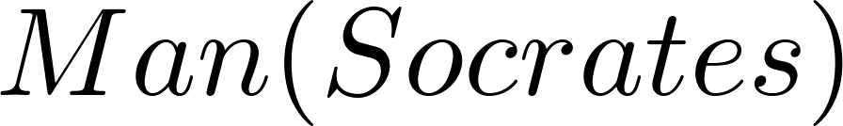
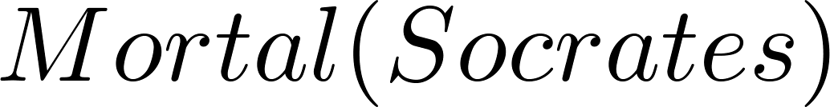
Returning to the Socrates Example
Introduce the propositional functions Man(x) denoting “x is a man” and Mortal(x) denoting “x is mortal.” Specify the domain as all people.
The two premises are:
The conclusion is:
Later we will show how to prove that the conclusion follows from the premises.

Slide 23
Equivalences in Predicate Logic
Statements involving predicates and quantifiers are logically equivalent if and only if they have the same truth value
for every predicate substituted into these statements and
for every domain of discourse used for the variables in the expressions.
The notation S ≡T indicates that S and T are logically equivalent.
Example: ∀x ¬¬S(x) ≡ ∀x S(x)

Slide 24
Negating Quantified Expressions
Consider ∀x J(x)
“Every student in your class has taken a course in Java.”
Here J(x) is “x has taken a course in Java” and
the domain is students in your class.
Negating the original statement gives “It is not the case that every student in your class has taken Java.” This implies that “There is a student in your class who has not taken Java.”
Symbolically ¬∀x J(x) and ∃x ¬J(x) are equivalent

Slide 25
Negating Quantified Expressions (continued)
Now Consider ∃ x J(x)
“There is a student in this class who has taken a course in Java.”
Where J(x) is “x has taken a course in Java.”
Negating the original statement gives “It is not the case that there is a student in this class who has taken Java.” This implies that “Every student in this class has not taken Java”
Symbolically ¬∃ x J(x) and ∀ x ¬J(x) are equivalent

Slide 26
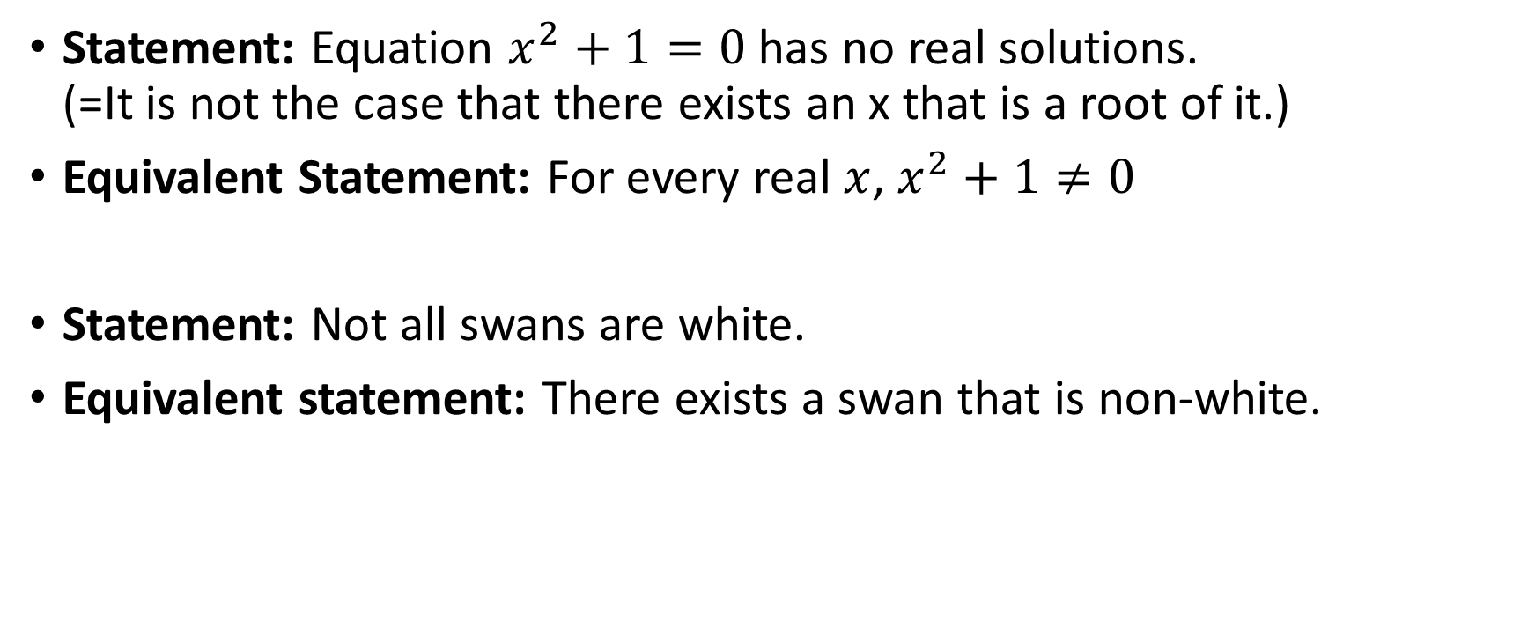
Statement: Equation $x^{2}+1=0$ has no real solutions. (=It is not the case that there exists an x that is a root of it.)
Equivalent Statement: For every real $x$, $x^{2}+1≠0$
Statement: Not all swans are white.
Equivalent statement: There exists a swan that is non-white.

Slide 27

Coq Demo: Propositional Tautology
https://twitter.com/mathslogicbot
Every few hours it tweets a new tautology. Most of them are somewhat boring.
Still, they might need a proof.

Slide 28
Lemma 1: a → ¬ ¬a
Lemma doubleNegation: forall a:Prop, a -> ~~a.
Proof.
intros a.
intros H.
unfold not.
intros H1.
apply H1 in H as H2.
contradiction H2.
Qed.

Slide 29
Lemma Tautology638982
Lemma Tautology638982:
forall a b:Prop, (~~((a <->(b -> b)) -> a)).
Proof.
intros a b.
assert ((a <->(b -> b)) -> a) as H0.
intros H1.
unfold iff in H1.
destruct H1 as [H2 H3].
assert (b -> b) as H4.
intros H5.
exact H5.
apply H3 in H4 as H6.
exact H6.
pose (doubleNegation (a <-> (b -> b) -> a)) as H1.
apply H1 in H0 as H7.
exact H7.
Qed.

Slide 30
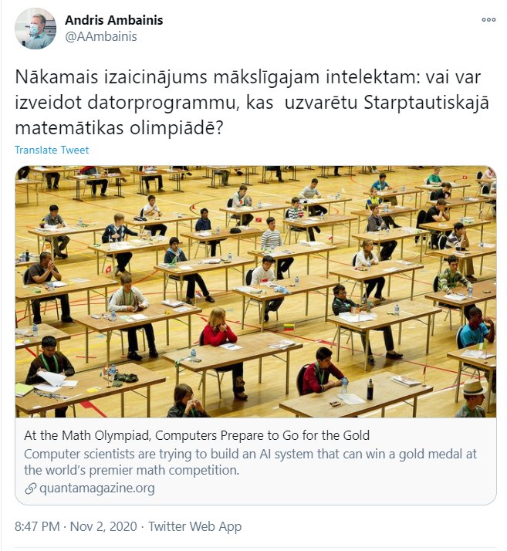
Why use Proof Assistants?
[Andris Ambainis]: The next challenge for the AI: Is there a software solution to win in the IMO (https://www.imo-official.org/ )
QuantaMagazine article: https://bit.ly/2LGnwDz

Slide 31
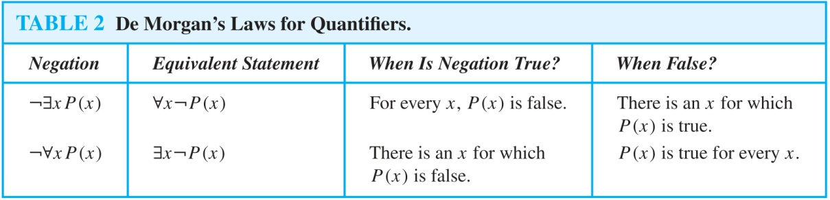
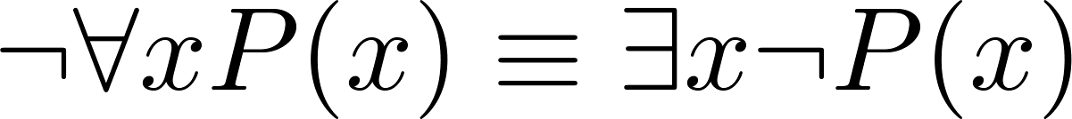
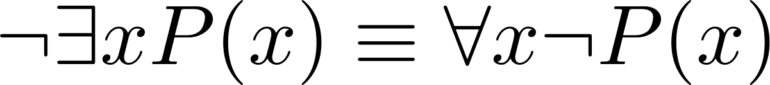
De Morgan’s Laws for Quantifiers
The rules for negating quantifiers are:
The reasoning in the table shows that:
These are important. You will use these.

Slide 32
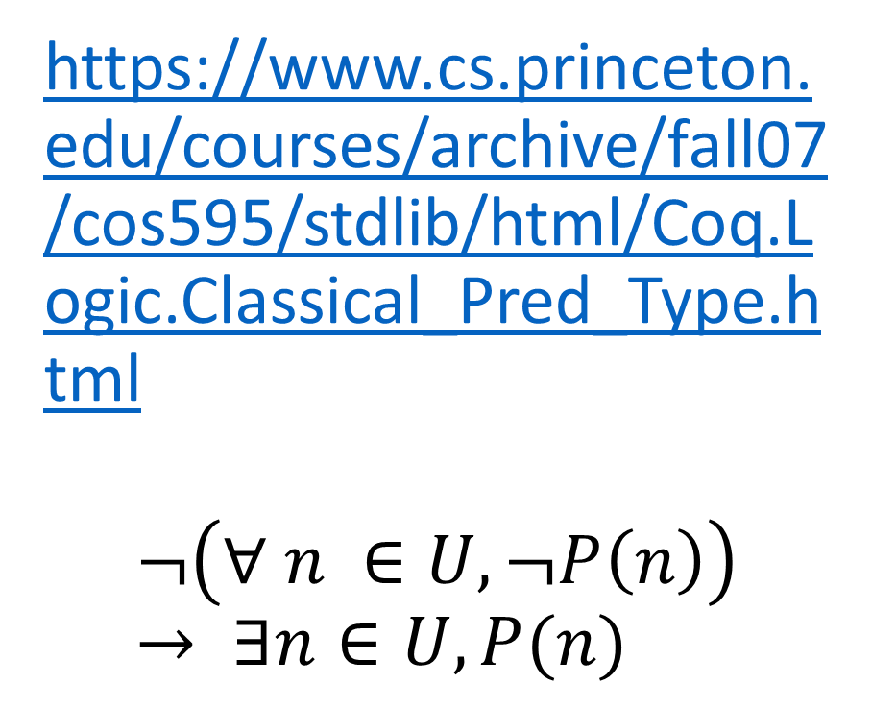
De Morgan's Laws in Proof Assistant
https://www.cs.princeton.edu/courses/archive/fall07/cos595/stdlib/html/Coq.Logic.Classical_Pred_Type.html
$$¬\left(∀ n ∈U, ¬P\left(n\right)\right)→ ∃n∈U, P(n)$$
Variable U : Type.
Require Import Classical_Prop.
Lemma not_all_not_ex :
forall P:U -> Prop, ~ (forall n:U, ~ P n) -> exists n : U, P n.
Proof.
intros P notall.
apply NNPP.
intro abs.
apply notall.
intros n H.
apply abs; exists n; exact H.
Qed.

Slide 33
Translation from English to Logic
Examples:
“Some student in this class has visited Mexico.”
Solution: Let M(x) denote “x has visited Mexico” and S(x) denote “x is a student in this class,” and U be all people.
∃x (S(x) ∧ M(x))
“Every student in this class has visited Canada or Mexico.”
Solution: Add C(x) denoting “x has visited Canada.”
∀x (S(x)→ (M(x)∨C(x)))

Slide 34
Some Fun with Translating from English into Logical Expressions
U = {fleegles, snurds, thingamabobs}
F(x): x is a fleegle
S(x): x is a snurd
T(x): x is a thingamabob
Translate “Everything is a fleegle”
Solution: ∀x F(x)

Slide 35
Translation (cont)
U = {fleegles, snurds, thingamabobs}
F(x): x is a fleegle
S(x): x is a snurd
T(x): x is a thingamabob
“Nothing is a snurd.”
Solution: ¬∃x S(x) What is this equivalent to?
Solution: ∀x ¬ S(x)

Slide 36
Translation (cont)
U = {fleegles, snurds, thingamabobs}
F(x): x is a fleegle
S(x): x is a snurd
T(x): x is a thingamabob
“All fleegles are snurds.”
Solution: ∀x (F(x)→ S(x))

Slide 37
Translation (cont)
U = {fleegles, snurds, thingamabobs}
F(x): x is a fleegle
S(x): x is a snurd
T(x): x is a thingamabob
“Some fleegles are thingamabobs.”
Solution: ∃x (F(x) ∧ T(x))

Slide 38
Translation (cont)
U = {fleegles, snurds, thingamabobs}
F(x): x is a fleegle
S(x): x is a snurd
T(x): x is a thingamabob
“No snurd is a thingamabob.”
Solution: ¬∃x (S(x) ∧ T(x)) What is this equivalent to?
Solution: ∀x (¬S(x) ∨ ¬T(x))

Slide 39
Translation (cont)
U = {fleegles, snurds, thingamabobs}
F(x): x is a fleegle
S(x): x is a snurd
T(x): x is a thingamabob
“If any fleegle is a snurd then it is also a thingamabob.”
Solution: ∀x ((F(x) ∧ S(x))→ T(x))

Slide 40
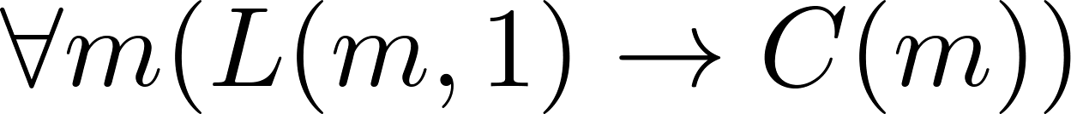
System Specification Example
Predicate logic is used for specifying properties that systems must satisfy.
For example, translate into predicate logic:
“Every mail message larger than one megabyte will be compressed.”
“If a user is active, at least one network link will be available.”
Decide on predicates and domains (left implicit here) for the variables:
Let L(m, y) be “Mail message m is larger than y megabytes.”
Let C(m) denote “Mail message m will be compressed.”
Let A(u) represent “User u is active.”
Let S(n, x) represent “Network link n is state x.
Now we have:

Slide 41
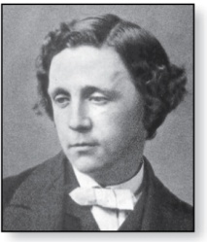
Lewis Carroll Example
Charles Lutwidge Dodgson
(AKA Lewis Caroll)
(1832-1898)
The first two are called premises and the third is called the conclusion.
“All lions are fierce.”
“Some lions do not drink coffee.”
“Some fierce creatures do not drink coffee.”
Here is one way to translate these statements to predicate logic. Let P(x), Q(x), and R(x) be the propositional functions “x is a lion,” “x is fierce,” and “x drinks coffee,” respectively.
∀x (P(x)→ Q(x))
∃x (P(x) ∧ ¬R(x))
∃x (Q(x) ∧ ¬R(x))
Later we will see how to prove that the conclusion follows from the premises.

Slide 42
De Morgan's Laws in Proof Assistant
Lemma carrol: exists x:CRE, isFierce(x) /\ ~drinksCoffee(x).
Proof.
destruct itemB as [myL H].
destruct H as [H1 H2].
exists myL.
split.
apply itemA.
exact H1. exact H2.
Qed.
End lions_coffee.
Section lions_coffee.
(* Set of all creatures *)
Variable CRE: Set.
Variables isLion isFierce drinksCoffee: CRE -> Prop.
(* Our Assumptions *)
Hypothesis itemA: forall x:CRE, isLion(x) -> isFierce(x).
Hypothesis itemB: exists x:CRE, isLion(x) /\ ~drinksCoffee(x).

Slide 43
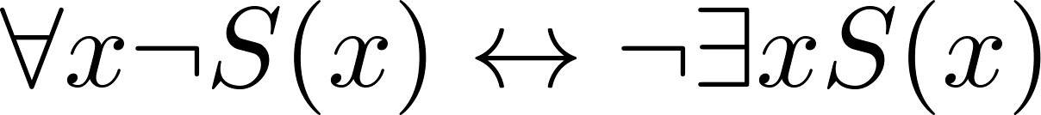
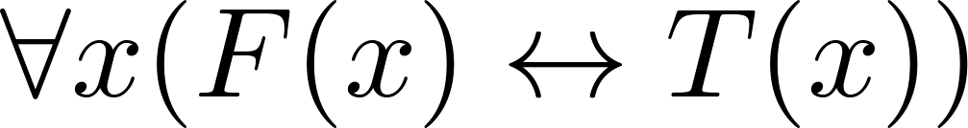
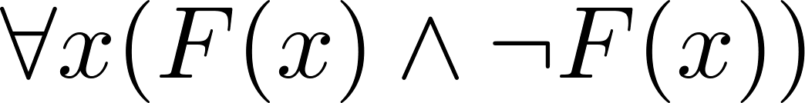
Some Predicate Calculus Definitions (optional)
An assertion involving predicates and quantifiers is valid if it is true
for all domains
every propositional function substituted for the predicates in the assertion.
Example:
An assertion involving predicates is satisfiable if it is true
for some domains
some propositional functions that can be substituted for the predicates in the assertion.
Otherwise it is unsatisfiable.
Example: not valid but satisfiable
Example: unsatisfiable

Slide 44
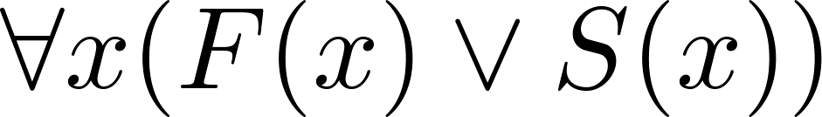
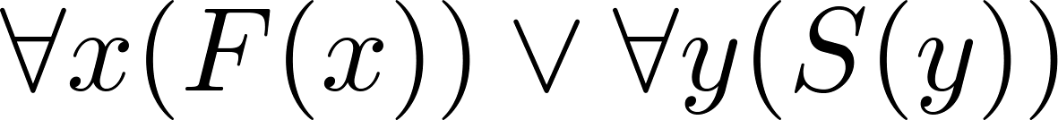
MorePredicate Calculus Definitions (optional)
The scope of a quantifier is the part of an assertion in which variables are bound by the quantifier.
Example: x has wide scope
Example: x has narrow scope

