Slide 1
Set Operations
Section 2.2

Slide 2
Section Summary
Set Operations
Union
Intersection
Complementation
Difference
More on Set Cardinality
Set Identities
Proving Identities
Membership Tables

Slide 3
Boolean Algebra
Propositional calculus and set theory are both instances of an algebraic system called a Boolean Algebra. This is discussed in Chapter 12.
The operators in set theory are analogous to the corresponding operator in propositional calculus.
As always there must be a universal set U. All sets are assumed to be subsets of U.

Slide 4
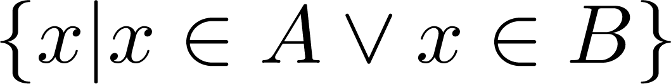
Union
Definition: Let A and B be sets. The union of the sets A and B, denoted by A ∪ B, is the set:
Example: What is {1,2,3} ∪ {3, 4, 5}?
Solution: {1,2,3,4,5}
Venn Diagram for A ∪ B
U
A
B

Slide 5
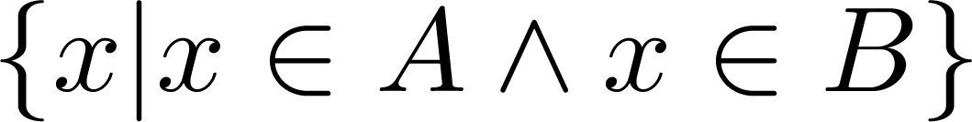
Intersection
Definition: The intersection of sets A and B, denoted by A ∩ B, is
Note if the intersection is empty, then A and B are said to be disjoint.
Example: What is? {1,2,3} ∩ {3,4,5} ?
Solution: {3}
Example:What is?
{1,2,3} ∩ {4,5,6} ?
Solution: ∅
Venn Diagram for A ∩B
U
A
B

Slide 6
Complement
Definition: If A is a set, then the complement of the A (with respect to U), denoted by Ā is the set U - A
Ā = {x ∈ U | x ∉ A}
(The complement of A is sometimes denoted by A^{c} .)
Example: If U is the positive integers less than 100, what is the complement of {x | x > 70}
Solution: {x | x ≤ 70}
Venn Diagram for Complement
U
Ā
A

Slide 7
Difference
Definition: Let A and B be sets. The difference of A and B, denoted by A – B, is the set containing the elements of A that are not in B. The difference of A and B is also called the complement of B with respect to A.
A – B = {x | x ∈ A ∧ x ∉ B} = A ∩‾B
U
Venn Diagram for A − B
A
B

Slide 8
The Cardinality of the Union of Two Sets
U
Inclusion-Exclusion
|A ∪ B| = |A| + | B| − |A ∩ B|
A
B
Venn Diagram for A, B, A ∩ B, A ∪ B
Example: Let A be the math majors in your class and B be the CS majors. To count the number of students who are either math majors or CS majors, add the number of math majors and the number of CS majors, and subtract the number of joint CS/math majors.
We will return to this principle in Chapter 6 and Chapter 8 where we will derive a formula for the cardinality of the union of n sets, where n is a positive integer.

Slide 9
Review Questions
Example: U = {0,1,2,3,4,5,6,7,8,9,10} A = {1,2,3,4,5}, B ={4,5,6,7,8}
A ∪ B
Solution: {1,2,3,4,5,6,7,8}
A ∩ B
Solution: {4,5}
Ā
Solution: {0,6,7,8,9,10}
Solution: {0,1,2,3,9,10}
A – B
Solution: {1,2,3}
B – A
Solution: {6,7,8}

Slide 10


Symmetric Difference (optional)
Definition: The symmetric difference of A and B, denoted by is the set
Example:
U = {0,1,2,3,4,5,6,7,8,9,10}
A = {1,2,3,4,5} B ={4,5,6,7,8}
What is:
Solution: {1,2,3,6,7,8}
U
A
B
Venn Diagram

Slide 11



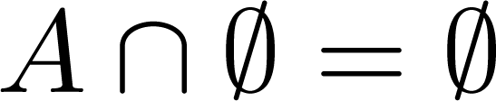


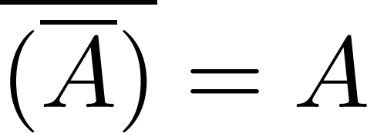
Set Identities
Identity laws
Domination laws
Idempotent laws
Complementation law
Continued on next slide →

Slide 12


Set Identities
Commutative laws
Associative laws
Distributive laws
Continued on next slide →

Slide 13


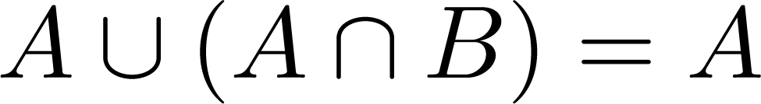
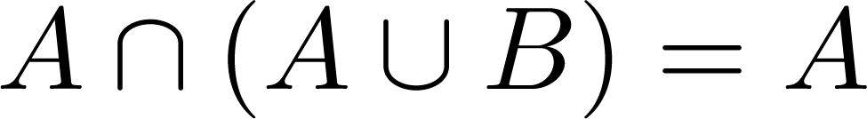

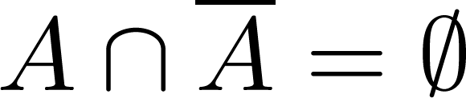
Set Identities
De Morgan’s laws
Absorption laws
Complement laws

Slide 14
Proving Set Identities
Different ways to prove set identities:
Prove that each set (side of the identity) is a subset of the other.
Use set builder notation and propositional logic.
Membership Tables: Verify that elements in the same combination of sets always either belong or do not belong to the same side of the identity. Use 1 to indicate it is in the set and a 0 to indicate that it is not.

Slide 15


Proof of Second De Morgan Law
Example: Prove that
Solution: We prove this identity by showing that:
1) and
2)
Continued on next slide →

Slide 16
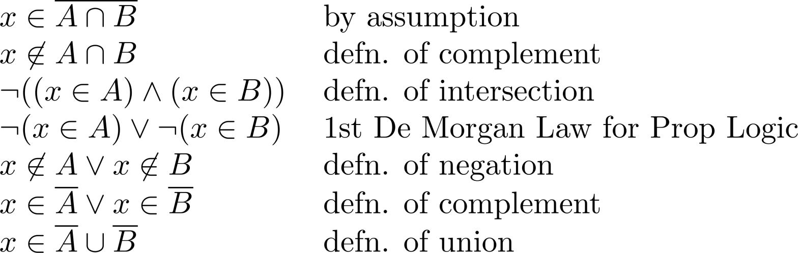
Proof of Second De Morgan Law
These steps show that:
Continued on next slide →

Slide 17
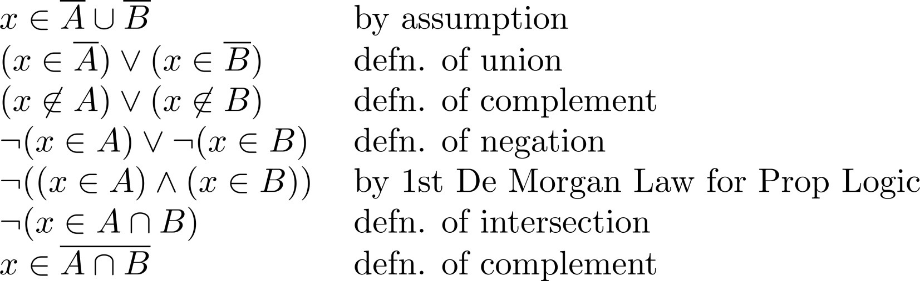
Proof of Second De Morgan Law
These steps show that:

Slide 18
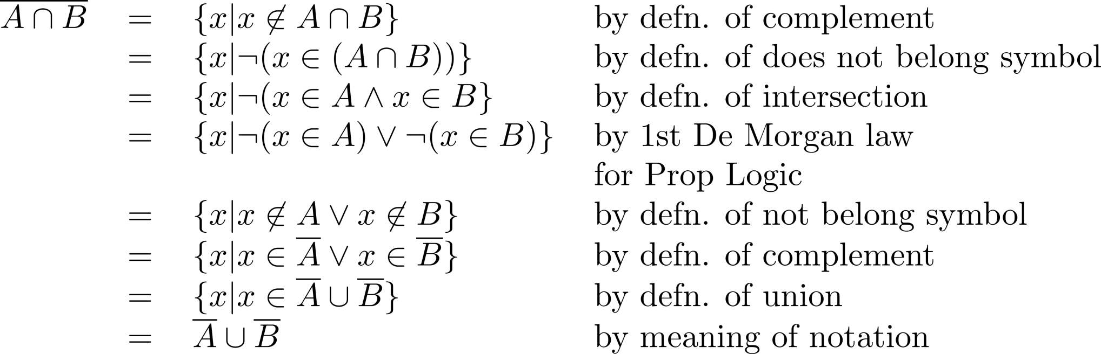
Set-Builder Notation: Second De Morgan Law

Slide 19





Membership Table
Example:
Construct a membership table to show that the distributive law holds.
Solution:
A | B | C
1 | 1 | 1 | 1 | 1 | 1 | 1 | 1
1 | 1 | 0 | 0 | 1 | 1 | 1 | 1
1 | 0 | 1 | 0 | 1 | 1 | 1 | 1
1 | 0 | 0 | 0 | 1 | 1 | 1 | 1
0 | 1 | 1 | 1 | 1 | 1 | 1 | 1
0 | 1 | 0 | 0 | 0 | 1 | 0 | 0
0 | 0 | 1 | 0 | 0 | 0 | 1 | 0
0 | 0 | 0 | 0 | 0 | 0 | 0 | 0

Slide 20
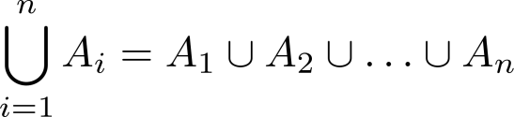
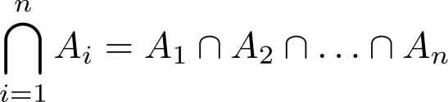
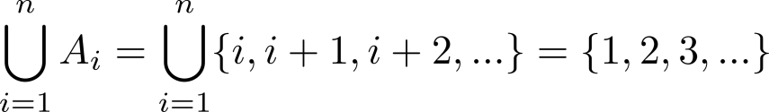
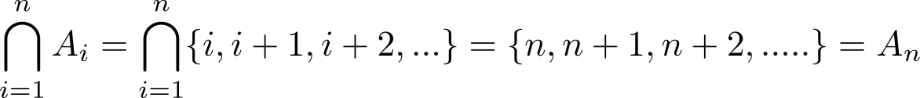
Generalized Unions and Intersections
Let A₁, A₂ ,…, A_{n} be an indexed collection of sets.
We define:
These are well defined, since union and intersection are associative.
For i = 1,2,…, let A_{i} = {i, i + 1, i + 2, ….}. Then,

