Slide 1
Complexity of Algorithms
Section 3.3

Slide 2
Section Summary
Time Complexity
Worst-Case Complexity
Algorithmic Paradigms
Understanding the Complexity of Algorithms

Slide 3
The Complexity of Algorithms
Given an algorithm, how efficient is this algorithm for solving a problem given input of a particular size? To answer this question, we ask:
How much time does this algorithm use to solve a problem?
How much computer memory does this algorithm use to solve a problem?
When we analyze the time the algorithm uses to solve the problem given input of a particular size, we are studying the time complexity of the algorithm.
When we analyze the computer memory the algorithm uses to solve the problem given input of a particular size, we are studying the space complexity of the algorithm.

Slide 4
The Complexity of Algorithms
In this course, we focus on time complexity. The space complexity of algorithms is studied in later courses.
We will measure time complexity in terms of the number of operations an algorithm uses and we will use big-O and big-Theta notation to estimate the time complexity.
We can use this analysis to see whether it is practical to use this algorithm to solve problems with input of a particular size. We can also compare the efficiency of different algorithms for solving the same problem.
We ignore implementation details (including the data structures used and both the hardware and software platforms) because it is extremely complicated to consider them.

Slide 5
Time Complexity
To analyze the time complexity of algorithms, we determine the number of operations, such as comparisons and arithmetic operations (addition, multiplication, etc.). We can estimate the time a computer may actually use to solve a problem using the amount of time required to do basic operations.
We ignore minor details, such as the “house keeping” aspects of the algorithm.
We will focus on the worst-case time complexity of an algorithm. This provides an upper bound on the number of operations an algorithm uses to solve a problem with input of a particular size.
It is usually much more difficult to determine the average case time complexity of an algorithm. This is the average number of operations an algorithm uses to solve a problem over all inputs of a particular size.

Slide 6
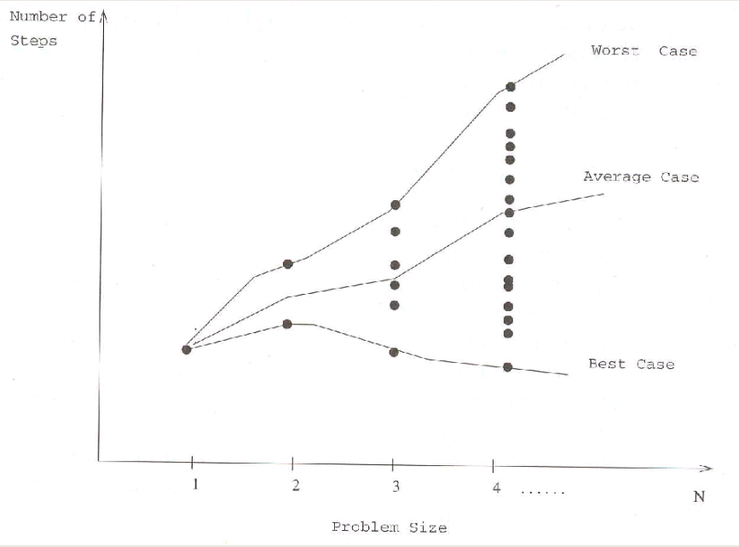
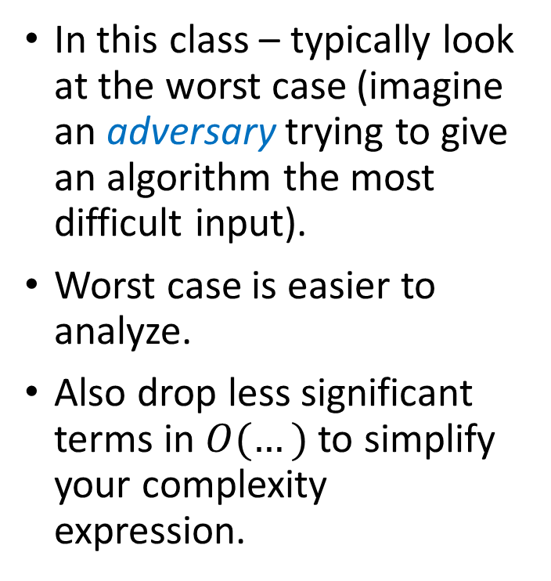
Best/Worst/Average Analysis
In this class – typically look at the worst case (imagine an adversary trying to give an algorithm the most difficult input).
Worst case is easier to analyze.
Also drop less significant terms in $O(…)$to simplify your complexity expression.

Slide 7
Complexity Analysis of Algorithms
Example: Describe the time complexity of the algorithm for finding the maximum element in a finite sequence.
Solution: Count the number of comparisons.
The max < a_{i} comparison is made n − 1 times.
Each time i is incremented, a test is made to see if i ≤ n.
One last comparison determines that i > n.
Exactly 2(n − 1) + 1 = 2n − 1 comparisons are made.
Hence, the time complexity of the algorithm is Θ(n).
procedure max(a₁, a₂, …., a_{n}: integers)
max := a₁
for i := 2 to n
if max < a_{i} then max := a_{i}
return max{max is the largest element}

Slide 8
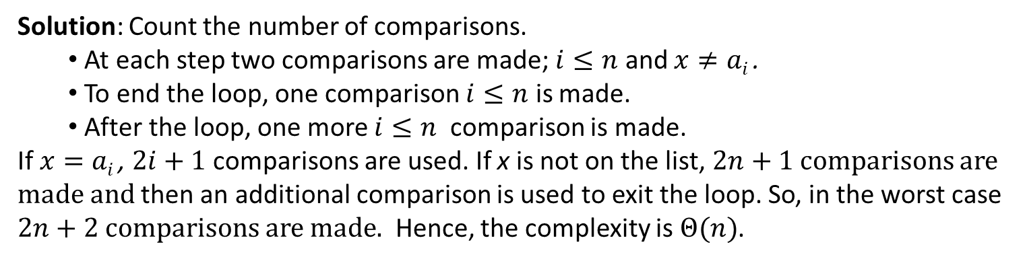
Worst-Case Complexity of Linear Search
Example: Determine the time complexity of the linear search.
procedure linear search(x:integer,
a₁, a₂, …,a_{n}: distinct integers)
i := 1
while (i ≤ n and x ≠ a_{i})
i := i + 1
if i ≤ n then location := i
else location := 0
return location{location is the subscript of the term that equals x, or is 0 if x is not found}
Solution: Count the number of comparisons.
At each step two comparisons are made; $i≤n$ and $x≠ai$ .
To end the loop, one comparison $i≤n$ is made.
After the loop, one more $i≤n$ comparison is made.
If $x=ai$ , $2i+1$ comparisons are used. If x is not on the list, $2n+1$ comparisons are made and then an additional comparison is used to exit the loop. So, in the worst case $2n+2$ comparisons are made. Hence, the complexity is $Θ(n)$.

Slide 9
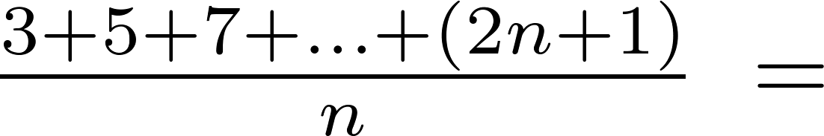
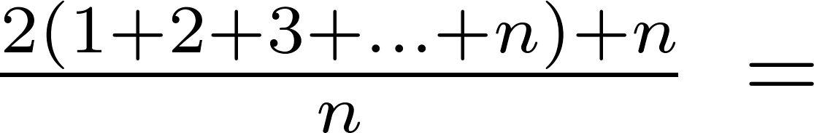
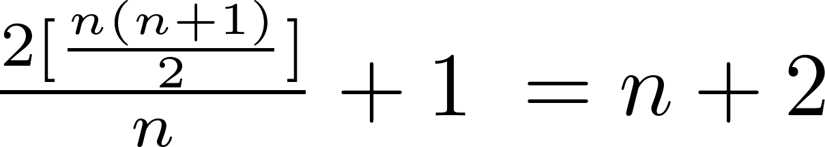
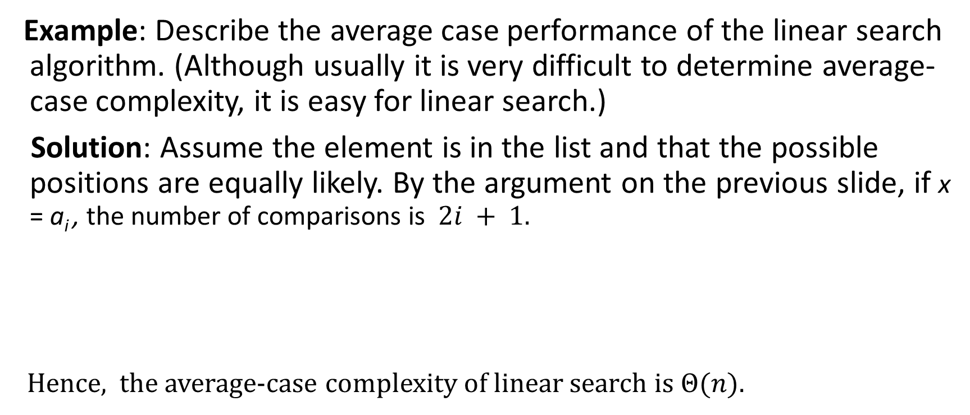
Average-Case Complexity of Linear Search
Example: Describe the average case performance of the linear search algorithm. (Although usually it is very difficult to determine average-case complexity, it is easy for linear search.)
Solution: Assume the element is in the list and that the possible positions are equally likely. By the argument on the previous slide, if x = a_{i} , the number of comparisons is $2i + 1$.
Hence, the average-case complexity of linear search is $Θ(n)$.

Slide 10
Worst-Case Complexity of Binary Search
Example: Describe the time complexity of binary search in terms of the number of comparisons used.
procedure binary search(x: integer, a₁,a₂,…, a_{n}: increasing integers)
i := 1 {i is the left endpoint of interval}
j := n {j is right endpoint of interval}
while i < j
m := ⌊(i + j)/2⌋
if x > a_{m} then i := m + 1
else j := m
if x = a_{i} then location := i
else location := 0
return location{location is the subscript i of the term a_{i} equal to x, or 0 if x is not found}
Solution: Assume (for simplicity) n = 2^{k} elements. Note that k = log n.
Two comparisons are made at each stage; i < j, and x > a_{m} .
At the first iteration the size of the list is 2^{k} and after the first iteration it is 2^{k-1}. Then 2^{k-2} and so on until the size of the list is 2¹ = 2.
At the last step, a comparison tells us that the size of the list is the size is 2⁰ = 1 and the element is compared with the single remaining element.
Hence, at most 2k + 2 = 2 log n + 2 comparisons are made.
Therefore, the time complexity is Θ (log n), better than linear search.

Slide 11
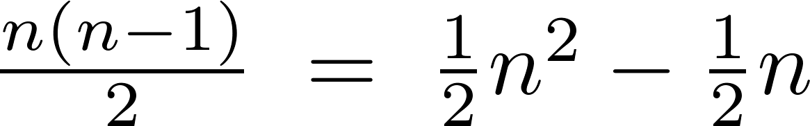



Worst-Case Complexity of Bubble Sort
Example: What is the worst-case complexity of bubble sort in terms of the number of comparisons made?
$$j$$
procedure bubblesort(a₁,…,a_{n}: real numbers
with n ≥ 2)
for i := 1 to n− 1
for j := 1 to n − i
if a_{j} >a_{j+1} then interchange a_{j} and a_{j+1}
{a₁,…, a_{n} is now in increasing order}
$$i$$
$$n=6$$
Solution: A sequence of n−1 passes is made through the list. On each pass n − i comparisons are made.
The worst-case complexity of bubble sort is Θ(n²) since .

Slide 12
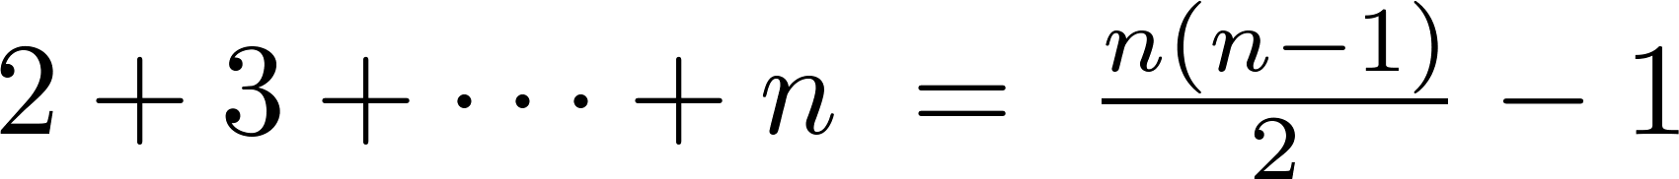
Worst-Case Complexity of Insertion Sort
Example: What is the worst-case complexity of insertion sort in terms of the number of comparisons made?
procedure insertion sort(a₁,…,a_{n}:
real numbers with n ≥ 2)
for j := 2 to n
i := 1
while a_{j} > a_{i}
i := i + 1
m := a_{j}
for k := 0 to j − i − 1
a_{j-k} := a_{j-k-1}
a_{i} := m
Solution: The total number of comparisons are:
Therefore the complexity is Θ(n²).

Slide 13

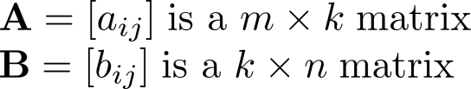
Matrix Multiplication Algorithm
The definition for matrix multiplication can be expressed as an algorithm; C = A B where C is an m n matrix that is the product of the m k matrix A and the k n matrix B.
This algorithm carries out matrix multiplication based on its definition.
procedure matrix multiplication(A,B: matrices)
for i := 1 to m
for j := 1 to n
c_{ij} := 0
for q := 1 to k
c_{ij} := c_{ij} + a_{iq} b_{qj}
return C{C = [c_{ij}] is the product of A and B}

Slide 14
Complexity of Matrix Multiplication
Example: How many additions of integers and multiplications of integers are used by the matrix multiplication algorithm to multiply two n n matrices.
Solution: There are n² entries in the product. Finding each entry requires n multiplications and n − 1 additions. Hence, n³ multiplications and n²(n − 1) additions are used.
Hence, the complexity of matrix multiplication is O(n³).

Slide 15
Boolean Product Algorithm
The definition of Boolean product of zero-one matrices can also be converted to an algorithm.
procedure Boolean product(A,B: zero-one matrices)
for i := 1 to m
for j := 1 to n
c_{ij} := 0
for q := 1 to k
c_{ij} := c_{ij} ∨ (a_{iq} ∧ b_{qj})
return C{C = [c_{ij}] is the Boolean product of A and B}

Slide 16
Complexity of Boolean Product Algorithm
Example: How many bit operations are used to find A ⊙ B, where A and B are n n zero-one matrices?
Solution: There are n² entries in the A ⊙ B. A total of n Ors and n ANDs are used to find each entry. Hence, each entry takes 2n bit operations. A total of 2n³ operations are used.
Therefore the complexity is O(n³)

Slide 17
Matrix-Chain Multiplication
How should the matrix-chain A₁A₂∙ ∙ ∙A_{n} be computed using the fewest multiplications of integers, where A₁ , A₂ , ∙ ∙ ∙ , A_{n} are m₁ m₂, m₂ m₃ , ∙ ∙ ∙ m_{n} m_{n+1} integer matrices. Matrix multiplication is associative (exercise in Section 2.6).
Example: In which order should the integer matrices A₁A₂A₃ - where A₁ is 30 20 , A₂ 20 40, A₃ 40 10 - be multiplied to use the least number of multiplications.
Solution: There are two possible ways to compute A₁A₂A₃.
A₁(A₂A₃): A₂A₃ takes 20 ∙ 40 ∙ 10 = 8000 multiplications. Then multiplying A₁ by the 20 10 matrix A₂A₃ takes 30 ∙ 20 ∙ 10 = 6000 multiplications. So the total number is 8000 + 6000 = 14,000.
(A₁A₂)A₃: A₁A₂ takes 30 ∙ 20 ∙ 40 = 24,000 multiplications. Then multiplying the 30 40 matrix A₁A₂ by A₃ takes 30 ∙ 40 ∙ 10 = 12,000 multiplications. So the total number is 24,000 + 12,000 = 36,000.
So the first method is best.
An efficient algorithm for finding the best order for matrix-chain multiplication can be based on the algorithmic paradigm known as dynamic programming. (see Ex. 57 in Section 8.1)

Slide 18
Algorithmic Paradigms
An algorithmic paradigm is a a general approach based on a particular concept for constructing algorithms to solve a variety of problems.
Greedy algorithms were introduced in Section 3.1.
We discuss brute-force algorithms in this section.
We will see divide-and-conquer algorithms (Chapter 8), dynamic programming (Chapter 8), backtracking (Chapter 11), and probabilistic algorithms (Chapter 7). There are many other paradigms that you may see in later courses.

Slide 19
Brute-Force Algorithms
A brute-force algorithm is solved in the most straightforward manner, without taking advantage of any ideas that can make the algorithm more efficient.
Brute-force algorithms we have previously seen are sequential search, bubble sort, and insertion sort.

Slide 20
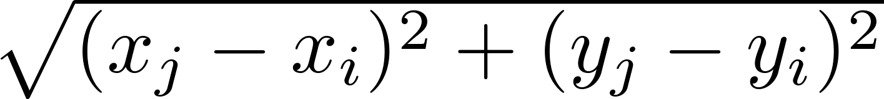
Computing the Closest Pair of Points by Brute-Force
Example: Construct a brute-force algorithm for finding the closest pair of points in a set of n points in the plane and provide a worst-case estimate of the number of arithmetic operations.
Solution: Recall that the distance between (x_{i},y_{i}) and (x_{j}, y_{j}) is
A brute-force algorithm simply computes the distance between all pairs of points and picks the pair with the smallest distance.
Note: There is no need to compute the square root, since the square of the distance between two points is smallest when the distance is smallest.
Continued →

Slide 21
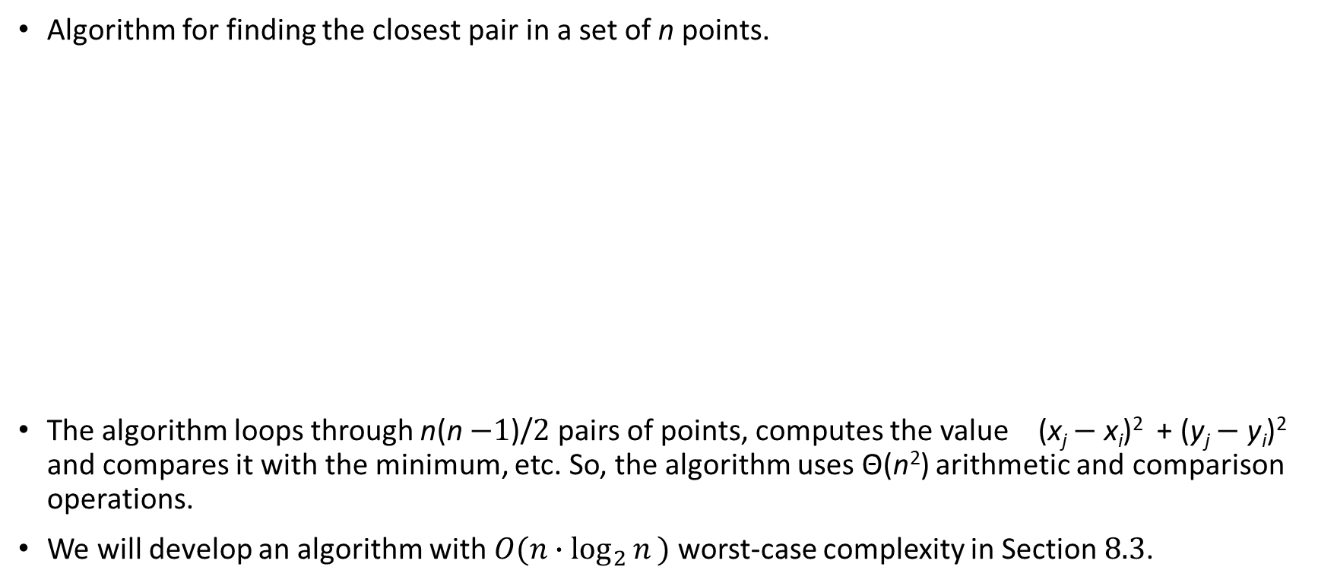
Computing the Closest Pair of Points by Brute-Force
Algorithm for finding the closest pair in a set of n points.
The algorithm loops through n(n −1)/2 pairs of points, computes the value (x_{j} − x_{i})² + (y_{j} − y_{i})² and compares it with the minimum, etc. So, the algorithm uses Θ(n²) arithmetic and comparison operations.
We will develop an algorithm with $O(n∙\log_{2}{n}⁡)$ worst-case complexity in Section 8.3.
procedure closest pair((x₁, y₁), (x₂, y₂), … ,(x_{n}, y_{n}): x_{i}, y_{i} real numbers)
min = ∞
for i := 1 to n
for j := 1 to i
if (x_{j} − x_{i})² + (y_{j} − y_{i})² < min
then min := (x_{j} − x_{i})² + (y_{j} − y_{i})²
closest pair := (x_{i}, y_{i}), (x_{j}, y_{j})
return closest pair

Slide 22
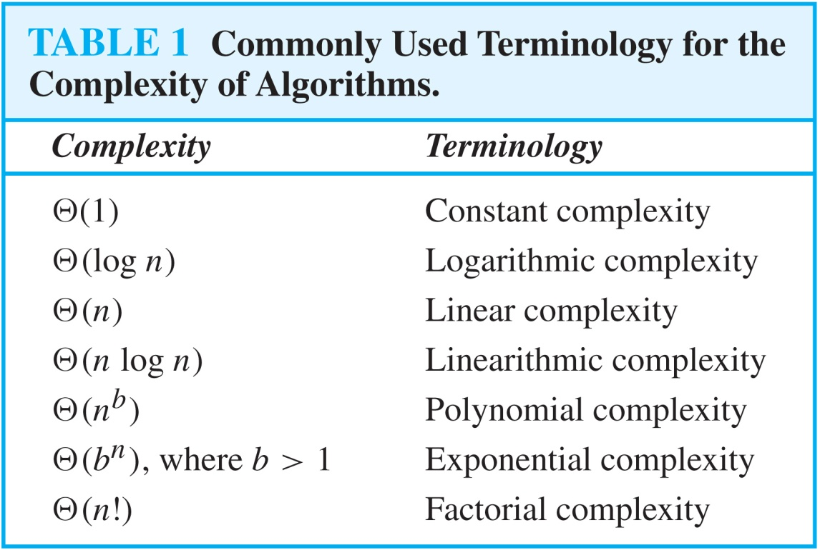
Understanding the Complexity of Algorithms

Slide 23
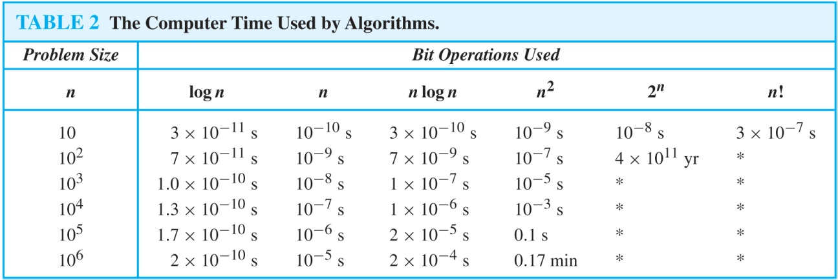
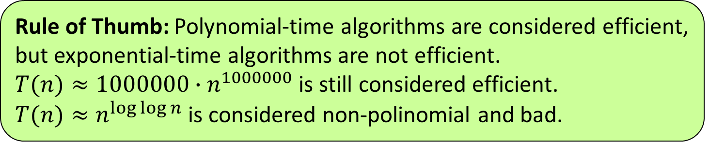
Understanding the Complexity of Algorithms
Times of more than 10¹⁰⁰ years are indicated with an *.
Rule of Thumb: Polynomial-time algorithms are considered efficient, but exponential-time algorithms are not efficient.
$T(n)≈1000000∙n^{1000000}$ is still considered efficient.
$T(n){≈n}^{\log{\log{n}}}$ is considered non-polinomial and bad.

Slide 24

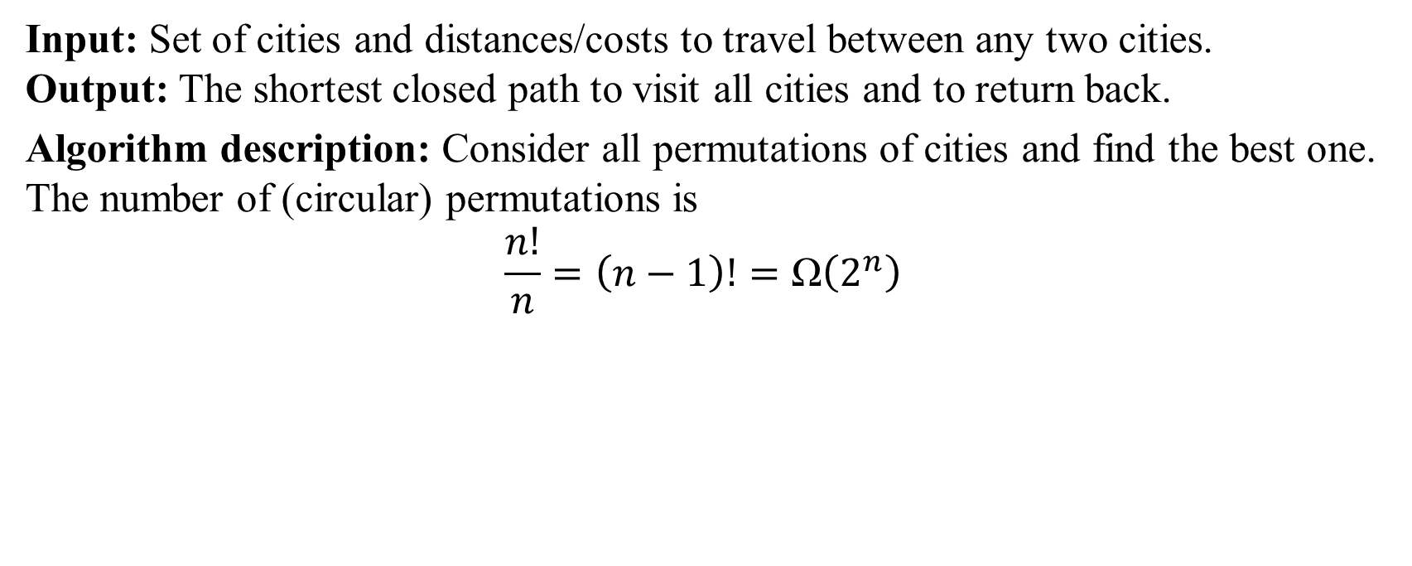
Problem: Traveling Salesman
Input: Set of cities and distances/costs to travel between any two cities. Output: The shortest closed path to visit all cities and to return back.
Algorithm description: Consider all permutations of cities and find the best one. The number of (circular) permutations is
$$\frac{n!}{n}=\left(n−1\right)!=\text{Ω}\left(2^{n}\right)$$
Notes:
This part did not fit in our course.

Slide 25
Complexity of Problems
Tractable Problem: There exists a polynomial time algorithm to solve this problem. These problems are said to belong to the Class P.
Intractable Problem: There does not exist a polynomial time algorithm to solve this problem
Unsolvable Problem : No algorithm exists to solve this problem, e.g., halting problem.
Class NP: Solution can be checked in polynomial time. But no polynomial time algorithm has been found for finding a solution to problems in this class.
NP Complete Class: If you find a polynomial time algorithm for one member of the class, it can be used to solve all the problems in the class.

Slide 26

P Versus NP Problem
Stephen Cook
(Born 1939)
The P versus NP problem asks whether the class P = NP? Are there problems whose solutions can be checked in polynomial time, but can not be solved in polynomial time?
Note that just because no one has found a polynomial time algorithm is different from showing that the problem can not be solved by a polynomial time algorithm.
If a polynomial time algorithm for any of the problems in the NP complete class were found, then that algorithm could be used to obtain a polynomial time algorithm for every problem in the NP complete class.
Satisfiability (in Section 1.3) is an NP complete problem.
It is generally believed that P≠NP since no one has been able to find a polynomial time algorithm for any of the problems in the NP complete class.
The problem of P versus NP remains one of the most famous unsolved problems in mathematics (including theoretical computer science). The Clay Mathematics Institute has offered a prize of $1,000,000 for a solution.

Slide 27
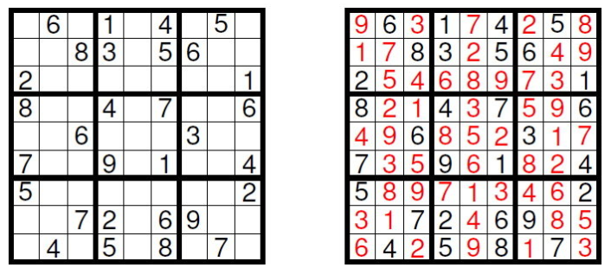
Non-deterministic Time Analysis
Nondeterministic algorithm (not to be confused with probabilistic) assumes that it is incredibly lucky. It can generate answer randomly – then checks it in polynomial time.
For a decision problem (YES/NO question) there exists a way to guess so as to say YES (but can also fail). If the true answer is NO, it always fails.
Notes:
[The Eternal Battle between Determinism and Non-Determinism by Francesco Calimeri](https://www.researchgate.net/figure/Example-of-Sudoku-puzzle-left-with-its-solution-right_fig1_301551207).
Image (c) Calimeri2013

Slide 28
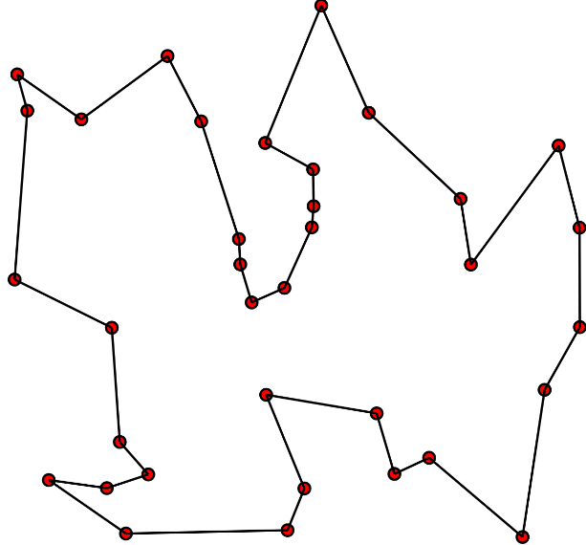
P = NP?
Many important problems (apart from a large-size sudoku!) can be solved in "non-deterministically polinomial" time.
Traveling salesman can guess his cyclical path (then verify, if it fits the money available).
Nobody knows, if efficient regular algorithm exists for traveling salesman.
Can the non-deterministic polynomial problems (sudoku, traveling salesman) be solved in polynomial time?
If one can be – then they all can.
Famous open question.

