Slide 1
Integer Representations and Algorithms
Section 4.2

Slide 2
Section Summary
Integer Representations
Base b Expansions
Binary Expansions
Octal Expansions
Hexadecimal Expansions
Base Conversion Algorithm
Algorithms for Integer Operations

Slide 3
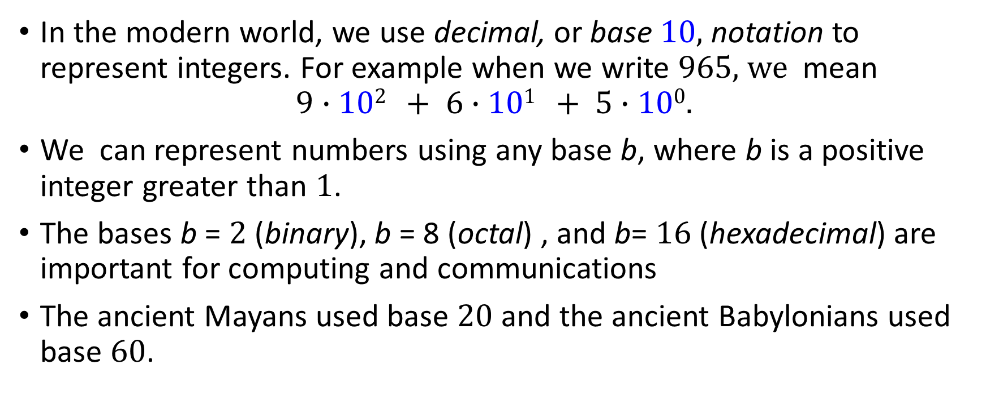
Representations of Integers
In the modern world, we use decimal, or base 10, notation to represent integers. For example when we write 965, we mean
$$9∙102 + 6∙101 + 5∙100.$$
We can represent numbers using any base b, where b is a positive integer greater than 1.
The bases b = 2 (binary), b = 8 (octal) , and b= 16 (hexadecimal) are important for computing and communications
The ancient Mayans used base 20 and the ancient Babylonians used base 60.

Slide 4
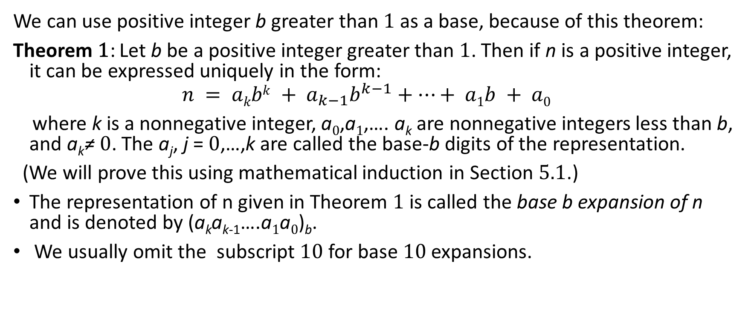
Base b Representations
We can use positive integer b greater than 1 as a base, because of this theorem:
Theorem 1: Let b be a positive integer greater than 1. Then if n is a positive integer, it can be expressed uniquely in the form:
$$n = akbk + a_{k−1}b^{k−1}+⋯+ a1b + a0$$
where k is a nonnegative integer, a₀,a₁,…. a_{k} are nonnegative integers less than b, and a_{k}≠ 0. The a_{j}, j = 0,…,k are called the base-b digits of the representation.
(We will prove this using mathematical induction in Section 5.1.)
The representation of n given in Theorem 1 is called the base b expansion of n and is denoted by (a_{k}a_{k-1}….a₁a₀)_{b}.
We usually omit the subscript 10 for base 10 expansions.

Slide 5
Binary Expansions
Computers represent integers and do arithmetic with binary (base 2) expansions of integers. In these expansions, only digits 0 and 1 are used.
Example: What is the decimal expansion of the integer that has (1 0101 1111)₂ as its binary expansion?
Solution:
(1 0101 1111)₂ = 1∙2⁸ + 0∙2⁷ + 1∙2⁶ + 0∙2⁵ + 1∙2⁴ + 1∙2³ + 1∙2² + 1∙2¹ + 1∙2⁰ =351.
Example: What is the decimal expansion of the integer that has (11011)₂ as its binary expansion?
Solution: (11011)₂ = 1 ∙2⁴ + 1∙2³ + 0∙2² + 1∙2¹ + 1∙2⁰ =27.

Slide 6
Octal Expansions
The octal expansion (base 8) uses the digits {0,1,2,3,4,5,6,7}.
Example: What is the decimal expansion of the number with octal expansion (7016)₈ ?
Solution: 7∙8³ + 0∙8² + 1∙8¹ + 6∙8⁰ =3598
Example: What is the decimal expansion of the number with octal expansion (111)₈ ?
Solution: 1∙8² + 1∙8¹ + 1∙8⁰ = 64 + 8 + 1 = 73

Slide 7
Hexadecimal Expansions
The hexadecimal expansion needs 16 digits, but our decimal system provides only 10. So letters are used for the additional symbols. The hexadecimal system uses the digits {0,1,2,3,4,5,6,7,8,9,A,B,C,D,E,F}. The letters A through F represent the decimal numbers 10 through 15.
Example: What is the decimal expansion of the number with hexadecimal expansion (2AE0B)₁₆ ?
Solution:
2∙16⁴ + 10∙16³ + 14∙16² + 0∙16¹ + 11∙16⁰ =175627 (
Example: What is the decimal expansion of the number with hexadecimal expansion (E5)₁₆ ?
Solution: 14∙16¹ + 5∙16⁰ = 224 + 5 = 229

Slide 8
Base Conversion
To construct the base b expansion of an integer n:
Divide n by b to obtain a quotient and remainder.
n = bq₀ + a₀ 0 ≤ a₀ ≤ b
The remainder, a₀ , is the rightmost digit in the base b expansion of n. Next, divide q₀ by b.
q₀ = bq₁ + a₁ 0 ≤ a₁ ≤ b
The remainder, a₁, is the second digit from the right in the base b expansion of n.
Continue by successively dividing the quotients by b, obtaining the additional base b digits as the remainder. The process terminates when the quotient is 0.
continued →

Slide 9
Algorithm: Constructing Base b Expansions
q represents the quotient obtained by successive divisions by b, starting with q = n.
The digits in the base b expansion are the remainders of the division given by q mod b.
The algorithm terminates when q = 0 is reached.
procedure base b expansion(n, b: positive integers with b > 1)
q := n
k := 0
while (q ≠ 0)
a_{k} := q mod b
q := q div b
k := k + 1
return(a_{k-1} ,…, a₁,a₀){(a_{k-1} … a₁a₀)_{b} is base b expansion of n}

Slide 10
Base Conversion
Example: Find the octal expansion of (12345)₁₀
Solution: Successively dividing by 8 gives:
12345 = 8 ∙ 1543 + 1
1543 = 8 ∙ 192 + 7
192 = 8 ∙ 24 + 0
24 = 8 ∙ 3 + 0
3 = 8 ∙ 0 + 3
The remainders are the digits from right to left yielding (30071)₈.

Slide 11

Demo: Convert Decimal to Binary
BinaryDigits(n): // n - positive integer
if n==0
return [0]
dd = emptyList()
while n>0
dd.prepend(n mod 2)
n = n div 2
return dd
Convert to binary notation
$n=2021$.
Prepend a digit
(remainder)
Divide by 2
Notes:
def binaryDigits(n):
if n==0:
return [0]
dd = []
while n>0:
dd.insert(0, n%2)
n //= 2
return dd

Slide 12
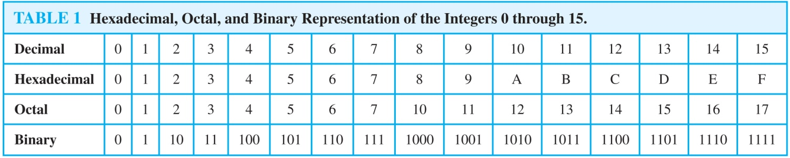
Comparison of Hexadecimal, Octal, and Binary Representations
Initial 0s are not shown
Each octal digit corresponds to a block of 3 binary digits.
Each hexadecimal digit corresponds to a block of 4 binary digits.
So, conversion between binary, octal, and hexadecimal is easy.

Slide 13
Conversion Between Binary, Octal, and Hexadecimal Expansions
Example: Find the octal and hexadecimal expansions of (11 1110 1011 1100)₂.
Solution:
To convert to octal, we group the digits into blocks of three (011 111 010 111 100)₂, adding initial 0s as needed. The blocks from left to right correspond to the digits 3,7,2,7, and 4. Hence, the solution is (37274)₈.
To convert to hexadecimal, we group the digits into blocks of four (0011 1110 1011 1100)₂, adding initial 0s as needed. The blocks from left to right correspond to the digits 3,E,B, and C. Hence, the solution is (3EBC)₁₆.

Slide 14
Binary Addition of Integers
Algorithms for performing operations with integers using their binary expansions are important as computer chips work with binary numbers. Each digit is called a bit.
The number of additions of bits used by the algorithm to add two n-bit integers is O(n).
procedure add(a, b: positive integers)
{the binary expansions of a and b are (a_{n-1},a_{n-2},…,a₀)₂ and (b_{n-1},b_{n-2},…,b₀)₂, respectively}
c := 0
for j := 0 to n − 1
d := ⌊(a_{j} + b_{j} + c)/2⌋
s_{j} := a_{j} + b_{j} + c − 2d
c := d
s_{n} := c
return(s₀,s₁,…, s_{n}){the binary expansion of the sum is (s_{n},s_{n-1},…,s₀)₂}

Slide 15
Binary Multiplication of Integers
Algorithm for computing the product of two n bit integers.
The number of additions of bits used by the algorithm to multiply two n-bit integers is O(n²).
procedure multiply(a, b: positive integers)
{the binary expansions of a and b are (a_{n-1},a_{n-2},…,a₀)₂ and (b_{n-1},b_{n-2},…,b₀)₂, respectively}
for j := 0 to n − 1
if b_{j} = 1 then c_{j} = a shifted j places
else c_{j} := 0
{c_{o},c₁,…, c_{n-1} are the partial products}
p := 0
for j := 0 to n − 1
p := p + c_{j}
return p {p is the value of ab}

Slide 16
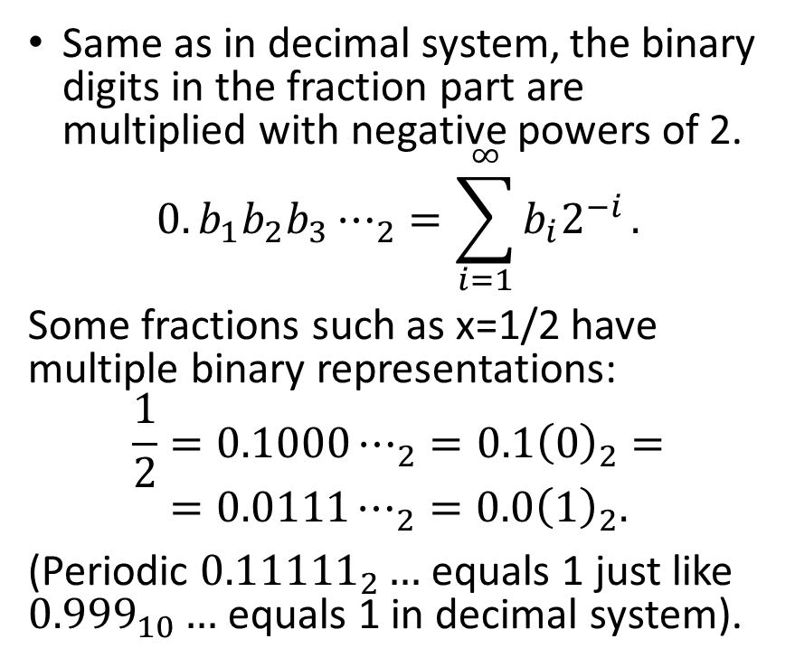
Binary Fractions
Same as in decimal system, the binary digits in the fraction part are multiplied with negative powers of 2.
$${0.b_{1}b_{2}b_{3}⋯}_{2}=\sum_{i=1}^{∞}{b_{i}2^{−i}}.$$
Some fractions such as x=1/2 have multiple binary representations:
$$\frac{1}{2}={0.1000⋯}_{2}={0.1\left(0\right)}_{2}=$$
$$={0.0111⋯}_{2}={0.0\left(1\right)}_{2}.$$
(Periodic ${0.11111}_{2}…$ equals 1 just like ${0.999}_{10}…$ equals 1 in decimal system).
Some examples of fractions:
Rational Number | Binary fraction
1/8 | 0.001=0.001000...=0.000111...
3/16 | 0.0011
1/4=4/16 | 0.1=0.0100
3/8=6/16 | 0.011=0.0110
1/3 | 0.010101... =0.(01)
1/5 | 0.00110011...=0.(0011)
1/6 | 0.0010101...=0.0(01)
1/7 | 0.001001...=0.(001)

Slide 17
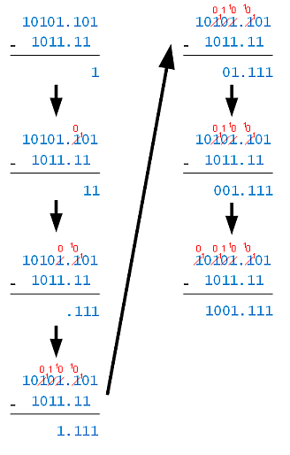
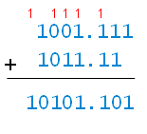
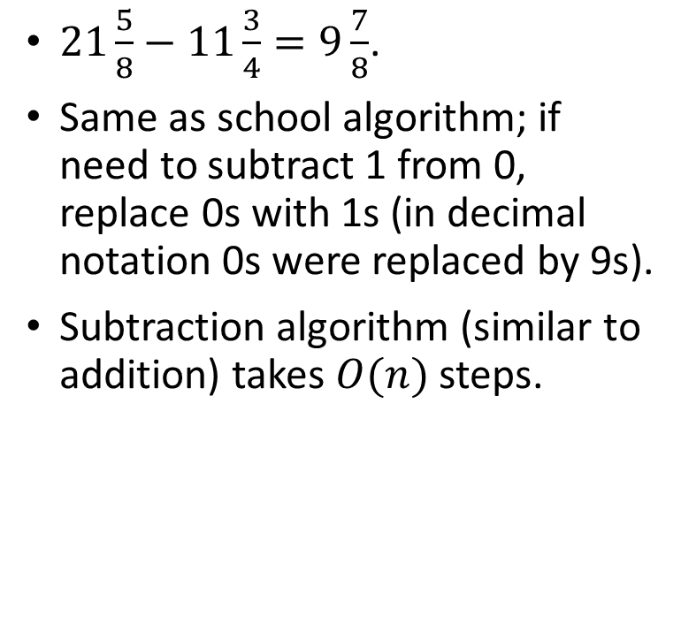
Subtraction (and binary fractions)
Subraction:
$21\frac{5}{8}−11\frac{3}{4}=9\frac{7}{8}$.
Same as school algorithm; if need to subtract 1 from 0, replace 0s with 1s (in decimal notation 0s were replaced by 9s).
Subtraction algorithm (similar to addition) takes $O(n)$ steps.
Checking
answer:

Slide 19
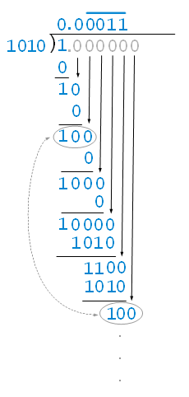
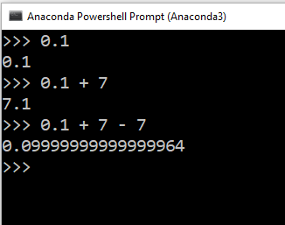
Computing 1/10
result
Somebody had 0.10 EUR (10 eurocents)
7 EUR was added to the account
Then 7 EUR was withdrawn from the account.
How much money is left on the account?
dividend
divisor
remainders

Slide 20
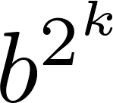
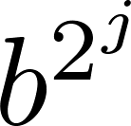
Binary Modular Exponentiation
In cryptography, it is important to be able to find b^{n} mod m efficiently, where b, n, and m are large integers.
Use the binary expansion of n, n = (a_{k-1},…,a₁,a_{o})₂ , to compute b^{n} . Note that:
Therefore, to compute b^{n}, we need only compute the values of b, b², (b²)² = b⁴, (b⁴)² = b⁸ , …, and the multiply the terms in this list, where a_{j} = 1.
Example: Compute 3¹¹ using this method.
Solution: Note that 11 = (1011)₂ so that 3¹¹ = 3⁸ 3² 3¹ =
((3²)² )² 3² 3¹ = (9² )² ∙ 9 ∙3 = (81)² ∙ 9 ∙3 =6561 ∙ 9 ∙3 =117,147.
continued →

Slide 21
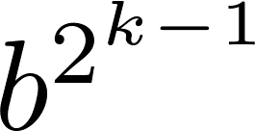
Binary Modular Exponentiation Algorithm
The algorithm successively finds b mod m, b² mod m, b⁴ mod m, …, mod m, and multiplies together the terms where a_{j} = 1.
O((log m )² log n) bit operations are used to find b^{n} mod m.
procedure modular exponentiation(b: integer, n = (a_{k-1}a_{k-2}…a₁a₀)₂ , m: positive integers)
x := 1
power := b mod m
for i := 0 to k − 1
if a_{i}= 1 then x := (x∙ power ) mod m
power := (power∙ power ) mod m
return x {x equals b^{n} mod m }

Slide 22
Socrative Quiz 6B
Skills
Transform one number into another notation
Efficient Modular Exponentiation
Binary fractions
Notes:
1. Some positive integer is written from binary into hexadecimal. What happens with the length of this number?
two times shorter, four times shorter, eight times shorter, sixteen times shorter.
2. Binary Modular Exponentiation (Efficient algorithm) is used to raise a number Raise a number to power 35. How many multiplications do we need.
3. What is the binary representation of the interval $\left[\frac{5}{32};\frac{3}{16}\right]$.

