Slide 1
Solving Congruences
Section 4.4

Slide 2
Section Summary
Linear Congruences
The Chinese Remainder Theorem
Fermat’s Little Theorem
Primitive Roots and Discrete Logarithms

Slide 3
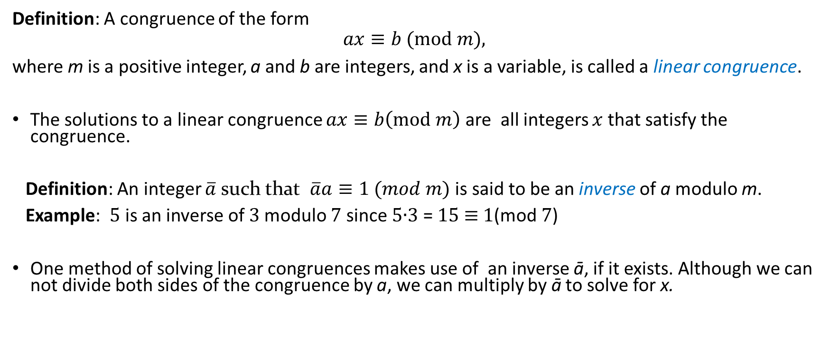
Linear Congruences
Definition: A congruence of the form
$$ax≡b (mod m),$$
where m is a positive integer, a and b are integers, and x is a variable, is called a linear congruence.
The solutions to a linear congruence $ax≡b\left(mod m\right)$ are all integers $x$ that satisfy the congruence.
Definition: An integer $\overline{a}$ such that $\overline{a}a≡1 (mod m)$ is said to be an inverse of a modulo m.
Example: 5 is an inverse of 3 modulo 7 since 5∙3 = 15 ≡ 1(mod 7)
One method of solving linear congruences makes use of an inverse ā, if it exists. Although we can not divide both sides of the congruence by a, we can multiply by ā to solve for x.

Slide 4
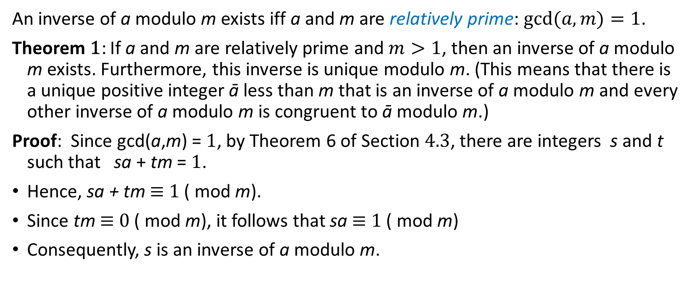
Inverse of a modulo m
An inverse of a modulo m exists iff a and m are relatively prime: $gcd⁡(a,m)=1$.
Theorem 1: If a and m are relatively prime and $m>1$, then an inverse of a modulo m exists. Furthermore, this inverse is unique modulo m. (This means that there is a unique positive integer ā less than m that is an inverse of a modulo m and every other inverse of a modulo m is congruent to ā modulo m.)
Proof: Since gcd(a,m) = 1, by Theorem 6 of Section 4.3, there are integers s and t such that sa + tm = 1.
Hence, sa + tm ≡ 1 ( mod m).
Since tm ≡ 0 ( mod m), it follows that sa ≡ 1 ( mod m)
Consequently, s is an inverse of a modulo m.
Notes:
Uniqueness can be proven indepedently.

Slide 5
Demo: Finding Inverses
The Euclidean algorithm and Bézout coefficients gives us a systematic approaches to finding inverses.
Example: Find an inverse of 3 modulo 7.
Solution: Because gcd(3,7) = 1, by Theorem 1, an inverse of 3 modulo 7 exists.
Using the Euclidian algorithm: 7 = 2∙3 + 1.
From this equation, we get −2∙3 + 1∙7 = 1, and see that −2 and 1 are Bézout coefficients of 3 and 7.
Hence, −2 is an inverse of 3 modulo 7.
Also every integer congruent to −2 modulo 7 is an inverse of 3 modulo 7, i.e., 5, −9, 12, etc.

Slide 6
Finding Inverses
Example: Find an inverse of 101 modulo 4620.
Solution: First use the Euclidian algorithm to show that gcd(101,4620) = 1.
Working Backwards:
42620 = 45∙101 + 75
101 = 1∙75 + 26
75 = 2∙26 + 23
26 = 1∙23 + 3
23 = 7∙3 + 2
3 = 1∙2 + 1
2 = 2∙1
1 = 3 − 1∙2
1 = 3 − 1∙(23 − 7∙3) = − 1 ∙23 + 8∙3
1 = −1∙23 + 8∙(26 − 1∙23) = 8∙26 − 9 ∙23
1 = 8∙26 − 9 ∙(75 − 2∙26 )= 26∙26 − 9 ∙75
1 = 26∙(101 − 1∙75) − 9 ∙75
= 26∙101 − 35 ∙75
1 = 26∙101 − 35 ∙(42620 − 45∙101)
= − 35 ∙42620 + 1601∙101
Since the last nonzero
remainder is 1,
gcd(101,4260) = 1
Bézout coefficients : − 35 and 1601
1601 is an inverse of 101 modulo 42620

Slide 8
Using Inverses to Solve Congruences
We can solve the congruence ax≡ b( mod m) by multiplying both sides by ā.
Example: What are the solutions of the congruence 3x≡ 4( mod 7).
Solution: We found that −2 is an inverse of 3 modulo 7 (two slides back). We multiply both sides of the congruence by −2 giving
−2 ∙ 3x ≡ −2 ∙ 4(mod 7).
Because −6 ≡ 1 (mod 7) and −8 ≡ 6 (mod 7), it follows that if x is a solution, then x ≡ −8 ≡ 6 (mod 7)
We need to determine if every x with x ≡ 6 (mod 7) is a solution. Assume that x ≡ 6 (mod 7). By Theorem 5 of Section 4.1, it follows that 3x ≡ 3 ∙ 6 = 18 ≡ 4( mod 7) which shows that all such x satisfy the congruence.
The solutions are the integers x such that x ≡ 6 (mod 7), namely, 6,13,20 … and −1, − 8, − 15,…

Slide 9
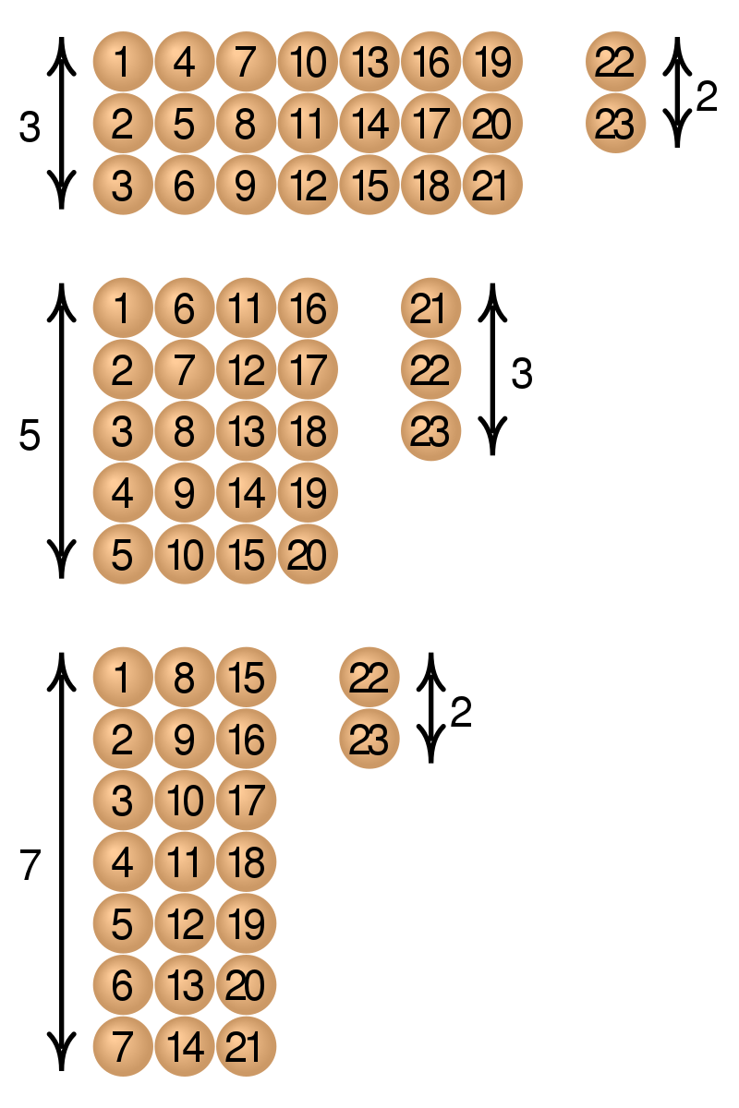
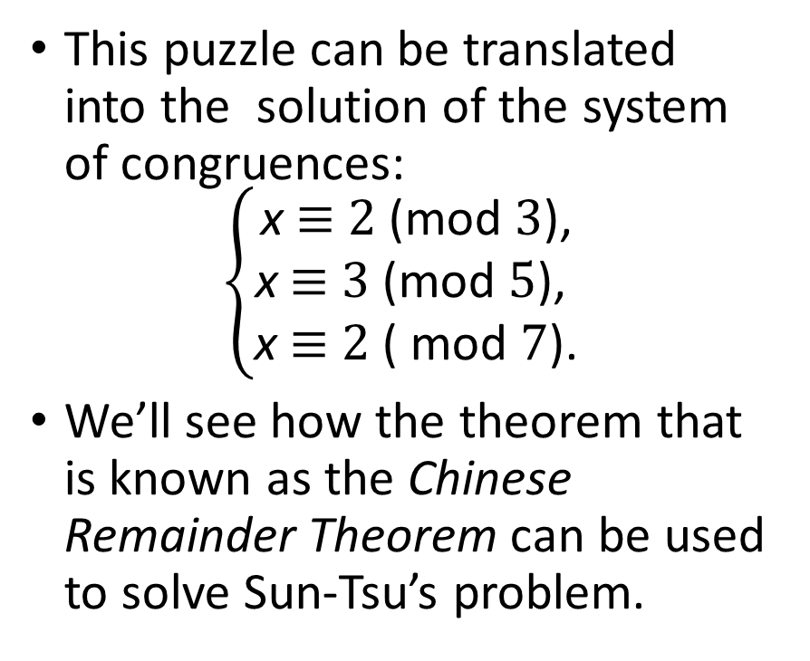
The Chinese Remainder Theorem
This puzzle can be translated into the solution of the system of congruences:
$$\left\{\begin{matrix}\text{x} \text{≡} \text{2 }\text{(}\text{mod} \text{3}\text{)}\text{,} \\ \text{x} \text{≡} \text{3 }\text{(}\text{mod} \text{5}\text{), } \\ \text{x} \text{≡} \text{2 }\text{( }\text{mod} \text{7}\text{)}\text{.}\end{matrix}\right.$$
We’ll see how the theorem that is known as the Chinese Remainder Theorem can be used to solve Sun-Tsu’s problem.
Notes:
There are certain things whose number is unknown. If we count them by threes, we have two left over; by fives, we have three left over; and by sevens, two are left over. How many things are there?

Slide 10
The Chinese Remainder Theorem
Theorem 2: (The Chinese Remainder Theorem) Let m₁,m₂,…,m_{n} be pairwise relatively prime positive integers greater than one and a₁,a₂,…,a_{n} arbitrary integers. Then the system
x ≡ a₁ ( mod m₁)
x ≡ a₂ ( mod m₂)
∙
∙
∙
x ≡ a_{n} ( mod m_{n})
has a unique solution modulo m = m₁m₂ ∙ ∙ ∙ m_{n}.
(That is, there is a solution x with 0 ≤ x <m and all other solutions are congruent modulo m to this solution.)
Proof: We’ll show that a solution exists by describing a way to construct the solution. Showing that the solution is unique modulo m is Exercise 30.
continued →

Slide 11
The Chinese Remainder Theorem
To construct a solution first let M_{k}=m/m_{k} for k = 1,2,…,n and m = m₁m₂ ∙ ∙ ∙ m_{n}.
Since gcd(m_{k} ,M_{k} ) = 1, by Theorem 1, there is an integer y_{k} , an inverse of M_{k} modulo m_{k}, such that
M_{k} y_{k} ≡ 1 ( mod m_{k} ).
Form the sum
x = a₁ M₁ y₁ + a₂ M₂ y₂ + ∙ ∙ ∙ + a_{n} M_{n} y_{n} .
Note that because M_{j} ≡ 0 ( mod m_{k}) whenever j ≠k , all terms except the kth term in this sum are congruent to 0 modulo m_{k} .
Because M_{k} y_{k} ≡ 1 ( mod m_{k} ), we see that x ≡ a_{k} M_{k} y_{k} ≡ a_{k}( mod m_{k}), for k = 1,2,…,n.
Hence, x is a simultaneous solution to the n congruences.
x ≡ a₁ ( mod m₁)
x ≡ a₂ ( mod m₂)
. . .
. . .
x ≡ a_{n} ( mod m_{n})

Slide 12
The Chinese Remainder Theorem
Example: Consider the 3 congruences from Sun-Tsu’s problem:
x ≡ 2 ( mod 3), x ≡ 3 ( mod 5), x ≡ 2 ( mod 7).
Let m = 3∙ 5 ∙ 7 = 105, M₁ = m/3 = 35, M₃ = m/5 = 21, M₃ = m/7 = 15.
We see that
2 is an inverse of M₁ = 35 modulo 3, since 35 ∙ 2 ≡ 2 ∙ 2 ≡ 1 (mod 3)
1 is an inverse of M₂ = 21 modulo 5, since 21 ≡ 1 (mod 5)
1 is an inverse of M₃ = 15 modulo 7, since 15 ≡ 1 (mod 7)
Hence,
x = a₁M₁y₁ + a₂M₂y₂ + a₃M₃y₃
= 2 ∙ 35 ∙ 2 + 3 ∙ 21 ∙ 1 + 2 ∙ 15 ∙ 1 = 233 ≡ 23 (mod 105)
We have shown that 23 is the smallest positive integer that is a simultaneous solution. Check it!

Slide 13
Back Substitution
We can also solve systems of linear congruences with pairwise relatively prime moduli by rewriting a congruences as an equality using Theorem 4 in Section 4.1, substituting the value for the variable into another congruence, and continuing the process until we have worked through all the congruences. This method is known as back substitution.
Example: Use the method of back substitution to find all integers x such that x ≡ 1 (mod 5), x ≡ 2 (mod 6), and x ≡ 3 (mod 7).
Solution: By Theorem 4 in Section 4.1, the first congruence can be rewritten as x = 5t +1, where t is an integer.
Substituting into the second congruence yields 5t +1 ≡ 2 (mod 6).
Solving this tells us that t ≡ 5 (mod 6).
Using Theorem 4 again gives t = 6u + 5 where u is an integer.
Substituting this back into x = 5t +1, gives x = 5(6u + 5) +1 = 30u + 26.
Inserting this into the third equation gives 30u + 26 ≡ 3 (mod 7).
Solving this congruence tells us that u ≡ 6 (mod 7).
By Theorem 4, u = 7v + 6, where v is an integer.
Substituting this expression for u into x = 30u + 26, tells us that x = 30(7v + 6) + 26 = 210u + 206.
Translating this back into a congruence we find the solution x ≡ 206 (mod 210).

Slide 14
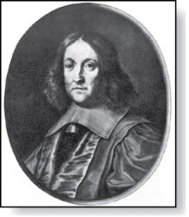
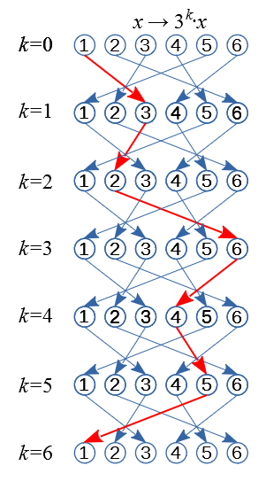
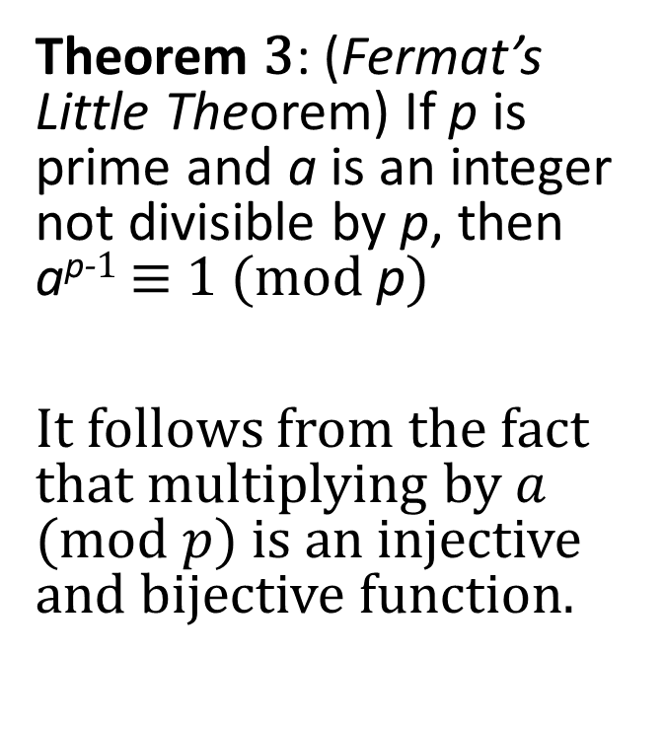
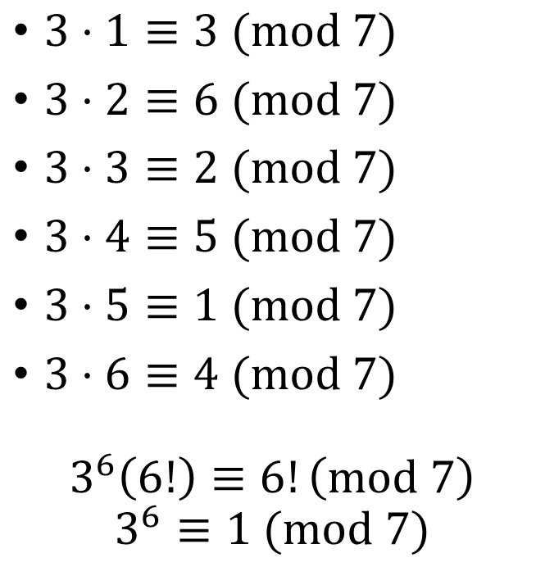
Fermat’s Little Theorem
Pierre de Fermat
(1601-1665)
Theorem 3: (Fermat’s Little Theorem) If p is prime and a is an integer not divisible by p, then a^{p-1} ≡ 1 (mod p)
It follows from the fact that multiplying by $a$ $(mod p)$ is an injective and bijective function.
$3⋅1≡3 (mod 7)$
$3⋅2≡6 (mod 7)$
$3⋅3≡2 (mod 7)$
$3⋅4≡5 (mod 7)$
$3⋅5≡1 (mod 7)$
$3⋅6≡4 (mod 7)$
$$3^{6}\left(6!\right)≡6!\left(mod 7\right)$$
$$3^{6}≡1 (mod 7)$$
Multiply
the
congruences

Slide 15
Demo: Simplify Large Powers
Fermat’s little theorem is useful in computing the remainders modulo p of large powers of integers.
Example: Find 7²²² mod 11.
Solution: By Fermat’s little theorem, we know that 7¹⁰ ≡ 1 (mod 11), and so (7¹⁰ )^{k} ≡ 1 (mod 11), for every positive integer k. Therefore,
7²²² = 7^{22∙10 + 2} = (7¹⁰)²²7² ≡ (1)²² ∙49 ≡ 5 (mod 11).
Hence, 7²²² mod 11 = 5.

Slide 16
Primitive Roots
Definition: A primitive root modulo a prime p is an integer r in Z_{p} such that every nonzero element of Z_{p} is a power of r.
Example: Since every element of Z₁₁ is a power of 2, 2 is a primitive root of 11. Powers of 2 modulo 11: 2¹ = 2, 2² = 4, 2³ = 8, 2⁴ = 5, 2⁵ = 10, 2⁶ = 9, 2⁷ = 7, 2⁸ = 3, 2¹⁰ = 2.
Example: Since not all elements of Z₁₁ are powers of 3, 3 is not a primitive root of 11. Powers of 3 modulo 11: 3¹ = 3, 3² = 9, 3³ = 5, 3⁴ = 4, 3⁵ = 1, and the pattern repeats for higher powers.
Important Fact: There is a primitive root modulo p for every prime number p.

Slide 17






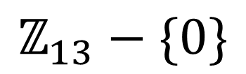






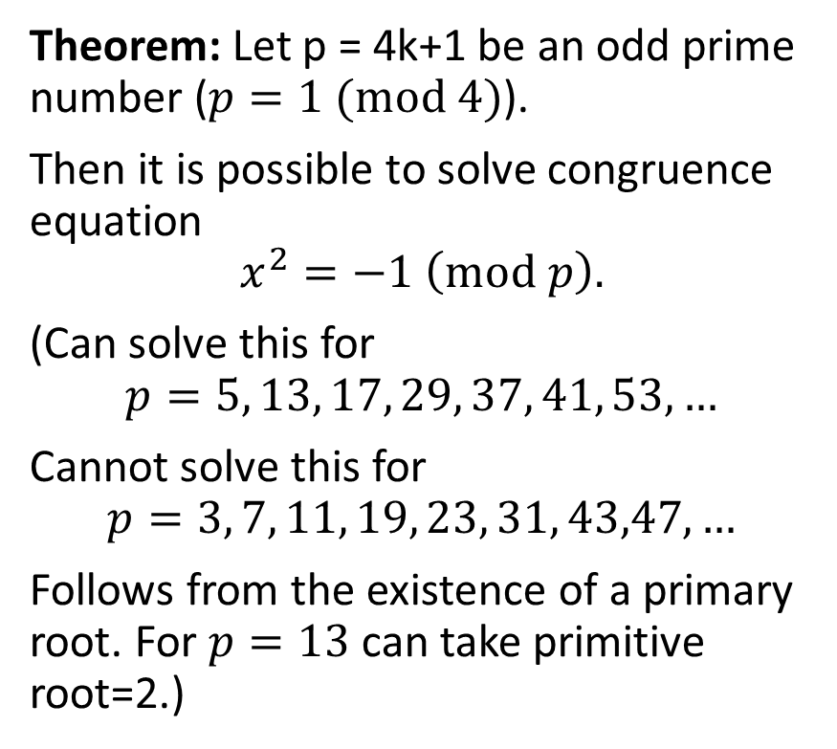


Square root of -1 (mod p)
$x^{2}=−1 \left(mod 13\right)$ has solutions $x_{1,2}=±5.$
Theorem: Let p = 4k+1 be an odd prime number ($p=1 (mod 4)$).
Then it is possible to solve congruence equation
$$x^{2}=−1 \left(mod p\right).$$
(Can solve this for
$$p=5, 13, 17, 29, 37, 41, 53,…$$
Cannot solve this for
$$p=3, 7, 11, 19, 23, 31, 43,47,…$$
Follows from the existence of a primary root. For $p=13$ can take primitive root=2.)
$${2^{12}=2}^{0}$$
$$2^{11}$$
1
$$2^{1}$$
7
2
$$2^{10}$$
$$2^{2}$$
10
4
$${\text{ℤ}}_{13}−\{0\}$$
$$2^{3}$$
$$2^{9}$$
5
8
$$2^{8}$$
9
3
$$2^{4}$$
$$−1$$
11
6
$$2^{5}$$
$$2^{7}$$
12
$$2^{6}$$

Slide 18
Discrete Logarithms
Suppose p is prime and r is a primitive root modulo p. If a is an integer between 1 and p −1, that is an element of Z_{p}, there is a unique exponent e such that r^{e} = a in Z_{p}, that is, r^{e} mod p = a.
Definition: Suppose that p is prime, r is a primitive root modulo p, and a is an integer between 1 and p −1, inclusive. If r^{e} mod p = a and 1 ≤ e ≤ p − 1, we say that e is the discrete logarithm of a modulo p to the base r and we write log_{r} a = e (where the prime p is understood).
Example 1: We write log₂ 3 = 8 since the discrete logarithm of 3 modulo 11 to the base 2 is 8 as 2⁸ = 3 modulo 11.
Example 2: We write log₂ 5 = 4 since the discrete logarithm of 5 modulo 11 to the base 2 is 4 as 2⁴ = 5 modulo 11.
There is no known polynomial time algorithm for computing the discrete logarithm of a modulo p to the base r (when given the prime p, a root r modulo p, and a positive integer a ∊Z_{p}). The problem plays a role in cryptography as will be discussed in Section 4.6.

Slide 19
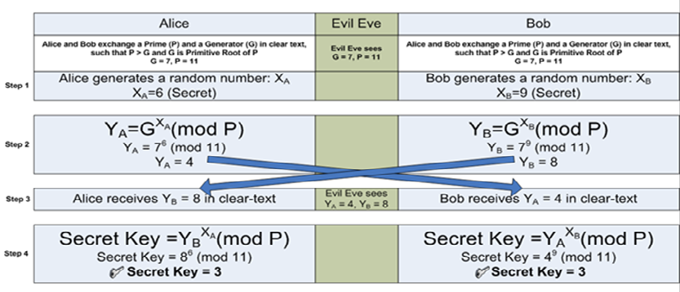
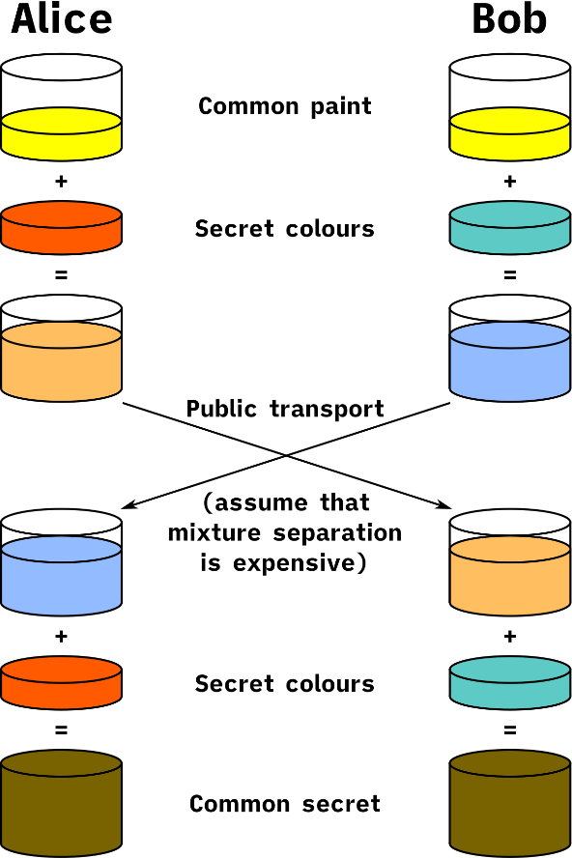
Diffie Hellman Key Exchange (1976)
Applications include SSH (e.g. tunnels), TLS or SSL (including HTTPS), PKI (Public Key Infrastructure – certificates, signatures), IPSec-based VPNs.
Notes:
http://www.sharetechnote.com/html/Handbook_IP_Network_SecurityKey_DH.html

Slide 20
Find the inverse of number 4 (mod 13). You can use the picture with primitive roots, if you wish.
Identify, which quadratic equation is unsolvable (mod 13)

Slide 21












$${2^{12}=2}^{0}$$
$$2^{11}$$
1
$$2^{1}$$
7
2
$$2^{10}$$
$$2^{2}$$
10
4
$$2^{9}$$
5
8
$$2^{3}$$
$$2^{8}$$
9
3
$$2^{4}$$
11
6
$$2^{5}$$
$$2^{7}$$
12
$$2^{6}$$

