Slide 1
Applications of Congruences
Section 4.5

Slide 2
Section Summary
Hashing Functions
Pseudorandom Numbers
Check Digits
Personas kodi (Personal IDs) in Latvia
Credit Card numbers

Slide 3
Hashing Functions – 1
Definition: A hashing function h assigns memory location h(k) to the record that has k as its key.
A common hashing function is h(k) = k mod m, where m is the number of memory locations.
Because this hashing function is onto, all memory locations are possible.
Example: Let h(k) = k mod 111. This hashing function assigns the records of customers with social security numbers as keys to memory locations in the following manner:
h(064212848) = 064212848 mod 111 = 14
h(037149212) = 037149212 mod 111 = 65
h(107405723) = 107405723 mod 111 = 14, but since location 14 is already occupied, the record is assigned to the next available position, which is 15.

Slide 4
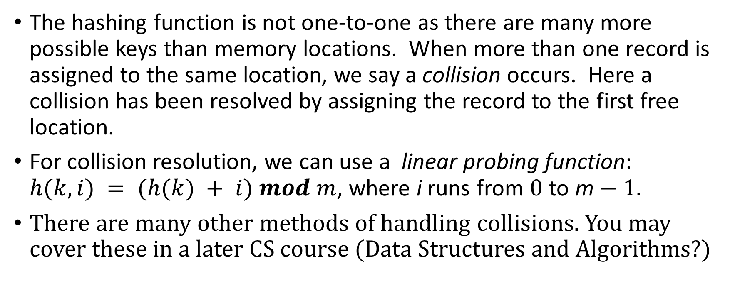
Hashing Functions – 2
The hashing function is not one-to-one as there are many more possible keys than memory locations. When more than one record is assigned to the same location, we say a collision occurs. Here a collision has been resolved by assigning the record to the first free location.
For collision resolution, we can use a linear probing function: $h(k,i) = (h(k) + i) mod m$, where i runs from 0 to m − 1.
There are many other methods of handling collisions. You may cover these in a later CS course (Data Structures and Algorithms?)

Slide 5

Pseudorandom Numbers
Randomly chosen numbers are needed for many purposes, including computer simulations.
Pseudorandom numbers are not truly random since they are generated by systematic methods.
The linear congruential method is one commonly used procedure for generating pseudorandom numbers.
Four integers are needed: the modulus m, the multiplier a, the increment c, and seed x₀, with 2 ≤ a < m, 0 ≤ c < m, 0 ≤ x₀ < m.
We generate a sequence of pseudorandom numbers {x_{n}}, with 0 ≤ x_{n} < m for all n, by successively using the recursively defined function
(an example of a recursive definition, discussed in Section 5.3)
If psudorandom numbers between 0 and 1 are needed, then the generated numbers are divided by the modulus, x_{n} /m.
$$x_{n+1}= (axn + c) mod m.$$

Slide 6
Pseudorandom Numbers
Example: Find the sequence of pseudorandom numbers generated by the linear congruential method with modulus m = 9, multiplier a = 7, increment c = 4, and seed x₀ = 3.
Solution: Compute the terms of the sequence by successively using the congruence x_{n+1} = (7x_{n} + 4) mod 9, with x₀ = 3.
x₁ = 7x₀ + 4 mod 9 = 7∙3 + 4 mod 9 = 25 mod 9 = 7,
x₂ = 7x₁ + 4 mod 9 = 7∙7 + 4 mod 9 = 53 mod 9 = 8,
x₃ = 7x₂ + 4 mod 9 = 7∙8 + 4 mod 9 = 60 mod 9 = 6,
x₄ = 7x₃ + 4 mod 9 = 7∙6 + 4 mod 9 = 46 mod 9 = 1,
x₅ = 7x₄ + 4 mod 9 = 7∙1 + 4 mod 9 = 11 mod 9 = 2,
x₆ = 7x₅ + 4 mod 9 = 7∙2 + 4 mod 9 = 18 mod 9 = 0,
x₇ = 7x₆ + 4 mod 9 = 7∙0 + 4 mod 9 = 4 mod 9 = 4,
x₈ = 7x₇ + 4 mod 9 = 7∙4 + 4 mod 9 = 32 mod 9 = 5,
x₉ = 7x₈ + 4 mod 9 = 7∙5 + 4 mod 9 = 39 mod 9 = 3.
The sequence generated is 3,7,8,6,1,2,0,4,5,3,7,8,6,1,2,0,4,5,3,…
It repeats after generating 9 terms.
Commonly, computers use a linear congruential generator with increment c = 0. This is called a pure multiplicative generator. Such a generator with modulus 2³¹ − 1 and multiplier 7⁵ = 16,807 generates 2³¹ − 2 numbers before repeating.

Slide 7
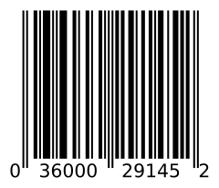
Check Digits: UPCs
A common method of detecting errors in strings of digits is to add an extra digit at the end, which is evaluated using a function. If the final digit is not correct, then the string is assumed not to be correct.
Example: Retail products are identified by their Universal Product Codes (UPCs). Usually these have 12 decimal digits, the last one being the check digit. The check digit is determined by the congruence:
3x₁ + x₂ + 3x₃ + x₄ + 3x₅ + x₆ + 3x₇ + x₈ + 3x₉ + x₁₀ + 3x₁₁ + x₁₂ ≡ 0 (mod 10).
Suppose that the first 11 digits of the UPC are 79357343104. What is the check digit?
Is 041331021641 a valid UPC?
Solution:
3∙7 + 9 + 3∙3 + 5 + 3∙7 + 3 + 3∙4 + 3 + 3∙1 + 0 + 3∙4 + x₁₂ ≡ 0 (mod 10)
21 + 9 + 9 + 5 + 21 + 3 + 12+ 3 + 3 + 0 + 12 + x₁₂ ≡ 0 (mod 10)
98 + x₁₂ ≡ 0 (mod 10)
x₁₂ ≡ 2 (mod 10) So, the check digit is 2.
3∙0 + 4 + 3∙1 + 3 + 3∙3 + 1 + 3∙0 + 2 + 3∙1 + 6 + 3∙4 + 1 ≡ 0 (mod 10)
0 + 4 + 3 + 3 + 9 + 1 + 0+ 2 + 3 + 6 + 12 + 1 = 44 ≡ 4 ≢ 0 (mod 10)
Hence, 041331021641 is not a valid UPC.

Slide 8
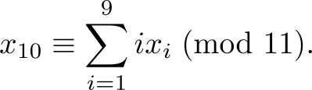

Checking ISBNs – 1
Books are identified by an International Standard Book Number (ISBN-10), a 10 digit code. The first 9 digits identify the language, the publisher, and the book. The tenth digit is a check digit, which is determined by the following congruence
The validity of an ISBN-10 number can be evaluated with the equivalent

Slide 9
Checking ISBNs - 2
Suppose that the first 9 digits of the ISBN-10 are 007288008. What is the check digit?
Is 084930149X a valid ISBN10?
Solution:
a. X₁₀ ≡ 1∙0 + 2∙0 + 3∙7 + 4∙2 + 5∙8 + 6∙8 + 7∙ 0 + 8∙0 + 9∙8 (mod 11).
X₁₀ ≡ 0 + 0 + 21 + 8 + 40 + 48 + 0 + 0 + 72 (mod 11).
X₁₀ ≡ 189 ≡ 2 (mod 11). Hence, X₁₀ = 2.
b. 1∙0 + 2∙8 + 3∙4 + 4∙9 + 5∙3 + 6∙0 + 7∙ 1 + 8∙4 + 9∙9 + 10∙10 =
0 + 16 + 12 + 36 + 15 + 0 + 7 + 32 + 81 + 100 = 299 ≡ 2 ≢ 0 (mod 11)
Hence, 084930149X is not a valid ISBN-10.
A single error is an error in one digit of an identification number and a transposition error is the accidental interchanging of two digits. Both of these kinds of errors can be detected by the check digit for ISBN-10. (see text for more details)

Slide 10
The Anatomy of "Personas kods" in Latvia – 1
121282-1121X
Sample P.k. from
Andris Paraudziņš (by Migration Service – the "PMLP")
Month
of birth
Checksum digit
Day
of birth
Century
"1" or "2"
Year
of birth
Twins or matching birthdays register in the same office
Birth
registration
place
The default checksum algorithm is deemed "information of limited access" ("ierobežotas pieejamības informācija"), but everyone knows it.
Since July 2017 new personal codes are often issued (starting with digits "32" etc. – impossible date). Only big players should find birth dates by personal ID etc.
Notes:
<?
function PK_VALID($pk) { $pk = trim(str_replace("-", "", $pk)); if (!$pk || !strlen($pk)==11) return false;
$checksum = 1; for ($i=0; $i<10; $i++) $checksum -= (int)substr($pk, $i, 1) *
(int)substr("01060307091005080402", $i * 2, 2); if ( ($checksum - floor($checksum / 11) * 11) != (int)substr($pk, 10, 1) ) return false; return true; }
?>
<? function PK_VALID($pk) { $pk = trim(str_replace("-", "", $pk)); if (!$pk || !strlen($pk)==11) return false; $checksum = 1; for ($i=0; $i<10; $i++) $checksum -= (int)substr($pk, $i, 1) * (int)substr("01060307091005080402", $i * 2, 2); if ( ($checksum - floor($checksum / 11) * 11) != (int)substr($pk, 10, 1) ) return false; return true; } $valid = PK_VALID($_POST['pk']); echo ($valid ? 'Personas kods ir valīds' : 'Personas kods ir invalīds;-)'); ?>
New Personal IDs (personas kodi) do not have any validation algorithm; regex much shorter; may start by 32, 33, 34, etc.
https://viss.gov.lv/-/media/Files/VRAA/Dokumentacija/Vadlinijas/E_pakalpojumi/Programmetaja_rokasgramatas/VISS2014REKPKMEPAK.ashx

Slide 11
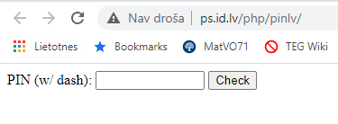
The Anatomy of "Personas kods" in Latvia – 2
http://ps.id.lv/php/pinlv/
Better implement your own checksum – this service is very strange
https://viss.gov.lv/-/media/Files/VRAA/Dokumentacija/Vadlinijas/E_pakalpojumi/Programmetaja_rokasgramatas/VISS2014REKPKMEPAK.ashx
Last/checksum digit: PK[11] = (1101 - (1PK[1] + 6PK[2] + 3PK[3] + 7PK[4] + 9PK[5] + 10PK[6] + 5PK[7] + 8PK[8] + 4PK[9] + 2PK[10])) mod 11
10th digit may occasionally cause invalid expression (when PK[11]=10 – an impossible digit)
New validation guidelines (since about 2017) allow pretty much everything.
Many old-standard Personas Kodi still in use.

Slide 12
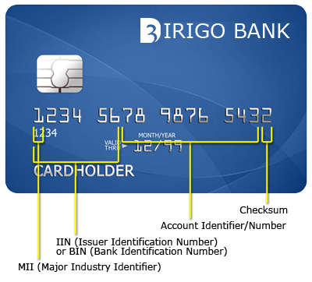
On Credit Cards
All numbers are important to verify a credit card number
If the first numbers passes the issuer validity check than if all other numbers are entered radnomly last number can be adjusted to pass the Luhn check
Notes:
First digit: Represents the network that produced the credit card. It is called the Major Industry Identifier (MII). Each digit represents a different industry.
0 – industry assignments
1 – Airlines
2 – Airlines, financial and other future industry assignments
3 – Travel and entertainment
4 – Banking and financial
5 – Banking and financial
6 – Merchandising and banking/financial
7 – Petroleum and other future industry assignments
8 – Healthcare, telecommunications and other future industry assignments
9 – For assignment by national standards bodies
The first digit is different for each card network:
Visa cards – Begin with a 4 and have 13 or 16 digits
Mastercard cards – Begin with a 5 and has 16 digits
American Express cards – Begin with a 3, followed by a 4 or a 7 has 15 digits
Discover cards – Begin with a 6 and have 16 digits
Diners Club and Carte Blanche cards – Begin with a 3, followed by a 0, 6, or 8 and have 14 digits

Slide 13
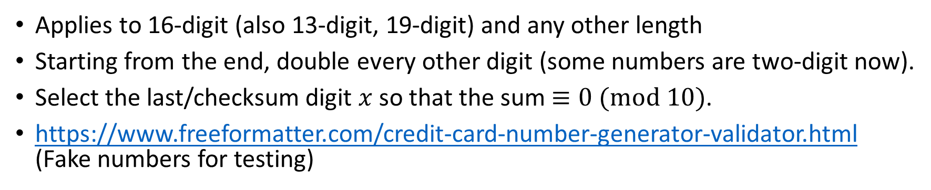
Luhn Algorithm
 | 7 | 9 | 9 | 2 | 7 | 3 | 9 | 8 | 7 | 1 | x
Double every other | 7 | 18 | 9 | 4 | 7 | 6 | 9 | 16 | 7 | 2 | x
Sum digits | 7 | 9 | 9 | 4 | 7 | 6 | 9 | 7 | 7 | 2 | x
Applies to 16-digit (also 13-digit, 19-digit) and any other length
Starting from the end, double every other digit (some numbers are two-digit now).
Select the last/checksum digit $x$ so that the sum $≡0 (mod 10)$.
https://www.freeformatter.com/credit-card-number-generator-validator.html (Fake numbers for testing)

Slide 14
How to Detect CCN Leaks?
Random 16-digits have 10% chance to satisfy Luhn check → Not every time we leak a single credit card, a DLP product (Data Leak Prevention) should raise alert (false positives).
A few more mechanisms:
Separators XXXX-XXXX-XXXX-XXXX XXXX/XXXX/XXXX/XXXX
Fingerprint your databases to protect known credit card numbers
Check IINs (Bank Issuer Numbers – combinations of the first 6 digits). Disregard less common banking institutions – depending on your area.
Even more context
Support terms: Surrounding info – CVV, Expiration, address, name.
Violation count: # of leaked cards in a single transaction
Cumulative rules: Violations within a time window.
Statistical Validation: Random 16-digit numbers have 10% chance of passing Luhn check; set threshold >>10%.
User Behavior Patterns: Depends on previous behavior of the given user; current activity across different channels.
What would attackers do? Use unmonitored channels. Uploads via SCP or via SSH Tunnels; pack sensitive data in large ZIPs – containing 1000s of clean files, use steganography.

