Slide 1
Mathematical Induction
Section 5.1
Notes:
http://nms.lu.lv/wp-content/uploads/2013/02/1112MMU3_Indukcija.pdf

Slide 2
Section Summary
Mathematical Induction
Examples of Proof by Mathematical Induction
Mistaken Proofs by Mathematical Induction
Guidelines for Proofs by Mathematical Induction

Slide 3
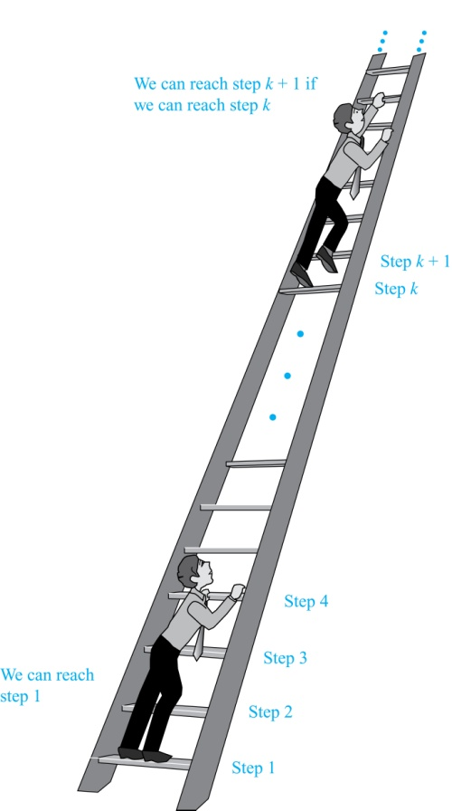
Climbing an Infinite Ladder
Suppose we have an infinite ladder:
We can reach the first rung of the ladder.
From a particular rung of the ladder can reach the next rung.
By (1), we can reach the first rung. By applying (2), reach the second rung. Apply (2) again, reach the third rung. And so on. Therefore can reach any particular rung, no matter how high up.
This example motivates proof by mathematical induction.

Slide 4
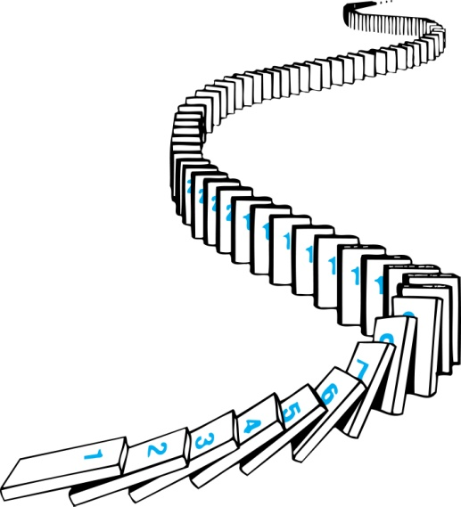
Mathematical Induction – More Intuition
Consider an infinite sequence of dominoes, labeled 1,2,3, …, where each domino is standing.
Let P(n) be the proposition that the nth domino is knocked over.
We know that the first domino is knocked down, i.e., P(1) is true .
We also know that if whenever the kth domino is knocked over, it knocks over the (k + 1)st domino, i.e, P(k) → P(k + 1) is true for all positive integers k.
Hence, all dominos are knocked over.
P(n) is true for all positive integers n.

Slide 5
Principle of Mathematical Induction
Principle of Mathematical Induction: To prove that P(n) is true for all positive integers n, we complete these steps:
Basis Step: Show that P(1) is true.
Inductive Step: Show that P(k) → P(k + 1) is true for all positive integers k.
To complete the inductive step, assuming the inductive hypothesis that P(k) holds for an arbitrary integer k, show that must P(k + 1) be true.
Climbing an Infinite Ladder Example:
BASIS STEP: By (1), we can reach rung 1.
INDUCTIVE STEP: Assume the inductive hypothesis that we can reach rung k. Then by (2), we can reach rung k + 1.
Hence, P(k) → P(k + 1) is true for all positive integers k. We can reach every rung on the ladder.

Slide 6
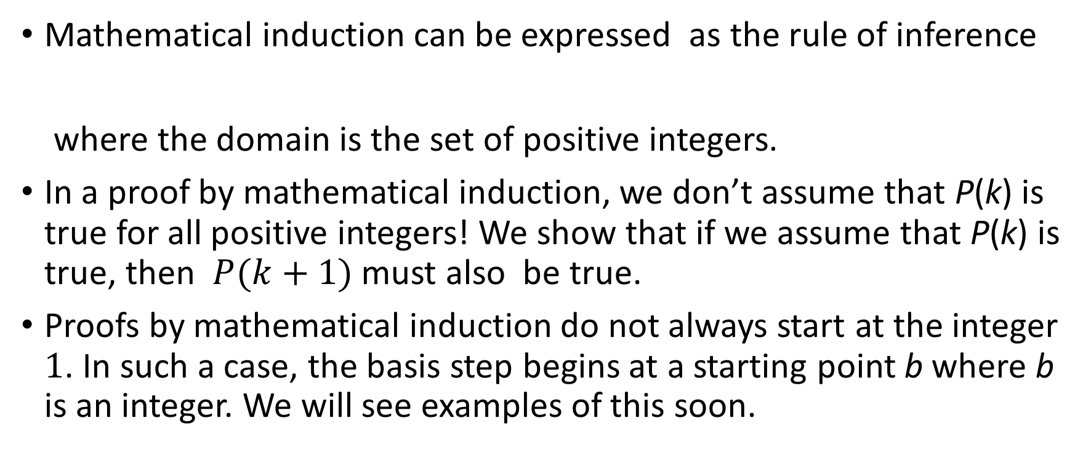
How to Use Mathematical Induction
Mathematical induction can be expressed as the rule of inference
where the domain is the set of positive integers.
In a proof by mathematical induction, we don’t assume that P(k) is true for all positive integers! We show that if we assume that P(k) is true, then $P(k+1)$ must also be true.
Proofs by mathematical induction do not always start at the integer 1. In such a case, the basis step begins at a starting point b where b is an integer. We will see examples of this soon.
(P(1) ∧ ∀k (P(k) → P(k + 1))) → ∀n P(n),

Slide 7
Validity of Mathematical Induction
Mathematical induction is valid because of the well-ordering property, which states that every nonempty subset of the set of positive integers has a least element (see Section 5.2 and Appendix 1). Here is the proof:
Suppose that P(1) holds and P(k) → P(k + 1) is true for all positive k.
Assume there is at least one positive integer n for which P(n) is false. Then the set S of positive integers for which P(n) is false is nonempty.
By the well-ordering property, S has a least element, say m.
We know that m can not be 1 since P(1) holds.
Since m is positive and greater than 1, m − 1 must be a positive integer. Since m − 1 < m, it is not in S, so P(m − 1) must be true.
But then, since the conditional P(k) → P(k + 1) for every positive integer k holds, P(m) must also be true. This contradicts P(m) being false.
Hence, P(n) must be true for every positive integer n.

Slide 8
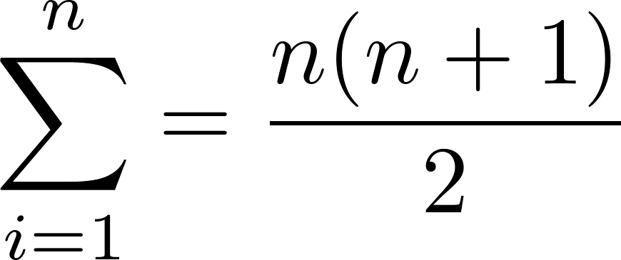
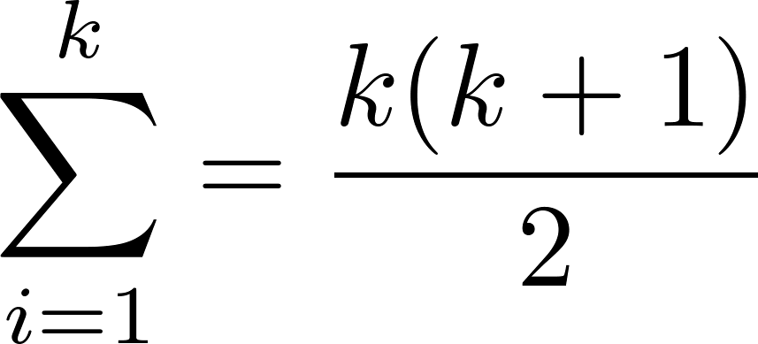
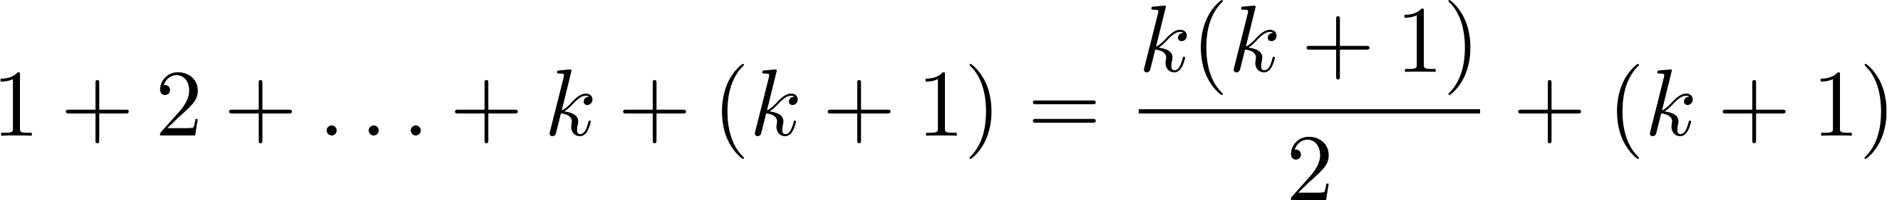
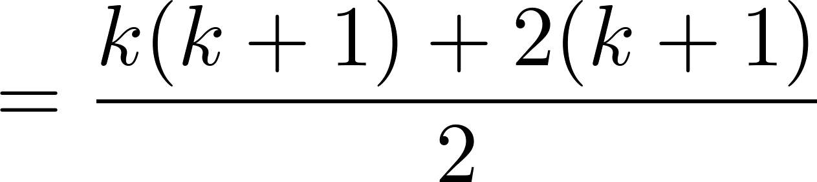
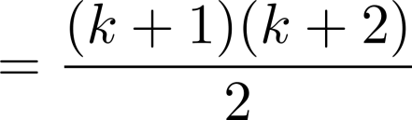
Proving a Summation Formula by Mathematical Induction
Example: Show that:
Solution:
BASIS STEP: P(1) is true since 1(1 + 1)/2 = 1.
INDUCTIVE STEP: Assume true for P(k).
The inductive hypothesis is
Under this assumption,
Note: Once we have this conjecture, mathematical induction can be used to prove it correct.
i
i

Slide 9
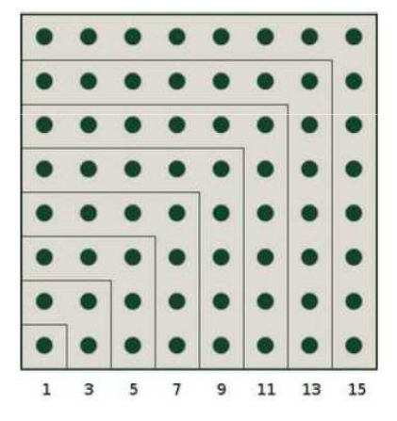
Proving a Summation Formula – 1
Example: Conjecture and prove correct a formula for the sum of the first n positive odd integers. Then prove your conjecture.
Solution: We have: 1= 1, 1 + 3 = 4, 1 + 3 + 5 = 9, 1 + 3 + 5 + 7 = 16, 1 + 3 + 5 + 7 + 9 = 25.
We can conjecture that the sum of the first n positive odd integers is n²,
1 + 3 + 5 + ∙∙∙+ (2n − 1) =n² .
We prove the conjecture is proved correct with mathematical induction.
BASIS STEP: P(1) is true since 1² = 1.

Slide 10
Proving a Summation Formula – 2
INDUCTIVE STEP: P(k) → P(k + 1) for every positive integer k. Assume the inductive hypothesis holds and then show that P(k + 1) holds has well.
Inductive Hypothesis: 1 + 3 + 5 + ∙∙∙+ (2k − 1) =k²
So, assuming P(k), it follows that:
1 + 3 + 5 + ∙∙∙+ (2k − 1) + (2k + 1) =[1 + 3 + 5 + ∙∙∙+ (2k − 1)] + (2k + 1)
= k² + (2k + 1) (by the inductive hypothesis)
= k² + 2k + 1
= (k + 1) ²
Hence, we have shown that P(k + 1) follows from P(k). Therefore the sum of the first n positive odd integers is n².

Slide 11
Proving Inequalities
Example: Use mathematical induction to prove that n < 2^{n} for all positive integers n.
Solution: Let P(n) be the proposition that n < 2^{n}.
BASIS STEP: P(1) is true since 1 < 2¹ = 2.
INDUCTIVE STEP: Assume P(k) holds, i.e., k < 2^{k}, for an arbitrary positive integer k.
Must show that P(k + 1) holds. Since by the inductive hypothesis, k < 2^{k}, it follows that:
k + 1 < 2^{k} + 1 ≤ 2^{k} + 2^{k} = 2 ∙ 2^{k} = 2^{k+1}
Therefore n < 2^{n} holds for all positive integers n.

Slide 12
Proving Inequalities
Example: Use mathematical induction to prove that 2^{n} < n!, for every integer n ≥ 4.
Solution: Let P(n) be the proposition that 2^{n} < n!.
BASIS STEP: P(4) is true since 2⁴ = 16 < 4! = 24.
INDUCTIVE STEP: Assume P(k) holds, i.e., 2^{k} < k! for an arbitrary integer k ≥ 4. To show that P(k + 1) holds: 2^{k+1} = 2∙2^{k} < 2∙ k! (by the inductive hypothesis)
< (k + 1)k! = (k + 1)!
Therefore, 2^{n} < n! holds, for every integer n ≥ 4.
Note: The basis step is P(4), since P(0), P(1), P(2), and P(3) are all false.

Slide 13




Induction Schemes
Base case n=1
Inductive step
1
2
Base case: n=4
Inductive step (k→k+1):
$$k$$
$$k+1$$

Slide 14
Proving Divisibility Results
Example: Use mathematical induction to prove that n³ − n is divisible by 3, for every positive integer n.
Solution: Let P(n) be the proposition that n³ − n is divisible by 3.
BASIS STEP: P(1) is true since 1³ − 1 = 0, which is divisible by 3.
INDUCTIVE STEP: Assume P(k) holds, i.e., k³ − k is divisible by 3, for an arbitrary positive integer k. To show that P(k + 1) follows:
(k + 1)³ − (k + 1) = (k³ + 3k² + 3k + 1) − (k + 1)
= (k³ − k) + 3(k² + k)
By the inductive hypothesis, the first term (k³ − k) is divisible by 3 and the second term is divisible by 3 since it is an integer multiplied by 3. So by part (i) of Theorem 1 in Section 4.1 , (k + 1)³ − (k + 1) is divisible by 3.
Therefore, n³ − n is divisible by 3, for every integer positive integer n.

Slide 15
Counting Subsets of a Finite Set – 1
Example: Use mathematical induction to show that if S is a finite set with n elements, where n is a nonnegative integer, then S has 2^{n} subsets. (Chapter 6 uses combinatorial methods to prove this result.)
Solution: Let P(n) be the proposition that a set with n elements has 2^{n} subsets.
Basis Step: P(0) is true: The empty set has only itself as a subset and 2⁰ = 1.
Inductive Step: Assume P(k) is true for an arbitrary nonnegative integer k.

Slide 16
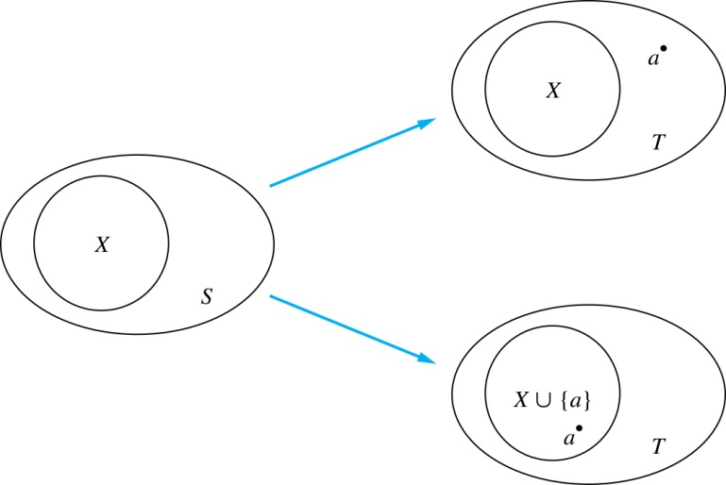
Counting Subsets of a Finite Set – 2
Inductive Hypothesis: For an arbitrary nonnegative integer k, every set with k elements has 2^{k} subsets.
Let T be a set with k + 1 elements. Then T = S ∪ {a}, where a ∈ T and S = T − {a}. Hence |S| = k.
For each subset X of S, there are exactly two subsets of T, i.e., X and X ∪ {a}.
By the inductive hypothesis S has 2^{k} subsets. Since there are two subsets of T for each subset of S, the number of subsets of T is 2 ∙2^{k} = 2^{k+1} .

Slide 17


Tiling Checkerboards – 1
Example: Show that every 2^{n} ×2^{n} checkerboard with one square removed can be tiled using right triominoes. (A right triomino is an L-shaped tile which covers three squares at a time.)
Solution: Let P(n) be the proposition that every 2^{n} ×2^{n} checkerboard with one square removed can be tiled using right triominoes. Use mathematical induction to prove that P(n) is true for all positive integers n.
BASIS STEP: P(1) is true, because each of the four 2 ×2 checkerboards with one square removed can be tiled using one right triomino.
INDUCTIVE STEP: Assume that P(k) is true for every 2^{k} ×2^{k} checkerboard, for some positive integer k.

Slide 18


Tiling Checkerboards – 2
Consider a 2^{k+1} ×2^{k+1} checkerboard with one square removed. Split this checkerboard into four checkerboards of size 2^{k} ×2^{k},by dividing it in half in both directions.
Remove a square from one of the four 2^{k} ×2^{k} checkerboards. By the inductive hypothesis, this board can be tiled. Also by the inductive hypothesis, the other three boards can be tiled with the square from the corner of the center of the original board removed. We can then cover the three adjacent squares with a triominoe.
Hence, the entire 2^{k+1} ×2^{k+1} checkerboard with one square removed can be tiled using right triominoes.
Inductive Hypothesis: Every 2^{k} ×2^{k} checkerboard, for some positive integer k, with one square removed can be tiled using right triominoes.

Slide 19
An Incorrect “Proof” by Induction – 1
Example: Let P(n) be the statement that every set of n lines in the plane, no two of which are parallel, meet in a common point. Here is a “proof” that P(n) is true for all positive integers n ≥ 2.
BASIS STEP: The statement P(2) is true because any two lines in the plane that are not parallel meet in a common point.
INDUCTIVE STEP: The inductive hypothesis is the statement that P(k) is true for the positive integer k ≥ 2, i.e., every set of k lines in the plane, no two of which are parallel, meet in a common point.
We must show that if P(k) holds, then P(k + 1) holds, i.e., if every set of k lines in the plane, no two of which are parallel, k ≥ 2, meet in a common point, then every set of k + 1 lines in the plane, no two of which are parallel, meet in a common point.

Slide 20
An Incorrect “Proof” by Induction – 2
Inductive Hypothesis: Every set of k lines in the plane, where k ≥ 2, no two of which are parallel, meet in a common point.
Consider a set of k + 1 distinct lines in the plane, no two parallel. By the inductive hypothesis, the first k of these lines must meet in a common point p₁. By the inductive hypothesis, the last k of these lines meet in a common point p₂.
If p₁ and p₂ are different points, all lines containing both of them must be the same line since two points determine a line. This contradicts the assumption that the lines are distinct. Hence, p₁ = p₂ lies on all k + 1 distinct lines, and therefore P(k + 1) holds. Assuming that k ≥2, distinct lines meet in a common point, then every k + 1 lines meet in a common point.
There must be an error in this proof since the conclusion is absurd. But where is the error?
Answer: P(k)→ P(k + 1) only holds for k ≥3. It is not the case that P(2) implies P(3). The first two lines must meet in a common point p₁ and the second two must meet in a common point p₂. They do not have to be the same point since only the second line is common to both sets of lines.

Slide 21
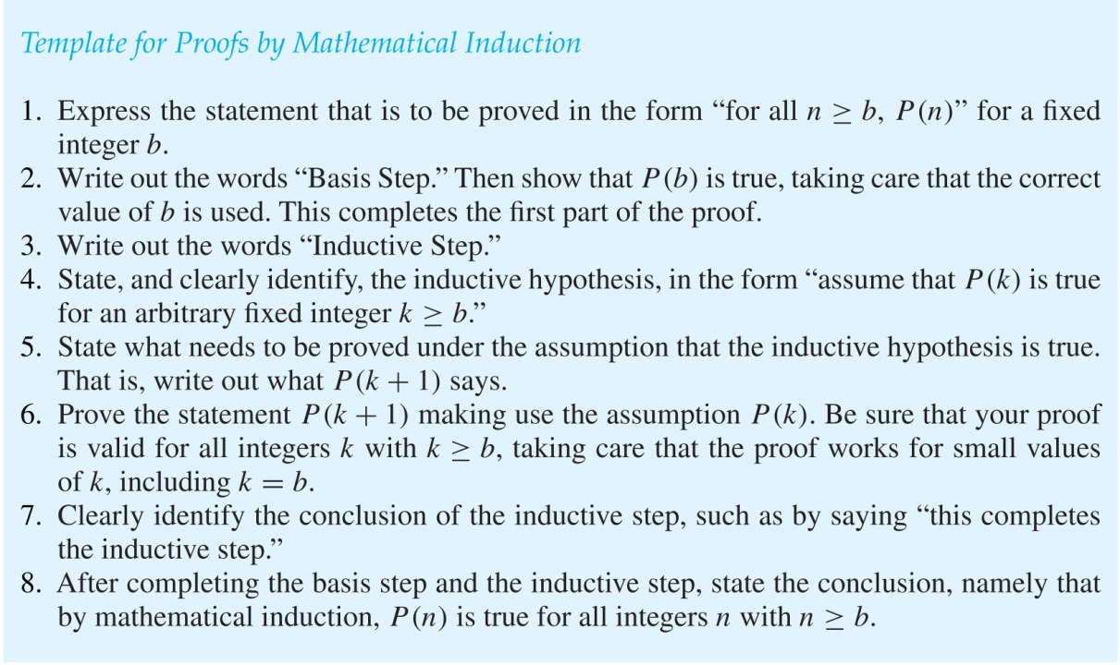
Guidelines: Mathematical Induction Proofs

Slide 22
Quiz7A: Well-Ordering and Induction
In order to prove summation formula 1^2 + 2^2+ ... + n^2 = ... What is the Inductive hypothesis?

