Slide 1
Permutations and Combinations
Section 6.3

Slide 2
Section Summary
Permutations
Combinations
Combinatorial Proofs

Slide 3
Permutations
Definition: A permutation of a set of distinct objects is an ordered arrangement of these objects. An ordered arrangement of r elements of a set is called an r-permuation.
Example: Let S = {1,2,3}.
The ordered arrangement 3,1,2 is a permutation of S.
The ordered arrangement 3,2 is a 2-permutation of S.
The number of r-permuatations of a set with n elements is denoted by P(n,r).
The 2-permutations of S = {1,2,3} are 1,2; 1,3; 2,1; 2,3; 3,1; and 3,2. Hence, P(3,2) = 6.

Slide 4
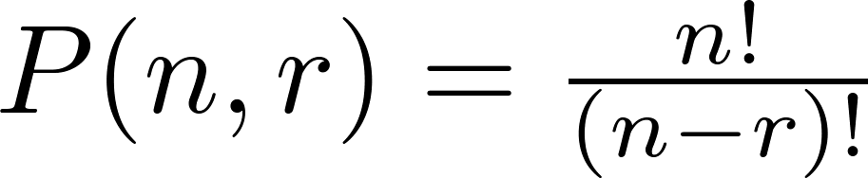
A Formula for the Number of Permutations
Theorem 1: If n is a positive integer and r is an integer with 1 ≤ r ≤ n, then there are
P(n, r) = n(n − 1)(n − 2) ∙∙∙ (n − r + 1)
r-permutations of a set with n distinct elements.
Proof: Use the product rule. The first element can be chosen in n ways. The second in n − 1 ways, and so on until there are (n − ( r − 1)) ways to choose the last element.
Note that P(n,0) = 1, since there is only one way to order zero elements.
Corollary 1: If n and r are integers with 1 ≤ r ≤ n, then

Slide 5
Solving Counting Problems by Counting Permutations
Example: How many ways are there to select a first-prize winner, a second prize winner, and a third-prize winner from 100 different people who have entered a contest?
Solution:
P(100,3) = 100 ∙ 99 ∙ 98 = 970,200

Slide 6
Solving Counting Problems by Counting Permutations (continued)
Example: Suppose that a saleswoman has to visit eight different cities. She must begin her trip in a specified city, but she can visit the other seven cities in any order she wishes. How many possible orders can the saleswoman use when visiting these cities?
Solution: The first city is chosen, and the rest are ordered arbitrarily. Hence the orders are:
7! = 7 ∙ 6 ∙ 5 ∙ 4 ∙ 3 ∙ 2 ∙ 1 = 5040
If she wants to find the tour with the shortest path that visits all the cities, she must consider 5040 paths!

Slide 7
Solving Counting Problems by Counting Permutations (continued)
Example: Consider all words of all 8 letters using every {A,B,C,D,E,F,G,H} just once. How many of them contain letters "ABC" in this order.
Solution: We solve this problem by counting the permutations of six objects, ABC, D, E, F, G, and H.
6! = 6 ∙ 5 ∙ 4 ∙ 3 ∙ 2 ∙ 1 = 720
This is considerably less than all the permutations out of 8:
8! = 8 ∙ 7 ∙ 6 ∙ 5 ∙ 4 ∙ 3 ∙ 2 ∙ 1 = 40320.

Slide 8

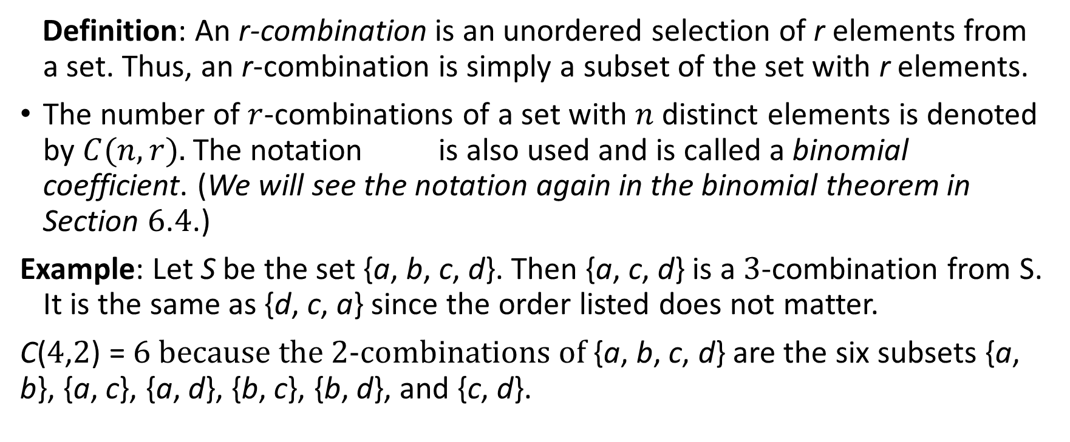
Combinations
Definition: An r-combination is an unordered selection of r elements from a set. Thus, an r-combination is simply a subset of the set with r elements.
The number of $r$-combinations of a set with $n$ distinct elements is denoted by $C(n, r).$The notation is also used and is called a binomial coefficient. (We will see the notation again in the binomial theorem in Section 6.4.)
Example: Let S be the set {a, b, c, d}. Then {a, c, d} is a 3-combination from S. It is the same as {d, c, a} since the order listed does not matter.
C(4,2) = 6 because the 2-combinations of {a, b, c, d} are the six subsets {a, b}, {a, c}, {a, d}, {b, c}, {b, d}, and {c, d}.

Slide 9
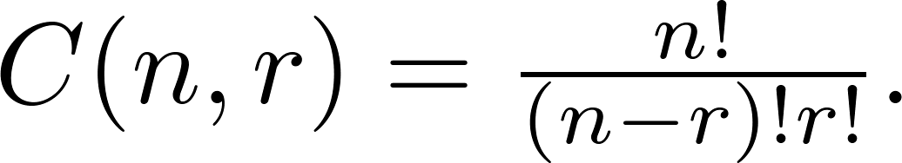
Combinations
Theorem 2: The number of r-combinations of a set with n elements, where n ≥ r ≥ 0, equals
Proof: By the product rule P(n, r) = C(n,r) ∙ P(r,r). Therefore,

Slide 10
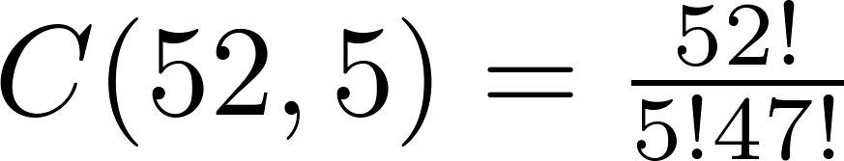
Combinations
Example: How many poker hands of five cards can be dealt from a standard deck of 52 cards? Also, how many ways are there to select 47 cards from a deck of 52 cards?
Solution: Since the order in which the cards are dealt does not matter, the number of five card hands is:
The different ways to select 47 cards from 52 is
This is a special case of a general result. →

Slide 11
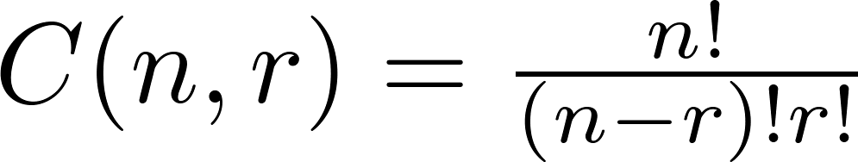
Combinations
Corollary 2: Let n and r be nonnegative integers with r ≤ n. Then C(n, r) = C(n, n − r).
Proof: From Theorem 2, it follows that
and
Hence, C(n, r) = C(n, n − r).
This result can be proved without using algebraic manipulation. →

Slide 12
Combinatorial Proofs
Definition 1: A combinatorial proof of an identity is a proof that uses one of the following methods.
A double counting proof uses counting arguments to prove that both sides of an identity count the same objects, but in different ways.
A bijective proof shows that there is a bijection between the sets of objects counted by the two sides of the identity.

Slide 13

Combinatorial Proofs
Here are two combinatorial proofs that
C(n, r) = C(n, n − r)
when r and n are nonnegative integers with r < n:
Bijective Proof: Suppose that S is a set with n elements. The function that maps a subset A of S to is a bijection between the subsets of S with r elements and the subsets with n − r elements. Since there is a bijection between the two sets, they must have the same number of elements.
Double Counting Proof: By definition the number of subsets of S with r elements is C(n, r). Each subset A of S can also be described by specifying which elements are not in A, i.e., those which are in . Since the complement of a subset of S with r elements has n − r elements, there are also C(n, n − r) subsets of S with r elements.

Slide 14
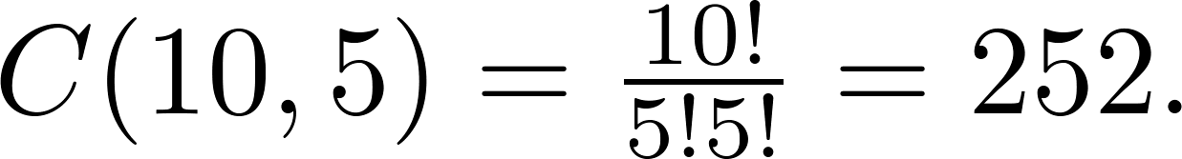
Combinations
Example: How many ways are there to select five players from a 10-member tennis team to make a trip to a match at another school.
Solution: By Theorem 2, the number of combinations is
Example: A group of 30 people have been trained as astronauts to go on the first mission to Mars. How many ways are there to select a crew of six people to go on this mission?
Solution: By Theorem 2, the number of possible crews is

