Slide 1
Generalized Permutations and Combinations
Section 6.5

Slide 2
Section Summary
Permutations with Repetition
Combinations with Repetition
Permutations with Indistinguishable Objects
Distributing Objects into Boxes

Slide 3
Permutations with Repetition
Theorem 1: The number of r-permutations of a set of n objects with repetition allowed is n^{r}.
Proof: There are n ways to select an element of the set for each of the r positions in the r-permutation when repetition is allowed. Hence, by the product rule there are n^{r} r-permutations with repetition.
Example: How many strings of length r can be formed from the uppercase letters of the English alphabet?
Solution: The number of such strings is 26^{r}, which is the number of r-permutations of a set with 26 elements.

Slide 4
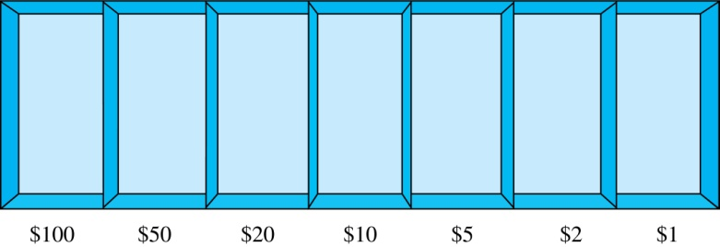
Combinations with Repetition
Example: How many ways are there to select five bills from a box containing at least five of each of the following denominations: $1, $2, $5, $10, $20, $50, and $100?
Solution: Place the selected bills in the appropriate position of a cash box illustrated below:
continued →

Slide 5
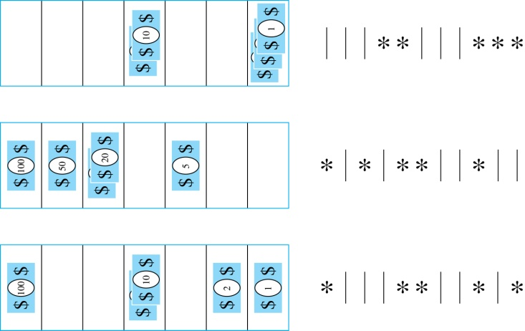

Combinations with Repetition
Some possible ways of
placing the five bills:
The number of ways to select five bills corresponds to the number of ways to arrange six bars and five stars in a row.
This is the number of unordered selections of 5 objects from a set of 11. Hence, there are
ways to choose five bills with seven types of bills.

Slide 6
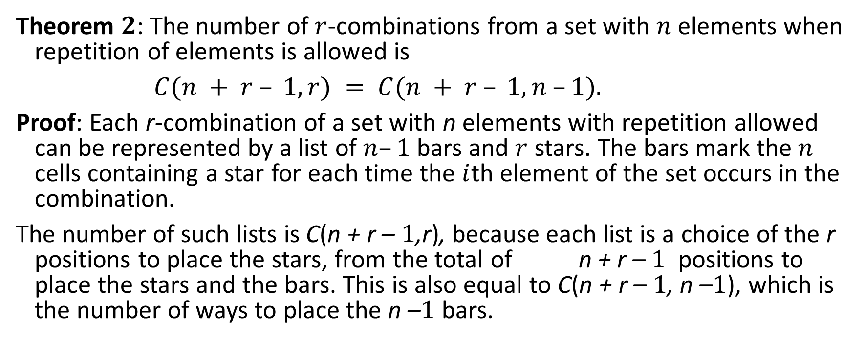
Combinations with Repetition
Theorem 2: The number of $r$-combinations from a set with $n$ elements when repetition of elements is allowed is
$C(n + r – 1,r) = C(n + r – 1, n –1).$
Proof: Each r-combination of a set with n elements with repetition allowed can be represented by a list of $n–1$ bars and $r$ stars. The bars mark the $n$ cells containing a star for each time the $i$th element of the set occurs in the combination.
The number of such lists is C(n + r – 1,r), because each list is a choice of the r positions to place the stars, from the total of n + r – 1 positions to place the stars and the bars. This is also equal to C(n + r – 1, n –1), which is the number of ways to place the n –1 bars.

Slide 7
Combinations with Repetition
Example: How many solutions does the equation
x₁ + x₂ + x₃ = 11
have, where x₁ , x₂ and x₃ are nonnegative integers?
Solution: Each solution corresponds to a way to select 11 items from a set with three elements; x₁ elements of type one, x₂ of type two, and x₃ of type three.
By Theorem 2 it follows that there are
solutions.

Slide 8
Combinations with Repetition
Example: Suppose that a cookie shop has four different kinds of cookies. How many different ways can six cookies be chosen?
Solution: The number of ways to choose six cookies is the number of 6-combinations of a set with four elements. By Theorem 2
is the number of ways to choose six cookies from the four kinds.

Slide 9
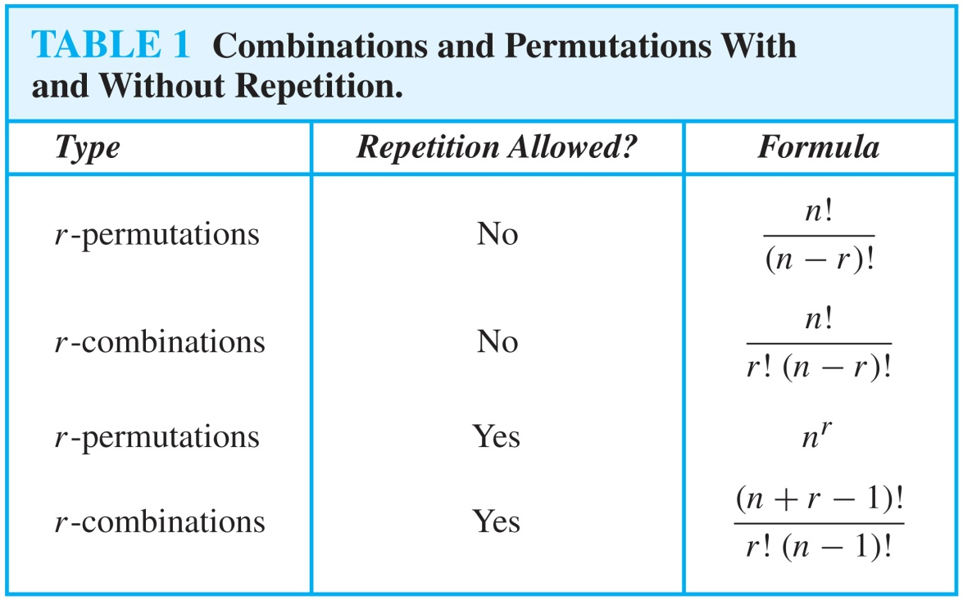
Formulas for Permutations/Combinations with/without Repetition

Slide 10
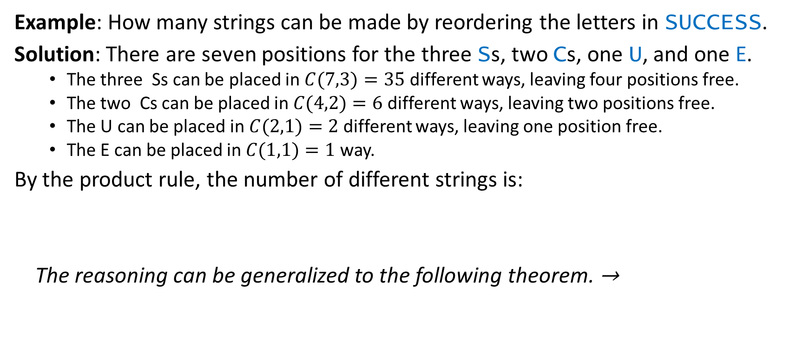
Permutations with Indistinguishable Objects
Example: How many strings can be made by reordering the letters in SUCCESS.
Solution: There are seven positions for the three Ss, two Cs, one U, and one E.
The three Ss can be placed in $C(7,3)=35$ different ways, leaving four positions free.
The two Cs can be placed in $C(4,2)=6$ different ways, leaving two positions free.
The U can be placed in $C(2,1)=2$ different ways, leaving one position free.
The E can be placed in $C(1,1)=1$ way.
By the product rule, the number of different strings is:
The reasoning can be generalized to the following theorem. →

Slide 11
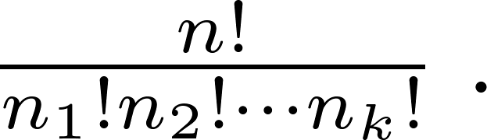
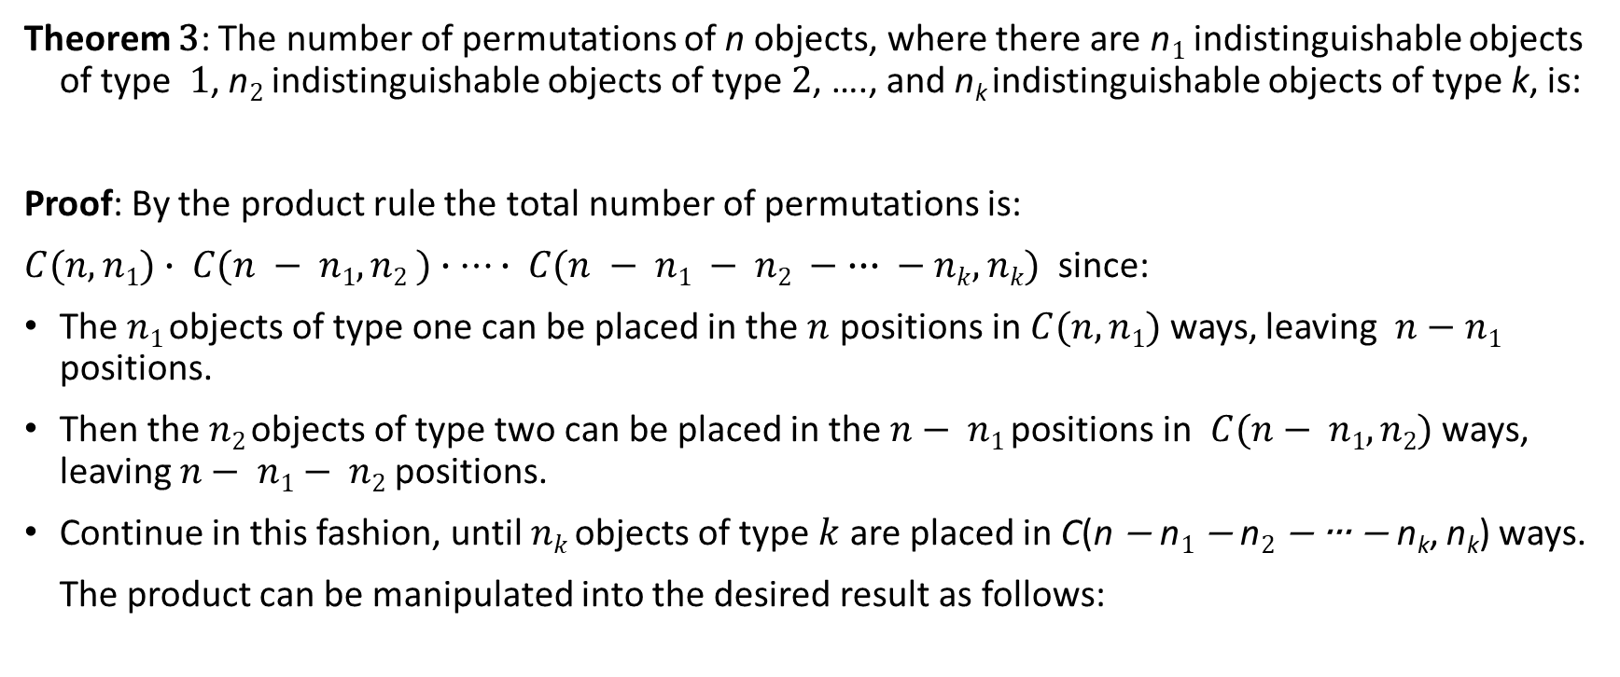
Permutations with Indistinguishable Objects
Theorem 3: The number of permutations of n objects, where there are n₁ indistinguishable objects of type 1, n₂ indistinguishable objects of type 2, …., and n_{k} indistinguishable objects of type k, is:
Proof: By the product rule the total number of permutations is:
$C(n,n1)∙ C(n − n1, n2 )∙⋯∙ C(n − n1 − n2 − ∙∙∙ − nk, nk)$ since:
The $n1$ objects of type one can be placed in the $n$ positions in $C(n, n1)$ ways, leaving $n−n1$ positions.
Then the $n2$ objects of type two can be placed in the $n− n1$ positions in $C(n− n1, n2)$ ways, leaving $n− n1− n2$ positions.
Continue in this fashion, until $nk$ objects of type $k$ are placed in C(n − n₁ − n₂ − ∙∙∙ − n_{k}, n_{k}) ways.
The product can be manipulated into the desired result as follows:

Slide 12
Distributing Objects into Boxes
Many counting problems can be solved by counting the ways objects can be placed in boxes.
The objects may be either different from each other (distinguishable) or identical (indistinguishable).
The boxes may be labeled (distinguishable) or unlabeled (indistinguishable).

Slide 13
Distributing Objects into Boxes
Distinguishable objects and distinguishable boxes.
There are n!/(n₁!n₂! ∙∙∙n_{k}!) ways to distribute n distinguishable objects into k distinguishable boxes.
(See Exercises 47 and 48 for two different proofs.)
Example: There are 52!/(5!5!5!5!32!) ways to distribute hands of 5 cards each to four players.
Indistinguishable objects and distinguishable boxes.
There are C(n + r − 1, n − 1) ways to place r indistinguishable objects into n distinguishable boxes.
Proof based on one-to-one correspondence between n-combinations from a set with k-elements when repetition is allowed and the ways to place n indistinguishable objects into k distinguishable boxes.
Example: There are C(8 + 10 − 1, 10) = C(17,10) = 19,448 ways to place 10 indistinguishable objects into 8 distinguishable boxes.

Slide 14
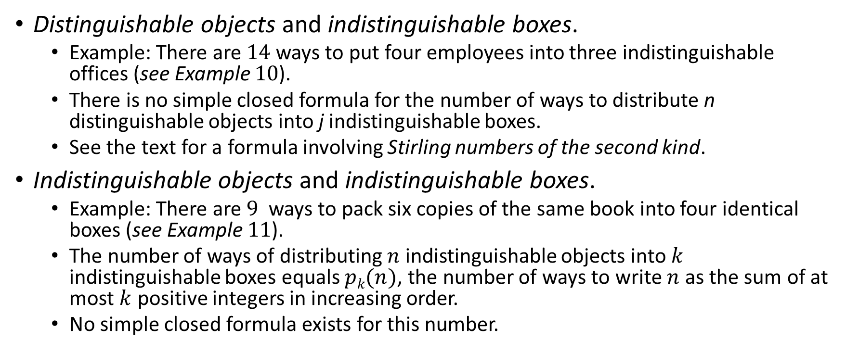
Distributing Objects into Boxes
Distinguishable objects and indistinguishable boxes.
Example: There are 14 ways to put four employees into three indistinguishable offices (see Example 10).
There is no simple closed formula for the number of ways to distribute n distinguishable objects into j indistinguishable boxes.
See the text for a formula involving Stirling numbers of the second kind.
Indistinguishable objects and indistinguishable boxes.
Example: There are 9 ways to pack six copies of the same book into four identical boxes (see Example 11).
The number of ways of distributing $n$ indistinguishable objects into $k$ indistinguishable boxes equals $pk(n)$, the number of ways to write $n$ as the sum of at most $k$ positive integers in increasing order.
No simple closed formula exists for this number.

