Slide 1
Probability Theory
Section 7.2

Slide 2
Section Summary
Assigning Probabilities
Probabilities of Complements and Unions of Events
Conditional Probability
Independence
Bernoulli Trials and the Binomial Distribution
Random Variables
The Birthday Problem
Monte Carlo Algorithms
The Probabilistic Method (not currently included in the overheads)

Slide 3
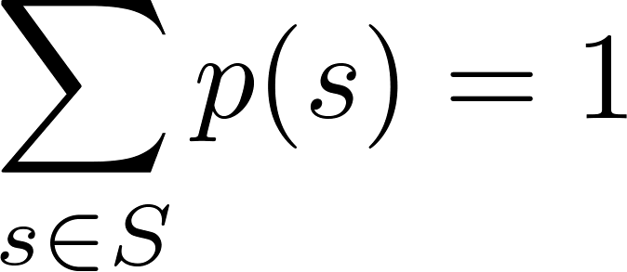
Assigning Probabilities
Laplace’s definition from the previous section, assumes that all outcomes are equally likely. Now we introduce a more general definition of probabilities that avoids this restriction.
Let S be a sample space of an experiment with a finite number of outcomes. We assign a probability p(s) to each outcome s, so that: (i) 0 ≤ p(s) ≤ 1 for each s ∈ S (ii)
The function p from the set of all outcomes of the sample space S is called a probability distribution.

Slide 4
Assigning Probabilities
Example: What probabilities should we assign to the outcomes H(heads) and T (tails) when a fair coin is flipped? What probabilities should be assigned to these outcomes when the coin is biased so that heads comes up twice as often as tails?
Solution: For a fair coin, we have p(H) = p(T) = ½.
For a biased coin, we have p(H) = 2p(T).
Because p(H) + p(T) = 1, it follows that
2p(T) + p(T) = 3p(T) = 1.
Hence, p(T) = 1/3 and p(H) = 2/3.

Slide 5
Uniform Distribution
Definition: Suppose that S is a set with n elements. The uniform distribution assigns the probability 1/n to each element of S. (Note that we could have used Laplace’s definition here.)
Example: Consider again the coin flipping example, but with a fair coin. Now p(H) = p(T) = 1/2.

Slide 6
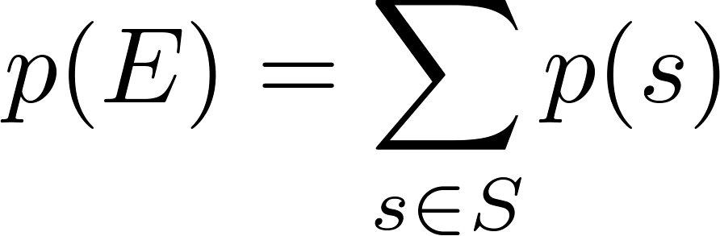
Probability of an Event
Definition: The probability of the event E is the sum of the probabilities of the outcomes in E.
Note that now no assumption is being made about the distribution.

Slide 7
Example
Example: Suppose that a die is biased so that 3 appears twice as often as each other number, but that the other five outcomes are equally likely. What is the probability that an odd number appears when we roll this die?
Solution: We want the probability of the event E = {1,3,5}. We have p(3) = 2/7 and
p(1) = p(2) = p(4) = p(5) = p(6) = 1/7.
Hence, p(E) = p(1) + p(3) + p(5) = 1/7 + 2/7 + 1/7 = 4/7.

Slide 8
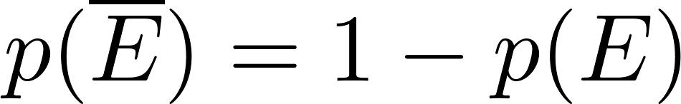

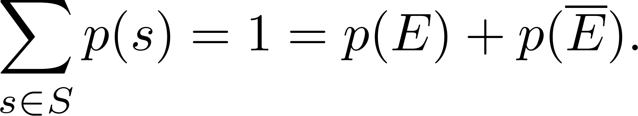
Probabilities of Complements and Unions of Events
Complements: still holds. Since each outcome is in either E or , but not both,
Unions:
also still holds under the new definition.

Slide 9
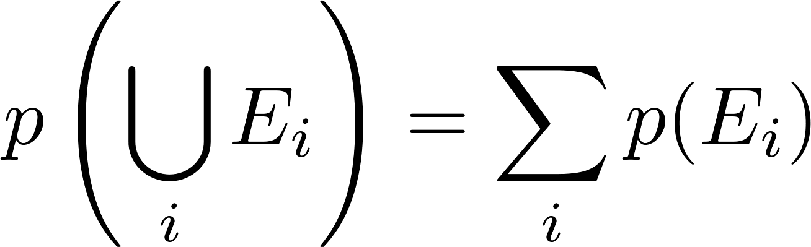
Combinations of Events
Theorem: If E₁, E₂, … is a sequence of pairwise disjoint events in a sample space S, then
see Exercises 36 and 37 for the proof

Slide 10
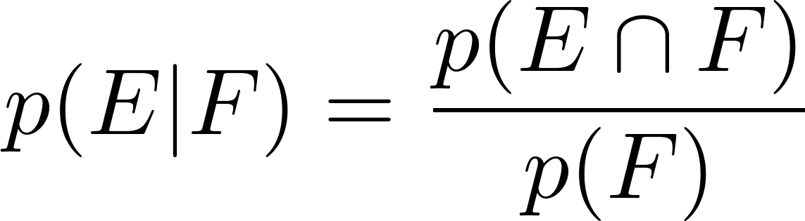
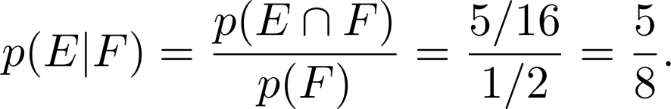
Conditional Probability
Definition: Let E and F be events with p(F) > 0. The conditional probability of E given F, denoted by P(E|F), is defined as:
Example: A bit string of length four is generated at random so that each of the 16 bit strings of length 4 is equally likely. What is the probability that it contains at least two consecutive 0s, given that its first bit is a 0?
Solution: Let E be the event that the bit string contains at least two consecutive 0s, and F be the event that the first bit is a 0.
Since E ⋂ F = {0000, 0001, 0010, 0011, 0100}, p(E⋂F)=5/16.
Because 8 bit strings of length 4 start with a 0, p(F) = 8/16= ½.
Hence,

Slide 11
Conditional Probability
Example: What is the conditional probability that a family with two children has two boys, given that they have at least one boy. Assume that each of the possibilities BB, BG, GB, and GG is equally likely where B represents a boy and G represents a girl.
Question 1: Mr. Jones has two children. The older child is a girl. What is the probability that both children are girls?
Question 2: Mr. Smith has two children. At least one of them is a boy. What is the probability that both children are boys?

Slide 12
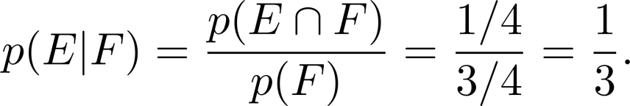
Solution for Question 1: The youngest child being a boy is independent from the oldest child being a boy. So the probability is 1/2.
Solution for Question 2: Let E be the event that the family has two boys and let F be the event that the family has at least one boy. Then E = {BB}, F = {BB, BG, GB}, and E ⋂ F = {BB}.
It follows that p(F) = 3/4 and p(E⋂F)=1/4.
Hence,
Notes:
For Question 2: What is the "protocol" how you gained the knowledge?
(1) Mr. Smith - was he randomly selected out of all two-child parent population?
(2) Mr. Smith – was he caught walking with one of his children that he introduced to us?

Slide 13
Probability w.r.t. Boys/Girls, Weekdays etc.
Question 3: "I have two children. One is a boy born on a Tuesday. What is the probability I have two boys?"
13/27
(See https://math.stackexchange.com/questions/4400/boy-born-on-a-tuesday-is-it-just-a-language-trick)

Slide 14
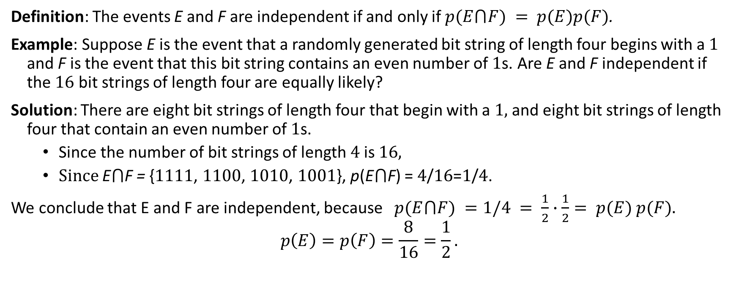
Independence
Definition: The events E and F are independent if and only if $p(E⋂F) = p(E)p(F)$.
Example: Suppose E is the event that a randomly generated bit string of length four begins with a 1 and F is the event that this bit string contains an even number of 1s. Are E and F independent if the 16 bit strings of length four are equally likely?
Solution: There are eight bit strings of length four that begin with a 1, and eight bit strings of length four that contain an even number of 1s.
Since the number of bit strings of length 4 is 16,
Since E⋂F = {1111, 1100, 1010, 1001}, p(E⋂F) = 4/16=1/4.
We conclude that E and F are independent, because $p(E⋂F) =1/4 = \frac{1}{2}∙\frac{1}{2}= p(E) p(F)$.
$$p\left(E\right)=p\left(F\right)=\frac{8}{16}=\frac{1}{2}.$$

Slide 15
Independence
Example: Assume (as in the previous example) that each of the four ways a family can have two children (BB, GG, BG,GB) is equally likely. Are the events E, that a family with two children has two boys, and F, that a family with two children has at least one boy, independent?
Solution: Because E = {BB}, p(E) = 1/4. We saw previously that that p(F) = 3/4 and p(E⋂F)=1/4. The events E and F are not independent since p(E) p(F) = 3/16 ≠ 1/4= p(E⋂F) .

Slide 16
Pairwise and Mutual Independence
Definition: The events E₁, E₂, …, E_{n} are pairwise independent if and only if p(E_{i}⋂E_{j}) = p(E_{i}) p(E_{j}) for all pairs i and j with i ≤ j ≤ n.
The events are mutually independent if
whenever i_{j}, j = 1,2,…., m, are integers with
1 ≤ i₁ < i₂ <∙∙∙ < i_{m} ≤ n and m ≥ 2.

Slide 17
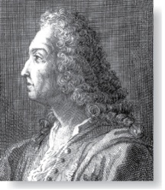
Bernoulli Trials
James Bernoulli
(1854 – 1705)
Definition: Suppose an experiment can have only two possible outcomes, e.g., the flipping of a coin generates a random bit.
Each performance of the experiment is called a Bernoulli trial.
One outcome is called a success and the other a failure.
If p is the probability of success and q the probability of failure, then p + q = 1.
Many problems involve determining the probability of k successes when an experiment consists of n independent Bernoulli trials.

Slide 18
Bernoulli Trials
Example: A coin is biased so that the probability of heads is 2/3. What is the probability that exactly four heads occur when the coin is flipped seven times?
Solution: There are 2⁷ = 128 possible outcomes. The number of ways four of the seven flips can be heads is C(7,4). The probability of each of the outcomes is (2/3)⁴(1/3)³ since the seven flips are independent. Hence, the probability that exactly four heads occur is
C(7,4) (2/3)⁴(1/3)³ = (35∙ 16)/ 2⁷ = 560/ 2187.

Slide 19
k Successes in n Independent Bernoulli Trials
Theorem 2: The probability of exactly k successes in n independent Bernoulli trials, with probability of success p and probability of failure q = 1 − p, is
C(n,k)p^{k}q^{n−k}.
Proof: The outcome of n Bernoulli trials is an n-tuple (t₁,t₂,…,t_{n}), where each is t_{i} either S (success) or F (failure). The probability of each outcome of n trials consisting of k successes and k − 1 failures (in any order) is p^{k}q^{n−k}. Because there are C(n,k) n-tuples of Ss and Fs that contain exactly k Ss, the probability of k successes is C(n,k)p^{k}q^{n−k}.
We denote by b(k:n,p) the probability of k successes in n independent Bernoulli trials with p the probability of success. Viewed as a function of k, b(k:n,p) is the binomial distribution. By Theorem 2,
b(k:n,p) = C(n,k)p^{k}q^{n−k}.

Slide 20
Random Variables
Definition: A random variable is a function from the sample space of an experiment to the set of real numbers. That is, a random variable assigns a real number to each possible outcome.
A random variable is a function. It is not a variable, and it is not random!
In the late 1940s W. Feller and J.L. Doob flipped a coin to see whether both would use “random variable” or the more fitting “chance variable.” Unfortunately, Feller won and the term “random variable” has been used ever since.

Slide 21
Random Variables
Definition: The distribution of a random variable X on a sample space S is the set of pairs (r, p(X = r)) for all r ∊ X(S), where p(X = r) is the probability that X takes the value r.
Example: Suppose that a coin is flipped three times. Let X(t) be the random variable that equals the number of heads that appear when t is the outcome. Then X(t) takes on the following values:
X(HHH) = 3, X(TTT) = 0,
X(HHT) = X(HTH) = X(THH) = 2,
X(TTH) = X(THT) = X(HTT) = 1.
Each of the eight possible outcomes has probability 1/8. So, the distribution of X(t) is p(X = 3) = 1/8, p(X = 2) = 3/8, p(X = 1) = 3/8, and p(X = 0) = 1/8.

Slide 22
The Famous Birthday Problem
For what number of people the probability of at least two of them have the same birthday is more than ½.
Solution: Assume all 366 birthdays to be equally likely. Let p_{n} denote that all n people have different birthdays.
Increase n one-by-one. The probability that at least two have the same birthday is 1− p_{n} .
The probability that the birthday of the second person is different from that of the first is 365/366.
The probability that the birthday of the third person is different from two different birthdays, is 364/366.
In general, the probability that the j-th person has a birthday different from the birthdays of those already in the room, assuming that these people all have different birthdays, is (366 − (j − 1))/366 = (367 − j)/366.
Hence, p_{n} = (365/366)(364/366)∙∙∙ (367 − n)/366.
Therefore , 1− p_{n} = 1−(365/366)(364/366)∙∙∙ (367 − n)/366.
Checking values for n tells us that for n = 22, 1− p_{n} ≈ 0.457, and for n = 23, 1− p_{n} ≈ 0.506. So at least 23 people are needed to have coinciding birthday greater than 1/2.

Slide 23
Monte Carlo Algorithms
Algorithms that make random choices at one or more steps are called probabilistic algorithms.
Monte Carlo algorithms are probabilistic algorithms used to answer decision problems, which are problems that either have “true” or “false” as their answer.
A Monte Carlo algorithm consists of a sequence of tests. For each test the algorithm responds “true” or ‘unknown.’
If the response is “true,” the algorithm terminates with the answer is “true.”
After running a specified sequence of tests where every step yields “unknown”, the algorithm outputs “false.”
The idea is that the probability of the algorithm incorrectly outputting “false” should be very small as long as a sufficient number of tests are performed.

Slide 24
Probabilistic Primality Testing
Probabilistic primality testing (see Example 16 in text) is an example of a Monte Carlo algorithm, which is used to find large primes to generate the encryption keys for RSA cryptography (as discussed in Chapter 4).
An integer n greater than 1 can be shown to be composite (i.e., not prime) if it fails a particular test (Miller’s test), using a random integer b with 1 < b < n as the base. But if n passes Miller’s test for a particular base b, it may either be prime or composite. The probability that a composite integer passes n Miller’s test is for a random b, is less that ¼.
So failing the test, is the “true” response in a Monte Carlo algorithm, and passing the test is “unknown.”
If the test is performed k times (choosing a random integer b each time) and the number n passes Miller’s test at every iteration, then the probability that it is composite is less than (1/4)^{k}. So for a sufficiently, large k, the probability that n is composite even though it has passed all k iterations of Miller’s test is small. For example, with 10 iterations, the probability that n is composite is less than 1 in 1,000,000.
https://docs.sympy.org/latest/modules/ntheory.html (see isprime function)

