Slide 1
Bayes’ Theorem
Section 7.3

Slide 2
Section Summary
Bayes’ Theorem
Generalized Bayes’ Theorem
Bayesian Spam Filters
A.I. Applications (optional, not currently included in the overheads)

Slide 3
Motivation for Bayes’ Theorem
Bayes’ theorem allows us to use probability to answer questions such as the following:
Given that someone tests positive for having a particular disease, what is the probability that they actually do have the disease?
Given that someone tests negative for the disease, what is the probability, that in fact they do have the disease?
Bayes’ theorem has applications to medicine, law, artificial intelligence, engineering, and many diverse other areas.

Slide 4
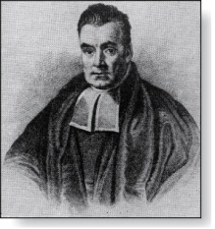
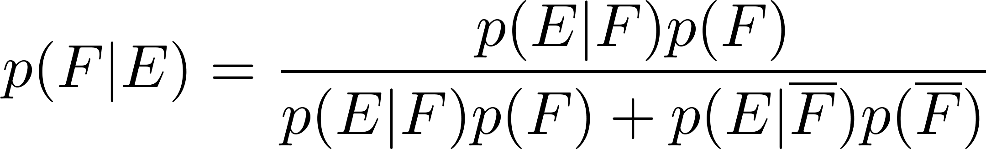
Bayes’ Theorem
Thomas Bayes
(1702-1761)
Bayes’ Theorem: Suppose that E and F are events from a sample space S such that p(E)≠ 0 and p(F) ≠ 0. Then:
Example: We have two boxes. The first box contains two green balls and seven red balls. The second contains four green balls and three red balls. Bob selects one of the boxes at random. Then he selects a ball from that box at random. If he has a red ball, what is the probability that he selected a ball from the first box.
Let E be the event that Bob has chosen a red ball and F be the event that Bob has chosen the first box.
By Bayes’ theorem the probability that Bob has picked the first box is:

Slide 5
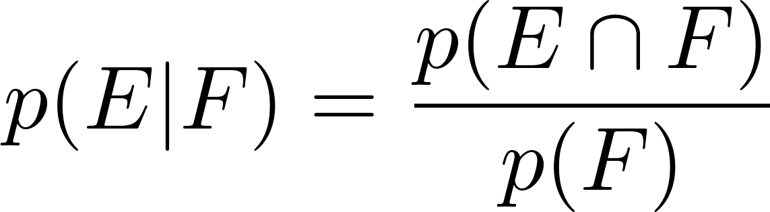
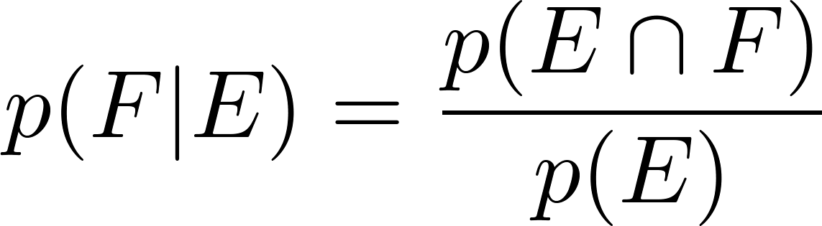
Derivation of Bayes’ Theorem
Recall the definition of the conditional probability p(E|F):
From this definition, it follows that:
,
continued →

Slide 6
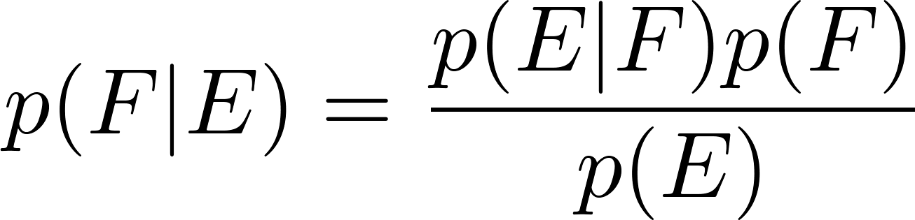
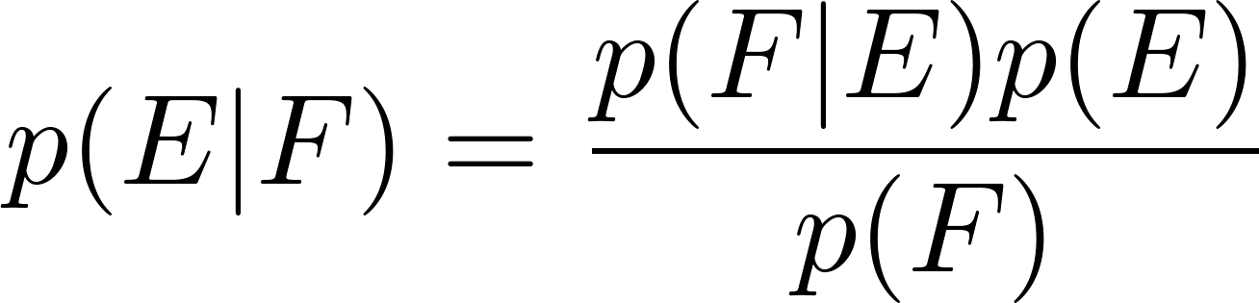
Derivation of Bayes’ Theorem
On the last slide we showed that
,
Equating the two formulas for p(E | F) shows that
Solving for p(E|F) and for p(F|E) tells us that
,
continued →

Slide 7
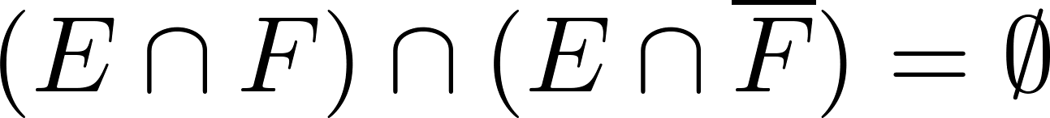
Derivation of Bayes’ Theorem
On the last slide we showed that:
Note that
since
because
and
By the definition of conditional probability,
Hence,

Slide 8
Applying Bayes’ Theorem
Example: Suppose that one person in 100,000 has a particular disease. There is a test for the disease that gives a positive result 99% of the time when given to someone with the disease. When given to someone without the disease, 99.5% of the time it gives a negative result. Find
the probability that a person who test positive has the disease.
the probability that a person who test negative does not have the disease.
Should someone who tests positive be worried?

Slide 9

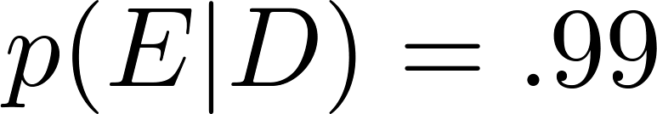

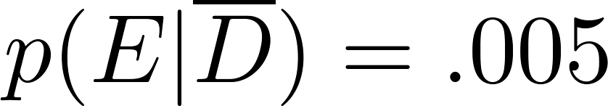
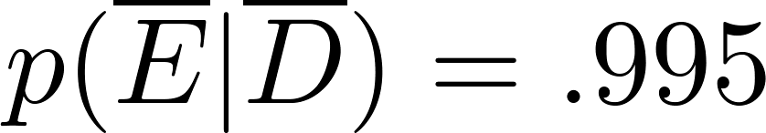
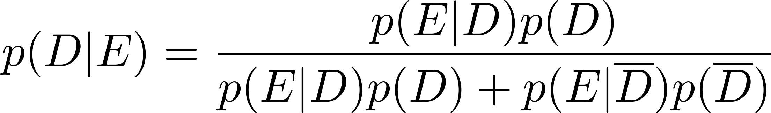
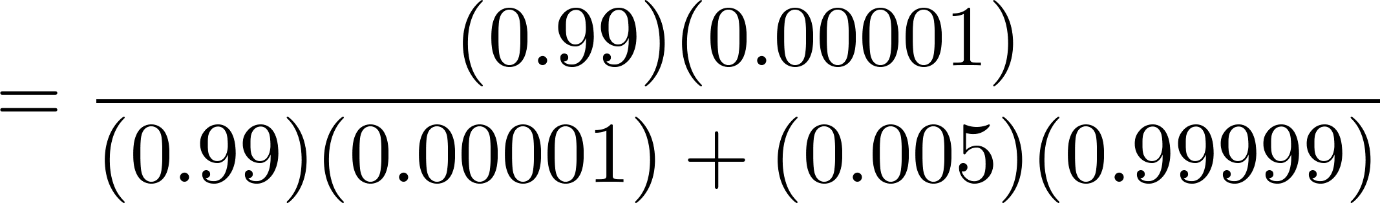

Applying Bayes’ Theorem
Solution: Let D be the event that the person has the disease, and E be the event that this person tests positive. We need to compute p(D|E) from p(D), p(E|D), p( E | ), p( ).
Can you use this formula to explain why the resulting probability is surprisingly small?

Slide 10
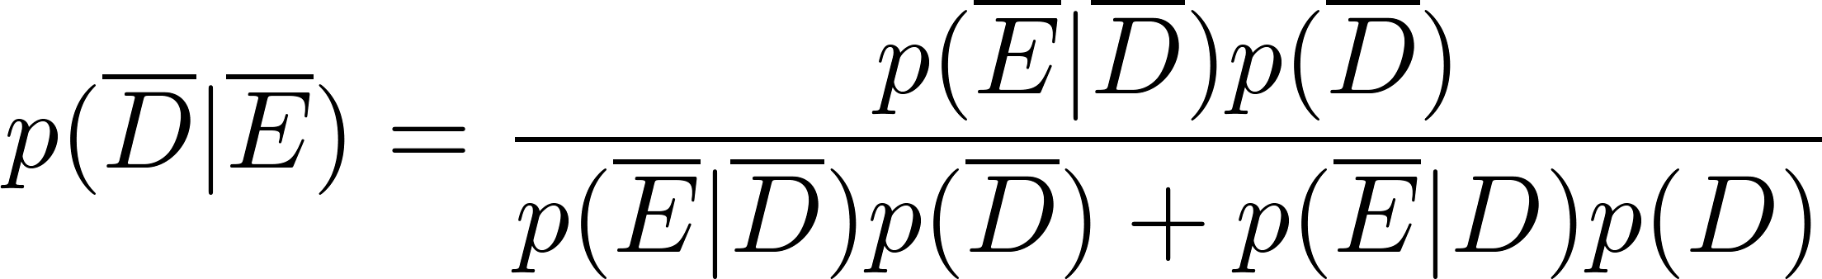
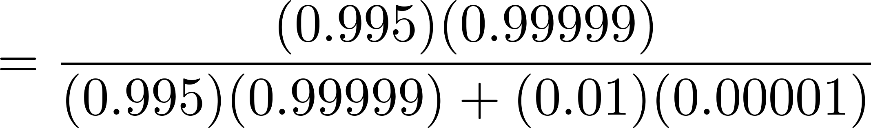
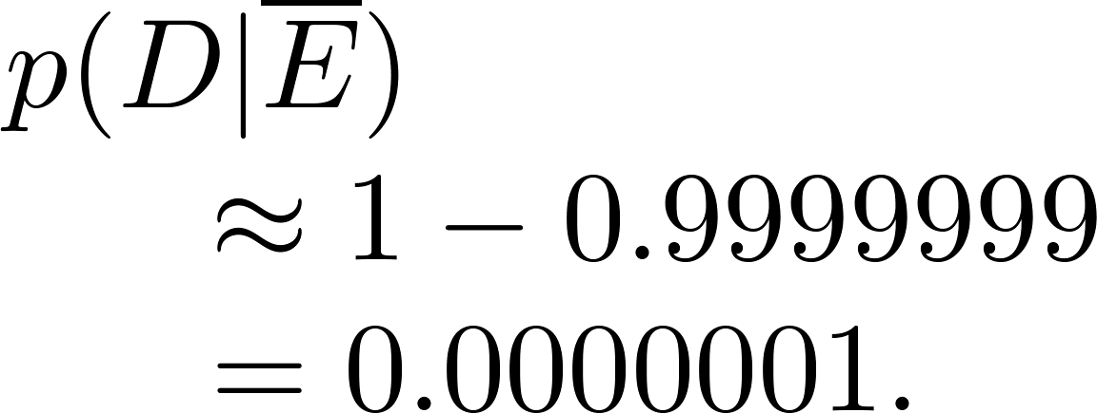

Applying Bayes’ Theorem
What if the result is negative?
So, it is extremely unlikely you have the disease if you test negative.
So, the probability you have the disease if you test negative is

Slide 11
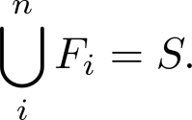
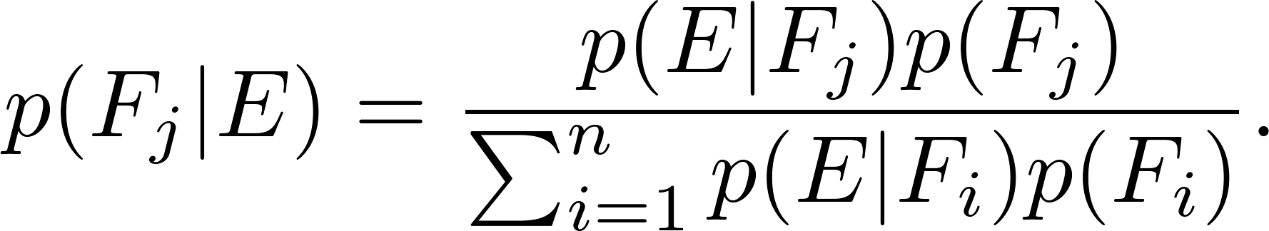
Generalized Bayes’ Theorem
Generalized Bayes’ Theorem: Suppose that E is an event from a sample space S and that F₁, F₂, …, F_{n} are mutually exclusive events such that
Assume that p(E) ≠ 0 for i = 1, 2, …, n. Then
Exercise 17 asks for the proof.

Slide 12
Bayesian Spam Filters
How do we develop a tool for determining whether an email is likely to be spam?
If we have an initial set B of spam messages and set G of non-spam messages. We can use this information along with Bayes’ law to predict the probability that a new email message is spam.
We look at a particular word w, and count the number of times that it occurs in B and in G; n_{B}(w) and n_{G}(w).
Estimated probability that a spam message contains w is: p(w) = n_{B}(w)/|B|
Estimated probability that a message that is not spam contains w is: q(w) = n_{G}(w)/|G|
continued →

Slide 13
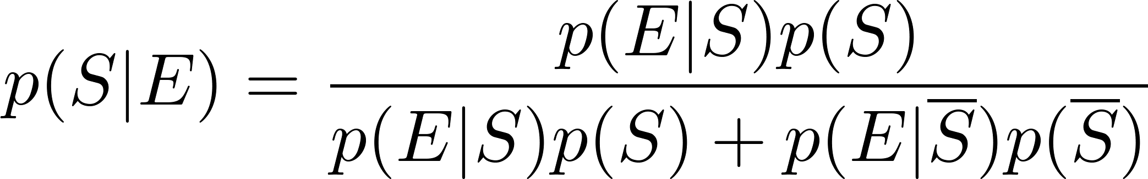
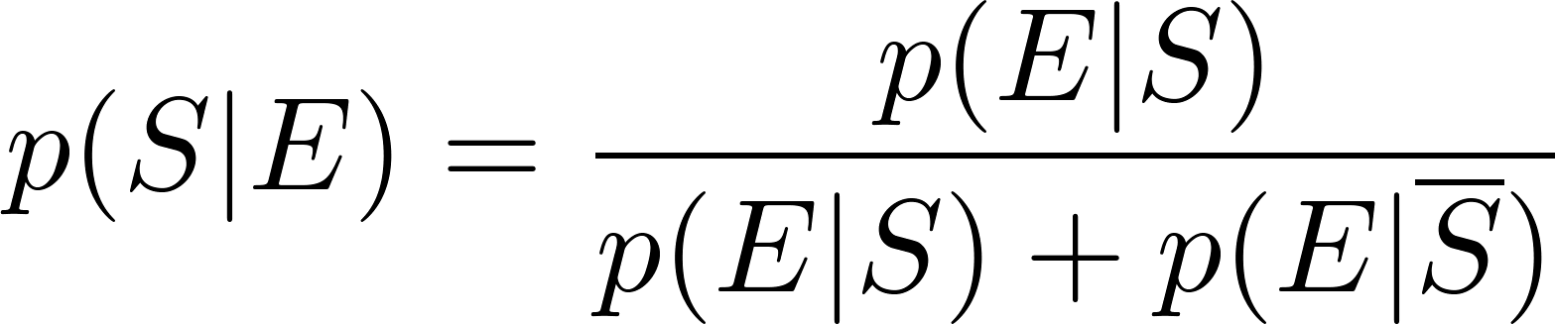
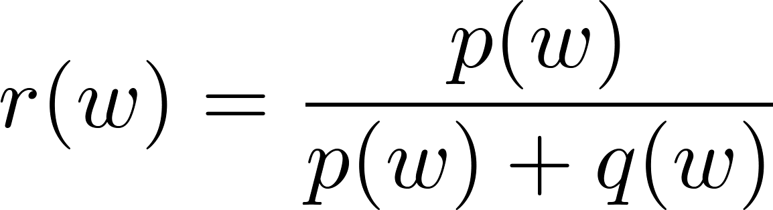
Bayesian Spam Filters
Let S be the event that the message is spam, and E be the event that the message contains the word w.
Using Bayes’ Rule,
Assuming that it is equally likely that an arbitrary message is spam and is not spam; i.e., p(S) = ½.
Note: If we have data on the frequency of spam messages, we can obtain a better estimate for p(s).
(See Exercise 22.)
Using our empirical estimates of
p(E | S) and
p(E |‾S).
r(w) estimates the probability that the message is spam. We can class the message as spam if r(w) is above a threshold.

Slide 14
Bayesian Spam Filters
Example: We find that the word “Rolex” occurs in 250 out of 2000 spam messages and occurs in 5 out of 1000 non-spam messages. Estimate the probability that an incoming message is spam. Suppose our threshold for rejecting the email is 0.9.
Solution: p(Rolex) = 250/2000 =.0125 and q(Rolex) = 5/1000 = 0.005.
We class the message as spam and reject the email!

Slide 15
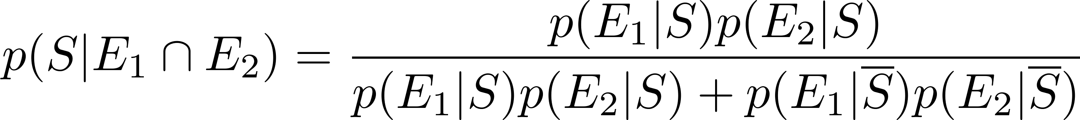
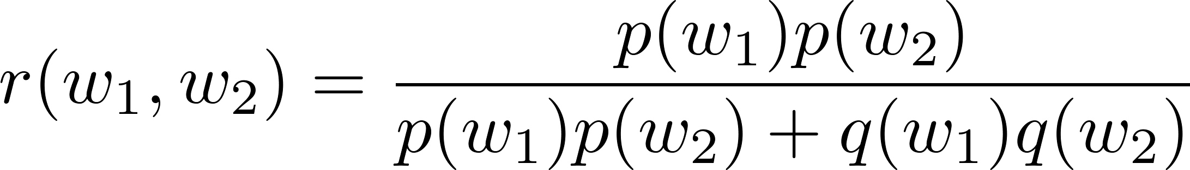
Bayesian Spam Filters using Multiple Words
Accuracy can be improved by considering more than one word as evidence.
Consider the case where E₁ and E₂ denote the events that the message contains the words w₁ and w₂ respectively.
We make the simplifying assumption that the events are independent. And again we assume that p(S) = ½.

Slide 16
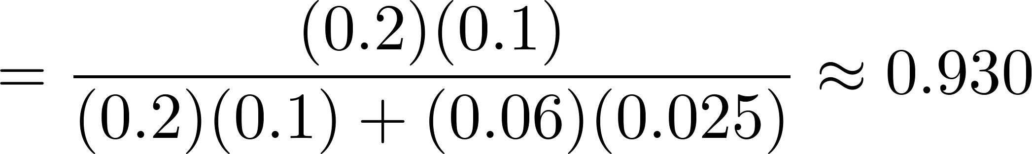
Bayesian Spam Filters using Multiple Words
Example: We have 2000 spam messages and 1000 non-spam messages. The word “stock” occurs 400 times in the spam messages and 60 times in the non-spam. The word “undervalued” occurs in 200 spam messages and 25 non-spam.
Solution: p(stock) = 400/2000 = .2, q(stock) = 60/1000=.06,
p(undervalued) = 200/2000 = .1, q(undervalued) = 25/1000 = .025
If our threshold is .9, we class the message as spam and reject it.

Slide 17
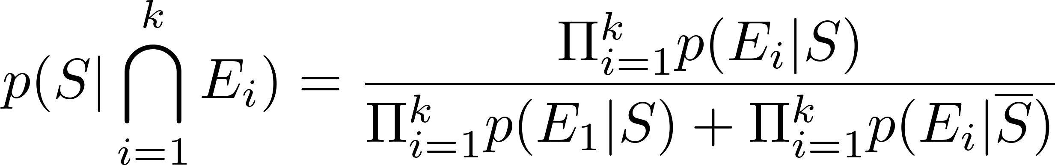
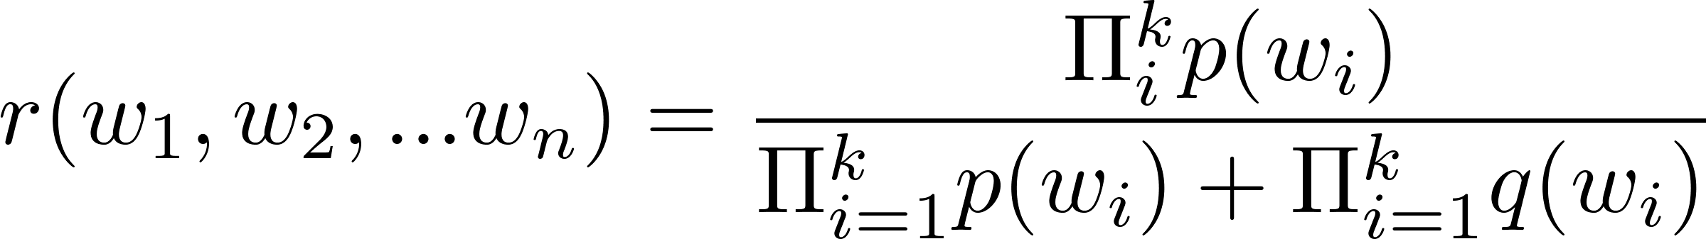
Bayesian Spam Filters using Multiple Words
In general, the more words we consider, the more accurate the spam filter. With the independence assumption if we consider k words:
We can further improve the filter by considering pairs of words as a single block or certain types of strings.

Slide 18
Bayessian Classifiers in IT Security Solutions
Web Proxies // Web Security Gateways. (Also Firewalls.)
Role: Control user's Web traffic as man-in-the middle for HTTP(S) protocols).
Bayes filters are useful in category-based filtering. (Can prevent users from browsing Web in certain categories – Travel, Sports, etc. Even if the URLs look innocuous; just analyze the Web content that is fetched.)
Mail Transfer Agents // Email Security Gateways. (Also social media filters)
Role: Control incoming and outgoing email traffic. Control spam.
Bayes filters can recognize spam or spoofing // social engineering messages of certain kinds.

Slide 19
Bayessian Classifiers in IT Security Solutions
Data Leak Prevention (DLP)
Role: Prevent sending out documents containing Intellectual Property ("IP").
Train the Bayes classifier on certain types of confidential documents (legal agreements, movie scripts, computer software in some language) and then alert the network owner whenever similar stuff is sent out.
User and Entity Behavior Analytics (UEBA)
Role: Detect deviations from "baseline" or "normal" behavior.

