Slide 1
Expected Value and Variance
Section 7.4

Slide 2
Section Summary
Expected Value
Linearity of Expectations
Average-Case Computational Complexity
Geometric Distribution
Independent Random Variables
Variance
Chebyshev’s Inequality

Slide 3
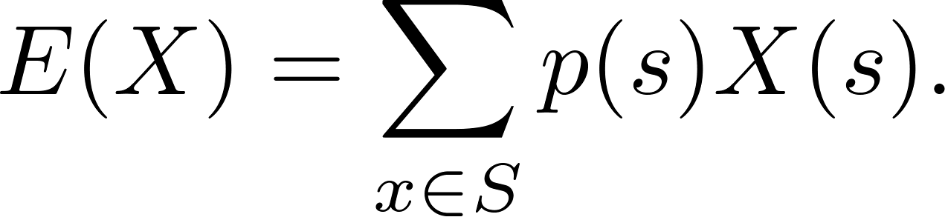
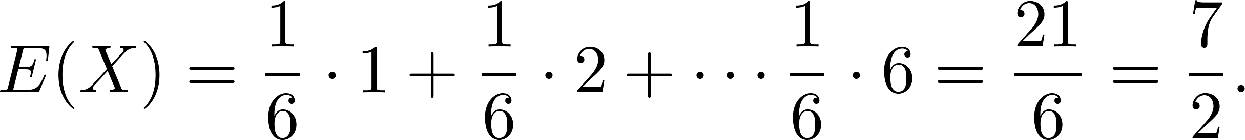
Expected Value
Definition: The expected value (or expectation or mean) of the random variable X(s) on the sample space S is equal to
Example-Expected Value of a Die: Let X be the number that comes up when a fair die is rolled. What is the expected value of X?
Solution: The random variable X takes the values 1, 2, 3, 4, 5, or 6. Each has probability 1/6. It follows that

Slide 4
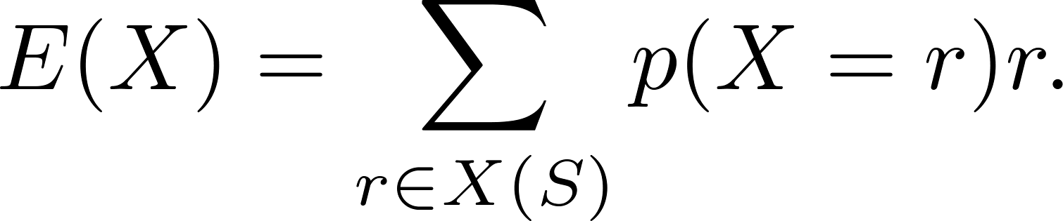
Expected Value
Theorem 1: If X is a random variable and p(X = r) is the probability that X = r, so that
then
Proof: Suppose that X is a random variable with range X(S) and let p(X = r) be the probability that X takes the value r. Consequently, p(X = r) is the sum of the probabilities of the outcomes s such that X(s) = r. Hence,

Slide 5
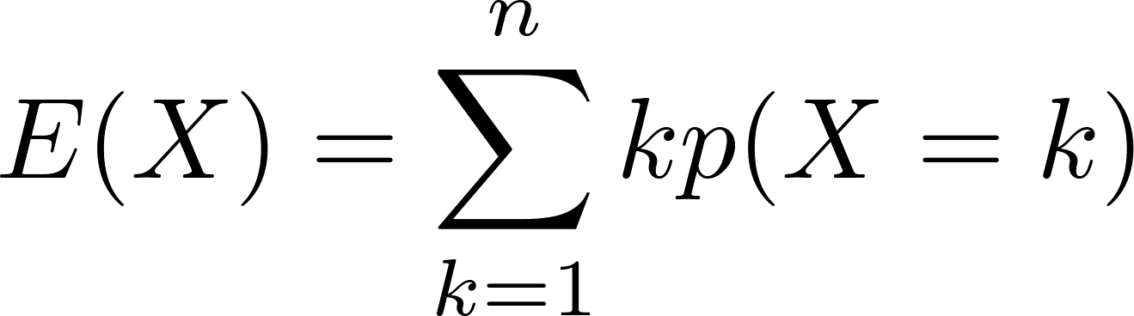
Expected Value
Theorem 2: The expected number of successes when n mutually independent Bernoulli trials are performed, where, the probability of success on each trial, p = np.
Proof: Let X be the random variable equal to the number of success in n trials. By Theorem 2 of section 7.2, p(X = k) = C(n,k)p^{k}q^{n−k}. Hence,
by Theorem 1
continued →

Slide 6
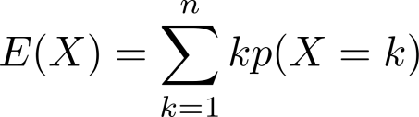
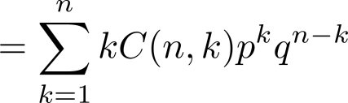
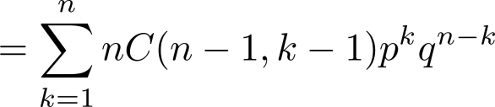
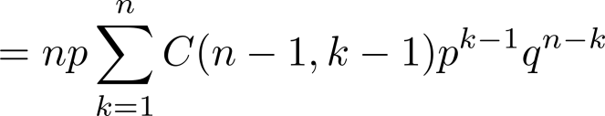
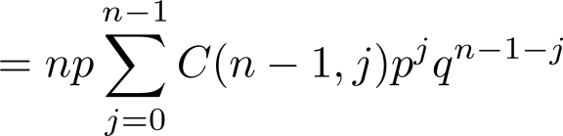

Expected Value
from previous page
by Theorem 2 in Section 7.2
by Exercise 21 in Section 6.4
factoring np from each term
shifting index of summation with j = k − 1
by the binomial theom
because p + q = 1
We see that the expected number of successes in n mutually independent Bernoulli trials is np.

Slide 7
Linearity of Expectations
The following theorem tells us that expected values are linear. For example, the expected value of the sum of random variables is the sum of their expected values.
Theorem 3: If X_{i}, i = 1, 2, …,n with n a positive integer, are random variables on S, and if a and b are real numbers, then
(i) E(X₁ + X₂ + …. + X_{n}) = E(X₁ )+ E(X₂) + …. + E(X_{n})
(ii) E(aX + b) = aE(X) + b.
see the text for the proof

Slide 8
Linearity of Expectations - Hatcheck
Expected Value in the Hatcheck Problem: A new employee started a job checking hats, but forgot to put the claim check numbers on the hats. So, the n customers just receive a random hat from those remaining. What is the expected number of hat returned correctly?
Solution: Let X be the random variable that equals the number of people who receive the correct hat. Note that X = X₁ + X₂ + ∙∙∙ + X_{n}, where X_{i} = 1 if the ith person receives the hat and X_{i} = 0 otherwise. Because it is equally likely that the checker returns any of the hats to the ith person, it follows that the probability that the ith person receives the correct hat is 1/n. Consequently (by Theorem 1), for all I
E(X_{i}) = 1 ∙p(X_{i} = 1) + 0 ∙p(X_{i} = 0) = 1 ∙ 1/n + 0 = 1/n .
By the linearity of expectations (Theorem 3), it follows that:
E(X )= E(X₁) + E(X₂) + ∙∙∙ + E(X_{n}) = n ∙ 1/n – 1.
Consequently, the average number of people who receive the correct hat is exactly 1. (Surprisingly, this answer remains the same no matter how many people checked their hats!)

Slide 9
Linearity of Expectations - Inversions
Expected Number of Inversions in a Permutation: The ordered pair (i,j) is an inversion in a permutation of the first n positive integers if i < j, but j precedes i in the permutation.
Example: There are six inversions in the permutation of 3,5, 1, 4, 2
(1, 3), (1, 5), (2, 3), (2, 4), (2, 5), (4, 5).
Find the average number of inversions in a random permutation of the first n integers.

Slide 10
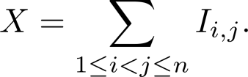

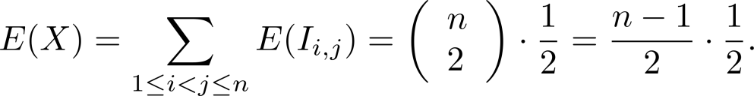
Linearity of Expectations – Inversions (Solved)
Solution: Let I_{i,j} be the random variable on the set of all permutations of the first n positive integers with I_{i,j} = 1 if (i,j) is an inversion of the permutation and I_{i,j} = 0 otherwise. If X is the random variable equal to the number of inversions in the permutation, then
Since it is equally likely for i to precede j in a randomly chosen permutation as it is for j to precede i, we have: E(I_{i,j}) = 1 ∙p(I_{i ,j} = 1) + 0 ∙p(I_{i,j} = 0) = 1 ∙ 1/2 + 0 = ½, for all (i,j).
Because there are pairs i and j with 1 ≤ i < j ≤ n, by the linearity of expectations (Theorem 3), we have:
Consequently, it follows that there is an average of n(n −1)/4 inversions in a random permutation of the first n positive integers.

Slide 11
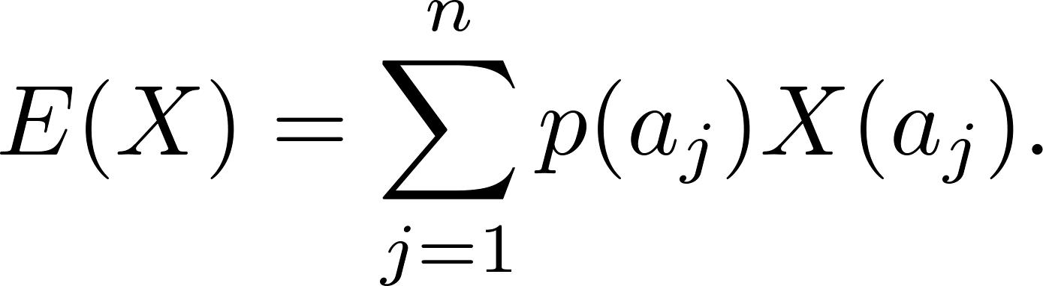
Average-Case Computational Complexity
The average-case computational complexity
of an algorithm can be found by computing the
expected value of a random variable.
Let the sample space of an experiment be the set of possible inputs a_{j}, j = 1, 2, …,n, and let the random variable X be the assignment to a_{j} of the number of operations used by the algorithm when given a_{j} as input.
Assign a probability p(a_{j}) to each possible input value a_{j}.
The expected value of X is the average-case computational complexity of the algorithm.

Slide 12
Average-Case Complexity of Linear Search
What is the average-case complexity of linear search (described in Chapter 3) if the probability that x is in the list is p and it is equally likely that x is any of the n elements of the list?
procedure linear search(x: integer, a₁, a₂, …,a_{n}: distinct integers)
i := 1
while (i ≤ n and x ≠ a_{i})
i := i + 1
if i ≤ n then location := i
else location := 0
return location{location is the subscript of the term that equals x, or is 0 if x is not found}
continued →

Slide 13
Average-Case Complexity of Linear Search
Solution: There are n + 1 possible types of input: one type for each of the n numbers on the list and one additional type for the numbers not on the list. We have:
2i + 1 comparisons are needed if x equals the ith element of the list.
2n + 2 comparisons are used if x is not on the list.
The probability that x equals a_{i} is p/n and the probability that x is not in the list is q = 1− p. The average-case case computational complexity of the linear search algorithm is:
E = 3p/n + 5p/n + … + (2n + 1)p/n + (2n + 2)q = (p/n)( 3 + 5 + …. + (2n + 1)) + (2n + 2)q
= (p/n)((n + 1)² − 1) + (2n + 2)q (Example 2 from Section 5.1)
= p(n + 2) + (2n + 2)q.
When x is guaranteed to be in the list, p = 1, q = 0, so that E = n + 2.
When p is ½ and q = ½, then E = (n + 2)/2 + n + 1 = (3n + 4) /2.
When p is ¾ and q = ¼ then E = (n + 2)/4 + (n + 1)/2 = (5n + 8) /4.
When x is guaranteed not to be in the list, p = 0 and q = 1, then E = 2n + 2.

Slide 14
Average-Case Complexity of Insertion Sort
What is the average number of comparisons used by insertion sort from Chapter 3) to sort n distinct elements?
At step i for i = 2, ….,n, insertion sort inserts the ith element in the original list into the correct position in the sorted list of the first i -1 elements.
procedure insertion sort
(a₁,…,a_{n}: reals with n ≥ 2)
for j := 2 to n
i := 1
while a_{j} > a_{i}
i := i + 1
m := a_{j}
for k := 0 to j − i − 1
a_{j-k} := a_{j-k-1}
a_{i} := m
{Now a₁,…,a_{n} is in increasing order}
continued →

Slide 15
Average-Case Complexity of Insertion Sort
Solution: Let X be the random variable equal to the number of comparisons used by insertion sort to sort a list of a₁, a₂, …., a_{n} distinct elements. E(X) is the average number of comparisons.
Let X_{i} be the random variable equal to the number of comparisons used to insert a_{i} into the proper position after the first i −1 elements a₁, a₂, …., a_{i-1} have been sorted.
Since X = X₂ + X₃ + ∙∙∙ + X_{n},
E(X) = E(X₂ + X₃ + ∙∙∙ + X_{n}) = E(X₂) + E(X₃) + ∙∙∙ + E(X_{n}).
To find E(X_{i}) for i = 2,3,…,n, let p_{j}(k) be the probability that the largest of the first j elements in the list occurs at the kth position, that is, max(a₁, a₂, …., a_{j} ) = a_{k}, where 1 ≤ k ≤ j.
Assume uniform distribution; p_{j}(k) = 1/j .
Then X_{i}(k) = k.
continued →

Slide 16
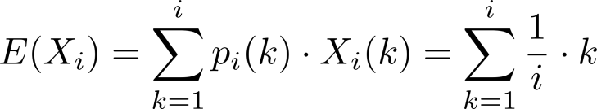
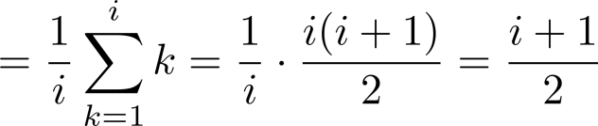
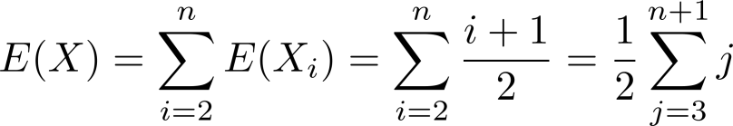

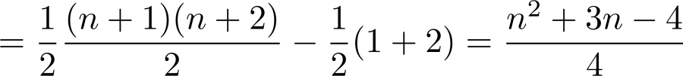
Average-Case Complexity of Insertion Sort
Since a_{i} could be inserted into any of the first i positions
It follows that
The average-case complexity is

Slide 17
The Geometric Distribution
Definition 2: A random variable X has geometric distribution with parameter p if p(X = k) = (1 − p)^{k-1}p for k = 1,2,3,…, where p is a real number with 0 ≤ p ≤ 1.
Theorem 4: If the random variable X has the geometric distribution with parameter p, then E(X) = 1/p.
Example: Suppose the probability that a coin comes up tails is p. What is the expected number of flips until this coin comes up tails?
The sample space is {T, HT, HHT, HHHT, HHHHT, …}.
Let X be the random variable equal to the number of flips in an element of the sample space; X(T) = 1, X(HT) = 2, X(HHT) = 3, etc.
By Theorem 4, E(X) = 1/p.
see text for full details

Slide 18
Independent Random Variables
Definition 3: The random variables X and Y on a sample space S are independent if
p(X = r₁ and Y = r₂) = p(X = r₁)∙ p(Y = r₂).
Theorem 5: If X and Y are independent variables on a sample space S, then E(XY) = E(X)E(Y).
see text for the proof

Slide 19
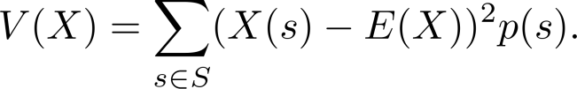

Variance
Deviation: The deviation of X at s ∊ S is X(s) − E(X), the difference between X and the mean of X.
Variance: Let X be a random variable on the sample space S. The variance of X, denoted by V(X) is
That is V(X) is the weighted average of the square of the deviation of X. The standard deviation of X, denoted by σ(X) is defined to be
Theorem 6: If X is a random variable on a sample space S, then V(X) = E(X²) − E(X)².
Corollary 1: If X is a random variable on a sample space S and E(X) = μ , then V(X) = E((X −μ)²).

Slide 20
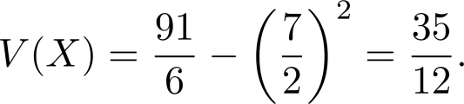
Variance
Example: What is the variance of the random variable X, where X(t) = 1 if a Bernoulli trial is a success and X(t) = 0 if it is a failure, where p is the probability of success and q is the probability of failure?
Solution: Because X takes only the values 0 and 1, it follows that X²(t) = X(t). Hence, V(X) = E(X²) − E(X)² = p − p² = p(1 − p) = pq.
Variance of the Value of a Die: What is the variance of a random variable X (number rolled on a dice)?
Solution: We have V(X) = E(X²) − E(X)² . In an earlier example, we saw that E(X) = 7/2. Note that
E(X²) = 1/6(1² + 2² + 3² +4² + 5² + 6²) = 91/6.
We conclude that

Slide 21
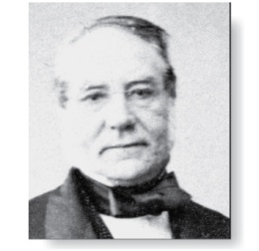
Variance
Irenée-Jules Bienaymé
(1796-1878)
Bienaymé‘s Formula: If X and Y are two independent random variables on a sample space S, then V(X + Y) = V(X) + V(Y). Furthermore, if X_{i}, i = 1,2, …,n, with n a positive integer, are pairwise independent random variables on S, then V(X₁ + X₂ + ∙∙∙ + X_{n}) = V(X₁) + V(X₂) + ∙∙∙ + V(X_{n}).
Example: Find the variance of the number of successes when n independent Bernoulli trials are performed, where on each trial, p is the probability of success and q is the probability of failure.
Solution: Let X_{i} be the random variable with X_{i} ((t₁, t₂, …., t_{n})) = 1 if trial t_{i} is a success and X_{i} ((t₁, t₂, …., t_{n})) = 0 if it is a failure. Let X = X₂ + X₃ + …. X_{n}. Then X counts the number of successes in the n trials.
By Bienaymé ‘s Formula, it follows that V(X)= V(X₁) + V(X₂) + ∙∙∙ + V(X_{n}).
By the previous example ,V(X_{i}) = pq for i = 1,2, …,n. Hence, V(X) = npq.

Slide 22
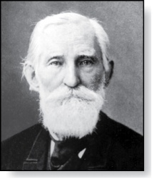
Chebyshev’s Inequality
Pafnuty Lvovich Chebyshev
(1821-1894)
Chebyschev’s Inequality: Let X be a random variable on a sample space S with probability function p. If r is a positive real number, then p(|X(s) − E(X)| ≥ r ) ≤ V(X)/r².
Example: Suppose that X is a random variable that counts the number of tails when a fair coin is tossed n times. Note that X is the number of successes when n independent Bernoulli trials, each with probability of success ½ are done. Hence, (by Theorem 2) E(X) = n/2 and (by Example 18) V(X) = n/4.
By Chebyschev’s inequality with r = √n, p(|X(s) − n/2| ≥ √n ) ≤ (n/4 )(√n )² = ¼.
This means that the probability that the number of tails that come up on n tosses deviates from the mean , n/2, by more than √n is no larger than ¼.

