Slide 1
Advanced Combinatorics: Generating Functions
Section 8.4

Slide 2
Section Summary
Generating Functions
Counting Problems and Generating Functions
Useful Generating Functions
Solving Recurrence Relations Using Generating Functions (not yet covered in the slides)
Proving Identities Using Generating Functions (not yet covered in the slides)

Slide 3
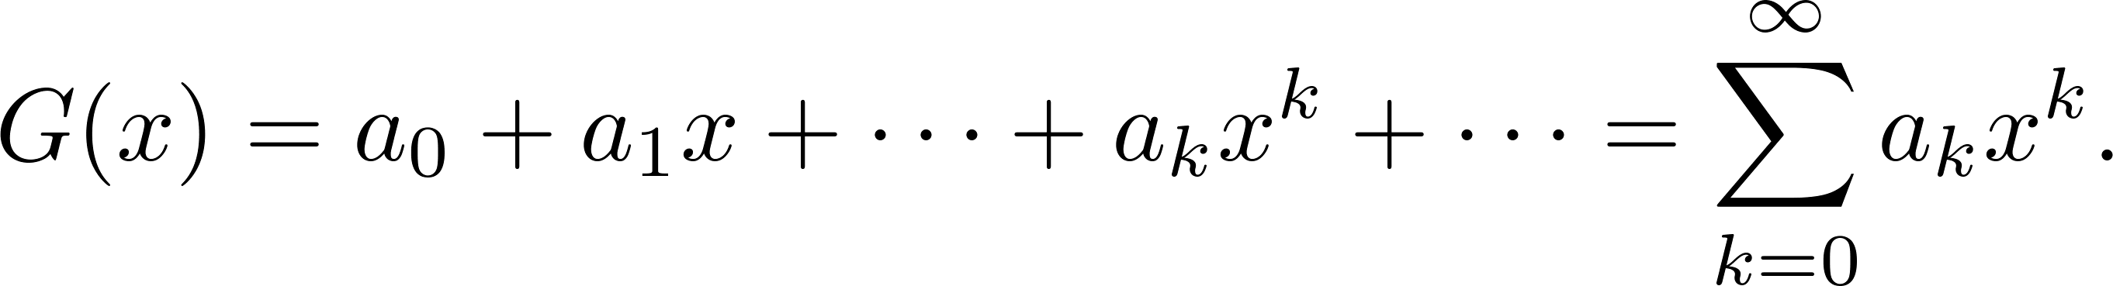
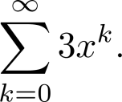
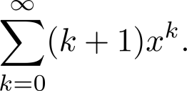
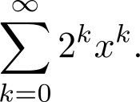
Generating Functions
Definition: The generating function for the sequence a₀, a₁,…, a_{k}, … of real numbers is the infinite series
Examples:
The sequence {a_{k}} with a_{k} = 3 has the generating function
The sequence {a_{k}} with a_{k} = k + 1 has the generating function has the generating function
The sequence {a_{k}} with a_{k} = 2^{k} has the generating function has the generating function

Slide 4
Generating Functions for Finite Sequences
Generating functions for finite sequences of real numbers can be defined by extending a finite sequence a₀,a₁, … , a_{n} into an infinite sequence by setting a_{n+1} = 0, a_{n+2} = 0, and so on.
The generating function G(x) of this infinite sequence {a_{n}} is a polynomial of degree n because no terms of the form a_{j}x^{j} with j > n occur, that is,
G(x) = a₀ + a₁x + ⋯ + a_{n} x^{n}.

Slide 5
Generating Functions for Finite Sequences (continued)
Example: What is the generating function for the sequence 1,1,1,1,1,1?
Solution: The generating function of 1,1,1,1,1,1 is
1 + x + x² + x³ + x⁴ + x⁵.
By Theorem 1 of Section 2.4, we have
(x⁶ − 1)/(x −1) = 1 + x + x² + x³ + x⁴ + x⁵ when x ≠ 1.
Consequently G(x) = (x⁶ − 1)/(x −1) is the generating function of the sequence.

Slide 6
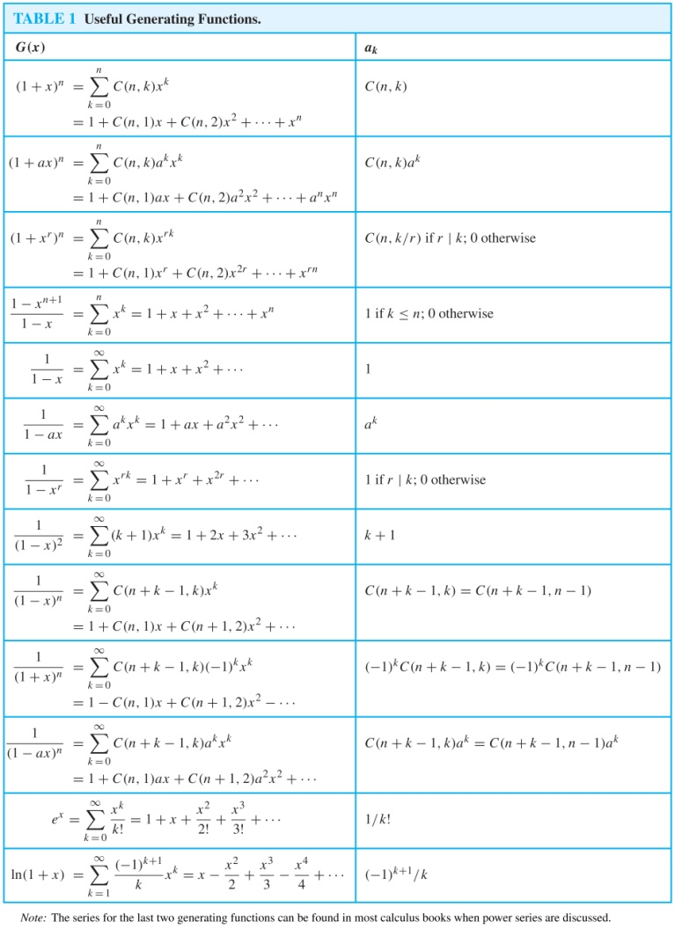
Useful Generating Functions

Slide 7
Counting Problems and Generating Functions
Example: Find the number of solutions of
e₁ + e₂ + e₃ = 17,
where e₁, e₂, and e₃ are nonnegative integers with 2 ≤ e₁≤ 5, 3 ≤ e₂ ≤ 6, and 4 ≤ e₃ ≤ 7.
Solution: The number of solutions is the coefficient of x¹⁷ in the expansion of
(x² + x³ + x⁴ + x⁵) (x³ + x⁴ + x⁵ + x⁶) (x⁴ + x⁵ + x⁶ + x⁷).
This follows because a term equal to is obtained in the product by picking a term in the first sum x^{e1}, a term in the second sum x^{e2}, and a term in the third sum x^{e3}, where e₁ + e₂ + e₃ = 17.
There are three solutions since the coefficient of x¹⁷ in the product is 3.

Slide 8

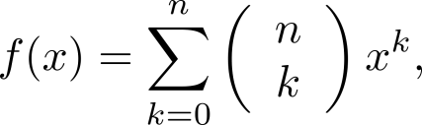
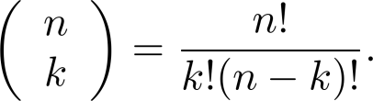
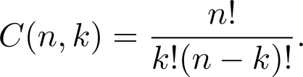
Counting Problems and Generating Functions (continued)
Example: Use generating functions to find the number of k-combinations of a set with n elements, i.e., C(n,k).
Solution: Each of the n elements in the set contributes the term (1 + x) to the generating function
Hence f(x) = (1 + x)^{n} where f(x) is the generating function for {a^{k}}, where a^{k} represents the number of k-combinations of a set with n elements.
By the binomial theorem, we have
where
Hence,

