Slide 1
Representing Relations
Section 9.3

Slide 2
Section Summary
Representing Relations using Matrices
Representing Relations using Digraphs

Slide 3
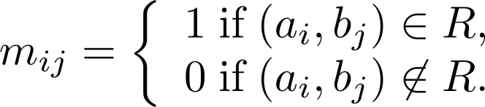
Representing Relations Using Matrices
A relation between finite sets can be represented using a zero-one matrix.
Suppose R is a relation from A = {a₁, a₂, …, a_{m}} to B = {b₁, b₂, …, b_{n}}.
The elements of the two sets can be listed in any particular arbitrary order. When A = B, we use the same ordering.
The relation R is represented by the matrix M_{R} = [m_{ij}], where
The matrix representing R has a 1 as its (i,j) entry when a_{i} is related to b_{j} and a 0 if a_{i} is not related to b_{j}.

Slide 4
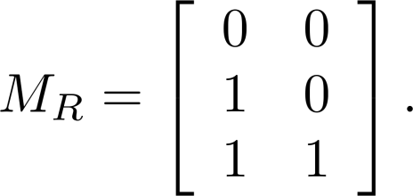
Examples of Relations as Matrices – 1
Example 1: Suppose that A = {1,2,3} and B = {1,2}. Let R be the relation from A to B containing (a,b) if a ∈ A, b ∈ B, and a > b. What is the matrix representing R (assuming the ordering of elements is the same as the increasing numerical order)?
Solution: Because R = {(2,1), (3,1),(3,2)}, the matrix is

Slide 5
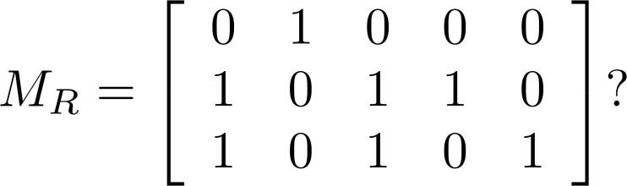
Examples of Relations as Matrices – 2
Example 2: Let A = {a₁,a₂, a₃} and B = {b₁,b₂, b₃,b₄, b₅}. Which ordered pairs are in the relation R represented by the matrix
Solution: Because R consists of those ordered pairs (a_{i},b_{j}) with m_{ij} = 1, it follows that: R = {(a₁, b₂), (a₂, b₁),(a₂, b₃), (a₂, b₄),(a₃, b₁), {(a₃, b₃), (a₃, b₅)}.

Slide 6
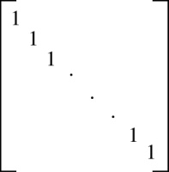
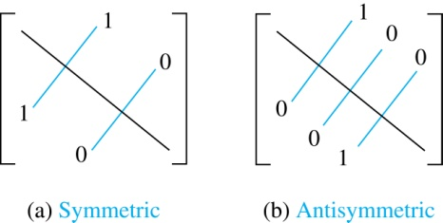
Matrices of Relations on Sets
If R is a reflexive relation, all the elements on the main diagonal of M_{R} are equal to 1.
R is a symmetric relation, if and only if m_{ij} = 1 whenever m_{ji} = 1. R is an antisymmetric relation, if and only if m_{ij} = 0 or m_{ji} = 0 when i≠ j.

Slide 7
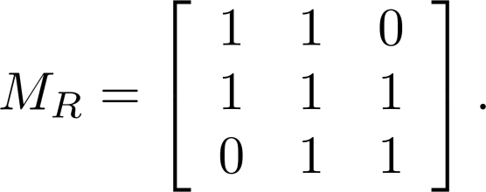
Example of a Relation on a Set
Example 3: Suppose that the relation R on a set is represented by the matrix
Is R reflexive, symmetric, and/or antisymmetric?
Solution: Because all the diagonal elements are equal to 1, R is reflexive. Because M_{R} is symmetric, R is symmetric and not antisymmetric because both m_{1,2} and m_{2,1} are 1.

Slide 8
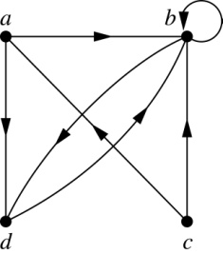
Representing Relations Using Digraphs
Definition: A directed graph, or digraph, consists of a set V of vertices (or nodes) together with a set E of ordered pairs of elements of V called edges (or arcs). The vertex a is called the initial vertex of the edge (a,b), and the vertex b is called the terminal vertex of this edge.
An edge of the form (a,a) is called a loop.
Example 7: A drawing of the directed graph with vertices a, b, c, and d, and edges (a, b), (a, d), (b, b), (b, d), (c, a), (c, b), and (d, b) is shown here.

Slide 9
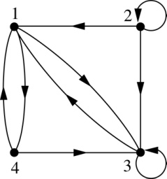
Examples of Digraphs Representing Relations
Example 8: What are the ordered pairs in the relation represented by this directed graph?
Solution: The ordered pairs in the relation are (1, 3), (1, 4), (2, 1), (2, 2), (2, 3), (3, 1), (3, 3), (4, 1), and (4, 3)

Slide 10
Determining which Properties a Relation has from its Digraph
Reflexivity: A loop must be present at all vertices in the graph.
Symmetry: If (x,y) is an edge, then so is (y,x).
Antisymmetry: If (x,y) with x ≠ y is an edge, then (y,x) is not an edge.
Transitivity: If (x,y) and (y,z) are edges, then so is (x,z).

Slide 11
Properties from Digraph - 1
Reflexive? No, not every vertex has a loop
Symmetric? Yes (trivially), there is no edge from one vertex to another
Antisymmetric? Yes (trivially), there is no edge from one vertex to another
Transitive? Yes, (trivially) since there is no edge from one vertex to another
a
b
c
d

Slide 12
Properties from Digraph - 2
Reflexive? No, there are no loops
Symmetric? No, there is an edge from a to b, but not from b to a
Antisymmetric? No, there is an edge from d to b and b to d
Transitive? No, there are edges from a to c and from c to b, but there is no edge from a to d
a
b
c
d

Slide 13
Properties from Digraph - 3
Reflexive? No, there are no loops
Symmetric? No, for example, there is no edge from c to a
Antisymmetric? Yes, whenever there is an edge from one vertex to another, there is not one going back
Transitive? No, there is no edge from a to b
a
b
c
d

Slide 14
Properties from Digraph - 4
Reflexive? No, there are no loops
Symmetric? No, for example, there is no edge from d to a
Antisymmetric? Yes, whenever there is an edge from one vertex to another, there is not one going back
Transitive? Yes (trivially), there are no two edges where the first edge ends at the vertex where the second edge begins
b
a
c
d

Slide 15
Example of the Powers of a Relation
R
R²
b
a
b
a
d
c
d
c
R⁴
R³
a
b
a
b
d
c
d
c
The pair (x,y) is in R^{n} if there is a path of length n from x to y in R (following the direction of the arrows).

