Slide 1
Closures of Relations
Section 9.4

Slide 2
Section Summary
Revisit reflexive, symmetric, transitive concepts. Define closures.
Paths in Directed Graphs and Powers of Relations
How to obtain closures in Matrices
Analyze Warshall's algorithm

Slide 3
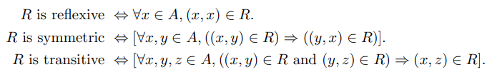
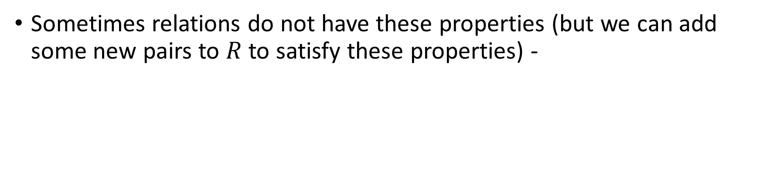
Definitions of Reflexive, Symmetric, Transitive
Sometimes relations do not have these properties (but we can add some new pairs to $R$ to satisfy these properties) -

Slide 4
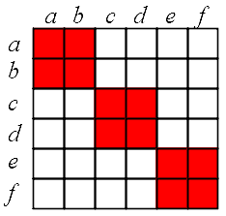
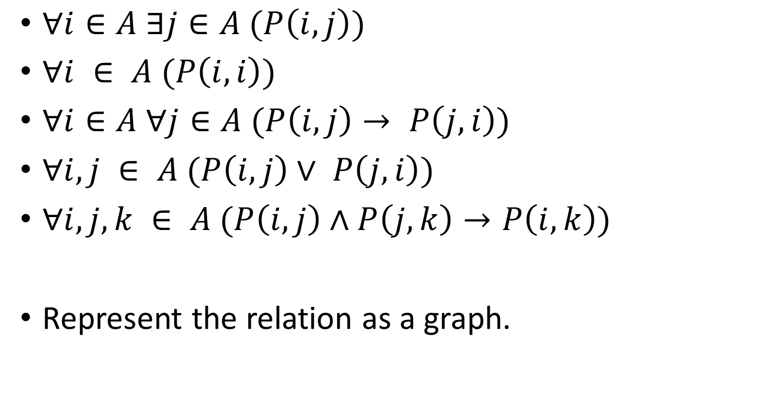
Check Some Predicate Expressions
$∀i∈A ∃j∈A (P\left(i, j\right))$
$∀i ∈ A (P\left(i,i\right))$
$∀i∈A ∀j∈A (P\left(i, j\right)→ P\left(j,i\right))$
$∀i, j ∈ A (P\left(i, j\right)∨ P\left(j,i\right))$
$∀i, j,k ∈ A (P\left(i, j\right)∧P\left(j,k\right)→P\left(i,k\right))$
Represent the relation as a graph.

Slide 5
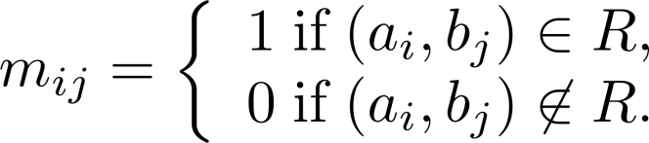
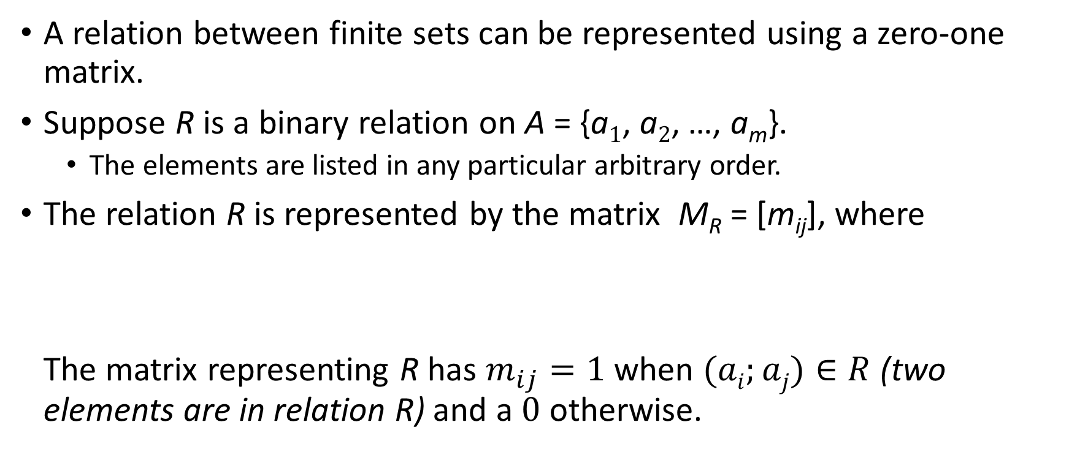
Representing Relations Using Matrices
A relation between finite sets can be represented using a zero-one matrix.
Suppose R is a binary relation on A = {a₁, a₂, …, a_{m}}.
The elements are listed in any particular arbitrary order.
The relation R is represented by the matrix M_{R} = [m_{ij}], where The matrix representing R has $m_{ij}=1$ when $(ai;aj)∈R$ (two elements are in relation R) and a 0 otherwise.

Slide 6
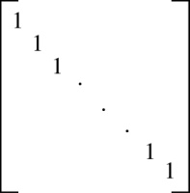
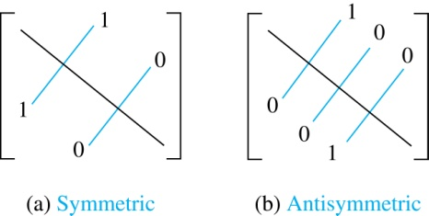
Matrices of Relations on Sets
If R is a reflexive relation, all the elements on the main diagonal of M_{R} are equal to 1.
R is a symmetric relation, if and only if m_{ij} = 1 whenever m_{ji} = 1. R is an antisymmetric relation, if and only if m_{ij} = 0 or m_{ji} = 0 when i≠ j.

Slide 7
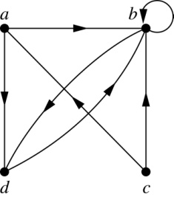
Representing Relations Using Digraphs
Definition: A directed graph, or digraph, consists of a set V of vertices (or nodes) together with a set E of ordered pairs of elements of V called edges (or arcs). The vertex a is called the initial vertex of the edge (a,b), and the vertex b is called the terminal vertex of this edge.
An edge of the form (a,a) is called a loop.
Example 7: A drawing of the directed graph with vertices a, b, c, and d, and edges (a, b), (a, d), (b, b), (b, d), (c, a), (c, b), and (d, b) is shown here.

Slide 8
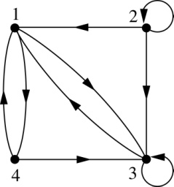
Examples of Digraphs Representing Relations
Example 8: What are the ordered pairs in the relation represented by this directed graph?
Solution: The ordered pairs in the relation are (1, 3), (1, 4), (2, 1), (2, 2), (2, 3), (3, 1), (3, 3), (4, 1), and (4, 3)

Slide 9
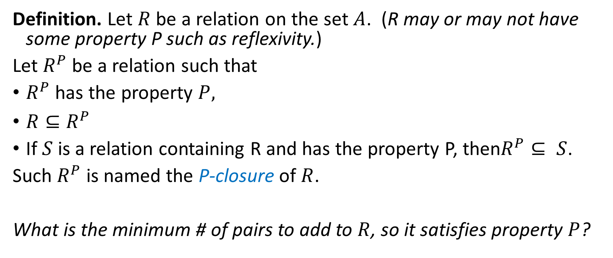
Defining Closure
Definition. Let $R$ be a relation on the set $A$. (R may or may not have some property P such as reflexivity.)
Let $R^{P}$ be a relation such that
$R^{P}$ has the property $P,$
$R⊆R^{P}$
If $S$ is a relation containing R and has the property P, then$R^{P}⊆ S$.
Such $R^{P}$ is named the P-closure of $R$.
What is the minimum # of pairs to add to $R$, so it satisfies property $P$?

Slide 10

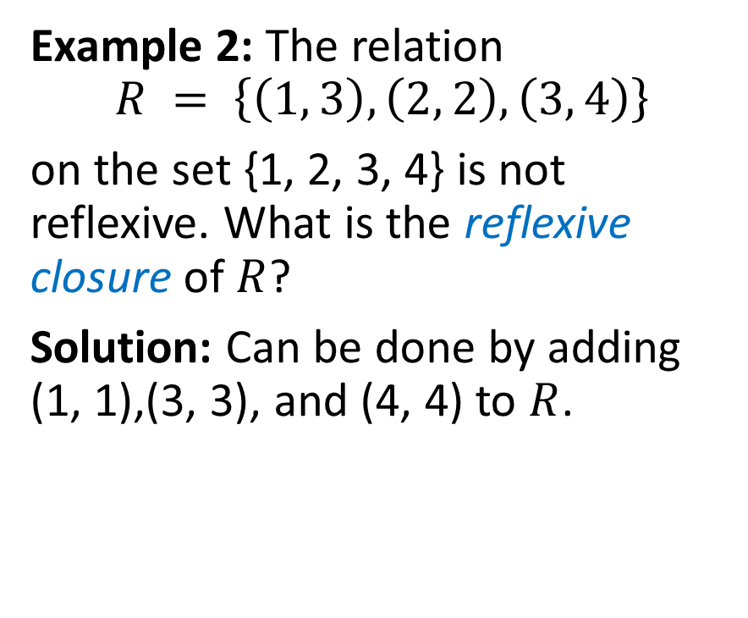

Reflexive Closure – 1
Example 1:
Example 2: The relation
$$R = \left\{\left(1, 3\right),\left(2, 2\right),\left(3, 4\right)\right\}$$ on the set {1, 2, 3, 4} is not reflexive. What is the reflexive closure of $R$?
Solution: Can be done by adding (1, 1),(3, 3), and (4, 4) to $R$.
$$R$$
b
a
d
c
Reflexive
closure
$$R^{∗}$$
a
b
d
c

Slide 11
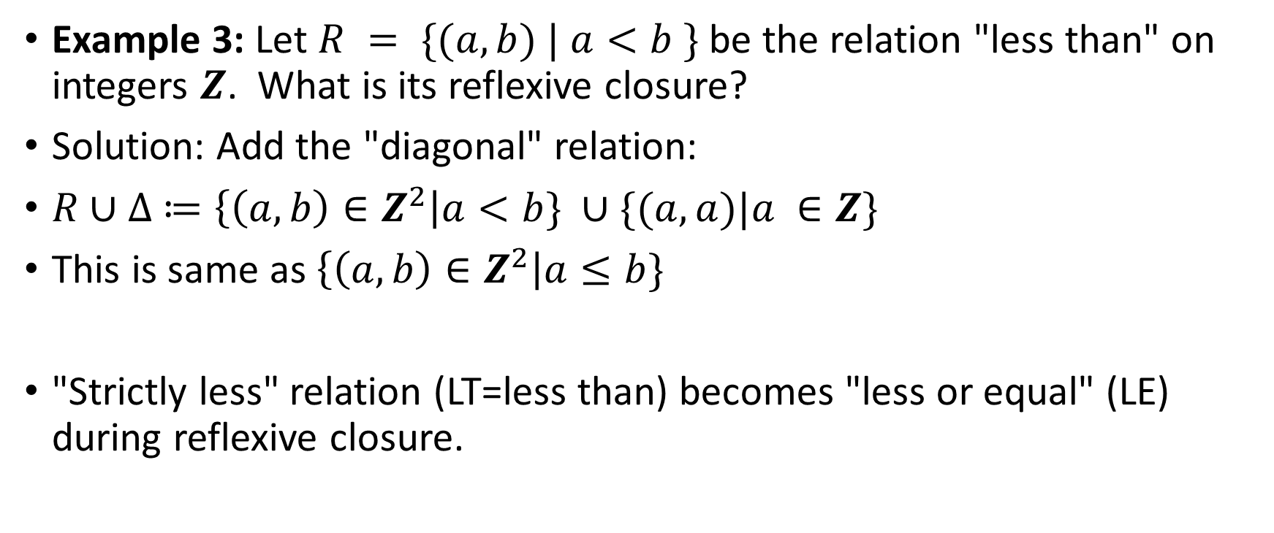
Reflexive Closure – 2
Example 3: Let $R = \{(a,b) | a<b \}$be the relation "less than" on integers $Z$. What is its reflexive closure?
Solution: Add the "diagonal" relation:
$R∪∆ ≔\left\{\left(a,b\right)∈Z^{2}\right|a<b\} ∪\{(a,a)|a ∈Z\}$
This is same as $\left\{\left(a,b\right)∈Z^{2}\right|a≤b\}$
"Strictly less" relation (LT=less than) becomes "less or equal" (LE) during reflexive closure.

Slide 12
Symmetric Closure – 1
Example 1: The relation R = {(1, 3),(2, 2),(3, 4)} on the set {1, 2, 3, 4} is not symmetric. What is the symmetric closure of R?
Solution: Add pairs (3,1), (4,3) and get closure: {(1,3), (2,2), (3,1), (3,4),(4,3)}

Slide 13
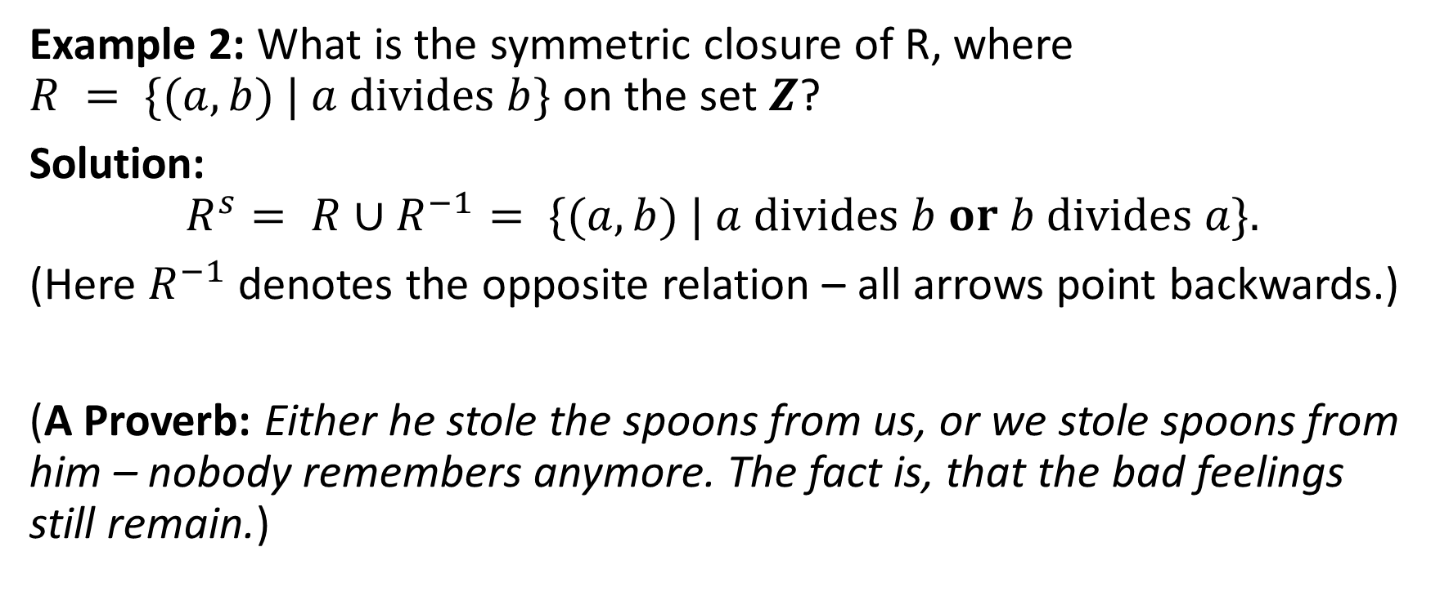
Symmetric Closure – 2
Example 2: What is the symmetric closure of R, where $R = \{(a, b) | a divides b\}$ on the set $Z$?
Solution: $$R^{s}= R∪R^{−1}= \{(a, b) | a divides b or b divides a\}.$$
(Here $R^{−1}$ denotes the opposite relation – all arrows point backwards.)
(A Proverb: Either he stole the spoons from us, or we stole spoons from him – nobody remembers anymore. The fact is, that the bad feelings still remain.)

Slide 14
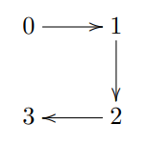
Transitive Closure
Example: Let A = {0, 1, 2, 3} and consider the relation R on A as follows: R = {(0, 1),(1, 2),(2, 3)}. Find the transitive closure of R
Since (0,1) and (1,2) are in R, then (0, 2) ∈ Rt.
Since (1, 2) ∈ R and (2, 3) ∈ R, then (1, 3) ∈ Rt.
But that is not all! Need to consider newly added arrows...

Slide 15
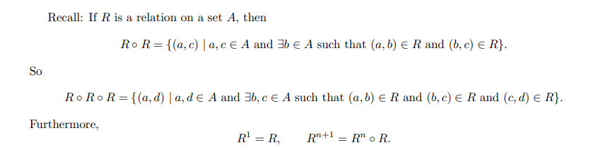

Composition of Relations
Composition builds paths of length 2, 3, and so on.

Slide 16
Example of the Powers of a Relation
R
R²
b
a
b
a
d
c
d
c
R⁴
R³
a
b
a
b
d
c
d
c
The pair (x,y) is in R^{n} if there is a path of length =n from x to y in R (following the direction of the arrows).

Slide 17


Transitive Closure in a Directed Graph
$$R$$
$$R^{t}$$
a
b
a
b
d
c
d
c
Find the transitive closure of R.
Transitive closure can add some loops (if the path ever returns back to the same vertex.

Slide 18

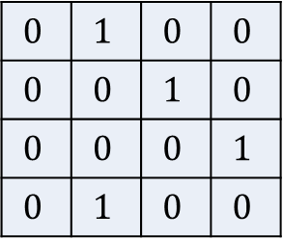
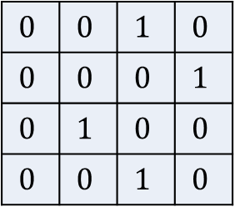
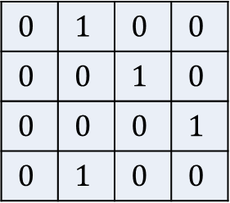
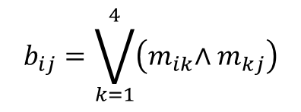
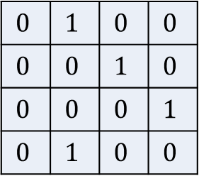



Matrix "Multiplication" – for Relations
R
R²
b
a
b
$$b_{ij}=\bigvee_{k=1}^{4}{\left({m_{ik}\text{∧ }m}_{kj}\right)}$$
a
d
c
d
c
$$0$$ | $$1$$ | $$0$$ | $$0$$
$$0$$ | $$0$$ | $$1$$ | $$0$$
$$0$$ | $$0$$ | $$0$$ | $$1$$
$$0$$ | $$1$$ | $$0$$ | $$0$$
$$0$$ | $$1$$ | $$0$$ | $$0$$
$$0$$ | $$0$$ | $$1$$ | $$0$$
$$0$$ | $$0$$ | $$0$$ | $$1$$
$$0$$ | $$1$$ | $$0$$ | $$0$$
$$0$$ | $$1$$ | $$0$$ | $$0$$
$$0$$ | $$0$$ | $$1$$ | $$0$$
$$0$$ | $$0$$ | $$0$$ | $$1$$
$$0$$ | $$1$$ | $$0$$ | $$0$$
$$0$$ | $$0$$ | $$1$$ | $$0$$
$$0$$ | $$0$$ | $$0$$ | $$1$$
$$0$$ | $$1$$ | $$0$$ | $$0$$
$$0$$ | $$0$$ | $$1$$ | $$0$$
$$M_{R}=$$
$$M_{R}^{[2]}=$$
$$×$$
$$=$$

Slide 19
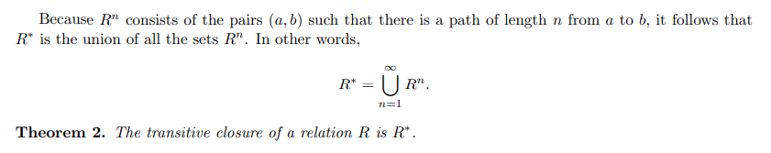

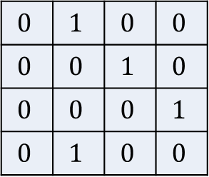

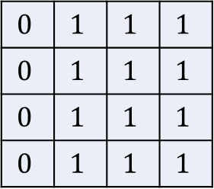
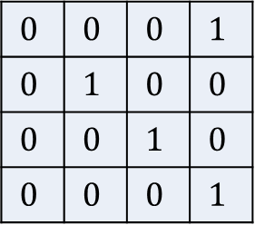

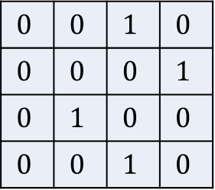

Computing Transitive Closure
$$R^{t}$$
a
b
$$0$$ | $$1$$ | $$0$$ | $$0$$
$$0$$ | $$0$$ | $$1$$ | $$0$$
$$0$$ | $$0$$ | $$0$$ | $$1$$
$$0$$ | $$1$$ | $$0$$ | $$0$$
$$0$$ | $$0$$ | $$1$$ | $$0$$
$$0$$ | $$0$$ | $$0$$ | $$1$$
$$0$$ | $$1$$ | $$0$$ | $$0$$
$$0$$ | $$0$$ | $$1$$ | $$0$$
$$0$$ | $$0$$ | $$0$$ | $$1$$
$$0$$ | $$1$$ | $$0$$ | $$0$$
$$0$$ | $$0$$ | $$1$$ | $$0$$
$$0$$ | $$0$$ | $$0$$ | $$1$$
$$0$$ | $$1$$ | $$1$$ | $$1$$
$$0$$ | $$1$$ | $$1$$ | $$1$$
$$0$$ | $$1$$ | $$1$$ | $$1$$
$$0$$ | $$1$$ | $$1$$ | $$1$$
c
d
$$∪$$
$$∪$$
$$=$$
Time complexity: $(n−1)$ times multiply, spend $n^{3}$ every time.

Slide 20
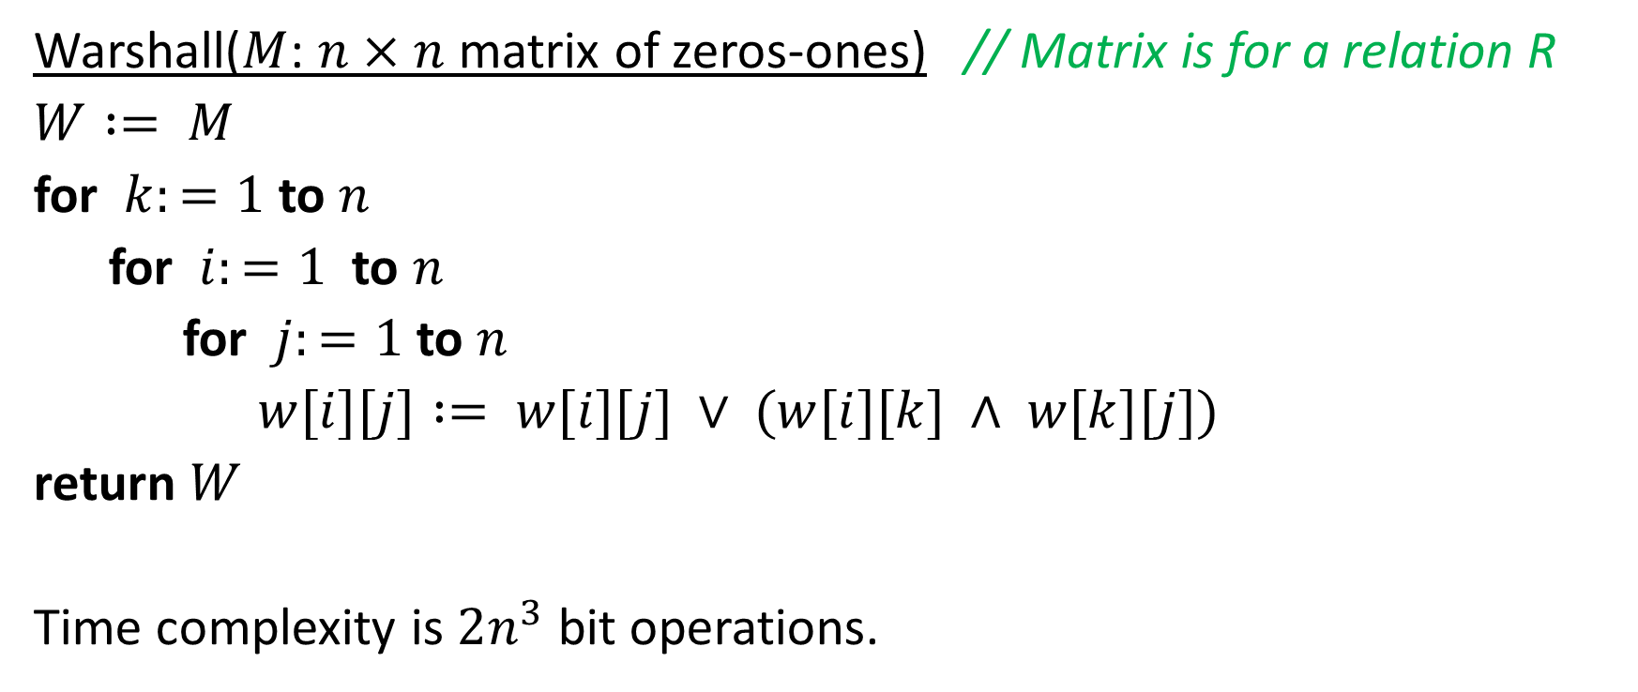
More Efficient: Warshall Algorithm
Warshall($M$: $n×n$ matrix of zeros-ones) // Matrix is for a relation R
$W := M$
for $k:=1$ to $n$
for $i:=1$ to $n$
for $j:=1$ to $n$
$w[i][j] := w[i][j] ∨ (w[i][k] ∧ w[k][j])$
return $W$
Time complexity is $2n^{3}$ bit operations.

Slide 21
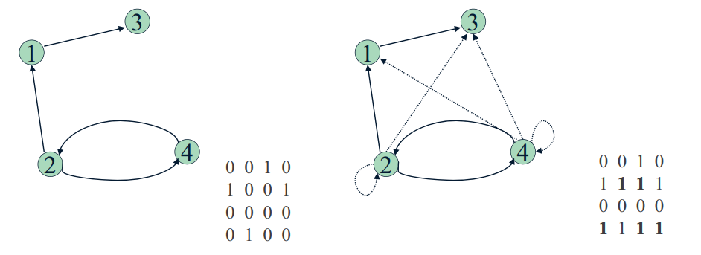
Example of Warshall's Algorithm
Relation to the left is given by a matrix. Find its transitive closure.

Slide 22
How it is supposed to work
Main idea: A path exists between two vertices i, j, iff
there is an edge from i to j; or
there is a path from i to j going through vertex 1; or
there is a path from i to j going through vertex 1 and/or 2; or
there is a path from i to j going through vertex 1, 2, and/or 3; or
... and so on…

Slide 23
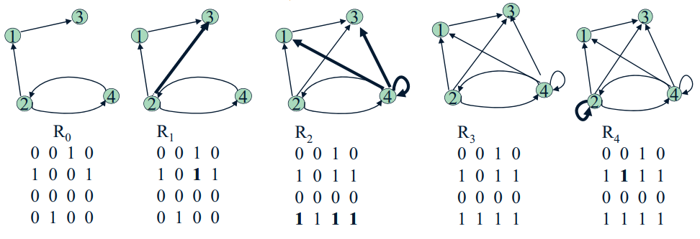

Warshall Algorithm on a Real Graph
Cannot be impatient and finish faster than after all $n$ iterations.

