Slide 1
Equivalence Relations
Section 9.5

Slide 2
Section Summary
Equivalence Relations
Equivalence Classes
Equivalence Classes and Partitions

Slide 3
Equivalence Relations
Definition 1: A relation on a set A is called an equivalence relation if it is reflexive, symmetric, and transitive.
Definition 2: Two elements a, and b that are related by an equivalence relation are called equivalent. The notation a ∼ b is often used to denote that a and b are equivalent elements with respect to a particular equivalence relation.

Slide 4
Strings
Example: Suppose that R is the relation on the set of strings of English letters such that aRb if and only if l(a) = l(b), where l(x) is the length of the string x. Is R an equivalence relation?
Solution: Show that all of the properties of an equivalence relation hold.
Reflexivity: Because l(a) = l(a), it follows that aRa for all strings a.
Symmetry: Suppose that aRb. Since l(a) = l(b), l(b) = l(a) also holds and bRa.
Transitivity: Suppose that aRb and bRc. Since l(a) = l(b),and l(b) = l(c), l(a) = l(a) also holds and aRc.

Slide 5
Congruence Modulo m
Example: Let m be an integer with m > 1. Show that the relation
R = {(a,b) | a ≡ b (mod m)} is an equivalence relation on the set of integers.
Solution: Recall that a ≡ b (mod m) if and only if m divides a − b.
Reflexivity: a ≡ a (mod m) since a − a = 0 is divisible by m since 0 = 0 ∙ m.
Symmetry: Suppose that a ≡ b (mod m). Then a − b is divisible by m, and so a − b = km, where k is an integer. It follows that b − a = (− k) m, so b ≡ a (mod m).
Transitivity: Suppose that a ≡ b (mod m) and b ≡ c (mod m). Then m divides both a − b and b − c. Hence, there are integers k and l with a − b = km and b − c = lm. We obtain by adding the equations:
a − c = (a − b) + (b − c) = km + lm = (k + l) m.
Therefore, a ≡ c (mod m).

Slide 6
Divides
Example: Show that the “divides” relation on the set of positive integers is not an equivalence relation.
Solution: The properties of reflexivity, and transitivity do hold, but there relation is not transitive. Hence, “divides” is not an equivalence relation.
Reflexivity: a ∣ a for all a.
Not Symmetric: For example, 2 ∣ 4, but 4 ∤ 2. Hence, the relation is not symmetric.
Transitivity: Suppose that a divides b and b divides c. Then there are positive integers k and l such that b = ak and c = bl. Hence, c = a(kl), so a divides c. Therefore, the relation is transitive.

Slide 7
Equivalence Classes
Definition 3: Let R be an equivalence relation on a set A. The set of all elements that are related to an element a of A is called the equivalence class of a. The equivalence class of a with respect to R is denoted by [a]_{R}.
When only one relation is under consideration, we can write [a], without the subscript R, for this equivalence class. Note that [a]_{R} = {s|(a,s) ∈ R}.
If b ∈ [a]_{R}, then b is called a representative of this equivalence class. Any element of a class can be used as a representative of the class.

Slide 8
Example: Congruence Classes (mod m)
The equivalence classes of the relation congruence modulo m are called the congruence classes modulo m. The congruence class of an integer a modulo m is denoted by [a]_{m}, so [a]_{m} = {…, a−2m, a−m, a+2m, a+2m, … }. For example,
[0]₄ = {…, −8, −4 , 0, 4 , 8 , …}
[1]₄ = {…, −7, −3 , 1, 5 , 9 , …}
[2]₄ = {…, −6, −2 , 2, 6 , 10 , …}
[3]₄ = {…, −5, −1 , 3, 7 , 11 , …}

Slide 9
Equivalence Classes and Partitions
Theorem 1: let R be an equivalence relation on a set A. These statements for elements a and b of A are equivalent:
(i) aRb
(ii) [a] = [b]
(iii) [a] ∩ [b] = ∅
Proof: We show that (i) implies (ii). Assume that aRb. Now suppose that c ∈ [a]. Then aRc. Because aRb and R is symmetric, bRa. Because R is transitive and bRa and aRc, it follows that bRc. Hence, c ∈ [b]. Therefore, [a]⊆ [b]. A similar argument (omitted here) shows that [b]⊆ [a]. Since [a]⊆ [b] and [b]⊆ [a], we have shown that [a] = [b].
(see text for proof that (ii) implies (iii) and (iii) implies (i))

Slide 10
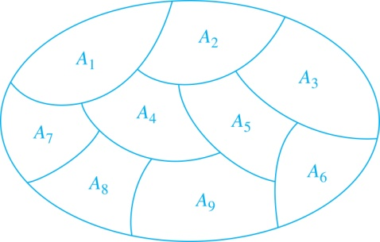
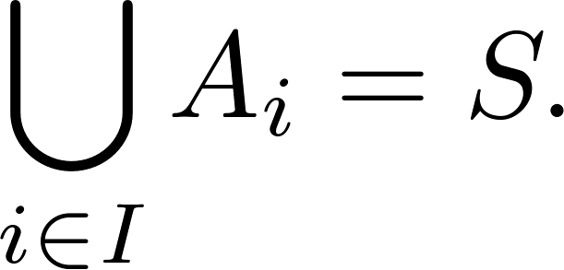
Partition of a Set
Definition: A partition of a set S is a collection of disjoint nonempty subsets of S that have S as their union. In other words, the collection of subsets A_{i}, where i ∈ I (where I is an index set), forms a partition of S if and only if
A_{i} ≠ ∅ for i ∈ I,
A_{i} ∩ A_{j}=∅ when i ≠ j,
and
A Partition of a Set

Slide 11
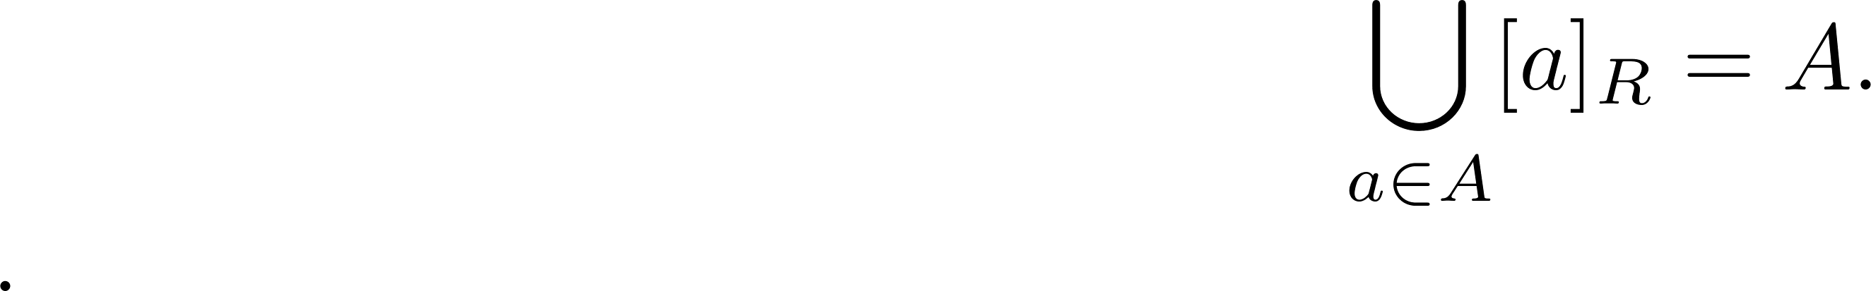
An Equivalence and Partitions of a Set – 1
Let R be an equivalence relation on a set A. The union of all the equivalence classes of R is all of A, since an element a of A is in its own equivalence class [a]_{R}. In other words,
From Theorem 1, it follows that these equivalence classes are either equal or disjoint, so [a]_{R} ∩[b]_{R}=∅ when [a]_{R} ≠ [b]_{R}.
Therefore, the equivalence classes form a partition of A, because they split A into disjoint subsets.

Slide 12
An Equivalence and Partitions of a Set – 2
Theorem 2: Let R be an equivalence relation on a set S. Then the equivalence classes of R form a partition of S. Conversely, given a partition {A_{i} | i ∈ I} of the set S, there is an equivalence relation R that has the sets A_{i}, i ∈ I, as its equivalence classes.
Proof: We have already shown the first part of the theorem.
For the second part, assume that {A_{i} | i ∈ I} is a partition of S. Let R be the relation on S consisting of the pairs (x, y) where x and y belong to the same subset A_{i} in the partition. We must show that R satisfies the properties of an equivalence relation.
Reflexivity: For every a ∈ S, (a,a) ∈ R, because a is in the same subset as itself.
Symmetry: If (a,b) ∈ R, then b and a are in the same subset of the partition, so (b,a) ∈ R.
Transitivity: If (a,b) ∈ R and (b,c) ∈ R, then a and b are in the same subset of the partition, as are b and c. Since the subsets are disjoint and b belongs to both, the two subsets of the partition must be identical. Therefore, (a,c) ∈ R since a and c belong to the same subset of the partition.

