Slide 1
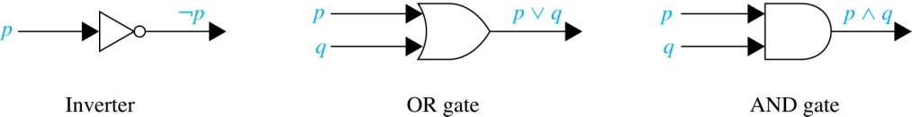
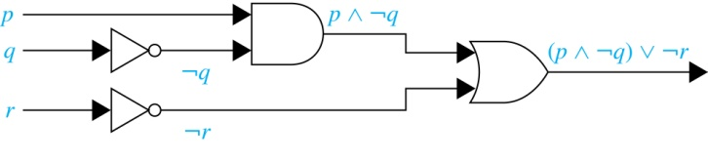
Logic Circuits (Studied in depth in Chapter 12)
Electronic circuits; each input/output signal can be viewed as a 0 or 1.
0 represents False
1 represents True
Complicated circuits are constructed from three basic circuits called gates.
The inverter (NOT gate) computes negation
The OR gate takes two input bits and produces the disjunction.
The AND gate takes two input bits and produces the conjunction of the two bits.
More complicated digital circuits can be constructed by combining these basic circuits to produce the desired output given the input signals by building a circuit for each piece of the output expression and then combining them. For example:

Slide 2
Electrical System Diagram
Outside Power
s1
cb1
Have lights (L1, L2), switches (s1, s2, s3), and circuit breakers (cb1)
How to do disjunction with electric switches?
Conjunction with switches?
Biconditional with switches?
Negation with switches?
w2
s2
s3
L1
L2

Slide 3
Notation
Needed for the next example.

Slide 4
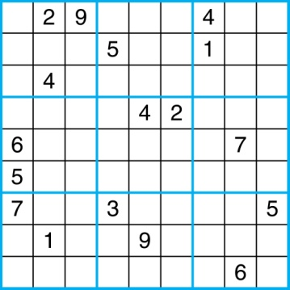
Sudoku
A Sudoku puzzle is represented by a 9×9 grid made up of nine 3×3 subgrids, known as blocks. Some of the 81 cells of the puzzle are assigned one of the numbers 1,2, …, 9.
The puzzle is solved by assigning numbers to each blank cell so that every row, column and block contains each of the nine possible numbers.

Slide 5
Encoding as a Satisfiability Problem
Let p(i,j,n) denote the proposition that is true when the number n is in the cell in the ith row and the jth column.
There are 9×9 × 9 = 729 such propositions.
In the sample puzzle p(5,1,6) is true, but p(5,j,6) is false for j = 2,3,…9

Slide 6
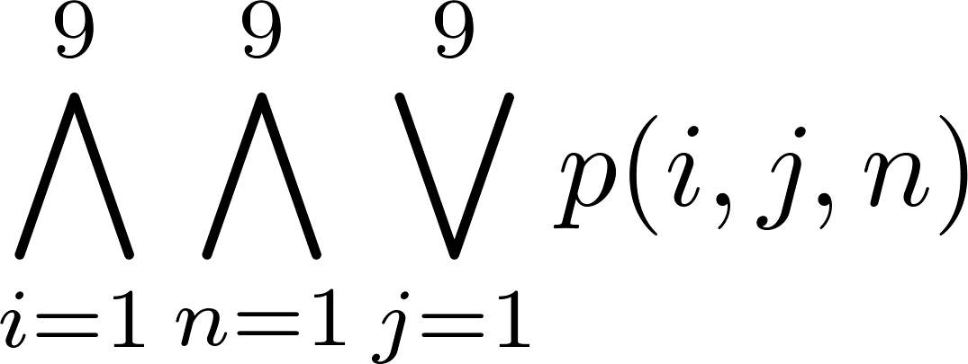
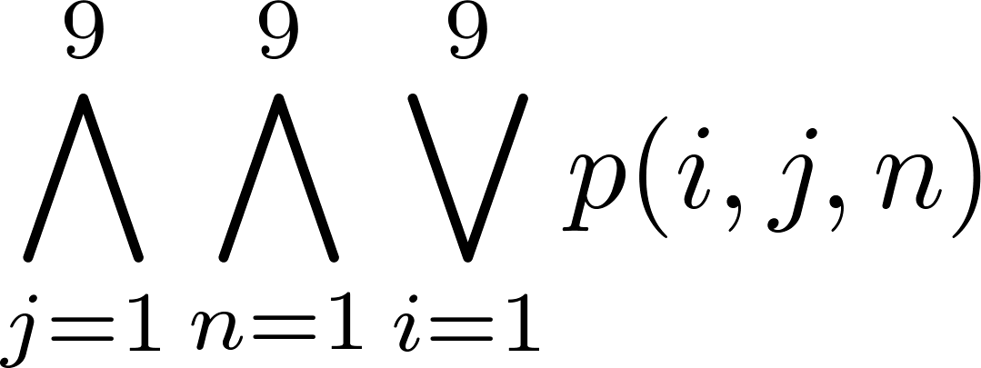
Encoding (cont)
For each cell with a given value, assert p(i,j,n), when the cell in row i and column j has the given value.
Assert that every row contains every number.
Assert that every column contains every number.

Slide 7
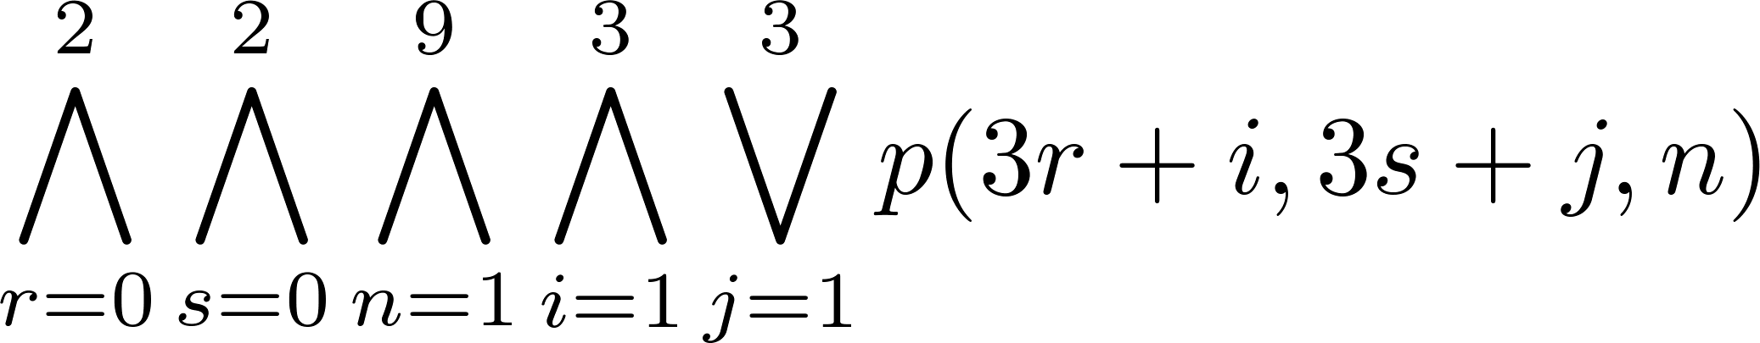
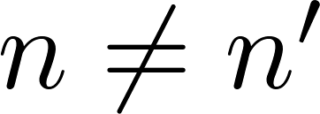
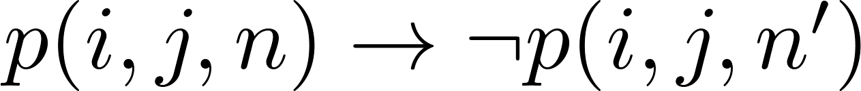
Encoding (cont)
Assert that each of the 3 x 3 blocks contain every number.
(this is tricky - ideas from chapter 4 help)
Assert that no cell contains more than one number. Take the conjunction over all values of n, n’, i, and j, where each variable ranges from 1 to 9 and ,
of

Slide 8
Solving Satisfiability Problems
To solve a Sudoku puzzle, we need to find an assignment of truth values to the 729 variables of the form p(i,j,n) that makes the conjunction of the assertions true. Those variables that are assigned T yield a solution to the puzzle.
A truth table can always be used to determine the satisfiability of a compound proposition. But this is too complex even for modern computers for large problems.
There has been much work on developing efficient methods for solving satisfiability problems as many practical problems can be translated into satisfiability problems.

Slide 9
Pseudoprimes
By Fermat’s little theorem n > 2 is prime, where
2^{n-1} ≡ 1 (mod n).
But if this congruence holds, n may not be prime. Composite integers n such that 2^{n-1} ≡ 1 (mod n) are called pseudoprimes to the base 2.
Example: The integer 341 is a pseudoprime to the base 2.
341 = 11 ∙ 31
2³⁴⁰ ≡ 1 (mod 341) (see in Exercise 37)
We can replace 2 by any integer b ≥ 2.
Definition: Let b be a positive integer. If n is a composite integer, and b^{n-1} ≡ 1 (mod n), then n is called a pseudoprime to the base b.

Slide 10
Pseudoprimes
Given a positive integer n, such that 2^{n-1} ≡ 1 (mod n):
If n does not satisfy the congruence, it is composite.
If n does satisfy the congruence, it is either prime or a pseudoprime to the base 2.
Doing similar tests with additional bases b, provides more evidence as to whether n is prime.
Among the positive integers not exceeding a positive real number x, compared to primes, there are relatively few pseudoprimes to the base b.
For example, among the positive integers less than 10¹⁰ there are 455,052,512 primes, but only 14,884 pseudoprimes to the base 2.

Slide 11
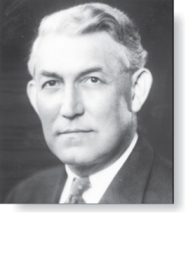
Carmichael Numbers (optional)
Robert Carmichael
(1879-1967)
There are composite integers n that pass all tests with bases b such that gcd(b,n) = 1.
Definition: A composite integer n that satisfies the congruence b^{n-1} ≡ 1 (mod n) for all positive integers b with gcd(b,n) = 1 is called a Carmichael number.
Example: The integer 561 is a Carmichael number. To see this:
561 is composite, since 561 = 3 ∙ 11 ∙ 13.
If gcd(b, 561) = 1, then gcd(b, 3) = 1, then gcd(b, 11) = gcd(b, 17) =1.
Using Fermat’s Little Theorem: b² ≡ 1 (mod 3), b¹⁰ ≡ 1 (mod 11), b¹⁶ ≡ 1 (mod 17).
Then
b⁵⁶⁰ = (b²) ²⁸⁰ ≡ 1 (mod 3),
b⁵⁶⁰ = (b¹⁰) ⁵⁶ ≡ 1 (mod 11),
b⁵⁶⁰ = (b¹⁶) ³⁵ ≡ 1 (mod 17).
It follows (see Exercise 29) that b⁵⁶⁰ ≡ 1 (mod 561) for all positive integers b with gcd(b,561) = 1. Hence, 561 is a Carmichael number.
Even though there are infinitely many Carmichael numbers, there are other tests (described in the exercises) that form the basis for efficient probabilistic primality testing. (see Chapter 7)

