Slide 1
First Year Seminar Fall 2020, Week 5
Kalvis Apsītis

Slide 2
Prototype Grading (max 300 points)
Teamwork (max 50 points): Team Working Agreement Delegation and Task/Issue Management Bookmarks in GitHub. | Functional Specification (50 points) Requirements alligned with Value Proposition. Functional Design document Peer-reviews and reacting to these reviews. | Config. Mgmt. (max 100 points): Orderly procedure to apply changes. "Deliver Early and Often" Testability of your solution. | Iteration Planning (max 50 points): Planning, reviewing and retrospecting your iterations by Agile/Scrum methodology. Iteration 1 Iteration 2 Iteration 3 | Validation/Data (max 50 points): Perceiving real-world feedback. Metrics and Reports External data integration (mandatory for BITL teams)

Slide 3
Prototype Activity #2: Functional Design
Functional design answers the question: What the product or solution should do?
Large projects may have a separate list of requirements (traceable to the customer communication) and the Functional Design.
Functional designs and requirements should be easy to understand for external people (and peer-review).
Create a coherent story about your functionality – with screenshots and technical hints on implementation (Technical design is optional).

Slide 4
Prototype Activity #3: Configuration Management
Definition: A configuration is a set of artefacts (hardware, software items, files, settings) that enable to create your solution.
Even a static website or a social-media ad campaign has a configuration.
Configurations will be reviewed; they should be:
Easy to change yet stable
Easy to replicate
Ensure early prototyping and "proof of concept"
Testable

Slide 5

Designing Make us Human
Functional Specifications
Middle Paleolithic (300 –50 thousands of years ago).
Tool-making in steps,
Resource planning,
Art,
Language,
Religion.
Humans near the top of the food-chain (Yuval Harari)
Happened at about the same time.
Stone tools: Prepared core technique

Slide 6
Why → How → What
Problem
Solution
Execution
BusDev Analysis
3 lenses of innovation
Customer segments
Gains/Pains/Jobs
Competitors
Differentiators
Design
Functional specification
(Optionally) Technical specification – data+software architectures
New Product(s)
Content creation
Software coding/configuration
Mgmt: Tasks/Backlog
Iterations 0, 1, 2, 3
Maintenance
Content creation
Software coding/configuration

Slide 7
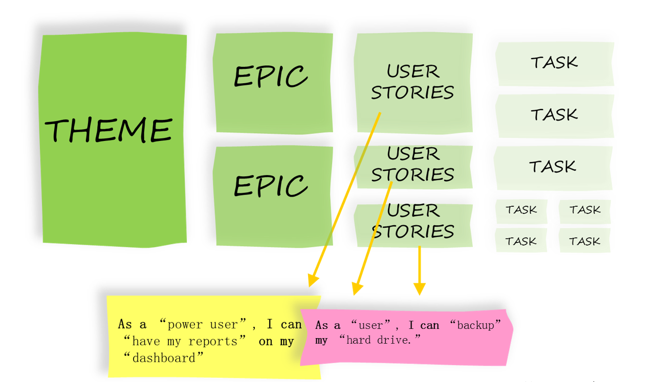
Hierarchy of Agile Tasks
Your Region,
Organization,
Environment
Epic – usually the same as your current project.
Theme – Related activities in an organization towards the same goal.
Is every requirement
also a user story?
Is every activity also a project (or part of a project)?

Slide 8
What Parts are Included in the Functional Design
Traditional Design
Functional Design template
Preamble: Authors; Change History; Approvals
Introduction
Solution Overview
Functional Requirements
Non-functional Requirements
Agile is Shorter and Trickier:
Ask the same questions one would ask when creating a user story: “As a ____ I want _____ so I can _____.” The identification of the consumer and its value can dramatically change the documentation approach.
Notes:
Functional specification answers the question: What the product should do?
Agile method is about customer value (working prototype > documentation).
Unfortunately, some level of documentation is still required to keep stakeholders outside of the team informed of software functionality, or to hand off to a maintenance team after delivery.

Slide 9
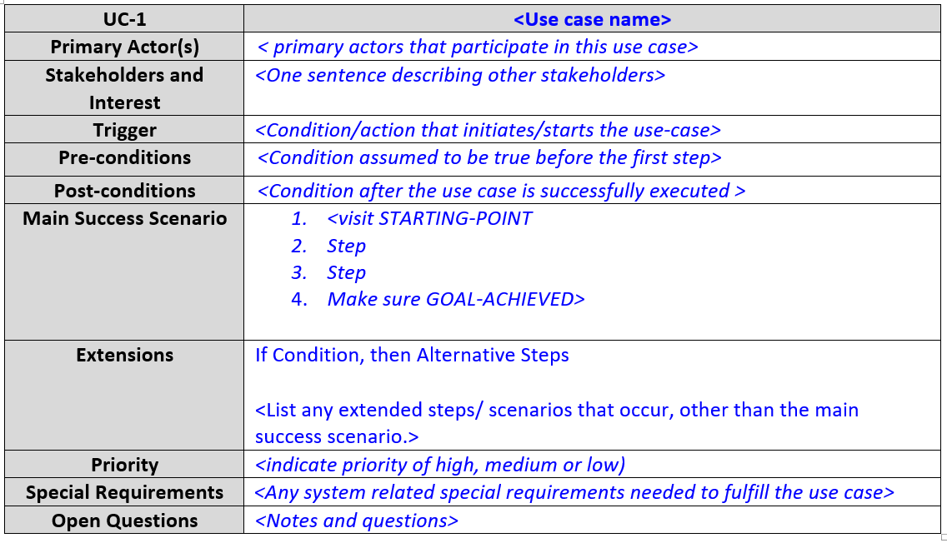
Do not Overdo Func.Spec + Cut the Fluff
Classical Functional Specification documents (and templates) are meant to look frightening.
Drop the stuff that is irrelevant for your project.

Slide 10
What should be in your Functional Specification? (Can use Classic or Agile style – Your Choice)
Title.
Document changes (small table).
Project scope: What is covered by your product and what is not.
Explicit assumptions and risks. (Your solution may be affected by some factors not under your control).
Functional requirements:
Solution Overview (Actors/Roles in your system; how they will interact with your system)
Data used in your solution
Non-functional requirements:
Performance/speed
Audit and logging
Integrations with other systems (if any)

Slide 11
Technical/Implementation Part
Some teams might need technical specification (as a chapter in their functional specification) – to document the implementation details.
Your implementation and architecture - what systems and components you will use, how they are mutually integrated.
How the users will interact with your system.

Slide 12
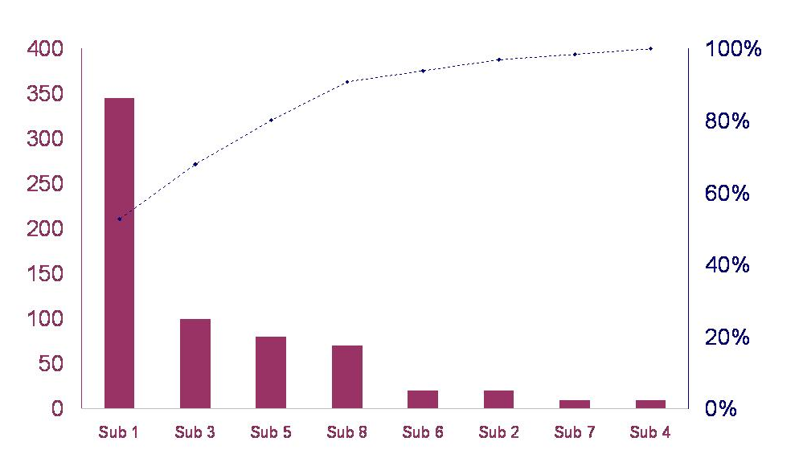
Pareto Principle 80/20 Rule
Jargon: Pareto Principle?
About 80% of the effects come from 20% of the causes.
Finishing 80% of the planned work takes 20% effort.
Time is limited → Find how to work on the most important area first.

Slide 13
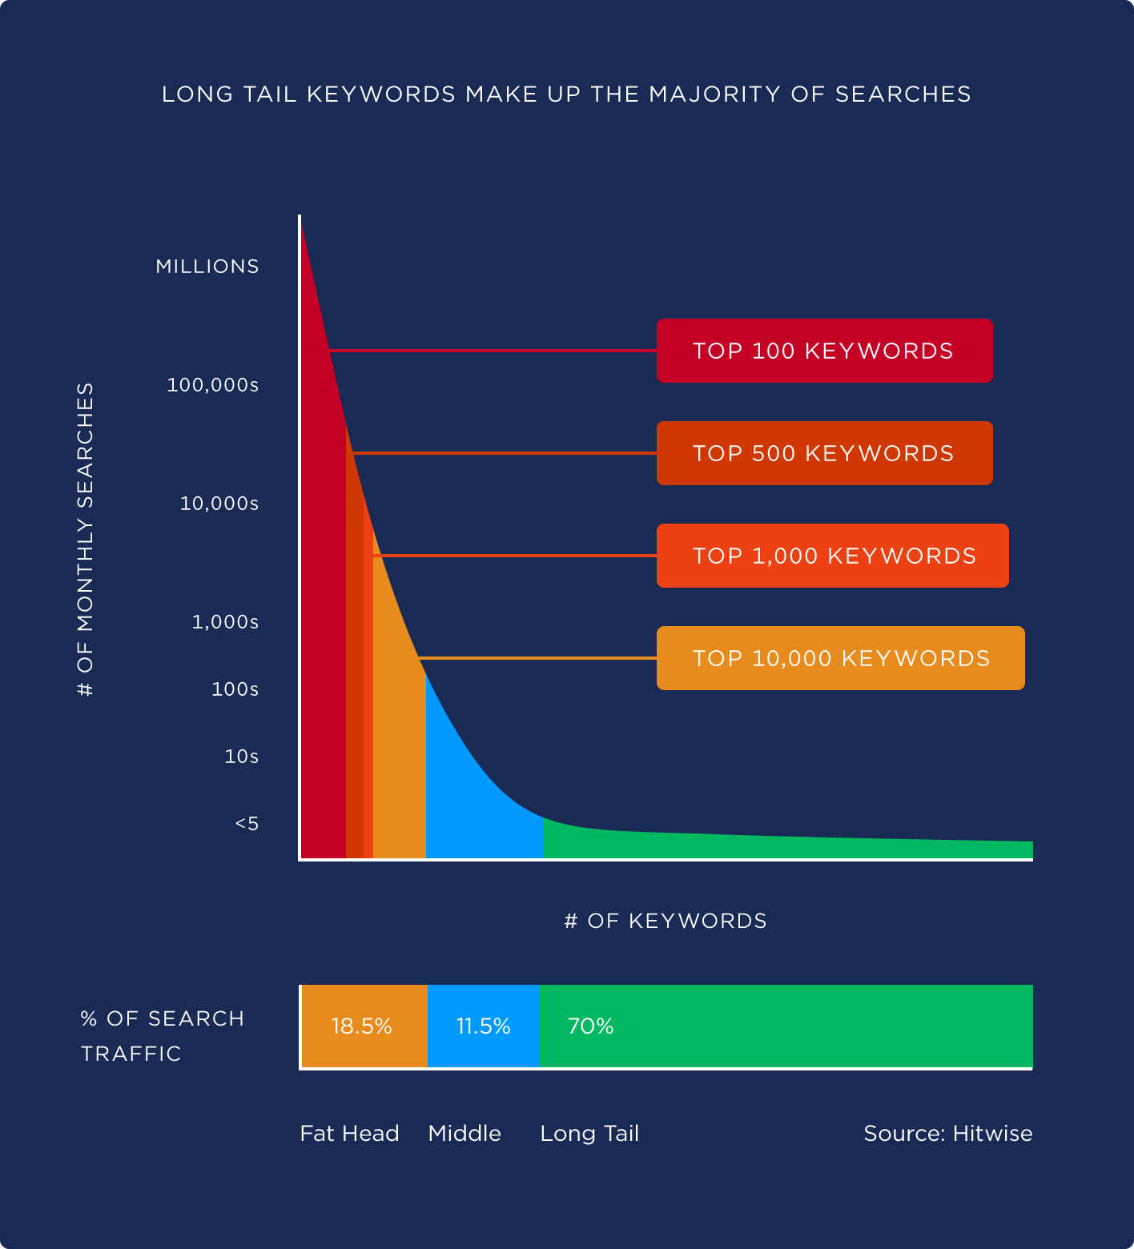
Is Pareto Actionable?
How do you categorize your world to enjoy Pareto Principle?
Implement the 20% of the most needed functions of your software application?
Find the few largest types of wrongly sorted garbage?
Identify the easiest 20% of activities to avoid 80% of the infection risks?
Identify the 20% "hardest cases" that will cause 80% of all the work for Bauska social workers?
BUT: Sometimes the focus is on the "long tail". ( https://backlinko.com/hub/seo/long-tail-keywords )

Slide 14
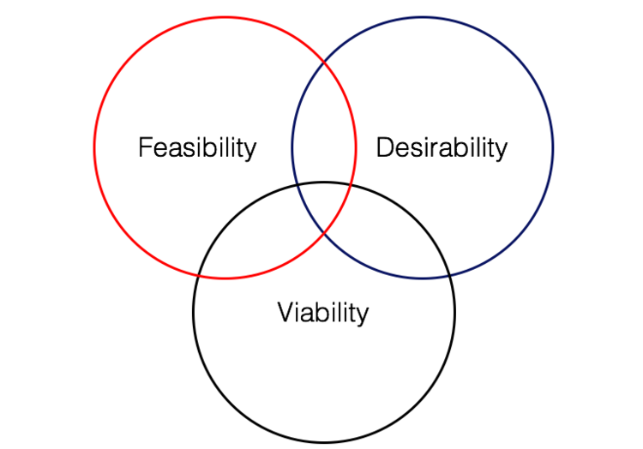
Proof of Concept
Jargon: POC? Showstopper?
Proof of Concept (POC) or Proof of Principle, is a realization of a certain method or idea in order to demonstrate its feasibility, or to verify that the chosen approach (or "concept") has practical use.
Starting with "low-hanging fruit" (as in Pareto Principle) is fine, but there may be showstoppers.
You can plan around the risks (and take the riskier steps early).
POC is mainly
about
Feasibility

Slide 15
POC Examples: Stuff that does not happen by itself
If you plan to use a cellphone company – how do you locate people approaching Bauska?
If you plan marketing videos – can you publish it in the way you want? Can you measure metrics of user engagement?
If you plan to poll the inhabitants of Bauska – does your authentication method work?
If you plan to integrate with an existing Webpage - do the owners of the Website give you the right permissions?

Slide 16
Development vs. Production
Jargon: Development Environment? Production Environment?
Development Environment (all the files you create on your laptop to run your prototype)
Production Environment (all the files you run to serve other people)
These are related, but different. Development changes frequently ("nightly builds" etc.). Production environment has "releases".
Agile principle: Deliver early and often (so you can validate)

Slide 17
Minimum Viable Product
Jargon: Minimum Viable Product
Minimum Viable Product (MVC) by Eric Ries - a consultant on startups:
A minimum viable product (MVP) is the the most limited version of a product that can still be released. An MVP has three key characteristics:
It has enough value that people are willing to use it or buy it.
It demonstrates enough future benefit to retain early adopters.
It provides a feedback loop to guide future development.
The MVP technique assumes that early adopters can see the vision or promise of the final product and provide their feedback. Feedback is essential to move ahead
You can have super-optimistic assumptions about your customers, but still need to follow this MVP definition.

Slide 18
Validation = Real-world feedback
Jargon: Validation
When will you know that your solution for a Bauska problem topic was successful? (That moment is named validation.)
What should happen to expose anyone to your product?
Instructor(s) may be wrong in this course, but your customer is always right.
Empirical philosophy: Practice is the only criterion of truth (not any logical reasoning, authority, applying tried and tested procedures etc.).
Practice also shows that this criterion can be tricky.) If You Are So Clever, Show Me Your Money… The more progressive societies win wars… Environment considerations: Efficient is not quite the same as effective.

Slide 19
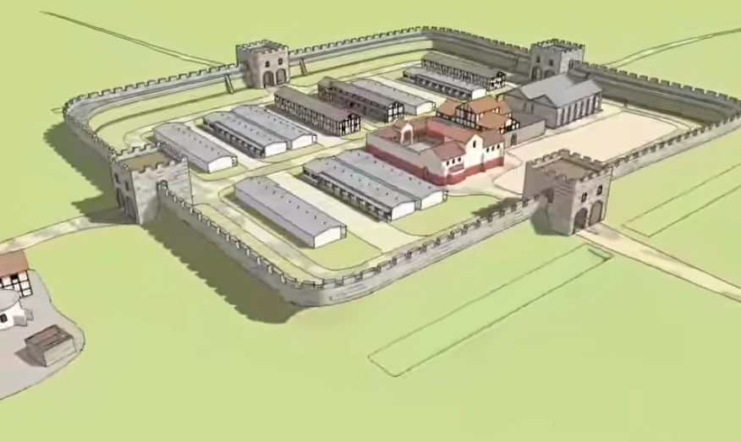
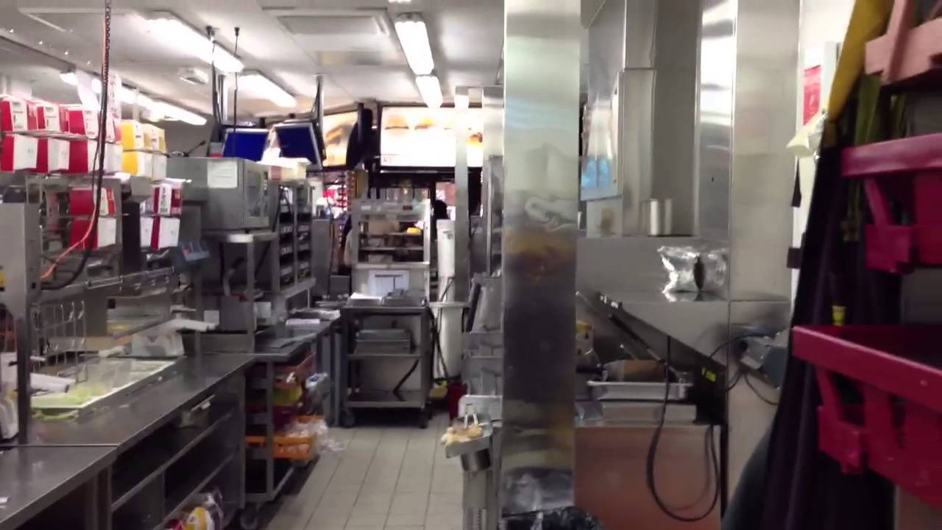
Define: Configuration Management
Configuration Management
Roman fort (Castrum)
McDonald's kitchen

Slide 20
Configuration Management Questions
POC in your case? What is the first high-value step that involves risks and does not seem trivial?
Artefacts in your case? What files your developers will create? How to store/update? Other pieces of data or physical reality?
Change Management in your case? How do you apply modifications to your solution. Who can be a contributor?

Slide 21
Suggested Timeline
Four 2-week Slots | What
Today to 2019-10-16 | Iteration 0: POC is done. Development Environment exists. Everybody knows how to contribute.
2019-10-16 … 2019-10-30 | Iteration 1: (Plan by yourselves. Depends on project)
2019-10-30 … 2019-11-13 | Iteration 2: (Plan by yourselves. Depends on project)
2019-11-13 … 2019-11-27 | Iteration 3: (Depends on project. Can release MVP)
After Nov.27 | Product is live, can demo, can get real-world interactions, final presentations, other TOI/conservation activity.

Slide 22
Objectives: Summary
Summary
Discussed where Design Activities (Functional Specification and others) fit in your team's project lifetime?
Reviewed 2 approaches to do Functional Specification (Classical and Agile).
Introduced some jargon used during design activities.
Discussed what is Configuration Management and how to start it with a POC.

Slide 23


Summary of Your Tasks
Functional Specification for Review (Due on October 6).
Functional requirements (use-cases; mock UI – "screenshots")?
Integrations with other systems?
Non-functional requirements?
Peer-reviewing Functional Specifications for 2 other teams (Due on October 13 – instructions will follow).
Proof of Concept (POC) Discussed during an Office Hour: Some non-trivial step towards your goal that adds most value for the effort (and also presents some risks). Tell me in the class – what it could be. Perform this step as your Iteration 0 before Friday, October 16 = Start of Iteration 1.
Config Mgmt Guide (Job Aid) for 1 role in your project. Discussed during an Office Hour: Outline the process – how can a team member contribute to your solution (Continuous integration or other approach as appropriate.)
5-8 pages.
Should be sth interesting…
2x
1 page
One
post-it
note
One Physical A4 Page (single side)

Slide 24
Before your Team Leaves (on October 2)
Explain your Proof of Concept (can be very short).
Have a short talk regarding your func spec.

