Slide 1
Chapters 1 & 2
Programming and Programs
Bjarne Stroustrup
www.stroustrup.com/Programming

Slide 2
Abstract
Today, we’ll outline the aims for this course and present a rough course plan. We’ll introduce the basic notion of programming and give examples of areas in which software is critical to our civilization. Finally, we’ll present the simplest possible C++ program and outline how it can be made into running code.
Stroustrup/Programming/2015

Slide 3
Overview
Course aims and outline
Programming
"Hello, world!"
Compilation
Stroustrup/Programming/2015

Slide 4
This is a course
In Programming
For beginners
  who want to become professionals
    i.e., people who can produce systems that others will use
  who are assumed to be bright
    Though not (necessarily) geniuses
  who are willing to work hard
    Though do need sleep occasionally, and take a normal course load
Using the C++ programming language
Stroustrup/Programming/2015

Slide 5
Not!
A Washout course
  “If you can get into the science/engineering parts of a university, you can handle this course”
A course in
  The C++ programming language
For students
  who want to become language lawyers
    We try not to get bogged down in technical obscurities
  who are assumed to be a bit dim and fairly lazy
    We try not to spoon feed
Using
  Some untested software development methodologies and a lot of unnecessarily long words
Stroustrup/Programming/2015

Slide 6
The Aims
Teach/learn
  Fundamental programming concepts
  Key useful techniques
  Basic Standard C++ facilities
After the course, you’ll be able to
  Write small colloquial C++ programs
  Read much larger programs
  Learn the basics of many other languages by yourself
  Proceed with an “advanced” C++ programming course
After the course, you will not (yet) be
  An expert programmer
  A C++ language expert
  An expert user of advanced libraries
Stroustrup/Programming/2015

Slide 7
The Means
Lectures
  Attend every one
Notes/Chapters
  Read a chapter ahead (about one per lecture)
  Read the chapter again after each lecture
  Feedback is welcome (typos, suggestions, etc.)
Stroustrup/Programming/2015

Slide 8
The Means (Cont.)
Work
  Review questions in chapters
  Review “Terms” in Chapters
  Drills
    Always do the drills
    Always do the drills before the exercises
  Exercises
  Course specific
    Projects
      That’s where the most fun and the best learning takes place
    Quizzes
    Exams
Stroustrup/Programming/2015

Slide 9
Cooperate on Learning
Except for the work you hand in as individual contributions, we strongly encourage you to collaborate and help each other
If in doubt if a collaboration is legitimate: ask!
  Don’t claim to have written code that you copied from others
  Don’t give anyone else your code (to hand in for a grade)
  When you rely on the work of others, explicitly list all of your sources – i.e. give credit to those who did the work
Don’t study alone when you don’t have to
  Form study groups
  Do help each other (without plagiarizing)
Go to your TA's office hours
  Go prepared with questions
  The only stupid questions are the ones you wanted to ask but didn’t
Stroustrup/Programming/2015

Slide 10
Why C++ ?
You can’t learn to program without a programming language
The purpose of a programming language is to allow you to express your ideas in code
C++ is the language that most directly allows you to express ideas from the largest number of application areas
C++ is the most widely used language in engineering areas
  http://www.stroustrup.com/applications.html
Stroustrup/Programming/2015

Slide 11
Why C++ ?
C++ is precisely and comprehensively defined by an ISO standard
  And that standard is almost universally accepted
  The most recent standard is ISO C++ 2014
C++ is available on almost all kinds of computers
Programming concepts that you learn using C++ can be used fairly directly in other languages
  Including C, Java, C#, and (less directly) Fortran
Stroustrup/Programming/2015

Slide 12
Rough course outline
Part I: The basics
  Types, variables, strings, console I/O, computations, errors, vectors functions, source files, classes
Part II: Input and Output
  File I/O, I/O streams
  Graphical output
  Graphical User Interface
Part III: Data structures and algorithms
  Free store, pointers, and arrays
  Lists, maps, sorting and searching, vectors, templates
  The STL
Part IV: Broadening the view
  Software ideals and history
  Text processing, numerics, embedded systems programming, testing, C, etc.
Stroustrup/Programming/2015

Slide 13
Rough course outline (Cont.)
Throughout
  Program design and development techniques
  C++ language features
  Background and related fields, topics, and languages
Note: Appendices
  C++ language summary
  C++ standard library summary
  Index (extensive)
  Glossary (short)
Stroustrup/Programming/2015

Slide 14
Promises
Detail: We will try to explain every construct used in this course in sufficient detail for real understanding
  There is no “magic”
Utility: We will try to explain only useful concepts, constructs, and techniques
  We will not try to explain every obscure detail
Completeness: The concepts, constructs, and techniques can be used in combination to construct useful programs
  There are, of course, many useful concepts, constructs, and techniques beyond what is taught here
Stroustrup/Programming/2015

Slide 15
More Promises
Realism: The concepts, constructs, and techniques can be used to build “industrial strength” programs
  i.e., they have been used to …
Simplicity: The examples used are among the simplest realistic ones that illustrate the concepts, constructs, and techniques
  Your exercises and projects will provide more complex examples
Scalability: The concepts, constructs, and techniques can be used to construct large, reliable, and efficient programs
  i.e., they have been used to …
Stroustrup/Programming/2015

Slide 16
Feedback request
Please mail questions and constructive comments to
bs@cse.tamu.edu
Your feedback will be most appreciated
  On style, contents, detail, examples, clarity, conceptual problems, exercises, missing information, depth, etc.
Book support website (www.stroustrup.com/Programming)
Local course support website
Stroustrup/Programming/2015

Slide 17
Why programming?
Our civilization runs on software
  Most engineering activities involve software
Note: most programs do not run on things that look like a PC
  a screen, a keyboard, a box under the table
Stroustrup/Programming/2015

Slide 18
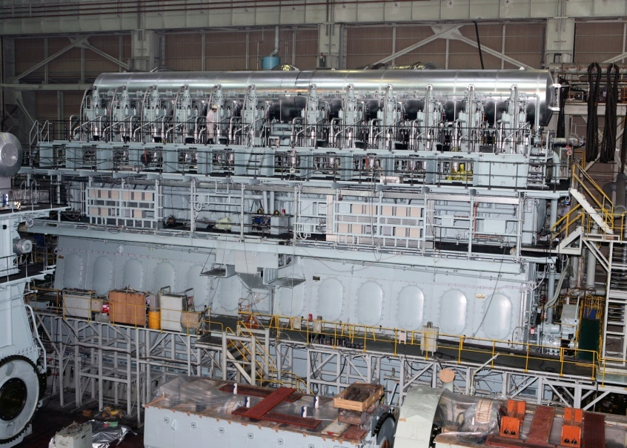
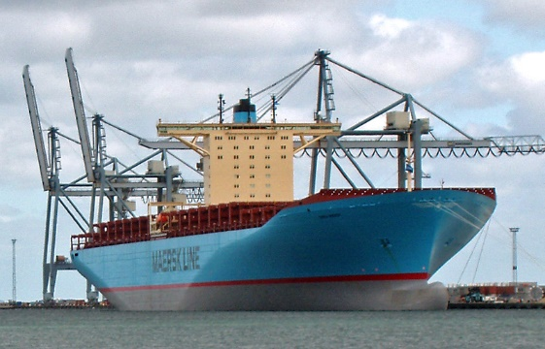
Ships
Monitoring
Engine
Hull design
Pumps
Design
Construction
Management
Stroustrup/Programming/2015

Slide 19

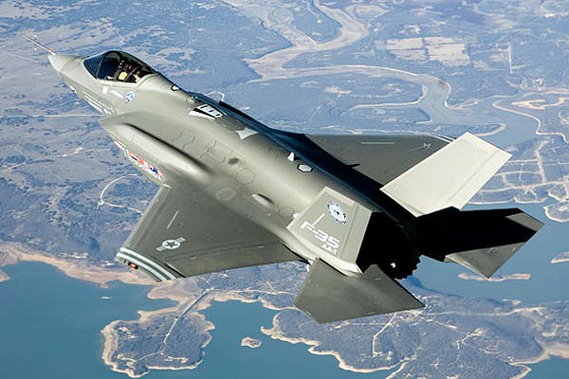
Aircraft
Signal processing
“Gadget” control
Monitoring
Communication
Control
Display
Stroustrup/Programming/2015

Slide 20
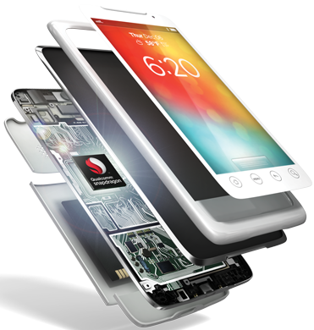
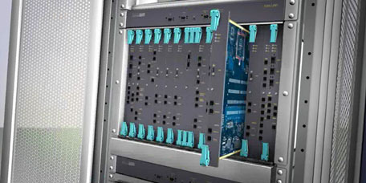
Phones
Voice quality
User interfaces
Billing
Mobility
Switching
Reliability
Provisioning
Images
Stroustrup/Programming/2015

Slide 21


Energy
Control
Monitoring
Analysis
Design
Communications
Visualization
Manufacturing
Stroustrup/Programming/2015

Slide 22
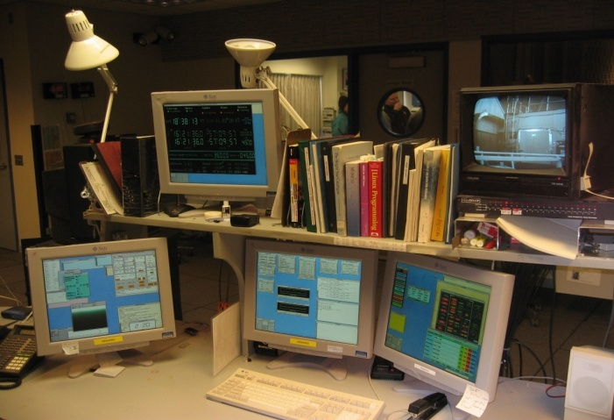

PC/tablet/workstation
There’s a lot more to computing than games, word processing, browsing, and spreadsheets!
Stroustrup/Programming/2015

Slide 23
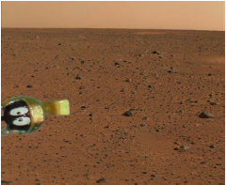
Where is C++ Used?
Just about everywhere
Mars rovers, animation, graphics, Photoshop, GUI, OS, compilers, slides, chip design, chip manufacturing, semiconductor tools, etc.
See www.stroustrup.com/applications.html
Stroustrup/Programming/2015

