Slide 1
Data Structures 1.1. HelloWorld Programs
Data Structures and Algorithms
http://linen-tracer-682.appspot.com/data-structures/index.html
Notes:
# Changes
* Separate "Introduction" module – explain course goals; Linux OS course goals;
* Explain STDOUT; STDERR; STDIN streams – cin/cout work with these streams.
*
# Every module has the following content
* Title (1 slide)
* Table of Contents (1 slide) – where are we in the material?
* Motivation (1 slide) – why do we need this module?
* Anchor Task (1x) – introduce the key problem handled by this module
* Objectives (1x)
* Theory Section (1 subtitle + more slides) or Demo Section (1 subtitle + more slides)
* Summary (1x) * References (1x)

Slide 2
Table of Contents
Part 1: Use C++ and Object Orientation (6 modules, 3W)
Part 2: Express algorithms with Abstract Data Types (ADTs) and libraries (5 modules, 2W)
Part 3: Analyze the implementations of some data structures (10 modules, 5W)
Part 4: Introduce general paradigms for algorithms (7 modules, 3W)
1.1. HelloWorld Programs
1.2. Expressions, control statements, functions.
1.3. C++ classes.
1.4. Multi-file programs.
1.5. Object orientation.
1.6. C++ memory model.

Slide 3
Why care about programs with text-based input/output?
What makes algorithms special among other types of software?
What algorithmic characeristics can we learn from "Hello, World" and similar examples?
Why learn C++ language?
Notes:
* For people who want to become professionals = can create systems that others will use
* For people who like to challenge themselves with difficult problems.
* For highly motivated people who also want to sleep; who take normal course-load, but typically do not work full-time yet.

Slide 4
Syllabus: Objectives
Topics: Arrays, vectors, lists, stacks, queues, trees, hash tables and more.
High-level language: C++ is used to implement algorithms.
Theory: Time-space analysis and tradeoffs; patterns of algorithm design.

Slide 5
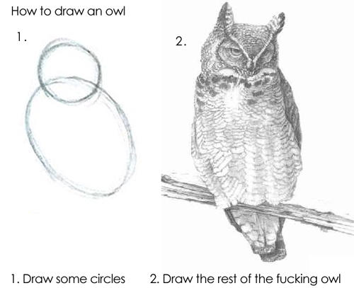
Syllabus: Teaching Methods
Theory sessions: About 2 out of 3 classes per week explain theory concepts, solve problems on paper, introduce other assignments.
Practice sessions: About 1 out of 3 classes – finish lose ends, introduce the coding exercises and labs.
Coding exercises (the first 5 weeks): Small programs using C++ constructs.
Larger labs (the last 10 weeks): About 5 larger coding exercises that build the "core" of this course.
In-class assignments (throughout the class): Short written exercises. For example, running some algorithm on sample data.
Notes:
If we overdo exercises with paper and pseudocode, we can end up in a situation, where people do not get real programming skills. On the other hand – these methods (written exercises, pseudocode and its analysis) are the ones we have. There has to be a way to resolve the tension between the teaching and the objectives.

Slide 6
What this course is NOT
This is not "a washout course". If you could handle your previous year, you should be doing fine.
The course tries to avoid obscure details of C++. It prefers common patterns.
The course avoids "spoon feeding". Need to search for answers.
The course skips complex software development methodologies. The development cycle (design, code, test, submit) stays the same.
Notes:
*Apophatic reasoning* is trying to define some concept by telling what it is **not** (for example, "a rose is not a camel", "a rose is not a table" and so on). It is usually insufficient to clarify anything; but it clears away common misconceptions. Apophatic methods are used in theology – as it may be easier to explain the concept of G-d by what it is not (rather by what it is).

Slide 7
Syllabus: Cooperation/Honesty Balance
Except for the work you hand in as individual contributions, we strongly encourage you to collaborate and help each other
If in doubt if a collaboration is legitimate: ask!
Do not study alone, but write the code you submit by yourself.
Copy-pasting C++ syntax constructs might be OK (but you will become fluent faster, if you type them yourself).
Copy-pasting implementations of entire algorithms (even from the public Internet) totally defeats the purpose of this class.
Use your office hours. Come with your questions prepared. There are no stupid questions.
BUT there might be "lazy questions" – if you can look them up in the documentation.

Slide 8
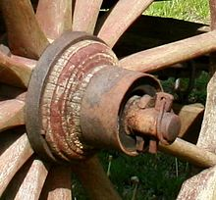
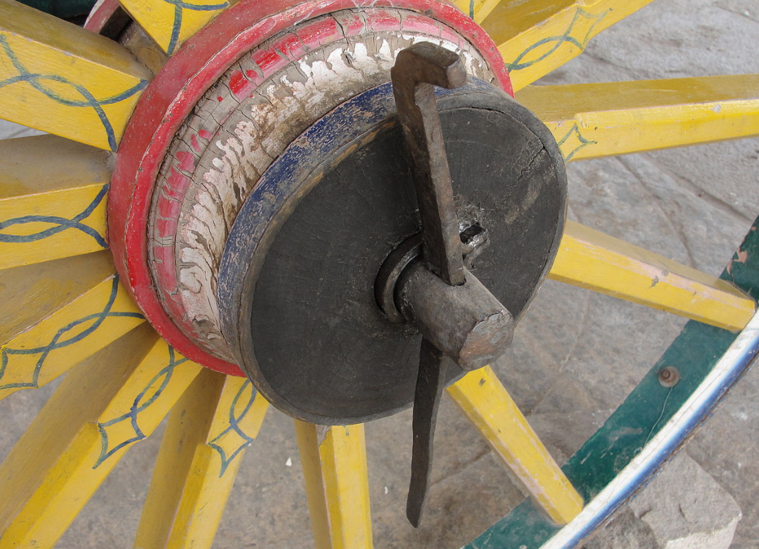
Hello World Demo
Hello World demo
Linchpins prevent wheels from falling off. In training these are called anchor activities. Major steps in PBM763 (the Data Structures)?
Read problem in the handout
Design your solution.
Implement and test your solution.
Submit your solution.
Notes:
**Goal:** We want to show that the approach (for this module – the large steps used in this course to analyze the data structure algorithms) are "natural". Or, perhaps, they are not, but then we will experience a sense of surprise, which is OK.
* Reading the problem is not obvious – you should skip all the prose that is irrelevant for the algorithm; only keep the essential parts; ask if the information is sufficient (or redundant? or contradictory?)
* Designing the solution – analyzing the data structures to be used, the relevant algorithms implemented
## Some concepts
* Linchpin (de: Achsnagel, lv: Riteņa fiksācijas tapa).
* Anchor Activity (lv: Āķa uzdevums).

Slide 9

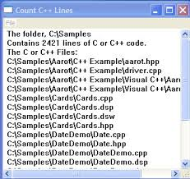


Anchor Activity: Summary
Stories are analyzed to pseudocode with ADT calls.
ADTs are implemented as C++ source (library calls or your code).
C++ code builds and runs on hardware.
1
2
3
Arrays; Stacks;
Queues; Lists;
Graphs; Trees.

Slide 10
A first program
#include <iostream>
#include <vector>
#include <string>
int main() {
std::vector<std::string> words {"Hello","C++","World", "from","VS Code"};
for (const std::string& word : words)
{
std::cout << word << " ";
}
std::cout << std::endl;
}
Notes:
Quotes delimit a string literal.
**NOTE:** Smart quotes will cause compiler problems. So make sure your quotes are of the style " ".
`\n` is a notation for a new line.

Slide 11
Even more minimalistic example
#include <iostream> // get I/O libraries
using namespace std;
int main() // main() is the single entry point
{
cout << "Hello, world!\n"; // output chars: Hello, world!
return 0; // return success
}
// instead of std::endl – "\n".
// instead of std::cout – using namespace std
Notes:
Semicolons terminate statements.
Curly braces { … } group statements into a block.
`main( )` is a function that takes no arguments ( ), returns `int`.

Slide 12
Hello, world!
“Hello world” is an important program
It helps to get used to your tools
Compiler
Development environment
Runtime environment
Type in the program carefully
After you get it to work, please make a few mistakes to see how the tools respond; for example
Forget the header
Forget to terminate the string
Misspell return (e.g., retrun)
Forget a semicolon
Forget { or } curly braces
…

Slide 13
Hello world
It’s almost all “boiler plate”
Only cout << "Hello, world!\n" directly does anything
That’s normal
Most of our code, and most of the systems we use simply exist to make some other code elegant and/or efficient
“real world” non-software analogies abound
“Boiler plate,” that is, notation, libraries, and other support is what makes our code simple, comprehensible, trustworthy, and efficient.
Take care that things are done elegantly, correctly, and in ways that ease the creation of more software:
Style Matters!

Slide 14
Compilation and linking
C++ source code
C++ compiler
Object code
Library Object code
linker
Executable program
C++ source code is meant to be human-readable.
Compiler translates it into object code.
The linker links your code to system code needed to execute
Input/output libraries, operating system code, and windowing code
The result is an executable program
myprogram.exe file on Windows or an a.out file on Linux

Slide 15
Definitions of Programming
Telling a very fast moron exactly what to do (Computer architect's view.)
A plan for solving a problem, "programming is understanding" (Some people dislike mathematics; hence "linear programming", etc.)
Specifying the structure and behavior of a program, and testing that the program performs its task correctly and with acceptable performance (Bjarne Stroustrup)
Empirical worldview – only observable (testable) phenomena are discussed.

Slide 16
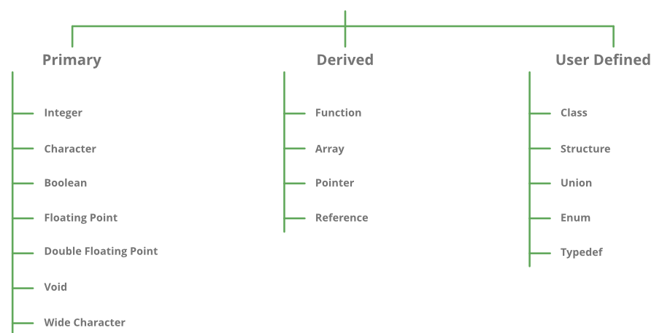
Fundamental Types in C++
Fundamental types in C++
Notes:
Describe how to input and output data.
Present the notion of a variable for holding data.
Introduce the central notions of “Type” and “Type Safety”.
Strings and string I/O
Integers and integer I/O
Types and objects
Type safety

Slide 17
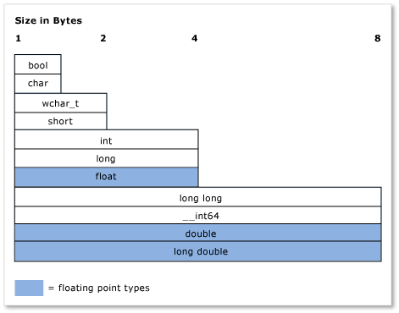
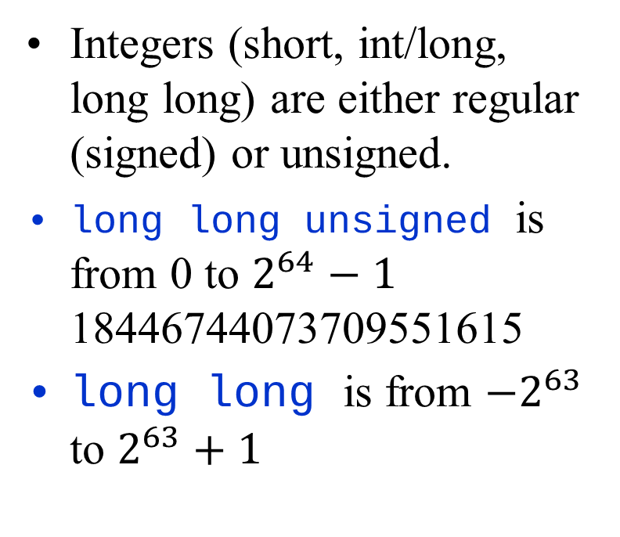
Fundamental Types
Integers (short, int/long, long long) are either regular (signed) or unsigned.
long long unsigned is from 0 to $2^{64}−1$ 18446744073709551615
long long is from $−2^{63}$ to $2^{63}+1$

Slide 18
Valid Names in C++
Starts with a letter, contains letters, digits, and underscores
x, number_of_elements, Fourier_transform, z2
Not names: 12x (starts with a digit) time$to$market (starts with a digit) main line _foo
Users can't define names that are taken as keywords. Such as int if while double
snake_case is more common than camelCase (but both are valid): partial_sum vs. partialSum
Notes:
**Style guideline:**
* Choose meaningful names that are sufficiently short. * Even one-letter variables can be meaningful (x – coordinate; i,j,k – loop variables).
In lexical analysis letters, digits and underscores (all together) are named *word characters* and regex shortcut `\w` matches any one of them. So a valid name in C++ matches this regular expression: `[A-Za-z]\w*`

Slide 19
Simple arithmetic
int main()
{
cout << "please enter a floating-point number: ";
double n; // floating-point variable
cin >> n;
cout << "n == " << n
<< "\nn+1 == " << n+1 // '\n' means “a newline”
<< "\nthree times n == " << 3*n
<< "\ntwice n == " << n+n
<< "\nn squared == " << n*n
<< "\nhalf of n == " << n/2
<< "\nsquare root of n == " << sqrt(n)
// sqrt(n) is library function
<< '\n';
}
// #include and "using namespace" statements left out.
// Do not forget them in real code

Slide 20
Closer Look at Hardware Implementation
int i = 97;
cout << "i = " << i << endl;
cout << "'int' size is " << sizeof(i) << endl;
char c = i;
cout << "'char' size is " << sizeof(i) << endl;
cout << "c = '" << c << "'" << endl;
long l = i;
long long L = i;
bool b = true;
'int' size=4
'char' size=4
'long' size=4
'long long' size=8
'bool' size is 4

Slide 21
Input and output
#include <string>
#include <iostream>
using namespace std;
int main()
{
cout << "Please enter your first name (followed " << "by 'enter'):\n";
string first_name;
cin >> first_name;
cout << "Hello, " << first_name << '\n';
}
// note how several values can be output by a single statement
// a statement that introduces a variable is called a declaration
// a variable holds a value of a specified type
// the final return 0; is optional in main()
// but you may need to include it to pacify your compiler

Slide 22
Streams as Byte Sequences
Explain STDIN, STDOUT, STDERR.
Program.exe < in.txt > out.txt
This reads from file in.txt as STDIN (e.g. using "cin").
This writes to file out.txt as STDOUT (e.g. using "cout").
You can also redirect STDERR to a file (but it is typically more useful to see on the console).

Slide 23
Printing newline vs. printing endl
cout << "c = " << c << '\n';
cout << "c = " << c << "\n";
cout << "c = " << c << endl;
std::cout << "c = " << c << std::endl;
All 4 commands print the same newline (a.k.a. linefeed) character (byte 0A).
The "endl" commands also flush the buffer. (You do not notice the difference unless your C++ program crashes – and then some unflushed bytes might stay unprinted.)
std::cerr << "c = " << c << std::endl;
Printing variables just before a crash.

Slide 24
Input and type
Variable has name and type
For example, first_name and string respectively
The type of a variable determines what operations we can do on it
Here, cin>>first_name; reads characters until a whitespace character is seen (“a word”)
Whitespace:
space ' ', tab '\t', carriage return '\r', newline '\n'.

Slide 25
String vs. Integer Input
int main()
{
cout << "please enter your first and second names\n";
string first;
string second;
cin >> first >> second; // read two strings
string name = first + ' ' + second;
// concatenate strings separated by a space
cout << "Hello, "<< name << '\n';
int age; // integer variable
cin >> age; // read digits only
}

Slide 26
Integer/String Comparison
Integers and floating-point numbers
cin >> reads a number
cout << writes
+ adds
+= n increments by the int n
++ increments by 1
- subtracts
…
Strings
cin >> reads a word
cout << writes
+ concatenates
+= s adds the string s at end
++ is an error
- is an error
…
The type of a variable determines which operations are valid and what their meanings are for that type
(that's called “overloading” or “operator overloading”)

Slide 27
Input in a Loop
// inch to cm and cm to inch conversion:
int main()
{
const double cm_per_inch = 2.54;
int val;
char unit;
while (cin >> val >> unit) { // keep reading
if (unit == 'i') // 'i' for inch
cout << val << "in == " << val*cm_per_inch << "cm\n";
else if (unit == 'c') // 'c' for cm
cout << val << "cm == " << val/cm_per_inch << "in\n";
else
return 0; // terminate on a “bad unit”, e.g. 'q'
}
}

Slide 28
Types and literals
Built-in types
Boolean type
bool
Character types
char
Integer types
int
and short and long
Floating-point types
double
and float
Standard-library types
string
complex<Scalar>
Boolean literals
true false
Character literals
'a', 'x', '4', '\n', '$'
Integer literals
0, 1, 123, -6, 034, 0xa3
Floating point literals
1.2, 13.345, .3, -0.54, 1.2e3, .3F
String literals "asdf",
"Howdy, all y'all!"
Complex literals
complex<double>(12.3,99)
complex<float>(1.3F)

Slide 29
Types
C++ provides a set of types
E.g. bool, char, int, double
Called “built-in types”
C++ programmers can define new types
Called “user-defined types”
We'll get to that eventually
The C++ standard library provides a set of types
E.g. string, vector, complex
Technically, these are user-defined types
they are built using only facilities available to every user

Slide 30
Declaration and initialization
7
int a = 7;
int b = 9;
char c = 'a';
double x = 1.2;
string s1 = "Hello, world";
string s2 = "1.2";
a:
b:
9
c:
'a'
x:
1.2
s1:
12 | "Hello, world"
s2:
3 | "1.2"

Slide 31
Objects
An object is some memory that can hold a value of a given type
A variable is a named object
A declaration names an object
int a = 7;
char c = 'x';
complex<double> z(1.0,2.0);
string s = "qwerty";
a:
7
c:
'x'
z:
1.0
2.0
s:
6
"qwerty"

Slide 32
Identify Periodic Strings
Coding Assignment
Input file contains a "mode marker" (str, dec, hex) on the first line.
After that it contains strings (without spaces) or integers in decimal notation (from 0 to 2^64-1)
Your program should output the shortest period (or 0, if the input string is not periodic).
For hex
Periodic.cpp
Periodic()
bool findPeriod(str)
bool findPeriod(n)
bool findPeriodHex(n)

Slide 33
Periodic Strings: Submitting
Create a private GitHub repository "workspace-cpp"
It will contain subdirectories – one subdirectory per exercise or lab.
Name one subdirectory of workspace-cpp root ex01-periodic
Ensure that it has 4 files PeriodicMain.cpp; Periodic.cpp; Periodic.h; Makefile
Write some test examples test01in.txt, etc. and check, if you get the expected output.

Slide 34
Palindromes: User Story
Inspiration: Simple Functions
Mode is either str
or dec.
Definition: A palindrome is a word that equals its reverse.
We need an executable that inputs strings or nonnegative integers; and outputs the same list with appended bit (0, if not a palindrome; 1, if it is a palindrome).
(Input lines starting with '#' are skipped.)
test01in.txt
dec
3
44
# comment
17
3 1
44 1
17 0
test02in.txt
str
anna
alusariirasula
one;two;one
anna 1
alusariirasula 1
one;two;one 0

Slide 35

Palindromes: Pseudocode
IsPalindrome($S$)
1 if $S.length≤1$
2 return true
3 else if $S[1]≠ S[S.length]$
4 return false
5 else
6 return IsPalindrome($S[2..S.length−1]$)

Slide 36
PalindromesMain.cpp – 1
#include <iostream>
#include <vector>
#include <string>
#include <sstream>
#include "Palindromes.h"
using namespace std;
using namespace ds_course;
int main()
{
Palindromes pal;
string mode;
cin >> mode;
string inputString;
int inputDec;
int inputHex;
//cout << '\'' << mode << '\'' << endl;
//cin.ignore(10000,'\n');

Slide 37
PalindromesMain.cpp – 2
string inputLine;
while (getline(cin, inputLine)) {
istringstream sstr(inputLine);
if (sstr.peek() == '#') {
continue;
}
else {
if (mode == "dec") {
sstr >> inputDec;
bool res = pal.isPalindrome(inputDec);
cout << inputDec << " " << res << endl;
} else if (mode == "str") {
sstr >> inputString;
bool res = pal.isPalindrome(inputString);
cout << inputString << " " << res << endl;
}
}
}
}

Slide 38
Palindromes.h
#include <string>
namespace ds_course
{
class Palindromes
{
public:
Palindromes();
bool isPalindrome(int number);
bool isPalindrome(std::string word);
};
}

Slide 39
Palindromes.cpp – 1
#include <string>
#include <iostream>
#include <sstream>
#include "Palindromes.h"
using namespace ds_course;
using namespace std;
Palindromes::Palindromes() {}
bool Palindromes::isPalindrome(int number)
{
int *digits = new int[20];
int count = 0;
for (int i = 0;;i++) {
digits[i] = number % 10;
number = number / 10;
if (number == 0) {
break;
}
count++;
}
for (int j = 0; j < count; j++) {
if (digits[j] !=
digits[count-j]) {
return false;
}
}
return true;
}

Slide 40
Palindromes.cpp – 2
bool Palindromes::isPalindrome(std::string word) {
int count = word.length();
if (count == 0) {
return true;
}
for (int j = 0; j < count; j++) {
if (word.at(j) != word.at((count-1)-j)) {
return false;
}
}
return true;
}

Slide 41
Palindromes.cpp – 3
#include <string>
namespace ds_course
{
class Palindromes
{
public:
Palindromes();
bool isPalindrome(int number);
bool isPalindrome(std::string word);
};
}

Slide 42
Makefile
OUTPUTFILE := palindromes
SRC_DIR := .
OBJ_DIR := .
SRC_FILES := $(wildcard $(SRC_DIR)/*.cpp)
OBJ_FILES := $(patsubst $(SRC_DIR)%.cpp,$(OBJ_DIR)/%.o,$(SRC_FILES))
LDFLAGS :=
CPPFLAGS :=
CXXFLAGS :=
all: $(OBJ_FILES)
g++ $(LDFLAGS) -o $(OUTPUTFILE) $^
$(OBJ_DIR)/%.o: $(SRC_DIR)/%.cpp
g++ $(CPPFLAGS) $(CXXFLAGS) -c -o $@ $<
clean:
rm -f $(OUTPUTFILE)

Slide 43
Summary
The Last Things
Run HelloWorld-style programs
Distinguish fundamental, derived and user-defined types.
Identify fundamental types, their size in bytes, range of values.
Write identifiers
Perform some arithmetic with fundamental types.
Understand "cin", "cout", input/output streams (input until the first space etc.)
Define what is type safety – and how C++ can violate it.

Slide 44
Why care about programming and C++?
Building your own software often causes more problems than it solves. BUT
Our civilization runs on software; engineering always involves software. (Most programs do not run on devices resembling PCs and laptops. On alternative hardware platforms C++ is widespread.)
C++ is used in olympiads (>90% of teams in ICPC International Collegiate Programming Contest use C++).
C++ algorithms are common in coding interviews – even for positions using other languages.
Notes:
* Need *some* language to implement algorithms.
* More recent languages isolate the user from concerns like memory management or garbage collection.
* The purpose of a programming language is to allow you to express your ideas in code. C++ allows you to express ideas from many application areas; see the consequences in hardware directly.

Slide 45
Engineering Tradeoffs
Ideals often conflict, you can choose what matters most:
Type safety (C++ users believe that it is very important!) vs. Implicit type conversions Strongly typed languages vs. Weakly typed languages (e.g. for scripting)
Run-time performance vs. Portability Hardware-oriented languages vs. Interpreted or Virtual-Machine oriented languages
Reusability vs. Flexibility Object-orientation vs. "flat" code structure.
Ease of construction vs. ease of maintenance Throwaway code vs. Long-term code.
Correctness or testability are always important (testability lets us to be brave!)

Slide 46
C++17
All language standards are updated occasionally
The latest standard has the most and the nicest features (in our case C++17)
Previously C++3, C++11, C++14
Preview C++20.
The latest standard is supported by Visual Studio Code and also Linux compilers.

