Slide 1
First Year Seminar Fall 2020, Week 2
Kalvis Apsītis

Slide 2
Different Types of Questions
Our main focus today:
Why (#0): The importance of your topic, vision, motivation, "mission statement"
How (#1) Technical execution: Skills to perform work and use proper tools.
How (#2) Communication: Inside your team and with stakeholders.
How (#3) Subject matter: Knowing your topic, area of specialization.
What steps do you take to combine these?
How?
Why?
How?
How?
What?
Notes:
Can review Simon Sinek videos; etc.

Slide 3
Evaluation for this Course (max 1000 points)
Grading Rubric | What is | Typical Activities
Class Contribution (200) | (Mostly Claudio) | Attendance; self-evaluations; some individualized contributions/grades.
Prototype Grading (300) | (Mostly Kalvis) | Teamwork (team working agreement; issue mgmt; Agile studies etc.); Functional design (requirements); Configuration mgmt; Iteration planning; Validation/Real-World Data/Reporting.
Team Progress Reports (200) | (Mostly Aldis) | Relevant business goals; interaction with stakeholders; risk management; adaptability to changes...
Final Presentation (300) | All 3 instructors | Minimum Viable Product, Transfer of Information, Happy Customers, Nice Presentation

Slide 4
Prototype Grading (max 300 points)
Teamwork (max 50 points): Team Working Agreement Delegation and Task/Issue Management Bookmarks in GitHub. | Functional Design (max 50 points): Requirements are alligned with BizDev. Functional Design document Peer-reviews and reacting to these reviews. | Config. Mgmt. (max 100 points): Orderly procedure to apply changes. "Deliver Early and Often" Testability of your solution. | Iteration Planning (max 100 points): Planning, reviewing and retrospecting your iterations by Agile/Scrum methodology. Iteration 1 Iteration 2 Iteration 3 | Validation/Data (max 100 points): Perceiving real-world feedback. Metrics and Reports External data integration (mandatory for BITL teams)

Slide 5

Prototype Activities #1: Teamwork
Team Working Agreement (one-time activity)
Q1: Where is the “backlog”?
Q2: Where can you learn about the statuses from other people?
Q3: Where will you keep project files and deliverables?
Q4: How do you interact; team meetings or conf.calls; resolving differences?
Issue Tracking and Project Management (continuous activity)
Q1: Issue Tracking Tool/Approach (your method to track TODOs) – knowing what's important
Q2: Project Management (your method to track dependencies and important deadlines) – knowing what's urgent
Knowledge Management (continuous activity)
Q1: Simple homepage (mostly for your team, NOT for your product). Can do fancy things later.
Q2: Shared bookmarks/links.
Q3: Relevant numeric data and statistics about Bauska (for BITL and optionally for BBA).
Respect the privacy of each other and your stakeholders!

Slide 6
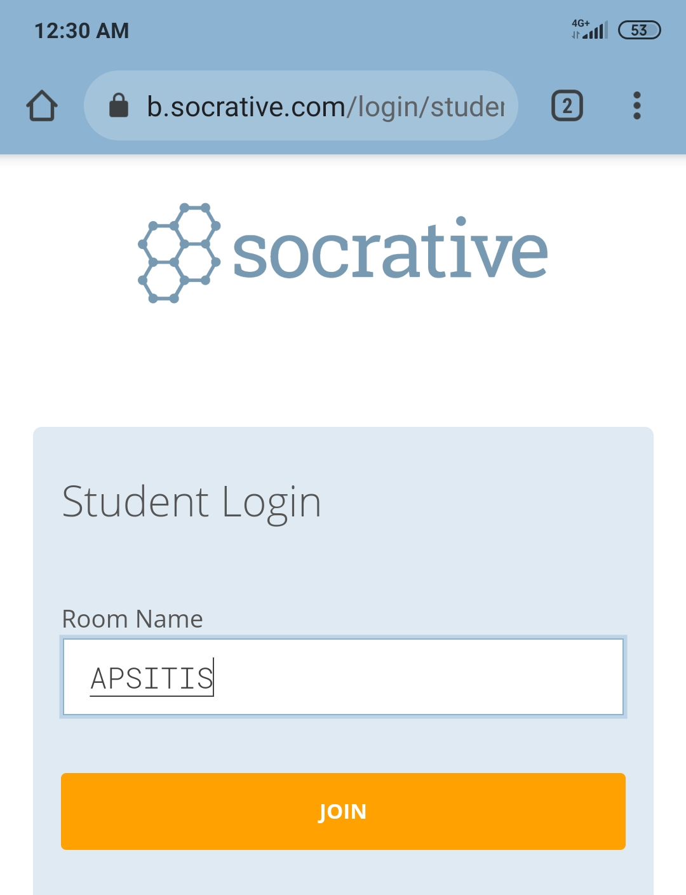
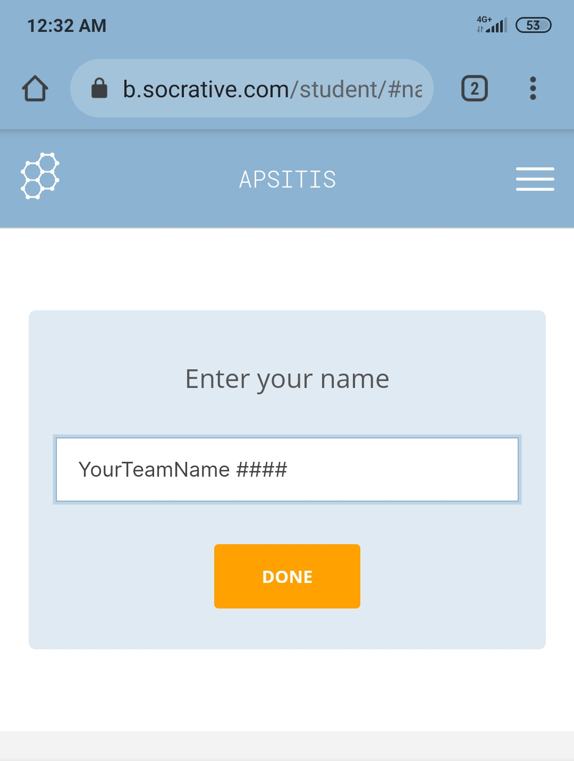
Visit https://www.socrative.com/
TheDevils | BSM
Fireball | Synergy
5OfAKind | TheBig6
Kowalsky | MakeA
Innovators | DAGAZ
HalfAndHalf | TeamRoyal
Clouds | Stonks
APSITIS
<YourTeamName> <FavoriteCalendarYear>

Slide 7
Team Working Agreements in Agile
https://www.uvm.edu/sites/default/files/working-agreements-defined.pdf
https://tech.gsa.gov/guides/agile_team_working_agreement/

Slide 8
Recommended Sections in your Working Agreement (can Rearrange)
Where and how you will learn about the statuses from other people in your team?
Where will you keep project-related documents? (i.e. "internal" stuff for your team)
Where will you keep project artefacts and deliverables? (i.e. "external", customer-facing stuff)
Where is the “backlog” - the list of things you still need to do for your project.
Gaps in Technical or Soft Skills: A few most important things that you think are worth learning because of your project? A table of skills – and how many students do you expect would need that skill.
(In longer projects – performance evaluations, individual goals, etc. We do not care about this.)
Example
Skill Description | # of People
Making black-and-white photos | 2

Slide 9
Additional Stuff in Working Agreement
How do you delegate? How do you keep track on who is responsible for which task.
Breaking rules? Resolve conflicts and bad behaviors.
Your Mission Statement? Certain values and guidelines.
Example Guidelines:
https://tech.gsa.gov/guides/agile_team_working_agreement/
ALL changes to the Sprint / Backlog must be approved by the Product Owner
Use the Impediment Backlog (or swimlane) for blocked issues
Define and adhere to ‘DONE’ criteria for stories
Define and adhere to Version Control rules
Adhere to code documentation standards
Update Backlog before Standup daily
Respect your team member’s time

Slide 10

Can A Team Succeed without a Working Agreement
???
Rules
What organizations are at the opposite extreme?
Can these organizations be effective?
At one extreme we have organizations with lots of formalized rules and procedures.
Notes:
People may obey rules for different reasons.
* Sometimes these are "nudges" or other motivation?
* Social pressure?
* Common "business culture" in your team?

Slide 11

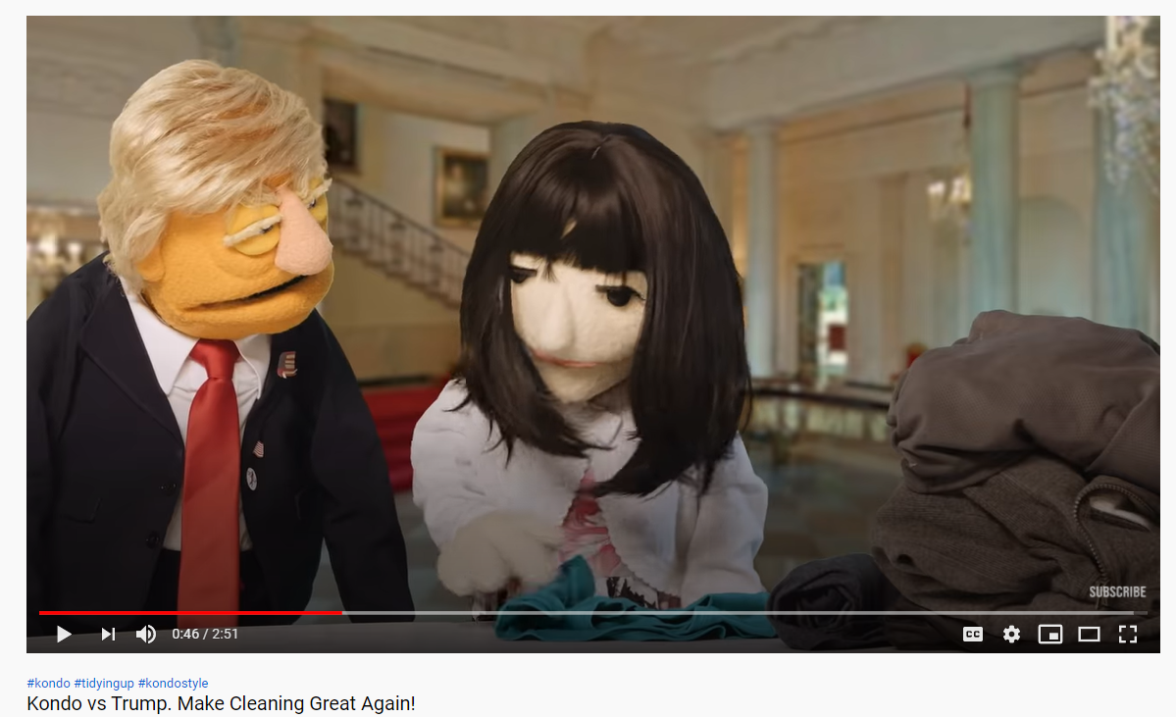


Self-Help Literature on How to Organize Things
David Allen. Getting things Done. 2001
Stephen Covey. The 7 Habits of Highly Effective People
Marie Kondo. Joy at Work.
https://youtu.be/2fb6OqeVl7Q
Notes:
Stephen Covey.
No involvement, no commitment. You can't talk your way out of a problem you behaved your way into! Begin with the end in mind.

Slide 12
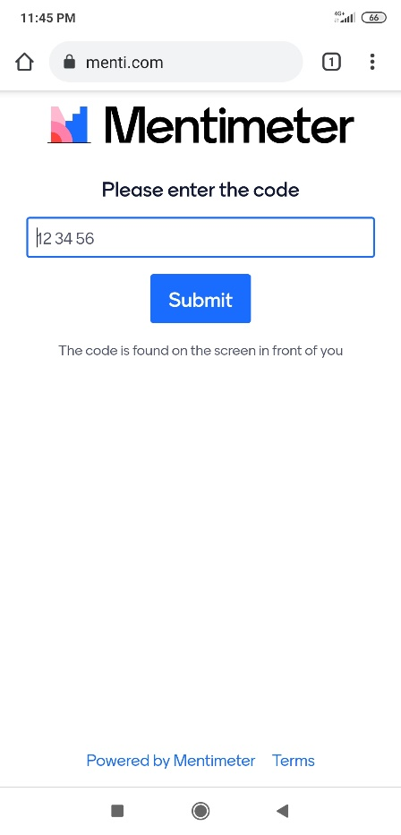
www.menti.com code 8901170
Chat and Teleconferencing Tools
Project Management Tools
Issue Tracking Tools

Slide 13

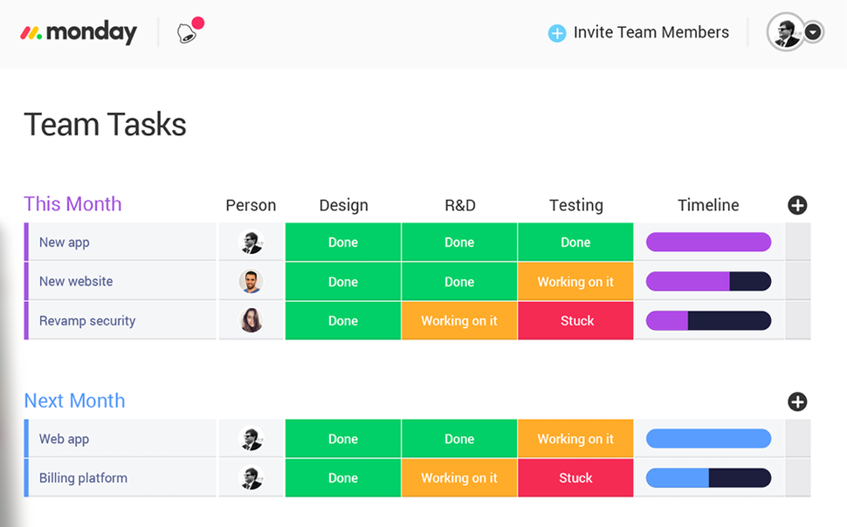
Some Tools (None Recommended/Required)
Google Hangouts
Slack
Microsoft Teams
Atlassian Jira
Bugzilla
Mantis
Basecamp
Asana
Monday
Salesforce
Issue/Bug Tracking tools
Project Management tools
Collaboration tools
Simple tools work, if consistently used:
Magnetic board, if you have office
GitHub, if everyone uses it
Shared spreadsheet

Slide 14
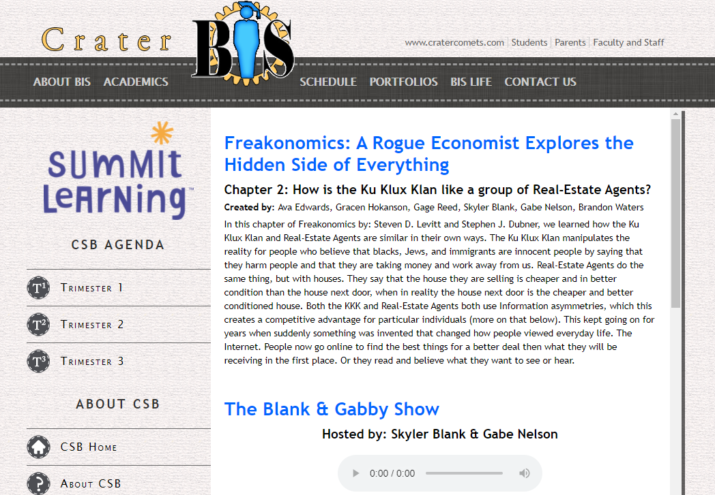
Information Asymmetry
Knowledge Management
Teams are defined by knowledge they control.
Ku Klux Klan, HR people, car dealers, lawyers, your team…
https://bit.ly/35p6ySg
https://bit.ly/2FhetGy
Notes:
Project viewer systems – short descriptions and relevant info. Individual project’s status page: Updates in development and changes in budget. Statistics and subitems.
Also consider George Akerlof – Market for Lemons.

Slide 15

Steven Levitt, Chicago School of Economics
Chapter 2: On Information Asymmetry in markets and elsewhere

Slide 16
Knowledge by Category
Reference information on Bauska
Statistical data about Bauska
Data collected by you/product
Your internal documentation
Information assets
Your product prototype site
Stories about your product
Your deliverables for this course
Contacts: names, emails, phones…
(A) Public Websites
(B) Social Network Profiles
??
(C) Weak Protection
(D) Limited Access

Slide 17
Walk-through: GitHub Pages
Register to https://github.com/
Check in some file in HTML or Markdown
Enable GitHub Pages

Slide 18
Objectives: Summary
The Last Things
Clarified some preconceptions (misconceptions?) about teams and teamwork – Socrative questions.
Introduced Team Working Agreement and Backlog.
Discussed Knowledge Management and suggested a way to make a simple (internal) website. And how to handle different categories of knowledge in your project.

Slide 19
Summary: Things to Do
Team Working Agreement (define your approach)
Put a few small issues in your team's Backlog
Create a simple (project-internal) Website:
Add some bookmarks and any other reference info.
Pay close attention to privacy protection.
Add links to your team's Backlog (guest/read access to instructors – we may inspect it); also a link to your website in your Team Working Agreement. Submit it by Tuesday, September 15, 2020. (One submission per team.)
BITL teams: Make sure to add public data-links to your website.

Slide 20

How to Succeed doing this Task
Team Working Agreement (PDF, HTML, DOCX/ODT)
======================= (1) Answer the questions (Slides 8 and 9)
(2) Add other things to define interactions and procedures in your team
(3) Link (+credentials?) to your team's Backlog
(4) Link to your team's website
Do not submit PAGES files and other fancy file types!
In ORTUS by Tuesday, September 15, 2020. Time <= 23:59:59 EEST.

