Slide 1

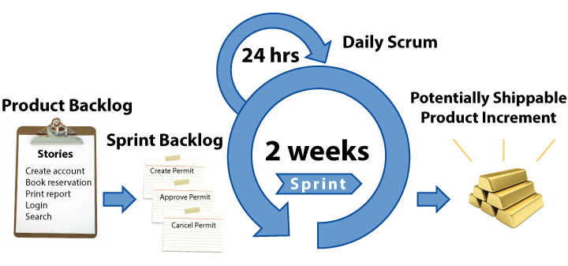
Quality and Agile Processes
Kalvis Apsītis
Notes:
Fulfilment
<number>
https://www.youtube.com/watch?v=AUBTAdI7zuY
Elevator pitch:
Welcome to the first edition of GoBeyond! You really have a great responsibility and you have a great adventure yet to come.
You are the learners, I am not the teacher
I am going to touch your deepest thoughts and feelings. You know what we are talking about – I am just going to put it in front of you.
Only one rule – rather a friendly request: keep total confidentiality on what we are going to do and say during this program. Everything is fine, but we need to protect intellectual rights and allow the future GoBeyond participants to keep some sense of intrigue. Of course, you can say if you are happy or you hate us.
Pieper: “The liberal arts, then, include all forms of human activity which are an end in themselves”. Leadership is a liberal art, therefore it is an end in itself.
Fulfilment

Slide 2
Grading Overview
Prototype: 300 points (The product and its implementation; mostly Kalvis)
Class contribution: 200 points (various assignments: mostly Claudio and Kalvis)
Team Progress Reports (4 x 50): 200 points (Business Development perspective: mostly Viesturs)
Final presentation: 300 points (Delivering and presenting the product, Dec 11)

Slide 3
Class Contribution (200 points)
Working Agreement: up to 20 points - update this.
Tools and Methods for Productivity: up to 30 points; some simple skills that could make you more productive
Agile Development Process: up to 50 points: Small reading assignments about the software engineering best practices. (Essential Scrum, etc.)
Up to 100 points awarded by Claudio (self-evaluations, etc.).

Slide 4
Prototype (300 points)
Functional Design (as Document by November 15): up to 50 points – Will Set Up a Folder in ORTUS
Technical Design (as Document by November 15): up to 50 points – Will Set Up a Folder in ORTUS
Review of Iteration 1 (presented near November 22): up to 50 points
Review of Iteration 2 (presented near December 6): up to 50 points
Development/Production Configuration (near December 6): up to 50 points.
Testing, audit and measurability (before December 11): up to 50 points

Slide 5
Iteration 0: Proof of Concept
Youth Development
Make Bauska Great Again
Bauska Move (Done)
Vote Bauska (Done)
Bunch of Bricks
Career Navigator (Done)
EduBauska (Done)
ProView (Done)
Bauska Live

Slide 6
Iteration 1: Recommended Go-Live
By November 22: Deploy your project in a live (production system or similar)
Arrange a meeting with me (pick a date between November 20 to November 28, endpoints inclusive)
Code inspections (not graded, but we should discuss)
Your approach to “validate” – how do you gather feedback from the stakeholders.
Your approach to testing and logging.

Slide 7
Iteration 2: Your Final Product
By December 6: Update your existing project in a live (production system or similar). Actively involve your stakeholders.
Arrange a meeting with me
More code inspections
Your validation and metrics.
Your unit tests, functional tests, acceptance/regression tests.

