Slide 1

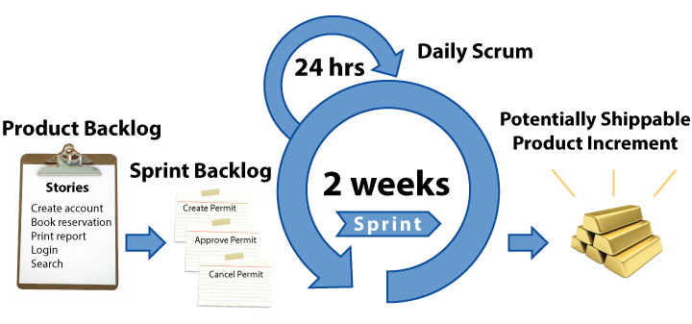
Quality and Agile Processes
Kalvis Apsītis
Notes:
https://www.youtube.com/watch?v=AUBTAdI7zuY
Elevator pitch:
Welcome to the first edition of GoBeyond! You really have a great responsibility and you have a great adventure yet to come.
You are the learners, I am not the teacher
I am going to touch your deepest thoughts and feelings. You know what we are talking about – I am just going to put it in front of you.
Only one rule – rather a friendly request: keep total confidentiality on what we are going to do and say during this program. Everything is fine, but we need to protect intellectual rights and allow the future GoBeyond participants to keep some sense of intrigue. Of course, you can say if you are happy or you hate us.
Pieper: “The liberal arts, then, include all forms of human activity which are an end in themselves”. Leadership is a liberal art, therefore it is an end in itself.
Fulfilment

Slide 2
Grading Overview
Prototype: 300 points (The product and its implementation; mostly Kalvis)
Class contribution: 200 points (various assignments: mostly Claudio and Kalvis)
Team Progress Reports (4 x 50): 200 points (Business Development perspective: mostly Viesturs)
Final presentation: 300 points (Delivering and presenting the product, Dec 11)

Slide 3
Class Contribution (200 points)
Working Agreement: up to 20 points - update this.
Tools and Methods for Productivity: up to 30 points; some simple skills that could make you more productive
Agile Development Process: up to 50 points: Small reading assignments about the software engineering best practices. (Essential Scrum, etc.)
Up to 100 points awarded by Claudio (self-evaluations, etc.).

Slide 4
Prototype (300 points)
Functional Design (as Document by November 15): up to 50 points – Will Set Up a Folder in ORTUS
Technical Design (as Document by November 15): up to 50 points – Will Set Up a Folder in ORTUS
Review of Iteration 1 (presented near November 22): up to 50 points
Review of Iteration 2 (presented near December 6): up to 50 points
Development/Production Configuration (near December 6): up to 50 points.
Testing, audit and measurability (before December 11): up to 50 points

Slide 5
Iteration 0: Proof of Concept
Youth Development
Make Bauska Great Again
Bauska Move (Done)
Vote Bauska (Done)
Bunch of Bricks
Career Navigator (Done)
EduBauska (Done)
ProView (Done)
Bauska Live

Slide 6
Iteration 1: Recommended Go-Live
By November 22: Deploy your project in a live (production system or similar)
Arrange a meeting with me (pick a date between November 20 to November 28, endpoints inclusive)
Code inspections (not graded, but we should discuss)
Your approach to “validate” – how do you gather feedback from the stakeholders.
Your approach to testing and logging.

Slide 7
Iteration 2: Your Final Product
By December 6: Update your existing project in a live (production system or similar). Actively involve your stakeholders.
Arrange a meeting with me
More code inspections
Your validation and metrics.
Your unit tests, functional tests, acceptance/regression tests.

Slide 8
What is CMM
CMM (Capability and Maturity Model) is developed by Carnegie Mellon University, has been applied in Siemens and other large organizations.
It is meant to improve the software creation processes

Slide 9
What is CMM
Everyone realizes the importance of having a motivated, quality work force but...
PEOPLE
Even the finest people cannot perform well when the process is not understood or not operating “at its best.”
TECHNOLOGY
PROCESS
Major determinants of product cost, schedule, and quality

Slide 10
Capability Levels
CMM Levels
A capability level is a well-defined evolutionary plateau describing the organization’s capability in a process area.
There are 5 capability levels.
For capability levels 1-5, there is an associated generic goal.
Each level is a layer in the foundation for continuous process improvement.
Thus, capability levels are cumulative, i.e., a higher capability level includes the attributes of the lower levels.

Slide 11
Maturity Levels Cannot Be Skipped It Is Organizationally Impossible
Maturity Levels Cannot be Skipped
Each maturity level provides a necessary foundation for effective implementation of processes at the next level.
Higher level processes have less chance of success without the discipline provided by lower levels.
The effect of innovation can be obscured in a noisy process.
Higher maturity level processes may be performed by organizations at lower maturity levels, with the risk of not being consistently applied in a crisis.

Slide 12
Soccer Teams: Amateur/Professional
Everyone runs around at random.
They might do the right thing, or they might not.
The next time the ball is hit in the same place, they may do something different.
Everyone moves in a coordinated fashion, based on practicing their tactics many times.
Sometimes they fail to make the right play, but they almost always try to do the right thing.

Slide 13
Soccer Teams: Amateur/Professional
When the team loses a top player? An amateur team is likely to get much worse.
Self-improvement after a bad play… Amateur players don’t know what went wrong, or they blame each other.
When the team loses a top player? A Professional team often has someone waiting to fill in.
Self-improvement after a bad play… Professional teams discuss their play and look for ways to improve.

Slide 14
Maturity is not about age
Mature (Pieaudzis/Izkopts, Зрелый/Матёрый)
A professional football team is more "mature" than an amateur team. Professionals have self-perpetuating quality:
They consistently play good football
They develop new players like themselves
They find ways to play even better

Slide 15
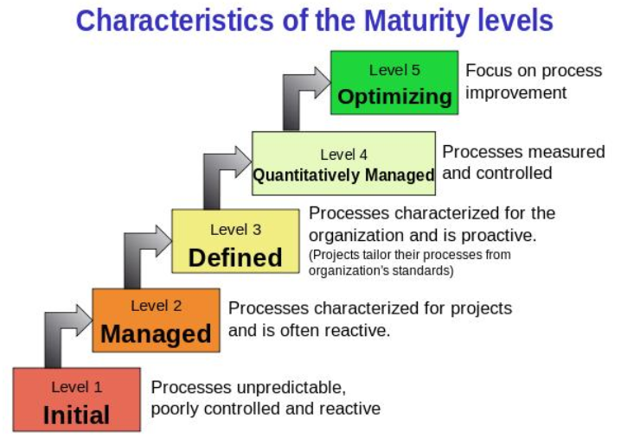
CMM Levels (Carnegie Mellon Univ.)

Slide 16

CMM L1: Initial
Level 1: Chaos and Hero Mentality
Software processes not defined
Planning and controls not used at all times
Success depends on some people only (personal motivation and sacrifice)
Success does not depend on proven processes; it is not repeatable.

Slide 17
CMM L2: Managed
Level 2: Repeatable and uses milestones
Basic project management controls implemented
Planning, monitor and quality control, cost and functionality
Processes are still not transparent («black boxes»), but with milestones and reviews.

Slide 18

CMM L3: Defined
Level 3: Defined software process
Processes are documented and used across the entire organization
The boxes are now internally visible
Staff understands their roles and responsibilities of processes

Slide 19

CMM L4: Quantitatively Managed
Level 4: Measurable processes
Quantitative quality goals set for software processes and products
Processes are predictable, measured
Management makes informed, objective decisions

Slide 20
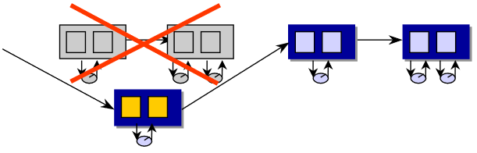
CMM L5: Optimizing
Level 5: Software process optimizing
Able to identify weaknesses and strengths proactively in processes
Continually improving range of processes capabilities
Continually improving processes performance

Slide 21
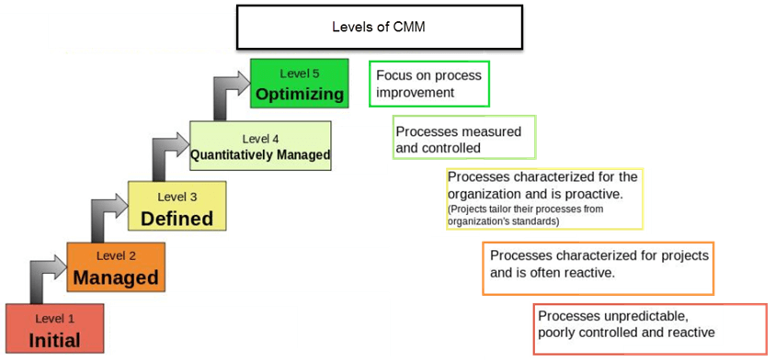
CMM: Summary

Slide 22
CMMI: CMM Integration
Level 5
Generic
Practices
Optimizing
Process
Capability
Level 4
Generic
Practices
Quantitatively
Managed
Process
Level 3
Generic
Practices
Defined
Process
Level 2
Generic
Practices
Managed
Process
Performed
Process

Slide 23
Process Areas by Maturity
Level
Focus
Process Areas
Continuous process improvement
Organizational Innovation and Deployment
Causal Analysis and Resolution
5 Optimizing
4 Quantitatively
Managed
Quantitative
management
Organizational Process Performance
Quantitative Project Management
Requirements Development
Technical Solution
Product Integration
Verification and Validation
Organizational Process Definition
Organizational Training Risk Management
Decision Analysis and Resolution
Organizational Environment for Integration
Integrated Teaming
3 Defined
Process
standardization
Basic
project
management
Requirements Management
Project Planning, Monitoring and Control
Process and Product Quality Assurance
Configuration Management
2 Managed
1 Initial

