Slide 1
Sequences and Summations
Section 2.4

Slide 2
Section Summary
Sequences.
Examples: Geometric Progression, Arithmetic Progression
Recurrence Relations
Example: Fibonacci Sequence
Summations
Special Integer Sequences (optional)

Slide 3
Introduction
Sequences are ordered lists of elements.
1, 2, 3, 5, 8
1, 3, 9, 27, 81, …….
Sequences arise throughout mathematics, computer science, and in many other disciplines, ranging from botany to music.
We will introduce the terminology to represent sequences and sums of the terms in the sequences.

Slide 4
Sequences
Definition: A sequence is a function from a subset of the integers (usually either the set {0, 1, 2, 3, 4, …..} or {1, 2, 3, 4, ….} ) to a set S.
The notation a_{n} is used to denote the image of the integer n. We can think of a_{n} as the equivalent of f(n) where f is a function from {0,1,2,…..} to S. We call a_{n} a term of the sequence.

Slide 5
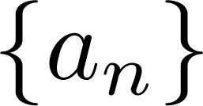
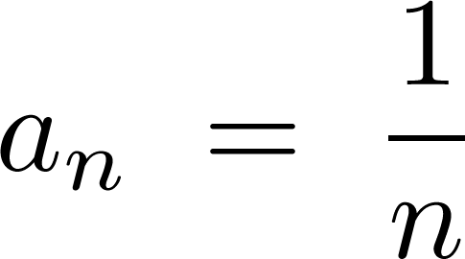
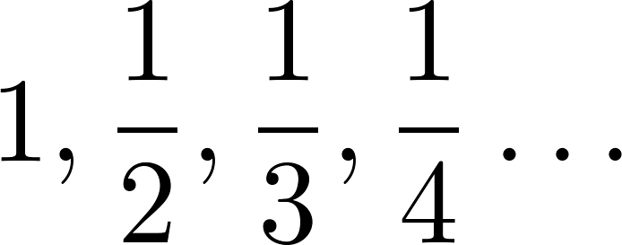
Sequences
Example: Consider the sequence where

Slide 6
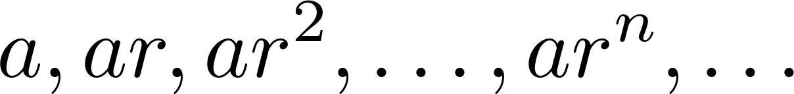
Geometric Progression
Definition: A geometric progression is a sequence of the form:
where the initial term a and the common ratio r are real numbers.
Examples:
Let a = 1 and r = −1. Then:
Let a = 2 and r = 5. Then:
Let a = 6 and r = 1/3. Then:

Slide 7
Arithmetic Progression
Definition: A arithmetic progression is a sequence of the form:
where the initial term a and the common difference d are real numbers.
Examples:
Let a = −1 and d = 4:
Let a = 7 and d = −3:
Let a = 1 and d = 2:

Slide 8
Strings
Definition: A string is a finite sequence of characters from a finite set (an alphabet).
Sequences of characters or bits are important in computer science.
The empty string is represented by λ.
The string abcde has length 5.

Slide 9
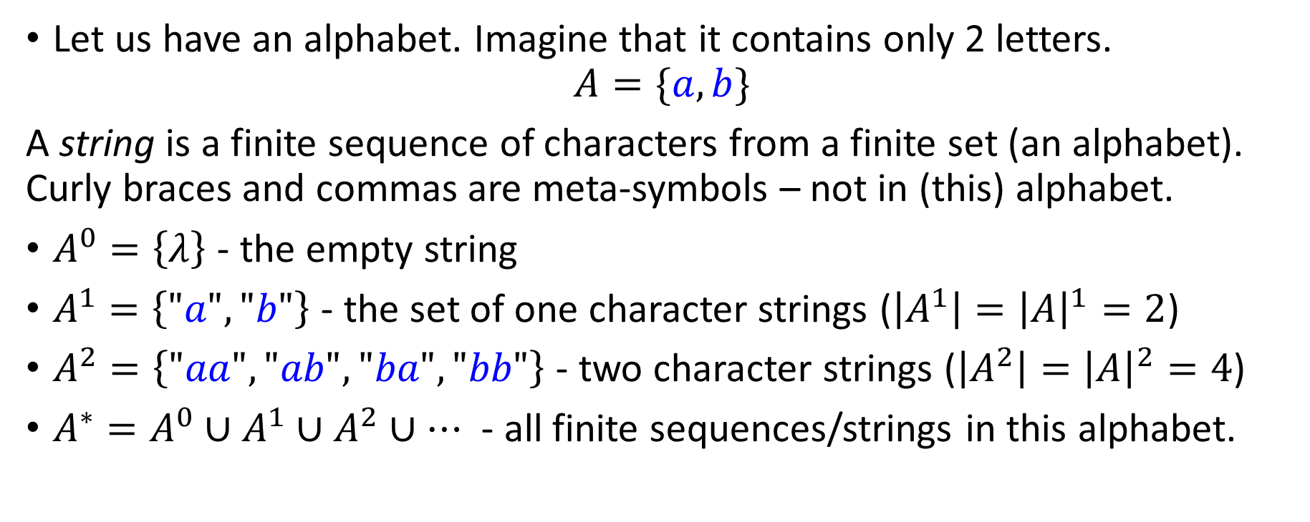
String Sets and String Sequences
Let us have an alphabet. Imagine that it contains only 2 letters.
$$A=\{a,b\}$$
A string is a finite sequence of characters from a finite set (an alphabet). Curly braces and commas are meta-symbols – not in (this) alphabet.
$A^{0}=\left\{λ\right\}$ - the empty string
$A^{1}=\left\{"a","b"\right\}$ - the set of one character strings ($\left|A^{1}\right|={\left|A\right|}^{1}=2$)
$A^{2}=\left\{"aa","ab","ba","bb"\right\}$ - two character strings ($\left|A^{2}\right|={\left|A\right|}^{2}=4$)
$A^{∗}=A^{0}∪A^{1}∪A^{2}∪…$ - all finite sequences/strings in this alphabet.

Slide 10
Lexicographic and Shortlex Order
Strings can be arranged by alphabet (lexicographic order). Examples:
"aaa" < "aaba"< "aabb" < "ab" < "aba" < "abaa" < "b" < "ba" < ...
Can we arrange lexicographically (by alphabet) all strings in this alphabet {a,b} in an infinite sequence?
Lexicographic vs. Shortlex order.

Slide 11
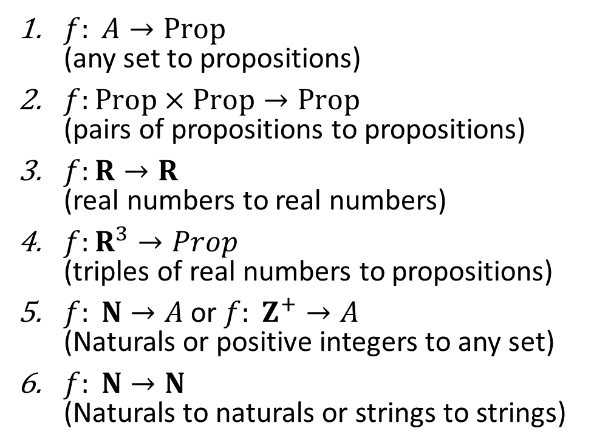
Find the Names for the Functions
$f: A→Prop$ (any set to propositions)
$f:Prop×Prop→Prop$ (pairs of propositions to propositions)
$f:R→R$ (real numbers to real numbers)
$f:R^{3}→Prop$ (triples of real numbers to propositions)
$f: N→A$ or $f: Z^{+}→A$ (Naturals or positive integers to any set)
$f: N→N$ (Naturals to naturals or strings to strings)
Boolean expressions
Computer programs in Python or Scala
Functions from Kristine's calculus classes
Geometric shapes
Predicates
Sequences
Notes:
1. Predicates.
2. Boolean expressions
3. Calculus functions
4. Geometric shapes
5. Sequences
6. Computer programs (on numeric or symbolic inputs)

Slide 12
Recurrence Relations
Definition: A recurrence relation for the sequence {a_{n}} is an equation that expresses a_{n} in terms of one or more of the previous terms of the sequence, namely, a₀, a₁, …, a_{n-1}, for all integers n with n ≥ n₀, where n₀ is a nonnegative integer.
A sequence is called a solution of a recurrence relation if its terms satisfy the recurrence relation.
The initial conditions for a sequence specify the terms that precede the first term where the recurrence relation takes effect.

Slide 13
Questions about Recurrence Relations
Example 1: Let {a_{n}} be a sequence that satisfies the recurrence relation a_{n} = a_{n-1} + 3 for n = 1,2,3,4,…. and suppose that a₀ = 2. What are a₁ , a₂ and a₃?
[Here a₀ = 2 is the initial condition.]
Solution: We see from the recurrence relation that
a₁ = a₀ + 3 = 2 + 3 = 5
a₂ = 5 + 3 = 8
a₃ = 8 + 3 = 11

Slide 14
Questions about Recurrence Relations
Example 2: Let {a_{n}} be a sequence that satisfies the recurrence relation a_{n} = a_{n-1} – a_{n-2} for n = 2,3,4,…. and suppose that a₀ = 3 and a₁ = 5. What are a₂ and a₃?
[Here the initial conditions are a₀ = 3 and a₁ = 5. ]
Solution: We see from the recurrence relation that
a₂ = a₁ - a₀ = 5 – 3 = 2
a₃ = a₂ – a₁ = 2 – 5 = –3

Slide 15
Fibonacci Sequence
Definition: Define the Fibonacci sequence, f₀ ,f₁ ,f₂,…, by:
Initial Conditions: f₀ = 0, f₁ = 1
Recurrence Relation: f_{n} = f_{n-1} + f_{n-2}
Example: Find f₂ ,f₃ ,f₄ , f₅ and f₆ .
Answer:
f₂ = f₁ + f₀ = 1 + 0 = 1,
f₃ = f₂ + f₁ = 1 + 1 = 2,
f₄ = f₃ + f₂ = 2 + 1 = 3,
f₅ = f₄ + f₃ = 3 + 2 = 5,
f₆ = f₅ + f₄ = 5 + 3 = 8.

Slide 16
Solving Recurrence Relations
Finding a formula for the nth term of the sequence generated by a recurrence relation is called solving the recurrence relation.
Such a formula is called a closed formula.
Various methods for solving recurrence relations will be covered in Chapter 8 where recurrence relations will be studied in greater depth.
Here we illustrate by example the method of iteration in which we need to guess the formula. The guess can be proved correct by the method of induction (Chapter 5).

Slide 17
Iterative Solution Example
Method 1: Working upward, forward substitution
Let {a_{n}} be a sequence that satisfies the recurrence relation a_{n} = a_{n-1} + 3 for n = 2,3,4,…. and suppose that a₁ = 2.
a₂ = 2 + 3
a₃ = (2 + 3) + 3 = 2 + 3 ∙ 2
a₄ = (2 + 2 ∙ 3) + 3 = 2 + 3 ∙ 3
.
.
.
a_{n} = a_{n-1} + 3 = (2 + 3 ∙ (n – 2)) + 3 = 2 + 3(n – 1)

Slide 18
Iterative Solution Example
Method 2: Working downward, backward substitution
Let {a_{n}} be a sequence that satisfies the recurrence relation a_{n} = a_{n-1} + 3 for n = 2,3,4,…. and suppose that a₁ = 2.
a_{n} = a_{n-1} + 3
= (a_{n-2} + 3) + 3 = a_{n-2} + 3 ∙ 2
= (a_{n-3} + 3 )+ 3 ∙ 2 = a_{n-3} + 3 ∙ 3
.
.
.
= a₂ + 3(n – 2) = (a₁ + 3) + 3(n – 2) = 2 + 3(n – 1)

Slide 19
Financial Application
Example: Suppose that a person deposits $10,000.00 in a savings account at a bank yielding 11% per year with interest compounded annually. How much will be in the account after 30 years?
Let P_{n} denote the amount in the account after 30 years. P_{n} satisfies the following recurrence relation:
P_{n} = P_{n-1} + 0.11P_{n-1} = (1.11) P_{n-1}
with the initial condition P₀ = 10,000
Continued on next slide →

Slide 20
Financial Application
P_{n} = P_{n-1} + 0.11P_{n-1} = (1.11) P_{n-1}
with the initial condition P₀ = 10,000
Solution: Forward Substitution
P₁ = (1.11)P₀
P₂ = (1.11)P₁ = (1.11)²P₀
P₃ = (1.11)P₂ = (1.11)³P₀
:
P_{n} = (1.11)P_{n-1} = (1.11)^{n}P₀ = (1.11)^{n} 10,000
P_{n} = (1.11)^{n} 10,000 (Can prove by induction, covered in Chapter 5)
P₃₀ = (1.11)³⁰ 10,000 = $228,992.97

Slide 21
Special Integer Sequences (opt)
Given a few terms of a sequence, try to identify the sequence. Conjecture a formula, recurrence relation, or some other rule.
Some questions to ask?
Are there repeated terms of the same value?
Can you obtain a term from the previous term by adding an amount or multiplying by an amount?
Can you obtain a term by combining the previous terms in some way?
Are they cycles among the terms?
Do the terms match those of a well known sequence?

Slide 22
Questions on Special Integer Sequences (opt)
Example 1: Find formulae for the sequences with the following first five terms: 1, ½, ¼, 1/8, 1/16
Solution: Note that the denominators are powers of 2. The sequence with a_{n} = 1/2^{n} is a possible match. This is a geometric progression with a = 1 and r = ½.
Example 2: Consider 1,3,5,7,9
Solution: Note that each term is obtained by adding 2 to the previous term. A possible formula is a_{n} = 2n + 1. This is an arithmetic progression with a =1 and d = 2.
Example 3: 1, -1, 1, -1,1
Solution: The terms alternate between 1 and -1. A possible sequence is a_{n} = (−1)^{n} . This is a geometric progression with a = 1 and r = −1.

Slide 23
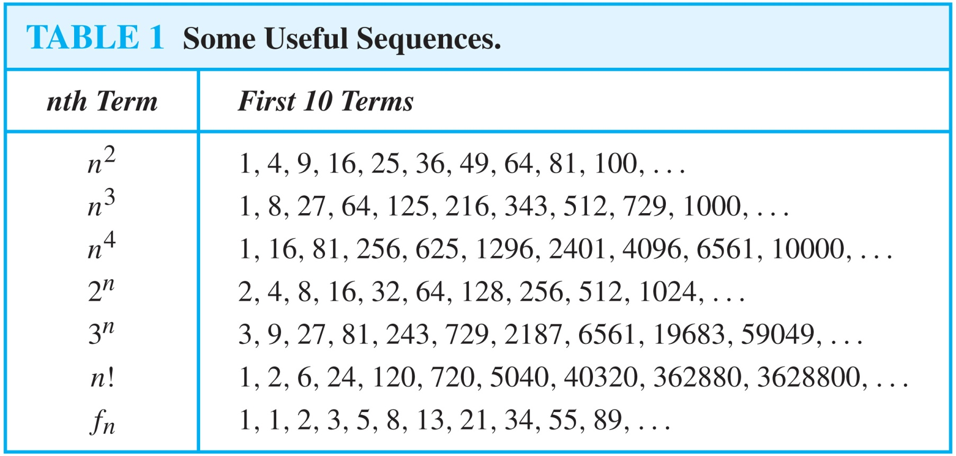
Useful Sequences

Slide 24
Guessing Sequences (optional)
Example: Conjecture a simple formula for a_{n} if the first 10 terms of the sequence {a_{n}} are 1, 7, 25, 79, 241, 727, 2185, 6559, 19681, 59047.
Solution: Note the ratio of each term to the previous approximates 3. So now compare with the sequence 3^{n} . We notice that the nth term is 2 less than the corresponding power of 3. So a good conjecture is that a_{n} = 3^{n} − 2.

Slide 25
Integer Sequences (optional)
Integer sequences appear in a wide range of contexts. Later we will see the sequence of prime numbers (Chapter 4), the number of ways to order n discrete objects (Chapter 6), the number of moves needed to solve the Tower of Hanoi puzzle with n disks (Chapter 8), and the number of rabbits on an island after n months (Chapter 8).
Integer sequences are useful in many fields such as biology, engineering, chemistry and physics.
On-Line Encyclopedia of Integer Sequences (OESIS) contains over 200,000 sequences. Began by Neil Stone in the 1960s (printed form). Now found at http://oeis.org/Spuzzle.html

Slide 26
Integer Sequences (optional)
Here are three interesting sequences to try from the OESIS site. To solve each puzzle, find a rule that determines the terms of the sequence.
Guess the rules for forming for the following sequences:
2, 3, 3, 5, 10, 13, 39, 43, 172, 177, ...
Hint: Think of adding and multiplying by numbers to generate this sequence.
0, 0, 0, 0, 4, 9, 5, 1, 1, 0, 55, ...
Hint: Think of the English names for the numbers representing the position in the sequence and the Roman Numerals for the same number.
2, 4, 6, 30, 32, 34, 36, 40, 42, 44, 46, ...
Hint: Think of the English names for numbers, and whether or not they have the letter ‘e.’
The answers and many more can be found at
http://oeis.org/Spuzzle.html

Slide 27
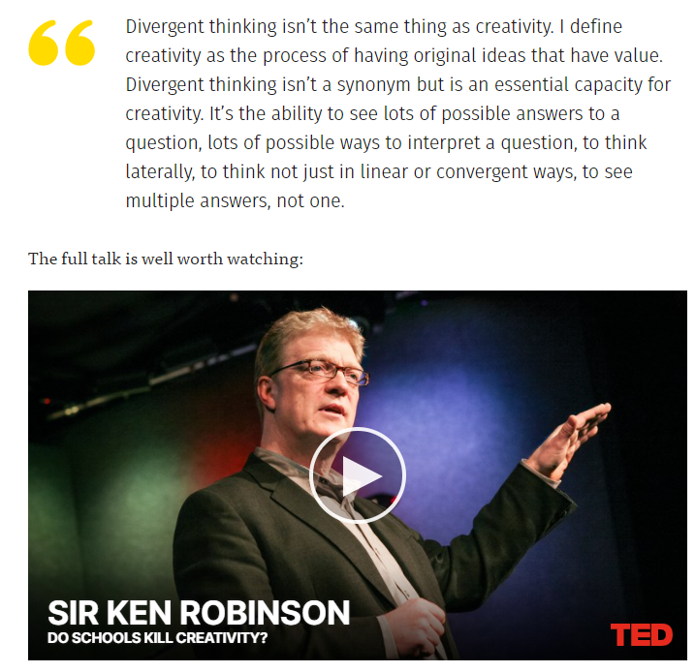
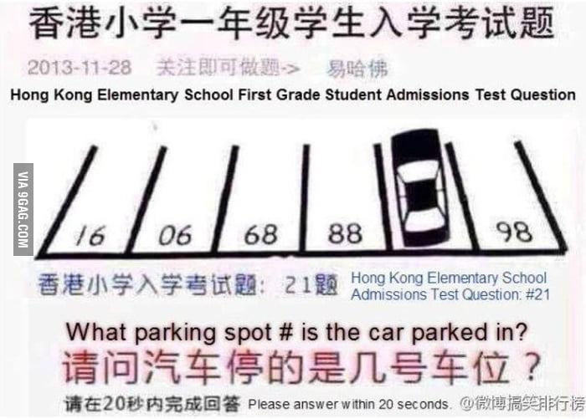
An Entertaining Problem on Sequences

Slide 28
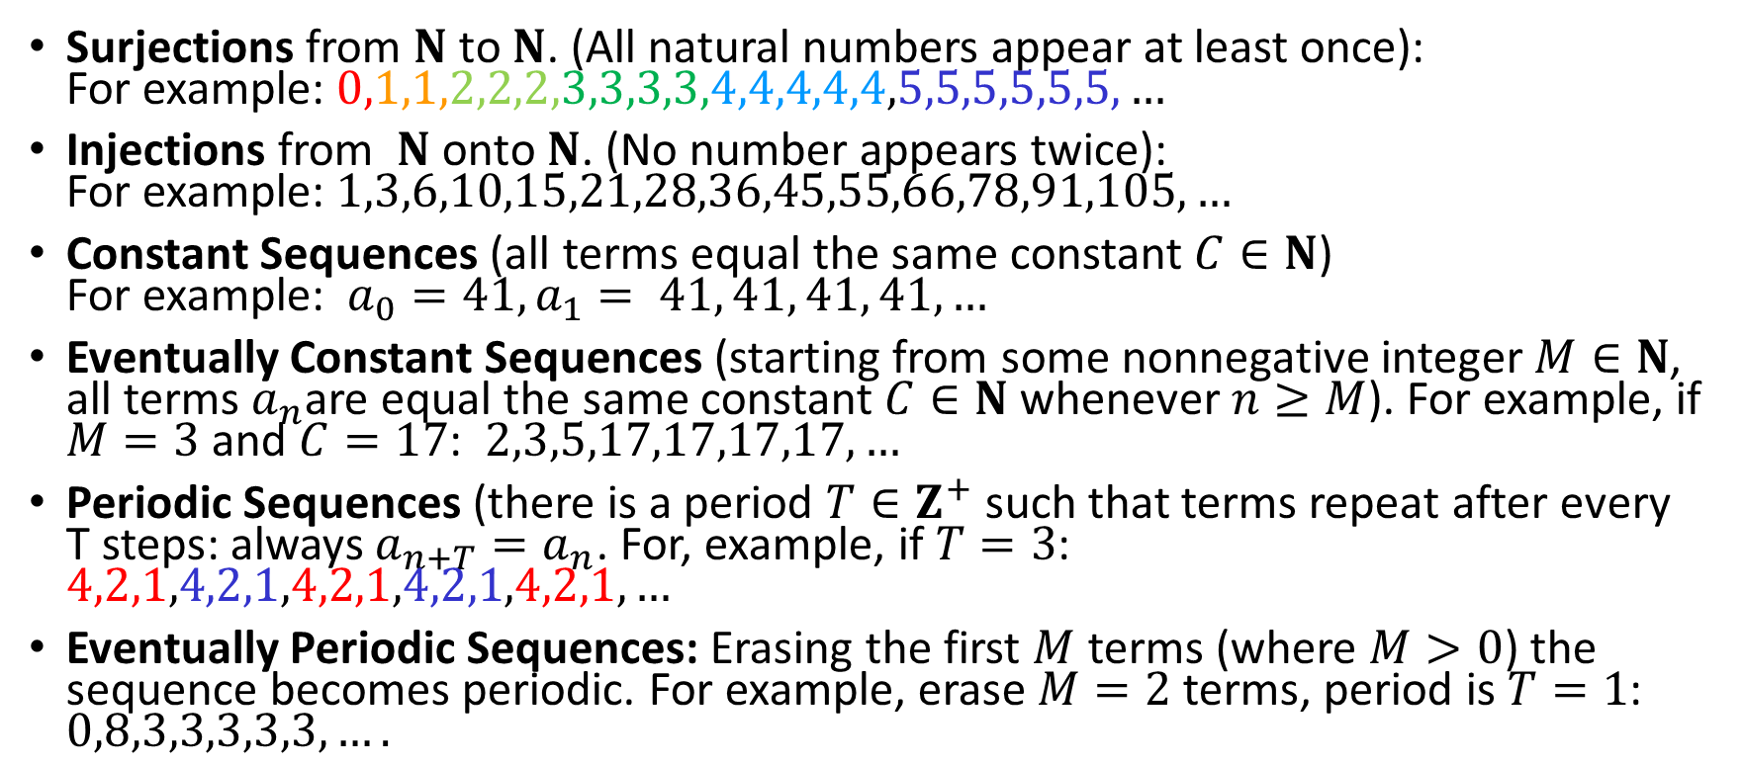
Properties of Sequences of Natural Numbers
Surjections from $N$ to $N$. (All natural numbers appear at least once): For example: $0,1,1,2,2,2,3,3,3,3,4,4,4,4,4,5,5,5,5,5,5,…$
Injections from $N$ onto $N$. (No number appears twice): For example: $1,3,6,10,15,21,28,36,45,55,66,78,91,105,…$
Constant Sequences (all terms equal the same constant $C∈N$) For example: $a_{0}=41,a_{1}= 41, 41, 41, 41,…$
Eventually Constant Sequences (starting from some nonnegative integer $M∈N$, all terms $a_{n}$are equal the same constant $C∈N$ whenever $n≥M$). For example, if $M=3$ and $C=17$: $2,3,5,17,17,17,17,…$
Periodic Sequences (there is a period $T∈Z^{+}$ such that terms repeat after every T steps: always $a_{n+T}=a_{n}$. For, example, if $T=3$: $4,2,1,4,2,1,4,2,1,4,2,1,4,2,1,…$
Eventually Periodic Sequences: Erasing the first $M$ terms (where $M>0$) the sequence becomes periodic. For example, erase $M=2$ terms, period is $T=1$: $0,8,3,3,3,3,3,….$

Slide 29
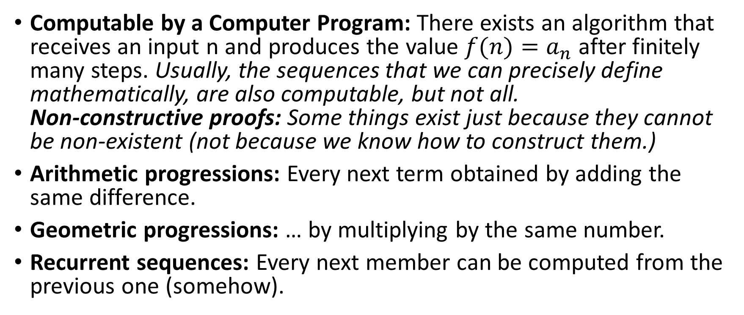
More Properties of Number Sequences
Computable by a Computer Program: There exists an algorithm that receives an input n and produces the value $f(n)=a_{n}$after finitely many steps. Usually, the sequences that we can precisely define mathematically, are also computable, but not all. Non-constructive proofs: Some things exist just because they cannot be non-existent (not because we know how to construct them.)
Arithmetic progressions: Every next term obtained by adding the same difference.
Geometric progressions: … by multiplying by the same number.
Recurrent sequences: Every next member can be computed from the previous one (somehow).

Slide 30
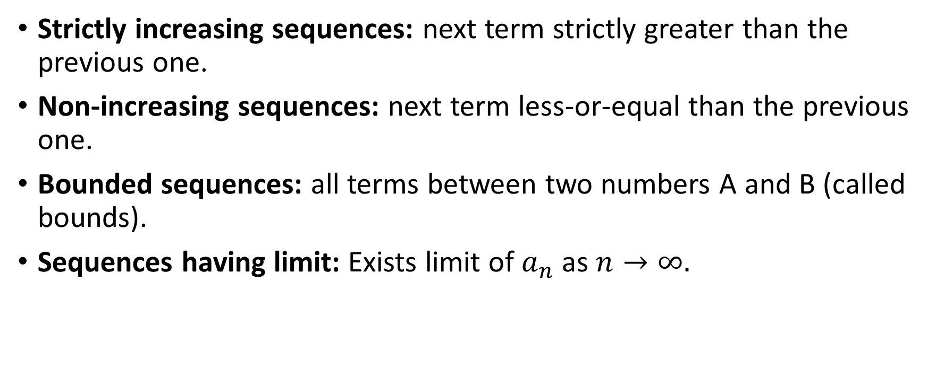
More Properties of Number Sequences
Strictly increasing sequences: next term strictly greater than the previous one.
Non-increasing sequences: next term less-or-equal than the previous one.
Bounded sequences: all terms between two numbers A and B (called bounds).
Sequences having limit: Exists limit of $a_{n}$ as $n→∞.$

Slide 31


Are these formulas OK?
(A) Points A,B,C are all on the plane "alpha":
(B) Planes "alpha" and "beta" are parallel
(D) There exist points A,B,C,D that are not on the same plane

Slide 32
Quiz4A: Expressing Sequences with Predicates
Log into Socrative
Room name = APSITIS
Write in your name.

Slide 33
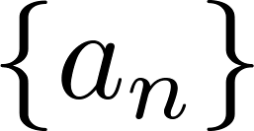
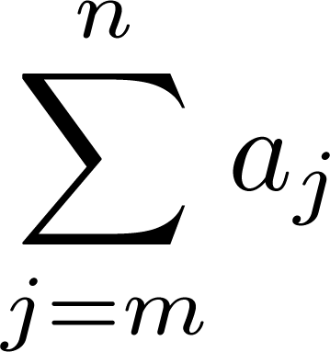
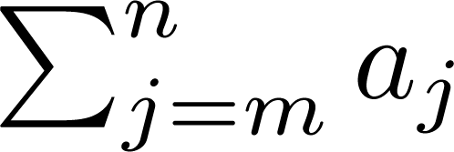
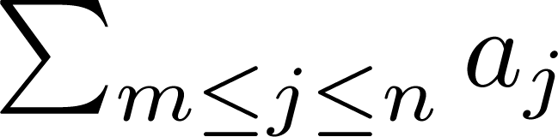
Summations
Sum of the terms
from the sequence
The notation:
represents
The variable j is called the index of summation. It runs through all the integers starting with its lower limit m and ending with its upper limit n.

Slide 34
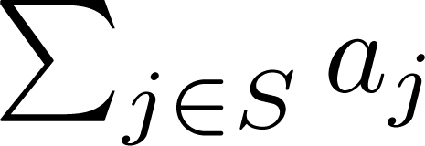
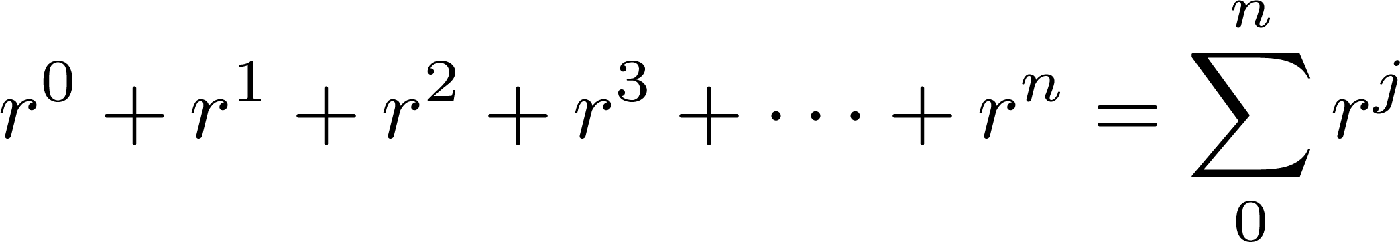
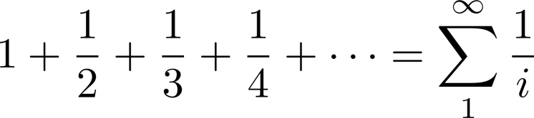
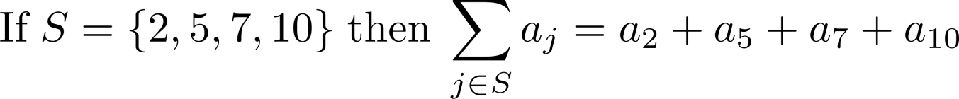
Summations
More generally for a set S:
Examples:

Slide 35
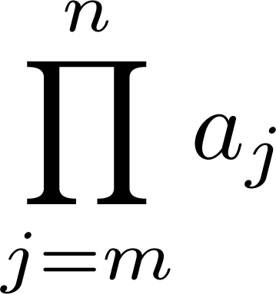
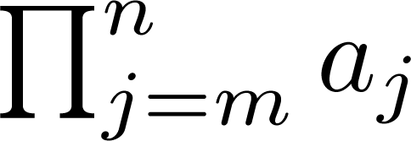
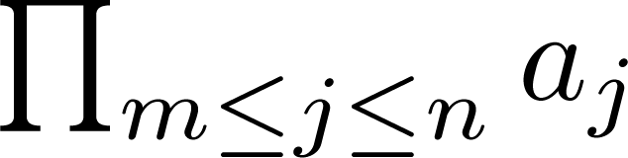
Product Notation (optional)
Product of the terms
from the sequence
The notation:
represents

Slide 36
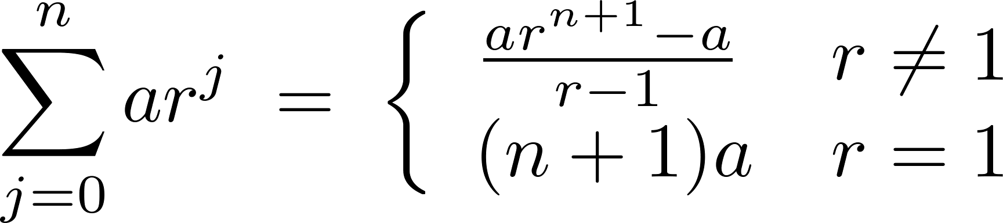
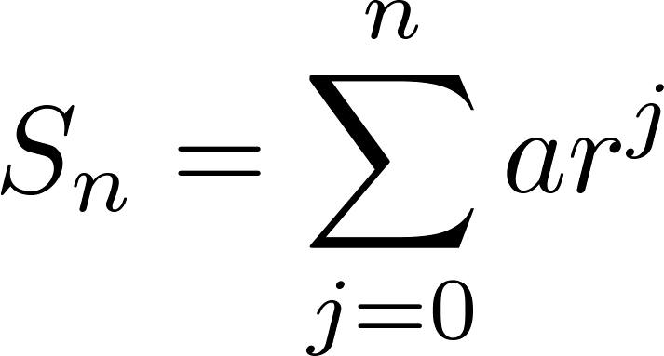
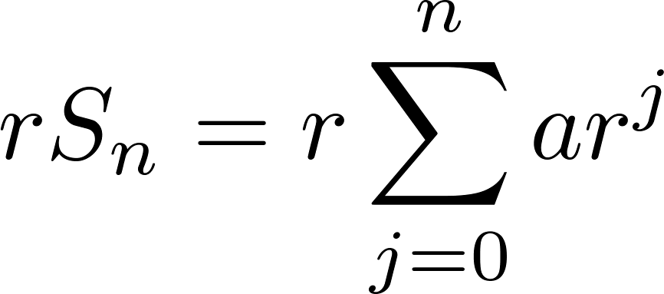
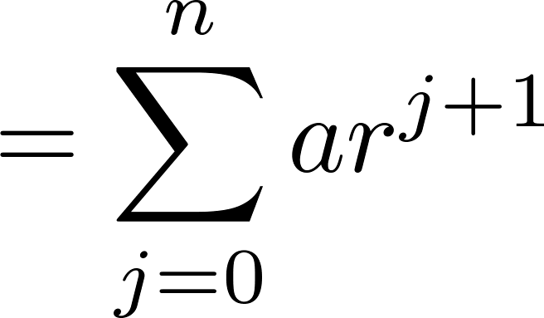
Geometric Series
Sums of the first $n+1$ terms of geometric progressions.
To compute S_{n} , first multiply both sides of the equality by r and then manipulate the resulting sum as follows:
Proof:
Let
Continued on next slide →

Slide 37
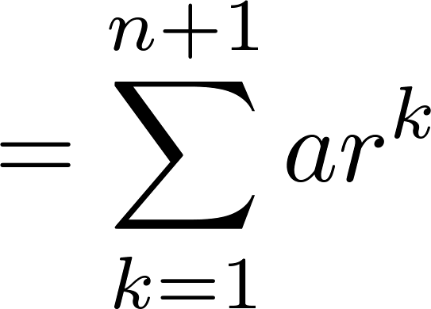
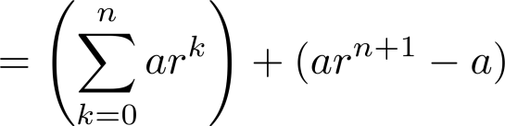
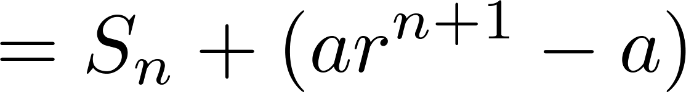
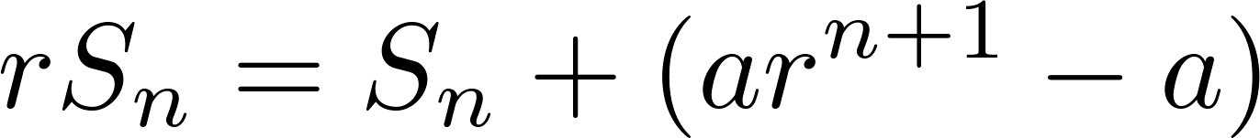
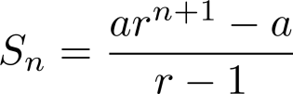
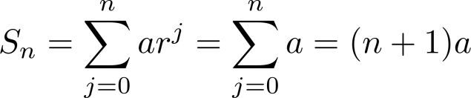
Geometric Series
From previous slide.
Shifting the index of summation with k = j + 1.
Removing k = n + 1 term and
adding k = 0 term.
Substituting S for summation formula
∴
if r ≠1
if r = 1

Slide 38
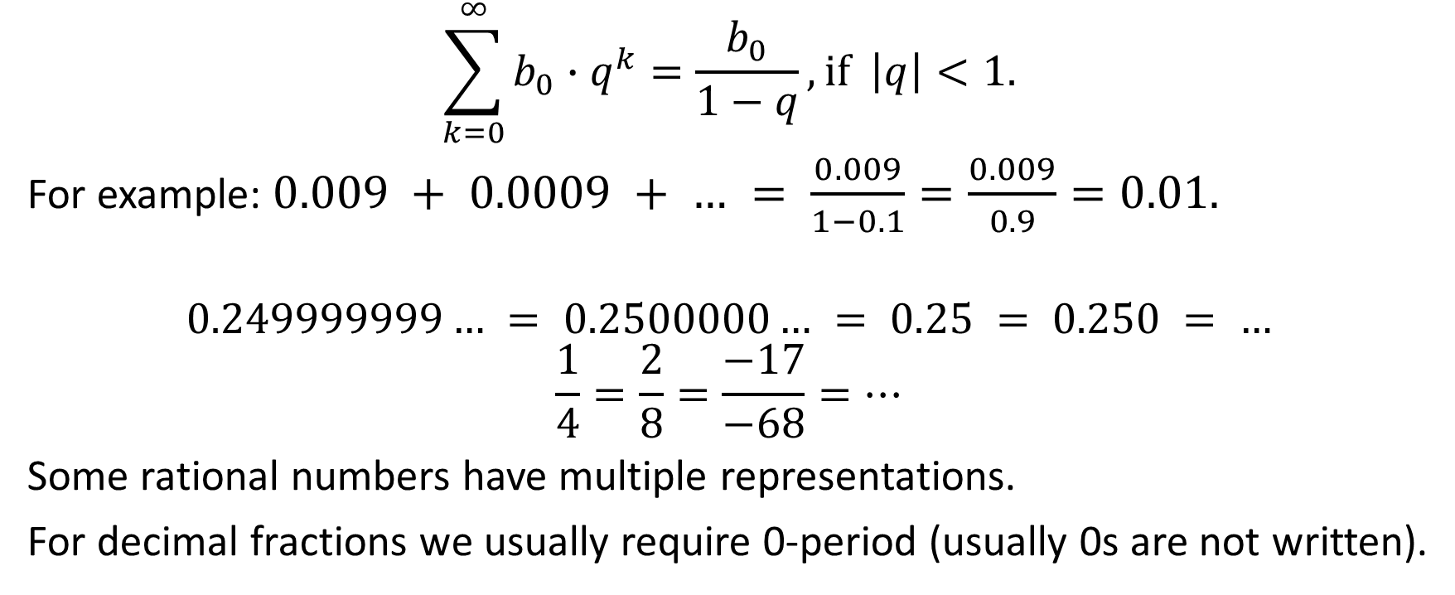
Infinite Geometric Progressions
$$\sum_{k=0}^{∞}{b_{0}∙q^{k}=\frac{b_{0}}{1−q}}, if \left|q\right|<1.$$
For example: $0.009 + 0.0009 + … = \frac{0.009}{1−0.1}=\frac{0.009}{0.9}=0.01.$
$$0.249999999… = 0.2500000… = 0.25 = 0.250 = …$$
$$\frac{1}{4}=\frac{2}{8}=\frac{−17}{−68}=…$$
Some rational numbers have multiple representations.
For decimal fractions we usually require 0-period (usually 0s are not written).

Slide 39
Example
Infinite geometric progressions: Express this number as a rational fraction: x = 0.41463414634146341463... 100000*0.41463414634146341463... = 41463.414634146341463... 0.41463414634146341463...
100000*x – x = 41463
99999*x = 41463

Slide 40
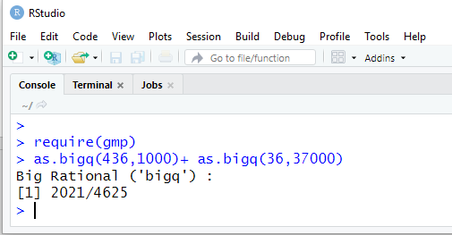
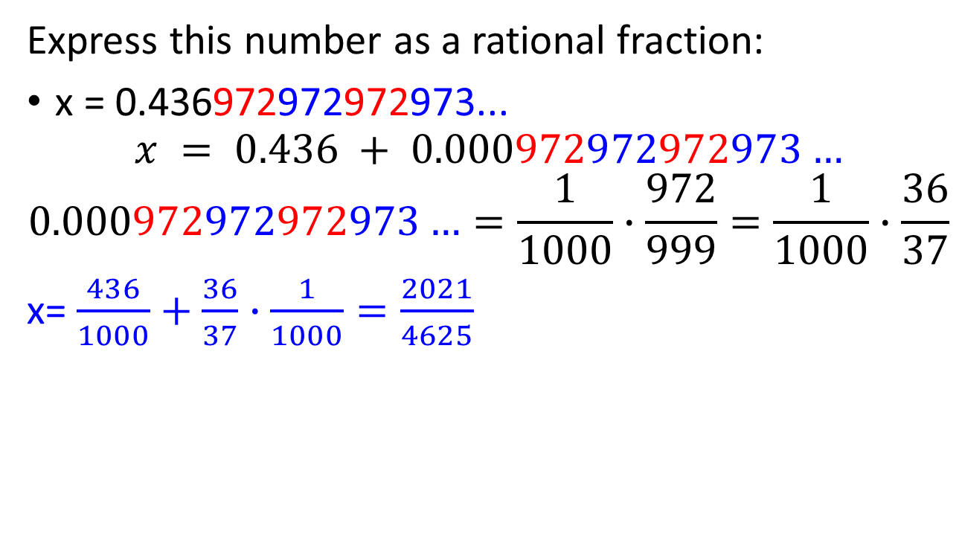
Eventually Periodic Decimal Fractions
Express this number as a rational fraction:
x = 0.436972972972973...
$$x = 0.436 + 0.000972972972973…$$
$$0.000972972972973…=\frac{1}{1000}∙\frac{972}{999}=\frac{1}{1000}∙\frac{36}{37}$$
x= $\frac{436}{1000}+\frac{36}{37}∙\frac{1}{1000}=\frac{2021}{4625}$
Notes:
2021/(37*125)

Slide 41
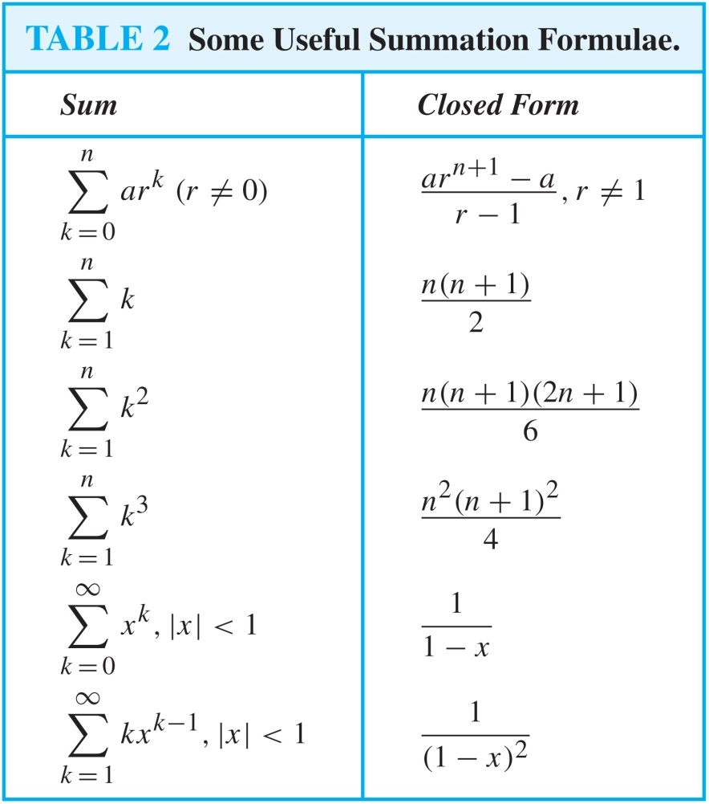
Some Useful Summation Formulae
Geometric Series: We just proved this.
Later we will prove some of these by induction.
Proof in text
(requires calculus)

