Slide 1
Cardinality of Sets
Section 2.5

Slide 2
Section Summary
Cardinality
Countable Sets
Computability
TODO
Real-valued bijections (examples) – logarithm, arctan, hyperbolas.
Coding 2D into 1D (multiplexing/demultiplexing).
Examples of Schröder–Bernstein
Transforming strings into numbers

Slide 3
Cardinality
Definition: The cardinality of a set A is equal to the cardinality of a set B, denoted
|A| = |B|,
if and only if there is a one-to-one correspondence (i.e., a bijection) from A to B.
If there is a one-to-one function (i.e., an injection) from A to B, the cardinality of A is less than or the same as the cardinality of B and we write |A| ≤ |B|.
When |A| ≤ |B| and A and B have different cardinality, we say that the cardinality of A is less than the cardinality of B and write |A| < |B|.

Slide 4
Cardinality
Definition: A set that is either finite or has the same cardinality as the set of positive integers (Z⁺) is called countable. A set that is not countable is uncountable.
The set of real numbers R is an uncountable set.
When an infinite set is countable (countably infinite) its cardinality is ℵ₀ (where ℵ is aleph, the 1st letter of the Hebrew alphabet). We write |S| = ℵ₀ and say that S has cardinality “aleph null.”

Slide 5
Showing that a Set is Countable
An infinite set is countable if and only if it is possible to list the elements of the set in a sequence (indexed by the positive integers).
The reason for this is that a one-to-one correspondence f from the set of positive integers to a set S can be expressed in terms of a sequence a₁,a₂,…, a_{n} ,… where a₁ = f(1), a₂ = f(2),…, a_{n} = f(n),…

Slide 6
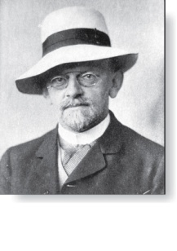
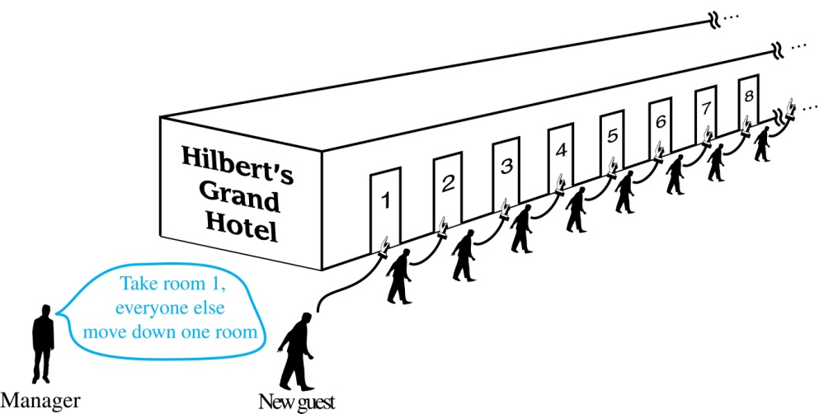
Hilbert’s Grand Hotel
David Hilbert
The Grand Hotel (example due to David Hilbert) has countably infinite number of rooms, each occupied by a guest. We can always accommodate a new guest at this hotel. How is this possible?
Explanation: Because the rooms of Grand Hotel are countable, we can list them as Room 1, Room 2, Room 3, and so on. When a new guest arrives, we move the guest in Room 1 to Room 2, the guest in Room 2 to Room 3, and in general the guest in Room n to Room n + 1, for all positive integers n. This frees up Room 1, which we assign to the new guest, and all the current guests still have rooms.
The hotel can also accommodate a countable number of new guests, all the guests on a countable number of buses where each bus contains a countable number of guests (see exercises).

Slide 7
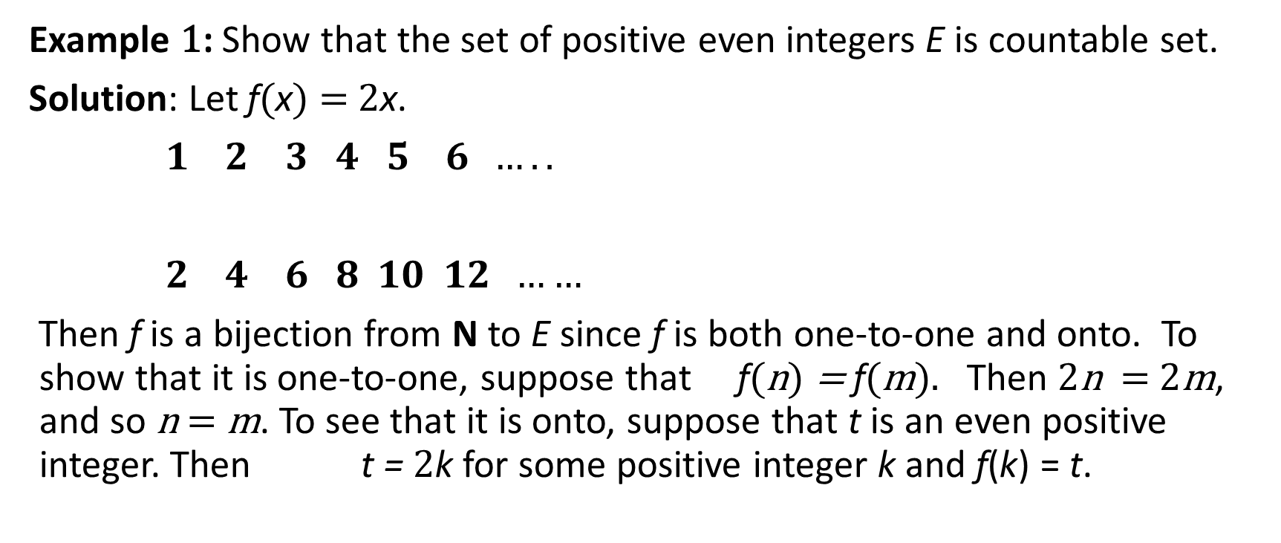
Showing that a Set is Countable
Example 1: Show that the set of positive even integers E is countable set.
Solution: Let f(x) = 2x.
$1 2 3 4 5 6 …..$
$2 4 6 8 10 12 ……$
Then f is a bijection from N to E since f is both one-to-one and onto. To show that it is one-to-one, suppose that f(n) = f(m). Then 2n = 2m, and so n = m. To see that it is onto, suppose that t is an even positive integer. Then t = 2k for some positive integer k and f(k) = t.

Slide 8
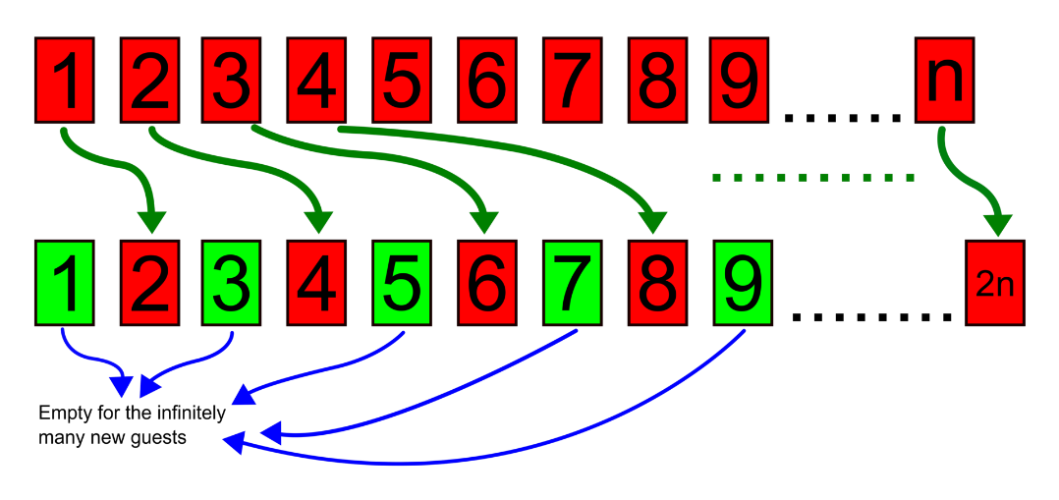
Showing that a Set is Countable
Example 2: Show that the set of integers Z is countable.
Solution: Can list in a sequence:
0, 1, − 1, 2, − 2, 3, − 3 ,………..
Or can define a bijection from N to Z:
When n is even: f(n) = n/2
When n is odd: f(n) = −(n−1)/2
Similar example: Two rows of positive integers
{1,2,3,4,…} can be fitted into a single line.

Slide 9
The Positive Rational Numbers are Countable
Definition: A rational number can be expressed as the ratio of two integers p and q such that q ≠ 0.
¾ is a rational number
√2 is not a rational number.
Example 3: Show that the positive rational numbers are countable.
Solution:The positive rational numbers are countable since they can be arranged in a sequence:
r₁ , r₂ , r₃ ,…
The next slide shows how this is done. →

Slide 10
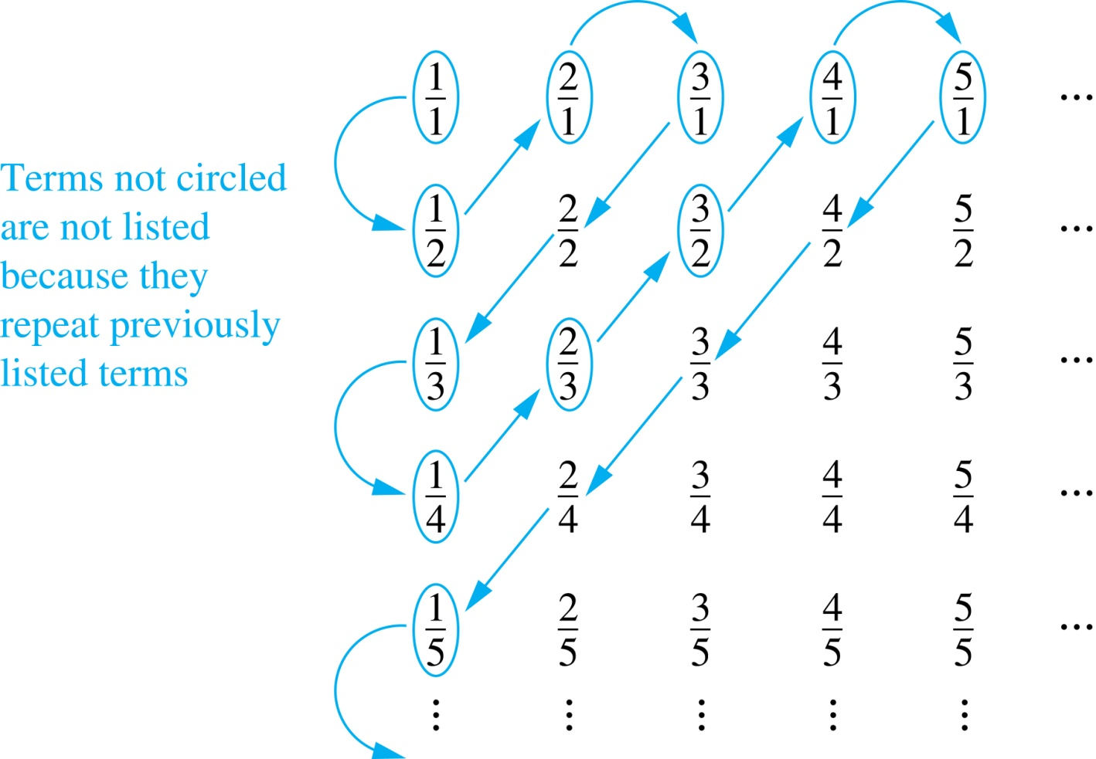
The Positive Rational Numbers are Countable
First row q = 1.
Second row q = 2.
etc.
Constructing the List
First list p/q with p + q = 2.
Next list p/q with p + q = 3
And so on.
1, ½, 2, 3, 1/3,1/4, 2/3, ….

Slide 11
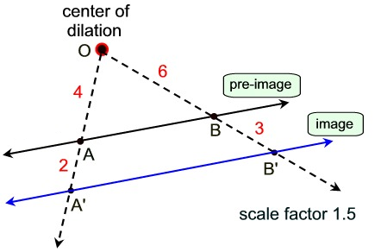
Are there more points on a short line segment or on a twice longer line segment?
Dilation (or other shape symmetry for other similar figures)
We arrange two shapes (so that their sides are parallel), define a center of dilation – and scale every vector by the given factor.
In this example, the bijection can make everything 1.5 times longer.

Slide 12
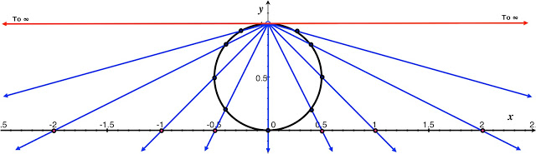
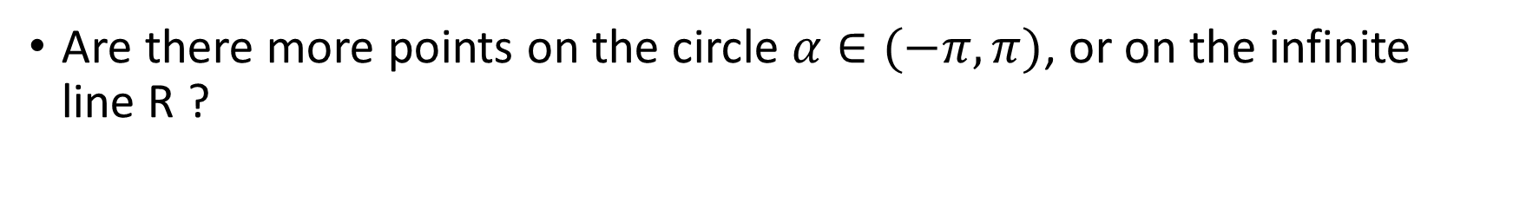
Comparing Circle with R.
Are there more points on the circle $α∈(−π,π)$, or on the infinite line R ?

Slide 13
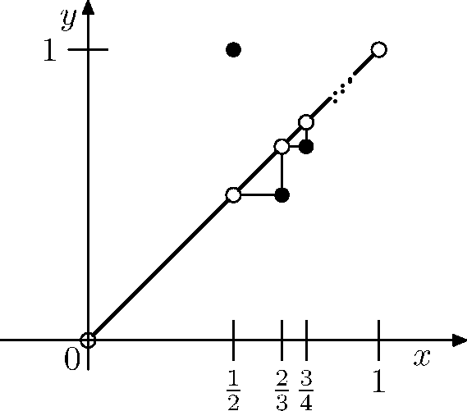
The function shows that x is in the open interval (0;1), but the values f(x) have range (0;1].

Slide 14
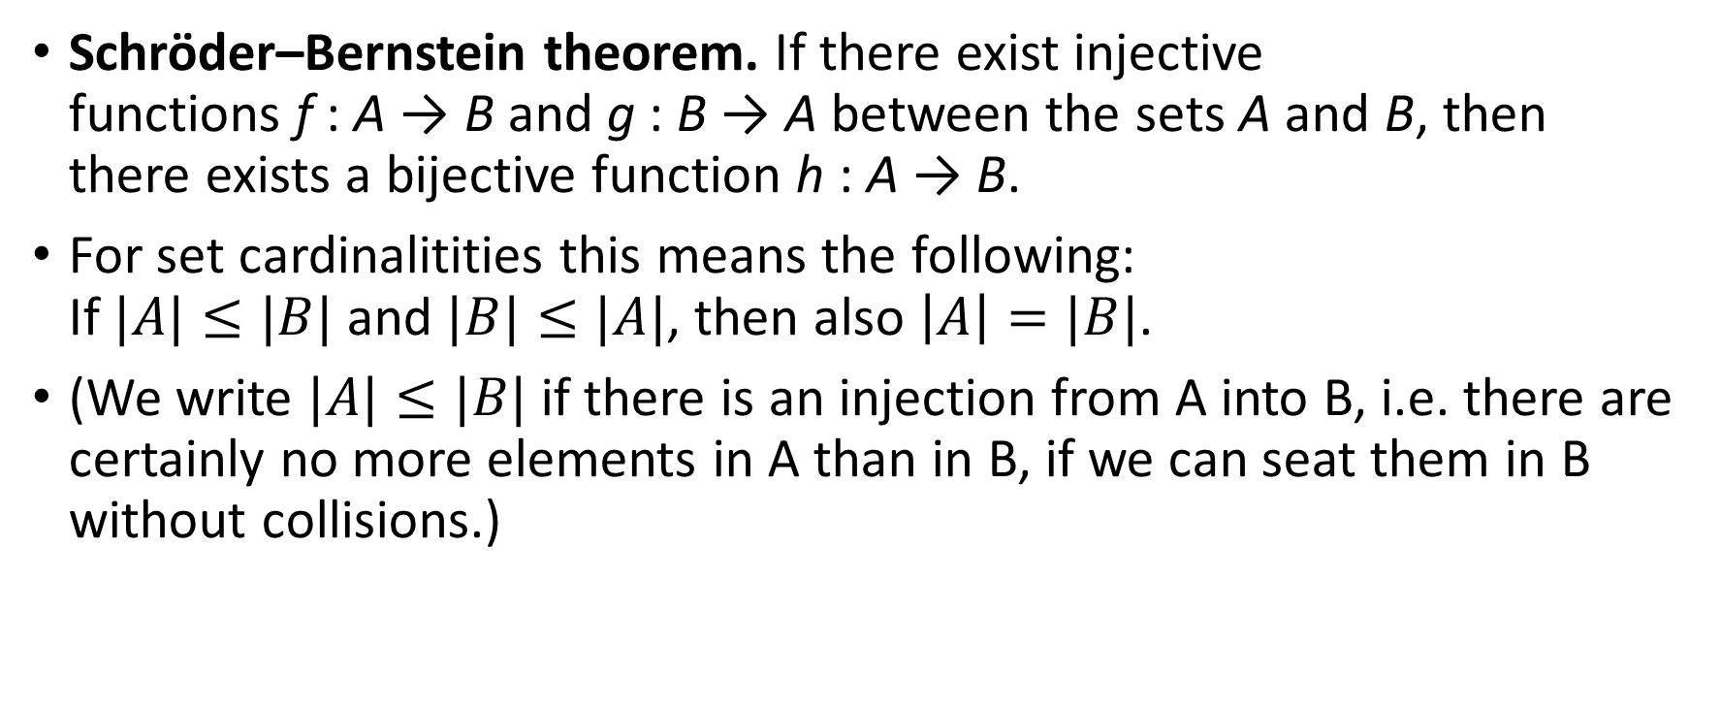
Theorem: Schröder–Bernstein
Schröder–Bernstein theorem. If there exist injective functions f : A → B and g : B → A between the sets A and B, then there exists a bijective function h : A → B.
For set cardinalitities this means the following: If $|A|≤|B|$ and $|B|≤|A|$, then also $\left|A\right|=|B|$.
(We write $|A|≤|B|$ if there is an injection from A into B, i.e. there are certainly no more elements in A than in B, if we can seat them in B without collisions.)

Slide 15
Strings
Example 4: Show that the set of finite strings S over a finite alphabet A is countably infinite.
Assume an alphabetical ordering of symbols in A
Solution: Show that the strings can be listed in a sequence. First list
All the strings of length 0 in alphabetical order.
Then all the strings of length 1 in lexicographic (as in a dictionary) order.
Then all the strings of length 2 in lexicographic order.
And so on.
This implies a bijection from N to S and hence it is a countably infinite set.

Slide 16
The set of all Java programs is countable.
Example 5: Show that the set of all Java programs is countable.
Solution: Let S be the set of strings constructed from the characters which can appear in a Java program. Use the ordering from the previous example. Take each string in turn:
Feed the string into a Java compiler. (A Java compiler will determine if the input program is a syntactically correct Java program.)
If the compiler says YES, this is a syntactically correct Java program, we add the program to the list.
We move on to the next string.
In this way we construct an implied bijection from N to the set of Java programs. Hence, the set of Java programs is countable.

Slide 17
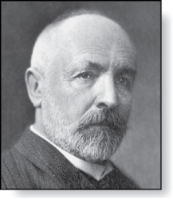
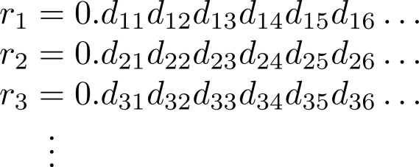
The Real Numbers are Uncountable
Georg Cantor
(1845-1918)
Example: Show that the set of real numbers is uncountable.
Solution: The method is called the Cantor diagnalization argument, and is a proof by contradiction.
Suppose R is countable. Then the real numbers between 0 and 1 are also countable (any subset of a countable set is countable - an exercise in the text).
The real numbers between 0 and 1 can be listed in order r₁ , r₂ , r₃ ,… .
Let the decimal representation of this listing be
Form a new real number with the decimal expansion
where
r is not equal to any of the r₁ , r₂ , r₃ ,... Because it differs from r_{i} in its ith position after the decimal point. Therefore there is a real number between 0 and 1 that is not on the list since every real number has a unique decimal expansion. Hence, all the real numbers between 0 and 1 cannot be listed, so the set of real numbers between 0 and 1 is uncountable.
Since a set with an uncountable subset is uncountable (an exercise), the set of real numbers is uncountable.

Slide 18
Computability (Optional)
Definition: We say that a function is computable if there is a computer program in some programming language that finds the values of this function. If a function is not computable we say it is uncomputable.
There are uncomputable functions. We have shown that the set of Java programs is countable. Exercise 38 in the text shows that there are uncountably many different functions from a particular countably infinite set (i.e., the positive integers) to itself. Therefore (Exercise 39) there must be uncomputable functions.

Slide 19

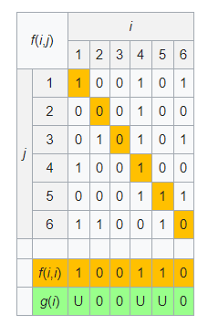
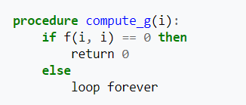
Halting Problem – Uncomputable Function
Halting function h(i,j) is defined.
Assume f(i,j) is an algorithm to compute it.
Build a single-argument g(i) – it does not stop, when f(i,j) says to stop.
g(i) is a computable function – so it also has some algorithm number.
Can f(i,j) behave correctly on g's number?

Slide 20
Totally Recursive and Primitive Recursive Functions
At first it seems that ability to not halt (loop forever) is the cause of this paradox.
What if we could limit our functions – avoid indefinite waiting (in "while loops"). And allow only programming constructs that are guaranteed to finish ("for loops"- if we do not change the loop variable is a typical example).
You can still compute a lot of things. But now there is another problem – some things (that actually always halt – are nice and defined everywhere) you cannot express in this restricted language.

Slide 21
Other Applications of Countability in Computer Science.
https://fa.its.tudelft.nl/~hart/37/publications/talks/20190628-Winchester-handout.pdf
Continuum Hypothesis and Machine Learning

