Slide 1
The Growth of Functions
Section 3.2

Slide 2
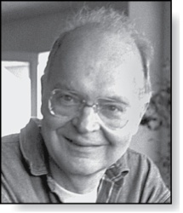
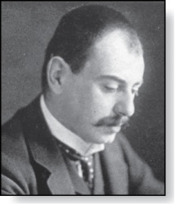
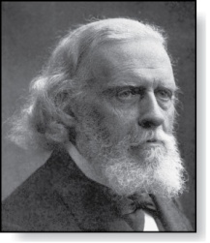
Section Summary
Donald E. Knuth
(Born 1938)
Big-O Notation
Big-O Estimates for Important Functions
Big-Omega and Big-Theta Notation
Edmund Landau
(1877-1938)
Paul Gustav Heinrich Bachmann
(1837-1920)

Slide 3
The Growth of Functions
In both computer science and in mathematics, there are many times when we care about how fast a function grows.
In computer science, we want to understand how quickly an algorithm can solve a problem as the size of the input grows.
We can compare the efficiency of two different algorithms for solving the same problem.
We can also determine whether it is practical to use a particular algorithm as the input grows.
We’ll study these questions in Section 3.3.
Two of the areas of mathematics where questions about the growth of functions are studied are:
number theory (covered in Chapter 4)
combinatorics (covered in Chapters 6 and 8)

Slide 4
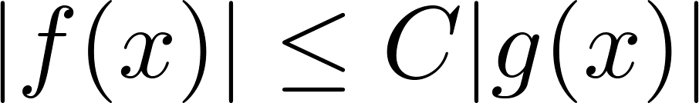
Big-O Notation
Definition: Let f and g be functions from the set of integers or the set of real numbers to the set of real numbers. We say that f(x) is O(g(x)) if there are constants C and k such that
whenever x > k. (illustration on next slide)
This is read as “f(x) is big-O of g(x)” or “g asymptotically dominates f.”
The constants C and k are called witnesses to the relationship f(x) is O(g(x)). Only one pair of witnesses is needed.

Slide 5



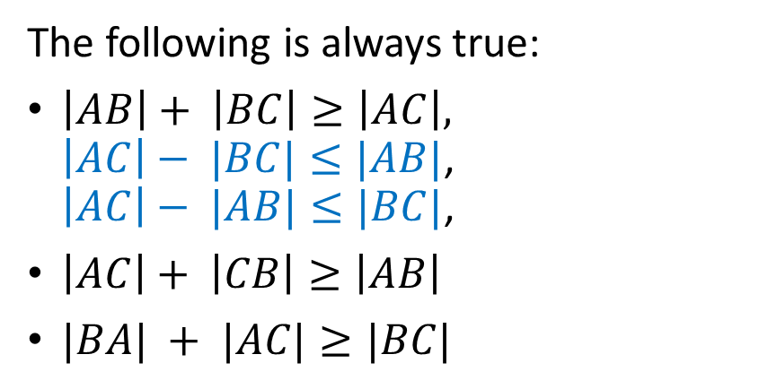
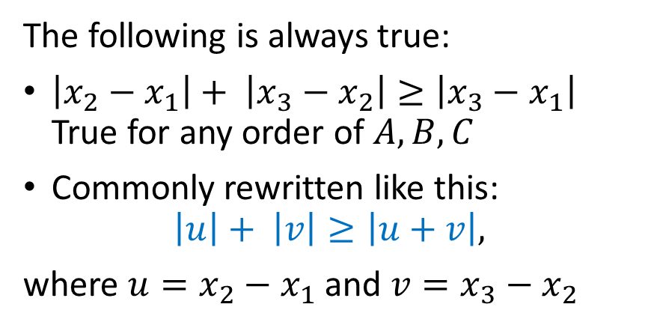



Triangle Inequality
Two-Dimensional Case:
One-Dimensional Case:
B
$$A$$
$$B$$
$$C$$
C
$$x_{1}$$
$$x_{2}$$
$$x_{3}$$
A
The following is always true:
$\left|AB\right|+ \left|BC\right|≥\left|AC\right|,$ $\left|AC\right|− |BC|≤|AB|$, $\left|AC\right|− |AB|≤|BC|$,
$\left|AC\right|+ \left|CB\right|≥\left|AB\right|$
$|BA| + |AC|≥|BC|$
The following is always true:
$\left|x_{2}−x_{1}\right|+ \left|x_{3}−x_{2}\right|≥\left|x_{3}−x_{1}\right|$ True for any order of $A,B,C$
Commonly rewritten like this: $\left|u\right|+ \left|v\right|≥\left|u+v\right|,$
where $u=x_{2}−x_{1}$ and $v=x_{3}−x_{2}$

Slide 6
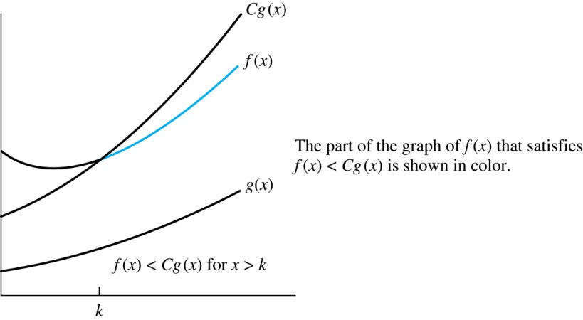
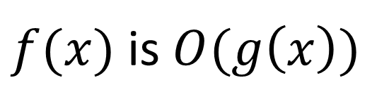
Illustration of Big-O Notation
$f(x)$ is $O(g\left(x\right))$

Slide 7

Some Important Points about Big-O Notation
If one pair of witnesses is found, then there are infinitely many pairs. We can always make the k or the C larger and still maintain the inequality .
Any pair C ̍ and k̍ where C < C̍ and k < k ̍ is also a pair of witnesses since whenever x > k̍ > k.
You may see “ f(x) = O(g(x))” instead of “ f(x) is O(g(x)).”
But this is an abuse of the equals sign since the meaning is that there is an inequality relating the values of f and g, for sufficiently large values of x.
It is ok to write f(x) ∊ O(g(x)), because O(g(x)) represents the set of functions that are O(g(x)).
Usually, we will drop the absolute value sign since we will always deal with functions that take on positive values.

Slide 8
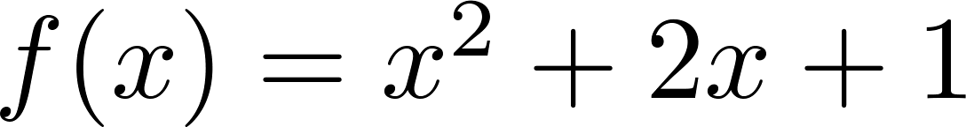
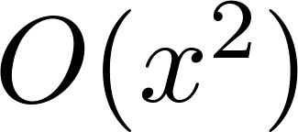
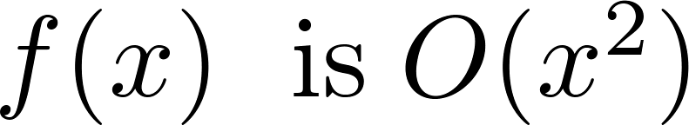
Using the Definition of Big-O Notation
Example: Show that is .
Solution: Since when x > 1, x < x² and 1 < x²
Can take C = 4 and k = 1 as witnesses to show that
(see graph on next slide)
Alternatively, when x > 2, we have 2x ≤ x² and 1 < x². Hence, when x > 2.
Can take C = 3 and k = 2 as witnesses instead.

Slide 9
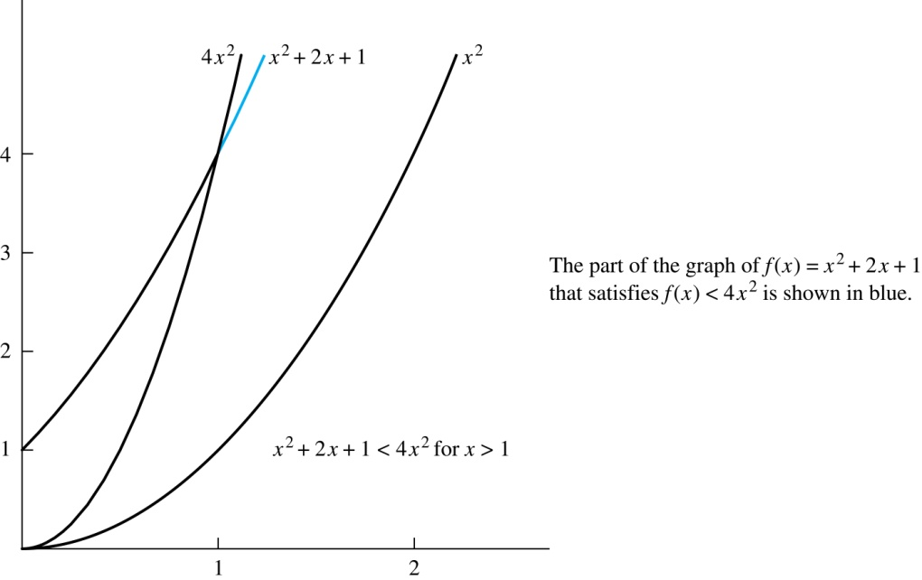
Illustration of Big-O Notation
is

Slide 10
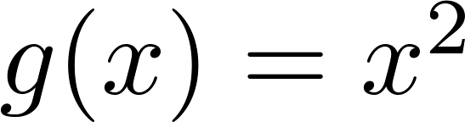
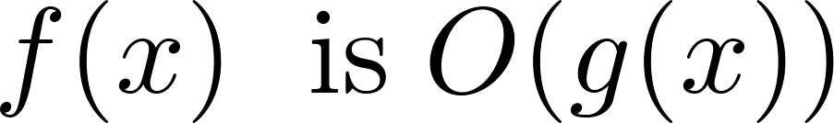

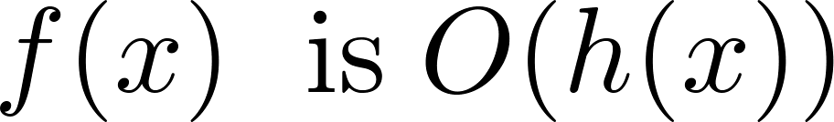
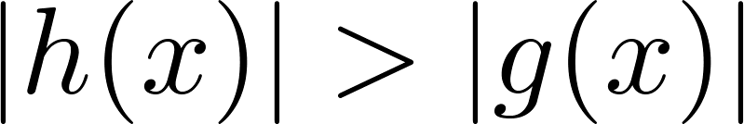
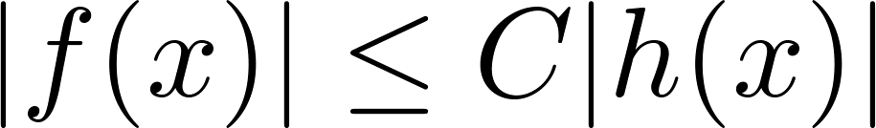
Big-O Notation
Both and
are such that and .
We say that the two functions are of the same order. (More on this later)
If and h(x) is larger than g(x) for all positive real numbers, then .
Note that if for x > k and if
for all x, then if x > k. Hence, .
For many applications, the goal is to select the function g(x) in O(g(x)) as small as possible (up to multiplication by a constant, of course).

Slide 11
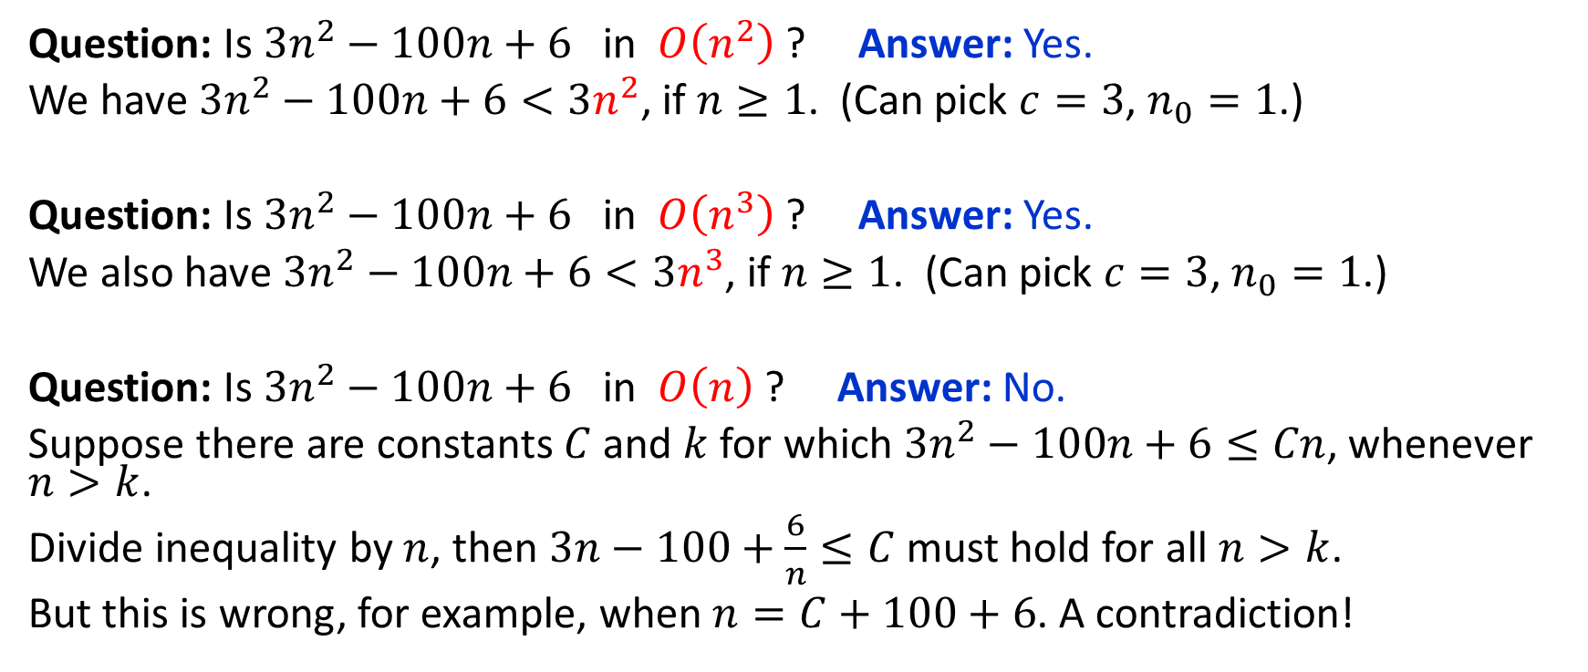
Big-O: Examples
Question: Is $3n^{2}−100n+6$ in $O\left(n^{2}\right)$ ? Answer: Yes.
We have $3n^{2}−100n+6<3n^{2}$, if $n≥1$. (Can pick $c=3$, $n_{0}=1$.)
Question: Is $3n^{2}−100n+6$ in $O\left(n^{3}\right)$ ? Answer: Yes.
We also have $3n^{2}−100n+6<3n^{3}$, if $n≥1$. (Can pick $c=3$, $n_{0}=1$.)
Question: Is $3n^{2}−100n+6$ in $O\left(n\right)$ ? Answer: No.
Suppose there are constants $C$ and $k$ for which $3n^{2}−100n+6≤Cn$, whenever $n>k$.
Divide inequality by $n$, then $3n−100+\frac{6}{n}≤C$ must hold for all $n>k$.
But this is wrong, for example, when $n=C+100+6$. A contradiction!

Slide 12
Using the Definition of Big-O Notation
Example: Show that 7x² is O(x³).
Solution: When x > 7, 7x² < x³. Take C =1 and k = 7 as witnesses to establish that 7x² is O(x³).
(Would C = 7 and k = 1 work?)
Example: Show that n² is not O(n).
Solution: Suppose there are constants C and k for which n² ≤ Cn, whenever n > k. Then (by dividing both sides of n² ≤ Cn) by n, then n ≤ C must hold for all n > k. A contradiction!

Slide 13

Big-O Estimates for Polynomials
Example: Let
where are real numbers with a_{n} ≠0.
Then f(x) is O(x^{n}).
Proof: |f(x)| = |a_{n}x^{n} + a_{n-1} x^{n-1} + ∙∙∙ + a₁x¹ + a₀|
≤ |a_{n}|x^{n} + |a_{n-1}| x^{n-1} + ∙∙∙ + |a₁|x¹ + |a₀|
= x^{n} (|a_{n}| + |a_{n-1}| /x + ∙∙∙ + |a₁|/x^{n-1} + |a₀|/ x^{n})
≤ x^{n} (|a_{n}| + |a_{n-1}| + ∙∙∙ + |a₁|+ |a₀|)
Take C = |a_{n}| + |a_{n-1}|+ ∙∙∙ + |a₀| and k = 1. Then f(x) is O(x^{n}).
The leading term a_{n}x^{n} of a polynomial dominates its growth.
Uses triangle inequality, an exercise in Section 1.8.
Assuming x > 1

Slide 14
Big-O Estimates for some Important Functions
Example: Use big-O notation to estimate the sum of the first n positive integers.
Solution:
Example: Use big-O notation to estimate the factorial function
Solution:
Continued →

Slide 15
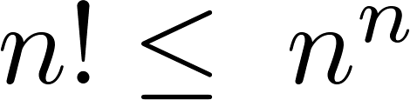
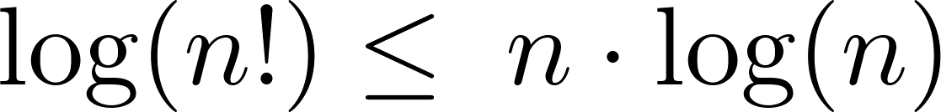
Big-O Estimates for some Important Functions
Example: Use big-O notation to estimate log n!
Solution: Given that (previous slide)
then .
Hence, log(n!) is O(n∙log(n)) taking C = 1 and k = 1.

Slide 16
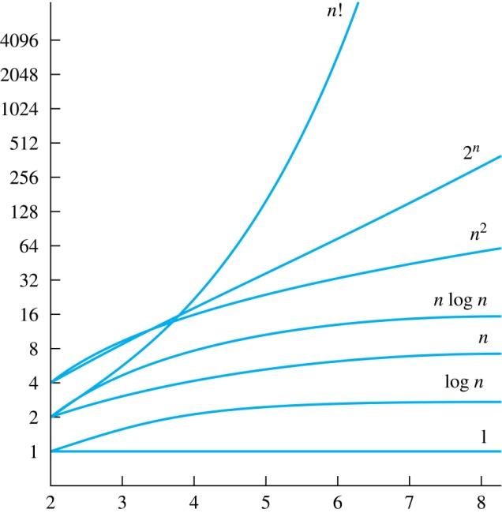
Display of Growth of Functions
Note the difference in behavior of functions as n gets larger

Slide 17
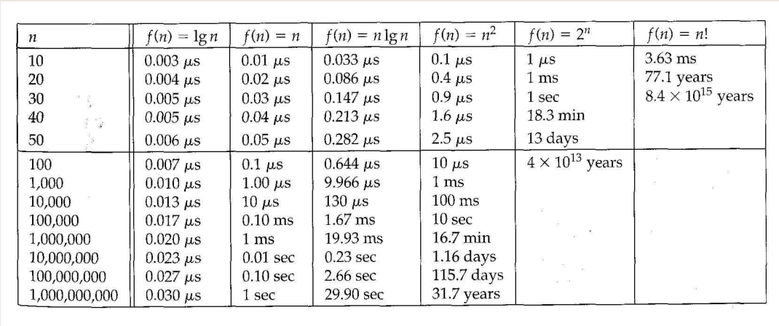

Waiting Times and Asymptotics
1 operation is 1 nanosecond (${10}^{−9}$ s). 1 μs = ${10}^{−6}$ s. 1 ms = ${10}^{−3}$ s.

Slide 18
Useful Big-O Estimates Involving Logarithms, Powers, and Exponents
If d > c > 1, then
n^{c} is O(n^{d}), but n^{d} is not O(n^{c}).
If b > 1 and c and d are positive, then
(log_{b} n)^{c} is O(n^{d}), but n^{d} is not O((log_{b} n)^{c}).
If b > 1 and d is positive, then
n^{d} is O(b^{n}), but b^{n} is not O(n^{d}).
If c > b > 1, then
b^{n} is O(c^{n}), but c^{n} is not O(b^{n}).

Slide 19
Combinations of Functions
If f₁ (x) is O(g₁(x)) and f₂ (x) is O(g₂(x)) then
( f₁ + f₂ )(x) is O(max(|g₁(x) |,|g₂(x) |)).
See next slide for proof
If f₁ (x) and f₂ (x) are both O(g(x)) then
( f₁ + f₂ )(x) is O(g(x)).
See text for argument
If f₁ (x) is O(g₁(x)) and f₂ (x) is O(g₂(x)) then
( f₁ f₂ )(x) is O(g₁(x)g₂(x)).
See text for argument

Slide 20
Combinations of Functions
If f₁ (x) is O(g₁(x)) and f₂ (x) is O(g₂(x)) then
( f₁ + f₂ )(x) is O(max(|g₁(x) |,|g₂(x) |)).
By the definition of big-O notation, there are constants C₁,C₂ ,k₁,k₂ such that f₁ (x) ≤ C₁|g₁(x) | when x > k₁ and f₂ (x) ≤ C₂|g₂(x) | when x > k₂ .
|( f₁ + f₂ )(x)| = |f₁(x) + f₂(x)|
≤ |f₁ (x)| + |f₂ (x)| by the triangle inequality |a + b| ≤ |a| + |b|
|f₁ (x)| + |f₂ (x)| ≤ C₁|g₁(x) | + C₂|g₂(x) |
≤ C₁|g(x) | + C₂|g(x) | where g(x) = max(|g₁(x)|,|g₂(x)|)
= (C₁ + C₂) |g(x)|
= C|g(x)| where C = C₁ + C₂
Therefore |( f₁ + f₂ )(x)| ≤ C|g(x)| whenever x > k, where k = max(k₁,k₂).

Slide 21
Ordering Functions by Order of Growth
Put the functions below in order so that each function is big-O of the next function on the list.
f₁(n) = (1.5)^{n}
f₂(n) = 8n³+17n² +111
f₃(n) = (log n )²
f₄(n) = 2^{n}
f₅(n) = log (log n)
f₆(n) = n² (log n)³
f₇(n) = 2^{n} (n² +1)
f₈(n) = n³+ n(log n)²
f₉(n) = 10000
f₁₀(n) = n!
We solve this exercise by successively finding the function that grows slowest among all those left on the list.
f₉(n) = 10000 (constant, does not increase with n)
f₅(n) = log (log n) (grows slowest of all the others)
f₃(n) = (log n )² (grows next slowest)
f₆(n) = n² (log n)³ (next largest, (log n)³ factor smaller than any power of n)
f₂(n) = 8n³+17n² +111 (tied with the one below)
f₈(n) = n³+ n(log n)² (tied with the one above)
f₁(n) = (1.5)^{n} (next largest, an exponential function)
f₄(n) = 2^{n} (grows faster than one above since 2 > 1.5)
f₇(n) = 2^{n} (n² +1) (grows faster than above because of the n² +1 factor)
f₁₀(n) = n! ( n! grows faster than c^{n} for every c)

Slide 22
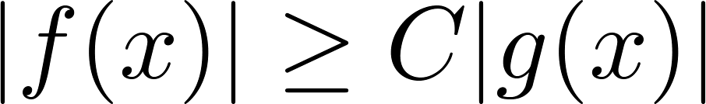
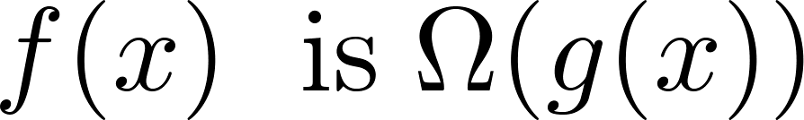
Big-Omega Notation
Definition: Let f and g be functions from the set of integers or the set of real numbers to the set of real numbers. We say that
if there are constants C and k such that
when x > k.
We say that “f(x) is big-Omega of g(x).”
Big-O gives an upper bound on the growth of a function, while Big-Omega gives a lower bound. Big-Omega tells us that a function grows at least as fast as another.
f(x) is Ω(g(x)) if and only if g(x) is O(f(x)). This follows from the definitions. See the text for details.
Ω is the upper case version of the lower case Greek letter ω.

Slide 23
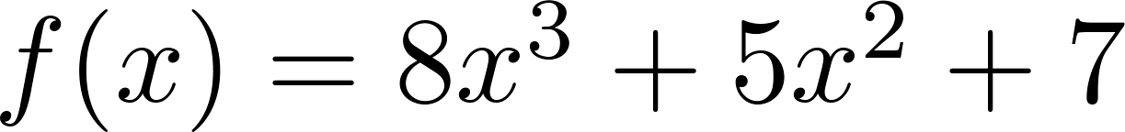
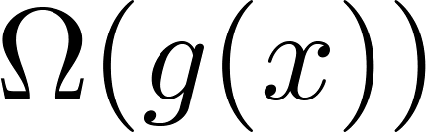
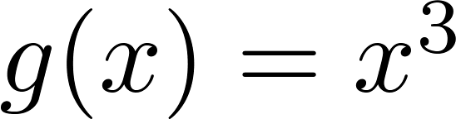
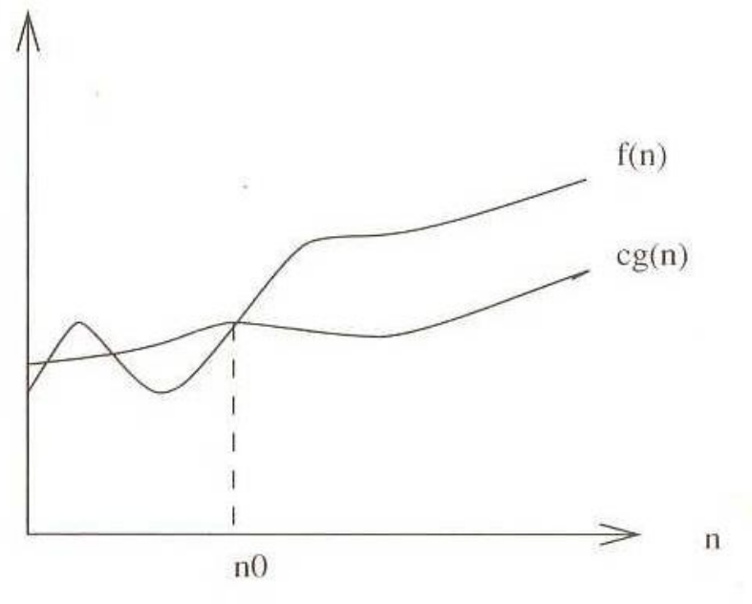
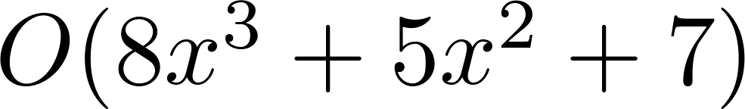
Big-Omega Notation
Example: Show that is
where .
Solution:
for all positive real numbers x.
Is it also the case that is
?

Slide 24
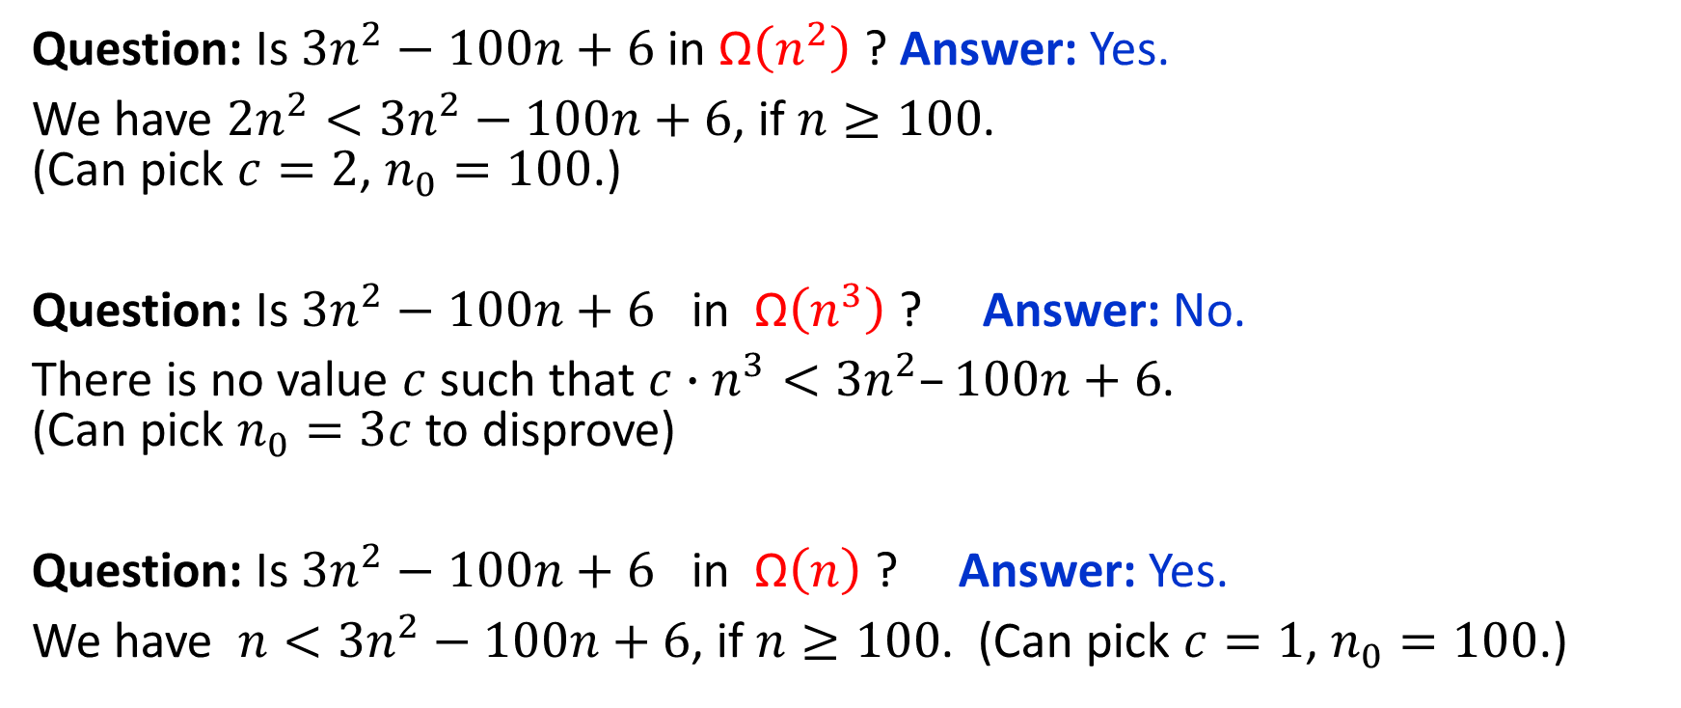
Big-Ω: Examples
Question: Is $3n^{2}−100n+6$ in $\text{Ω}\left(n^{2}\right)$ ? Answer: Yes.
We have $2n^{2}<3n^{2}−100n+6$, if $n≥100$. (Can pick $c=2$, $n_{0}=100$.)
Question: Is $3n^{2}−100n+6$ in $\text{Ω}\left(n^{3}\right)$ ? Answer: No.
There is no value $c$ such that ${c∙n}^{3}<3n^{2}–100n+6$. (Can pick $n_{0}=3c$ to disprove)
Question: Is $3n^{2}−100n+6$ in $\text{Ω}\left(n\right)$ ? Answer: Yes.
We have $n<3n^{2}−100n+6$, if $n≥100$. (Can pick $c=1$, $n_{0}=100$.)

Slide 25
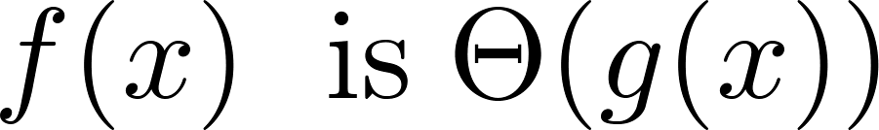
Big-Theta Notation
Definition: Let f and g be functions from the set of integers or the set of real numbers to the set of real numbers. The function if
and .
We say that “f is big-Theta of g(x)” and also that “f(x) is of order g(x)” and also that “f(x) and g(x) are of the same order.”
if and only if there exists constants C₁ , C₂ and k such that C₁g(x) < f(x) < C₂ g(x) if x > k. This follows from the definitions of big-O and big-Omega.
Θ is the upper case version of the lower case Greek letter θ.

Slide 26
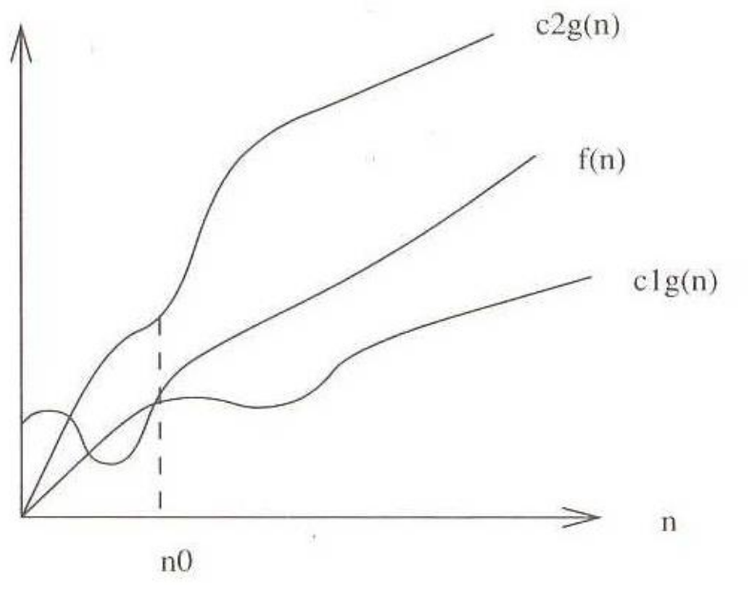
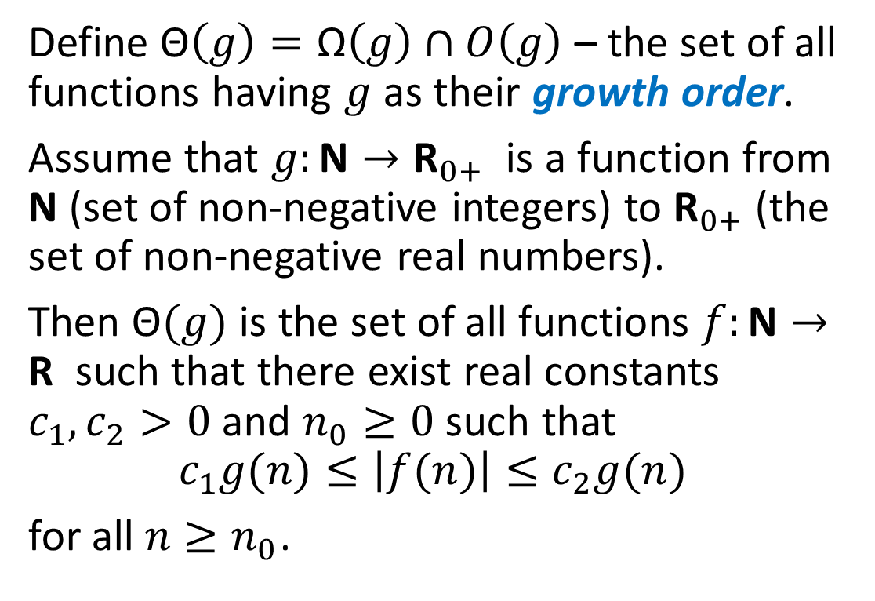
Big-Θ (Big-Theta) Notation
Define $\text{Θ}\left(g\right)=\text{Ω}\left(g\right)∩O\left(g\right)$ – the set of all functions having $g$ as their growth order.
Assume that $g:\text{N}→{\text{R}}_{0+}$ is a function from N (set of non-negative integers) to ${\text{R}}_{0+}$ (the set of non-negative real numbers).
Then $\text{Θ}(g)$ is the set of all functions $f:\text{N}→\text{R}$ such that there exist real constants $c_{1},c_{2}>0$ and $n_{0}≥0$ such that
$$c_{1}g(n)≤\left|f(n)\right|≤c_{2}g(n)$$
for all $n≥n_{0}$.

Slide 27

Big-Θ: Examples
$3n^{2}−100n+6=\text{Θ}\left(n^{2}\right)$, since both O and Ω are satisfied: $3n^{2}−100n+6=O\left(n^{2}\right) and 3n^{2}−100n+6=\text{Ω}\left(n^{2}\right)$
$3n^{2}−100n+6≠\text{Θ}\left(n^{3}\right)$, since only O is satisfied.
$3n^{2}−100n+6≠\text{Θ}\left(n\right)$, since only Ω is satisfied.

Slide 28
Big Theta Notation
Example: Show that the sum of the first n positive integers is Θ(n²).
Solution: Let f(n) = 1 + 2 + ∙∙∙ + n.
We have already shown that f(n) is O(n²).
To show that f(n) is Ω(n²), we need a positive constant C such that f(n) > Cn² for sufficiently large n. Summing only the terms greater than n/2 we obtain the inequality
1 + 2 + ∙∙∙ + n ≥ ⌈ n/2⌉ + (⌈ n/2⌉ + 1) + ∙∙∙ + n
≥ ⌈ n/2⌉ + ⌈ n/2⌉ + ∙∙∙ + ⌈ n/2⌉
= (n − ⌈ n/2⌉ + 1 ) ⌈ n/2⌉
≥ (n/2)(n/2) = n²/4
Taking C = ¼, f(n) > Cn² for all positive integers n. Hence, f(n) is Ω(n²), and we can conclude that f(n) is Θ(n²).

Slide 29
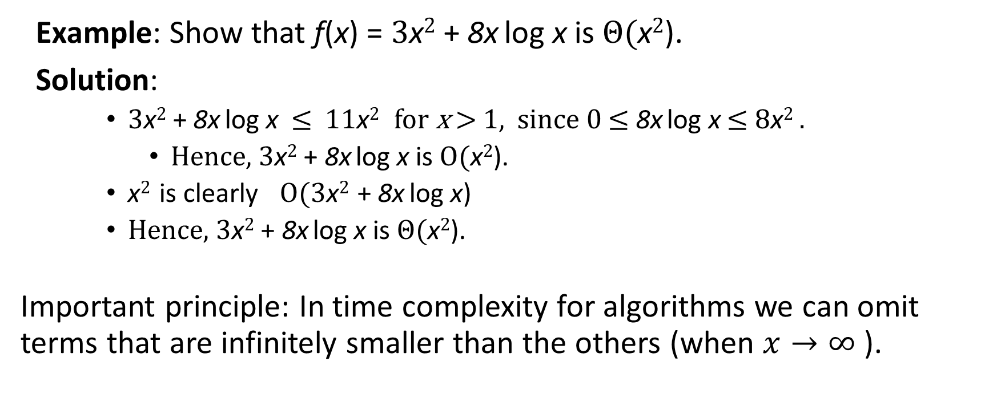
Big-Theta Notation
Example: Show that f(x) = 3x² + 8x log x is Θ(x²).
Solution:
3x² + 8x log x ≤ 11x² for x > 1, since 0 ≤ 8x log x ≤ 8x² .
Hence, 3x² + 8x log x is O(x²).
x² is clearly O(3x² + 8x log x)
Hence, 3x² + 8x log x is Θ(x²).
Important principle: In time complexity for algorithms we can omit terms that are infinitely smaller than the others (when $x→∞$ ).

Slide 30
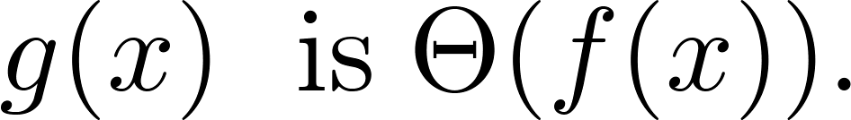
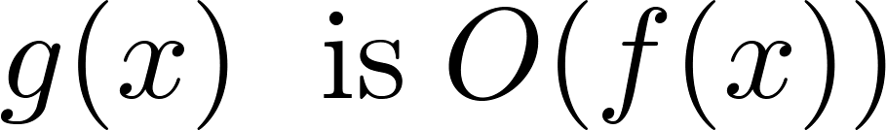
Big-Theta Notation
When it must also be the case that
Note that if and only if it is the case that and .
Sometimes writers are careless and write as if big-O notation has the same meaning as big-Theta.

Slide 31
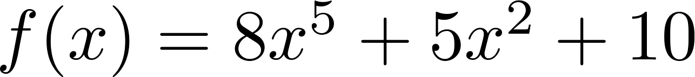
Big-Theta Estimates for Polynomials
Theorem: Let
where are real numbers with a_{n} ≠0.
Then f(x) is of order x^{n} (or Θ(x^{n})).
(The proof is an exercise.)
Example:
The polynomial is order of x⁵ (or Θ(x⁵)).
The polynomial is order of x¹⁹⁹ (or Θ(x¹⁹⁹) ).

