Slide 1
String matching algorithms
Naïve, Knuth-Morris-Pratt and Boyer-Moore algorithms

Slide 2
Why String Matching?
Why it is good for humanity?
Text editors
Database search queries for text fields (SQL clauses with LIKE)
Keyword-based search engines
Privacy and information security – finding virus signatures, leaks of personal data or lexicons pointing to illegal activity.
Why should we care?
Nearly always you will use an existing library for this. BUT…
Good idea of how the existing algorithms work; how to call them.
May need to add slight variations to text search not supported by libraries.

Slide 3
String Matching Problem
There is a text of length n characters:
T=T[0],…,T[n−1]
There is a pattern (of m characters; typically much shorter)
P=P[0],…,P[m−1]
String matching algorithm should find all offsets (or shifts) in T, where pattern P starts.
(A shift can take any value from 0 to n-m.)

Slide 4
Concept: Substrings
BTW: What is a substring?
"APPLE" has exactly 15 substrings: (length 0) "" (empty string),
(length 1) "A", "E", "L", "P",
(length 2) "AP", "LE", "PL", "PP",
(length 3) "APP", "PLE", "PPL",
(length 4) "APPL", "PPLE",
(length 5) "APPLE".
A text of length n should have up to 1 + n(n+1)/2 substrings.

Slide 5
Concepts: Prefixes and Suffixes
A prefix of a string: Substring that starts from the shift=0.
“APPLE” has 6 prefixes P_0 = “”
P_1 = “A”
P_2 = “AP” P_3 = “APP” P_4 = “APPL” P_5 = “APPLE”
A suffix of a string:
Substring that ends where the original string ends. “APPLE” has 6 suffixes: S_0 = “”
S_1 = “E”
S_2 = “LE” S_3 = “PLE” S_4 = “PPLE” S_5 = “APPLE”

Slide 6
Naïve Algorithm
Naive_String_Matcher(T, P)
1 n=T.length
2 m=P.length
3 for i=0 to n−m
4 if (P[0],…,P[m−1])==(T[i],…,T[i+m−1])
5 print “Pattern appears with shift ” i

Slide 7
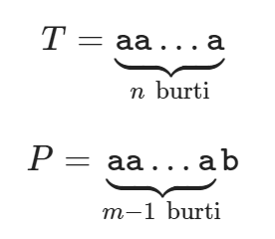
Bad Worst-Case Complexity
May need many comparisons: (n−m+1)⋅m≈n⋅m.
Time-complexity is O(n*m).
Even though m<<n, multiplying with “m” (the length of the search pattern) could be expensive.
Worst-case can be easily achieved:

Slide 8
KMP Algorithm

Slide 9
The Initial Idea behind KMP
Read the text once – from the left to the right.
At every moment pattern P is somehow aligned with the text – it is in the leftmost “feasible offset”, where a match could exist and no contradiction has been found (yet).
If there is a mismatch, pattern P jumps forward – to the next feasible offset.
For many patterns jumping forward means skipping the whole unsuccessfully matched length.
But sometimes jumps need to be more careful and smaller. They are given by a prefix function.

Slide 10
KMP Pseudocode
KMP_Matcher(T, P)
1 n=T.length
2 m=P.length
3 π=Compute_Prefix_Function(P)
4 k=0
5 for i=0 to n−1 // read the text once from left to right
6 while k>0 and P[k]≠T[i]
7 k=π(k) // mismatch; the pattern shifts forward
8 if P[k]==T[i]
9 k=k+1 // successful match of 1 more character
10 if k==m // the whole pattern P matched?
11 print “Pattern appearsh with shift” i−m
12 k=π(k) // shift it to the next feasible offset

Slide 11
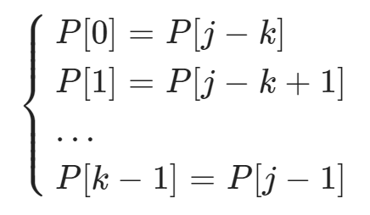
Definition of the Prefix Function
Set π[0]=-1
For every j=1,…,m find the largest k (k<j), that satisfies all the equalities to the left. Set π[j]=k
If no such k exists, define π[j]=0
Other definition: Denote P_i to be prefix of P of length i.
Then π[j]=k iff k is the length of the the longest suffix of P_k that is shorter than j itself:
π[j]=max{k:k<j and P_k is a suffix of P_j}

Slide 12
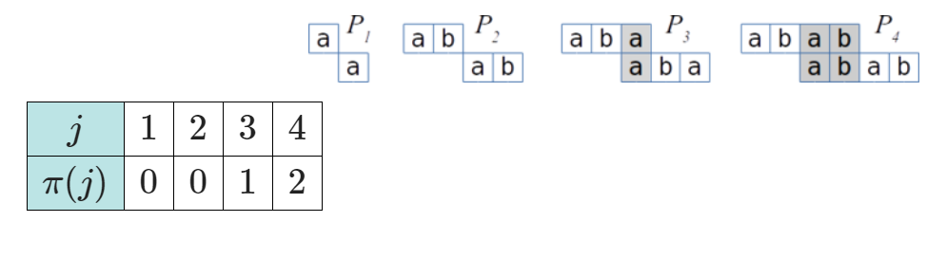
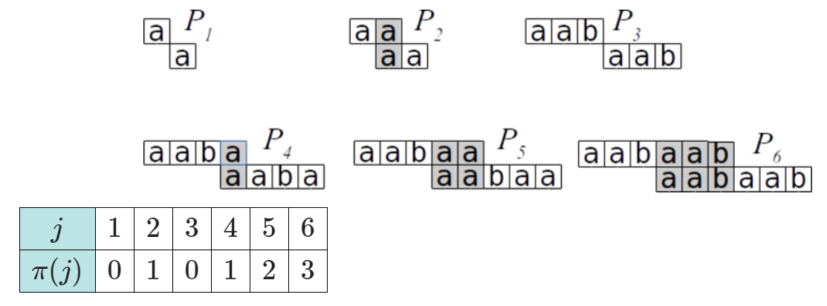
Examples of Prefix Functions
P = abab
P = aabaab

Slide 13
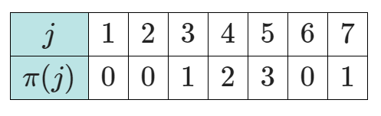
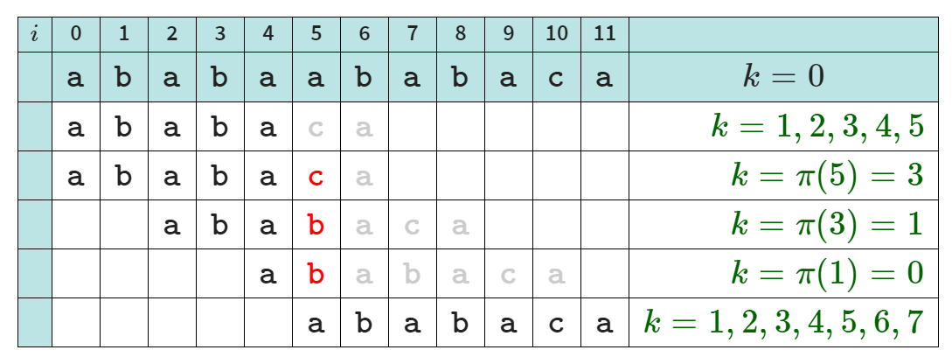
Example Run of KMP
Search pattern P=ababaca
in this text: T=ababaababaca.

Slide 14
Computing the Prefix Function
Compute_Prefix_Function(P)
1 m=P.length
2 Initialize the table π[0],π[1],…,π[m]
3 π[0]=-1; π[1]=0
4 k=0
5 for q=2 to m
6 while k>0 and P[k]≠P[q−1]
7 k=π[k]
8 if P[k]==P[q−1]
9 k=k+1
10 π[q]=k
11 return π

