Slide 1
String matching algorithms
Boyer-Moore Algorithm

Slide 2
Why Boyer Moore?
Real-World text search (in Relational databases, Semantic Web, Anti-plagiarism or IT security) use a combination of approaches – BM is just one building block.
Genetic Sequencing creates unusual challenges (genome letters A, C, G, T – make very short alphabet – but the searchable “texts” tend to be long).
You may need to use string search to optimize other algorithms – like Regular Expression matching.

Slide 3
String Matching Problem
There is a text of length n characters:
T=T[0],…,T[n−1]
There is a pattern (of m characters; typically much shorter)
P=P[0],…,P[m−1]
String matching algorithm should find all offsets (or shifts) in T, where pattern P starts.
(A shift can take any value from 0 to n-m.)

Slide 4
Reminder: Prefixes and Suffixes
A prefix of a string: Substring that starts from the shift=0.
“APPLE” has 6 prefixes P_0 = “”
P_1 = “A”
P_2 = “AP” P_3 = “APP” P_4 = “APPL” P_5 = “APPLE”
A suffix of a string:
Substring that ends where the original string ends. “APPLE” has 6 suffixes: S_0 = “”
S_1 = “E”
S_2 = “LE” S_3 = “PLE” S_4 = “PPLE” S_5 = “APPLE”

Slide 5
Boyer-Moore Algorithm

Slide 6
The Initial Idea behind KMP
Boyer-Moore also keeps the “current offset” – variable s.
It starts comparing the last symbols (P[m−1] and T[s+m−1]) – then move backwards. In the case of a mismatch, the offset can increase by much more than 1 symbol.
For the “average case” – if T[s+m−1] is a character that differs from any symbol in P[0],…,P[m−1], the offset can increment by m (the whole length of the pattern).
KMP always needs O(n) comparisons, but Boyer-Moore algorithm may typically perform just O(n/m) comparisons. (The worst case time for Boyer-Moore is not better than that for the KMP.)

Slide 7
BM Pseudocode
BM_Matcher(T, P)
1 n=T.length
2 m=P.length
3 s=0
4 while s≤n−m
5 j=m
6 while j>0 and P[j−1]=T[s+j−1] do
7 j=j−1
8 if j=0 then
9 print “Pattern appears with an offset” s
10 s=s+γ[0]
11 else s=s+max(γ[j],j−1−λ[T[s+j−1]])

Slide 8
Bad Character Function
λ - denotes the “bad character function”.
γ – denotes the “good suffix function.
Definition: Bad character function has non-negative value for any character that is contained in the pattern P. For every character x in P – find the maximal i, where P[i]=x.
If character x is not present in P, then we assume λ[x]=−1 but we do not need to include such values in our function explicitly (there may be too many).

Slide 9
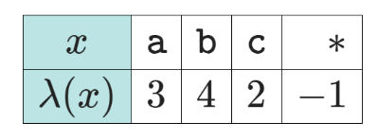
Bad Character F-n Example
Implicit values for any
other character, except a,b,c
P=abcab
The char indexing in the pattern is 0-based. For example, λ(‘c’)=2, because the letter “c” is the third letter in the pattern P.
For practical reasons, you memorize just these three values of λ (and if the table of λ does not contain some character, then -1 is the default value of λ. So it is defined for ALL characters; you just do not write them explicitly.)

Slide 10
Bad Character F-n Pseudocode
Bad_Character_Table(P)
1 for j=0 to m−1 do
2 λ[P[j]]=j
3 return λ

Slide 11
Intuition for Good Suffix Rule
The Good Suffix function γ[i] is defined for numbers from 0 to m.
Intuition behind the Suffix Function: The value γ[i] is set as follows: If P[i]…P[m−1] are respectively equal to some T[s+i]…T[s+m−1], but P[i−1]≠T[k+i−1], then γ[i] is the smallest increment to the offset j, that could lead to a next successful match.

Slide 12
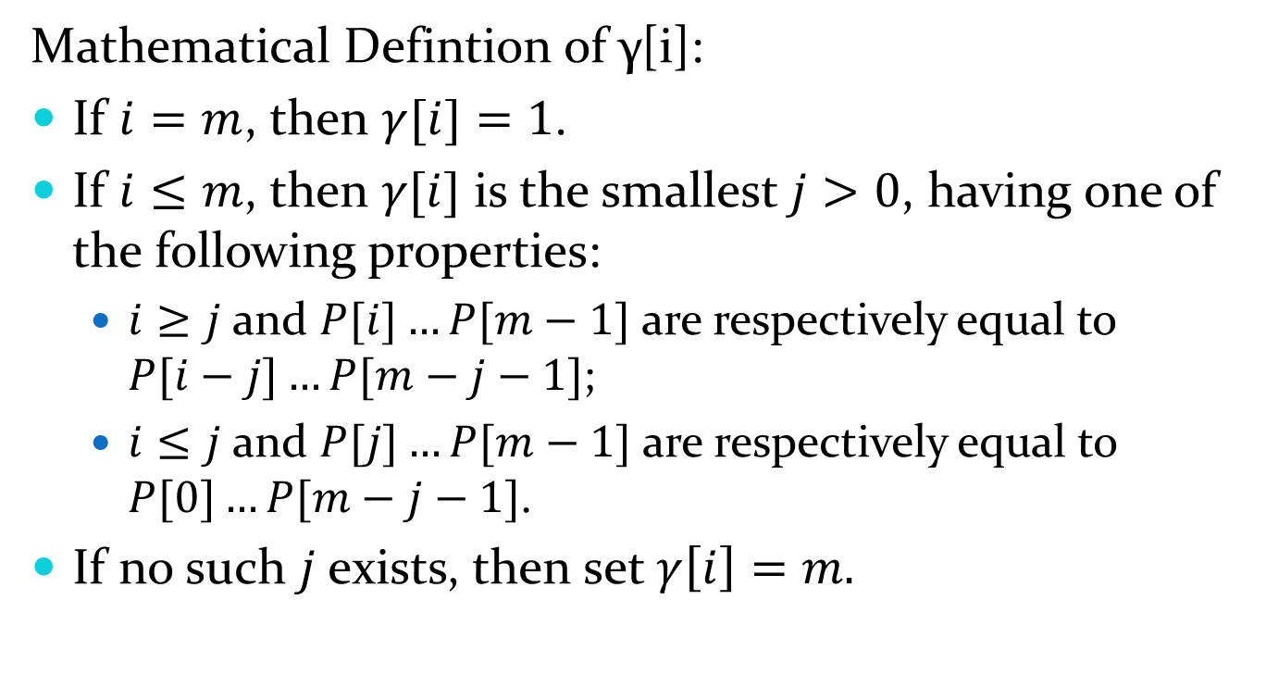
Formal Definition (just in terms of pattern P)
Mathematical Defintion of γ[i]:
If $i=m$, then $γ[i]=1$.
If $i≤m$, then $γ[i]$ is the smallest $j>0$, having one of the following properties:
$i≥j$ and $P[i]…P[m−1]$ are respectively equal to $P[i−j]…P[m−j−1]$;
$i≤j$ and $P[j]…P[m−1]$ are respectively equal to $P[0]…P[m−j−1]$.
If no such $j$ exists, then set $γ\left[i\right]=m.$

Slide 13
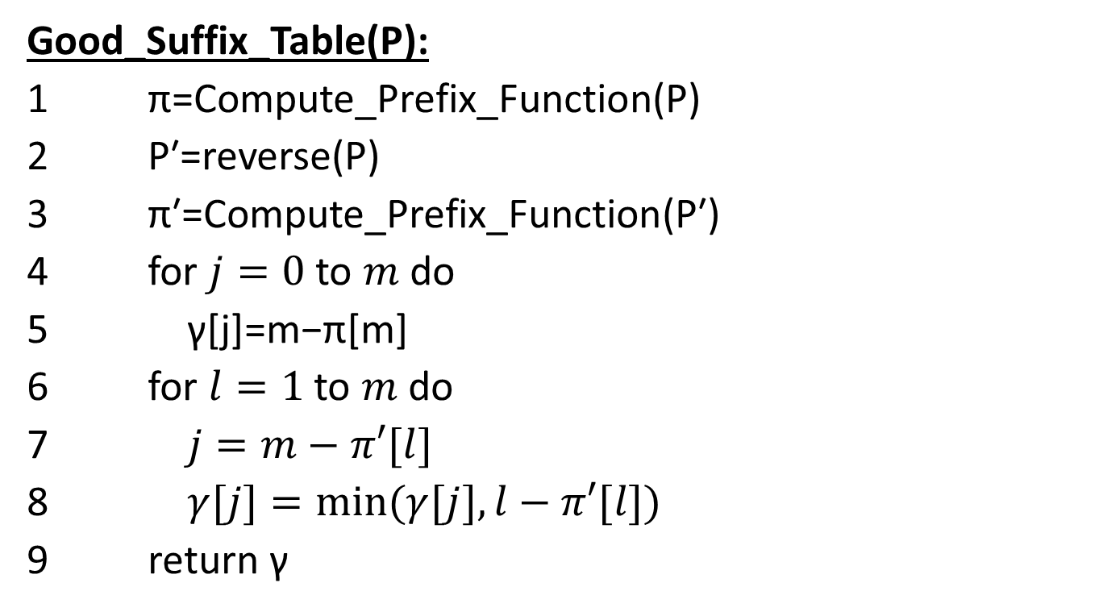
Good Suffix Pseudocode
Good_Suffix_Table(P):
1 π=Compute_Prefix_Function(P)
2 P′=reverse(P)
3 π′=Compute_Prefix_Function(P′)
4 for $j=0$ to $m$ do
5 γ[j]=m−π[m]
6 for $l=1$ to $m$ do
7 $j=m−π′[l]$
8 $γ[j]=min⁡(γ[j],l−π′[l])$
9 return γ

Slide 14
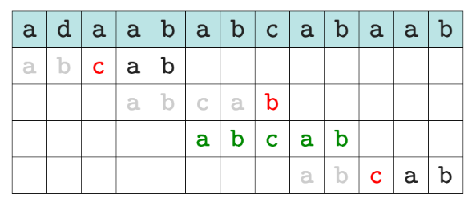
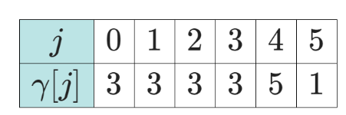
BM Algorithm Example
b
P=abcab

Slide 15
Good Suffix Function
Reference #1: https://www.geeksforgeeks.org/boyer-moore-algorithm-good-suffix-heuristic/
Pattern = CABAB
0 | 1 | 2 | 3 | 4 | 5
C | A | B | A | B
5 | 5 | 5 | 2 | 2 | 1

Slide 16
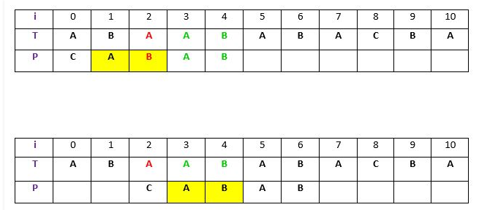
Case 1
Another occurrence of t in P matched with t in T Pattern P might contain few more occurrences of t. In such case, we will try to shift the pattern to align that occurrence with t in text T.

Slide 17
Good Suffix Function
Reference #1: https://www.geeksforgeeks.org/boyer-moore-algorithm-good-suffix-heuristic/
Pattern = ABBAB
0 | 1 | 2 | 3 | 4 | 5
A | B | B | A | B
3 | 3 | 3 | 3 | 2 | 1

Slide 18
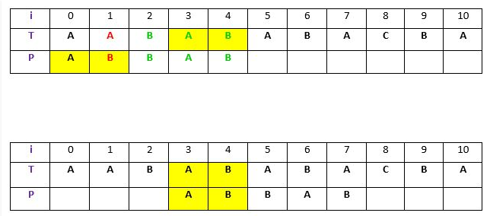
Case 2
A prefix of P, which matches with suffix of t in T

Slide 19
Good Suffix Function
Reference #1: https://www.geeksforgeeks.org/boyer-moore-algorithm-good-suffix-heuristic/
Pattern = ABBAB
0 | 1 | 2 | 3 | 4 | 5
C | B | A | A | B
5 | 5 | 5 | 5 | 3 | 1

Slide 20
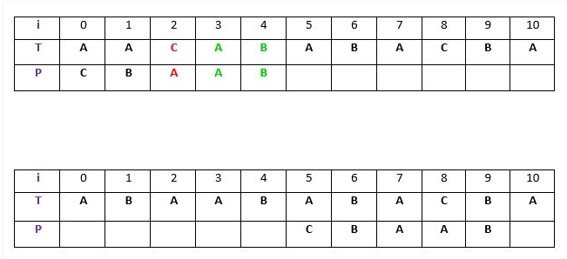
Case 3
P moves past t

Slide 21
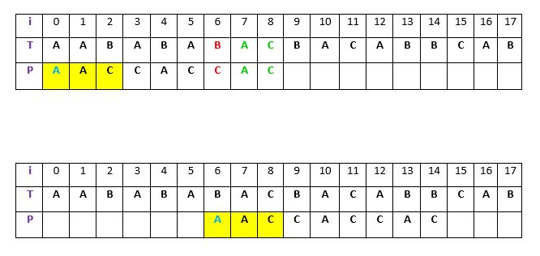
Good Suffix may be Suboptimal

Slide 22
Revisiting an Earlier Example
Pattern = CABAB
0 | 1 | 2 | 3 | 4 | 5
C | A | B | A | B
5 | 5 | 5 | 2 | 2 | 1
Offset | 0 | 1 | 2 | 3 | 4 | 5
Text | C | A | B | X | B | ..
Pattern | C | A | B | A | B

Slide 23
