Slide 1
Primes and Greatest Common Divisors
Section 4.3

Slide 2
Section Summary
Prime Numbers and their Properties
Conjectures and Open Problems About Primes
Greatest Common Divisors and Least Common Multiples
The Euclidian Algorithm
gcds as Linear Combinations

Slide 3
Primes
Definition: A positive integer p greater than 1 is called prime if the only positive factors of p are 1 and p. A positive integer that is greater than 1 and is not prime is called composite.
Example: The integer 7 is prime because its only positive factors are 1 and 7, but 9 is composite because it is divisible by 3.

Slide 4
The Fundamental Theorem of Arithmetic
Theorem: Every positive integer greater than 1 can be written uniquely as a prime or as the product of two or more primes where the prime factors are written in order of nondecreasing size.
Examples:
100 = 2 ∙ 2 ∙ 5 ∙ 5 = 2² ∙ 5²
641 = 641
999 = 3 ∙ 3 ∙ 3 ∙ 37 = 3³ ∙ 37
1024 = 2 ∙ 2 ∙ 2 ∙ 2 ∙ 2 ∙ 2 ∙ 2 ∙ 2 ∙ 2 ∙ 2 = 2¹⁰

Slide 5
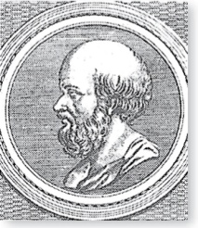
The Sieve of Erastosthenes
Erastothenes
(276-194 B.C.)
The Sieve of Erastosthenes can be used to find all primes not exceeding a specified positive integer. For example, begin with the list of integers between 1 and 100.
Delete all the integers, other than 2, divisible by 2.
Delete all the integers, other than 3, divisible by 3.
Next, delete all the integers, other than 5, divisible by 5.
Next, delete all the integers, other than 7, divisible by 7.
Since all the remaining integers are not divisible by any of the previous integers, other than 1, the primes are:
{2,3,5,7,11,15,1719,23,29,31,37,41,43,47,53,
59,61,67,71,73,79,83,89, 97}
continued →

Slide 6
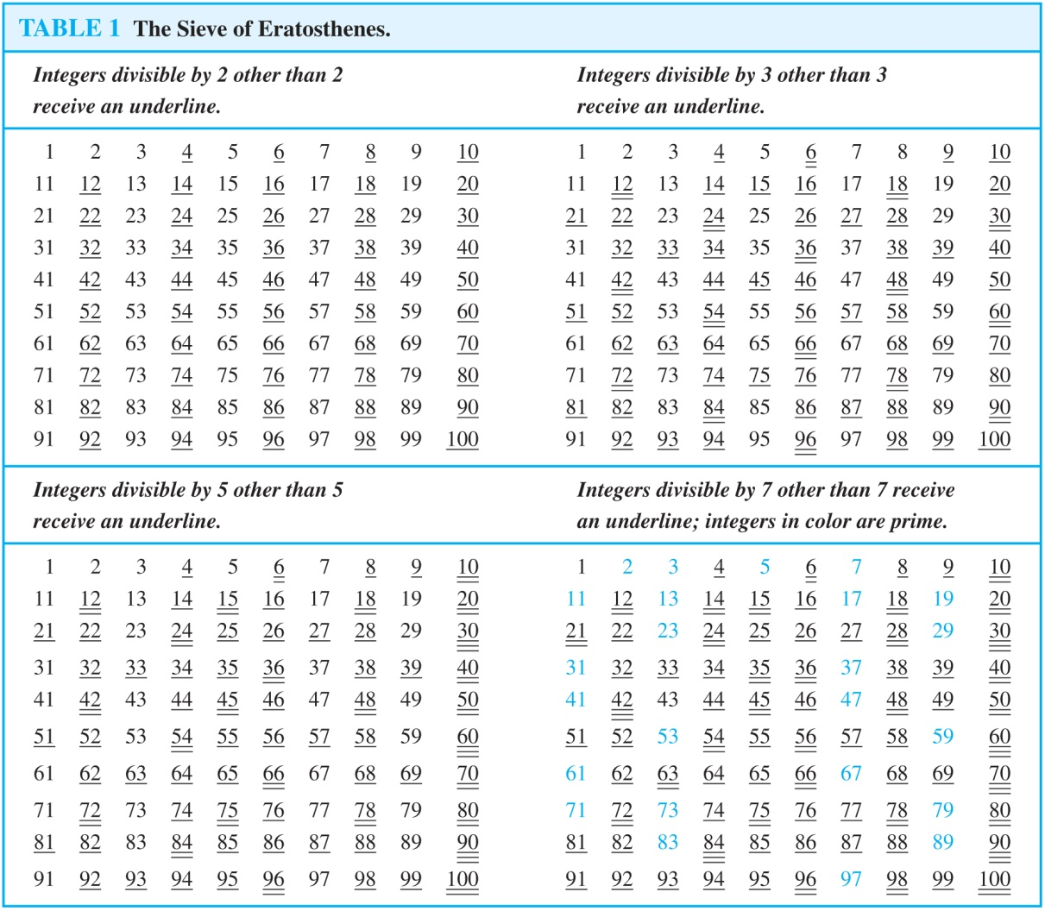
The Sieve of Erastosthenes
If an integer n is a composite integer, then it has a prime divisor less than or equal to √n.
To see this, note that if n = ab, then a ≤ √n or b ≤√n.
Trial division, a very inefficient method of determining if a number n is prime, is to try every integer i ≤√n and see if n is divisible by i.

Slide 7
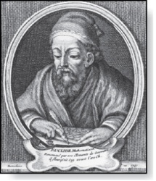
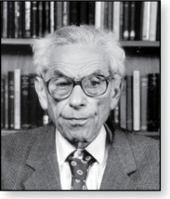
Infinitude of Primes
Euclid
(325 B.C.E. – 265 B.C.E.)
Theorem: There are infinitely many primes. (Euclid)
Proof: Assume finitely many primes: p₁, p₂, ….., p_{n}
Let q = p₁p₂∙∙∙ p_{n} + 1
Either q is prime or by the fundamental theorem of arithmetic it is a product of primes.
But none of the primes p_{j} divides q since if p_{j} | q, then p_{j} divides q − p₁p₂∙∙∙ p_{n} = 1 .
Hence, there is a prime not on the list p₁, p₂, ….., p_{n}. It is either q, or if q is composite, it is a prime factor of q. This contradicts the assumption that p₁, p₂, ….., p_{n} are all the primes.
Consequently, there are infinitely many primes.
This proof was given by Euclid The Elements. The proof is considered to be one of the most beautiful in all mathematics. It is the first proof in The Book, inspired by the famous mathematician Paul Erdős’ imagined collection of perfect proofs maintained by God.
Paul Erdős
(1913-1996)

Slide 8
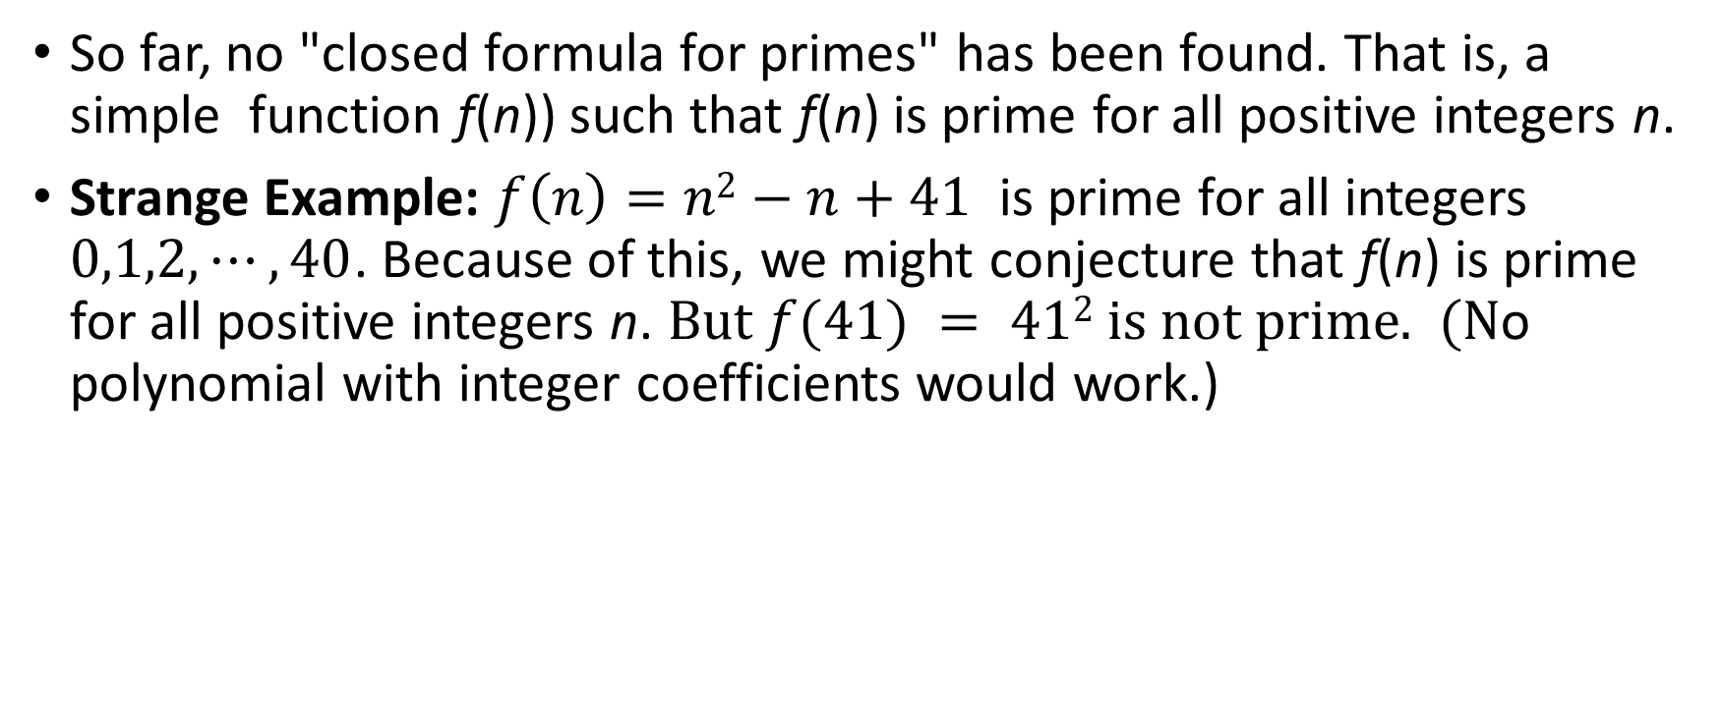
Generating Primes
So far, no "closed formula for primes" has been found. That is, a simple function f(n)) such that f(n) is prime for all positive integers n.
Strange Example: $f\left(n\right)=n2−n+41$ is prime for all integers $0,1,2,⋯, 40$. Because of this, we might conjecture that f(n) is prime for all positive integers n. But $f(41) = 412$ is not prime. (No polynomial with integer coefficients would work.)

Slide 9
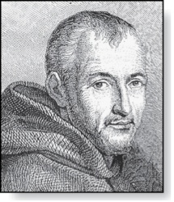
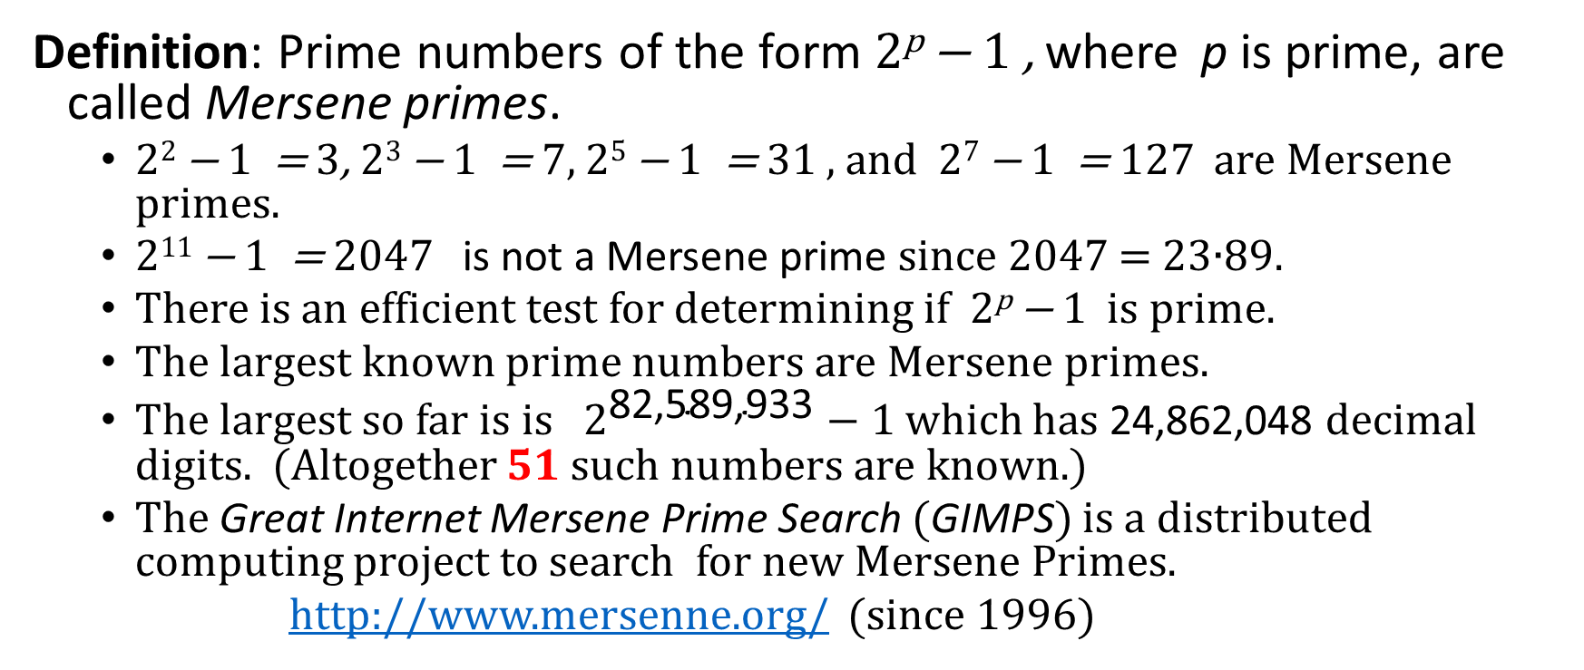
Mersene Primes
Marin Mersenne
(1588-1648)
Definition: Prime numbers of the form 2^{p} − 1 , where p is prime, are called Mersene primes.
2² − 1 = 3, 2³ − 1 = 7, 2⁵ − 1 = 31 , and 2⁷ − 1 = 127 are Mersene primes.
2¹¹ − 1 = 2047 is not a Mersene prime since 2047 = 23∙89.
There is an efficient test for determining if 2^{p} − 1 is prime.
The largest known prime numbers are Mersene primes.
The largest so far is is $2^{\text{82,589,933}}−1$ which has 24,862,048 decimal digits. (Altogether $51$ such numbers are known.)
The Great Internet Mersene Prime Search (GIMPS) is a distributed computing project to search for new Mersene Primes.
http://www.mersenne.org/ (since 1996)

Slide 10

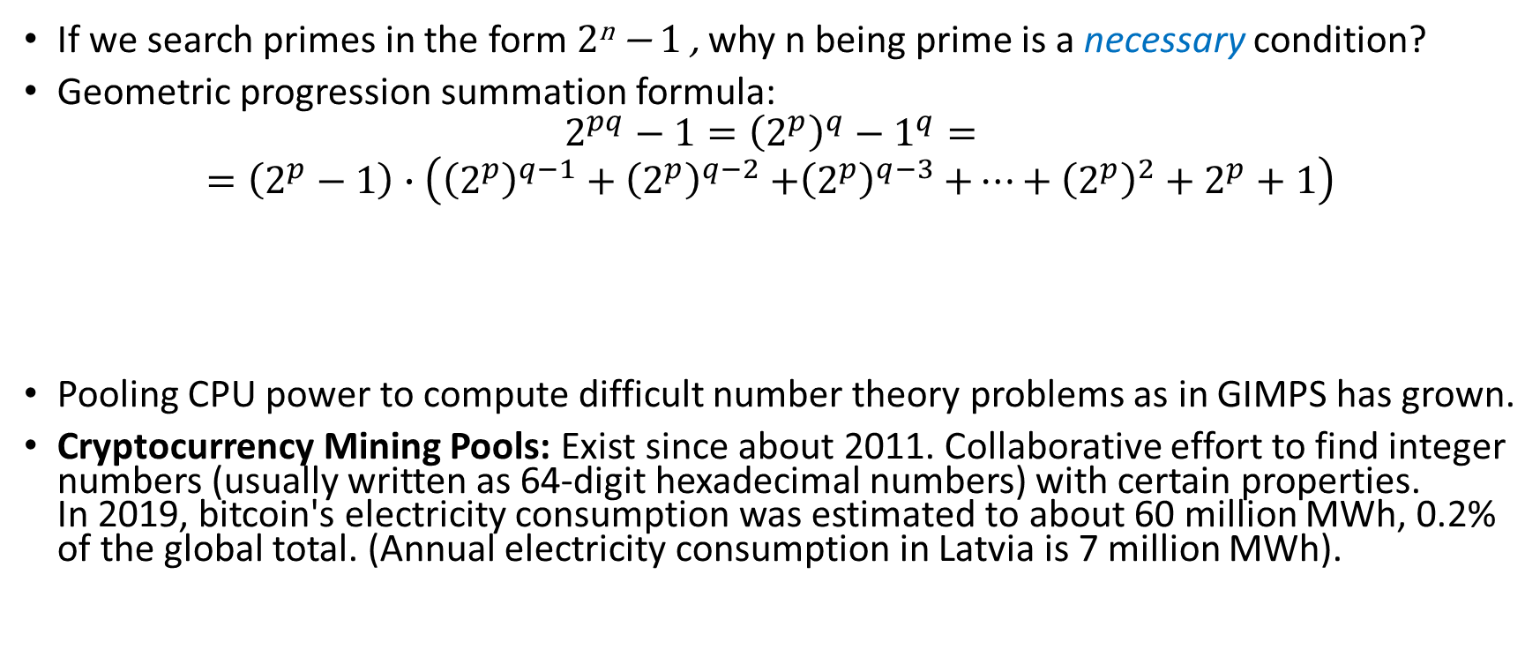
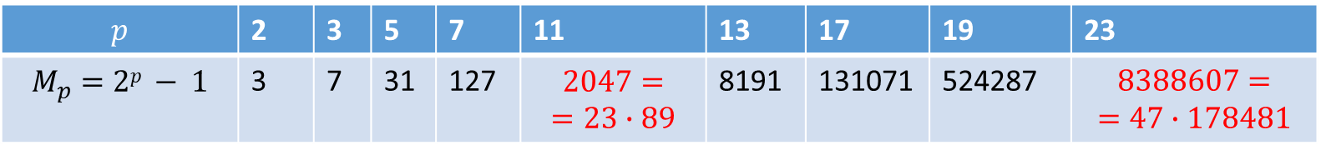
Break until 16:45
If we search primes in the form 2^{n} − 1 , why n being prime is a necessary condition?
Geometric progression summation formula:
$$2^{pq}−1={\left(2^{p}\right)}^{q}−1^{q}=$$
$$=\left(2^{p}−1\right)∙\left({\left(2^{p}\right)}^{q−1}+{\left(2^{p}\right)}^{q−2}{+\left(2^{p}\right)}^{q−3}+⋯+{\left(2^{p}\right)}^{2}+2^{p}+1\right)$$
Pooling CPU power to compute difficult number theory problems as in GIMPS has grown.
Cryptocurrency Mining Pools: Exist since about 2011. Collaborative effort to find integer numbers (usually written as 64-digit hexadecimal numbers) with certain properties. In 2019, bitcoin's electricity consumption was estimated to about 60 million MWh, 0.2% of the global total. (Annual electricity consumption in Latvia is 7 million MWh).
$$p$$ | 2 | 3 | 5 | 7 | 11 | 13 | 17 | 19 | 23
$$M_{p}=2p − 1$$ | 3 | 7 | 31 | 127 | $$2047=$$ $$=23∙89$$ | 8191 | 131071 | 524287 | $$8388607=$$ $$=47∙178481$$
Notes:
Trial-and-error search for hash values smaller than some threshold.
Their market bears some similarities to the market of artwork (value is not guaranteed by any issuer, but defined by the desire of people – art collectors – to acquire them).

Slide 11
Distribution of Primes
There is quite exact asymptotic estimate for the number of primes not exceeding x. (Prime satisfy probabilistic predictions –
Prime Number Theorem: The ratio of the number of primes not exceeding x and x/ln x approaches 1 as x grows without bound. (ln x is the natural logarithm of x)
The theorem tells us that the number of primes not exceeding x, can be approximated by x/ln x.
The probability that a randomly selected positive integer less than n is prime are approximately (n/ln n)/n = 1/ln n.

Slide 12
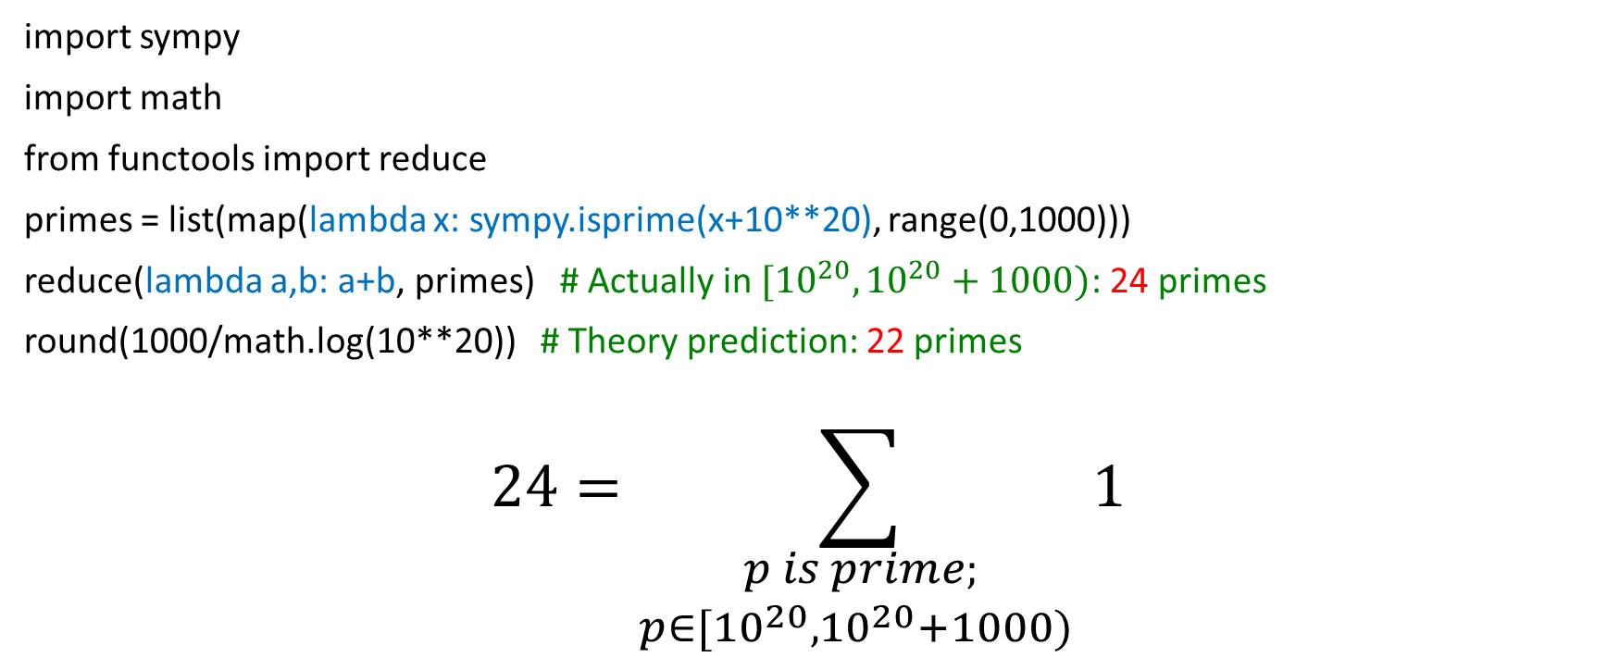
Counting Density of Large Primes
import sympy
import math
from functools import reduce
primes = list(map(lambda x: sympy.isprime(x+10**20), range(0,1000)))
reduce(lambda a,b: a+b, primes) # Actually in $[{10}^{20},{10}^{20}+1000)$: 24 primes
round(1000/math.log(10**20)) # Theory prediction: 22 primes
$$24=\sum_{\begin{aligned}p is prime; \\ p∈[{10}^{20},{10}^{20}+1000) \end{aligned}}{1}$$

Slide 13

Primes and Arithmetic Progressions (optional)
Euclid’s proof that there are infinitely many primes can be easily adapted to show that there are infinitely many primes in the following 4k + 3, k = 1,2,… (See Exercise 55)
In the 19th century G. Lejuenne Dirchlet showed that every arithmetic progression ka + b, k = 1,2, …, where a and b have no common factor greater than 1 contains infinitely many primes. (The proof is beyond the scope of the text.)
Are there long arithmetic progressions made up entirely of primes?
5,11, 17, 23, 29 is an arithmetic progression of five primes.
199, 409, 619, 829, 1039,1249,1459,1669,1879,2089 is an arithmetic progression of ten primes.
In the 1930s, Paul Erdős conjectured that for every positive integer n greater than 1, there is an arithmetic progression of length n made up entirely of primes. This was proven in 2006, by Ben Green and Terrence Tao.
Terence Tao
(Born 1975)

Slide 14
Conjectures about Primes
Even though primes have been studied extensively for centuries, many conjectures about them are unresolved, including:
Goldbach’s Conjecture: Every even integer n, n > 2, is the sum of two primes. It has been verified by computer for all positive even integers up to 1.6 ∙10¹⁸.
Are there are infinitely many primes of the form n² + 1, where n is a positive integer?

Slide 15
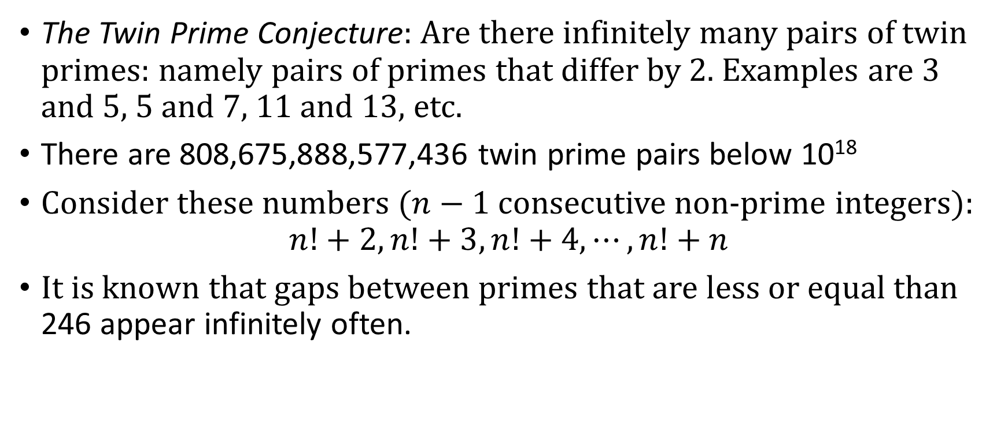
Gaps Between Primes
The Twin Prime Conjecture: Are there infinitely many pairs of twin primes: namely pairs of primes that differ by 2. Examples are 3 and 5, 5 and 7, 11 and 13, etc.
There are 808,675,888,577,436 twin prime pairs below 10¹⁸
Consider these numbers ($n−1$ consecutive non-prime integers):
$$n!+2, n!+3,n!+4,⋯,n!+n$$
It is known that gaps between primes that are less or equal than 246 appear infinitely often.

Slide 16
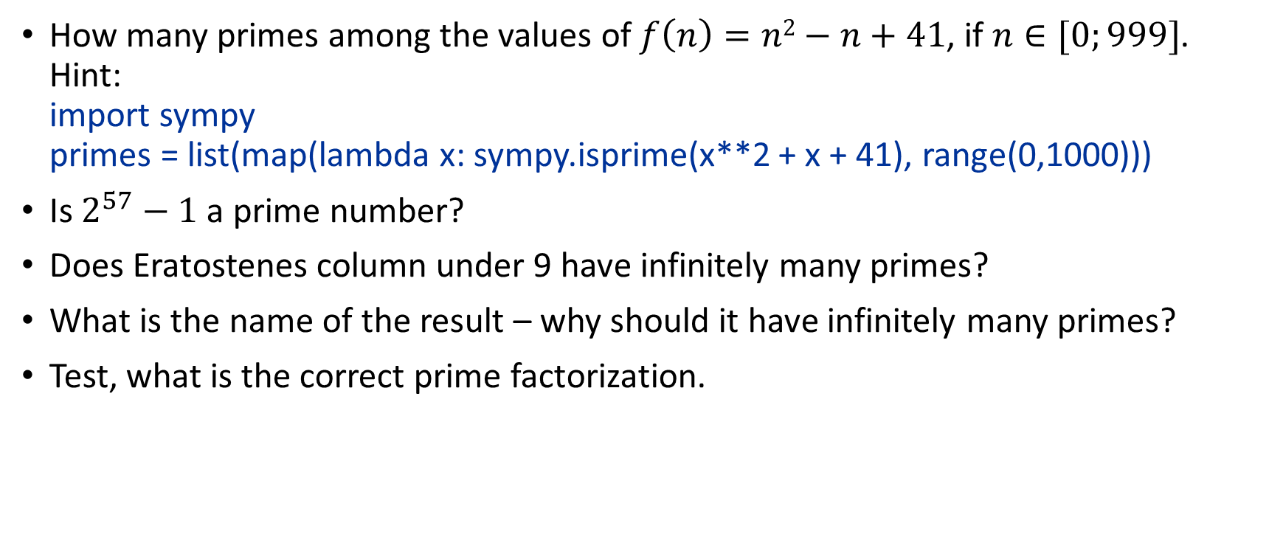
Socrative Quiz 6C.
How many primes among the values of $f\left(n\right)=n2−n+41$, if $n∈[0;999]$. Hint: import sympy primes = list(map(lambda x: sympy.isprime(x**2 + x + 41), range(0,1000)))
Is $2^{57}−1$ a prime number?
Does Eratostenes column under 9 have infinitely many primes?
What is the name of the result – why should it have infinitely many primes?
Test, what is the correct prime factorization.

Slide 17
Greatest Common Divisor
Definition: Let a and b be integers, not both zero. The largest integer d such that d | a and also d | b is called the greatest common divisor of a and b. The greatest common divisor of a and b is denoted by gcd(a,b).
One can find greatest common divisors of small numbers by inspection.
Example:What is the greatest common divisor of 24 and 36?
Solution: gcd(24, 36) = 12
Example:What is the greatest common divisor of 17 and 22?
Solution: gcd(17,22) = 1

Slide 18
Greatest Common Divisor
Definition: The integers a and b are relatively prime if their greatest common divisor is 1.
Example: 17 and 22
Definition: The integers a₁, a₂, …, a_{n} are pairwise relatively prime if gcd(a_{i}, a_{j})= 1 whenever 1 ≤ i<j ≤n.
Example: Determine whether the integers 10, 17 and 21 are pairwise relatively prime.
Solution: Because gcd(10,17) = 1, gcd(10,21) = 1, and gcd(17,21) = 1, 10, 17, and 21 are pairwise relatively prime.
Example: Determine whether the integers 10, 19, and 24 are pairwise relatively prime.
Solution: Because gcd(10,24) = 2, 10, 19, and 24 are not pairwise relatively prime.

Slide 19
Greatest Common Divisor
Definition: The integers a and b are relatively prime if their greatest common divisor is 1.
Example: 17 and 22
Definition: The integers a₁, a₂, …, a_{n} are pairwise relatively prime if gcd(a_{i}, a_{j})= 1 whenever 1 ≤ i<j ≤n.
Example: Determine whether the integers 10, 17 and 21 are pairwise relatively prime.
Solution: Because gcd(10,17) = 1, gcd(10,21) = 1, and gcd(17,21) = 1, 10, 17, and 21 are pairwise relatively prime.
Example: Determine whether the integers 10, 19, and 24 are pairwise relatively prime.
Solution: Because gcd(10,24) = 2, 10, 19, and 24 are not pairwise relatively prime.

Slide 20
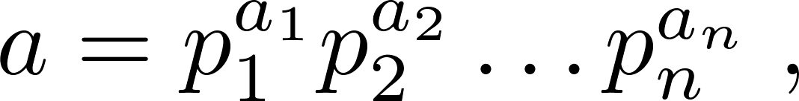
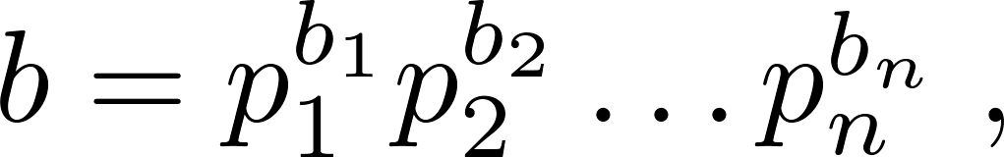
Finding the Greatest Common Divisor Using Prime Factorizations
Suppose the prime factorizations of a and b are:
where each exponent is a nonnegative integer, and where all primes occurring in either prime factorization are included in both. Then:
This formula is valid since the integer on the right (of the equals sign) divides both a and b. No larger integer can divide both a and b.
Example: 120 = 2³ ∙3 ∙5 500 = 2² ∙5³
gcd(120,500) = 2^{min(3,2)} ∙3^{min(1,0)} ∙5^{min(1,3)} = 2² ∙3⁰ ∙5¹ = 20
Finding the gcd of two positive integers using their prime factorizations is not efficient because there is no efficient algorithm for finding the prime factorization of a positive integer.

Slide 21
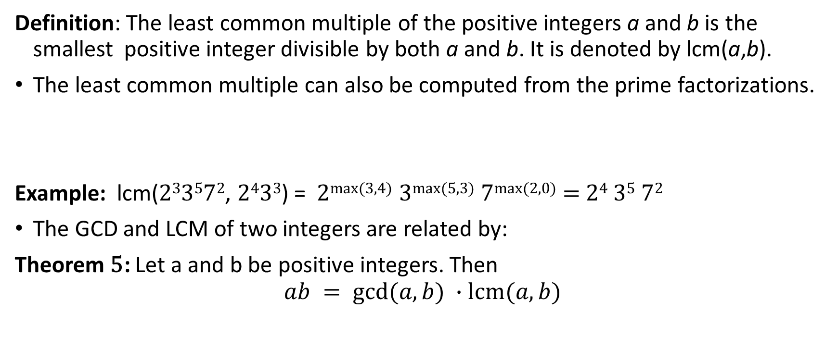
Least Common Multiple
Definition: The least common multiple of the positive integers a and b is the smallest positive integer divisible by both a and b. It is denoted by lcm(a,b).
The least common multiple can also be computed from the prime factorizations.
Example: lcm(2³3⁵7², 2⁴3³) = 2^{max(3,4)} 3^{max(5,3)} 7^{max(2,0)} = 2⁴ 3⁵ 7²
The GCD and LCM of two integers are related by:
Theorem 5: Let a and b be positive integers. Then
$$ab = gcd⁡(a,b) ∙lcm(a,b)$$

Slide 22
Euclidean Algorithm
Euclid
(325 B.C.E. – 265 B.C.E.)
The Euclidian algorithm is an efficient method for computing the greatest common divisor of two integers. It is based on the idea that gcd(a,b) is equal to gcd(a,c) when a > b and c is the remainder when a is divided by b.
Example: Find gcd(91, 287):
287 = 91 ∙ 3 + 14
91 = 14 ∙ 6 + 7
14 = 7 ∙ 2 + 0
gcd(287, 91) = gcd(91, 14) = gcd(14, 7) = 7
Divide 287 by 91
Divide 91 by 14
Divide 14 by 7
Stopping condition
continued →

Slide 23
Euclidean Algorithm
The Euclidean algorithm expressed in pseudocode is:
In Section 5.3, we’ll see that the time complexity of the algorithm is O(log b), where a > b.
procedure gcd(a, b: positive integers)
x := a
y := b
while y ≠ 0
r := x mod y
x := y
y := r
return x {gcd(a,b) is x}

Slide 24
Correctness of Euclidean Algorithm
Lemma 1: Let a = bq + r, where a, b, q, and r are integers. Then gcd(a,b) = gcd(b,r).
Proof:
Suppose that d divides both a and b. Then d also divides a − bq = r (by Theorem 1 of Section 4.1). Hence, any common divisor of a and b must also be any common divisor of b and r.
Suppose that d divides both b and r. Then d also divides bq + r = a. Hence, any common divisor of a and b must also be a common divisor of b and r.
Therefore, gcd(a,b) = gcd(b,r).

Slide 25
Correctness of Euclidean Algorithm
r₀ = r₁q₁ + r₂ 0 ≤ r₂ < r₁,
r₁ = r₂q₂ + r₃ 0 ≤ r₃ < r₂,
∙
∙
∙
r_{n-2} = r_{n-1}q_{n-1} + r₂ 0 ≤ r_{n} < r_{n-1},
r_{n-1} = r_{n}q_{n} .
Suppose that a and b are positive
integers with a ≥ b.
Let r₀ = a and r₁ = b.
Successive applications of the division
algorithm yields:
Eventually, a remainder of zero occurs in the sequence of terms: a = r₀ > r₁ > r₂ > ∙ ∙ ∙ ≥ 0. The sequence can’t contain more than a terms.
By Lemma 1
gcd(a,b) = gcd(r₀,r₁) = ∙ ∙ ∙ = gcd(r_{n-1},r_{n}) = gcd(r_{n} , 0) = r_{n}.
Hence the greatest common divisor is the last nonzero remainder in the sequence of divisions.

Slide 26
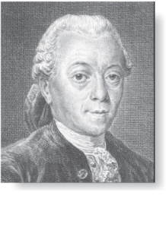
gcds as Linear Combinations
Étienne Bézout
(1730-1783)
Bézout’s Theorem: If a and b are positive integers, then there exist integers s and t such that gcd(a,b) = sa + tb.
(proof in exercises of Section 5.2)
Definition: If a and b are positive integers, then integers s and t such that gcd(a,b) = sa + tb are called Bézout coefficients of a and b. The equation gcd(a,b) = sa + tb is called Bézout’s identity.
By Bézout’s Theorem, the gcd of integers a and b can be expressed in the form sa + tb where s and t are integers. This is a linear combination with integer coefficients of a and b.
gcd(6,14) = (−2)∙6 + 1∙14

Slide 27
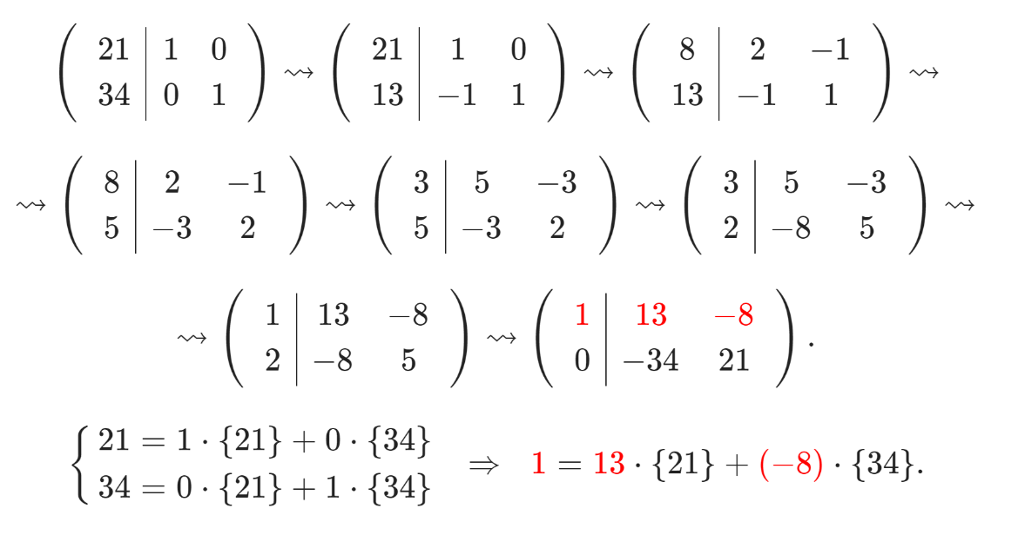
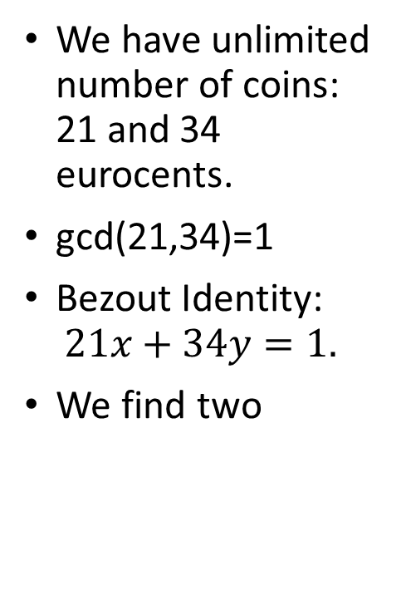
Blankinship Algorithm
We have unlimited number of coins: 21 and 34 eurocents.
gcd(21,34)=1
Bezout Identity: $21x+34y=1.$
We find two

Slide 28
Finding gcds as Linear Combinations
Example: Express gcd(252,198) = 18 as a linear combination of 252 and 198.
Solution: First use the Euclidean algorithm to show gcd(252,198) = 18
252 = 1∙198 + 54
198 = 3 ∙54 + 36
54 = 1 ∙36 + 18
36 = 2 ∙18
Now working backwards, from iii and i above
18 = 54 − 1 ∙36
36 = 198 − 3 ∙54
Substituting the 2nd equation into the 1st yields:
18 = 54 − 1 ∙(198 − 3 ∙54 )= 4 ∙54 − 1 ∙198
Substituting 54 = 252 − 1 ∙198 (from i)) yields:
18 = 4 ∙(252 − 1 ∙198) − 1 ∙198 = 4 ∙252 − 5 ∙198
This method illustrated above is a two pass method. It first uses the Euclidian algorithm to find the gcd and then works backwards to express the gcd as a linear combination of the original two integers. A one pass method, called the extended Euclidean algorithm, is developed in the exercises.

Slide 29
Consequences of Bézout’s Theorem
Lemma 2: If a, b, and c are positive integers such that gcd(a, b) = 1 and a | bc, then a | c.
Proof: Assume gcd(a, b) = 1 and a | bc
Since gcd(a, b) = 1, by Bézout’s Theorem there are integers s and t such that
sa + tb = 1.
Multiplying both sides of the equation by c, yields sac + tbc = c.
From Theorem 1 of Section 4.1:
a | tbc (part ii) and a divides sac + tbc since a | sac and a|tbc (part i)
We conclude a | c, since sac + tbc = c.
Lemma 3: If p is prime and p | a₁a₂∙∙∙a_{n}, then p | a_{i} for some i.
(proof uses mathematical induction; see Exercise 64 of Section 5.1)
Lemma 3 is crucial in the proof of the uniqueness of prime factorizations.

Slide 30


Uniqueness of Prime Factorization
We will prove that a prime factorization of a positive integer where the primes are in nondecreasing order is unique. (This part of the fundamental theorem of arithmetic. The other part, which asserts that every positive integer has a prime factorization into primes, will be proved in Section 5.2.)
Proof: (by contradiction) Suppose that the positive integer n can be written as a product of primes in two distinct ways:
n = p₁p₂ ∙∙∙ p_{s} and n = q₁q₂ ∙∙∙ p_{t}.
Remove all common primes from the factorizations to get
By Lemma 3, it follows that divides , for some k, contradicting the assumption that and are distinct primes.
Hence, there can be at most one factorization of n into primes in nondecreasing order.

Slide 31
Dividing Congruences by an Integer
Dividing both sides of a valid congruence by an integer does not always produce a valid congruence (see Section 4.1).
But dividing by an integer relatively prime to the modulus does produce a valid congruence:
Theorem 7: Let m be a positive integer and let a, b, and c be integers. If ac ≡ bc (mod m) and gcd(c,m) = 1, then a ≡ b (mod m).
Proof: Since ac ≡ bc (mod m), m | ac − bc = c(a − b) by Lemma 2 and the fact that gcd(c,m) = 1, it follows that m | a − b. Hence, a ≡ b (mod m).

Slide 32
Socrative Quiz6D
Check some linear equations with two unknowns; are there any integer solutions.
Express GCD (from prime factorizations or Euclid's algorithm)
Perform a step on Blankinship's algorithm.
Notes:
Which of the following equations has an integer solution? (Something that is easy to conclude from Bezout)
Express some GCD, if prime factorizations are known.
Use some conclusions from Blankinship's Algorithm. (After it has some values already used).

