Slide 1
Strong Induction and Well-Ordering
Section 5.2

Slide 2
Section Summary
Strong Induction
Example Proofs using Strong Induction
Using Strong Induction in Computational Geometry (not yet included in overheads)
Well-Ordering Property

Slide 3
Strong Induction
Strong Induction: To prove that P(n) is true for all positive integers n, where P(n) is a propositional function, complete two steps:
Basis Step: Verify that the proposition P(1) is true.
Inductive Step: Show the conditional statement
[P(1) ∧ P(2) ∧∙∙∙ ∧ P(k)] → P(k + 1) holds for all positive integers k.

Slide 4
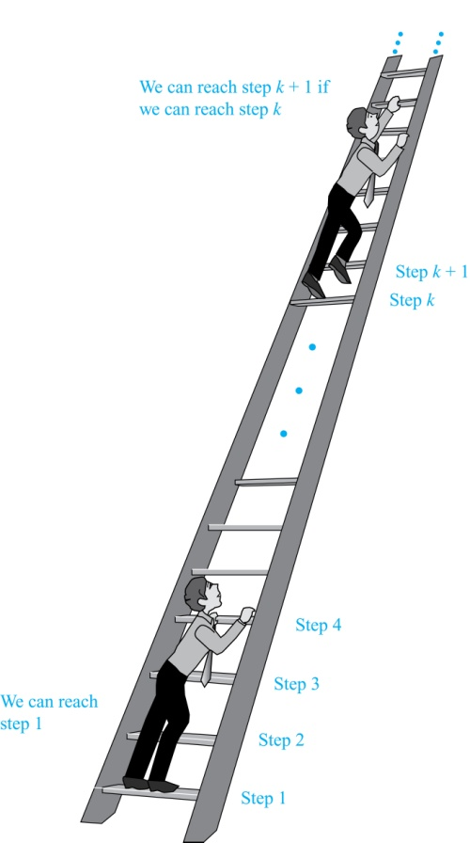
Strong Induction and the Infinite Ladder
Strong induction tells us that we can reach all rungs if:
We can reach the first rung of the ladder.
For every integer k, if we can reach the first k rungs, then we can reach the (k + 1)st rung.
To conclude that we can reach every rung by strong induction:
BASIS STEP: P(1) holds
INDUCTIVE STEP: Assume P(1) ∧ P(2) ∧∙∙∙ ∧ P(k) holds for an arbitrary integer k, and show that P(k + 1) must also hold.
We will have then shown by strong induction that for every positive integer n, P(n) holds, i.e., we can reach the nth rung of the ladder.

Slide 5
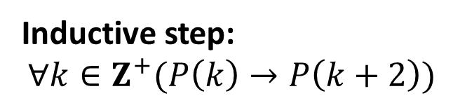
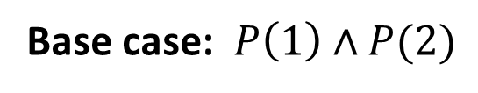

Strong Induction – Possible Proof Scheme
Example: Suppose we can reach the first and second rungs of an infinite ladder, and we know that if we can reach a rung, then we can reach two rungs higher. Prove that we can reach every rung.
(Try this with mathematical induction.)
Solution: Prove the result using strong induction.
BASIS STEP: We can reach the first step.
INDUCTIVE STEP: The inductive hypothesis is that we can reach the first k rungs, for any k ≥ 2. We can reach the (k + 1)st rung since we can reach the (k − 1)st rung by the inductive hypothesis.
Hence, we can reach all rungs of the ladder.
Base case: $P\left(1\right)∧P(2)$
. . .
1
2
Inductive step:
$$∀k∈Z^{+}(P\left(k\right)→P\left(k+2\right))$$
k
k
k+2
These steps imply:
. . .
1
2
$$∀k∈Z^{+} (P\left(k\right))$$

Slide 6
Which Form of Induction Should Be Used?
We can always use strong induction instead of mathematical induction. But there is no reason to use it if it is simpler to use mathematical induction. (See page 335 of text.)
In fact, the principles of mathematical induction, strong induction, and the well-ordering property are all equivalent. (Exercises 41-43)
Sometimes it is clear how to proceed using one of the three methods, but not the other two.

Slide 7
Completion of the proof of the Fundamental Theorem of Arithmetic
Example: Show that if n is an integer greater than 1, then n can be written as the product of primes.
Solution: Let P(n) be the proposition that n can be written as a product of primes.
BASIS STEP: P(2) is true since 2 itself is prime.
INDUCTIVE STEP: The inductive hypothesis is P(j) is true for all integers j with 2 ≤ j ≤ k. To show that P(k + 1) must be true under this assumption, two cases need to be considered:
If k + 1 is prime, then P(k + 1) is true.
Otherwise, k + 1 is composite and can be written as the product of two positive integers a and b with 2 ≤ a ≤ b < k + 1. By the inductive hypothesis a and b can be written as the product of primes and therefore k + 1 can also be written as the product of those primes.
Hence, it has been shown that every integer greater than 1 can be written as the product of primes.
(uniqueness proved in Section 4.3)

Slide 8
Proof using Strong Induction
Example: Prove that every amount of postage of 12 cents or more can be formed using just 4-cent and 5-cent stamps.
Solution: Let P(n) be the proposition that postage of n cents can be formed using 4-cent and 5-cent stamps.
BASIS STEP: P(12), P(13), P(14), and P(15) hold.
P(12) uses three 4-cent stamps.
P(13) uses two 4-cent stamps and one 5-cent stamp.
P(14) uses one 4-cent stamp and two 5-cent stamps.
P(15) uses three 5-cent stamps.
INDUCTIVE STEP: The inductive hypothesis states that P(j) holds for 12 ≤ j ≤ k, where k ≥ 15. Assuming the inductive hypothesis, it can be shown that P(k + 1) holds.
Using the inductive hypothesis, P(k − 3) holds since k − 3 ≥ 12. To form postage of k + 1 cents, add a 4-cent stamp to the postage for k − 3 cents.
Hence, P(n) holds for all n ≥ 12.

Slide 9
Proof of Same Example using Mathematical Induction
Example: Prove that every amount of postage of 12 cents or more can be formed using just 4-cent and 5-cent stamps.
Solution: Let P(n) be the proposition that postage of n cents can be formed using 4-cent and 5-cent stamps.
BASIS STEP: Postage of 12 cents can be formed using three 4-cent stamps.
INDUCTIVE STEP: The inductive hypothesis P(k) for any positive integer k is that postage of k cents can be formed using 4-cent and 5-cent stamps. To show P(k + 1) where k ≥ 12 , we consider two cases:
If at least one 4-cent stamp has been used, then a 4-cent stamp can be replaced with a 5-cent stamp to yield a total of k + 1 cents.
Otherwise, no 4-cent stamp have been used and at least three 5-cent stamps were used. Three 5-cent stamps can be replaced by four 4-cent stamps to yield a total of k + 1 cents.
Hence, P(n) holds for all n ≥ 12.

Slide 10
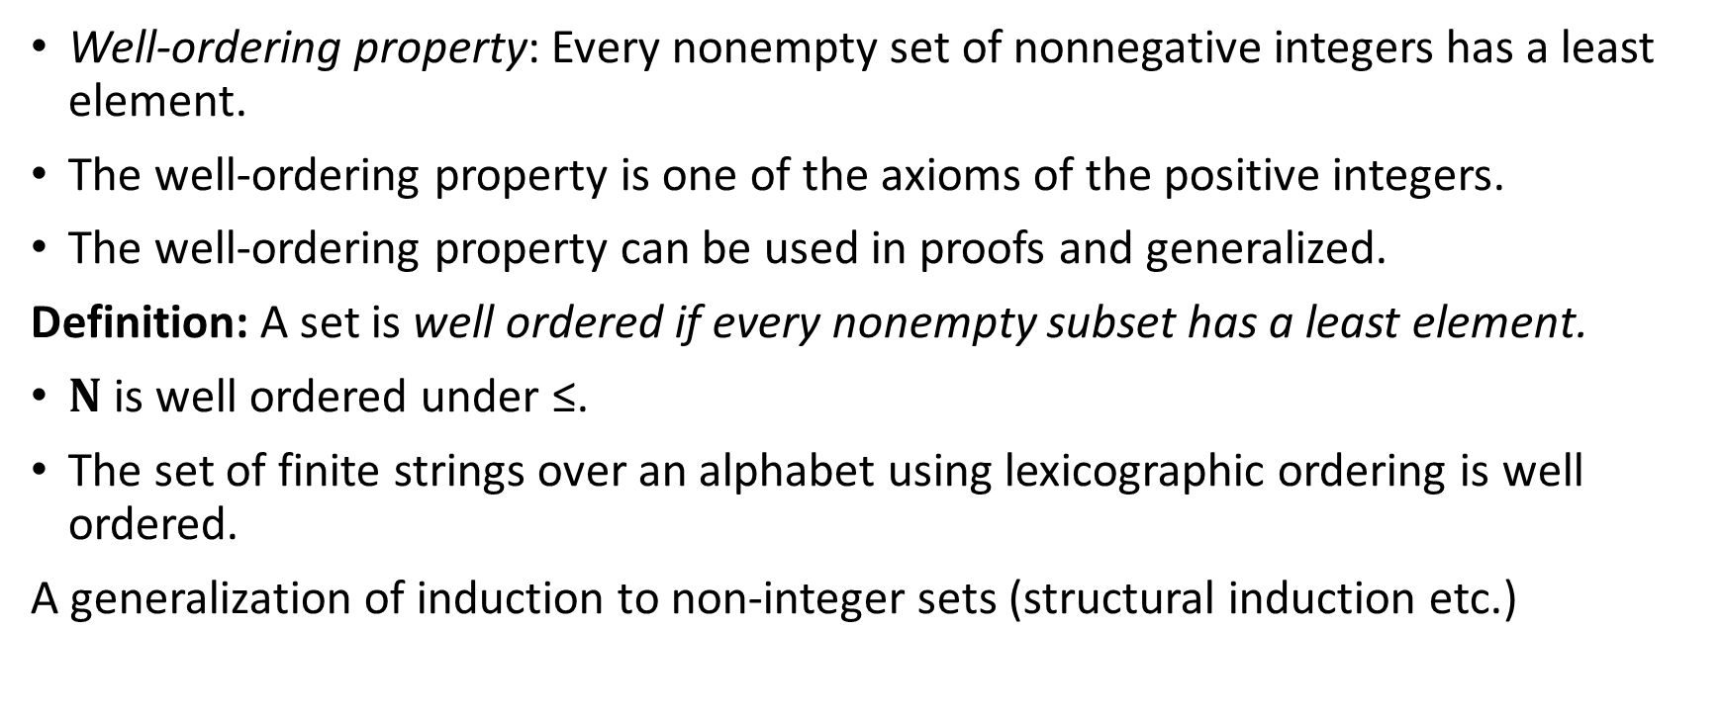
Well-Ordering Property
Well-ordering property: Every nonempty set of nonnegative integers has a least element.
The well-ordering property is one of the axioms of the positive integers.
The well-ordering property can be used in proofs and generalized.
Definition: A set is well ordered if every nonempty subset has a least element.
$N$ is well ordered under ≤.
The set of finite strings over an alphabet using lexicographic ordering is well ordered.
A generalization of induction to non-integer sets (structural induction etc.)

Slide 11
Well-Ordering Property
Example: Use the well-ordering property to prove the division algorithm, which states that if a is an integer and d is a positive integer, then there are unique integers q and r with 0 ≤ r < d, such that a = dq + r.
Solution: Let S be the set of nonnegative integers of the form a − dq, where q is an integer. The set is nonempty since −dq can be made as large as needed.
By the well-ordering property, S has a least element r = a − dq₀. The integer r is nonnegative. It also must be the case that r < d. If it were not, then there would be a smaller nonnegative element in S, namely, a − d(q₀ + 1) = a − dq₀ − d = r − d > 0.
Therefore, there are integers q and r with 0 ≤ r < d.
⁻² .

Slide 12
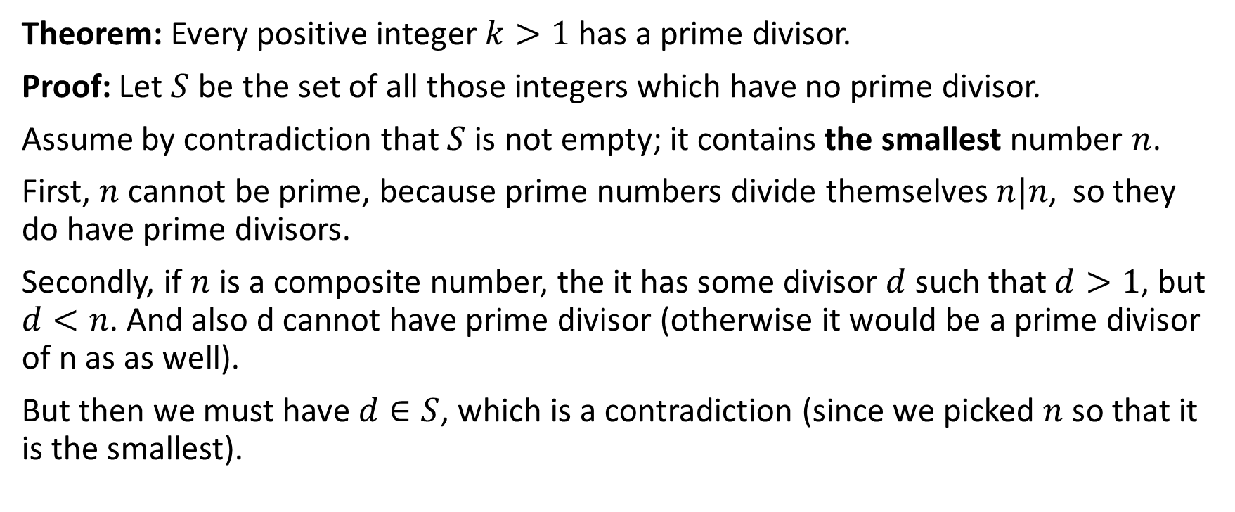
Proof using Well-Ordering Property
Theorem: Every positive integer $k>1$ has a prime divisor.
Proof: Let $S$ be the set of all those integers which have no prime divisor.
Assume by contradiction that $S$ is not empty; it contains the smallest number $n$.
First, $n$ cannot be prime, because prime numbers divide themselves $n|n$, so they do have prime divisors.
Secondly, if $n$ is a composite number, the it has some divisor $d$ such that $d>1$, but $d<n$. And also d cannot have prime divisor (otherwise it would be a prime divisor of n as as well).
But then we must have $d∈S$, which is a contradiction (since we picked $n$ so that it is the smallest).

Slide 13
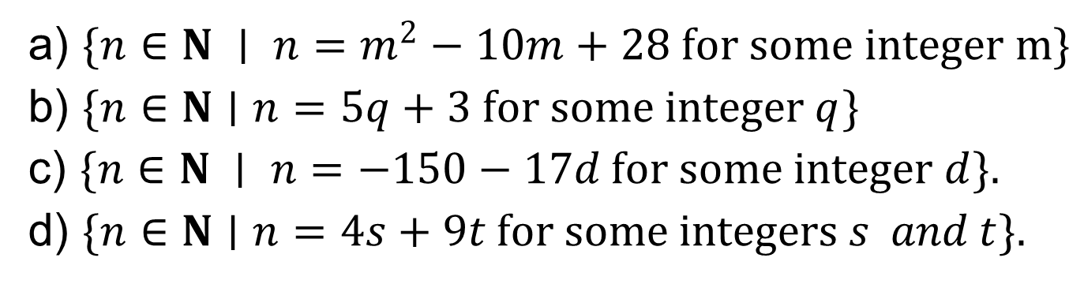
Smallest elements in these sets?
Consider the following subsets of N. Find their smallest elements.
a) $\{n∈N ∣ n=m^{2}−10m+28 for some integer m\}$
b) $\{n∈N∣n=5q+3 for some integer q\}$
c) $\{n∈N ∣ n=−150−17d for some integer d\}.$
d) $\{n∈N∣n=4s+9t for some integers s and t\}.$
Show that the interval $[3;5]$ of $R$ is not well ordered.

Slide 14
Socrative Test
Find the smallest elements in some sets.

