Slide 1
The Basics of Counting
Section 6.1

Slide 2
Section Summary
The Product Rule
The Sum Rule
The Subtraction Rule
The Division Rule
Examples, Examples, and Examples
Tree Diagrams

Slide 3
Basic Counting Principles: The Product Rule
The Product Rule: A procedure can be broken down into a sequence of two tasks. There are n₁ ways to do the first task and n₂ ways to do the second task. Then there are n₁∙n₂ ways to do the procedure.
Example: How many bit strings of length seven are there?
Solution: Since each of the seven bits is either a 0 or a 1, the answer is 2⁷ = 128.

Slide 4
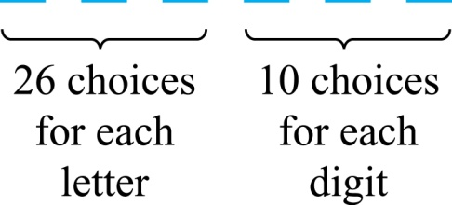
The Product Rule
Example: How many different license plates can be made if each plate contains a sequence of three uppercase English letters followed by three digits?
Solution: By the product rule, there are 26 ∙ 26 ∙ 26 ∙ 10 ∙ 10 ∙ 10 = 17,576,000 different possible license plates.

Slide 5


Counting All Functions
$$|A|=m$$
$$|B|=n$$
Counting Functions: How many functions are there from a set with m elements to a set with n elements?
Solution: Since a function represents a choice of one of the n elements of the codomain for each of the m elements in the domain, the product rule tells us that there are n ∙ n ∙ ∙ ∙ n = n^{m} such functions.
import numpy as np
np.random.choice(range(0,5),size=6)
Notes:
sample(1:5, replace=TRUE, size=6)

Slide 6
Counting Injective Functions
$$|A|=m$$
$$|B|=n$$
Counting One-to-One (Injective) Functions: How many one-to-one functions are there from a set with m elements to one with n elements?
Solution: Suppose the elements in the domain are a₁, a₂,…, a_{m}. There are n ways to choose the value of a₁ and n−1 ways to choose a₂, etc. The product rule tells us that there are n(n−1) (n−2)∙∙∙(n−m +1) such functions.
import numpy as np
np.random.choice(range(0,7),size=6, replace=False)

Slide 7
Telephone Numbering Plan
Example: The North American numbering plan (NANP) specifies a 10-digit phone number, consisting of a three-digit area code, a three-digit office code, and a four-digit station code. Some restrictions:
Let X denote a digit from 0 through 9.
Let N denote a digit from 2 through 9.
Let Y denote a digit that is 0 or 1.
In the old plan (in use in the 1960s) the format was NYX-NNX-XXX.
In the new plan, the format is NXX-NXX-XXX.
How many different telephone numbers are possible under the old plan and the new plan?
Solution: Use the Product Rule.
There are 8 ∙2 ∙10 = 160 area codes with the format NYX.
There are 8 ∙10 ∙10 = 800 area codes with the format NXX.
There are 8 ∙8 ∙10 = 640 office codes with the format NNX.
There are 10 ∙10 ∙10 ∙10 = 10,000 station codes with the format XXXX.
Number of old plan telephone numbers: 160 ∙640 ∙10,000 = 1,024,000,000.
Number of new plan telephone numbers: 800 ∙800 ∙10,000 = 6,400,000,000.

Slide 8
Counting Subsets of a Finite Set
Counting Subsets of a Finite Set: Use the product rule to show that the number of different subsets of a finite set S is 2^{|S|}. (In Section 5.1, mathematical induction was used to prove this same result.)
Solution: When the elements of S are listed in an arbitrary order, there is a one-to-one correspondence between subsets of S and bit strings of length |S|. When the ith element is in the subset, the bit string has a 1 in the ith position and a 0 otherwise.
By the product rule, there are 2^{|S|} such bit strings, and therefore 2^{|S|} subsets.

Slide 9
Product Rule in Terms of Sets
If A₁, A₂, … , A_{m} are finite sets, then the number of elements in the Cartesian product of these sets is the product of the number of elements of each set.
The task of choosing an element in the Cartesian product A₁ ⨉ A₂ ⨉ ∙∙∙ ⨉ A_{m} is done by choosing an element in A₁, an element in A₂ , …, and an element in A_{m}.
By the product rule, it follows that:
|A₁ ⨉ A₂ ⨉ ∙∙∙ ⨉ A_{m} |= |A₁| ∙ |A₂| ∙ ∙∙∙ ∙ |A_{m}|.

Slide 10
DNA and Genomes
A gene is a segment of a DNA molecule that encodes a particular protein and the entirety of genetic information of an organism is called its genome.
DNA molecules consist of two strands of blocks known as nucleotides. Each nucleotide is composed of bases: adenine (A), cytosine (C), guanine (G), or thymine (T).
The DNA of bacteria has between 10⁵ and 10⁷ links (one of the four bases). Mammals have between 10⁸ and 10¹⁰ links. So, by the product rule there are at least 4¹⁰⁵ different sequences of bases in the DNA of bacteria and 4¹⁰⁸ different sequences of bases in the DNA of mammals.
The human genome includes approximately 23,000 genes, each with 1,000 or more links.

Slide 11
Basic Counting Principles: The Sum Rule
The Sum Rule: If a task can be done either in one of n₁ ways or in one of n₂, where none of the set of n₁ ways is the same as any of the n₂ ways, then there are n₁ + n₂ ways to do the task.
Example: The mathematics department must choose either a student or a faculty member as a representative for a university committee. How many choices are there for this representative if there are 37 members of the mathematics faculty and 83 mathematics majors and no one is both a faculty member and a student.
Solution: By the sum rule it follows that there are 37 + 83 = 120 possible ways to pick a representative.

Slide 12
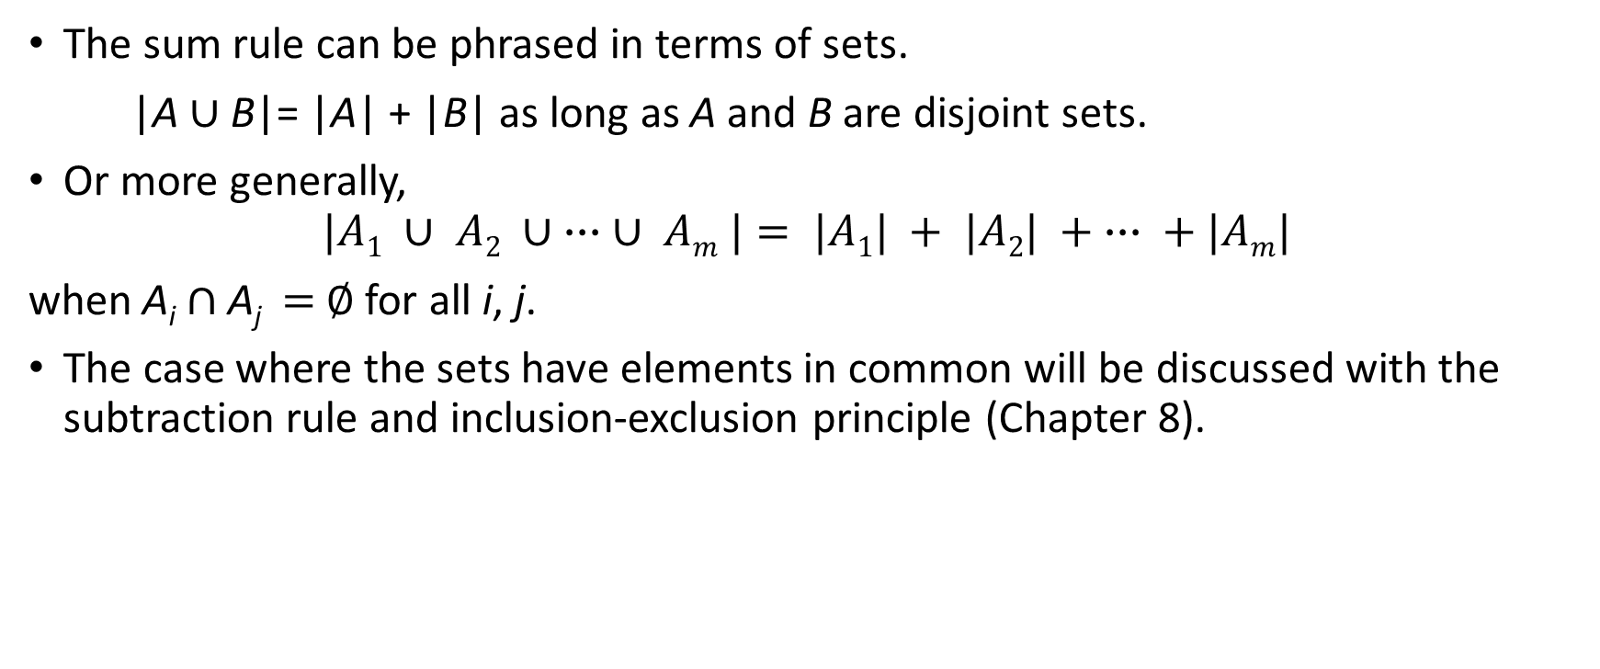
The Sum Rule in terms of sets.
The sum rule can be phrased in terms of sets.
|A ∪ B|= |A| + |B| as long as A and B are disjoint sets.
Or more generally,
$$|A1 ∪ A2 ∪ ∙∙∙ ∪ Am |= |A1| + |A2| + ∙∙∙ + |Am|$$ when A_{i} ∩ A_{j} = ∅ for all i, j.
The case where the sets have elements in common will be discussed with the subtraction rule and inclusion-exclusion principle (Chapter 8).

Slide 13
Combining the Sum and Product Rule
Example: Suppose statement labels in a programming language can be either a single letter or a letter followed by a digit. Find the number of possible labels.
Solution: Use the product rule.
26 + 26 ∙ 10 = 286

Slide 14
Counting Passwords
Combining the sum and product rule allows us to solve more complex problems.
Example: Each user on a computer system has a password, which is six to eight characters long, where each character is an uppercase letter or a digit. Each password must contain at least one digit. How many possible passwords are there?
Solution: Let P₆, P₇, and P₈ be the passwords of length 6, 7, and 8. We find P₆ + P₇ +P₈.
For each P₆, P₇, and P₈ , find the number of passwords of the specified length (and subtract letters-only passwords).
P₆ = 36⁶ − 26⁶ =2,176,782,336 − 308,915,776 =1,867,866,560.
P₇ = 36⁷ − 26⁷ = 78,364,164,096 − 8,031,810,176 = 70,332,353,920.
P₈ = 36⁸ − 26⁸ = 2,821,109,907,456 − 208,827,064,576 =2,612,282,842,880.
P = P₆ + P₇ +P₈ = 2,684,483,063,360.

Slide 15
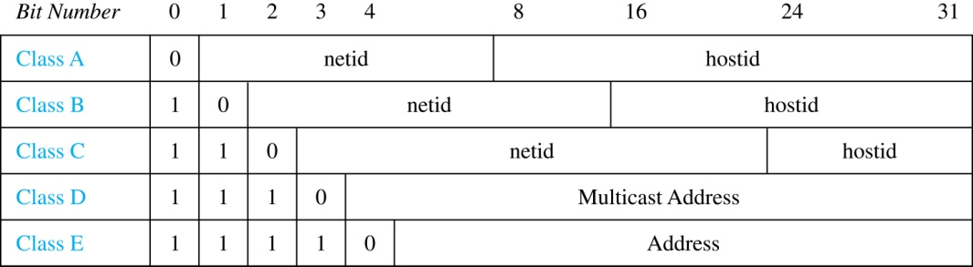
Internet Addresses
Version 4 of the Internet Protocol (IPv4) uses 32 bits.
Class A Addresses: used for the largest networks, a 0,followed by a 7-bit netid and a 24-bit hostid.
Class B Addresses: used for the medium-sized networks, a 10,followed by a 14-bit netid and a 16-bit hostid.
Class C Addresses: used for the smallest networks, a 110,followed by a 21-bit netid and a 8-bit hostid.
Neither Class D nor Class E addresses are assigned as the address of a computer on the internet. Only Classes A, B, and C are available.
1111111 is not available as the netid of a Class A network.
Hostids consisting of all 0s and all 1s are not available in any network.

Slide 16
Counting Internet Addresses
Example: How many different IPv4 addresses are available for computers on the internet?
Solution: Use both the sum and the product rule. Let x be the number of available addresses, and let x_{A}, x_{B}, and x_{C} denote the number of addresses for the respective classes.
To find, x_{A}: 2⁷ − 1 = 127 netids. 2²⁴ − 2 = 16,777,214 hostids.
x_{A} = 127∙ 16,777,214 = 2,130,706,178.
To find, x_{B}: 2¹⁴ = 16,384 netids. 2¹⁶ − 2 = 16,534 hostids.
x_{B} = 16,384 ∙ 16, 534 = 1,073,709,056.
To find, x_{C}: 2²¹ = 2,097,152 netids. 2⁸ − 2 = 254 hostids.
x_{C} = 2,097,152 ∙ 254 = 532,676,608.
Hence, the total number of available IPv4 addresses is
x = x_{A} + x_{B} + x_{C}
= 2,130,706,178 + 1,073,709,056 + 532,676,608
= 3, 737,091,842.
<4 billion addresses not enough.
Explain some methods how this is solved: (A) IPv6 (B) NAT (C) TCP Ports

Slide 17
Basic Counting Principles: Subtraction Rule
Subtraction Rule: If a task can be done either in one of n₁ ways or in one of n₂ ways, then the total number of ways to do the task is n₁ + n₂ minus the number of ways to do the task that are common to the two different ways.
Also known as, the principle of inclusion-exclusion:

Slide 18
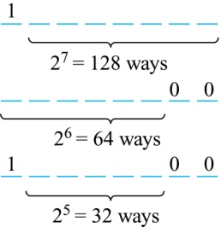
Counting Bit Strings
Example: How many bit strings of length eight either start with a 1 bit or end with the two bits 00?
Solution: Use the subtraction rule.
Number of bit strings of length eight that start with a 1 bit: 2⁷ = 128
Number of bit strings of length eight that end with bits 00: 2⁶ = 64
Number of bit strings of length eight that start with a 1 bit and end with bits 00 : 2⁵ = 32
Hence, the number is 128 + 64 − 32 = 160.

Slide 19
Basic Counting Principles: Division Rule
Division Rule: There are n/d ways to do a task if it can be done using a procedure that can be carried out in n ways, and for every way w, exactly d of the n ways correspond to way w.
Restated in terms of sets: If the finite set A is the union of n pairwise disjoint subsets each with d elements, then n = |A|/d.
In terms of functions: If f is a function from A to B, where both are finite sets, and for every value y ∈ B there are exactly d values x ∈ A such that f(x) = y, then |B| = |A|/d.

Slide 20
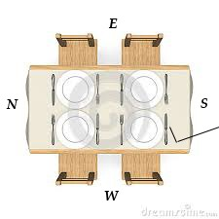
Division Principle
Example: How many ways are there to seat four people around a dinner table? (People are distinguishable)
Case 1 (Vaastu Shastra etc.). It is essential who is facing east, west, etc.
Case 2: The dinner table is round, nobody cares about compass directions; two seatings are considered the same (equivalent) when each person has the same left and right neighbor.
Solution Case 1: Number the seats from 1 to 4 proceeding clockwise. Four ways to fill seat #1, three ways to fill seat #2, two ways to fill seat #3, one way to fill seat #4. Thus there are 4! = 24 ways to seat the four people.
Solution Case 2: Since two seatings are the same when each person has the same left and right neighbor, for every choice for seat 1, we get the same seating. Therefore, by the division rule, there are 24/4 = 6 different seating arrangements.

Slide 21
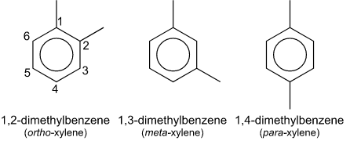
How Symmetry Affects Counting Results
Combinatorics of necklaces and bracelets. https://www.jasondavies.com/necklaces/ Example 1: Assume that the 4 people who sit around the table do not care about north-south. Moreovery, they do not distinguish their left-right neighbors either (only thing that matters – who are the two neighbors for every given person).
A
A
A
D
B
D
C
B
C
C
B
D
Example 2: 6 items sit at a round table (benzene ring): 4 of them are identical hydrogens;
2 are identical methyl groups. (Even more symmetry)
Notes:
Dimethylbenzenes (LV: Dimetilbenzoli – o-ksilols, m-ksilols, p-ksilols). Benzene ring (LV: benzola gredzens).
If hydrogens or methyl groups had any individuality, the counts would be different.

Slide 22
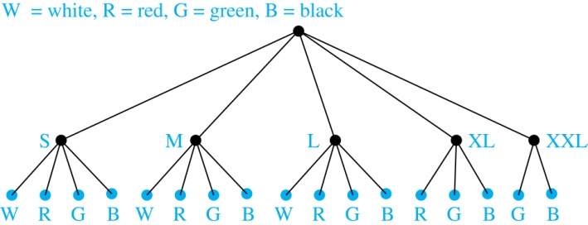
Tree Diagrams
Tree Diagrams: We can solve many counting problems through the use of tree diagrams, where a branch represents a possible choice and the leaves represent possible outcomes.
Example: Suppose that “I Love Discrete Math” T-shirts come in five different sizes: S,M,L,XL, and XXL. Each size comes in four colors (white, red, green, and black), except XL, which comes only in red, green, and black, and XXL, which comes only in green and black. What is the minimum number of shirts that the campus book store needs to stock to have one of each size and color available?
Solution: Draw the tree diagram.
The store must stock 17 T-shirts.

