Slide 1
Binomial Coefficients and Identities
Section 6.4

Slide 2
Section Summary
The Binomial Theorem
Pascal’s Identity and Triangle
Other Identities Involving Binomial Coefficients (not currently included in overheads)

Slide 3


Powers of Binomial Expressions
Definition: A binomial expression is the sum of two terms, such as x + y. (More generally, these terms can be products of constants and variables.)
We can use counting principles to find the coefficients in the expansion of (x + y)^{n} where n is a positive integer.
To illustrate this idea, we first look at the process of expanding (x + y)³.
(x + y) (x + y) (x + y) expands into a sum of terms that are the product of a term from each of the three sums.
Terms of the form x³, x²y, x y², y³ arise. The question is what are the coefficients?
To obtain x³ , an x must be chosen from each of the sums. There is only one way to do this. So, the coefficient of x³ is 1.
To obtain x²y, an x must be chosen from two of the sums and a y from the other. There are ways to do this and so the coefficient of x²y is 3.
To obtain xy², an x must be chosen from of the sums and a y from the other two . There are ways to do this and so the coefficient of xy² is 3.
To obtain y³ , a y must be chosen from each of the sums. There is only one way to do this. So, the coefficient of y³ is 1.
We have used a counting argument to show that (x + y)³ = x³ + 3x²y + 3x y² + y³ .
Next we present the binomial theorem gives the coefficients of the terms in the expansion of (x + y)^{n} .

Slide 4


Binomial Theorem
Binomial Theorem: Let x and y be variables, and n a nonnegative integer. Then:
Proof: We use combinatorial reasoning . The terms in the expansion of (x + y)^{n} are of the form x^{n−j}y^{j} for j = 0,1,2,…,n. To form the term x^{n−j}y^{j}, it is necessary to choose n−j xs from the n sums. Therefore, the coefficient of x^{n−j}y^{j} is which equals .

Slide 5
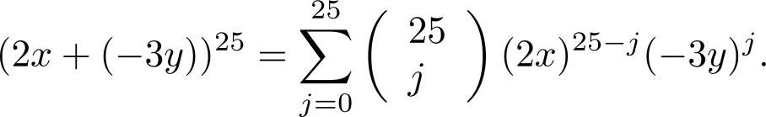
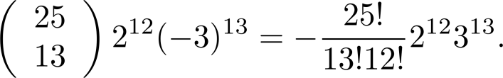
Using the Binomial Theorem
Example: What is the coefficient of x¹²y¹³ in the expansion of (2x − 3y)²⁵?
Solution: We view the expression as (2x +(−3y))²⁵. By the binomial theorem
Consequently, the coefficient of x¹²y¹³ in the expansion is obtained when j = 13.

Slide 6
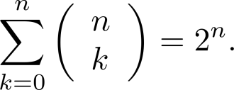
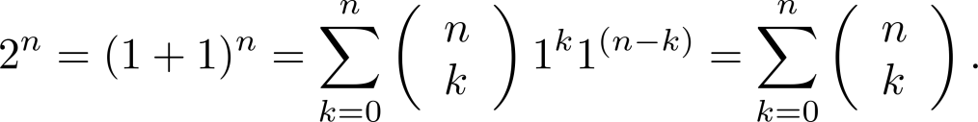




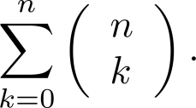
A Useful Identity
Corollary 1: With n ≥0,
Proof (using binomial theorem): With x = 1 and y = 1, from the binomial theorem we see that:
Proof (combinatorial): Consider the subsets of a set with n elements. There are subsets with zero elements, with one element, with two elements, …, and with n elements. Therefore the total is
Since, we know that a set with n elements has 2^{n} subsets, we conclude:

Slide 7
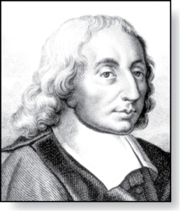
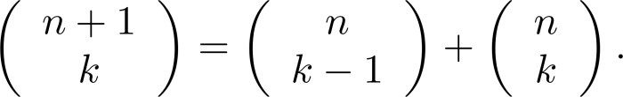



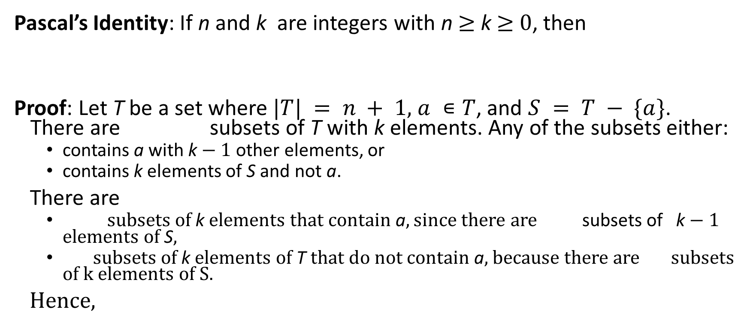
Pascal’s Identity
Blaise Pascal
(1623-1662)
Pascal’s Identity: If n and k are integers with n ≥ k ≥ 0, then
Proof: Let T be a set where $|T| = n + 1$, $a ∊T$, and $S = T − \{a\}$. There are subsets of T with k elements. Any of the subsets either:
contains a with k − 1 other elements, or
contains k elements of S and not a.
There are
subsets of k elements that contain a, since there are subsets of k − 1 elements of S,
subsets of k elements of T that do not contain a, because there are subsets of k elements of S.
Hence,
See Exercise 19 for an algebraic proof.

Slide 8
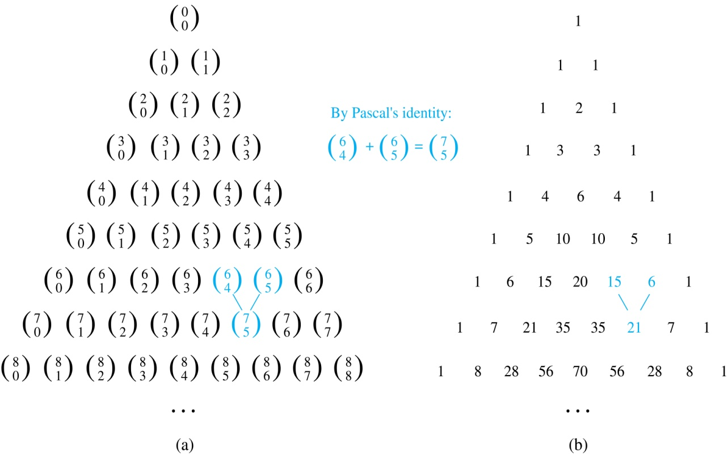
Pascal’s Triangle
The nth row in the triangle consists of the binomial coefficients ,
k = 0,1,….,n.
By Pascal’s identity, adding two adjacent bionomial coefficients results is the binomial coefficient in the next row between these two coefficients.

