Slide 1
Advanced Combinatorics: Recurrence Relations
Section 8.1

Slide 2
Section Summary
Applications of Recurrence Relations
Fibonacci Numbers
The Tower of Hanoi
Counting Problems
Algorithms and Recurrence Relations (not currently included in overheads)

Slide 3
Recurrence Relations (recalling definitions from Chapter 2)
Definition: A recurrence relation for the sequence {a_{n}} is an equation that expresses a_{n} in terms of one or more of the previous terms of the sequence, namely, a₀, a₁, …, a_{n-1}, for all integers n with n ≥ n₀, where n₀ is a nonnegative integer.
A sequence is called a solution of a recurrence relation if its terms satisfy the recurrence relation.
The initial conditions for a sequence specify the terms that precede the first term where the recurrence relation takes effect.

Slide 4
Rabbits and the Fibonacci Numbers
Example: A young pair of rabbits (one of each gender) is placed on an island. A pair of rabbits does not breed until they are 2 months old. After they are 2 months old, each pair of rabbits produces another pair each month. Find a recurrence relation for the number of pairs of rabbits on the island after n months, assuming that rabbits never die.
This is the original problem considered by Leonardo Pisano (Fibonacci) in the thirteenth century.

Slide 5
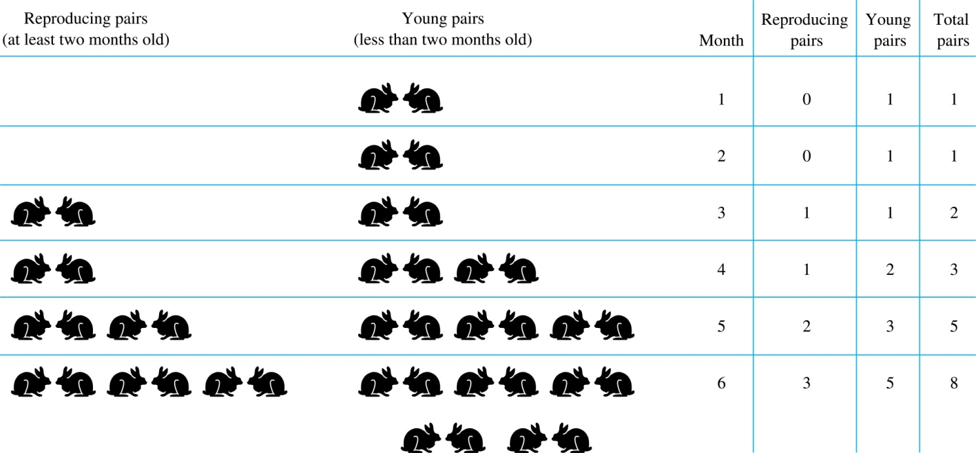
Rabbits and the Fibonacci Numbers (cont.)
Modeling the Population Growth of Rabbits on an Island

Slide 6
Rabbits and the Fibonacci Numbers (cont.)
Solution: Let f_{n} be the the number of pairs of rabbits after n months.
There are is f₁ = 1 pairs of rabbits on the island at the end of the first month.
We also have f₂ = 1 because the pair does not breed during the first month.
To find the number of pairs on the island after n months, add the number on the island after the previous month, f_{n-1}, and the number of newborn pairs, which equals f_{n-2}, because each newborn pair comes from a pair at least two months old.
Consequently the sequence {f_{n} } satisfies the recurrence relation f_{n} = f_{n-1} + f_{n-2} for n ≥ 3 with the initial conditions f₁ = 1 and f₂ = 1.
The number of pairs of rabbits on the island after n months is given by the nth Fibonacci number.

Slide 7
The Tower of Hanoi
In the late nineteenth century, the French mathematician Édouard Lucas invented a puzzle consisting of three pegs on a board with disks of different sizes. Initially all of the disks are on the first peg in order of size, with the largest on the bottom.
Rules: You are allowed to move the disks one at a time from one peg to another as long as a larger disk is never placed on a smaller.
Goal: Using allowable moves, end up with all the disks on the second peg in order of size with largest on the bottom.

Slide 8
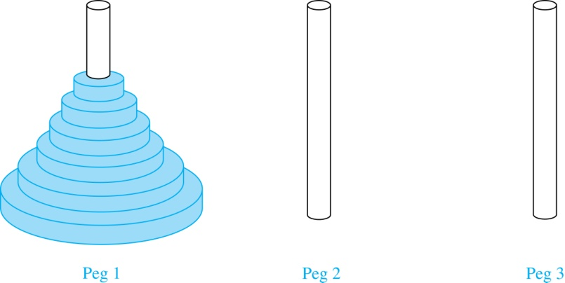
The Tower of Hanoi (continued)
The Initial Position in the Tower of Hanoi Puzzle
https://youtu.be/2SUvWfNJSsM

Slide 9
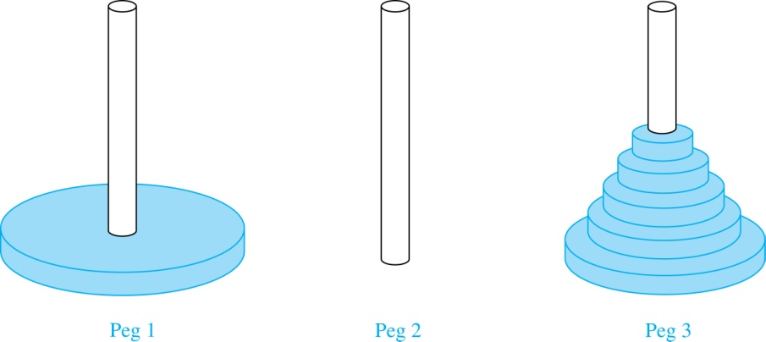
The Tower of Hanoi (continued)
Solution: Let {H_{n}} denote the number of moves to solve the Tower of Hanoi with n disks. Set up a recurrence relation for the sequence {H_{n}}. Begin with n disks on peg 1. We can transfer the top n −1 disks, following the rules of the puzzle, to peg 3 using H_{n−1} moves.
First, use 1 move to transfer the largest disk to the second peg. Then transfer the n −1 disks from peg 3 to peg 2 using H_{n−1} additional moves. (Cannot be done faster). Hence, H_{n} = 2H_{n−1} + 1.
The initial condition is H₁= 1 since a single disk can be transferred from peg 1 to peg 2 in one move.

Slide 10
The Tower of Hanoi (continued)
Use iterations to solve this recurrence relation by repeatedly expressing H_{n} in terms of the previous terms of the sequence.
H_{n} = 2H_{n−1} + 1 = 2(2H_{n−2} + 1) + 1 = 2² H_{n−2} +2 + 1
= 2²(2H_{n−3} + 1) + 2 + 1 = 2³ H_{n−3} +2² + 2 + 1
⋮
= 2^{n-1}H₁ + 2^{n−2} + 2^{n−3} + …. + 2 + 1
= 2^{n−1} + 2^{n−2} + 2^{n−3} + …. + 2 + 1 because H₁= 1
= 2^{n} − 1 using the formula for the sum of the terms of a geometric series
A Myth: Monks in a tower in Hanoi are transferring 64 gold disks from one peg to another following the rules of the puzzle. They move one disk each day. When the puzzle is finished, the world will end.
Using this formula for the 64 gold disks of the myth, 2⁶⁴ −1 = 18,446, 744,073, 709,551,615 days are needed to solve the puzzle, which is more than 500 billion years.
Reve’s puzzle (proposed in 1907 by Henry Dudeney) has 4 pegs. There is a well-known unsolved conjecture for the the minimum number of moves needed to solve this puzzle. (see Exercises 38-45)

Slide 11
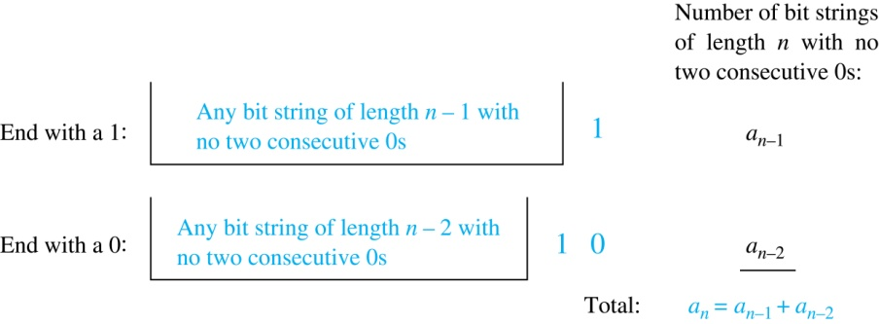
Counting Bit Strings
Example 3: Find a recurrence relation and give initial conditions for the number of bit strings of length n without two consecutive 0s. How many such bit strings are there of length five?
Solution: Let a_{n} denote the number of bit strings of length n without two consecutive 0s. To obtain a recurrence relation for {a_{n} } note that the number of bit strings of length n that do not have two consecutive 0s is the number of bit strings ending with a 0 plus the number of such bit strings ending with a 1.
Now assume that n ≥ 3.
The bit strings of length n ending with 1 without two consecutive 0s are the bit strings of length n −1 with no two consecutive 0s with a 1 at the end. Hence, there are a_{n−1} such bit strings.
The bit strings of length n ending with 0 without two consecutive 0s are the bit strings of length n −2 with no two consecutive 0s with 10 at the end. Hence, there are a_{n−2} such bit strings.
Conclude that a_{n} = a_{n−1} + a_{n−2} for n ≥ 3.

Slide 12
Bit Strings (continued)
The initial conditions are:
a₁ = 2, since both the bit strings 0 and 1 do not have consecutive 0s.
a₂ = 3, since the bit strings 01, 10, and 11 do not have consecutive 0s, while 00 does.
To obtain a₅ , use the recurrence relation three times:
a₃ = a₂ + a₁ = 3 + 2 = 5
a₄ = a₃ + a₂ = 5+ 3 = 8
a₅ = a₄ + a₃ = 8+ 5 = 13
Note that {a_{n} } satisfies the same recurrence relation as the Fibonacci sequence. Since a₁ = f₃ and a₂ = f₄ , we conclude that a_{n} = f_{n+2} .

Slide 13
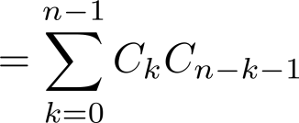
Counting the Ways to Parenthesize a Product
Example: Find a recurrence relation for C_{n} , to parenthesize the product of n + 1 numbers, x₀ ∙ x₁ ∙ x₂ ∙ ⋯ ∙ x_{n}, to specify the order of multiplication. For example, C₃ = 5, since all the possible ways to parenthesize 4 numbers are
((x₀ ∙ x₁ )∙ x₂ )∙ x₃ , (x₀ ∙ (x₁ ∙ x₂ ))∙ x₃ , (x₀ ∙ x₁ )∙ (x₂ ∙ x₃ ), x₀ ∙ (( x₁ ∙ x₂ ) ∙ x₃ ), x₀ ∙ ( x₁ ∙ ( x₂ ∙ x₃ ))
Solution: Note that however parentheses are inserted in x₀ ∙ x₁ ∙ x₂ ∙ ⋯ ∙ x_{n}, one “∙” operator remains outside all parentheses. This final operator appears between two of the n + 1 numbers, say x_{k} and x_{k+1}. Since there are C_{k} ways to insert parentheses in the product x₀ ∙ x₁ ∙ x₂ ∙ ⋯ ∙ x_{k} and C_{n−k−1} ways to insert parentheses in the product x_{k+1} ∙ x_{k+2} ∙ ⋯ ∙ x_{n}, we have
The initial conditions are C₀ = 1 and C₁ = 1.

Slide 14
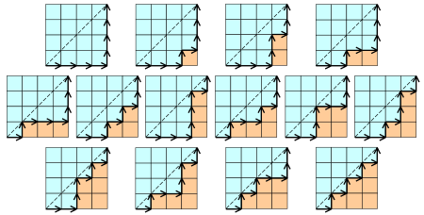
Catalan Numbers
The sequence {C_{n} } is Catalan Numbers. $C_{n}=\frac{1}{n+1}\left(\begin{matrix}2n \\ n\end{matrix}\right)$
$$n$$ | $$0$$ | $$1$$ | $$2$$ | $$3$$ | $$4$$ | $$5$$ | $$6$$ | $$7$$ | $$8$$ | $$9$$ | $$10$$
$$C_{n}$$ | $$1$$ | $$1$$ | $$2$$ | $$5$$ | $$14$$ | $$42$$ | $$132$$ | $$429$$ | $$1430$$ | $$4862$$ | $$16796$$
(((()))) ((()())) ((())()) (()(()))
()((())) (()()()) ((()))() (())(()) (()())()
(())()() ()(())() ()()(()) ()()()()
ABCDE**** ABCD*E*** ABCD**E** ABC*DE***
AB*CDE*** ABC*D*E** ABCD***E* ABC**DE** ABC*D**E*
ABC**D*E* AB*CD**E* AB*C*DE** AB*C*D*E*
Notes:
1, 1, 2, 5, 14, 42, 132, 429, 1430, 4862, 16796,

Slide 15
Reverse Polish Notation / Postfix Notation
Input | 2 | 3 | add | 11 | mul | 1 | add
Stack | 2 | 3 2 | 5 | 11 5 | 55 | 1 55 | 56
Jan Łukasiewicz (1924). Infix: (2+3)*11+1 Postfix: 2 3 add 11 mul 1 add Prefix/Coq: (add (mul (add 2 3) 11) 1)
ABCD***E*
(A*(B*(C*D)))*E
*
ABCDE**** ABCD*E*** ABCD**E** ABC*DE***
AB*CDE*** ABC*D*E** ABCD***E* ABC**DE** ABC*D**E*
ABC**D*E* AB*CD**E* AB*C*DE** AB*C*D*E*
*
E
A
*
B
*
C
D

