Slide 1
Advanced Combinatorics: Solving Linear Recurrences
Section 8.2

Slide 2
Section Summary
Linear Homogeneous Recurrence Relations
Solving Linear Homogeneous Recurrence Relations with Constant Coefficients.
Solving Linear Nonhomogeneous Recurrence Relations with Constant Coefficients.

Slide 3
Linear Homogeneous Recurrence Relations
Definition: A linear homogeneous recurrence relation of degree k with constant coefficients is a recurrence relation of the form a_{n} = c₁a_{n−1} + c₂a_{n−2} + ….. + c_{k} a_{n−k ,} where c₁, c₂, ….,c_{k} are real numbers, and c_{k} ≠ 0.
it is linear because the right-hand side is a sum of the previous terms of the sequence each multiplied by a function of n.
it is homogeneous because no terms occur that are not multiples of the a_{j}s. Each coefficient is a constant.
the degree is k because a_{n} is expressed in terms of the previous k terms of the sequence.
By strong induction, a sequence satisfying such a recurrence relation is uniquely determined by the recurrence relation and the k initial conditions a₀ = C₁, a₀ = C₁ ,… , a_{k−1} = C_{k−1}.

Slide 4
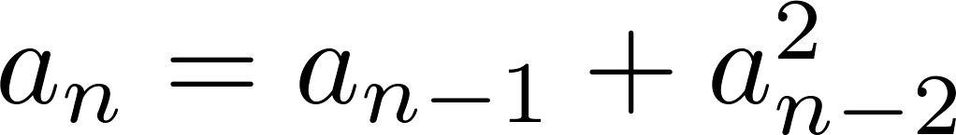
Examples of Linear Homogeneous Recurrence
P_{n} = (1.11)P_{n-1} linear homogeneous recurrence relation of degree one
f_{n} = f_{n-1} + f_{n-2} linear homogeneous recurrence relation of degree two
not linear
H_{n} = 2H_{n−1} + 1 not homogeneous
B_{n} = nB_{n−1} coefficients are not constants

Slide 5
Solving Linear Homogeneous Recurrences
Look for solutions of the form a_{n} = r^{n}, where r is a constant.
Note that a_{n} = r^{n} is a solution to the recurrence relation a_{n} = c₁a_{n−1} + c₂a_{n−2} + ⋯ + c_{k} a_{n−k} if and only if r^{n} = c₁r^{n−1} + c₂r^{n−2} + ⋯ + c_{k} r^{n−k} .
Algebraic manipulation yields the characteristic equation:
r^{k} − c₁r^{k−1} − c₂r^{k−2} − ⋯ − c_{k−1}r − c_{k} = 0
The sequence {a_{n}} with a_{n} = r^{n} is a solution if and only if r is a solution to the characteristic equation.
The solutions to the characteristic equation are called the characteristic roots of the recurrence relation. The roots are used to give an explicit formula for all the solutions of the recurrence relation.

Slide 6
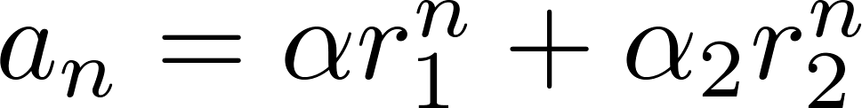
Homogeneous Recurrence Relations of Degree Two
Theorem 1: Let c₁ and c₂ be real numbers. Suppose that r² – c₁r – c₂ = 0 has two distinct roots r₁ and r₂. Then the sequence {a_{n}} is a solution to the recurrence relation a_{n} = c₁a_{n−1} + c₂a_{n−2} if and only if
for n = 0,1,2,… , where α₁ and α₂ are constants.

Slide 7
Using Theorem 1
Example: What is the solution to the recurrence relation
a_{n} = a_{n−1} + 2a_{n−2} with a₀ = 2 and a₁ = 7?
Solution: The characteristic equation is
r² − r − 2 = 0.
Its roots are r = 2 and r = −1 . Therefore, {a_{n}} is a solution to the recurrence relation if and only if a_{n} = α₁2^{n} + α₂(−1)^{n}, for some constants α₁ and α₂.
To find the constants α₁ and α₂, note that
a₀ = 2 = α₁ + α₂ and a₁ = 7 = α₁2 + α₂(−1).
Solving these equations, we find that α₁ = 3 and α₂ = −1.
Hence, the solution is the sequence {a_{n}} with a_{n} = 3∙2^{n} − (−1)^{n}.

Slide 8
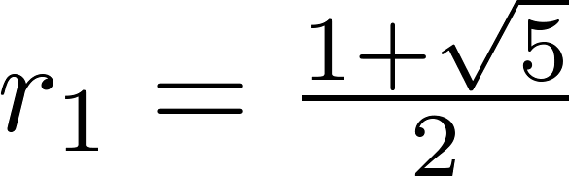
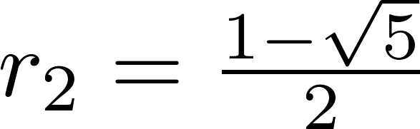
An Explicit Formula for the Fibonacci Numbers
We can use Theorem 1 to find an explicit formula for the Fibonacci numbers. The sequence of Fibonacci numbers satisfies the recurrence relation f_{n} = f_{n−1} + f_{n−2} with the initial conditions: f₀ = 0 and f₁ = 1.
Solution: The roots of the characteristic equation r² – r – 1 = 0 are

Slide 9
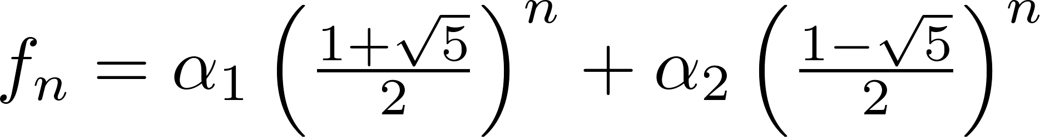
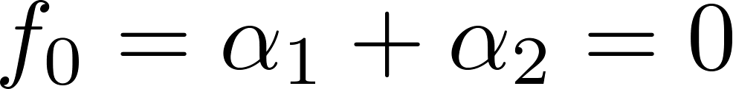
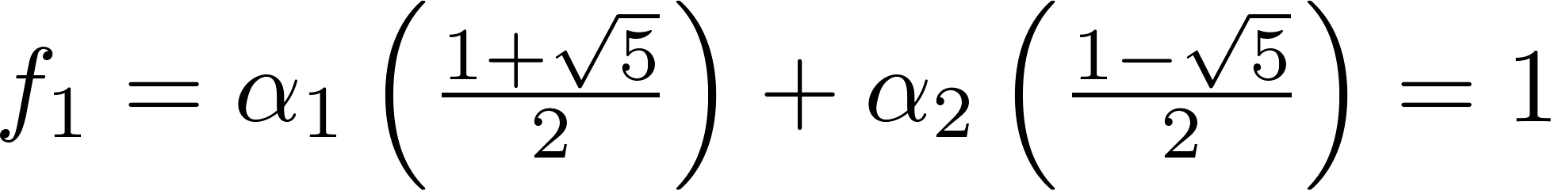
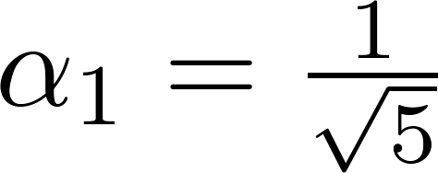
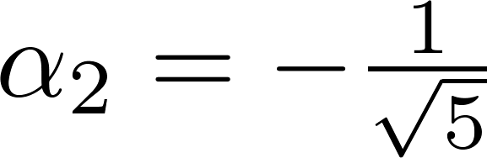
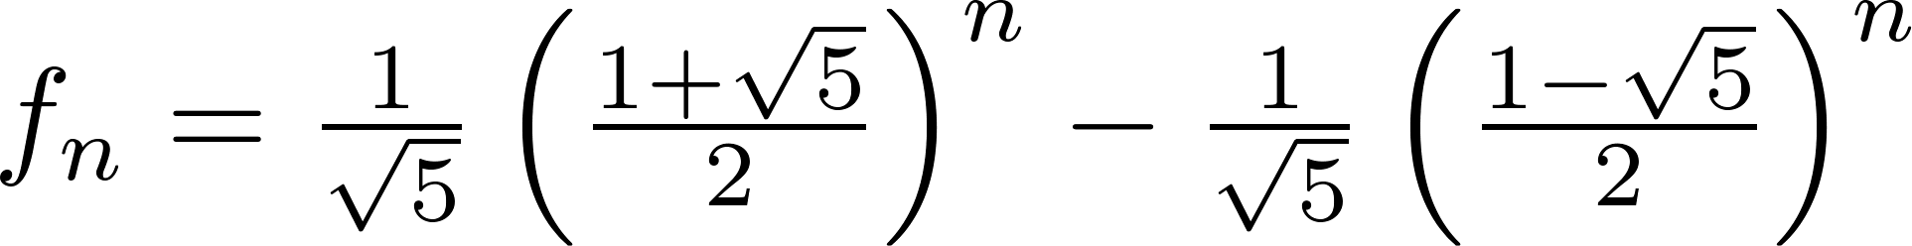
Fibonacci Numbers (continued)
Therefore by Theorem 1
for some constants α₁ and α₂.
Using the initial conditions f₀ = 0 and f₁ = 1 , we have
Solving, we obtain .
Hence,
.

Slide 10


Illustration with Domino Tilings
How many ways to fill rectangle 2x8 with dominoes 1x2?
Can reduce to 2x6 and 2x7 problems.

Slide 11
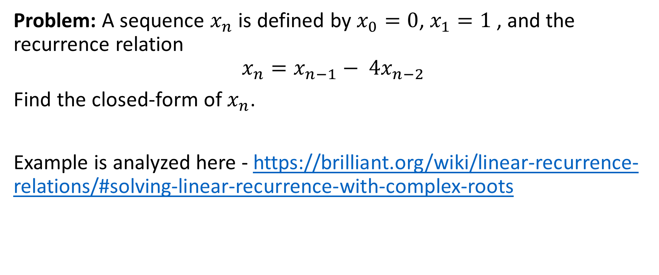
Linear Recurrences with Complex Roots
Problem: A sequence $x_{n}$​ is defined by $x_{0}=0$, $x_{1}=1$ , and the recurrence relation
$$x_{n}=x_{n−1}− 4x_{n−2}$$
Find the closed-form of $x_{n}$.
Example is analyzed here - https://brilliant.org/wiki/linear-recurrence-relations/#solving-linear-recurrence-with-complex-roots

Slide 12
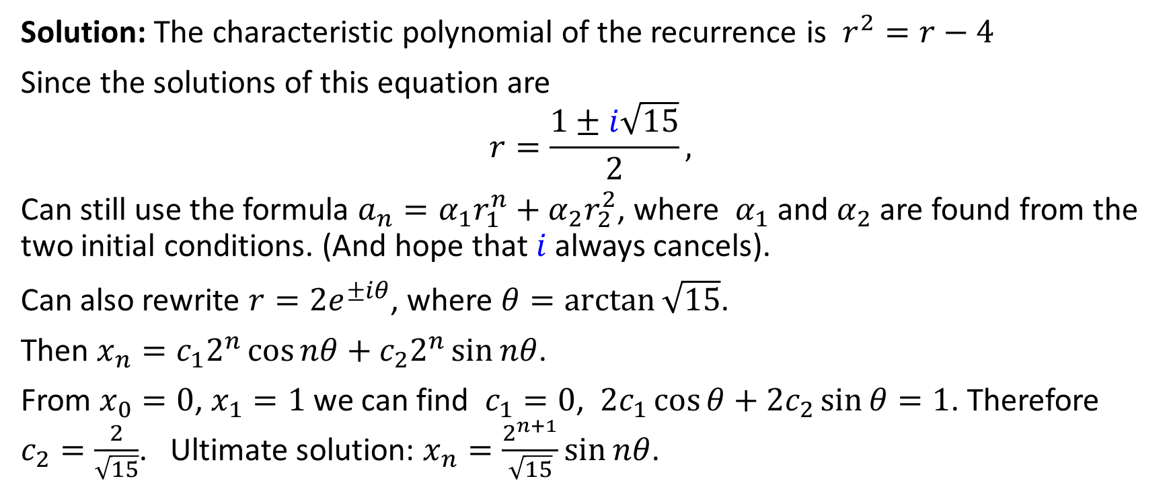
Solving the Recurrence
Solution: The characteristic polynomial of the recurrence is $r^{2}=r−4$
Since the solutions of this equation are
$$r=\frac{1±i\sqrt{15}}{2},$$
Can still use the formula $a_{n}=α_{1}r_{1}^{n}+α_{2}r_{2}^{2}$, where $α_{1}$ and $α_{2}$ are found from the two initial conditions. (And hope that $i$ always cancels).
Can also rewrite $r=2e^{±iθ}$, where $θ=\arctan{\sqrt{15}}$.
Then $x_{n}=c_{1}2^{n}\cos{nθ}+c_{2}2^{n}\sin{nθ}$.
From $x_{0}=0$, $x_{1}=1$ we can find $c_{1}=0$, ${2c}_{1}\cos{θ+2c_{2}\sin{θ}}=1$. Therefore $c_{2}=\frac{2}{\sqrt{15}}$. Ultimate solution: $x_{n}=\frac{2^{n+1}}{\sqrt{15}}\sin{nθ}$.

Slide 13
Finding the Recurrence in Python
x=[0,1]
for i in range(2,21):
x.append(x[i-1] - 4*x[i-2])
[0, 1, 1, -3, -7, 5, 33, 13, -119, -171, 305, 989, -231, -4187, -3263, 13485, 26537, -27403, -133551, -23939, 510265]
More complicated pattern how positive and negative values mix.
In fact, it is a sum of two (complex) geometric progressions, where imaginary parts cancel out.

Slide 14
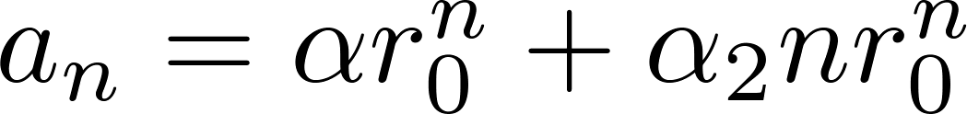
The Solution when there is a Repeated Root
Theorem 2: Let c₁ and c₂ be real numbers with c₂ ≠ 0. Suppose that r² – c₁r – c₂ = 0 has one repeated root r₀. Then the sequence {a_{n}} is a solution to the recurrence relation a_{n} = c₁a_{n−1} + c₂a_{n−2} if and only if
for n = 0,1,2,… , where α₁ and α₂ are constants.

Slide 15
Using Theorem 2
Example: What is the solution to the recurrence relation a_{n} = 6a_{n−1} − 9a_{n−2} with a₀ = 1 and a₁ = 6?
Solution: The characteristic equation is r² − 6r + 9 = 0.
The only root is r = 3. Therefore, {a_{n}} is a solution to the recurrence relation if and only if
a_{n} = α₁3^{n} + α₂n(3)^{n}
where α₁ and α₂ are constants.
To find the constants α₁ and α₂, note that
a₀ = 1 = α₁ and a₁ = 6 = α₁ ∙ 3 + α₂ ∙3.
Solving, we find that α₁ = 1 and α₂ = 1 .
Hence, a_{n} = 3^{n} + n3^{n} .

Slide 16
Linear Recurrence Relations of Arbitrary Degree
This theorem can be used to solve linear homogeneous recurrence relations with constant coefficients of any degree when the characteristic equation has distinct roots.
Theorem 3: Let c₁, c₂ ,…, c_{k} be real numbers. Suppose that the characteristic equation
r^{k} – c₁r^{k−1} –⋯ – c_{k} = 0
has k distinct roots r₁, r₂, …, r_{k}. Then a sequence {a_{n}} is a solution of the recurrence relation
a_{n} = c₁a_{n−1} + c₂a_{n−2} + ….. + c_{k} a_{n−k}
if and only if
for n = 0, 1, 2, …, where α₁, α₂,…, α_{k} are constants.

Slide 17
The General Case with Repeated Roots Allowed
Theorem 4: Let c₁, c₂ ,…, c_{k} be real numbers. Suppose that the characteristic equation
r^{k} – c₁r^{k−1} –⋯ – c_{k} = 0
has t distinct roots r₁, r₂, …, r_{t} with multiplicities m₁, m₂, …, m_{t}, respectively so that m_{i} ≥ 1 for i = 0, 1, 2, …,t and m₁ + m₂ + … + m_{t} = k. Then a sequence {a_{n}} is a solution of the recurrence relation
a_{n} = c₁a_{n−1} + c₂a_{n−2} + ….. + c_{k} a_{n−k} if and only if
for n = 0, 1, 2, …, where α_{i,j} are constants for 1≤ i ≤ t and 0≤ j ≤ m_{i−1}.

Slide 18
Linear Nonhomogeneous Recurrences – 1
Definition: A linear nonhomogeneous recurrence relation with constant coefficients is a recurrence relation of the form:
a_{n} = c₁a_{n−1} + c₂a_{n−2} + ….. + c_{k} a_{n−k} + F(n) ,
where c₁, c₂, ….,c_{k} are real numbers, and F(n) is a function not identically zero depending only on n.
The recurrence relation
a_{n} = c₁a_{n−1} + c₂a_{n−2} + ….. + c_{k} a_{n−k ,}
is called the associated homogeneous recurrence relation.

Slide 19
Linear Nonhomogeneous Recurrences – 2
The following are linear nonhomogeneous recurrence relations with constant coefficients:
a_{n} = a_{n−1} + 2^{n} ,
a_{n} = a_{n−1} + a_{n−2} + n² + n + 1,
a_{n} = 3a_{n−1} + n3^{n} ,
a_{n} = a_{n−1} + a_{n−2} + a_{n−3} + n!
where the following are the associated linear homogeneous recurrence relations, respectively:
a_{n} = a_{n−1 ,}
a_{n} = a_{n−1} + a_{n−2},
a_{n} = 3a_{n−1} ,
a_{n} = a_{n−1} + a_{n−2} + a_{n−3}

Slide 20
Linear Nonhomogeneous Recurrences – 3
Theorem 5: If {a_{n}^{(p)}} is a particular solution of the nonhomogeneous linear recurrence relation with constant coefficients
a_{n} = c₁a_{n−1} + c₂a_{n−2} + ⋯ + c_{k} a_{n−k} + F(n) ,
then every solution is of the form {a_{n}^{(p)} + a_{n}^{(h)}}, where {a_{n}^{(h)}} is a solution of the associated homogeneous recurrence relation
a_{n} = c₁a_{n−1} + c₂a_{n−2} + ⋯ + c_{k} a_{n−k .}

Slide 21
Linear Nonhomogeneous Recurrences – 4
Example: Find all solutions of the recurrence relation a_{n} = 3a_{n−1} + 2n.
What is the solution with a₁ = 3?
Solution: The associated linear homogeneous equation is a_{n} = 3a_{n−1}. Its solutions are a_{n}^{(h)} = α3^{n}, where α is a constant.
Because F(n)= 2n is a polynomial in n of degree one, to find a particular solution we might try a linear function in n, say p_{n} = cn + d, where c and d are constants. Suppose that p_{n} = cn + d is such a solution.
Then a_{n} = 3a_{n−1} + 2n becomes cn + d = 3(c(n− 1) + d)+ 2n.
Simplifying yields (2 + 2c)n + (2d − 3c) = 0. We get that cn + d is a solution if and only if
2 + 2c = 0 and 2d − 3c = 0. Therefore, cn + d is a solution iff c = − 1 and d = − 3/2.
Consequently, a_{n}^{(p)} = −n − 3/2 is a particular solution.
By Theorem 5, all solutions are of the form a_{n} = a_{n}^{(p)} + a_{n}^{(h)} = −n − 3/2 + α3^{n}, where α is a constant.
To find the solution with a₁ = 3, let n = 1 in the above formula for the general solution.
Then 3 = −1 − 3/2 + 3 α, and α = 11/6. Hence solution a_{n} = −n − 3/2 + (11/6)3^{n}.

