Slide 1
n-ary Relations and their Applications
Section 9.2
Notes:
Some sources of inspiration
http://www.cbcb.umd.edu/confcour/Spring2014/CMSC424/Relational_algebra.pdf
https://www.guru99.com/relational-algebra-dbms.html
https://db.inf.uni-tuebingen.de/staticfiles/teaching/ss09/db1/db1-03.pdf
https://mboehm7.github.io/teaching/ss19_dbs/04_RelationalAlgebra.pdf

Slide 2
Section Summary
N-ary relations and tabular data
Relational Algebra
Aggregate operations and visualizations
Applications of n-ary relational data for business analytics

Slide 3
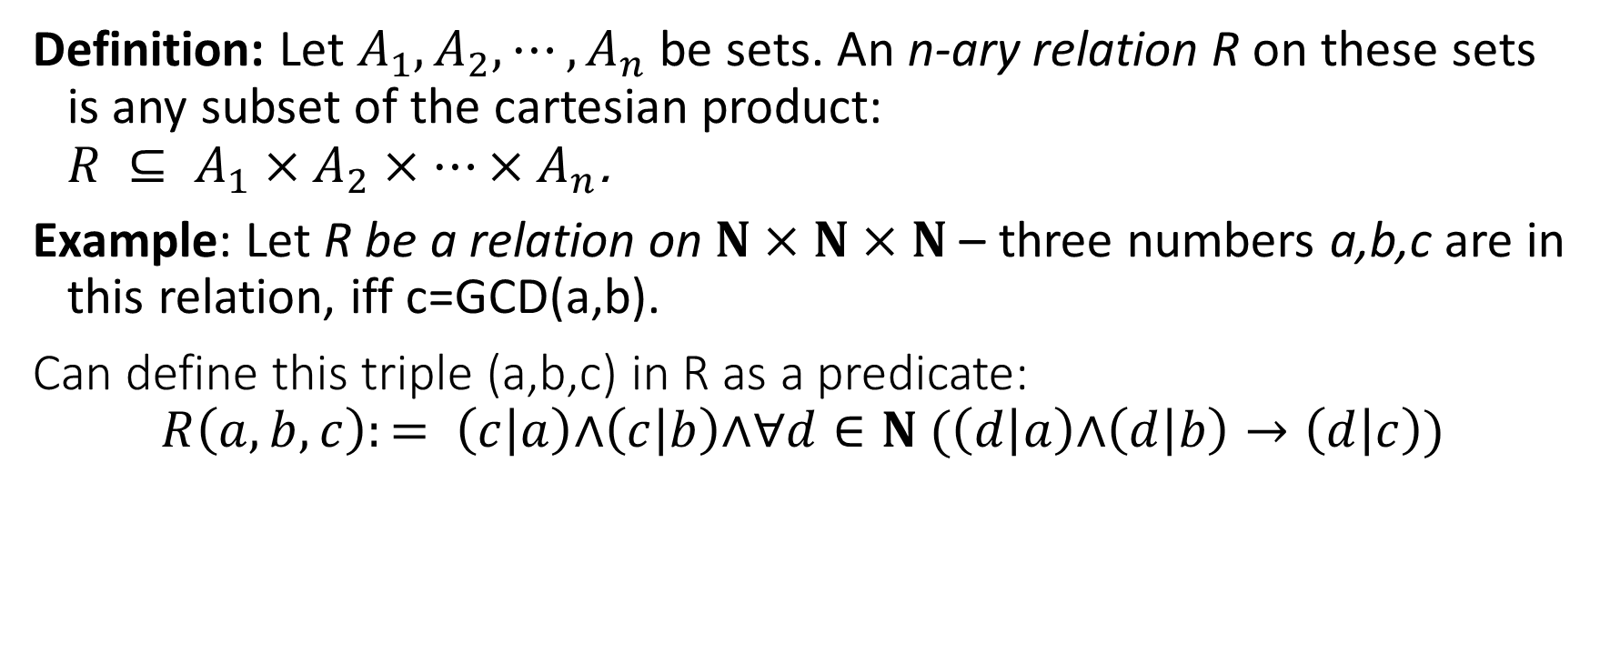
N-ary Relations
Definition: Let $A_{1},A_{2},⋯,A_{n}$ be sets. An n-ary relation R on these sets is any subset of the cartesian product: $R ⊆ A_{1}×A_{2}×⋯×A_{n}$.
Example: Let R be a relation on $N×N×N$ – three numbers a,b,c are in this relation, iff c=GCD(a,b).
Can define this triple (a,b,c) in R as a predicate:
$$R\left(a,b,c\right):= \left(c | a\right)\text{∧}\left(c | b\right)\text{∧}∀d∈N (\left(d | a\right)\text{∧}\left(d | b\right)→\left(d | c\right))$$
Question for the midterm: In the predicate expression, find the free variables and the bound variables.

Slide 4
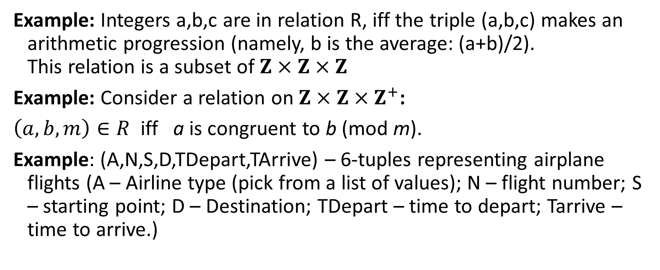
Other Examples
Example: Integers a,b,c are in relation R, iff the triple (a,b,c) makes an arithmetic progression (namely, b is the average: (a+b)/2). This relation is a subset of $Z×Z×Z$
Example: Consider a relation on $Z×Z×Z^{+}$:
$\left(a,b,m\right)∈R$ iff a is congruent to b (mod m).
Example: (A,N,S,D,TDepart,TArrive) – 6-tuples representing airplane flights (A – Airline type (pick from a list of values); N – flight number; S – starting point; D – Destination; TDepart – time to depart; Tarrive – time to arrive.)

Slide 5
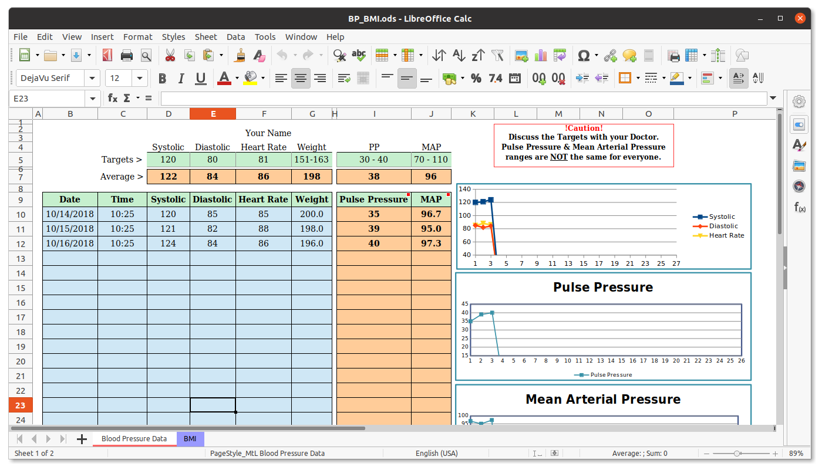
Spreadsheet Data vs. Relational Data
Spreadsheets may allow different data types in columns.
Arrange data items into 2 dimensions for easy entry and some initial analysis.
Relational Data
Relational Database systems (MySQL, Maria DB, Microsoft SQL server, Oracle, PostgreSQL, etc.)
In-memory databases (dataframes in R/RStudio – statistics tool; or Python library Pandas).
(Not all modern databases are relational; there are hierarchical "NoSQL style" databases e.g. in Google Firebase, MongoDB, other JSON data, etc.)
Still, SQL is a necessary part of our culture.

Slide 6
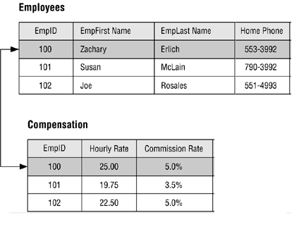
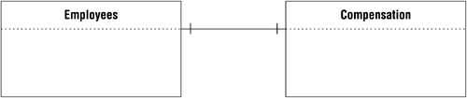
Entity Relations in a Database: 1-1 Relations
But there are also binary relations between the records
In this case, the tuple (100, Zachary, Erlich, 553-3992) is in the relation with another tuple: (100,25.00,5.0%)
In some cases the binary relationship is 1-to-1.
Access rights
Etc. May differ
Every table is a relation
(4-ary relation for employees)
(3-ary relation for compensation details)
Notes:
Can you do one very large table?

Slide 7
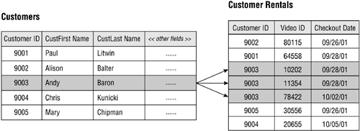
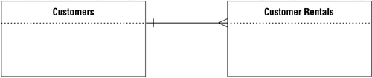
Entity Relations in a Database: 1-n Relations
The relationship between the tuples is named 1-to-many relation.
Can draw "crow feet"
Tuples correspond to Customers and their Video-rentals.
One customer may have multiple rentals (but each rental event has only one customer)

Slide 8
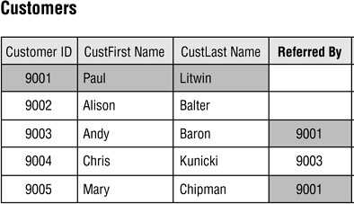
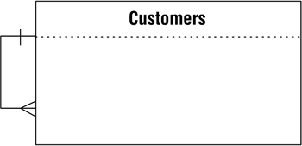
Self-Referring Relations
Just another flavor of one-to-many relation; in this case the binary relation is from the set "Customers" with itself.
Sometimes customer tables have one customer record in relation with another record in the same table.

Slide 9
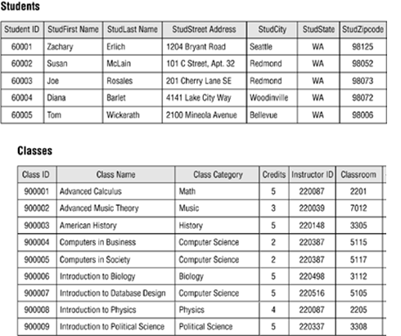
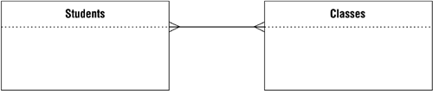
Many to Many relations
Student may take multiple classes; each class may have multiple students.
The relation in this case is many-to-many.
RegDate | StudentID | ClassID
2021-01-03 | 6001 | 900001
2021-01-03 | 6001 | 900006
2021-01-04 | 6002 | 900006
Can introduce "Class-Registration" table to store student-class relations.

Slide 10
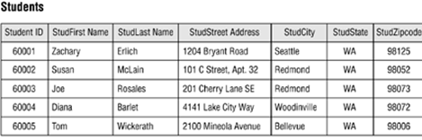
Primary Keys
In many relational tables there is one (or a few columns) that uniquely determine the n-ary tuple.
They are called Primary Keys.
Can be auto-generated IDs.
Can be unique combinations (e.g. if (firstname,lastname) do not repeat in the relation)). These are called composite primary keys.

Slide 11
Intension vs. Extension
N-ary relations may insert new tuples or update old ones).
There may be various cases:
If updates are frequent – use regular RDBMS (PostgreSQL)
If updates are rare – can also use "directories/registries" (such as Microsoft Active Directory or LDAP) – often non-relational.
If no updates – this is "Data Mining" scenario.
Intension (or DB Schema) is the table structure (+primary keys and other restrictions) is something that is stable across updates.
Extension (or DB contents) is the stuff that is currently inserted.
Define columns;
primary keys

Slide 12
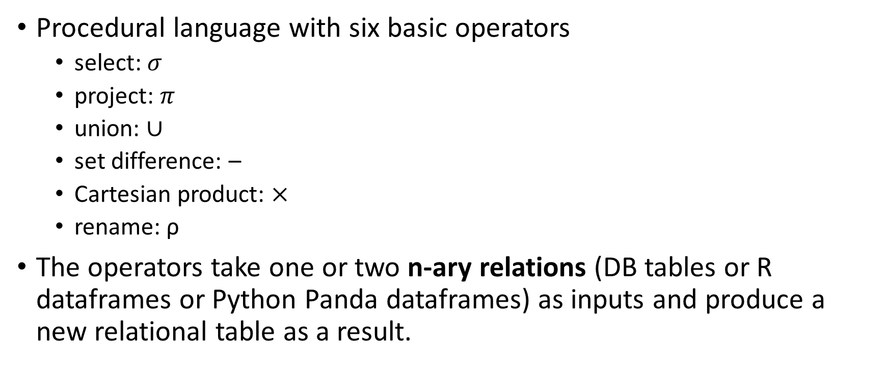
Relational Algebra
Procedural language with six basic operators
select: $σ$
project: $π$
union: $∪$
set difference: –
Cartesian product: $×$
rename: ρ
The operators take one or two n-ary relations (DB tables or R dataframes or Python Panda dataframes) as inputs and produce a new relational table as a result.

Slide 13
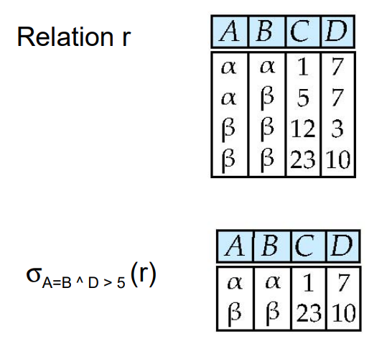
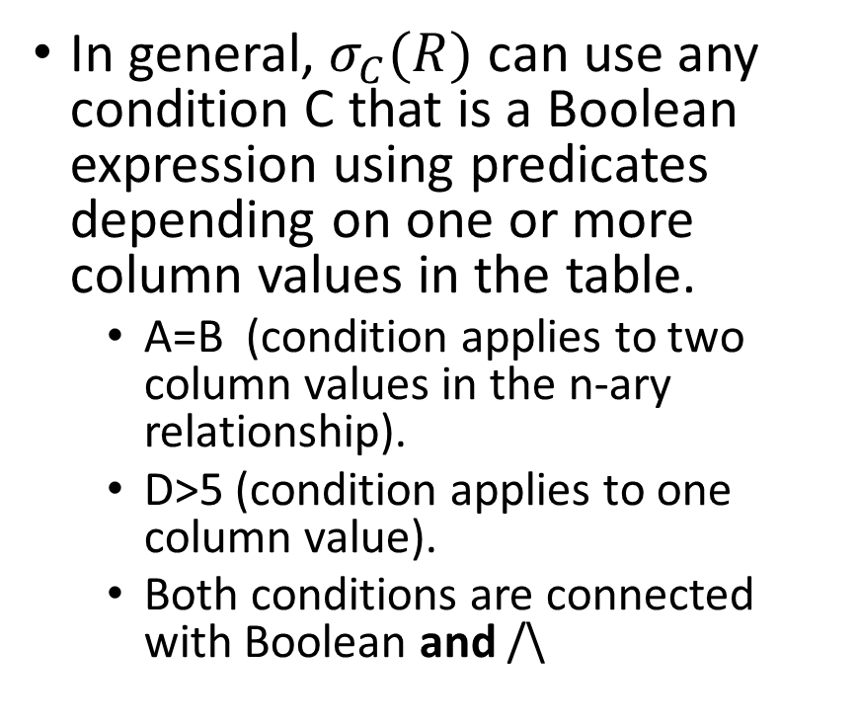
Select Operation – 1
In general, $σ_{C}(R)$ can use any condition C that is a Boolean expression using predicates depending on one or more column values in the table.
A=B (condition applies to two column values in the n-ary relationship).
D>5 (condition applies to one column value).
Both conditions are connected with Boolean and /\
For the enthusiasts of SQL (this course does not ask you to write this): SELECT FROM r WHERE r.A=r.B AND r.D>5

Slide 14
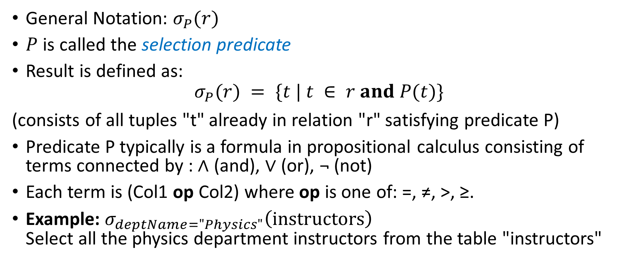
Select Operation – 2
General Notation: $σ_{P}(r)$
$P$ is called the selection predicate
Result is defined as:
$$σ_{P}(r) = \{t | t ∈ r and P(t)\}$$ (consists of all tuples "t" already in relation "r" satisfying predicate P)
Predicate P typically is a formula in propositional calculus consisting of terms connected by : ∧ (and), ∨ (or), ¬ (not)
Each term is (Col1 op Col2) where op is one of: =, ≠, >, ≥.
Example: $σ_{deptName="Physics"}\left(instructors\right)$ Select all the physics department instructors from the table "instructors"

Slide 15
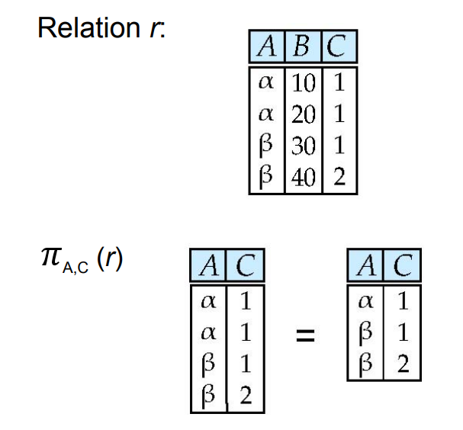
Projection
The result is defined as the relation of k columns obtained by erasing the columns that are not listed
Duplicate rows removed from result, since n-ary relations are sets (subsets of the Cartesian products).
Pick only relevant columns; drop all the others.

Slide 16
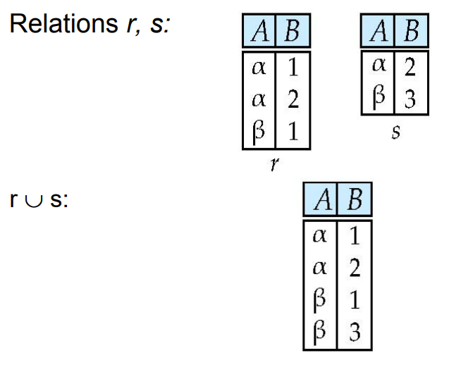
Union Operation
Notation: r ∪ s
Defined as: r ∪ s = {t | t ∈ r or t ∈ s}
For r ∪ s to be valid.
r, s must have the same arity (same attributes/columns)
The attribute domains/types must be compatible
Create one table out of two (must be identical structure)

Slide 17
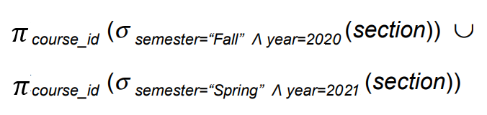
Putting Stuff together
Example: Find all courses taught in the Fall 2020 semester, or in the Spring 2021 semester, or in both.
Algebraic expression uses selection, then projection, then union.

Slide 18
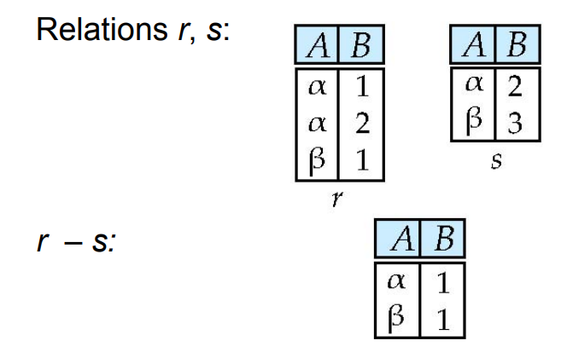
Set Difference of Two Relations
Notation r – s
Defined as:
r – s = {t | t ∈ r and t ∉ s}
Set differences must be taken between compatible relations.
r and s must have the same arity
The attribute domains of r and s must be compatible
Example: find all courses taught in the Fall 2020 semester, but not in the Spring 2021 semester
Just the set difference (consider n-ary relations as subsets from the same universe – the Cartesian product).

Slide 19
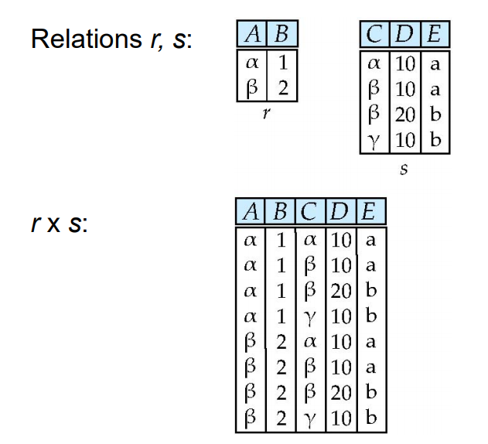
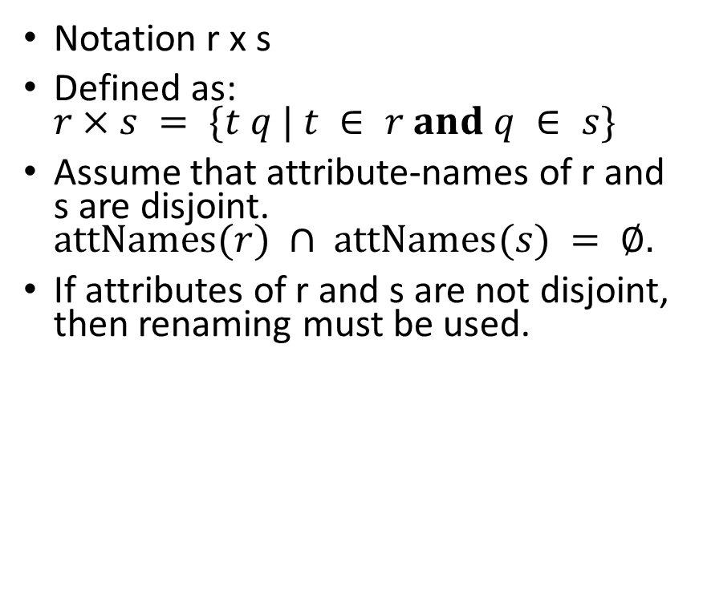
Cartesian Product of n-ary Relations
Notation r x s
Defined as: $r×s = \{t q | t ∈ r and q ∈ s\}$
Assume that attribute-names of r and s are disjoint. $attNames(r) ∩ attNames(s) = ∅.$
If attributes of r and s are not disjoint, then renaming must be used.
It will contain |r|*|s| records.
Typically we want to select some interesting combinations – do not want everything.

Slide 20
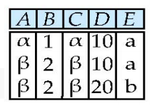
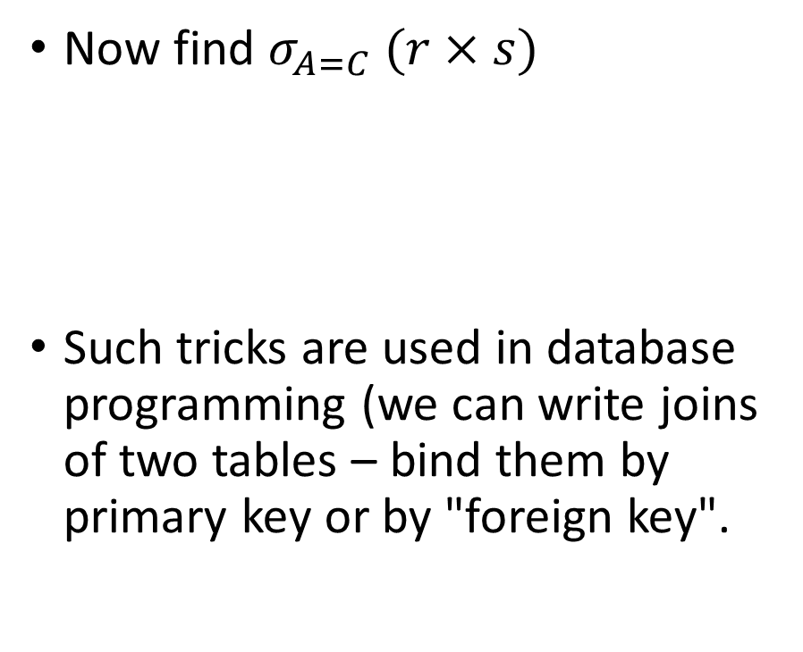
Combining Cartesian-Product and Select
PK
FK
Now find $σ_{A=C} (r×s)$
Such tricks are used in database programming (we can write joins of two tables – bind them by primary key or by "foreign key".

Slide 21

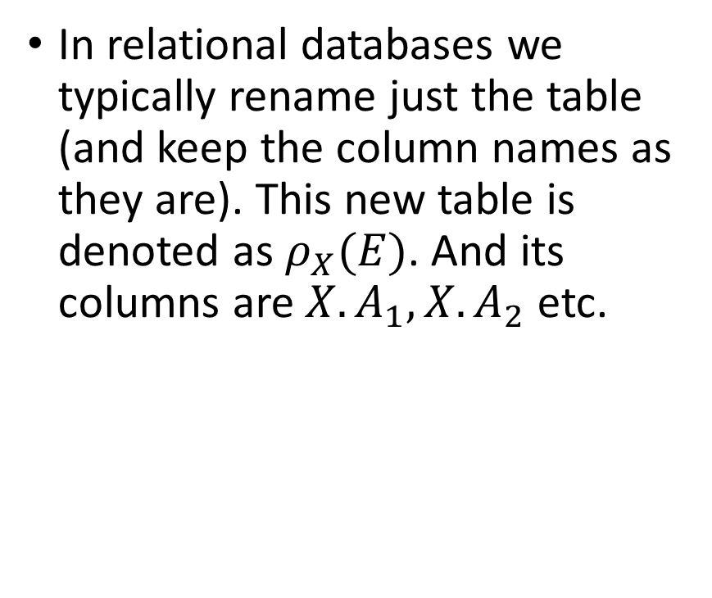
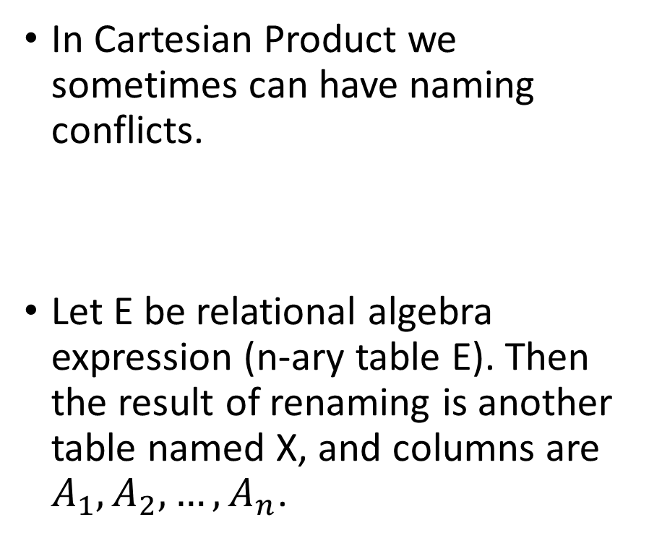
Renaming Operator
In Cartesian Product we sometimes can have naming conflicts.
Let E be relational algebra expression (n-ary table E). Then the result of renaming is another table named X, and columns are $A_{1},A_{2}, …,A_{n}$.
In relational databases we typically rename just the table (and keep the column names as they are). This new table is denoted as $ρ_{X}(E)$. And its columns are ${X.A}_{1},X.A_{2}$ etc.

Slide 22
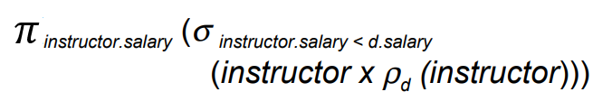
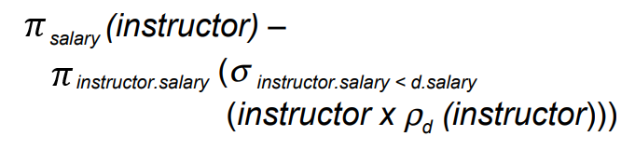
Examples – 1
Find the largest salary in the university:
Step 1: Find instructor salaries that are less than some other instructor salary (i.e. not maximum) –using a copy of instructor under a new name d.
Step 2: Find the largest salary

Slide 23
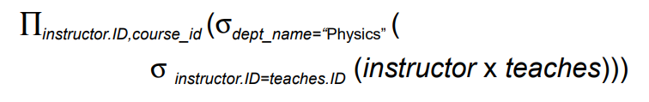
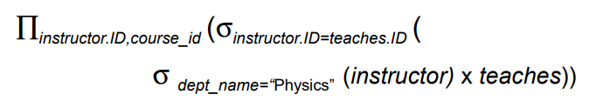
Examples – 2
Example: Find the names of all instructors in the Physics department, along with the course_id of all courses they have taught.
Two solutions:

Slide 24
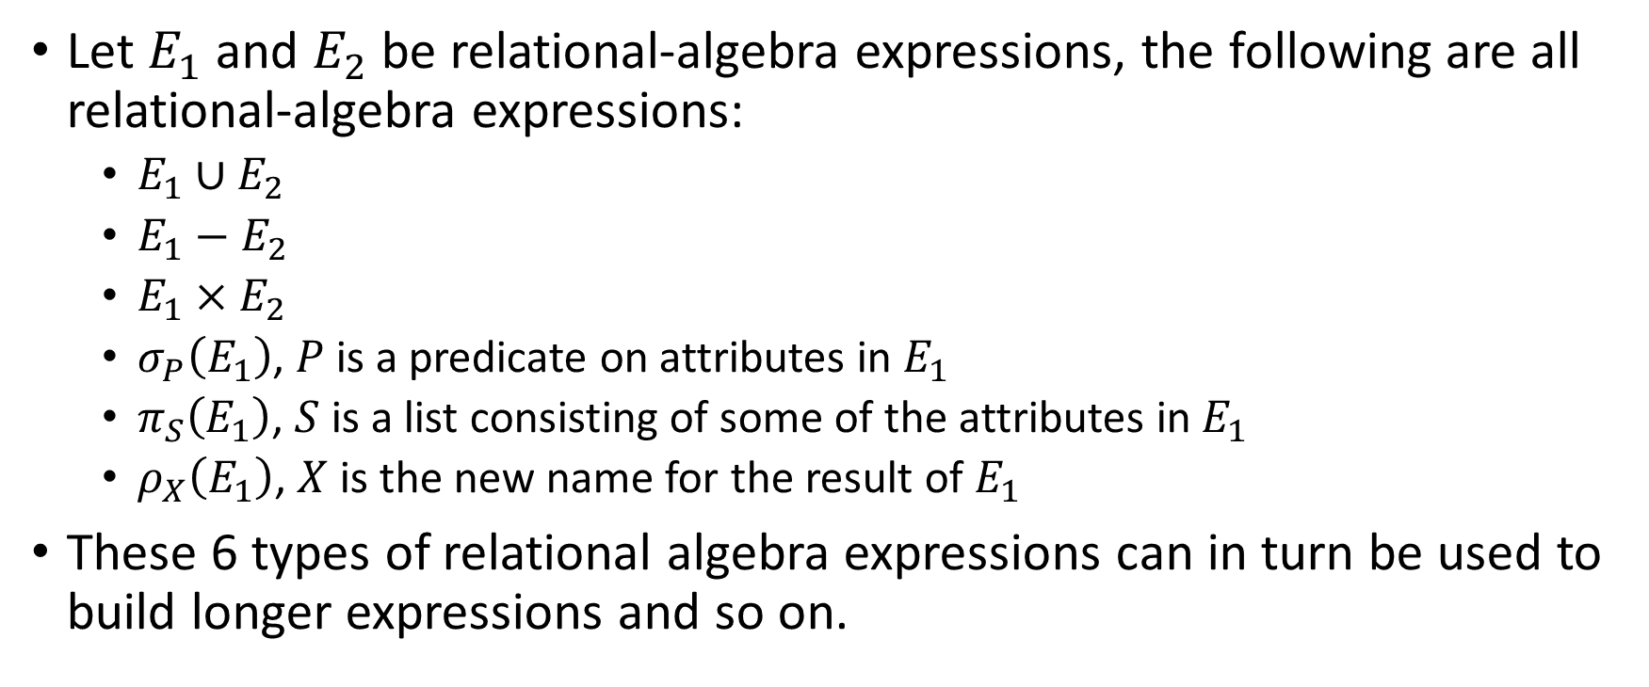
Relation Algebra: Formal Definition
Let $E_{1}$ and $E_{2}$ be relational-algebra expressions, the following are all relational-algebra expressions:
$E_{1}∪E_{2}$
$E_{1}−E_{2}$
$E_{1}×E_{2}$
$σ_{P}\left(E_{1}\right)$, $P$ is a predicate on attributes in $E_{1}$
$π_{S}\left(E_{1}\right)$, $S$ is a list consisting of some of the attributes in $E_{1}$
$ρ_{X}\left(E_{1}\right)$, $X$ is the new name for the result of $E_{1}$
These 6 types of relational algebra expressions can in turn be used to build longer expressions and so on.

Slide 25
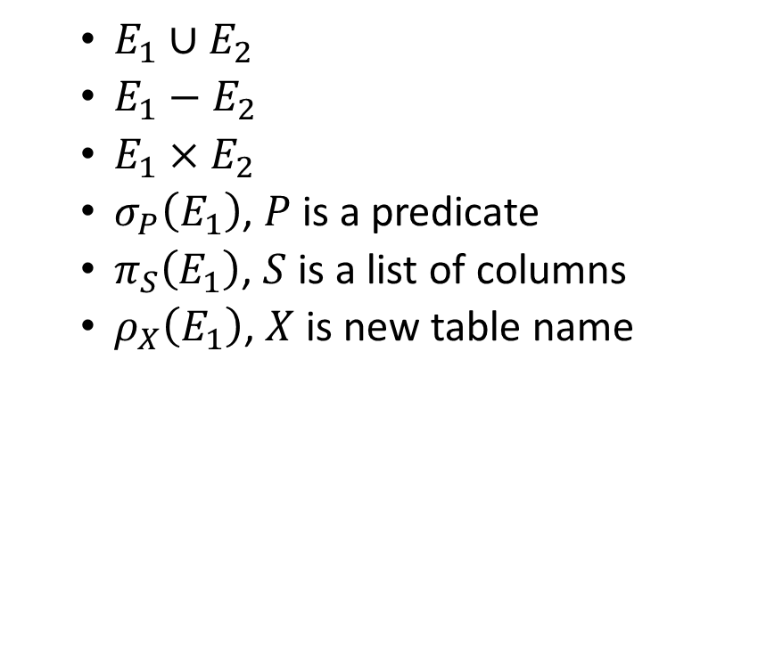

Some Additional Operations
Problem: Express intersection of two relational tables using the basic operations.
$E_{1}∩E_{2}$ consists of all n-tuples belonging to both expressions.
$E_{1}∪E_{2}$
$E_{1}−E_{2}$
$E_{1}×E_{2}$
$σ_{P}\left(E_{1}\right)$, $P$ is a predicate
$π_{S}\left(E_{1}\right)$, $S$ is a list of columns
$ρ_{X}\left(E_{1}\right)$, $X$ is new table name

Slide 26
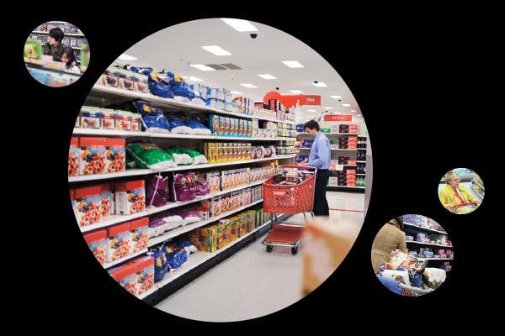
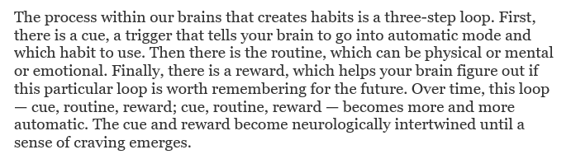
Decoding/Changing Shopping Habits
How Companies Learn your Secrets by Charles Duhigg, (the author of "The Power of Habit")
New York Times (2012-02-16)
Data Analyst work at "Target" supermarket chain.

Slide 27
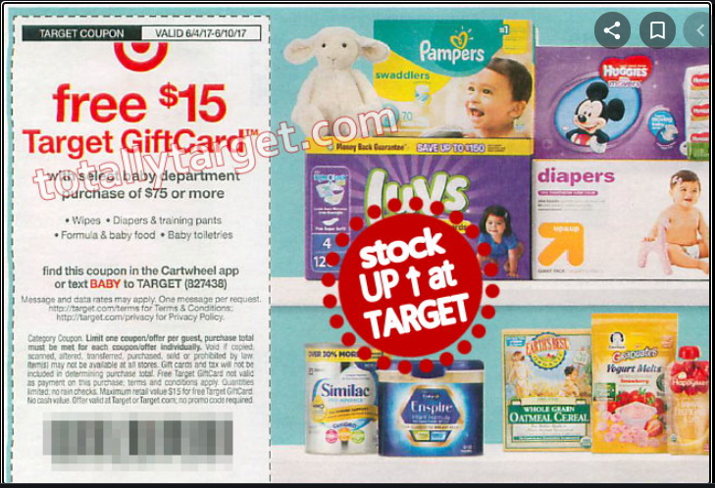
More precise advertising
Large packs of unscented lotion
Food supplements like calcium, magnesium and zinc
Scent-free soap
Extra-big bags of cotton balls
Hand sanitizers and washcloths
Usually – there is little point to offer coupons for stuff that customers are already buying. (They will use coupons and spend less money.)
Considerable gains, if you can predict other products and cross-sale.

Slide 28
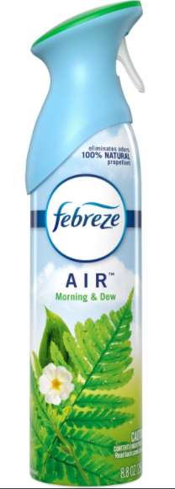
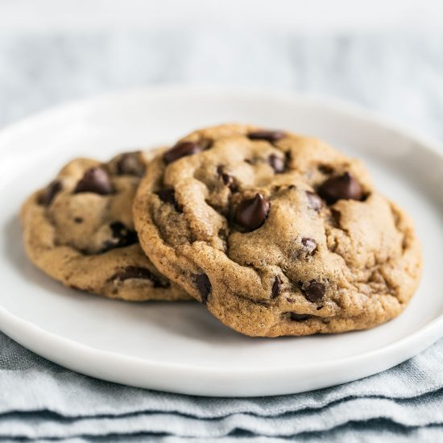
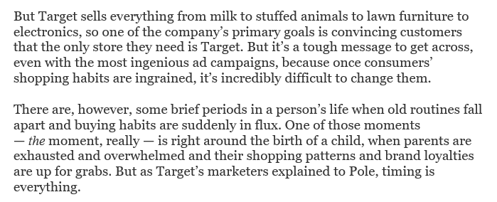
Association Rule Learning
Experience by Charles Duhigg:
Dropping a "cookie-eating habit".
Ingraining a new habit:
Selling "Febreze" by Procter&Gamble
Databases (collections of n-ary relations) used for learning.
Help customers to form new habits.
Learn about cues and rewards → Insert a new routine.
Also applies to house-cleaning routines – the ability to sell cleaning products.
Notes:
Where are you? (Sitting at my desk.)
What time is it? (3:36 p.m.)
What’s your emotional state? (Bored.)
Who else is around? (No one.)
What action preceded the urge? (Answered an e-mail.)
The next day I did the same thing. And the next. Pretty soon, the cue was clear: I always felt an urge to snack around 3:30.

Slide 29
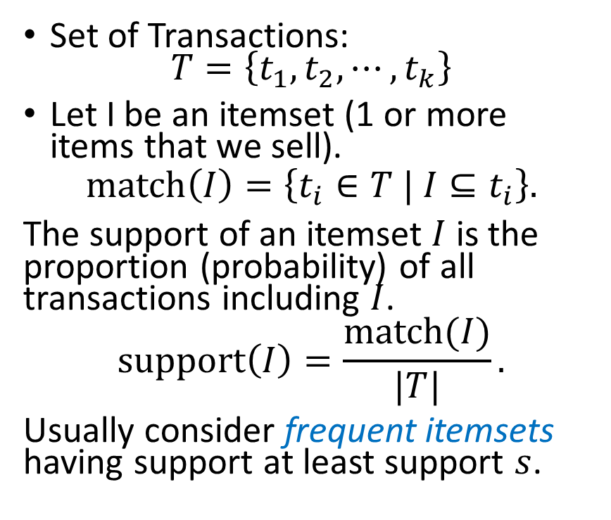
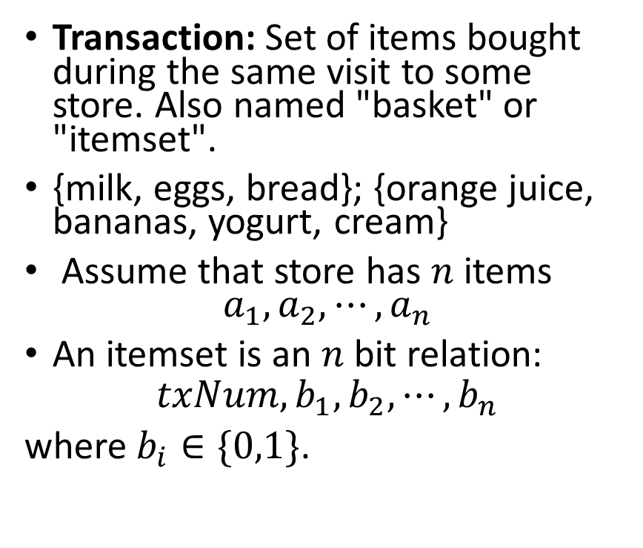
Some Definitions
Transaction: Set of items bought during the same visit to some store. Also named "basket" or "itemset".
{milk, eggs, bread}; {orange juice, bananas, yogurt, cream}
Assume that store has $n$ items $a_{1},a_{2},⋯,a_{n}$
An itemset is an $n$ bit relation:
$$txNum,b_{1},b_{2},⋯,b_{n}$$
where $b_{i}∈\{0,1\}$.
Set of Transactions: $T=\left\{t_{1},t_{2},⋯,t_{k}\right\}$
Let I be an itemset (1 or more items that we sell).
$$match\left(I\right)=\left\{t_{i}∈T | I⊆t_{i}\right\}.$$
The support of an itemset $I$ is the proportion (probability) of all transactions including $I$.
$$support\left(I\right)=\frac{match(I)}{|T|}.$$
Usually consider frequent itemsets having support at least support $s$.

Slide 30
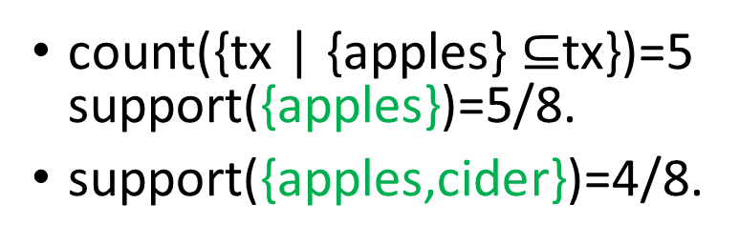
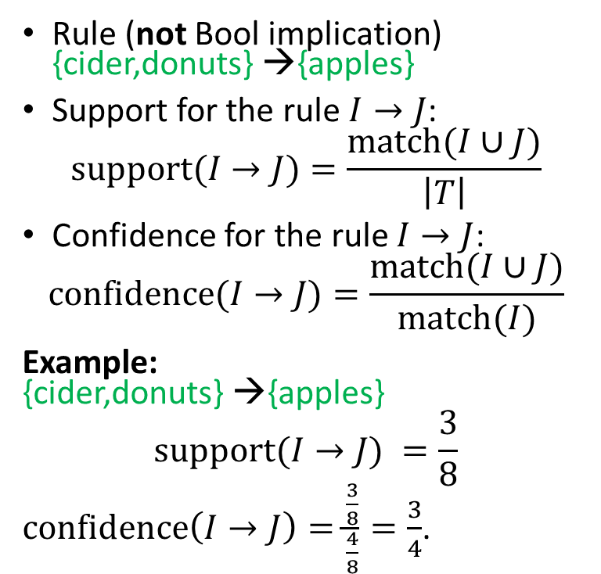
Support and Confidence for Assoc. Rules
TxNum | Apples | Pears | Cider | Donuts | Mangos
1 | 1 | 1 | 0 | 0 | 1
2 | 0 | 1 | 1 | 0 | 0
3 | 1 | 0 | 1 | 1 | 1
4 | 1 | 1 | 1 | 1 | 0
5 | 1 | 0 | 1 | 1 | 0
6 | 0 | 1 | 1 | 1 | 0
7 | 0 | 1 | 0 | 1 | 0
8 | 1 | 1 | 1 | 0 | 0
Rule (not Bool implication) {cider,donuts} →{apples}
Support for the rule $I→J$:
$$support(I→J)=\frac{match(I∪J)}{\left|T\right|}$$
Confidence for the rule $I→J$:
$$confidence(I→J)=\frac{match(I∪J)}{match(I)}$$
Example: {cider,donuts} →{apples}
$$support(I→J) =\frac{3}{8}$$
$confidence\left(I→J\right)=\frac{\frac{3}{8}}{\frac{4}{8}}=\frac{3}{4}$.
count({tx | {apples} $⊆$tx})=5 support({apples})=5/8.
support({apples,cider})=4/8.

Slide 31
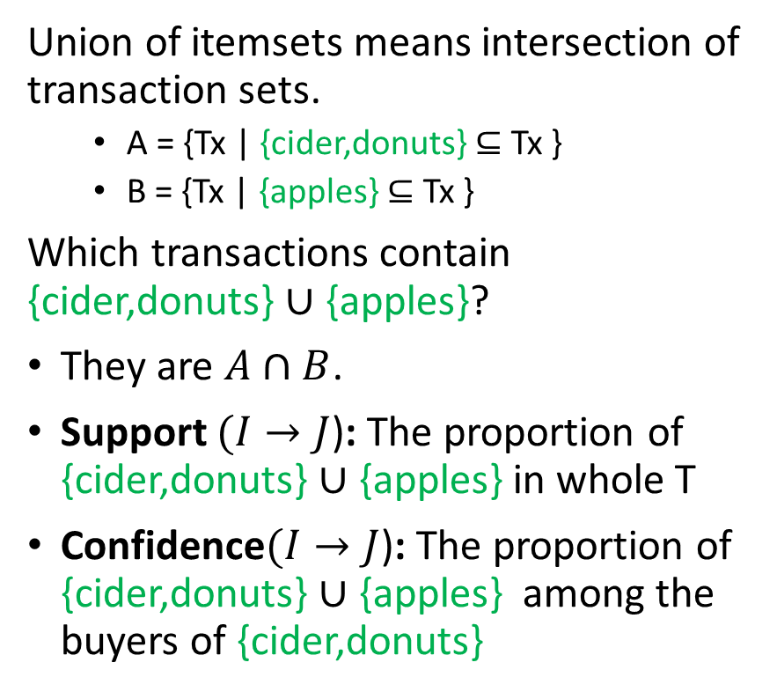
Illustration in a Venn Diagram
Union of itemsets means intersection of transaction sets.
A = {Tx | {cider,donuts} $⊆$ Tx }
B = {Tx | {apples} $⊆$ Tx }
Which transactions contain {cider,donuts} $∪$ {apples}?
They are $A∩B$.
Support $(I→J$): The proportion of {cider,donuts} $∪$ {apples} in whole T
Confidence$(I→J$): The proportion of {cider,donuts} $∪$ {apples} among the buyers of {cider,donuts}
Universe T: All transactions
I={cider,donuts}
A
B
J={apples}

