Slide 1
Spanning Trees
Section 11.4

Slide 2
Section Summary
Spanning Trees
Depth-First Search
Breadth-First Search
Backtracking Applications (not currently included in overheads)
Depth-First Search in Directed Graphs

Slide 3
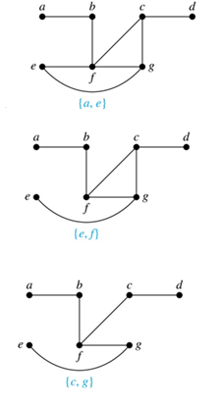
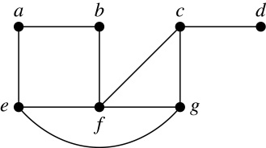
Spanning Trees
Definition: Let G be a simple graph. A spanning tree of G is a subgraph of G that is a tree containing every vertex of G.
Example: Find the spanning tree of this simple graph:
Solution: The graph is connected, but is not a tree because it contains simple circuits. Remove the edge {a, e}. Now one simple circuit is gone, but the remaining subgraph still has a simple circuit. Remove the edge {e, f} and then the edge {c, g} to produce a simple graph with no simple circuits. It is a spanning tree, because it contains every vertex of the original graph.

Slide 4
Spanning Trees (continued)
Theorem: A simple graph is connected if and only if it has a spanning tree.
Proof: Suppose that a simple graph G has a spanning tree T. T contains every vertex of G and there is a path in T between any two of its vertices. Because T is a subgraph of G, there is a path in G between any two of its vertices. Hence, G is connected.
Now suppose that G is connected. If G is not a tree, it contains a simple circuit. Remove an edge from one of the simple circuits. The resulting subgraph is still connected because any vertices connected via a path containing the removed edge are still connected via a path with the remaining part of the simple circuit. Continue in this fashion until there are no more simple circuits. A tree is produced because the graph remains connected as edges are removed. The resulting tree is a spanning tree because it contains every vertex of G.

Slide 5
Depth-First Search
To use depth-first search to build a spanning tree for a connected simple graph first arbitrarily choose a vertex of the graph as the root.
Form a path starting at this vertex by successively adding vertices and edges, where each new edge is incident with the last vertex in the path and a vertex not already in the path. Continue adding vertices and edges to this path as long as possible.
If the path goes through all vertices of the graph, the tree consisting of this path is a spanning tree.
Otherwise, move back to the next to the last vertex in the path, and if possible, form a new path starting at this vertex and passing through vertices not already visited. If this cannot be done, move back another vertex in the path.
Repeat this procedure until all vertices are included in the spanning tree.

Slide 6
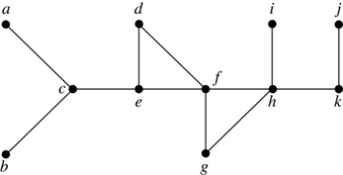
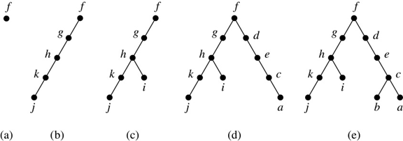
Depth-First Search (continued)
Example: Use depth-first search to find a spanning tree of this graph.
Solution: We start arbitrarily with vertex f. We build a path by successively adding an edge that connects the last vertex added to the path and a vertex not already in the path, as long as this is possible. The result is a path that connects f, g, h, k, and j. Next, we return to k, but find no new vertices to add. So, we return to h and add the path with one edge that connects h and i. We next return to f, and add the path connecting f, d, e, c, and a. Finally, we return to c and add the path connecting c and b. We now stop because all vertices have been added.

Slide 7
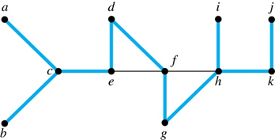
Depth-First Search (continued)
The edges selected by depth-first search of a graph are called tree edges. All other edges of the graph must connect a vertex to an ancestor or descendant of the vertex in the graph. These are called back edges.
In this figure, the tree edges are shown with heavy blue lines. The two thin black edges are back edges.

Slide 8
Depth-First Search Algorithm
We now use pseudocode to specify depth-first search. In this recursive algorithm, after adding an edge connecting a vertex v to the vertex w, we finish exploring w before we return to v to continue exploring from v.
procedure DFS(G: connected graph with vertices v₁, v₂, …, v_{n})
T := tree consisting only of the vertex v₁
visit(v₁)
procedure visit(v: vertex of G)
for each vertex w adjacent to v and not yet in T
add vertex w and edge {v,w} to T
visit(w)

Slide 9
Breadth-First Search
We can construct a spanning tree using breadth-first search. We first arbitrarily choose a root from the vertices of the graph.
Then we add all of the edges incident to this vertex and the other endpoint of each of these edges. We say that these are the vertices at level 1.
For each vertex added at the previous level, we add each edge incident to this vertex, as long as it does not produce a simple circuit. The new vertices we find are the vertices at the next level.
We continue in this manner until all the vertices have been added and we have a spanning tree.

Slide 10
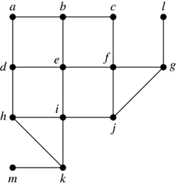
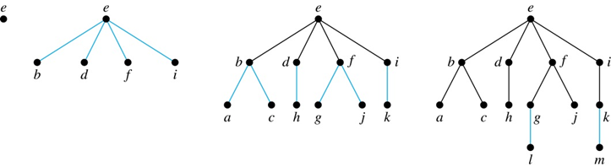
Breadth-First Search (continued)
Example: Use breadth-first search to find a spanning tree for this graph.
Solution: We arbitrarily choose vertex e as the root. We then add the edges from e to b, d, f, and i. These four vertices make up level 1 in the tree. Next, we add the edges from b to a and c, the edges from d to h, the edges from f to j and g, and the edge from i to k. The endpoints of these edges not at level 1 are at level 2. Next, add edges from these vertices to adjacent vertices not already in the graph. So, we add edges from g to l and from k to m. We see that level 3 is made up of the vertices l and m. This is the last level because there are no new vertices to find.

Slide 11
Breadth-First Search Algorithm
We now use pseudocode to describe breadth-first search.
procedure BFS(G: connected graph with vertices v₁, v₂, …, v_{n})
T := tree consisting only of the vertex v₁
L := empty list visit(v₁)
put v₁ in the list L of unprocessed vertices
while L is not empty
remove the first vertex, v, from L
for each neighbor w of v
if w is not in L and not in T then
add w to the end of the list L
add w and edge {v,w} to T

Slide 12
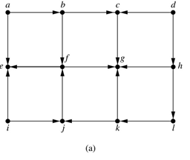
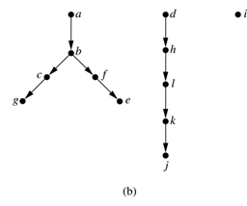
Depth-First Search in Directed Graphs
Both depth-first search and breadth-first search can be easily modified to run on a directed graph. But the result is not necessarily a spanning tree, but rather a spanning forest.
Example: For the graph in (a), if we begin at vertex a, depth-first search adds the path connecting a, b, c, and g. At g, we are blocked, so we return to c. Next, we add the path connecting f to e. Next, we return to a and find that we cannot add a new path. So, we begin another tree with d as its root. We find that this new tree consists of the path connecting the vertices d, h, l, k, and j. Finally, we add a new tree, which only contains i, its root.
Notes:
To index websites, search engines such as Google systematically explore the web starting at known sites. The programs that do this exploration are known as Web spiders. They may use both breath-first search or depth-first search to explore the Web graph.

