Slide 1
Proving things with Coq
Introductory Lecture

Slide 2
Summary
Initial setup, accessing documentation, troubles
Proving Boolean tautologies
Predicate calculus
Integer arithmetic on Z
Using mathematical induction
Relations and Setoids
Combinatorics
Graph theory

Slide 3
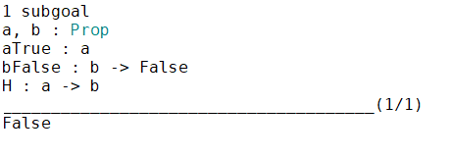
What if the Goal is "False"
Lemma sample2_VARVAR: forall a b: Prop, a -> (~b -> ~(a -> b)).
Proof.
unfold not.
intros a b aTrue bFalse H.
contradiction (bFalse (H aTrue)).
Qed.

