Slide 1
Consultation Week: Day 2 Number Theory; Recurrences
Number Theory: Divisibility, GCM and LCM, congruences, multiplicative inverses, exponentiation.
Recurrent Sequences: Proving periodicity, 1st and 2nd order recurrences, divide-and-conquer recurrences, Master theorem.
(Occasionally refer to arithmetic and geometric series, decimal notation, time complexity of algorithms (Big-O-Notation))
Notes:
Big ideas: **Invariants:** What stays the same as we repeat actions (such as GCD computation with Euclidean algorithm or arithmetic progressions).
**Geometric progressions:** Symmetry can help to evaluate things quickly. Also Little Fermat theorem; Euler's theorem etc.
**Periodic processes:** Intuitively, if we repeat some action multiple times (and the system can be only in finitely many states), the states start to repeat.
**Irrational numbers:** Some recurrent sequences (and integer-number processes) lead to square roots and to logarithms.
See also https://ocw.mit.edu/courses/electrical-engineering-and-computer-science/6-042j-mathematics-for-computer-science-spring-2015/lecture-slides/

Slide 2
Section Summary
Number Theory
Arithmetic Series and GCD: Preserving divisibility, Euclidean algorithm.
Bezout identity, multiplicative inverses: When injections are also surjections (by Pigeonhole principle)
Congruences, Chinese Remainder Theorem: Modular arithmetic, CRT.
Exponentiation: Euler's function. Theorems by Fermat and Euler. Primitive Roots.
Recurrent Sequences
Periodicity in Sequences: How predetermined moves between states lead to periods.
1st and 2nd order recurrences: Solving homogeneous and non-homogeneous recurrences.
Divide and Conquer recurrences: Recursion trees, solving by Master theorem.

Slide 3
Euclidean Algorithm
The Euclidian algorithm is an efficient method for computing the greatest common divisor of two integers. It is based on the idea that gcd(a,b) is equal to gcd(a,c) when a > b and c is the remainder when a is divided by b.
Example: Find gcd(91, 287):
287 = 91 ∙ 3 + 14
91 = 14 ∙ 6 + 7
14 = 7 ∙ 2 + 0
gcd(287, 91) = gcd(91, 14) = gcd(14, 7) = 7

Slide 4
Blankinship Algorithm
You can also use Euclidean algorithm (extended with parameters that show, how you can get GCD, if you start out with two numbers.)

Slide 6
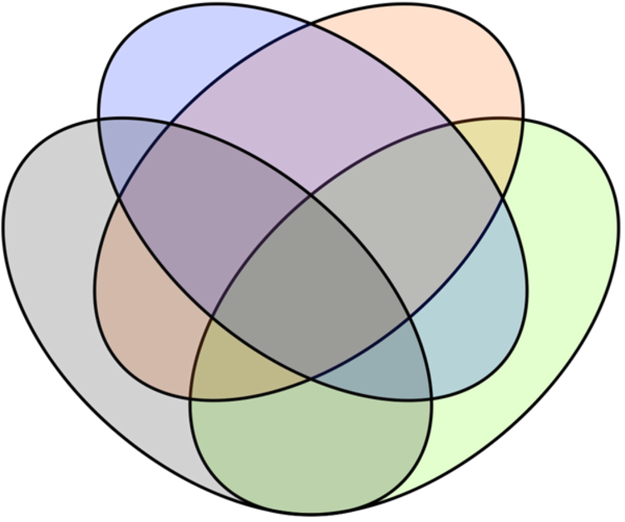
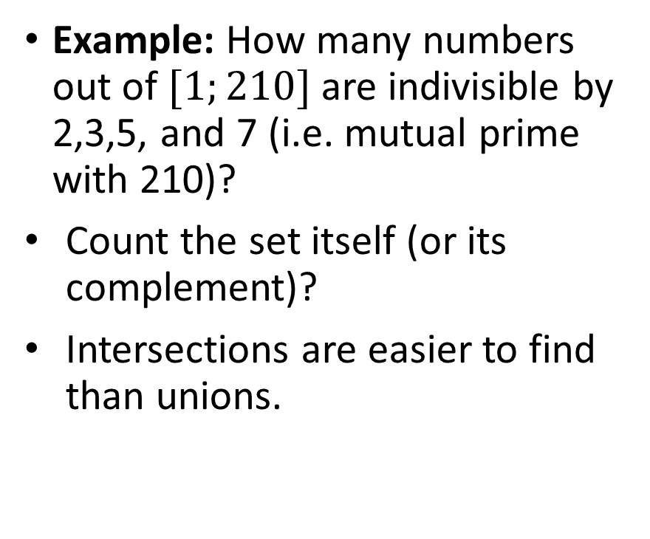
Euler Function – Intuition
Example: How many numbers out of $[1;210]$ are indivisible by 2,3,5, and 7 (i.e. mutual prime with 210)?
Count the set itself (or its complement)?
Intersections are easier to find than unions.
Divisible by 5
Divisible by 7
Divisible by 2
Divisible by 3
All numbers [1;210]

Slide 7
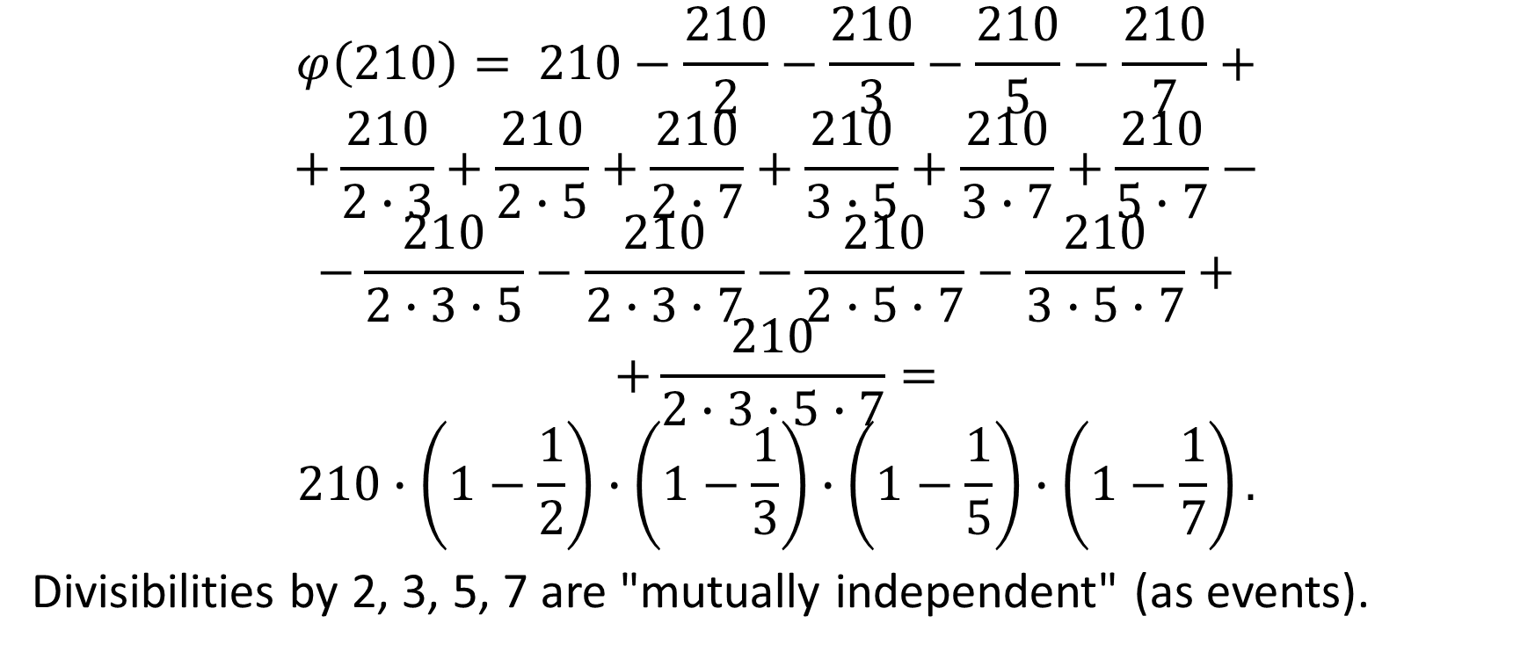
Euler Function
$$φ\left(210\right)= 210−\frac{210}{2}−\frac{210}{3}−\frac{210}{5}−\frac{210}{7}+$$
$$+\frac{210}{2∙3}+\frac{210}{2∙5}+\frac{210}{2∙7}+\frac{210}{3∙5}+\frac{210}{3∙7}+\frac{210}{5∙7}−$$
$$−\frac{210}{2∙3∙5}−\frac{210}{2∙3∙7}−\frac{210}{2∙5∙7}−\frac{210}{3∙5∙7}+$$
$$+\frac{210}{2∙3∙5∙7}=$$
$$210∙\left(1−\frac{1}{2}\right)∙\left(1−\frac{1}{3}\right)∙\left(1−\frac{1}{5}\right)∙\left(1−\frac{1}{7}\right).$$
Divisibilities by 2, 3, 5, 7 are "mutually independent" (as events).
Notes:
From Raivis Sīmanis presentation

Slide 8


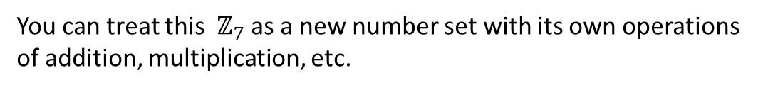
Congruences and their Equivalence Classes
Equivalence relation on $\text{ℤ}$ - being congruent (modulo 7)
-8
-7
-6
-5
-4
-3
-2
-1
0
1
2
3
4
5
6
7
8
9
10
11
12
0
You can treat this ${\text{ℤ}}_{7}$ as a new number set with its own operations
of addition, multiplication, etc.
6
1
$${\text{ℤ}}_{7}$$
5
2
4
3

Slide 9
Arithmetic Modulo m (Ring Axioms – 1)
The operations +_{m} and ∙_{m} satisfy many of the same properties as ordinary addition and multiplication.
Closure: If a and b belong to Z_{m} , then a +_{m} b and a ∙_{m} b belong to Z_{m} .
Associativity: If a, b, and c belong to Z_{m} , then (a +_{m} b) +_{m} c = a +_{m} (b +_{m} c) and (a ∙_{m} b) ∙_{m} c = a ∙_{m} (b ∙_{m} c).
Commutativity: If a and b belong to Z_{m} , then a +_{m} b = b +_{m} a and a ∙_{m} b = b ∙_{m} a.
Identity elements: The elements 0 and 1 are identity elements for addition and multiplication modulo m, respectively.
If a belongs to Z_{m} , then a +_{m} 0 = a and a ∙_{m} 1 = a.

Slide 10
Arithmetic Modulo m (Ring Axioms – 2)
Additive inverses: If a≠ 0 belongs to Z_{m} , then m− a is the additive inverse of a modulo m and 0 is its own additive inverse.
a +_{m} (m− a ) = 0 and 0 +_{m} 0 = 0
Distributivity: If a, b, and c belong to Z_{m} , then
a ∙_{m} (b +_{m} c) = (a ∙_{m} b) +_{m} (a ∙_{m} c) and (a +_{m} b) ∙_{m} c = (a ∙_{m} c) +_{m} (b ∙_{m} c).
Exercises 42-44 ask for proofs of these properties.
Multiplicatative inverses have not been included since they do not always exist. For example, there is no multiplicative inverse of 2 modulo 6.
Notes:
(optional) Using the terminology of abstract algebra, Z_{m} with +_{m} is a commutative group and Z_{m} with +_{m} and ∙_{m} is a commutative ring.

Slide 11
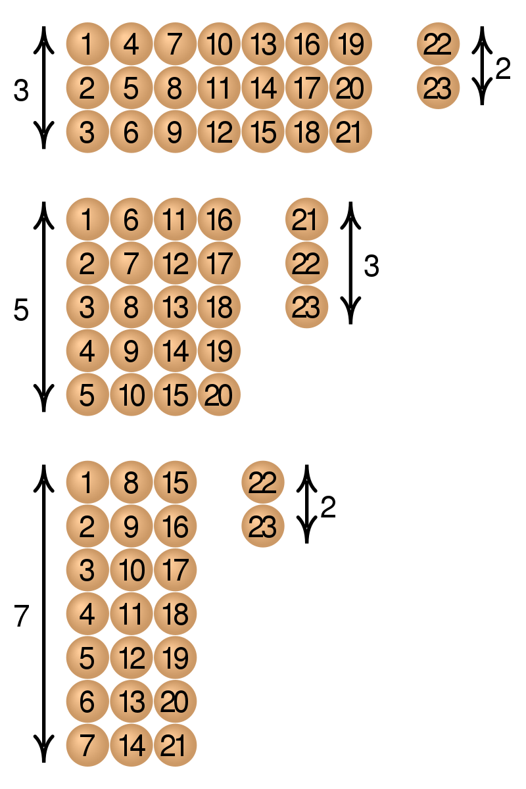
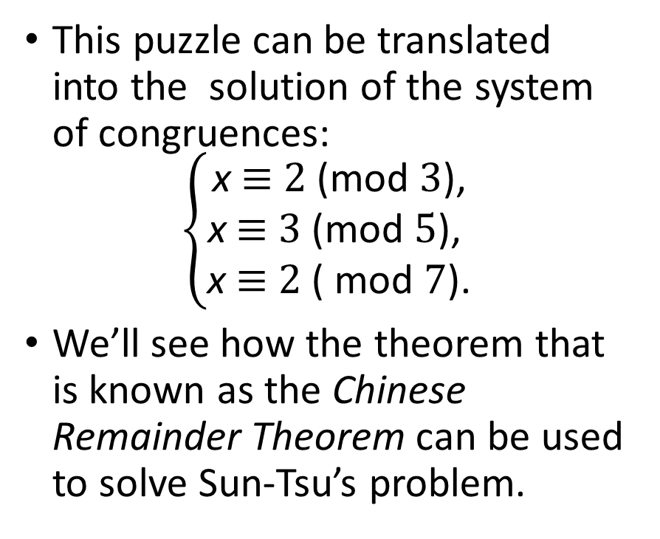
The Chinese Remainder Theorem
This puzzle can be translated into the solution of the system of congruences:
$$\left\{\begin{matrix}\text{x} \text{≡} \text{2 }\text{(}\text{mod} \text{3}\text{)}\text{,} \\ \text{x} \text{≡} \text{3 }\text{(}\text{mod} \text{5}\text{), } \\ \text{x} \text{≡} \text{2 }\text{( }\text{mod} \text{7}\text{)}\text{.}\end{matrix}\right.$$
We’ll see how the theorem that is known as the Chinese Remainder Theorem can be used to solve Sun-Tsu’s problem.
Notes:
There are certain things whose number is unknown. If we count them by threes, we have two left over; by fives, we have three left over; and by sevens, two are left over. How many things are there?

Slide 12
The Chinese Remainder Theorem
To construct a solution first let M_{k}=m/m_{k} for k = 1,2,…,n and m = m₁m₂ ∙ ∙ ∙ m_{n}.
Since gcd(m_{k} ,M_{k} ) = 1, by Theorem 1, there is an integer y_{k} , an inverse of M_{k} modulo m_{k}, such that
M_{k} y_{k} ≡ 1 ( mod m_{k} ).
Form the sum
x = a₁ M₁ y₁ + a₂ M₂ y₂ + ∙ ∙ ∙ + a_{n} M_{n} y_{n} .
Note that because M_{j} ≡ 0 ( mod m_{k}) whenever j ≠k , all terms except the kth term in this sum are congruent to 0 modulo m_{k} .
Because M_{k} y_{k} ≡ 1 ( mod m_{k} ), we see that x ≡ a_{k} M_{k} y_{k} ≡ a_{k}( mod m_{k}), for k = 1,2,…,n.
Hence, x is a simultaneous solution to the n congruences.
x ≡ a₁ ( mod m₁)
x ≡ a₂ ( mod m₂)
. . .
. . .
x ≡ a_{n} ( mod m_{n})

Slide 13
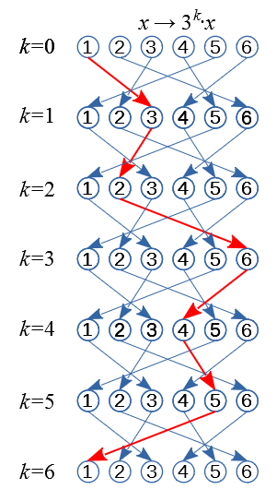

Fermat’s Little Theorem
Fermat’s Little Theorem: If p is prime and a is an integer not divisible by p, then a^{p-1} ≡ 1 (mod p)
Euler's Theorem:
If $a$ and $n$ are relative primes,
$a^{φ(n)}≡1 (mod n)$.

Slide 14
The Chinese Remainder Theorem
To construct a solution first let M_{k}=m/m_{k} for k = 1,2,…,n and m = m₁m₂ ∙ ∙ ∙ m_{n}.
Since gcd(m_{k} ,M_{k} ) = 1, by Theorem 1, there is an integer y_{k} , an inverse of M_{k} modulo m_{k}, such that
M_{k} y_{k} ≡ 1 ( mod m_{k} ).
Form the sum
x = a₁ M₁ y₁ + a₂ M₂ y₂ + ∙ ∙ ∙ + a_{n} M_{n} y_{n} .
Note that because M_{j} ≡ 0 ( mod m_{k}) whenever j ≠k , all terms except the kth term in this sum are congruent to 0 modulo m_{k} .
Because M_{k} y_{k} ≡ 1 ( mod m_{k} ), we see that x ≡ a_{k} M_{k} y_{k} ≡ a_{k}( mod m_{k}), for k = 1,2,…,n.
Hence, x is a simultaneous solution to the n congruences.
x ≡ a₁ ( mod m₁)
x ≡ a₂ ( mod m₂)
. . .
. . .
x ≡ a_{n} ( mod m_{n})

Slide 15





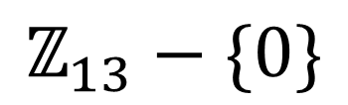








Primitive Roots
Example: 2 is a primitive root (mod 13).
Quadratic Congruences:
$x^{2}=−1 \left(mod 13\right)$ has solutions $x_{1,2}=±5.$
$${2^{12}=2}^{0}$$
$$2^{11}$$
1
$$2^{1}$$
7
2
$$2^{10}$$
$$2^{2}$$
10
4
$${\text{ℤ}}_{13}−\{0\}$$
$$2^{3}$$
$$2^{9}$$
5
8
$$2^{8}$$
9
3
$$2^{4}$$
11
6
$$2^{5}$$
$$2^{7}$$
12
$$2^{6}$$

