Slide 1
Algorithms
Section 3.1

Slide 2
Section Summary
Properties of Algorithms
Algorithms for Searching and Sorting
Greedy Algorithms
Halting Problem

Slide 3
Problems and Algorithms
In many domains there are key general problems that ask for output with specific properties when given valid input.
The first step is to precisely state the problem, using the appropriate structures to specify the input and the desired output.
We then solve the general problem by specifying the steps of a procedure that takes a valid input and produces the desired output. This procedure is called an algorithm.

Slide 4
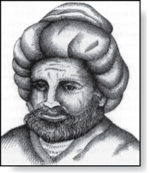
Algorithms
Abu Ja’far Mohammed Ibin Musa Al-Khowarizmi
(780-850)
Definition: An algorithm is a finite set of precise instructions for performing a computation or for solving a problem.
Example: Describe an algorithm for finding the maximum value in a finite sequence of integers.
Solution: Perform the following steps:
Set the temporary maximum equal to the first integer in the sequence.
Compare the next integer in the sequence to the temporary maximum. If it is larger than the temporary maximum, set the temporary maximum equal to this integer.
Repeat the previous step if there are more integers. If not, stop.
When the algorithm terminates, the temporary maximum is the largest integer in the sequence.
Notes:
Similar words of Arabic origin: alchemy, alcohol, algebra, alkali.

Slide 5
Specifying Algorithms
Algorithms can be specified in different ways. Their steps can be described in English or in pseudocode.
Pseudocode is an intermediate step between an English language description of the steps and a coding of these steps using a programming language.
The form of pseudocode we use is specified in Appendix 3. It uses some of the structures found in popular languages such as C++ and Java.
Programmers can use the description of an algorithm in pseudocode to construct a program in a particular language.
Pseudocode helps us analyze the time required to solve a problem using an algorithm, independent of the actual programming language used to implement algorithm.

Slide 6
Properties of Algorithms
String Input to String Output: An algorithm has inputs from a specified set (input format); produces the output values from a specified set.
Correctness: An algorithm should produce the correct output values for each set of input values. (+if necessary, recognizes invalid inputs.)
Finiteness: An algorithm should produce the output after a finite number of steps for any input.
Effectiveness: It must be possible to perform each step of the algorithm deterministically, and in a finite amount of time.
Generality: The same algorithm should work for all valid inputs.

Slide 7
Finding the Maximum Element in a Finite Sequence
The algorithm in pseudocode:
Does this algorithm have all the properties listed on the previous slide?
procedure max(a₁, a₂, …., a_{n}: integers)
max := a₁
for i := 2 to n
if max < a_{i} then max := a_{i}
return max{max is the largest element}

Slide 8
Some Example Algorithm Problems
Three classes of problems will be studied in this section.
Searching Problems: finding the position of a particular element in a list.
Sorting problems: putting the elements of a list into increasing order.
Optimization Problems: determining the optimal value (maximum or minimum) of a particular quantity over all possible inputs.

Slide 9
Searching Problems
Definition: The general searching problem is to locate an element x in the list of distinct elements a₁,a₂,...,a_{n}, or determine that it is not in the list.
The solution to a searching problem is the location of the term in the list that equals x (that is, i is the solution if x = a_{i}) or 0 if x is not in the list.
For example, a library might want to check to see if a patron is on a list of those with overdue books before allowing him/her to checkout another book.
We will study two different searching algorithms; linear search and binary search.

Slide 10
Linear Search Algorithm
The linear search algorithm locates an item in a list by examining elements in the sequence one at a time, starting at the beginning.
First compare x with a₁. If they are equal, return the position 1.
If not, try a₂. If x = a₂, return the position 2.
Keep going, and if no match is found when the entire list is scanned, return 0.
procedure linear search(x:integer,
a₁, a₂, …,a_{n}: distinct integers)
i := 1
while (i ≤ n and x ≠ a_{i})
i := i + 1
if i ≤ n then location := i
else location := 0
return location{location is the subscript of the term that equals x, or is 0 if x is not found}

Slide 11
Binary Search
Assume the input is a list of items in increasing order.
The algorithm begins by comparing the element to be found with the middle element.
If the middle element is lower, the search proceeds with the upper half of the list.
If it is not lower, the search proceeds with the lower half of the list (through the middle position).
Repeat this process until we have a list of size 1.
If the element we are looking for is equal to the element in the list, the position is returned.
Otherwise, 0 is returned to indicate that the element was not found.
In Section 3.3, we show that the binary search algorithm is much more efficient than linear search.

Slide 12
Binary Search
Here is a description of the binary search algorithm in pseudocode.
procedure binary search(x: integer, a₁,a₂,…, a_{n}: increasing integers)
i := 1 {i is the left endpoint of interval}
j := n {j is right endpoint of interval}
while i < j
m := ⌊(i + j)/2⌋
if x > a_{m} then i := m + 1
else j := m
if x = a_{i} then location := i
else location := 0
return location{location is the subscript i of the term a_{i} equal to x,
or 0 if x is not found}

Slide 13
Binary Search
Example: The steps taken by a binary search for 19 in the list:
1 2 3 5 6 7 8 10 12 13 15 16 18 19 20 22
The list has 16 elements, so the midpoint is 8. The value in the 8th position is 10. Since 19 > 10, further search is restricted to positions 9 through 16.
1 2 3 5 6 7 8 10 12 13 15 16 18 19 20 22
The midpoint of the list (positions 9 through 16) is now the 12th position with a value of 16. Since 19 > 16, further search is restricted to the 13th position and above.
1 2 3 5 6 7 8 10 12 13 15 16 18 19 20 22
The midpoint of the current list is now the 14th position with a value of 19. Since 19 ≯ 19, further search is restricted to the portion from the 13th through the 14th positions .
1 2 3 5 6 7 8 10 12 13 15 16 18 19 20 22
The midpoint of the current list is now the 13th position with a value of 18. Since 19> 18, search is restricted to the portion from the 14th position through the 14th.
1 2 3 5 6 7 8 10 12 13 15 16 18 19 20 22
Now the list has a single element and the loop ends. Since 19=19, the location 14 is returned.

Slide 14
Sorting
To sort a list means to put in in increasing order (numerically, alphabetically, etc).
Sorting is an important problem because:
Computing resources are used sorting lists, esp. large databases of information to present in a particular order.
Fundamentally different algorithms exist for sorting. Their relative advantages and disadvantages have been studied extensively.
A variety of sorting algorithms are studied in this book; binary, insertion, bubble, selection, merge, quick, and tournament.
In Section 3.3, we’ll study the amount of time required to sort a list using the sorting algorithms covered in this section.

Slide 15
Bubble Sort
Bubble sort makes multiple passes through a list. Every pair of elements that are found to be out of order are interchanged.
procedure bubblesort(a₁,…,a_{n}: real numbers
with n ≥ 2)
for i := 1 to n− 1
for j := 1 to n − i
if a_{j} >a_{j+1} then interchange a_{j} and a_{j+1}
{a₁,…, a_{n} is now in increasing order}

Slide 16
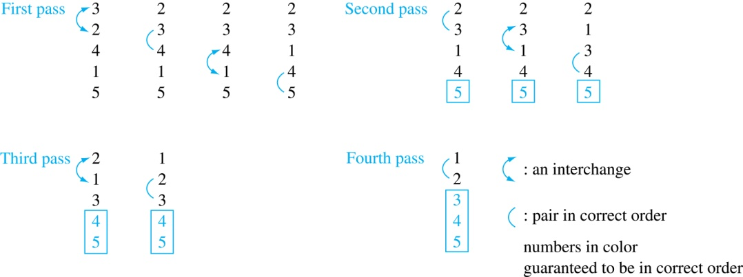
Bubble Sort
Example: Show the steps of bubble sort with 3 2 4 1 5
At the first pass the largest element has been put into the correct position
At the end of the second pass, the 2nd largest element has been put into the correct position.
In each subsequent pass, an additional element is put in the correct position.

Slide 17
Insertion Sort
Insertion sort begins with the 2nd element. It compares the 2nd element with the 1st and puts it before the first if it is not larger.
procedure insertion sort
(a₁,…,a_{n}:
real numbers with n ≥ 2)
for j := 2 to n
i := 1
while a_{j} > a_{i}
i := i + 1
m := a_{j}
for k := 0 to j − i − 1
a_{j-k} := a_{j-k-1}
a_{i} := m
{Now a₁,…,a_{n} is in increasing order}
Next the 3rd element is put into the correct position among the first 3 elements.
In each subsequent pass, the n+1st element is put into its correct position among the first n+1 elements.
Linear search is used to find the correct position.

Slide 18
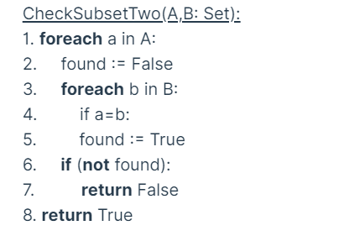
Break: To 9:58

Slide 19
Insertion Sort
Example: Show all the steps of insertion sort with the input: 3 2 4 1 5
2 3 4 1 5 (first two positions are interchanged)
2 3 4 1 5 (third element remains in its position)
1 2 3 4 5 (fourth is placed at beginning)
1 2 3 4 5 (fifth element remains in its position)

Slide 20
Greedy Algorithms
Optimization problems minimize or maximize something over all possibilities.
Among the many optimization problems we will study are:
Finding the shortest route between two cities.
Encode messages using the fewest possible bits.
Optimization problems sometimes use a greedy algorithm, which makes the “best” choice at each step. This does not necessarily produce an optimal solution to the overall problem, but in many instances, it does.
After specifying what the “best choice” at each step is, we try to prove that this approach always produces an optimal solution, or find a counterexample to show that it does not.
The greedy approach to solving problems is an example of an algorithmic paradigm, which is a general approach for designing an algorithm. We return to algorithmic paradigms in Section 3.3.

Slide 21
Greedy Algorithms: Making Change
Example: Design a greedy algorithm for making change (in euro money) of n cents with the following coins: 50-cents, 20-cents, 10-cents, 5-cents, 2-cents and 1-cents, using the least total number of coins.
Idea: At each step choose the coin with the largest possible value that does not exceed the amount of change left.
If n = 137 cents, first choose a 50-cent leaving 137−50 = 87 cents. Then choose another 50-cent leaving 87−50 = 37 cents
Choose one 20-cent, leaving 37 − 20 = 17 cents.
Choose one 10-cent, leaving 17 – 10 = 7 cents.
Choose one 5-cent, leaving 7 – 5 = 2 cents.
Choose one 2-cent, leaving 2 – 2 = 0 cents.

Slide 22

Greedy Change-Making Algorithm
Solution: Greedy change-making algorithm for n cents. The algorithm works with any coin denominations c₁, c₂, …,c_{r} .
For the example of U.S. currency, we may have quarters, dimes, nickels and pennies, with c₁ = 25, c₂ = 10, c₃ = 5, and c₄ = 1.
Eurocent currency has $c1=50>20>10>5>2>1$.
procedure change(c₁, c₂, …, c_{r}: values of coins, where c₁> c₂> … > c_{r} ; n: a positive integer)
for i := 1 to r
d_{i} := 0 [d_{i} counts the coins of denomination c_{i}]
while n ≥ c_{i}
d_{i} := d_{i} + 1 [add a coin of denomination c_{i}]
n = n - c_{i}
[d_{i} counts the coins c_{i}]

Slide 23
Proving Optimality for Eurocent Coins
Show that the change making algorithm for Eurocent coins is optimal.
Lemma 1: (A) If n is a positive integer, then n cents in change using 50-cent, 20-cent, 10-cent, 5-cent, 2-cent and 1-cent, using the fewest coins possible has at most two 20-cents, one 10-cent, one 5-cent, two 2-cent,and one 1-cent. (B) The total amount of change in 20-cent, 10-cent, 5-cent, 2-cent and 1-cent coins must not exceed 49 cents.
Proof: (A) By contradiction
If we had three 20-cents, we could replace 20+20+20 by 50+10
If we had two 10-cents, we would replace 10+10 by 20.
If we had two 5-cents, we would replace 5+5 by 10.
If we had three 2-cents, we would replace 2+2+2 by 5+1
If we had two 1-cents, we would replace 1+1 by 2.
(B) Picking two 20-cents and one 10-cent is also impossible as 20+20+10 we could replace by 50. The maximum is 20+20+5+2+2 = 49.

Slide 24
Proving Optimality for Eurocent Coins
Theorem: The greedy change-making algorithm for Eurocent coins produces change using the fewest coins possible.
Proof: By contradiction.
Assume there is a positive integer n such that change can be made for n cents using quarters, dimes, nickels, and pennies, with a fewer total number of coins than given by the greedy algorithm.
Then, q̍ ≤ q where q̍ is the number of 50-cent coins used in this optimal way and q is the number of 50-cent coins in the greedy algorithm’s solution. But this is not possible by Lemma 1, since the value of the coins other than 50-cents can not be greater than 49 cents.
Similarly, by Lemma 1, the two algorithms must have the same number of dimes, nickels, and quarters.

Slide 25
Greedy Change-Making Algorithm
Optimality depends on the denominations available.
For U.S. coins, optimality still holds if we add half dollar coins (50 cents) and dollar coins (100 cents).
But if we allow only quarters (25 cents), dimes (10 cents), and pennies (1 cent), the algorithm no longer produces the minimum number of coins.
Consider the example of 31 cents. The optimal number of coins is 4, i.e., 3 dimes and 1 penny. What does the algorithm output?

Slide 26
Greedy Scheduling
Example: We have a group of proposed talks with start and end times. Construct a greedy algorithm to schedule as many as possible in a lecture hall, under the following assumptions:
When a talk starts, it continues till the end.
No two talks can occur at the same time.
A talk can begin at the same time that another ends.
Once we have selected some of the talks, we cannot add a talk which is incompatible with those already selected because it overlaps at least one of these previously selected talks.
How should we make the “best choice” at each step of the algorithm? That is, which talk do we pick ?
The talk that starts earliest among those compatible with already chosen talks?
The talk that is shortest among those already compatible?
The talk that ends earliest among those compatible with already chosen talks?

Slide 27
Greedy Scheduling
Picking the shortest talk doesn’t work.
Can you find a counterexample here?
But picking the one that ends soonest does work. The algorithm is specified on the next page.
Start: 8:00 AM
Talk 1
Start: 9:00 AM
Talk 2
Start: 9:45 AM
End :9:45 AM
Talk 3
End: 10:00 AM
End: 11:00 AM

Slide 28
Greedy Scheduling algorithm
Solution: At each step, choose the talks with the earliest ending time among the talks compatible with those selected.
Will be proven correct by induction in Chapter 5.
procedure schedule(s₁ ≤ s₂ ≤ … ≤ s_{n} : start times, e₁ ≤ e₂ ≤ … ≤ e_{n} : end times)
sort talks by finish time and reorder so that e₁ ≤ e₂ ≤ … ≤ e_{n}
S := ∅
for j := 1 to n
if talk j is compatible with S then
S := S ∅∪{talk j}
return S [ S is the set of talks scheduled]

Slide 29
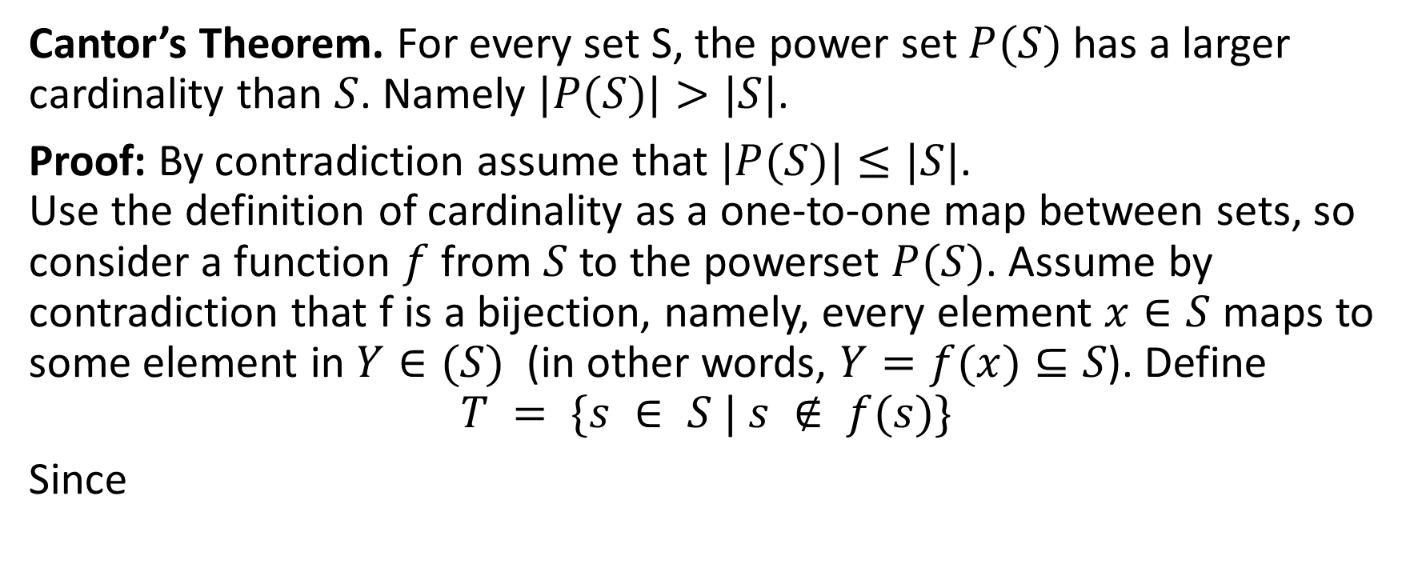
Classical Argument with Set Cardinalities
Cantor’s Theorem. For every set S, the power set $P(S)$ has a larger cardinality than $S$. Namely $|P(S)|>|S|$.
Proof: By contradiction assume that $|P(S)|≤|S|$. Use the definition of cardinality as a one-to-one map between sets, so consider a function $f$ from $S$ to the powerset $P(S)$. Assume by contradiction that f is a bijection, namely, every element $x∈S$ maps to some element in $Y∈(S)$ (in other words, $Y=f(x)⊆S$). Define
$$T = \{s ∈ S | s ∉ f(s)\}$$
Since

Slide 30






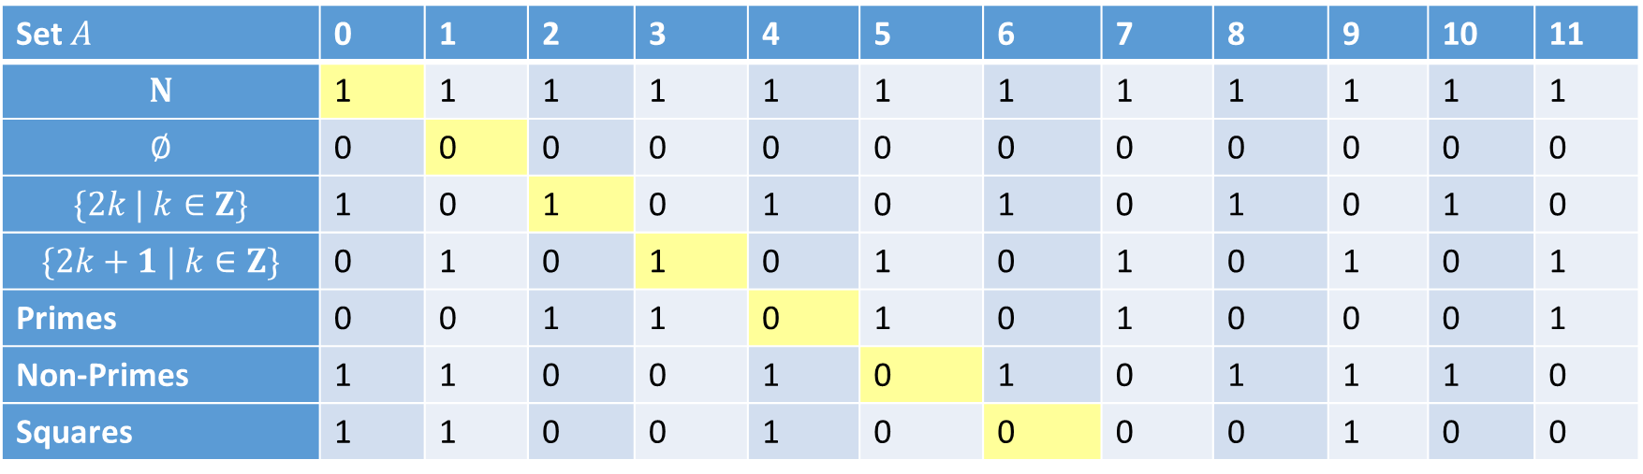

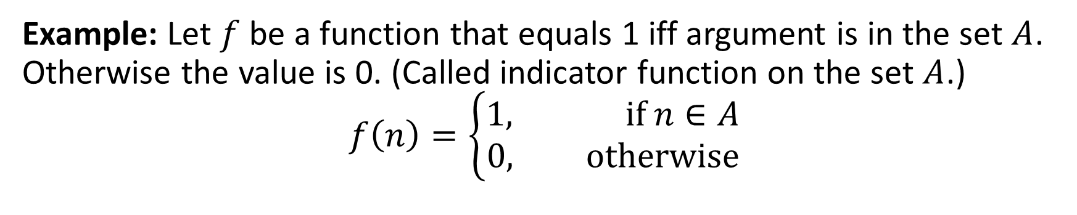

Indicator Functions on $N$ are uncountable
Example: Let $f$ be a function that equals 1 iff argument is in the set $A$. Otherwise the value is 0. (Called indicator function on the set $A$.)
$$f\left(n\right)=\left\{\begin{matrix}1, if n∈A \\ 0, otherwise\end{matrix}\right.$$
Various
Python programs that always output 0 and 1
Set $A$ | 0 | 1 | 2 | 3 | 4 | 5 | 6 | 7 | 8 | 9 | 10 | 11
$$N$$ | 1 | 1 | 1 | 1 | 1 | 1 | 1 | 1 | 1 | 1 | 1 | 1
$$∅$$ | 0 | 0 | 0 | 0 | 0 | 0 | 0 | 0 | 0 | 0 | 0 | 0
$$\{2k | k∈Z\}$$ | 1 | 0 | 1 | 0 | 1 | 0 | 1 | 0 | 1 | 0 | 1 | 0
$$\{2k+1 | k∈Z\}$$ | 0 | 1 | 0 | 1 | 0 | 1 | 0 | 1 | 0 | 1 | 0 | 1
Primes | 0 | 0 | 1 | 1 | 0 | 1 | 0 | 1 | 0 | 0 | 0 | 1
Non-Primes | 1 | 1 | 0 | 0 | 1 | 0 | 1 | 0 | 1 | 1 | 1 | 0
Squares | 1 | 1 | 0 | 0 | 1 | 0 | 0 | 0 | 0 | 1 | 0 | 0
$$f_{0}$$
$$f_{1}$$
$$f_{2}$$
$$f_{3}$$
$$f_{4}$$
$$f_{4}$$
$$f_{6}$$
Notes:
Some function in this list cannot have a computer program. The problem with this proof is that it is nonconstructive – nobody can tell, if a Python program would always output 0 and 1.

Slide 31
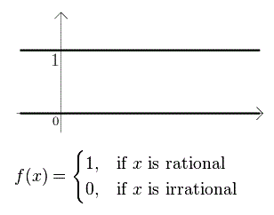
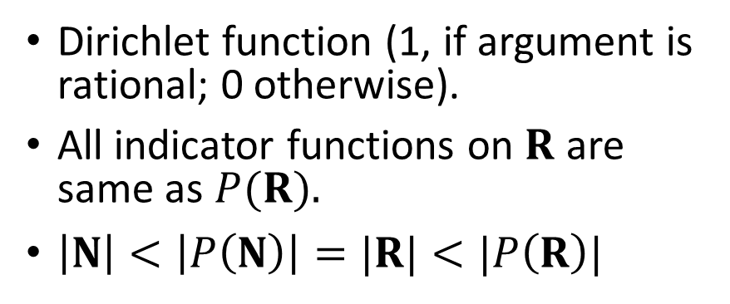

Indicator functions on $R$
There are more predicates on R than real numbers. There are even more predicates on predicates on R. And so on.
There are infinitely many infinities – every is the powerset of the previous one.
Cardinality of set of real continuous functions
Dirichlet function (1, if argument is rational; 0 otherwise).
All indicator functions on $R$ are same as $P(R).$
$\left|N\right|<\left|P\left(N\right)\right|=|R|<|P\left(R\right)|$

Slide 32
Halting Problem – 1
Example: Can we develop a procedure that takes as input a computer program along with its input and determines whether the program will eventually halt with that input.
Solution: Proof by contradiction.
Assume that there is such a procedure and call it H(P,I). The procedure H(P,I) takes as input a program P and the input I to P.
H outputs “halt” if it is the case that P will stop when run with input I.
Otherwise, H outputs “loops forever.”

Slide 33
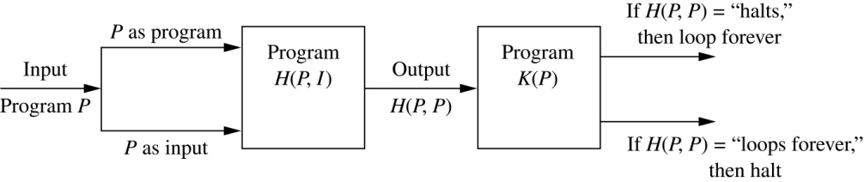
Halting Problem – 2
Since a program is a string of characters, we can call H(P,P). Construct a procedure K(P), which works as follows.
If H(P,P) outputs “loops forever” then K(P) halts.
If H(P,P) outputs “halt” then K(P) goes into an infinite loop printing “ha” on each iteration.

Slide 34
Halting Problem – 3
Now we call K with K as input, i.e. K(K).
If the output of H(K,K) is “loops forever” then K(K) halts. A Contradiction.
If the output of H(K,K) is “halts” then K(K) loops forever. A Contradiction.
Therefore, there can not be a procedure that can decide whether or not an arbitrary program halts. The halting problem is unsolvable.

